Slide 1
Ensemble of Trees: Boosting, Bagging, and Random Forest

Slide 2
Outline
Tree based methods
CART
MARS
Boosting
Adaboost for Classification
Gradient Boosting Method
Bagging
Random Forest

Slide 3

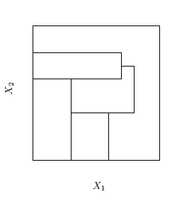
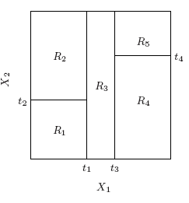
Tree based methods: CART
Tree-based methods partition the feature space into a set of rectangles, and then fit a simple model (like a constant) in each one.
Nonrecursive partition
A recursive partition

Slide 4
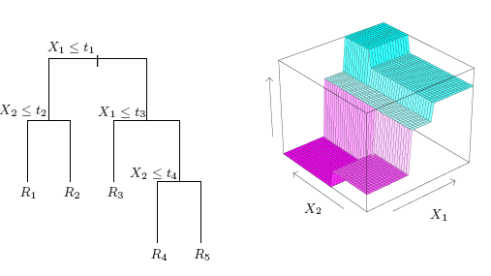
Tree based methods
Left: Tree representation for the recursive partition above; Right: piecewise constant function on the tree

Slide 5
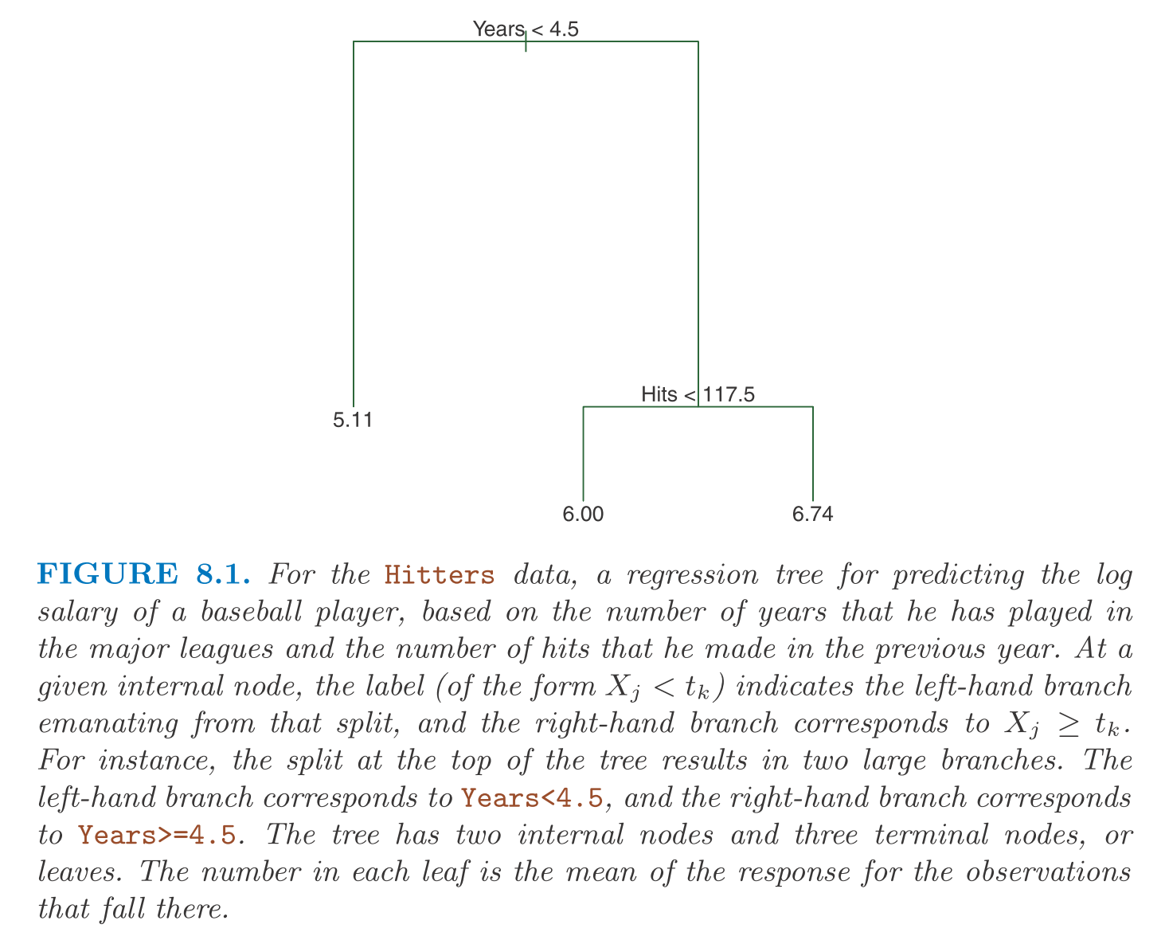
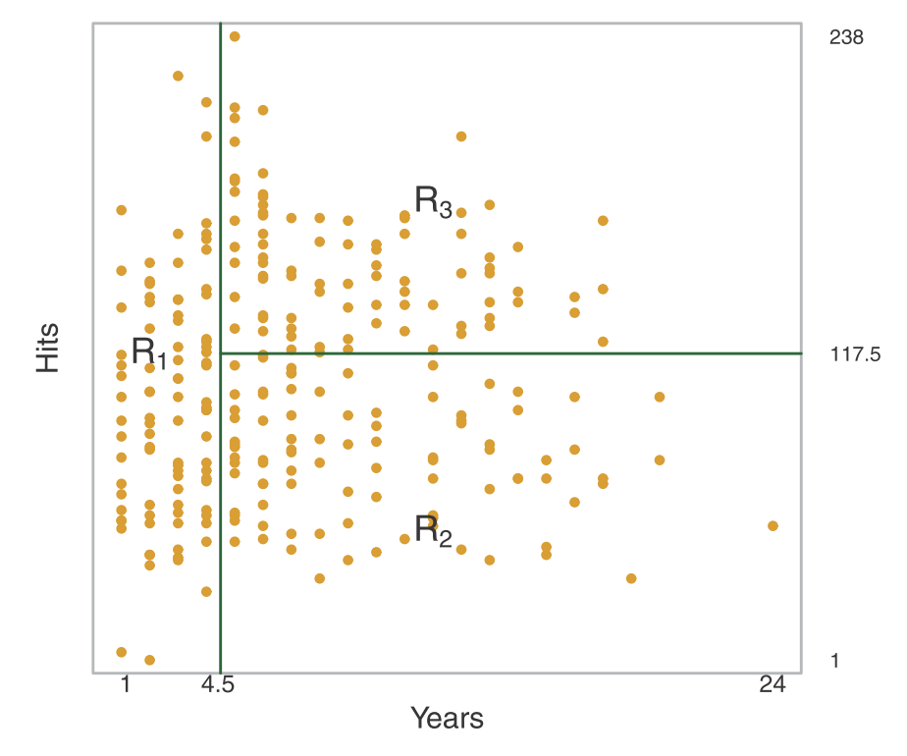
Example: Hitters

Slide 6


Regression Trees
P inputs and a response
(x_i,y_i),i=1,2,...,N
Goal: automatically decides on the splitting variables and split points, and also the topology (shape) of the tree
Alg: suppose we know the partition
R_1,R_2,...,R_M

Slide 7


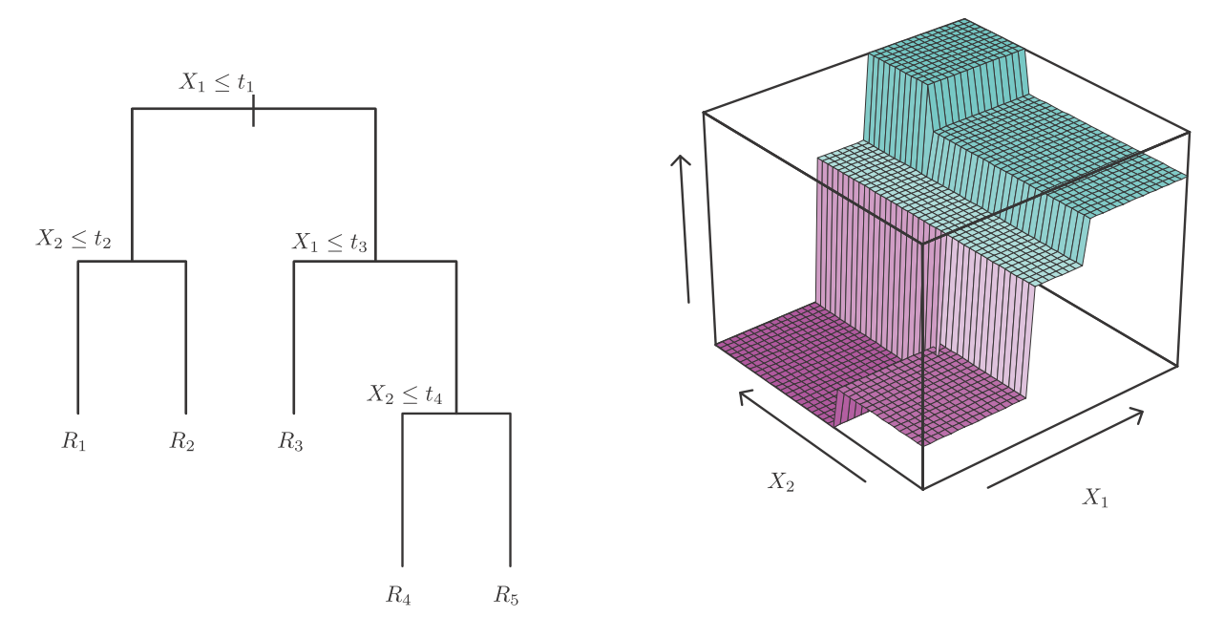
Regression Trees
Recursive binary splitting of variable in greedy way

Slide 8
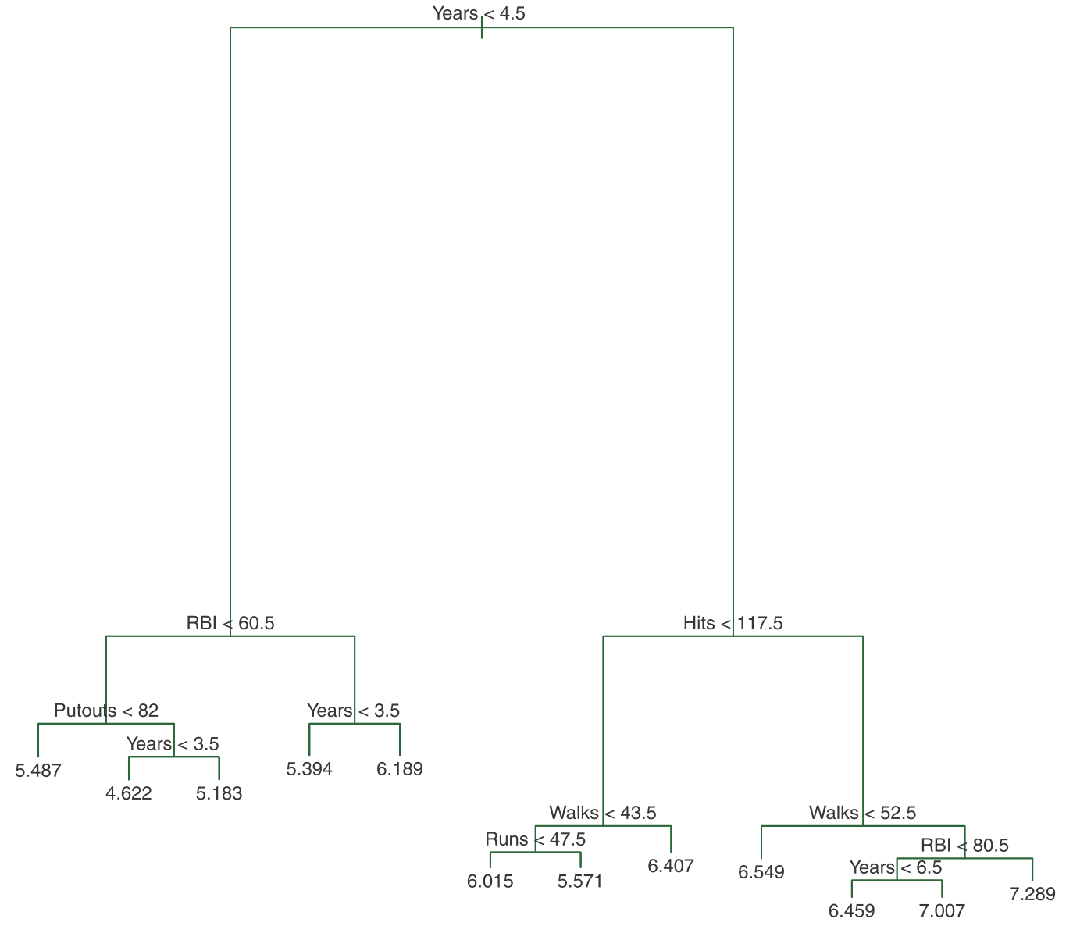
Tree size
Large tree might over-fit the data
Small tree might not capture the important structure
Tree size is a tuning parameter
Stop the splitting process only when some minimum node size (say 5) is reached
Then this large tree is pruned using cost complexity pruning

Slide 9
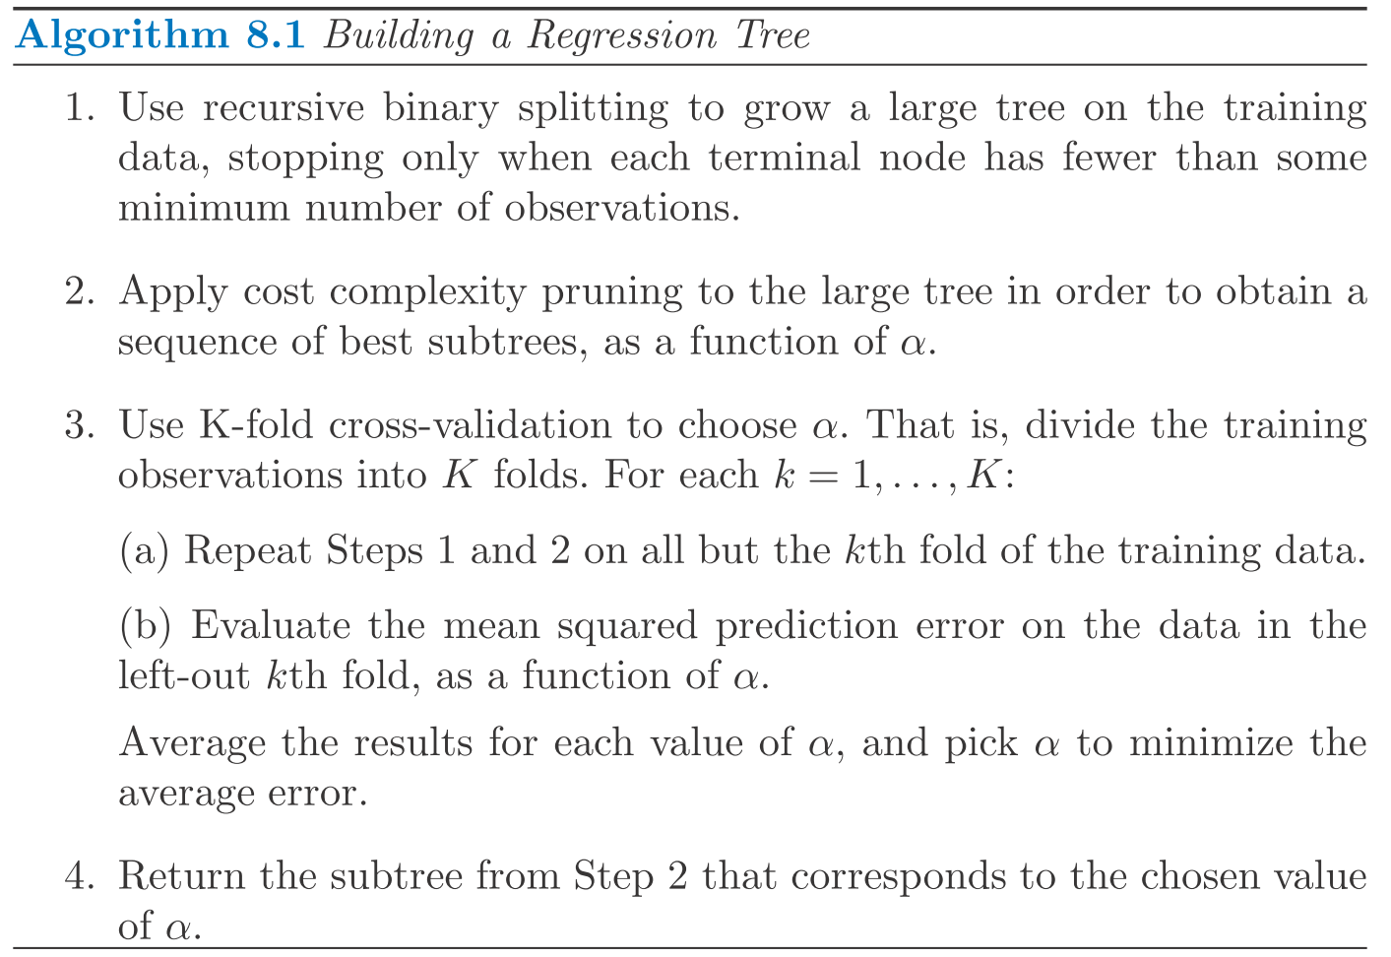
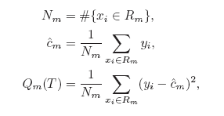

Optimal Pruning

Slide 10


Classification Trees
The target variable is a classification outcome taking values 1,2,...,K
The only change needed is the criteria for splitting nodes and pruning the tree.
Measures of node impurity:

Slide 11
Library(“tree”)
Section 8.3, Introduction to Statistical Learning with R
Classification tree
Regression tree
model = tree(y~., data)

Slide 12
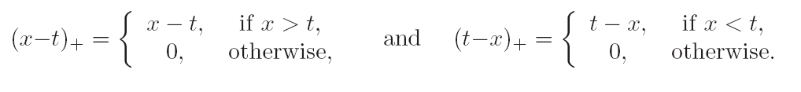

MARS
Multivariate Adaptive Regression Splines
Well suited for high-dim problems
A generalization of stepwise linear regression
It uses expansions in piecewise linear basis functions of the form:

Slide 13
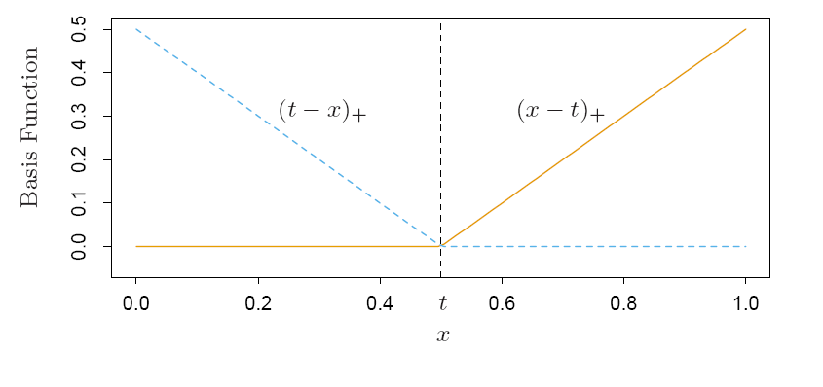
MARS
A reflected pair

Slide 14
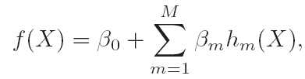


MARS
Where is a function in , or a product of two or more such functions.
Adaptive way to add basis functions:

Slide 15
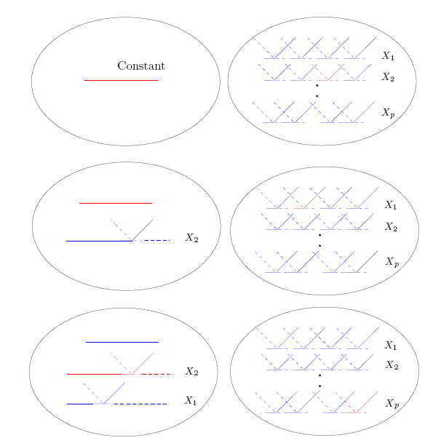
MARS

Slide 16

MARS
The size of terms matters
M is the effective number of parameters in the model: this accounts both for the number of terms and the number of parameters when selecting the positions of the knots.

Slide 17
Boosting
Originally designed for classification problems
Can be extended to regression problems
Motivation: combines the output of many weak classifiers to produce a powerful “committee” (How to boost a weak classifier which is slightly better than random guess to a strong one – Leslie Valiant problem)
What are ‘weak’ classifiers?
How to combine them?
Here we present a statistical point of view.

Slide 18
What’s weak classifiers
In theory, weak classifiers have expected error rate <1/2, but impossible to design with finite samples
In practice, Rob Schapire points out two elements about ‘weak’ classifiers:
Each classifier is simple, decided locally by small number of samples
Classifiers are independent, not highly correlated through using all samples
So CART (classification-and-regression-trees) are good candidates for weak classifiers

Slide 19

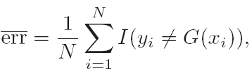
Adaboost
Consider a two-class problem:
G(X) is the classifier
Error rate:
Weak classifier: error rate is only slightly better than random guessing.

Slide 20

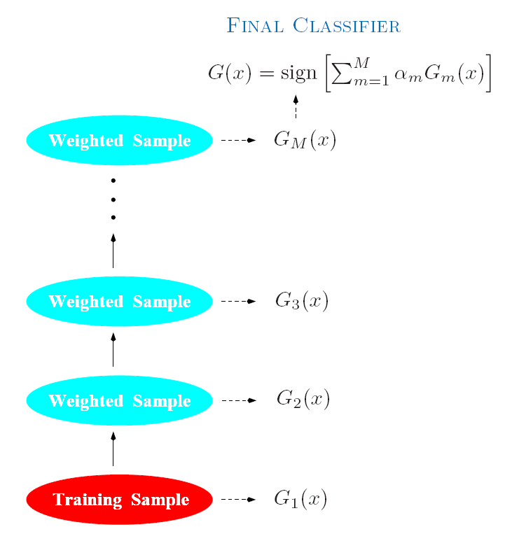
Adaboost
Boosting sequentially apply the week classification algorithm to repeatedly modified versions of the data, thereby producing a sequence of weak classifiers:

Slide 21
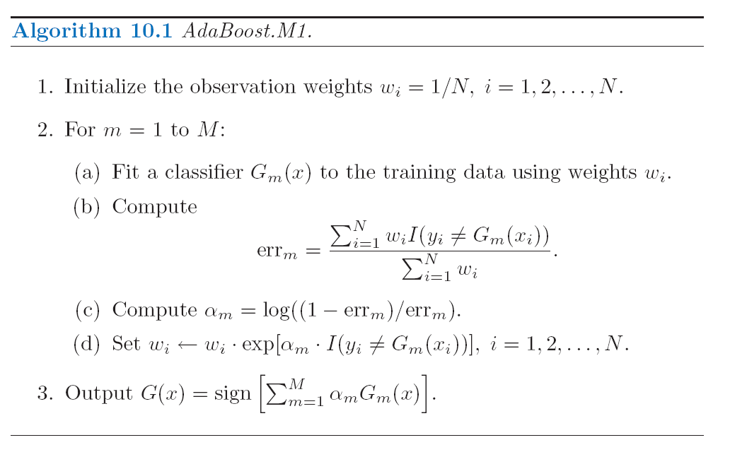
Adaboost.M1
Freund and Schapire 1997

Slide 22
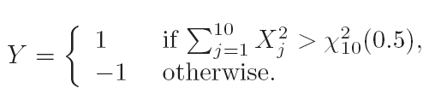
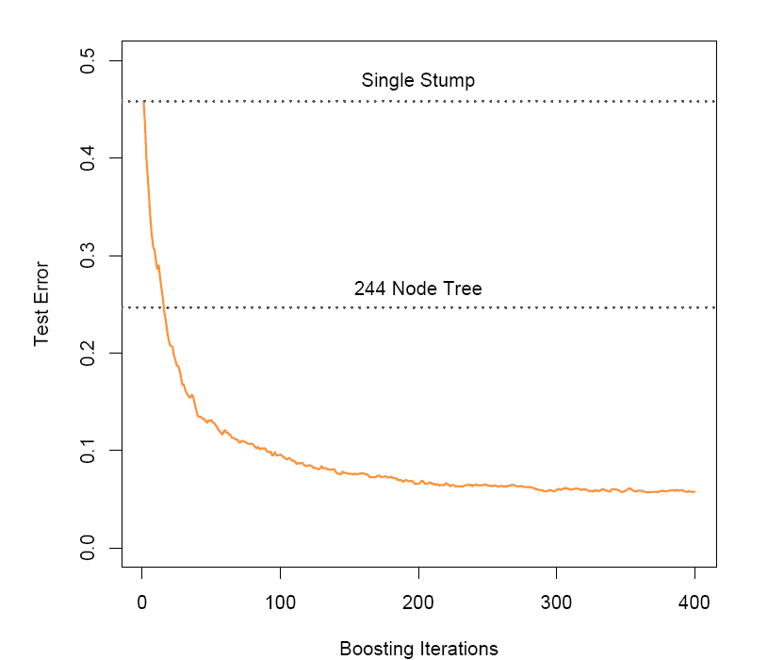
Example: Decision Stumps
2000 trains and 10,000 tests
Weak classifier is just a stump:
a two terminal node
classification tree.
Error rate: 48.5%

Slide 23

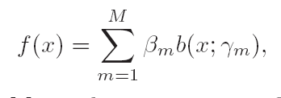
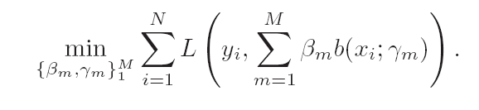
Boosting Fits and Additive Model
Boosting is a way of fitting an additive expansion in a set of elementary “basis” functions.
For Adaboost, basis functions are weak classifiers
More generally,
Additive Model:

Slide 24
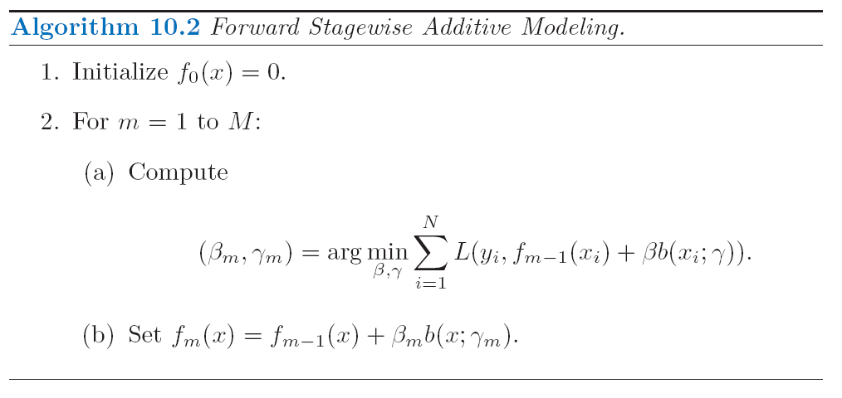
Forward Stagewise Additive Modeling

Slide 25

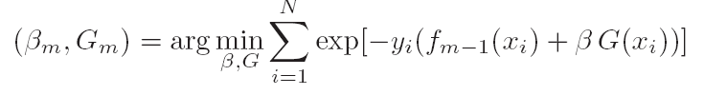
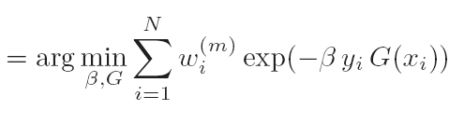

Exponential Loss and AdaBoost
Adaboost is equivalent to forward additive modeling using the following loss function:
Forward step:

Slide 26
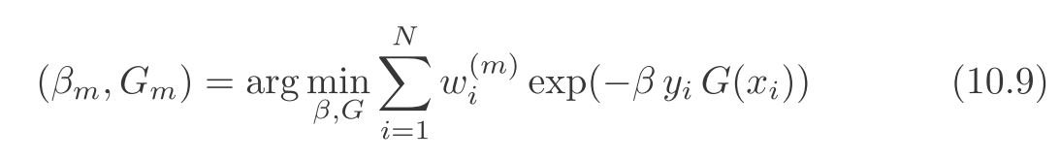

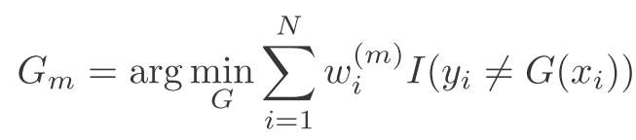
Joint optimization
Step I: Optimizer over G:

Slide 27
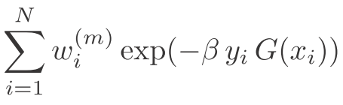
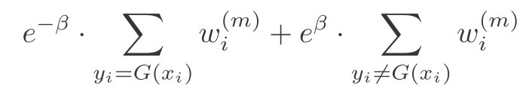

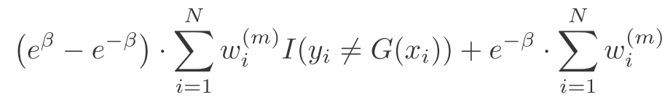

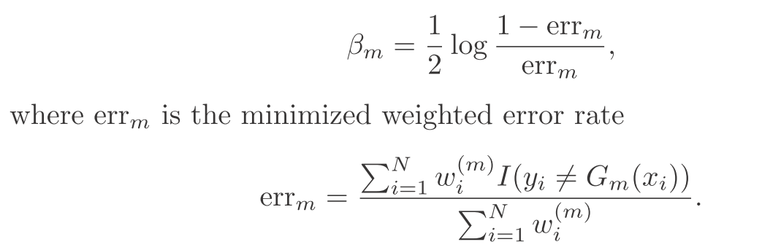
Step II: Optimizer over β

Slide 28
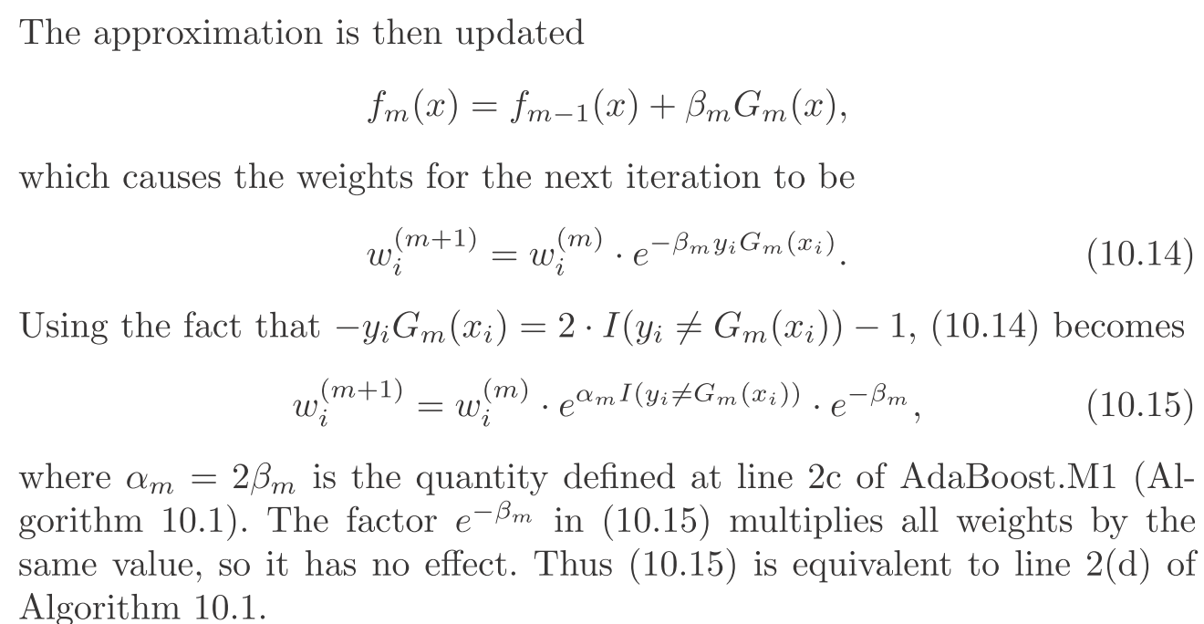
Finally adaBoost

Slide 29
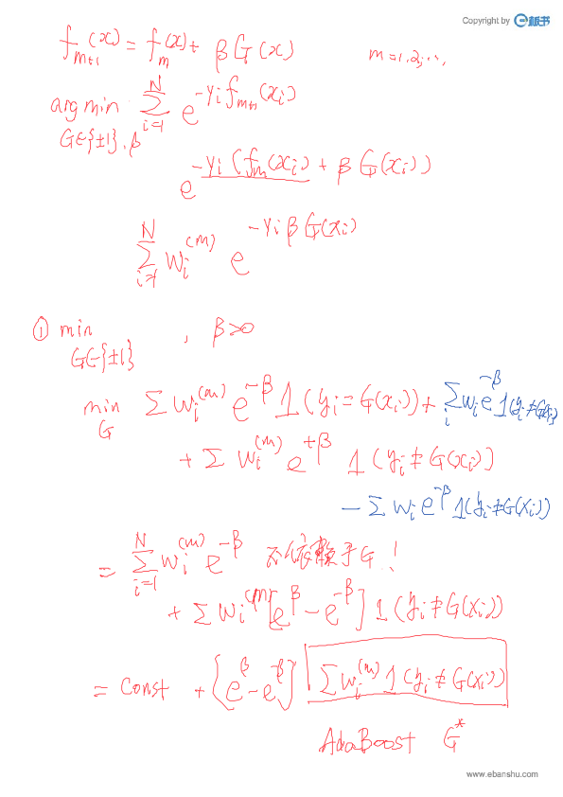

Slide 30
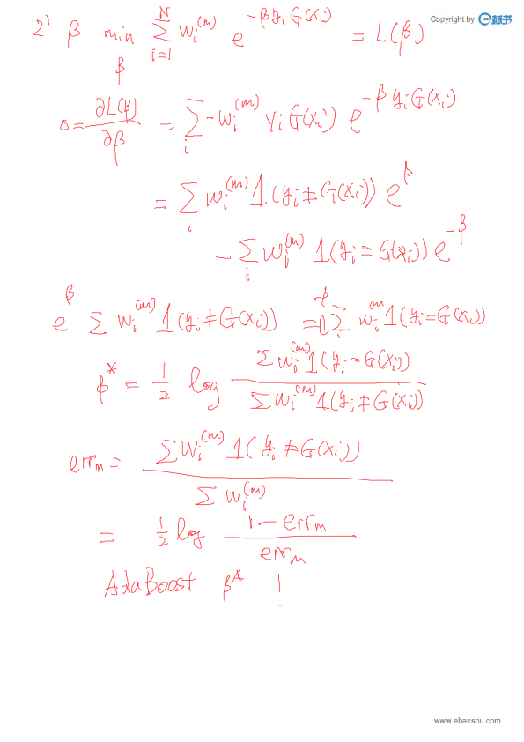

Slide 31
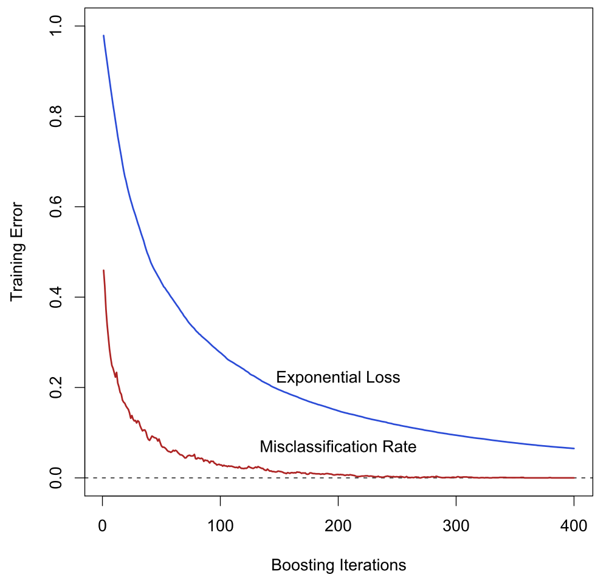
Exponential Loss reduction goes further than misclassification error

Slide 32
Why Exp Loss? Boosting the Margin
Computational reason
Leads the simple reweighting scheme
Question: what does adaBoost estimate?
Look at population minimizer…

Slide 33

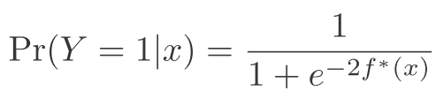


AdaBoost vs. LogitBoost
In population, AdaBoost
LogitBoost: It is the same maximal binomial log-likelihood (deviance) in population

Slide 34
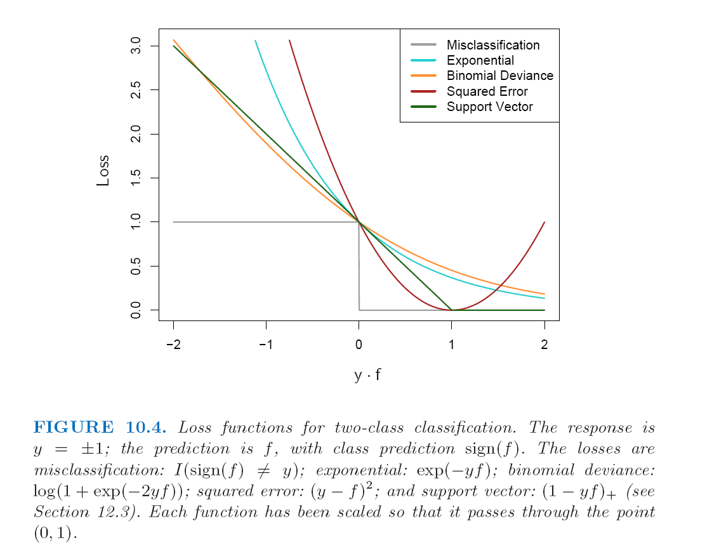
Loss functions and Robustness: classification

Slide 35
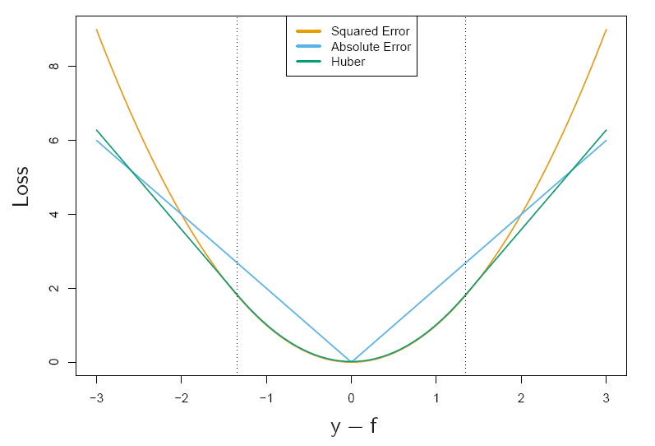
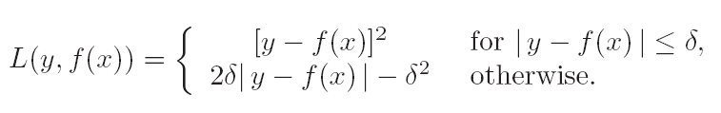
Loss functions and Robustness: Regression
For regression
Huber Loss

Slide 36
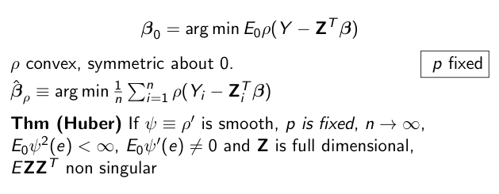
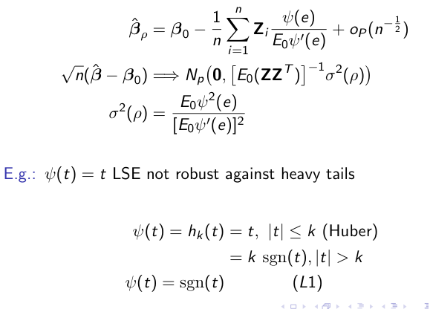
Huber’s M-Estimator in Regression

Slide 37
Other Interpretations on Boosting
Leo Breiman, Freund and Schapire, Game Theoretic View
Tong Zhang, Bin Yu, Early Stopping Regularization in convex optimization
Peter Buhlman, Bin Yu; Yuan Yao, Andrea Caponnetto and Lorenzo Rosasco, Early Stopping in RKHS
Peter Bartlett, Schapire et al.; Liwei Wang, Margin distribution boosting

Slide 38
Gradient Boosted Models Library(“gbm”)
Section 8.3.4, ISLR.
model = gbm(y~x, data, distribution,n.trees,interaction.depth)
distribution = [“gaussian”]|”Bernoulli”
n.trees = 1000, number of trees
interaction.depth = 2, the depth limit of each tree

Slide 39

Bagging (Leo Breiman 1996)
Bootstrap can be used to assess the accuracy of a prediction or parameter estimate
Bootstrap can also be used to improve the estimate or prediction itself.
Reduce variances of the prediction

Slide 40


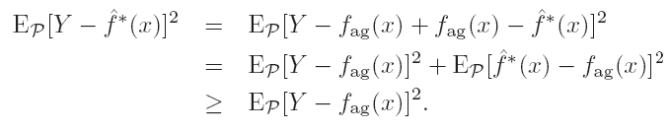

Bagging in Reduction of Variance
If is linear in data, then bagging is just itself.
Take cubic smooth spline as an example.
Property:
x fixed

Slide 41
Bagging Classifiers
Classifier
Bagging the classifier:

Slide 42
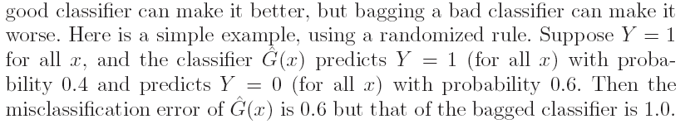
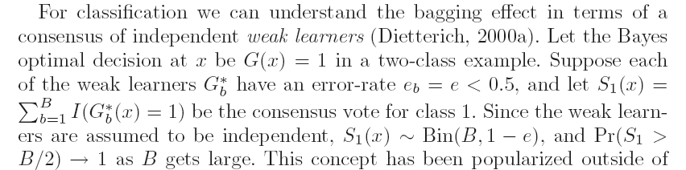
Bagging Classifiers
Bagging is not good for 0-1 loss
Wisdom of Crowds

Slide 43
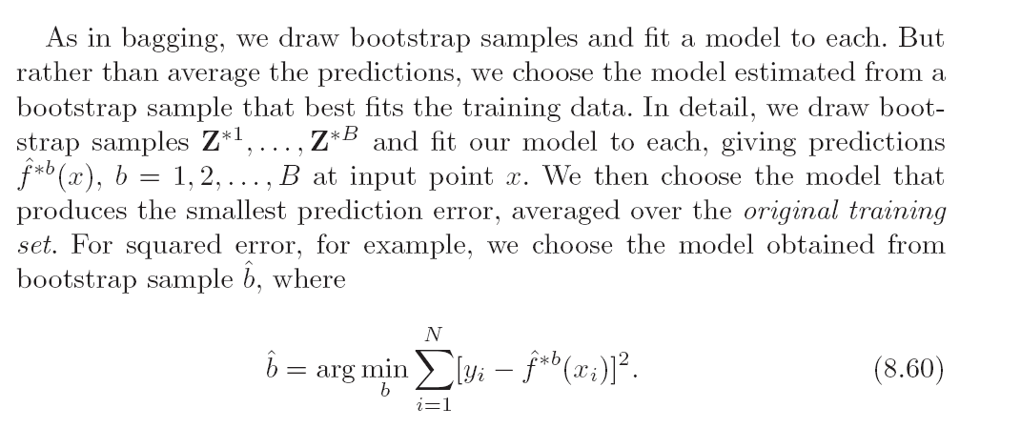
Bumping
Find a better single model.

Slide 44
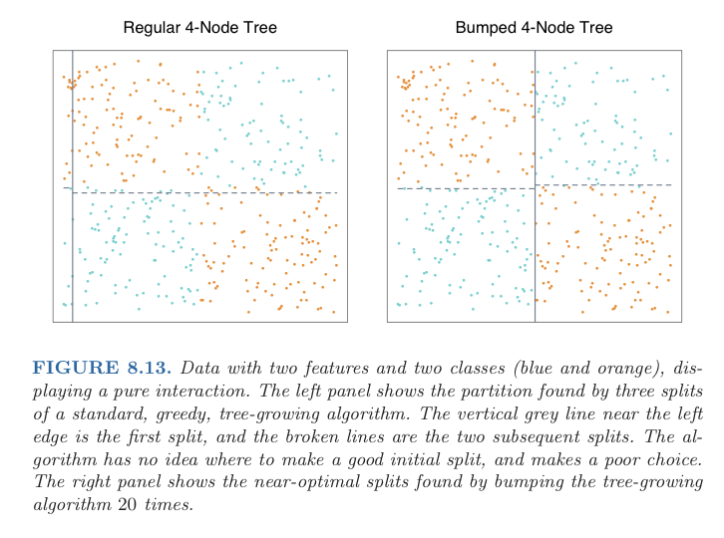
Example: Bumping

Slide 45
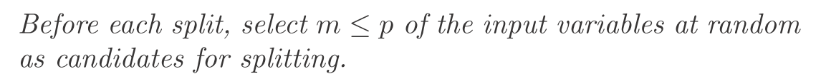
Random Forest
Suppose there is a very strong predictor, along with a small set of moderately strong ones: most of bagged trees will split this strong predictor on the top, since they look at all the predictors in every bootstrap – correlation of bagged trees
Random forests provide an improvement over bagging byway of decorrelating the trees

Slide 46
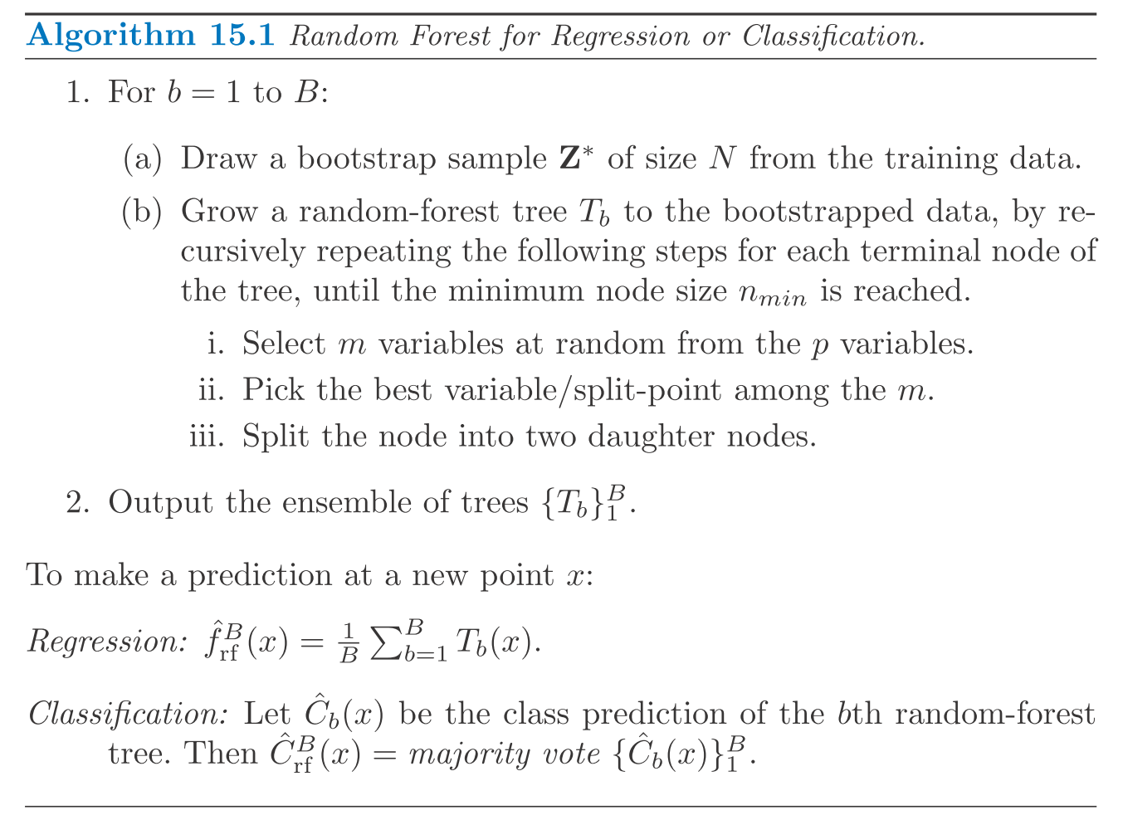
Random Forest (Leo Breiman 2001)

Slide 47
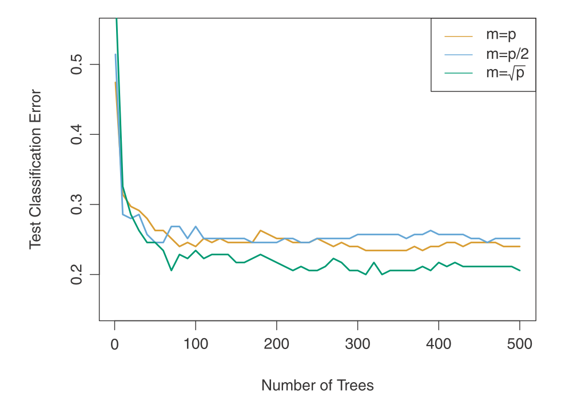

Slide 48
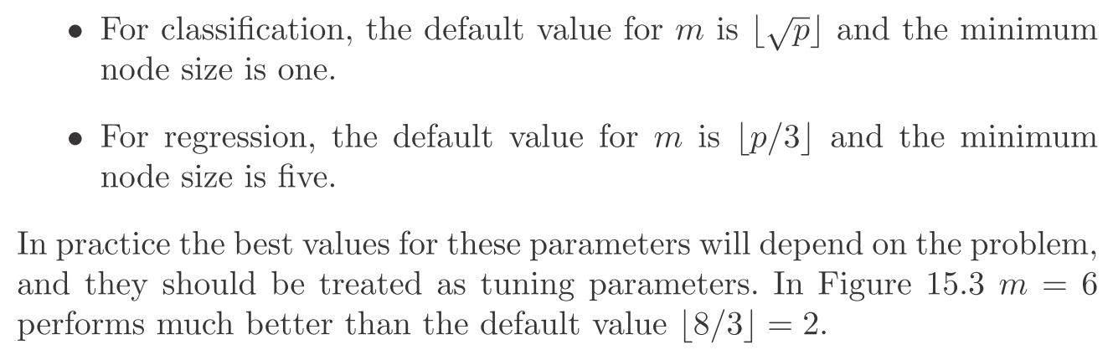
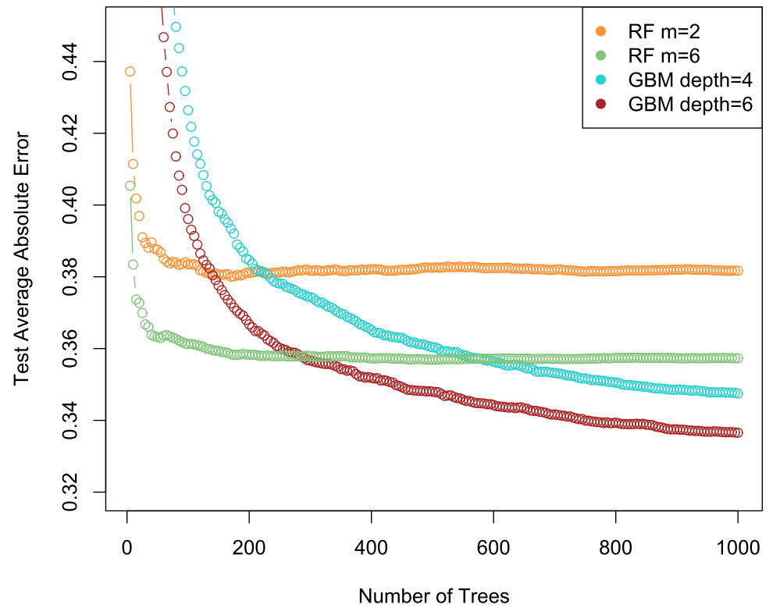
How to choose m?

Slide 49
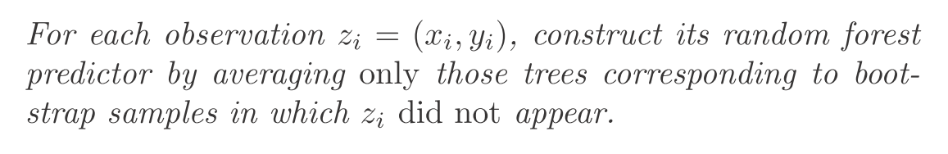

Error Estimate: Out-Of-Bag

Slide 50
Variable Importance
Gradient-Boosted Methods: at each split in each tree, the improvement in the split-criterion is the importance measure attributed to the splitting variable, and is accumulated over all the trees in the forest separately for each variable
OOB prediction power:
for the b-th tree, use OOB samples to estimate the prediction accuracy;
then the values for the j-th variable are randomly permuted in the OOB samples and recompute the prediction accuracy;
The accuracy decrease of such a permutation is averaged over all trees, as a measure of the importance of variable j in the random forest

Slide 51


Slide 52
Library(“randomForest”)
http://www.math.usu.edu/~adele/forests
model = randomForest(formula, data, mtry, ntree, importance, subset)
formula = y~.
mtry = [p/3]|[\sqrt{p}]|<=p, m is the number of variables to explore in random forest, if m=p it gives Bagging
p/3 for regression
\sqrt{p} for classification
importance=True|False
importance(model): show the variable importance

