Slide 1
Sparse Coding and Dictionary Learning
Yuan Yao and Ruohan Zhan
Peking University

Slide 2
Reference: Andrew Ng
http://ufldl.stanford.edu/wiki/index.php/UFLDL_Tutorial

Slide 3

Sparse Coding
The aim is to find a set of basis vectors (dictionary) such that we can represent an input vector x as a linear combination of these basis vectors:
PCA: a complete basis
Sparse coding: an overcomplete basis to represent (i.e. such that k > n)
The coefficients a_{i} are no longer uniquely determined by the input vector x
Need additional criterion of sparsity to resolve the degeneracy introduced by over-completeness.

Slide 4

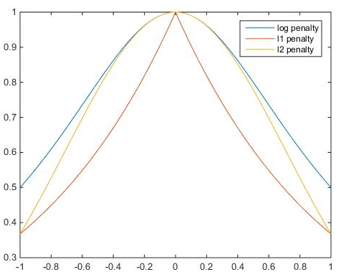
Sparsity Penalty
We define the sparse coding cost function on a set of m input vectors as
where S(.) is a sparsity cost function which penalizes a_{i} for being far from zero.
"L₀-norm”:
L₁ penalty:
log penalty:

Slide 5

Scale freedom
In addition, it is also possible to make the sparsity penalty arbitrarily small by scaling down a_{i} and scaling up by some large constant.
To prevent this from happening,
Olshausen and Field 1996

Slide 6


Identifiability: Scale
One can remove the scale degree of freedom either in constraint form
Or Lagrangian form:
where is simply the sum of squares of the entries of A (squared Frobenius norm)

Slide 7
Nonlinear Optimization
Bi-variate cost: not jointly convex, not differentiable
But J(A,s) is convex in A fixed s, and convex in s fixed A.

Slide 8
Alternating Optimization
Initialize A randomly
Repeat until convergence
Find the s that minimizes J(A,s) for the A found in the previous step (LASSO)
Solve for the A that minimizes J(A,s) for the s found in the previous step (Ridge Regression -> SVD)

Slide 9

Smoothing
So our final objective function:
where is shorthand for
the third term is simply the sum of squares of the entries of A (squared Frobenius norm)
Then you have a smooth objective function, restricted convex in A and s
Gradient descent such as BP algorithm can be applied here

Slide 10
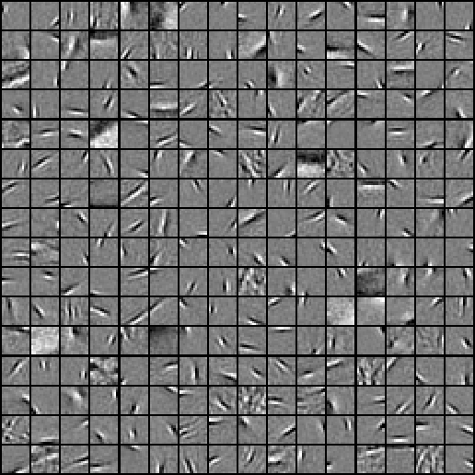
Dictionary Learned from natural image patches
http://ufldl.stanford.edu/wiki/index.php/Exercise:Sparse_Coding
http://ufldl.stanford.edu/wiki/resources/sparse_coding_exercise.zip

Slide 11
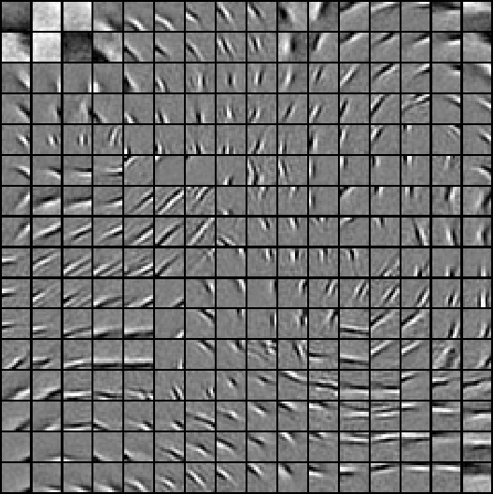
Adjacent features should be similar?

Slide 12

Topographic Sparse Coding: Group LASSO
Group adjacent features in group LASSO norm
Example: 3-by-3 neighborhood as ‘adjacency’

Slide 13
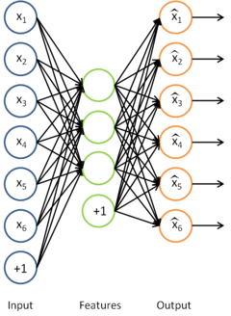

A Neural Network Interpretation: Sparse Autoencoder
Single-hidden layer NN, to learn features A to reconstruct signals x
Encoding: ${s=A}^{T}x$
Decoding: As
Sample torch codes: https://github.com/torch/tutorials/blob/master/3_unsupervised/2_models.lua
-- encoder
 | encoder = nn.Sequential()
 | encoder:add(nn.Linear(inputSize,outputSize))
 | encoder:add(nn.Tanh())
 | encoder:add(nn.Diag(outputSize))
 | -- decoder
 | decoder = nn.Sequential()
 | decoder:add(nn.Linear(outputSize,inputSize))
 | -- tied weights
 | if params.tied and not params.hessian then
 | -- impose weight sharing
 | decoder:get(1).weight = encoder:get(1).weight:t()
 | decoder:get(1).gradWeight = encoder:get(1).gradWeight:t()

Slide 14
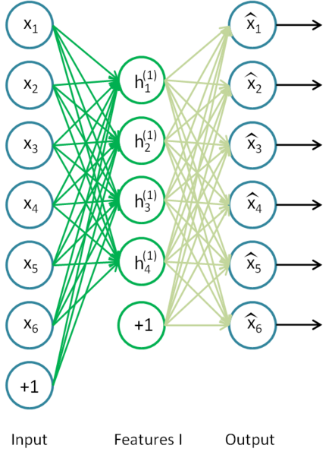
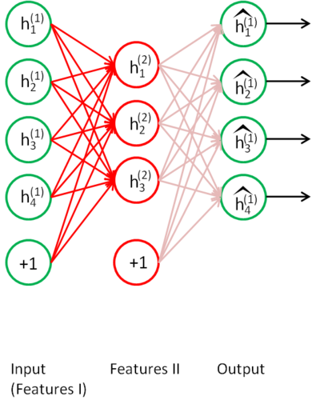
Deep Networks

Slide 15



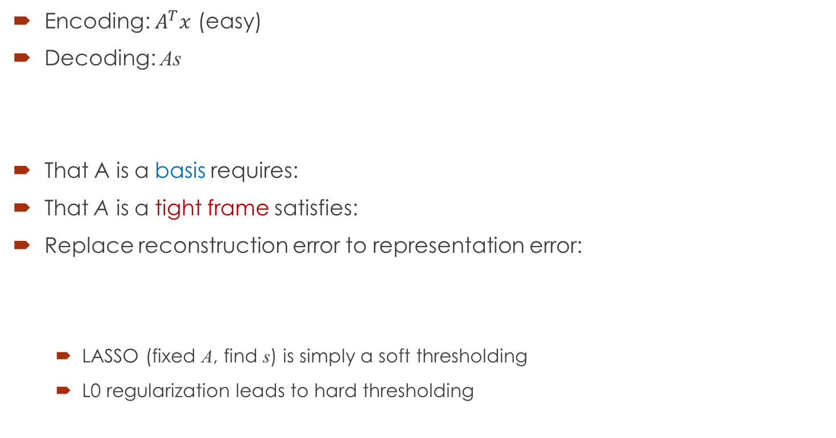
Other structures? -- Tight frame
Encoding: $A^{T}x$ (easy)
Decoding: As
That A is a basis requires:
That A is a tight frame satisfies:
Replace reconstruction error to representation error:
LASSO (fixed A, find s) is simply a soft thresholding
L0 regularization leads to hard thresholding

Slide 16
When does Dictionary Learning work?
Daniel Spielman, Huan Wang, and John Wright, Exact Recovery of Sparsely-Used Dictionaries, arXiv:1206.5882
Agarwal, Anandkumar, Jain, Netrapalli, Learning Sparsely Used Overcomplete Dictionaries via Alternating Minimization, arXiv:1310.7991
Sanjeev Arora, Rong Ge, and Ankur Moistra, New Algorithms for Learning Incoherent and Overcomplete Dictionaries, arXiv:1308.6273, 2013
Barak, Kelner, and Steurer, Dictionary Learning and Tensor Decomposition via the Sum-of-Squares Method, http://arxiv.org/abs/1407.1543, 2014

