Slide 1
DSP Bidding Competition 沈学华 x@ipinyou.com

Slide 2
Netflix Prize

Slide 3
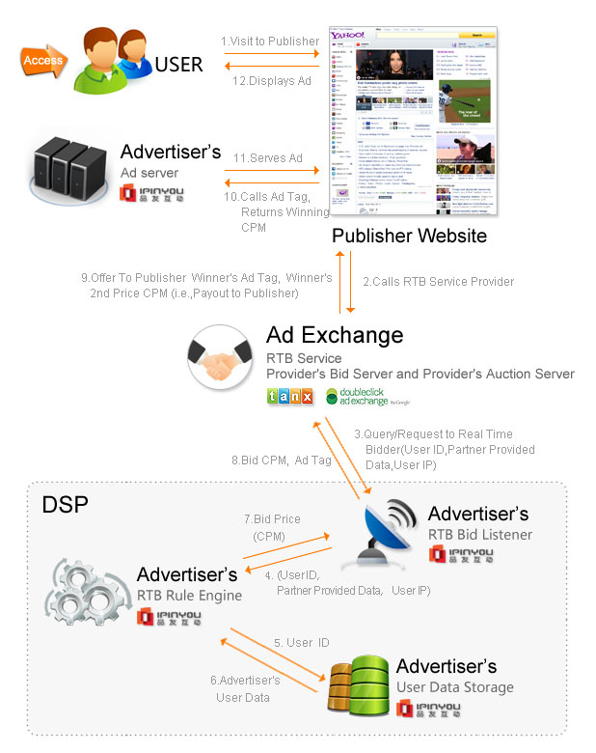

Slide 4
Maximize #clicks + 50 * #conversions
Subject to the fixed budget

Slide 5
Data Set

Slide 6
Offline/Online

Slide 7
Leaderboard

Slide 8
Sandbox Run
Regular Season
Final Three
Award Ceremony

Slide 9
Any question sent to
dsp-competition@ipinyou.com

