Slide 1
Update on DSP Bidding Competition 沈学华 x@ipinyou.com

Slide 2




Slide 3
3 Milestones +
1,000,000
Grand Prize

Slide 4

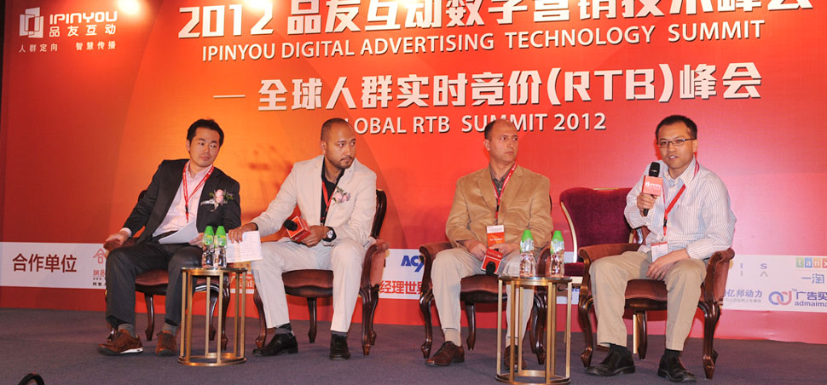


Slide 5
Maximize #clicks + N * #conversions
Subject to the fixed budget

Slide 6
Dropbox: https://www.dropbox.com/sh/xolf5thu8jsbmfu/kBrAsSxtAN
百度网盘: http://pan.baidu.com/share/link?shareid=374646&uk=3037373637

Slide 7
7.5G
bid: 13.6M imp: 9.2M clk: 7.5K conv: 72

Slide 8
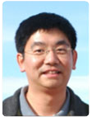
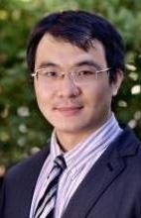

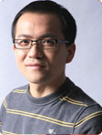

Slide 9
Any question sent to
dsp-competition@ipinyou.com

