Slide 1
Chapter 3: Linear Methods for Regression
Introduction(3.1)
Linear regression models and least squares(3.2)
Model selection
subset selection(3.3,3.5)
shrinkage methods(3.4)
Some Algorithms(3.4-3.8)

Slide 2
Linear regression models and least squares
Model:
Solution:
Hat matrix:

Slide 3
回归估计的性质
β的估计无偏
Variance σ^{２}的无偏估计
如果假设
则

Slide 4
回归估计的性质（续）
检验β_{j}=0
用Z-score,
更普遍的，有F统计量
下标1—the bigger model

Slide 5
The Gauss-Markov Theorem
的最小方差线形无偏估计是
(The Gauss-Markov Theorem)
If we have any linear estimator that is unbiased for a^{T} β, that is, E(c^{T} y)= a^{T} β,then

Slide 6
Then the expected prediction error(EPE) for is

Slide 7
Multiple Regression
正交化Algorithm
1. Initialize z0 = x0 = 1.
2. For j = 1, 2, . . . ,p
Regress x_{j} on z₀, z₁, . . . , , z_{j-1} to produce coefficients ,
, l = 0, . . . , j − 1 and residual vector
3. Regress y on the residual z_{p} to give the estimate .

Slide 8
由此可以引出回归结果的QR分解
X=ZΓ=ZD⁻¹ DΓ=QR, Γ是上三角矩阵， D是对角阵，Q 为 N*(p+1) 正交阵，Q⁻¹ Q=I, R是(p+1)*(p+1)上三角阵

Slide 9
Multiple Outputs
同样也可优化

Slide 10
LSE的两个缺点：
低bias高variance—Shrinkage Methods
变量太多—Subset Selection

Slide 11
Subset Selection
Forward and backward stepwise selection
backward只能用在N>p的情况下
Forward stagewise selection

Slide 12
Shrinkage Methods
Ridge regression
Lasoo
Least angle regression

Slide 13




Ridge regression

Slide 14



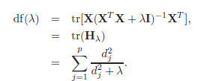
U,V分别是N*p和p*p正交阵，D是p*p对角阵

Slide 15


Lasso

Slide 16
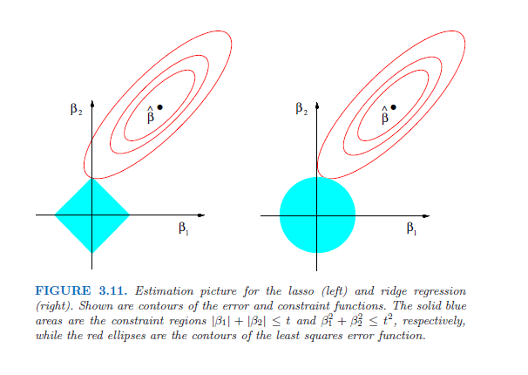
模型比较

Slide 17

Lasso, ridge regression, subset selection都可以看作是 有了某种先验分布的贝叶斯估计。
实际发现，q的估计没有太多的variance的差别，所以一般取在[1,2]

Slide 18
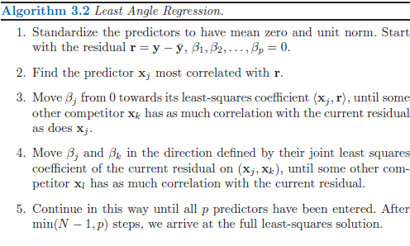
Least Angle Regression(LAR)

Slide 19

类似的，对lasso也可以采用这种算法

Slide 20
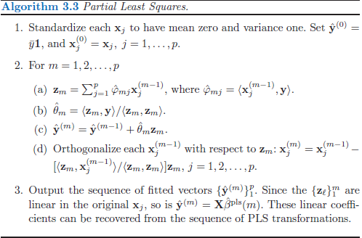
Principal Components Regression
Partial Least Squares(PLS)

Slide 21


PLS和principal components regression的区别
Principal components regression:
PLS:

Slide 22
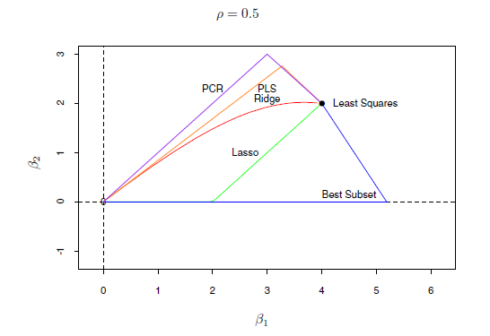
Comparison

Slide 23
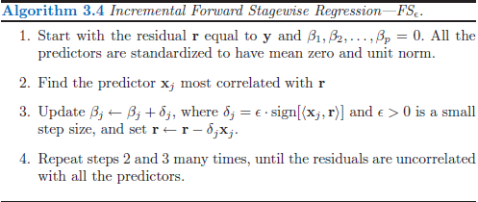
Incremental Forward Stagewise Regression

Slide 24
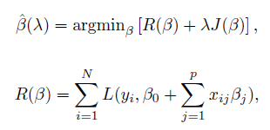
Piecewise-Linear Path Algorithms
L is the loss function, J is the penalty function
R is quadratic or piecewise-quadratic as a function of β
J is piecewise linear in β

Slide 25

The Grouped Lasso

Slide 26
Lasso的一些问题
Lasso shrinkage causes the estimates of the non-zero coefficients to be biased towards zero, and in general
they are not consistent
损失函数的设置

Slide 27


Pathwise Coordinate Optimization
可以写出显式解，
其中

