Slide 1
Lecture 2: Overview of Supervised Learning

Slide 2
Outline
Regression vs. Classification
Two Basic Ideas:
Linear Least Square -> generalized linear models
Nearest Neighbors -> kernel method and SVM
Bias-Variance Decomposition
Curse of Dimensionality and Model Selection
Generalized Linear Models and Basis Expansion

Slide 3
Regression vs. Classification in Supervised Learning
A Rough comparison:
 | Statistics | Machine Learning
Regression | 90% | <10%
Classification | <10% | 90%
Other problems such as ranking is often formulated as either problem.

Slide 4
Regression vs. Classification
Input (FEATURES) Vector: (p-dimensional)
X = X₁, X₂, …, X_{p}
Output: Y
Regression: real valued, R
Classification: discrete value, e.g. {0,1} or {-1,1} or {1,…,K}
Ranking: a (partial) order or element in S_{n}
Training Data :
(x₁, y₁), (x₂, y₂), …, (x_{N}, y_{N}) from joint distribution (X,Y).
Model :
Regression function: E(Y |X ) = f(X)
Classification function: f(X)>0 for class 1 and f(X)<0 for class -1.

Slide 5
Terminology
Input(s) –measured or preset (X)
Predictor var(s)
Independent var(s)
covariate(s)
Output(s) (Y) (G)
Response
Dependent var
Target
Types of variables
Quantitative {Infinite set}
Categorical
{finite set}
Group Labels
Codes (dummy vars)
Ordered (no metric)
Dummy Variable：K-level qualitative variable is represented by a vector of K binary variables or bits, only one of which is “on" at a time

Slide 6
Regression and Classification
Both Tasks Similar
Given the value of an input vector X, make a good prediction of the response Y.
Function approximation
Y ~ f(x)
Given
A set of Example
(Training Set)
A Performance Evaluation criteria e.g.,
Least Squares Error
Classification error
Find an Optimal Prediction Procedure
An Algorithm
Black box
Analytic expression

Slide 7
Loss Function and Optimal Prediction
Assume data drawn from a distribution
There is a Loss Function on true value y and prediction
Our purpose is to find a model minimize the following Expected Prediction Error

Slide 8
Loss Function and Optimal Prediction
There are two commonly used loss functions：
Square loss in regression
0-1 loss in classification
Optimal Prediction:

Slide 9
Loss Function and Optimal Prediction
With square loss
The optimal prediction is the conditional expectation (regression function)

Slide 11
Loss Function and Optimal Prediction
With 0-1 loss function
The optimal prediction function is

Slide 13
Supervised Learning - Classification
Discriminant Analysis (DA)
Linear, Quadratic, Flexible, Penalized, Mixture
Logistic Regression
Support Vector Machines (SVM)
K-Nearest Neighbors (NN)
Adaptive k-NN
Bayesian Classification
Monte Carlo and Genetic Algorithms

Slide 14
Supervised Learning – Classification and Regression
Linear Models, GLM, Kernel methods
Generalized Additive Models (Hastie & Tibshirani, 1990)
Decision Trees
CART (Classification and Regression Trees) (Breiman, etc. 1984)
MARS (Multivariate Adaptive Regression Splines) (Friedman, 1990)
QUEST (Quick, Unbiased, Efficient Statistical Tree) (Loh, 1997)
Decision Forests
Bagging (Breiman, 1996)
Boosting (Freund and Schapire, 1997)
MART (Multiple Additive Regression Trees) (Freiman, 1999)
Neural Networks (Adaptive Non-linear Models)

Slide 15
Least Squares v.s. Nearest Neighbors
Linear model fit by Least Squares
Makes huge structural assumption
a linear relationship,
yields stable but possibly inaccurate predictions
Method of k-nearest Neighbors
Makes very mild structural assumptions
points in close proximity in the feature space have similar responses (needs a distance metric)
Its predictions are often accurate, but can be unstable

Slide 16
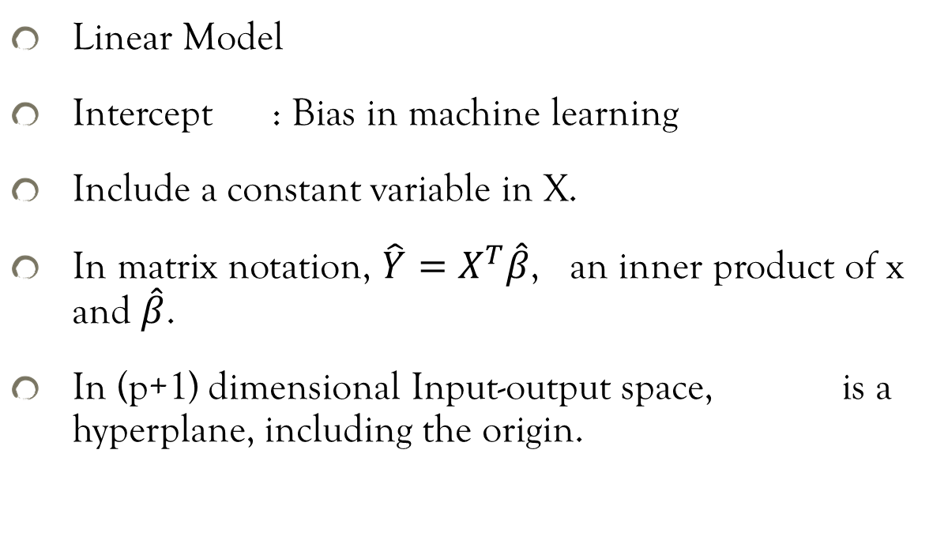
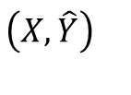
Least Squares
Linear Model
Intercept : Bias in machine learning
Include a constant variable in X.
In matrix notation, $\hat{Y}=X^{T}\hat{β}$, an inner product of x and $\hat{β}$.
In (p+1) dimensional Input-output space, is a hyperplane, including the origin.
$$\left(X,\hat{Y}\right)$$

Slide 17
Least Squares (cont)
Choose the coefficient vector to minimize Residual Sum of Squares RSS(β)
Differentiating wrt β:
If X^{T}X is non-singular,

Slide 18
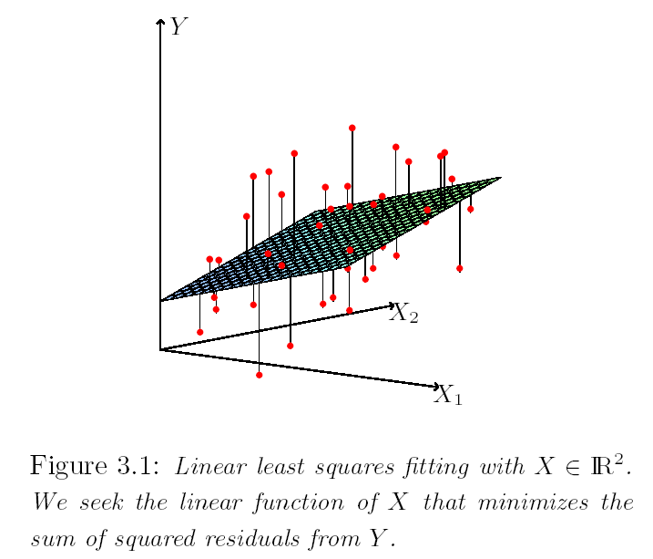
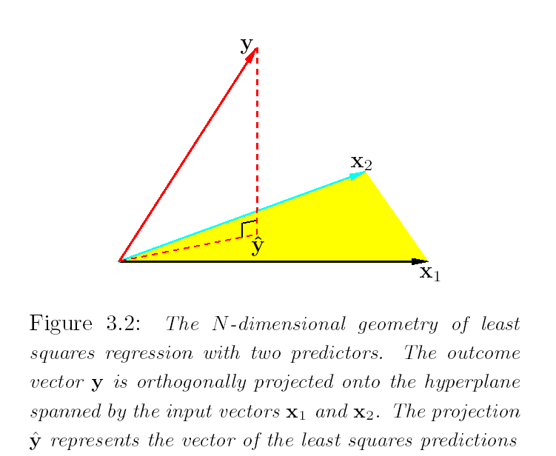
Least Squares- Geometrical Insight

Slide 19
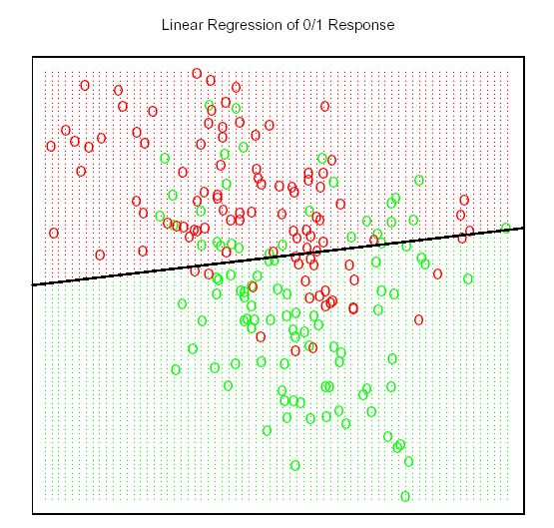
LS applied to Classification
A classification example:
The classes are coded as a binary variable—GREEN = 0, RED = 1—and then fit by linear regression.
The line is the decision boundary defined by x^{T}β = 0.5.
The red shaded region denotes that part of input space, classified as RED, while the green region is classified as GREEN.

Slide 20
Nearest Neighbors
Nearest Neighbor methods use those observations in the training set closest in the input space to x.
K-NN fit for ,
k-NN requires a parameter k and a distance metric.
For k = 1, training error is zero, but test error could be large (saturated model).
As k , training error tends to increase, but test error tends to decrease first, and then tends to increase.
For a reasonable k, both the training and test errors could be smaller than the Linear decision boundary.

Slide 21
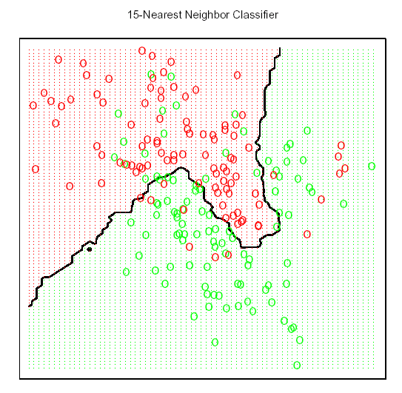
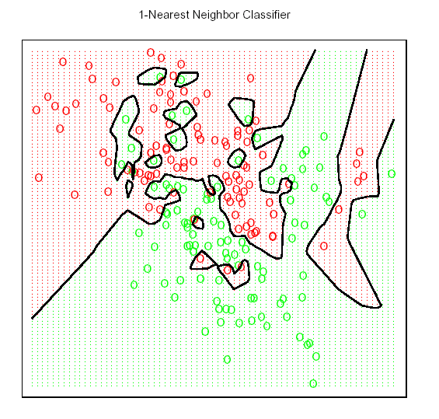
NN Example

Slide 22
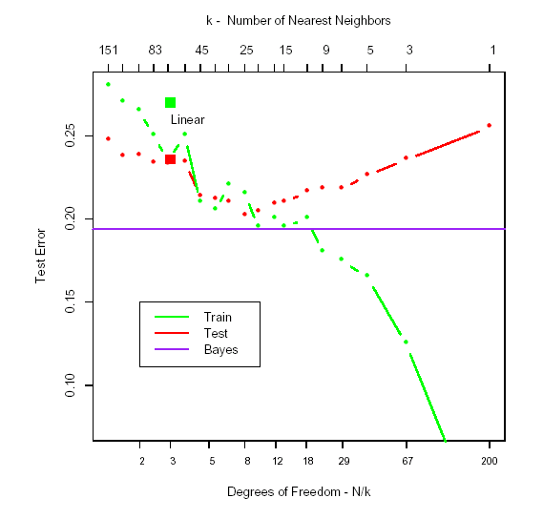
K vs misclassification error
How to choose k? Cross-validation
Bayes Error: If the underlying joint distribution was known (lowest expected loss)
Training error may go down to zero while test error goes large (overfitting)
Optimal k* reaches the smallest test error

Slide 23
Model Assessment and Selection
If we are in data-rich situation, split data into three parts: training, validation, and testing.
Train
Validation
Test
See chapter 7.1 for details

Slide 24
Cross Validation
When sample size not sufficiently large, Cross Validation is a way to estimate the out of sample estimation error (or classification rate).
Available Data
Randomly split
Training
Test
error₁
Split many times and get
error₂, …, error_{m} ,then average
over all error to get an estimate

Slide 25
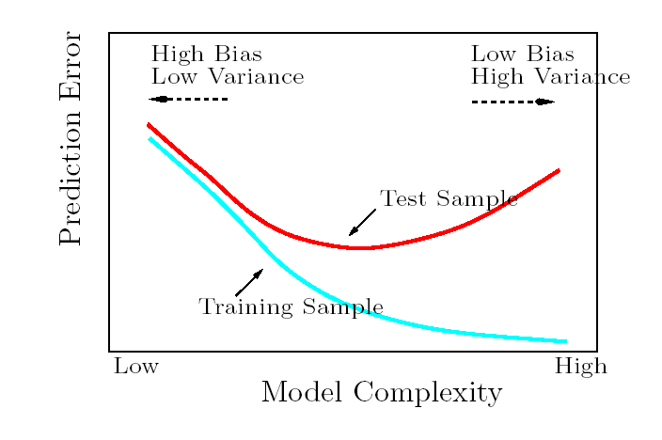
Model Selection and Bias-Variance Tradeoff

Slide 26
Linear Regression v.s. NN
Linear Regression- Assumed Model:
Then
Corresponding solution may not be conditional mean, if our assumption is wrong!
Estimates based on pooling over all x’s, assuming a parametric model for .
NN-methods attempt to estimate the regression, assuming only that the responses for all x’s in a small neighborhood are close.
Typically, we have at most one observation at any particular point. So
Conditioning at a point relaxed to conditioning on a region close to the target point x.

Slide 27
Linear Regression and NN
In both approaches, the conditional expectation over the population of x-values has been substituted by the average over the training sample.
Empirical Risk Minimization (ERM) principle.
Least Squares assumes f(x) is well approximated by a global linear function [low variance (stable estimates) , high bias].
k-NN only assumes f(x) is well approximated by a locally constant function- Adaptable to any situation [high variance (decision boundaries change from sample to sample), low bias].

Slide 28
Popular Variations & Enhancements
Kernel methods use weights that decrease smoothly to zero with the distance from the target point, rather than 0/1 weights used by k-NN methods.
In high-dimensional spaces, kernels are modified to emphasize some features more than the others
[variable (feature) selection]
Kernel design – possibly kernel with compact support
Local regression fits piecewise linear models by locally weighted least squares, rather than fitting constants locally.
Linear models fit to a basis expansion of the measured inputs allow arbitrarily complex models.
Neural network models consists of sums of non-linearly transformed linear models.

Slide 29
Framework for Classification
y-f(x): not meaningful error - need a different loss fn.
When G has K categories, the loss function can be expressed as a K x K matrix with 0 on the diagonal and non-negative elsewhere.
L(k,j) is the cost paid for erroneously classifying an object in class k as belonging to class j.
0-1 loss used most often. All misclassifications cost the same unit amount.
Exp. Prediction Error =
As before, suffices to minimize EPE pointwise:
For 0-1 loss, Bayes classifier uses the conditional distribution Pr(G|X). Its error rate is called Bayes rate.

Slide 30
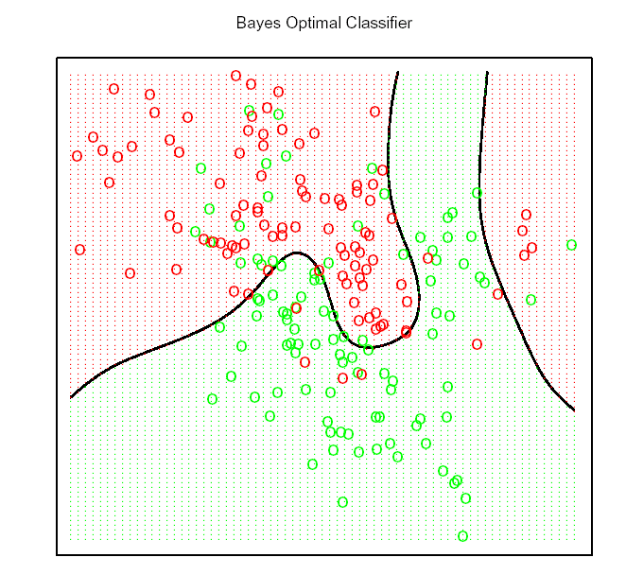
Bayes Classifier - Example
Knowing the true joint distribution in the simulated example, we can get the Bayes optimal classifier.
k-NN classifier approximates Bayes solution:
- conditional prob.is estimated by the training sample proportion in a nbd. of the point.
- Bayesian rule leads to a majority vote in the nbd. around at point.

Slide 31
Classification via Regression
For the two class, code g by a binary Y, Y=1 if in group 1, 0 otherwise, followed by squared error loss estimation.
For the K-class problem, use K-dummy variables.
Exact representation, but with linear regression, the fitted function may not be positive, and thus not an estimate of class probability for a given x.
Modeling Pr(G|X) will be discussed in Chapter 4.

Slide 32
Local Methods in High Dimensions
With a reasonably large set of training data, intuitively we should be able to find a fairly large neighborhood of observations close to any x
Could estimate the optimal conditional expectation by averaging k-nearest neighbors.
In high dimensions, this intuition breaks down. Points are spread sparsely even for N very large (“curse of dimensionality”)
Input uniformly dist. on an unit hypercube in p-dimension
Volume of a hypercube in in p dimensions, with an edge size a is
For a hypercubical nbd about a target point chosen at random to capture a fraction r of the observations, the expected edge length will be

Slide 33
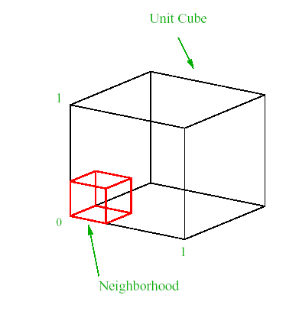
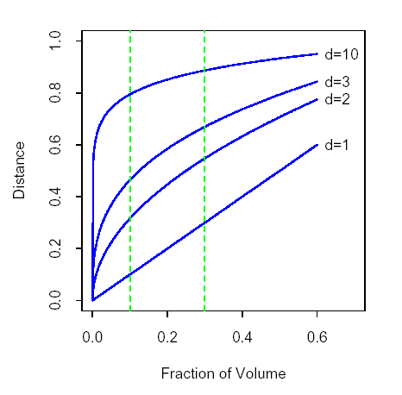
Curse of Dimensionality

Slide 34
Curse of Dimensionality (cont)
As p increases, even for a very small r, approaches 1 fast.
To capture 1% of the data for local averaging,
For 10 (50) dim, 63% (91%) of the range for each variable needs to be used.
Such nbd are no longer local.
Using very small r leads to very small k and a high variance estimate.
Consequences of sampling points in high dimensions
Sampling uniformly within an unit hypersphere
Most points are close to the boundary of the sample space.
Prediction is much more difficult near the edges of the training sample –extrapolation rather than interpolation.
Notes:
1
0.01
10
0.630957
20
0.794328
50
0.912011
1 0.01
10 0.630957344
20 0.794328235
0.912010839
N points distributed uniformly in an unit sphere around the origin
Prob. (a point within distance d of the center) = d^p.
Prob(a point outside a sphere of radius d)=1-d^p
Prob( all points outside a sphere of radius d) = (1-d^p)^N.
Median distance from the origin to the closest data point
d(p,N) requires this prob = ½. Thus d(p,N) = (1 - .5^1/N)^1/p

Slide 35
Curse of Dimensionality (cont)
Sampling density prop. to N^{(1/p)}
Thus if 100 obs in one dim are dense, the sample size required for same denseness in 10 dimensions is 100¹⁰ (infeasible!)
In high dimensions, all feasible training samples sparsely populate the sample space.
Bias-Variance trade-off phenomena for NN methods depends on the complexity of the function, which can grow exponentially with the dimension.

Slide 36
Summary-NN versus model based prediction
By relying on rigid model assumptions, the linear model has no bias at all and small variance (when model is “true”), while the error in 1-NN is substantially larger.
If assumptions wrong, all bets are off and 1-NN may dominate
Whole spectrum of models between rigid linear models and flexible 1-NN models, each with its own assumptions and biases to avoid exponential growth in complexity of functions in high dimensions by drawing heavily on these assumptions.

Slide 37
Supervised Learning as Function Approximation
Function fitting paradigm in ML
Error additive, Model
Supervised learning (learning f by example) through a teacher.
Observe the system under study, both the inputs and outputs
Assemble a training set T =
Feed the observed input x_{i} into a Learning algorithm, which produces
Learning algorithm can modify its input/output relationship in response to the differences in output and fitted output.
Upon completion of the process, hopefully the artificial and real outputs will be close enough to be useful for all sets of inputs likely to be encountered in practice.

Slide 38
Function Approximation
In statistics & applied math, the training set is considered as N points in (p+1)-dim Euclidean space
The function f has p-dim input space as domain, and related to the data via the model
The domain is
Goal: obtain useful approx to f for all x in some region of
Assume that f is a linear function of x’s
Or basis expansions

Slide 39
Basis and Criteria for Function Estimation
The basis functions h(.) could be
Polynomial (Taylor Series expansion)
Trignometric (Fourier expansion)
Any other basis (splines, wavelets)
non-linear functions, such as sigmoid function in neural network models
Mini Residual SS (Least Square Error)
Closed form solution
Linear model
If the basis functions do not involve any hidden parameters
Otherwise, need
iterative methods
numerical (stochastic) optimization

Slide 40
Criteria for Function Estimation
More general estimation method
Max. Likelihood estimation-Estimate the parameter so as to maximize the prob of the observed sample
Least squares for Additive error model, with Gaussian noise, is the MLE using the conditional likelihood
Multinomial likelihood for regression function Pr(G|X)
L is also called the cross- entropy

Slide 41
Regression on Large Dictionary
Using an arbitrarily large function basis dictionary (nonparametric)
Infinitely many solutions : interpolation with any function passing through the observed point is a solution [Over-fitting]
Any particular solution chosen might be a poor approximation at test points different from the training set.
Replications at each value of x – solution interpolates the weighted mean response at each point.
If N were sufficiently large, so that repeats were guaranteed, and densely arranged, these solutions might tend to the conditional expectations.

Slide 42
How to restrict the class of estimators?
The restrictions may be encoded via parametric representation of f.
Built into the learning algorithm
Different restrictions lead to different unique optimal solution
Infinitely many possible restrictions, so the ambiguity transferred to the choice of restrictions.
Generally, most learning methods: complexity restrictions of some kind
Regularity of in small nbd’s of x in some metric, such as special structure
Nearly constant
Linear or low order polynomial behavior
Estimate obtained by averaging or fitting in that nbd.

Slide 43
Restrictions on function class
Nbd size dictate the strength of the constraints
Larger the nbd, the stronger the constraint and more sensitive the solution to particular choice of constraint
Nature of constraint depends on the Metric
Directly specified metric and size of nbd.
Kernel and local regression and tree based methods
Splines, neural networks and basis-function methods implicitly define nbds of local behavior

Slide 44
Neighborhoods Nature
Any method that attempts to produce locally varying functions in small isotropic nbds will run into problems in high dimensions –curse of dimensionality.
All method that overcome the dimensionality problems have an associated (implicit and adaptive) metric for measuring nbds, which basically does not allow the nbd to be simultaneously small in all directions.

Slide 45
Classes of Restricted Estimators
Roughness penalty and Bayesian methods
Penalized RSS
RSS(f) + J(f)
User selected functional J(f) large for functions that vary too rapidly over small regions of input space, e.g., cubic smoothing splines
J(f) = integral of the squared second derivative
controls the amount of pemalty
Perturb and average can reduce variance: bagging, drop-out etc.
Kernel Methods and Local Regression provide estimates of the regression function or conditional expectation by specifying the nature of the local nbd
Gaussian Kernel
k-NN metric
Could also minimize kernel-weighted RSS
These methods need to be modified in high dimensions

Slide 46
Homework
Everyone submit your own homework answer, on the head of which, please mark your Name-ID.
Chapter 2
2.5
2.7
2.8 (experiment: source codes can be attached as Appendix)
2.9

