Slide 1
Lecture 4. Linear Methods for Classification

Slide 2

Last class --
Linear Regression
Least Square Solution
Gauss-Markov Theorem
Subset Selection
Forward, OMP, backward
Shrinkage
Ridge Regression
LASSO
Elastic Net = Ridge + Lasso

Slide 3
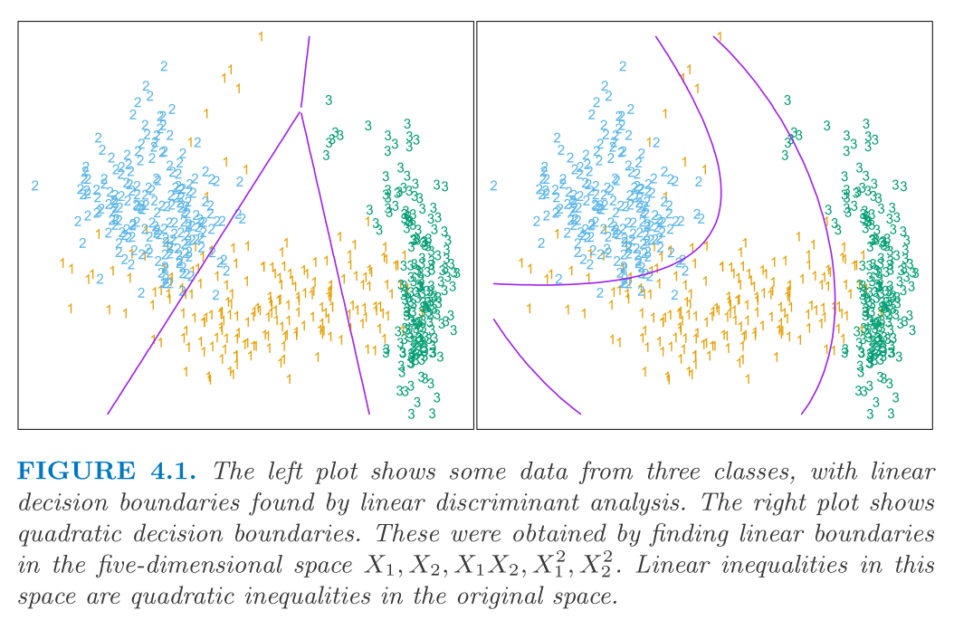
Outline
General framework of Classification
Discriminant Analysis
Logistic Regression
Perceptron and Separating Hyperplane
Support Vector Machines

Slide 4
Framework for Classification
Input: X₁, …, X_{p} Output: Y -- class labels
|y-f(x)|: not meaningful error - need a different loss function.
When Y has K categories, the loss function can be expressed as a K x K matrix with 0 on the diagonal and non-negative elsewhere.
L(k,j) is the cost paid for erroneously classifying an object in class k as belonging to class j.

Slide 5

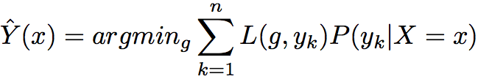
Framework for Classification(cont)
Expected Prediction Error:
Minimize Empirical Error:

Slide 6
Bayes Classifier
0-1 loss is most commonly used.
The optimal classifier (Bayes classifier) is:
Our goal: Learn a proxy f(x) for Bayes rule from training set examples

Slide 7
Linear Methods
Features X = X₁, X₂, …, X_{p}
OUTPUT G: Group Labels
LINEAR decision boundary in the feature space
Decision function:
Could be non-linear in original space
Features: Any arbitrary (known) functions of measured attributes
Transformations of Quantitative attributes
Basis expansions
Polynomials, Radial Basis function
0-Levelset (decision boundary) f(x) = 0 partitions the feature-space into two parts

Slide 8
Global Linear Rules – 2 classes
Linear Regression
Linear Discriminant Analysis: (a Bayes rule)
Normal: different means, same covariance matrix
Quadratic Discriminant Analysis:
Normal: different means and covariance matrices
RDA: Regularized Discriminant Analysis
Logistic Regression
Model or its monotone function as a linear function of x

Slide 9



Linear Regression
For a k-class classification problem:
Y is coded as a N by K matrix: Y_{k}=1 if G=k, otherwise 0
Then do a regression of Y on X
To classifier a new input x:
Computer , a K vector;
Identify the largest component and classify accordingly:

Slide 10
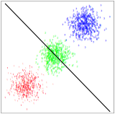
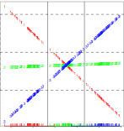
Multi-class in Linear Regression
Data
Prediction Vector with linear covariates: x₁, x₂
A three class problem, the middle class is blocked by others.

Slide 11
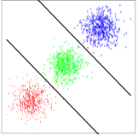
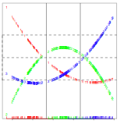
Linear Regression with Quadratic Terms
Data
Predictors: x₁, x₂, x₁², x₂², x₁x₂
In this three class problem, the middle
class is classified correctly

Slide 12



Linear Discriminant Analysis
Let P(G = k) = π_{k} and P(X=x|G=k) = f_{k}(x)
Then
Assume f_{k}(x) ~ N(μ_{k}, Σ_{k}) and Σ₁ = Σ₂ = …= Σ_{K}= Σ
Then we can show the decision rule is:

Slide 13


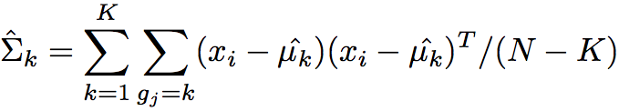
LDA (cont)
Plug in the estimates:

Slide 14
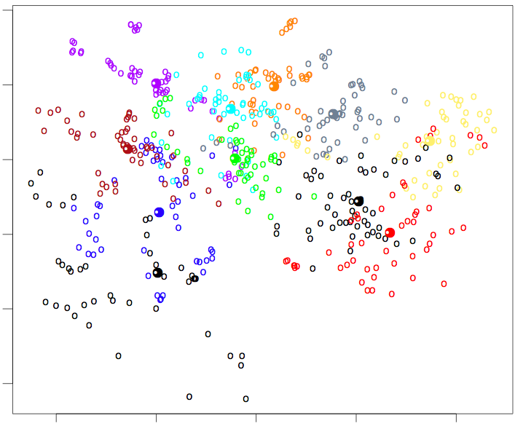
LDA Example
11 classes and X ∈ R¹⁰

Slide 15
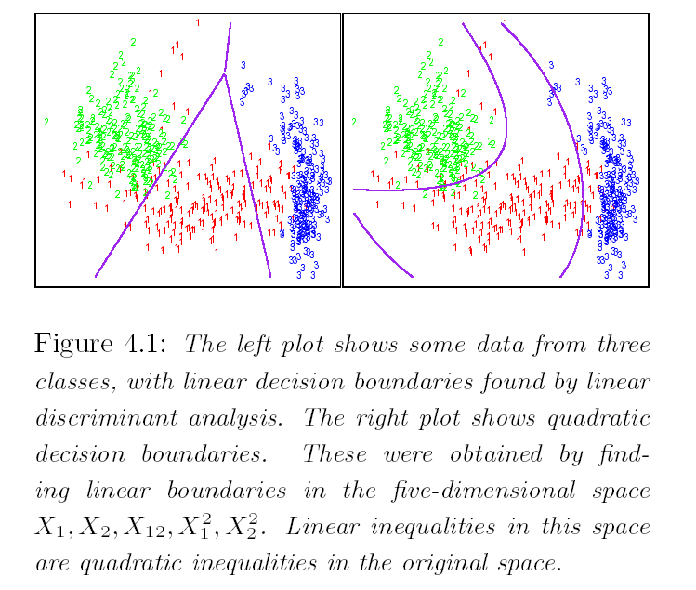
Linear Boundaries in Feature Space: Non-Linear in original Space
LDA on x₁ and x₂
LDA on x₁, x₂ , x₁x₂,
x₁² , and x₂²

Slide 16
Quadratic Discriminant Analysis
Let P(G = k) = π_{k} and P(X=x|G=k) = f_{k}(x)
Then
Assume f_{k}(x) ~ N(μ_{k}, Σ_{k})
Then we can show the decision rule is (HW#2):

Slide 17

QDA (cont)
Plug in the estimates:

Slide 18
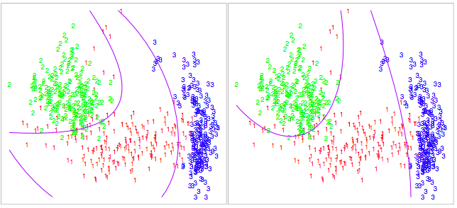
LDA v.s. QDA
LDA on x₁, x₂ , x₁x₂,
x₁² , and x₂²
QDA on x₁, x₂

Slide 19
LDA and QDA: Bayesian
LDA and QDA perform well on an amazingly large and diverse set of classification tasks.
The reason is NOT likely to be that the data are approximately Gaussian or the covariances are approximately equal.
More likely a reason is that the data can only support simple decision boundaries such as linear or quadratic, and the estimates provided via the Gaussian models are stable.

Slide 20

Regularized Discriminant Analysis
If number of classes K is large, the number of unknown parameters (=K p(p+1)/2) in the K covariance matrices Σ_{k} is very large.
May get better predictions by shrinking within class covariance matrix estimates toward a common covariance matrix Σ used in LDA
The shrunken estimates are known to perform better than the unregularized estimates, the usual MLEs
Estimate the mixing coefficient by cross-validation

Slide 21
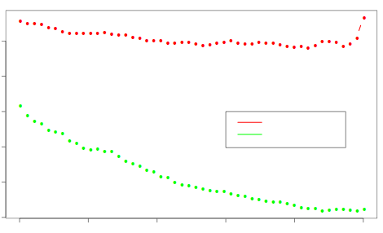
RDA examples
RDA on the vowel data:
Misclassification rate
Test data
Train data
α

Slide 22
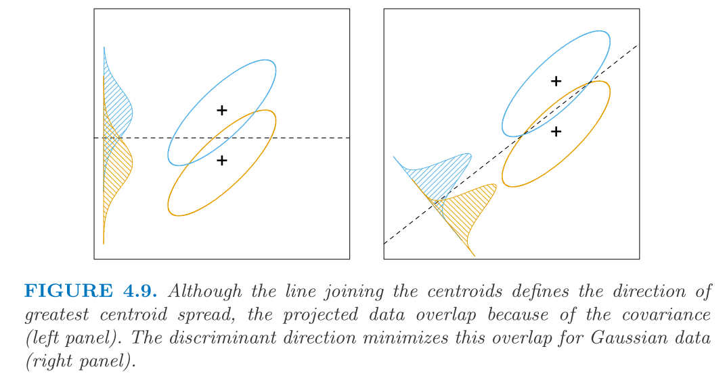
Reduced Rank LDA

Slide 23
Reduced Rank LDA: Generalized Eigenvalue Problem
B = Between class covariance matrix
Cov. Matrix of class means
measure of pair-wise distances between centroids
W = Same Within-class covariance matrix
Measures variability and the extent of ellipsoidal shape (departure from spherical) of inputs within a class
PCA (K-L transformation) converts these inputs into spherical point cloud (normalized and decorrelated)
Best Discriminating Direction
Maximize
or Maximize
Optimal solution:
First PC of
Generalized eigenvector (Bv =λ Wv)
If W =I, first PC of B
Max separation of data in direction orthogonal to

Slide 24
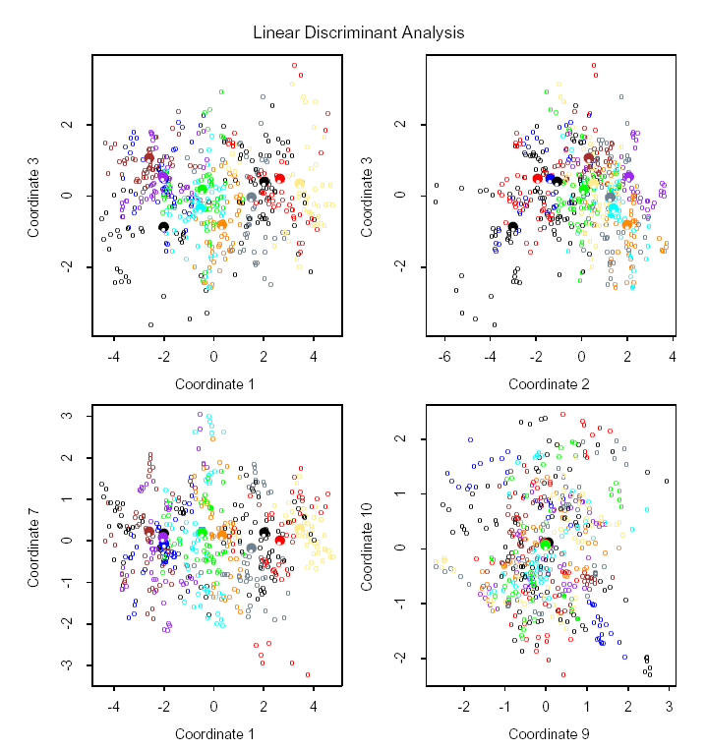
Two-Dimensional Projections of LDA Directions

Slide 25
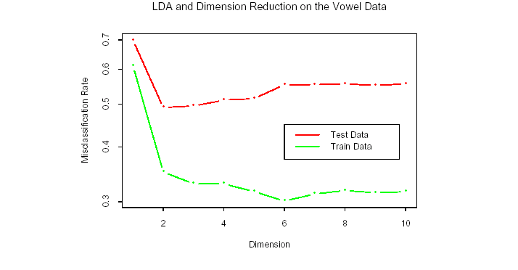
LDA and Dimension Reduction

Slide 26
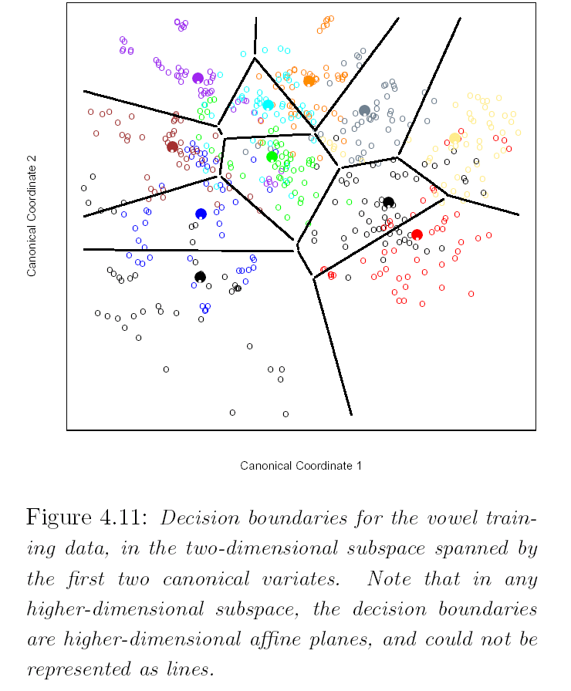
LDA in Reduced Subspace

Slide 27

Summary of Discriminant Analysis
Model the joint distribution of (G,X)
Let P(G = k) = π_{k} and P(X=x|G=k) = f_{k}(x)
Then
Assume f_{k}(x) ~ N(μ_{k}, Σ_{k})
LDA: Assume Σ₁ = Σ₂ = …= Σ_{K}= Σ
QDA: No assumption on Σ_{j}
RDA:
Fisher’s LDA (Generalized Eigenvector):

Slide 28
Discriminant Analysis Algorithm
Decision rule:
Parameters are estimated by empirical values:

Slide 29
Generalized Linear Models
In linear regression, we assume:
the conditional expectation (mean) is linear in X
the variance is constant in X
Generalized Linear Models:
the mean is linked to a linear function via transform g:
the variance can depend on mean

Slide 30
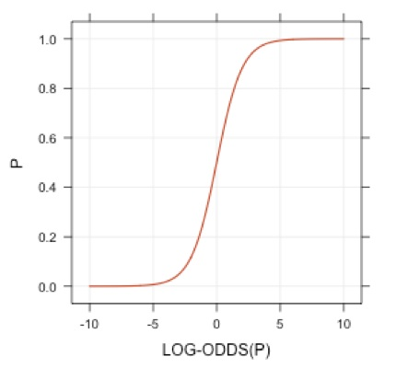
Examples
Linear regression: g=I, V=constant
Log-linear (Poisson) regression: g=log, V=I
Logistic Regression:
g(μ)=log(μ/(1 - μ))=logit (μ): log odds
V(μ)=μ (1-μ)
Probit Regression:
g(μ)=Φ⁻¹(μ)

Slide 31



K-class Logistic Regression
Model the conditional distribution P(G|X)
(K-1) log-odds of each class compared to a reference class (say K) modeled as linear functions of x, with unknown parameters
Given the class prob., a multinomial distribution for the training set.
Estimate the unknown parameters
Max Likelihood
Classify the object into the class with maximum posterior prob.

Slide 32
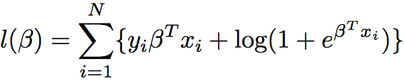
Fitting Logistic Regression
For a two-class problem: when the labels are coded as (0,1) and p(G=1) = p(x), the likelihood is: (HW#3)
derived by Binomial distribution with

Slide 33
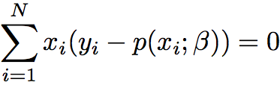
Fitting Logistic Regression (cont)
To maximize the likelihood over β, take partial derivative and set to 0:
p+1 equations (score equations) nonlinear in β
For β₀ it implies
To solve those equations, use Newton-Raphson.

Slide 34



Fitting Logistic Regression (cont)
Newton-Raphson leads to Iteratively Reweighted Least Squares (IRLS)
Given old β

Slide 35
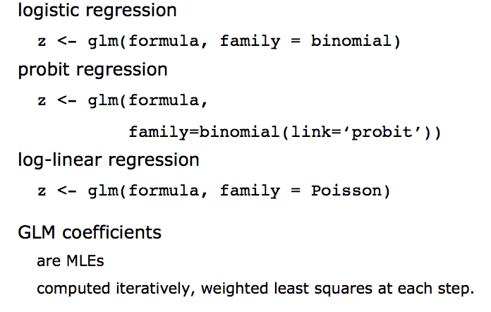
Generalized Linear Model in R

Slide 36
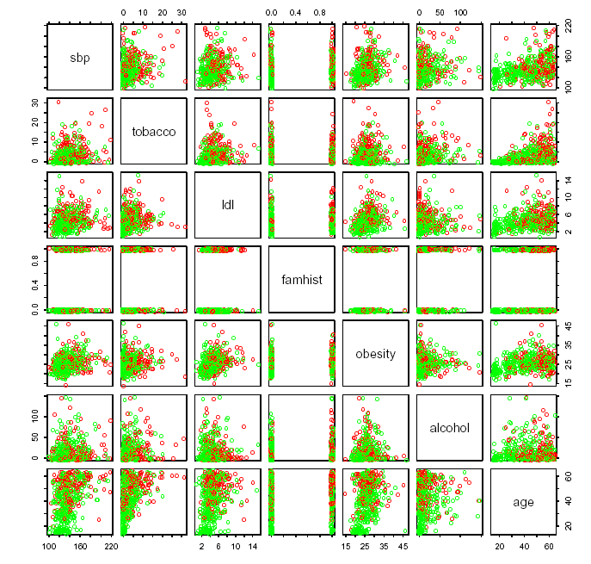
South African Heart Disease Data
Notes:
Red Case, Green Controls.
This example has interactions that should e included in the model for better understanding.

Slide 37
South African Heart Disease Data -- logistic regression
 | Coefficient | SE | Z score
Intercept | -4.130 | 0.964 | -4.285
sbp | 0.006 | 0.006 | 1.023
tabacco | 0.080 | 0.026 | 3.034
ldl | 0.185 | 0.057 | 3.219
famhist | 0.939 | 0.225 | 4.178
obesity | -0.035 | 0.029 | -1.187
alcohol | 0.001 | 0.004 | 0.136
age | 0.043 | 0.010 | 4.184
Notes:
Red Case, Green Controls.
This example has interactions that should e included in the model for better understanding.

Slide 38
South African Heart Disease Data
 | Coefficient | SE | Z score
Intercept | -4.204 | 0.498 | -8.45
tabacco | 0.081 | 0.026 | 3.16
ldl | 0.168 | 0.054 | 3.09
famhist | 0.924 | 0.223 | 4.14
age | 0.044 | 0.010 | 4.52
SE and Z score are computed based on Fisher Information
Notes:
Red Case, Green Controls.
This example has interactions that should e included in the model for better understanding.

Slide 39
Model (Variable) Selection
Best model selection via
Sequential (forward, backward) Likelihood Ratios (~deviance)
Information criteria (AIC or BIC) based methods
Significance of “t-values” of coefficients can sometimes lead to meaningless conclusions
Correlated inputs can lead to “non-monotone” t-statistic in Logistic Regression
L1 regularization
Graphical techniques can be very helpful

Slide 40
LDA vs. Logistic Regression
Both models similar
Linear posterior log-odds
Linear posterior prob
LDA maximizes log-likelihood based on joint density
Logistic Regression
Fewer assumptions
Directly models the posterior log-odds
Marginal density of X is left unspecified
Maximizes conditional log-likelihood

Slide 41
LDA vs. Logistic Regression
Advantage of LDA
-- When class conditionals are actually Gaussians, Additional assumption on the X provides better estimates
-- Loss of efficiency ~30% if only model posterior.
-- If unlabelled data exist, they provide information about X as well.
Advantage of Logistic Regression
-- No assumption on X distribution
-- Robust to outliers in X
-- model selection
Overall
-- both models give similar results
-- both depend on global structure

Slide 42
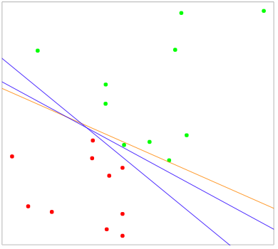
Separating hyperplanes
Least Square solution
Blue lines separate data perfectly

Slide 43
Separating hyperplanes
If two classes are perfectly separable with a linear boundary in feature space, different algorithms can find this boundary
Perceptron: Early form of Neural Networks
Maximal Margin Method: Vapnik’s SVM Principle

Slide 44
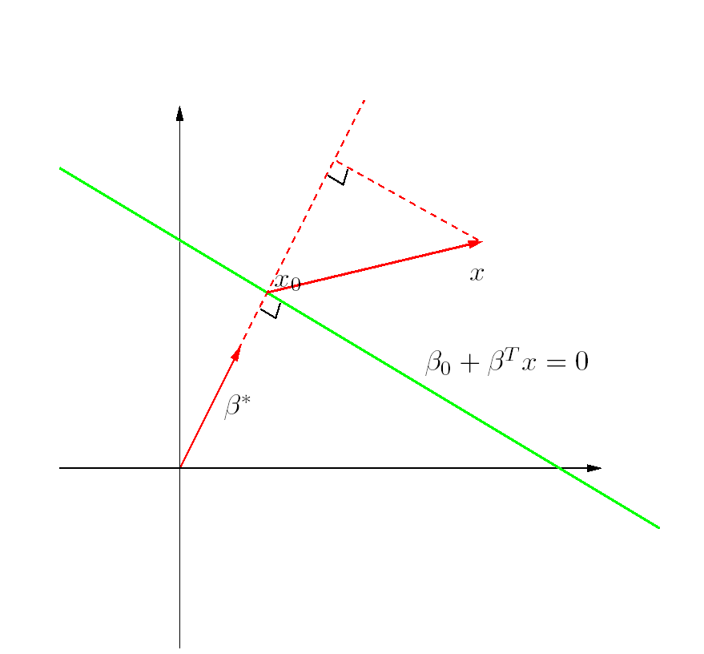
Hyperplanes?
Green line defines a hyperplane (affine) set L: in
For ,
Vector normal to surface L:
For any
(Signed) distance of any x to L:

Slide 45

Perceptron Algorithm
Find a separating hyperplane by minimizing the distance of misclassified points to the decision boundary.
If a respond y =1 is misclassified, then x^{T}β+β₀ < 0; and opposite for a misclassified y=-1.
The goal is to minimize

Slide 46
Perceptron Algorithm (cont)
Given
Linearly separable training set {(x_{i},y_{i})} , i = 1,2,…,n ; y_{i} =1 or -1
R = max || x_{i} || , i = 1,2,…,n ; Learning rate ρ > 0
Find: hyperplane w’x + b = 0 such that y_{i}(w’x_{i} + b) > 0, i = 1,2,…,n
Initialize
w₀ = 0 (normal vector to hyperplane); b₀ = 0 (intercept of hyperplane)
k = 0 (counts updates of the hyperplane)
Repeat
For i = 1 to n
If y_{i}(w’x + b) <= 0 (mistake), then
w_{k+1} = w_{k} + ρy_{i} x_{i} (tilt hyperplane toward or past misclassified point)
b_{k+1} = b_{k} + ρy_{i} R²
k = k+1
End If
End For
Until no mistakes
Return (w_{k}, b_{k})
Novikoff: Algorithm converges in < (2R/γ)² steps (γ = margin between sets)

Slide 47
Deficiencies of Perceptron
Many possible solutions
Order of observations in the training set
If γ is small, stopping time can be large
When data is NOT separable, the algorithm doesn’t converge, but goes into cycles
Cycles may be long and hard to recognize.

Slide 48
Optimal Separating Hyperplane – Basis for Support Vector Machine
Maximize the linear gap (margin) between two sets
Found by quadratic programming (Vapnik)
Solution is determined by just a few points (support vectors) near the boundary
Sparse solution in dual space
May be modified to maximize the margin γ that allows for a fixed number of misclassifications

Slide 49


Optimal Separating Hyperplanes
Optimal separating hyperplane
maximize the distance to the closest point from either class
By doing some calculation, the criterion can be rewritten as

Slide 50


Optimal Separating Hyperplanes
The Lagrange function
Karush-Kuhn-Tucker (KKT)conditions

Slide 51


Support Vectors
Support Vectors
whence
Parameter estimation is fully decided by the latter, called support vectors.

Slide 52
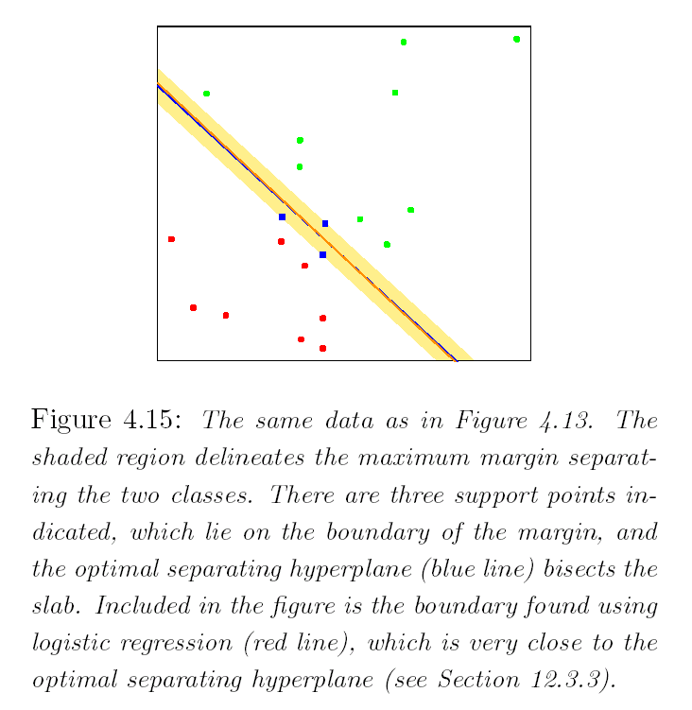
Toy Example: SVM
support vectors

Slide 53
Homework
4.1
4.2
4.4
4.6
4.9

