Slide 1
Lecture 5. Basis Expansions and Regularization

Slide 2
Outline
Background
Piecewise-polynomial
Splines
Wavelet
Dictionary learning

Slide 3
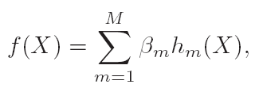
Background: Moving beyond Linear Model
Linear regression, LDA, Logistic Regression and separating hyperplanes —— linear models
Why ? Simple? Taylor expansion? Non-Overfitting?
Moving beyond linear model via transformation:
h_{m}(X) : basis function.
Beauty: Linear again!

Slide 4




Background: Examples
O(p^d) for a degree-d
polynomial

Slide 5
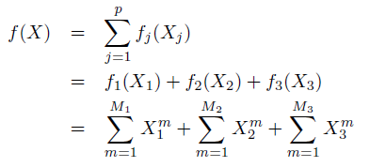
Background: How many basis do we use?
Restriction methods： polynomial, splines, wavelets, etc.
Selection methods: feature selection methods —— stagewise for example
Regularization methods: ridge regression for example.

Slide 6
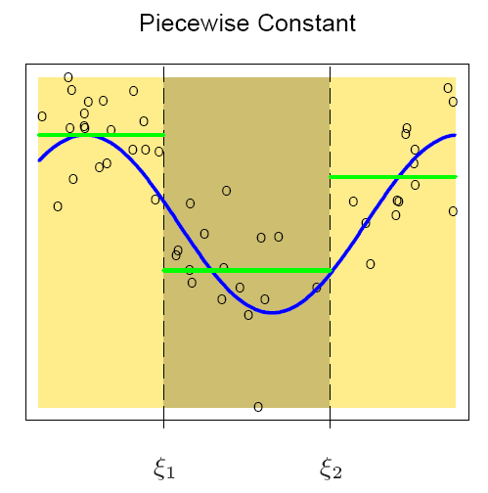

Piecewise Polynomials and Splines
Piecewise Constant
Supose that $ξ_{1}$ and $ξ_{2}$ are known
$f\left(X\right)=β_{1}h_{1}\left(X\right)+β_{2}h_{2}\left(X\right)+β_{3}h_{3}\left(X\right)$
Least square estimate:
$${\hat{β}}_{m}={\overline{Y}}_{m}$$
Degree of freedom: K+1

Slide 7
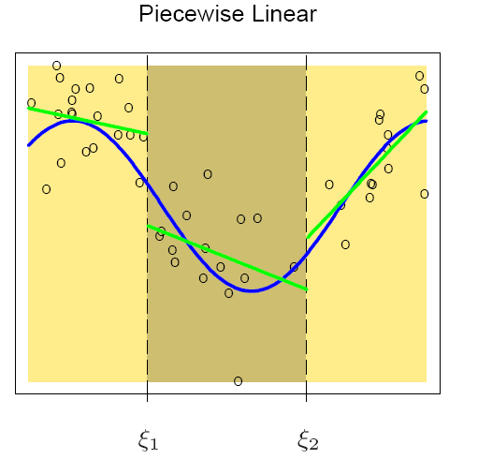
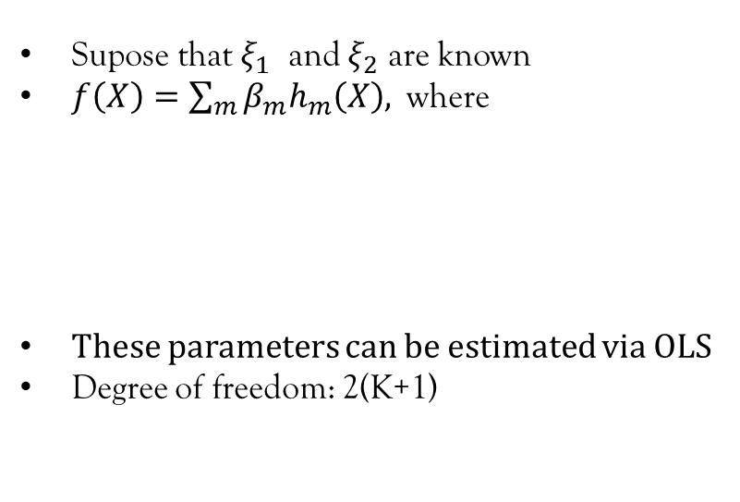
Piecewise Linear
Supose that $ξ_{1}$ and $ξ_{2}$ are known
$f\left(X\right)=\sum_{m}{β_{m}h_{m}\left(X\right), }$ where
These parameters can be estimated via OLS
Degree of freedom: 2(K+1)

Slide 8
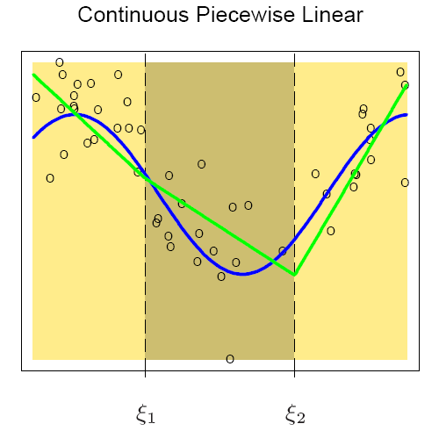
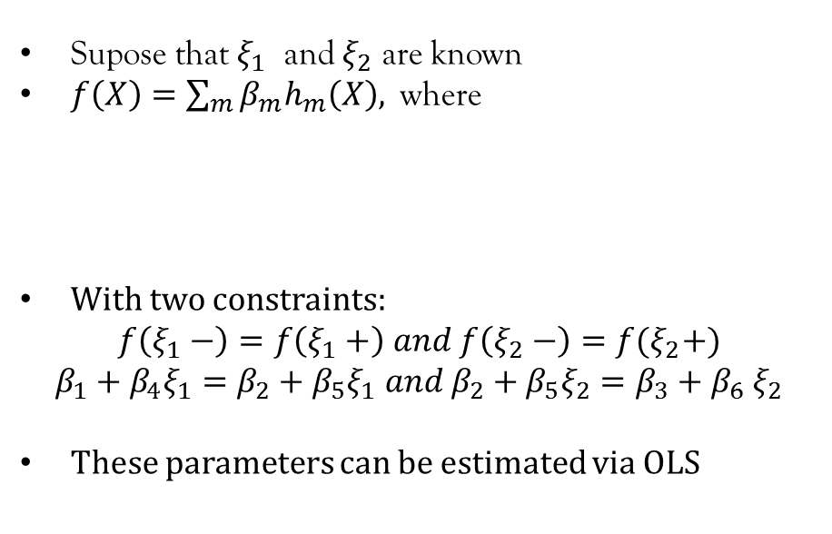
Continuous Piecewise Linear
Supose that $ξ_{1}$ and $ξ_{2}$ are known
$f\left(X\right)=\sum_{m}{β_{m}h_{m}\left(X\right), }$ where
With two constraints:
$$f\left(ξ_{1}−\right)=f\left(ξ_{1}+\right) and f\left(ξ_{2}−\right)=f(ξ_{2}+)$$
$$β_{1}+β_{4}ξ_{1}=β_{2}+β_{5}ξ_{1} and β_{2}+β_{5}ξ_{2}=β_{3}+β_{6} ξ_{2}$$
These parameters can be estimated via OLS

Slide 9
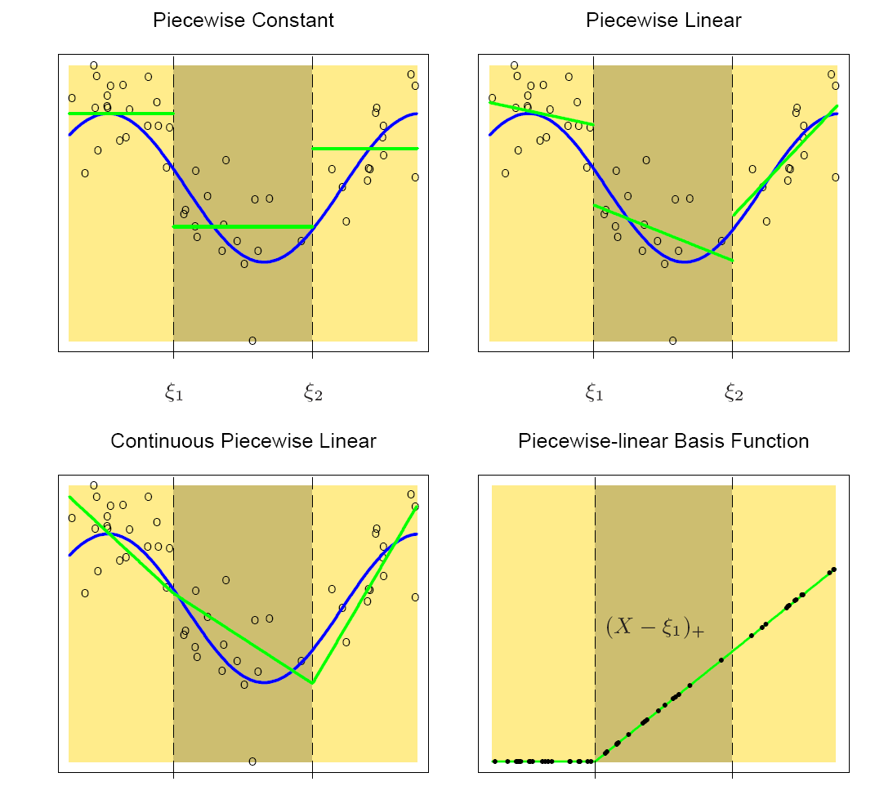
Piecewise Linear (Cont’)

Slide 10
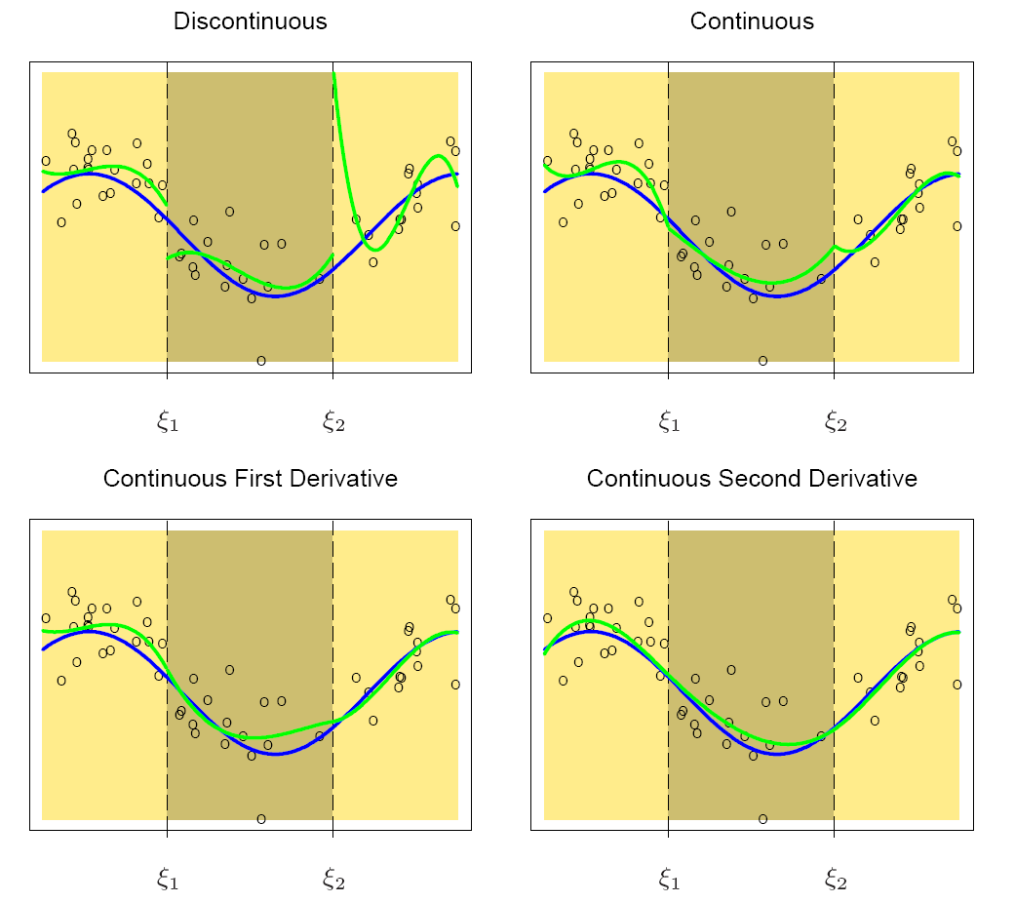
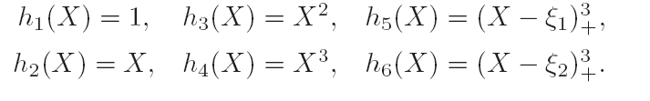
Piecewise Cubic
Degree of freedom:
(K+1) *4
Degree of freedom:
(K+1) *4 -K
Cubic Spline
Exercise!
Degree of freedom:
(K+1) *4 –K*2
Degree of freedom:
(K+1) *4 – K*3

Slide 11
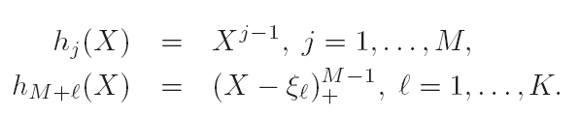
Piecewise Polynomial
K knots, order M spline (M-2 continous):
It is claimed that cubic splines are the lowest order splines for which the knot discontinuity is not visible to the human eye （2nd order Continuous)!
Widely used: piecewise constant, piecewise linear and cubic spline
Basis functions are not unique! B-spline basis is more efficient
DF: M+K = M(K+1) – K(M-1)

Slide 12
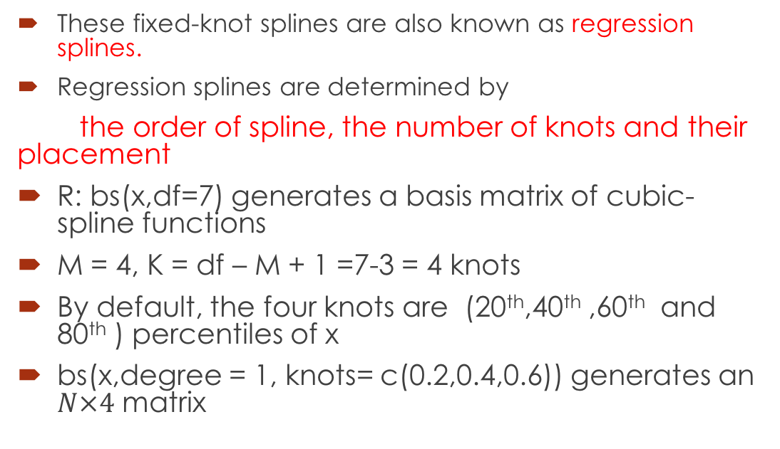
Piecewise Polynomial (Cont’)
These fixed-knot splines are also known as regression splines.
Regression splines are determined by
the order of spline, the number of knots and their placement
R: bs(x,df=7) generates a basis matrix of cubic-spline functions
M = 4, K = df – M + 1 =7-3 = 4 knots
By default, the four knots are (20th,40th ,60th and 80th ) percentiles of x
bs(x,degree = 1, knots= c(0.2,0.4,0.6)) generates an $N×4$ matrix

Slide 13
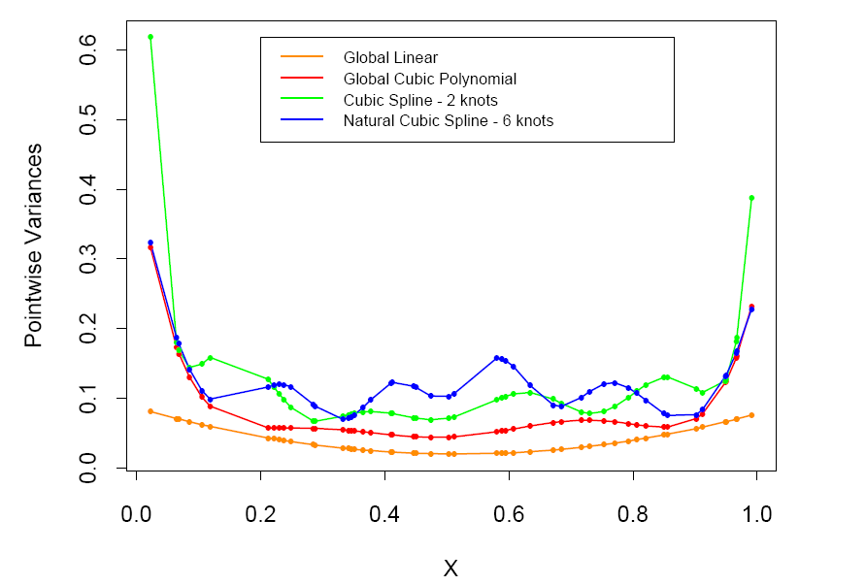


Natural Cubic Splines
$$X∼U\left[0,1\right]$$
$$Y=X+N\left(0,1\right)$$
n= 50
Cubic spline: two knots at
0.33 and 0.66
Natural spline: two boundary knots at
0.1 and 0.9, four interior knots
uniformly spaced between them
$$Y=∑h_{m}\left(X\right) β_{m}+ ϵ=Hβ+ ϵ$$
$$\hat{β}={(H}^{T}{H)}^{−1}H^{T}Y$$
$$var\left(\hat{β}\right)={(H}^{T}{H)}^{−1}σ^{2}$$
$$var\left(H\hat{β}\right)=H{(H}^{T}{H)}^{−1}H^{T}σ^{2}$$
Pointwise variance curves

Slide 14
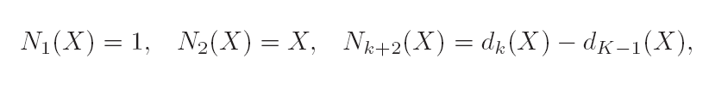
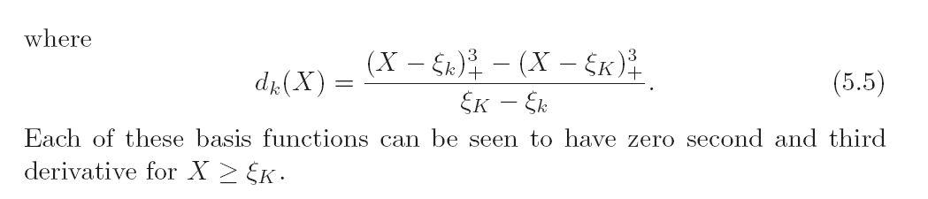
Natural Cubic Splines
Two more constraints: linear beyond the boundary knots: frees 4 parameters
K knots, K basis:
K + 4 -4

Slide 15
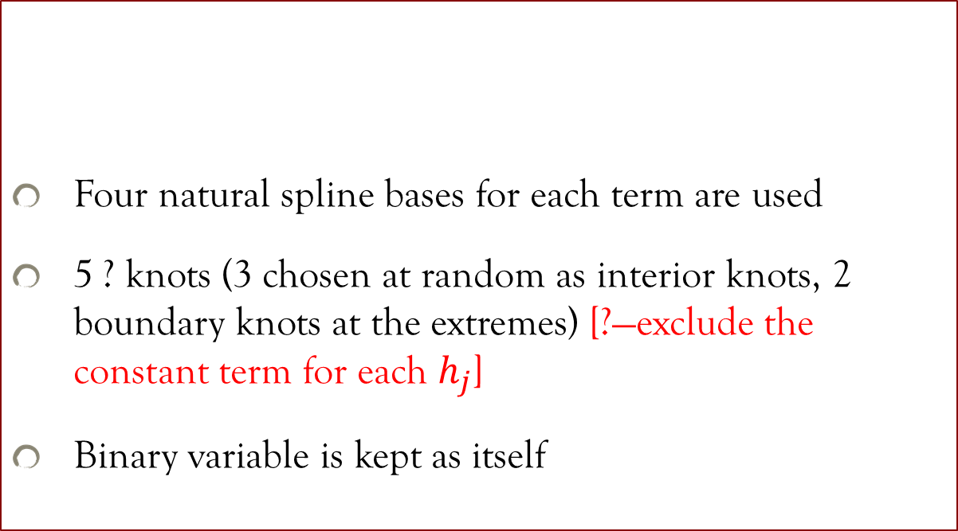
Example: South African Heart Disease
Four natural spline bases for each term are used
5 ? knots (3 chosen at random as interior knots, 2 boundary knots at the extremes) [?—exclude the constant term for each $h_{j}$]
Binary variable is kept as itself

Slide 16
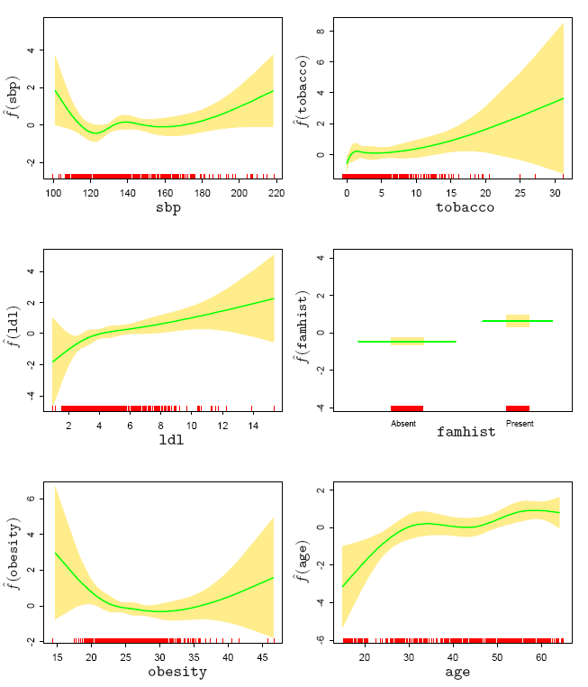
Example: South African Heart Disease (Cont’)
f（X)=h(X)^{T}θ

Slide 17
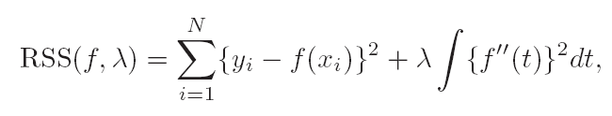
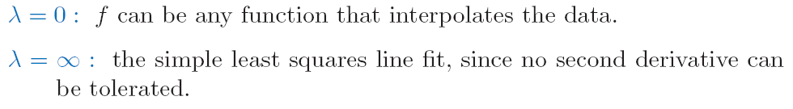

Smoothing Splines
To avoid Knot selection
Regularization
$λ$ is called smooth parameter, because
The solution of $\min_{f}{RSS(f,λ)}$is a natural cubic spline with knots at $x_{i}$. ——Exercise!

Slide 18
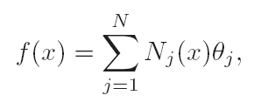


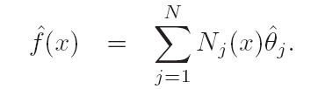
Smoothing Splines

Slide 19
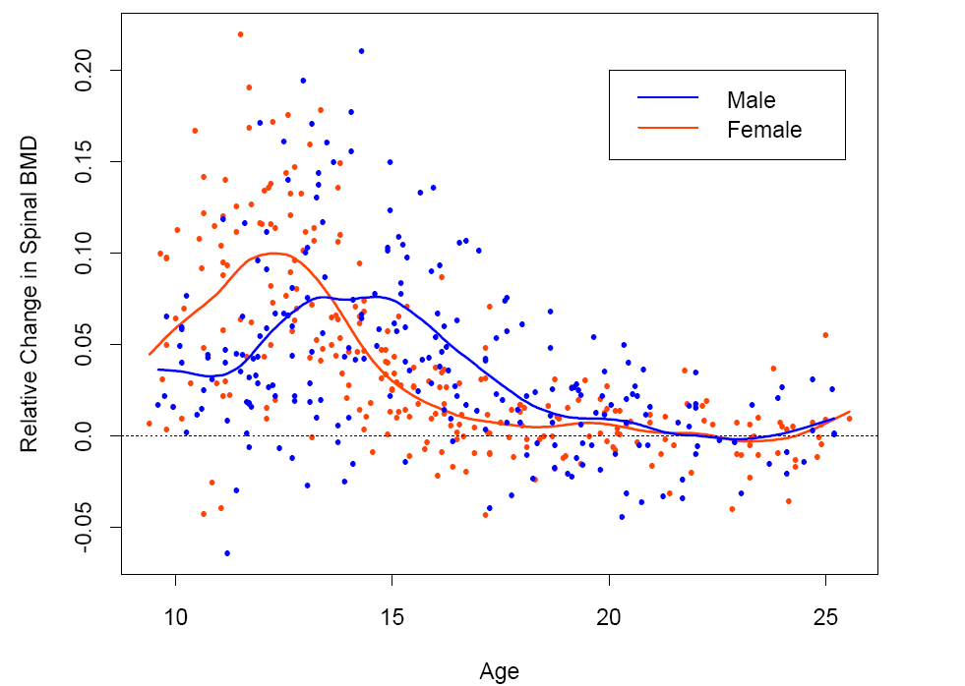

Example

Slide 20
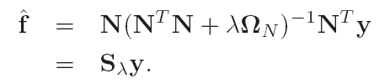

Degree of Freedom
Df: degree of freedom.

Slide 21
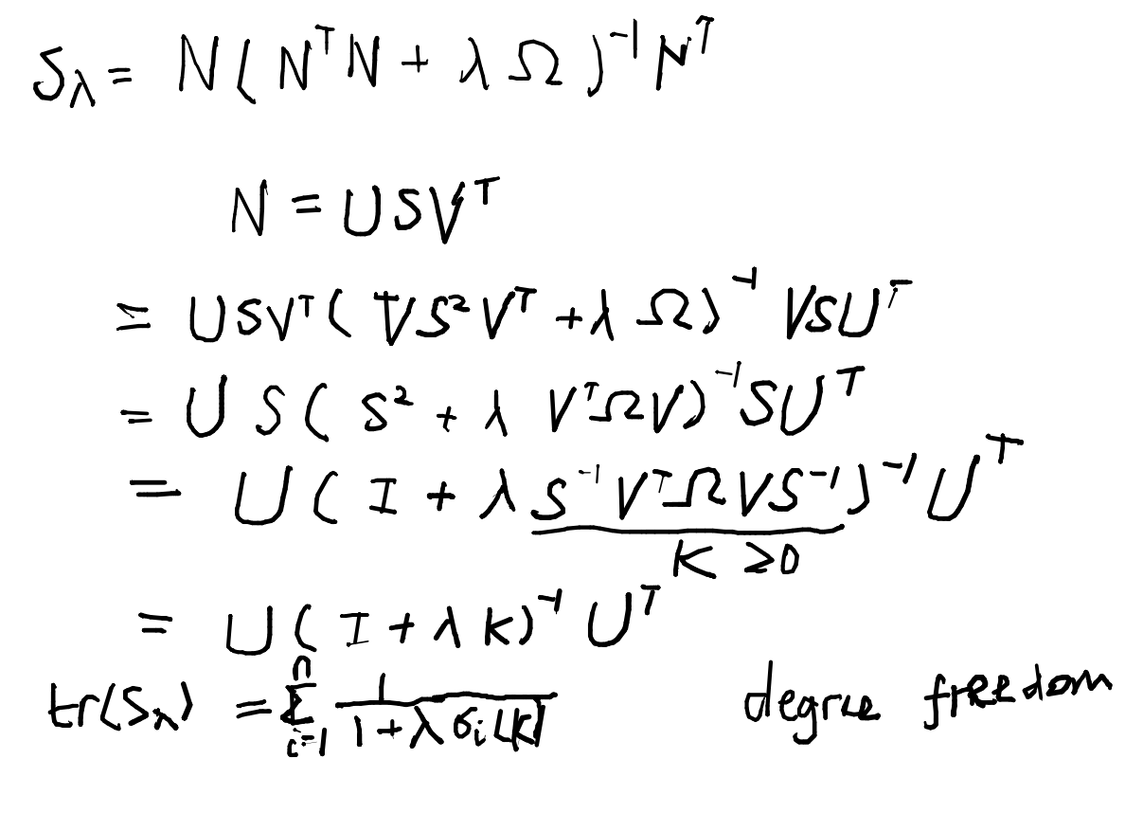
Degree of Freedom

Slide 22
Smoothing Parameter Selection
Specify fix degree of freedom Tr(S_{λ})
R> smooth.spline(x,y,df=??)
Try a couple of values of df. and choose one based on a model selection criteria
Integrated EPE
K-fold CV to choose the value of λ

Slide 23
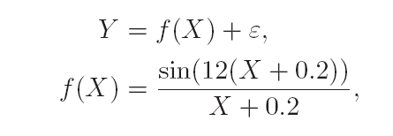
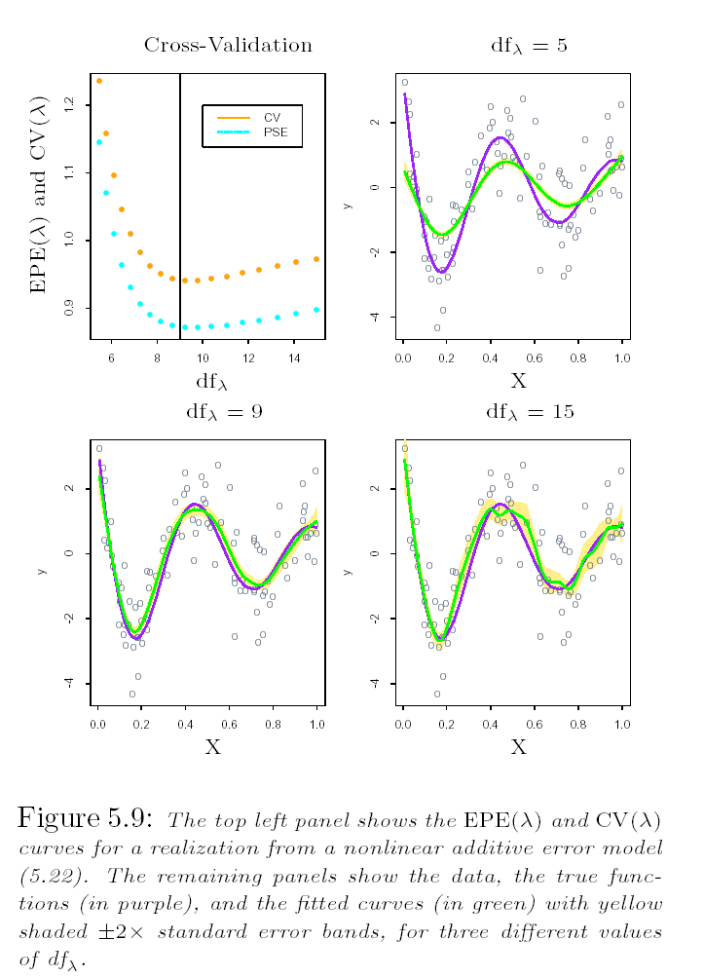
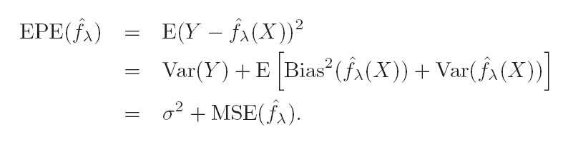
Smoothing Parameter Selection(Cont’)
True Function
Fitted Function

Slide 24
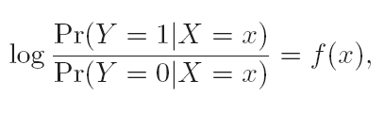
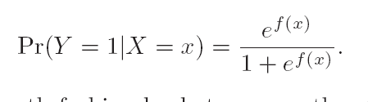
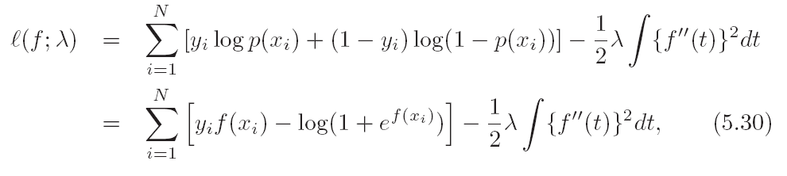
Nonparametric Logistic Regression

Slide 25


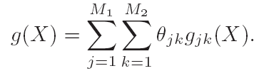
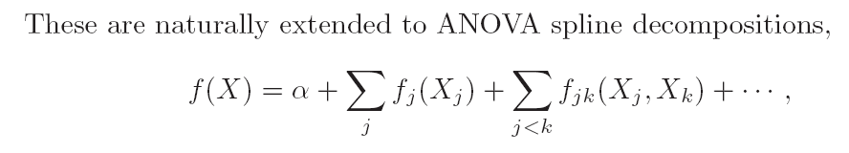
Multidimensional Splines: Tensor Products

Slide 26


Reproducing Kernel Hilbert Space
Wahba’90, Spline Models for Observational Data
Riesz Representation Theorem

Slide 27
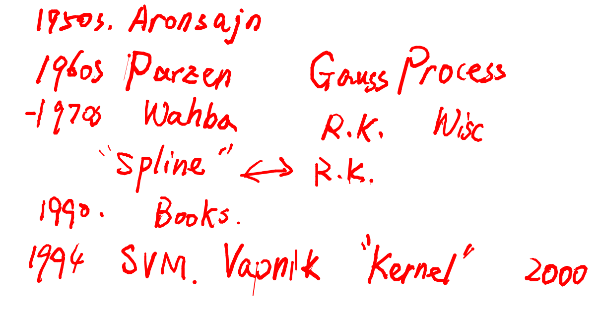
Brief History of RKHS

Slide 28
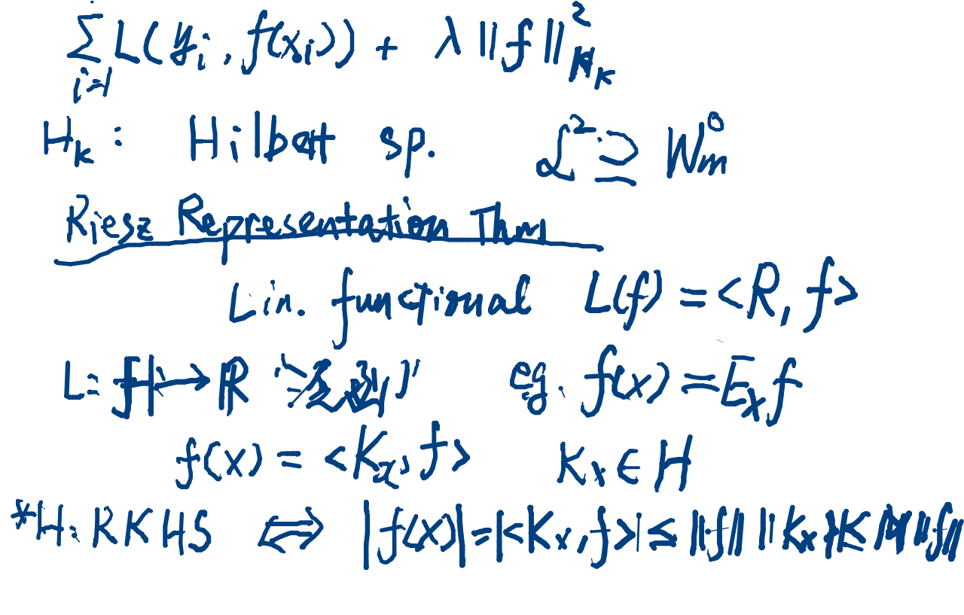
Riesz Representation Theorem

Slide 29
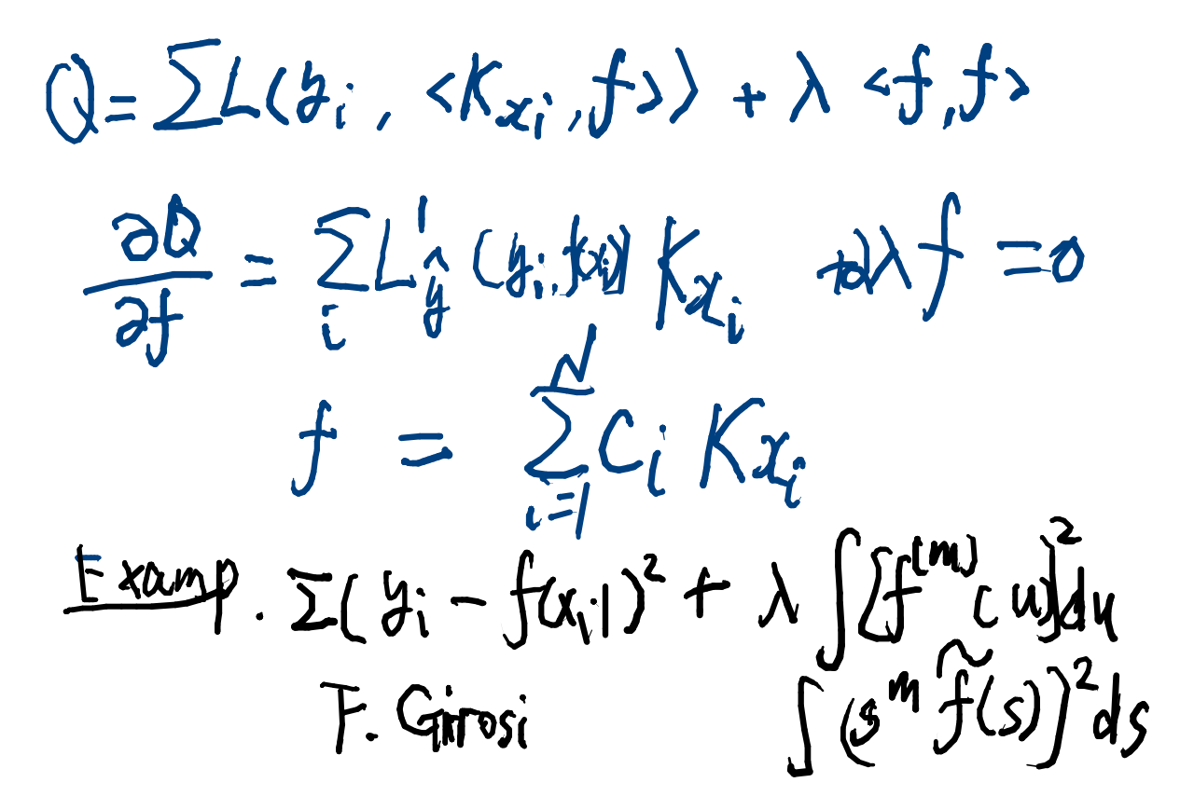
“Representer” Theorem

Slide 30
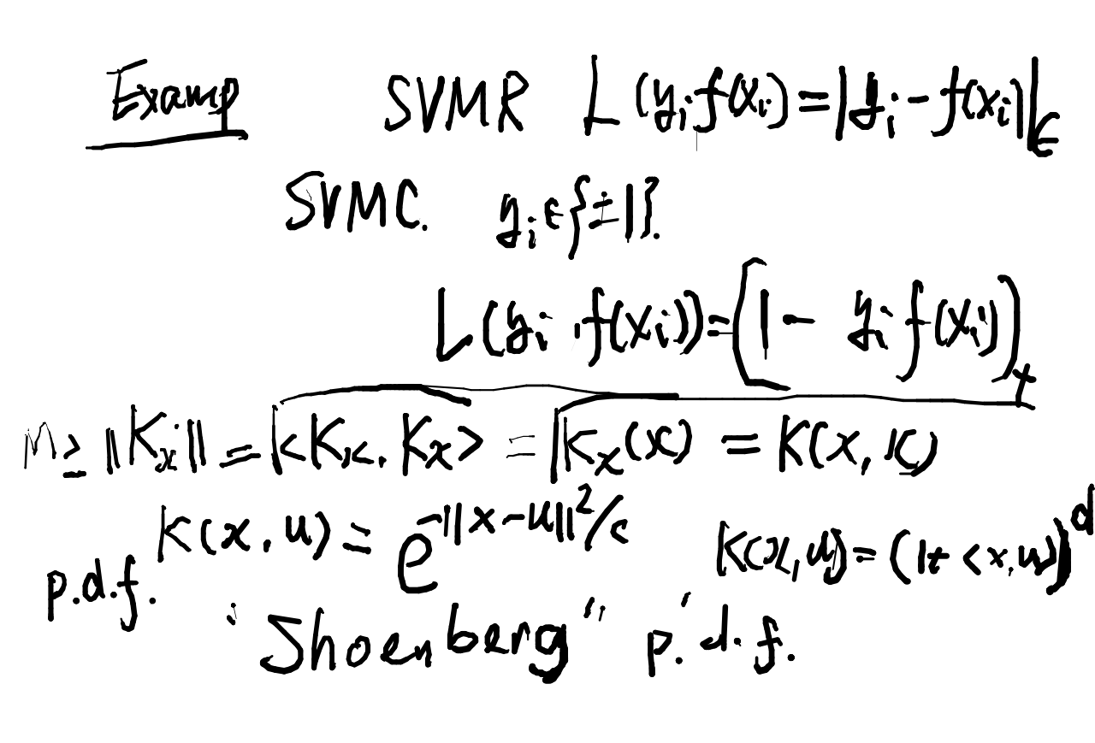
Examples

Slide 31
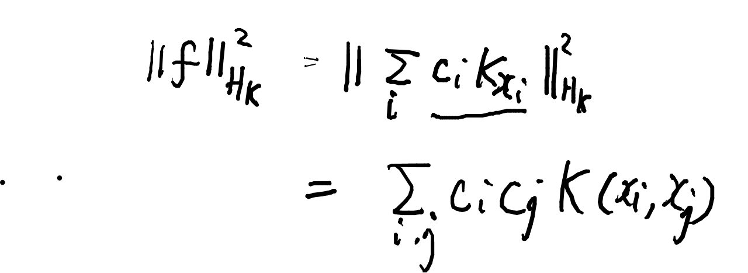
RKHS Norm

Slide 32
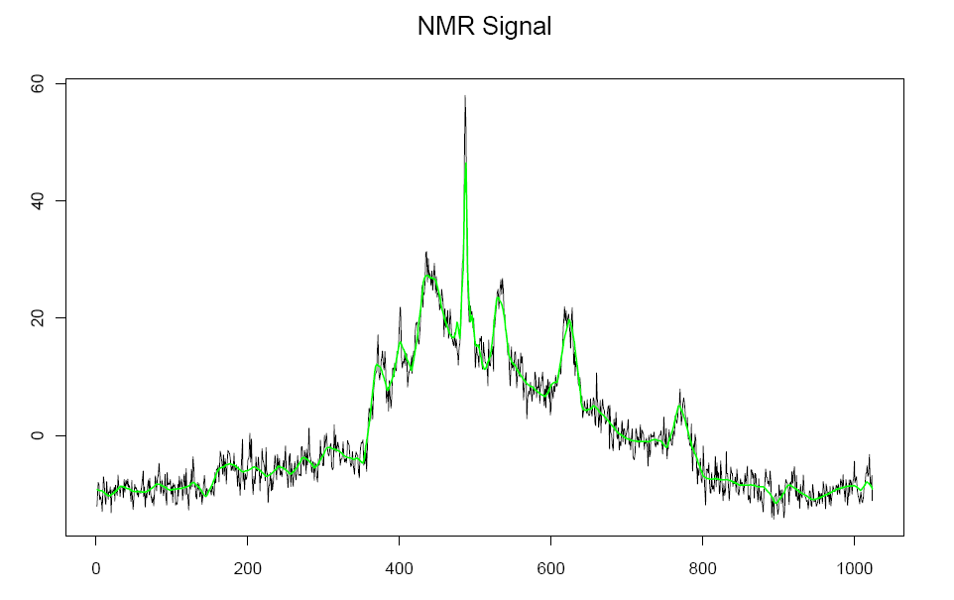
Wavelet Smoothing

Slide 33
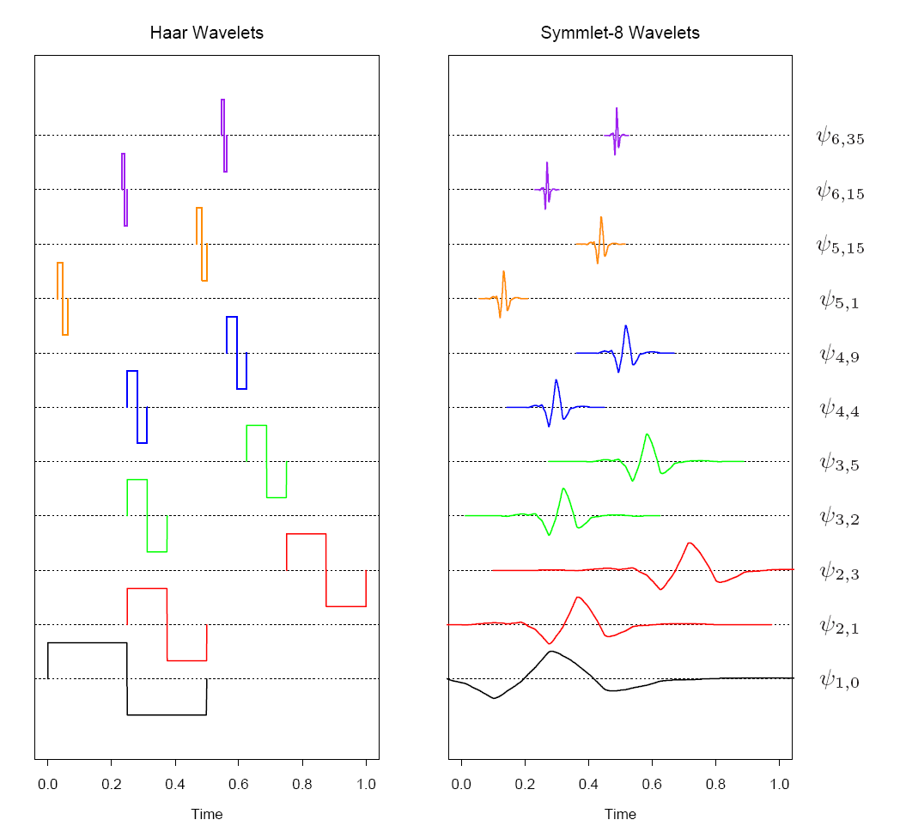
Wavelet Smoothing
Daubechies, Ten Lectures on Wavelets

Slide 34
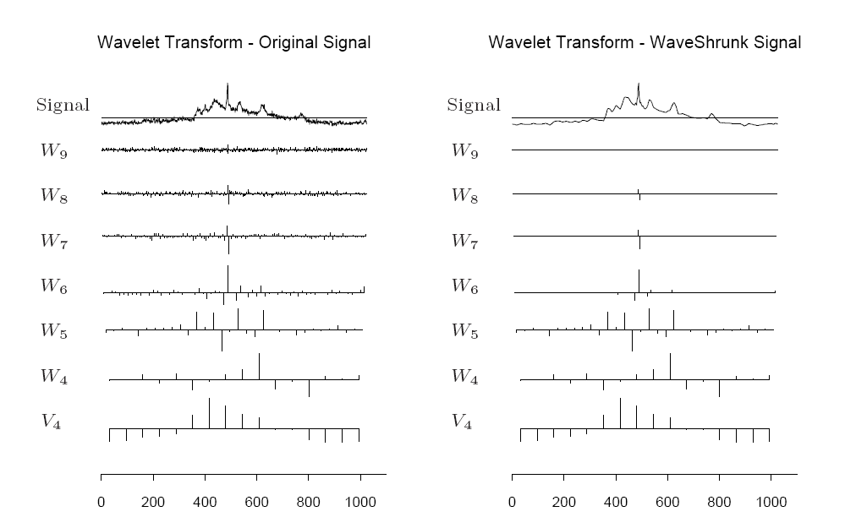

Wavelet Smoothing
Donoho-Johnstone’1994

Slide 35
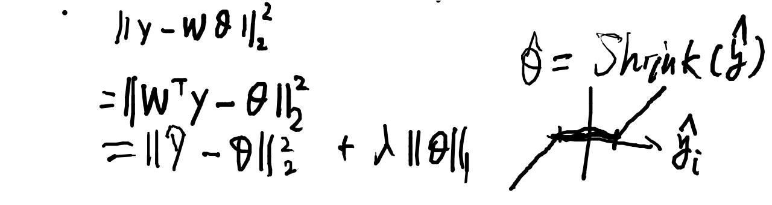
Shrinkage under Orthonormal Wavelet Basis

Slide 36
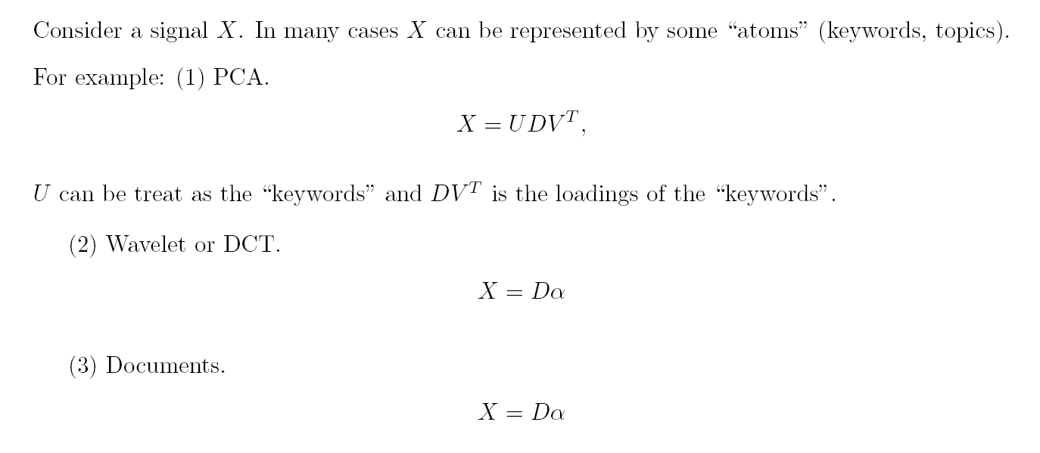
Dictionary Learning

Slide 37
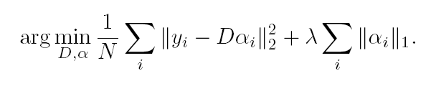

Dictionary Learning
Cane we learn a good dictionary?

Slide 38
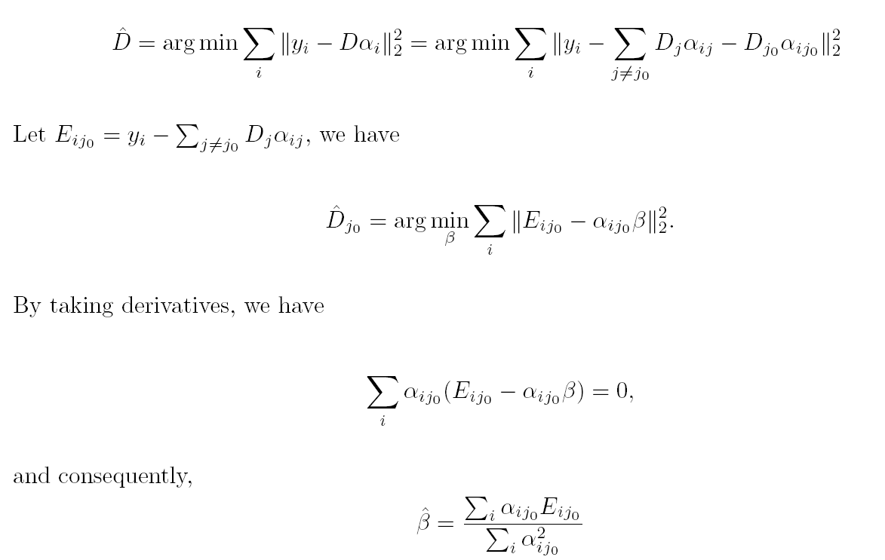
Dictionary Learning

Slide 39
Homework
ESLII Exercise:
5.1
5.7
5.10
5.15
Thanks to Prof. Tao Shi from OSU for sharing his slides.

