Slide 1
Lecture 6. Kernel Smoothing Methods

Slide 2
Outline
Description of Kernel
One-dimensional Kernel smoothing
Selecting the Width of the Kernel
Local Regression in R^{p}
Kernel Density Estimation and Classification

Slide 3
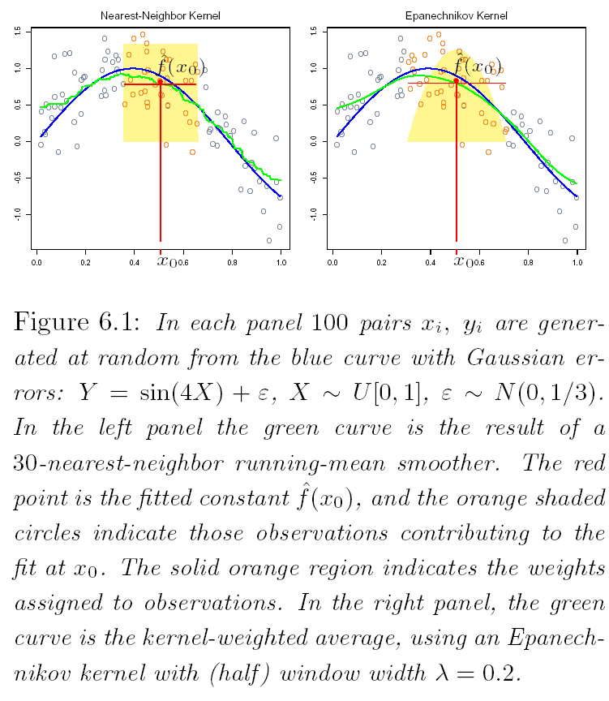

Nearest Neighbor Smoothing
Average according to uniform
weights on all k neighbors

Slide 4

Nearest Neighbor Smoothing
Properties:
Approximates E(Y|X)
Not continuous
To overcome discontinuity: assign weights that die off smoothly with distance from the target point.
Nadaraya-Watson kernel-weighted average

Slide 5
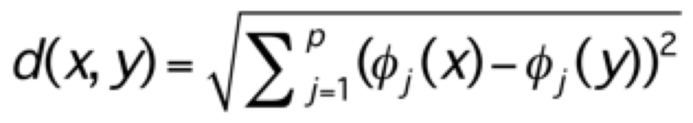
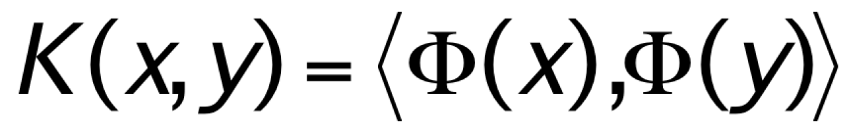
Kernels - Definition
A Reproducing (Mercer’s) Kernel K(., .), function of two variables, is an inner product of two vectors that are the image of the two variables under a feature mapping
Positive-definiteness:
Inner product is related to a distance metric, e.g.,
d(x,y) = <x-y,x-y> = ||x||² + ||y||² - 2<x,y>
A (Nadaraya-Watson) kernel can be represented as a decreasing function of a distance between the two objects
a measure of similarity between two objects

Slide 6
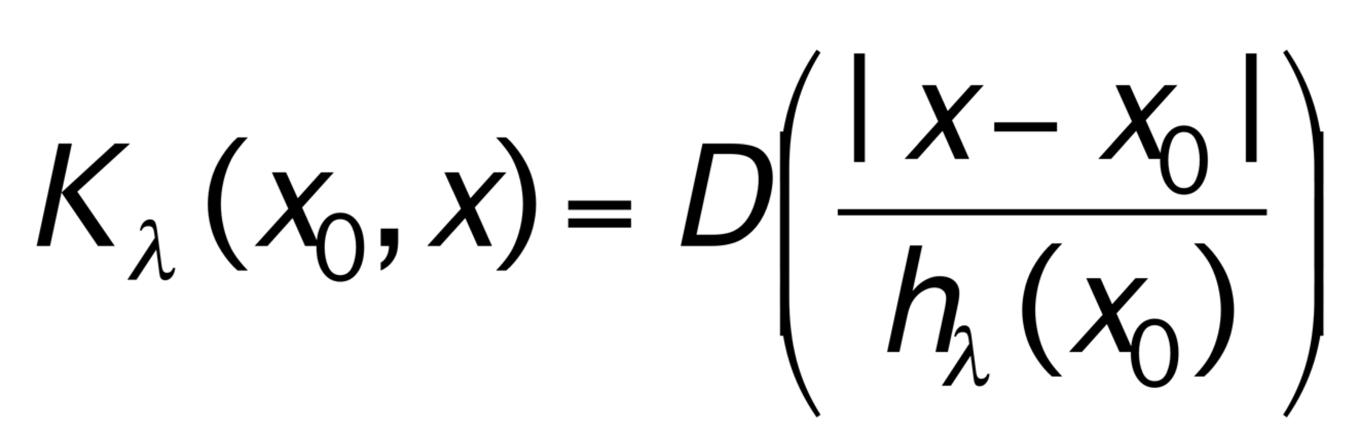
Kernels with One-dimensional Features
D: a decreasing (often with a compact support) function on R⁺
h_{λ}(.):
a window with some specified width, e.g. h_{λ}(x₀)=λ
often adaptive to data points
a scaling function on R

Slide 7

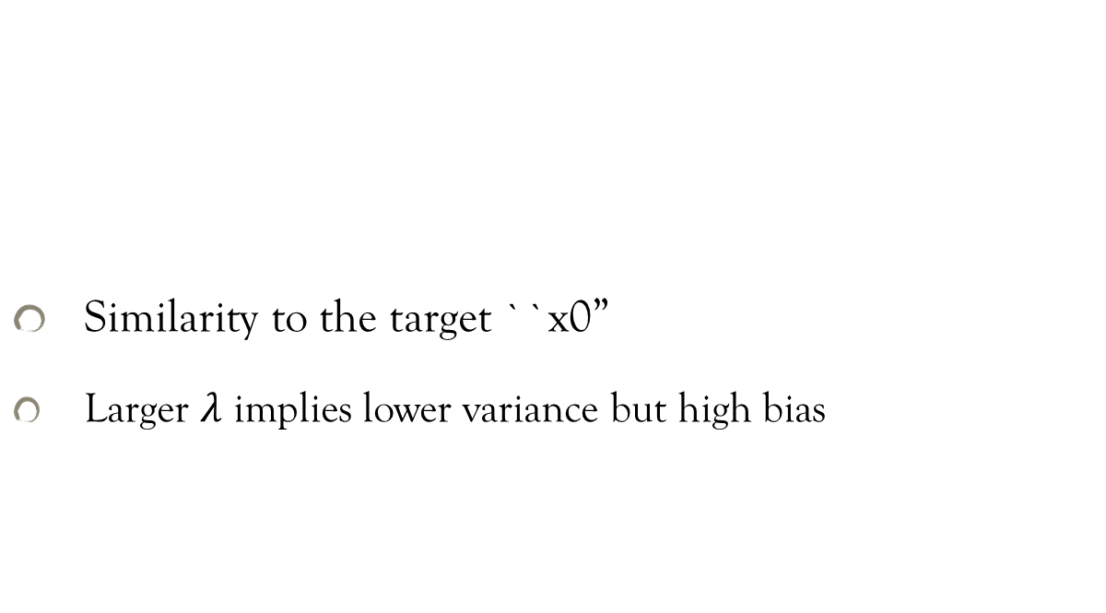

Kernel
Similarity to the target ``x0”
Larger $λ$ implies lower variance but high bias

Slide 8
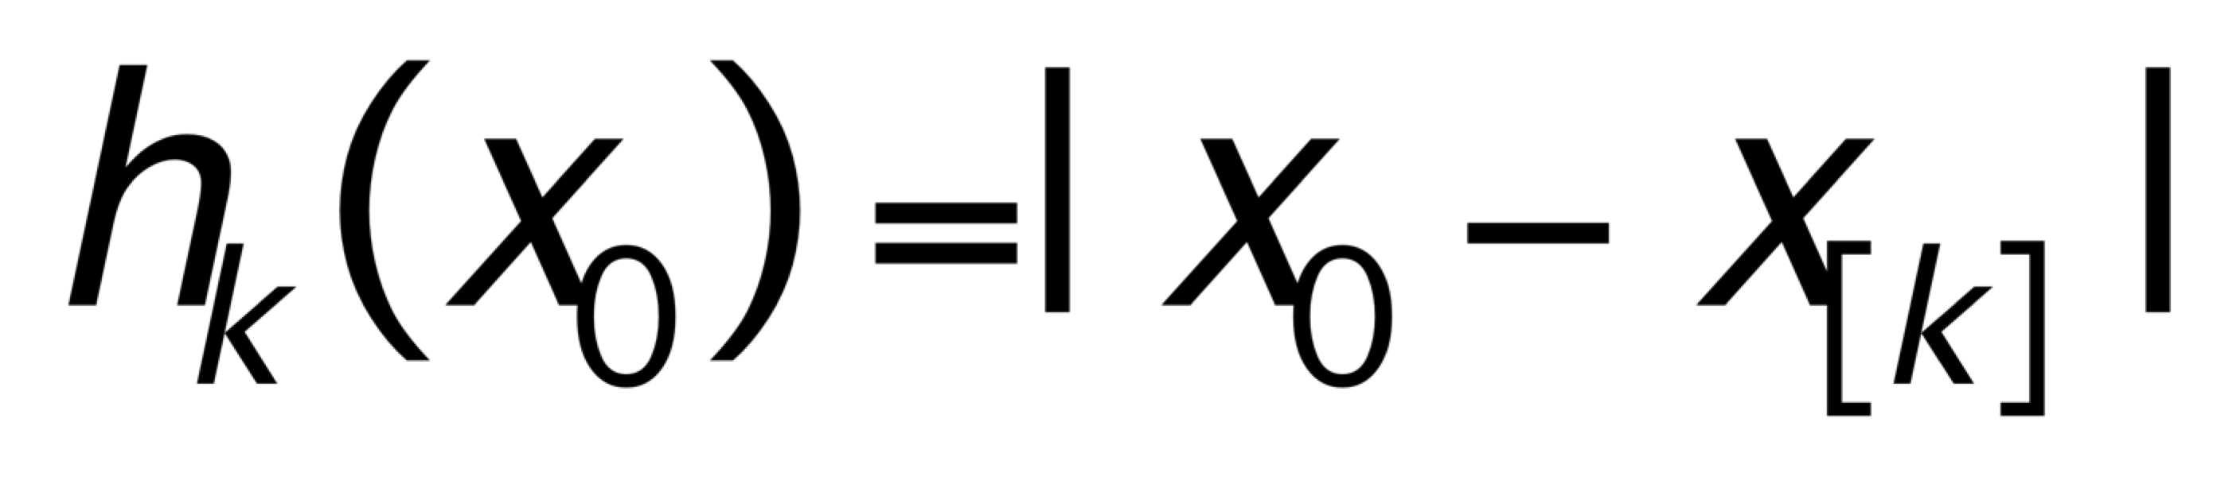
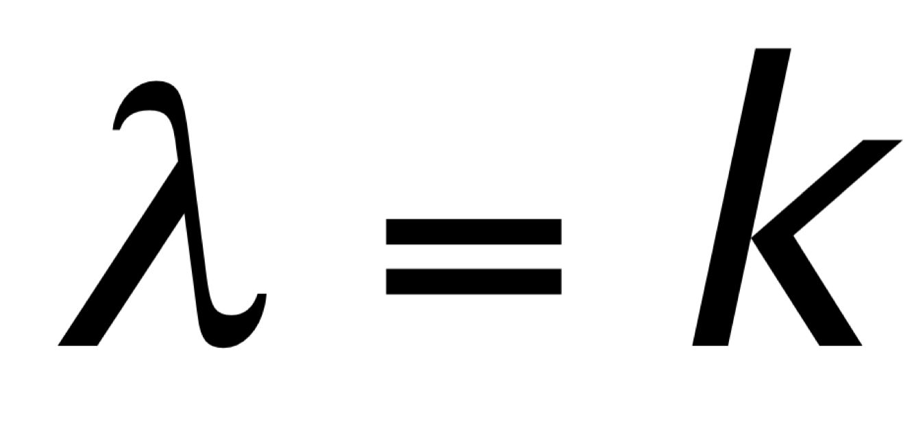
K-Nearest Neighbor Kernel
In conjunction with a D(.) that has compact support, and use,
X_{[k]} denotes the k^{th} nearest neighbor to x₀

Slide 9
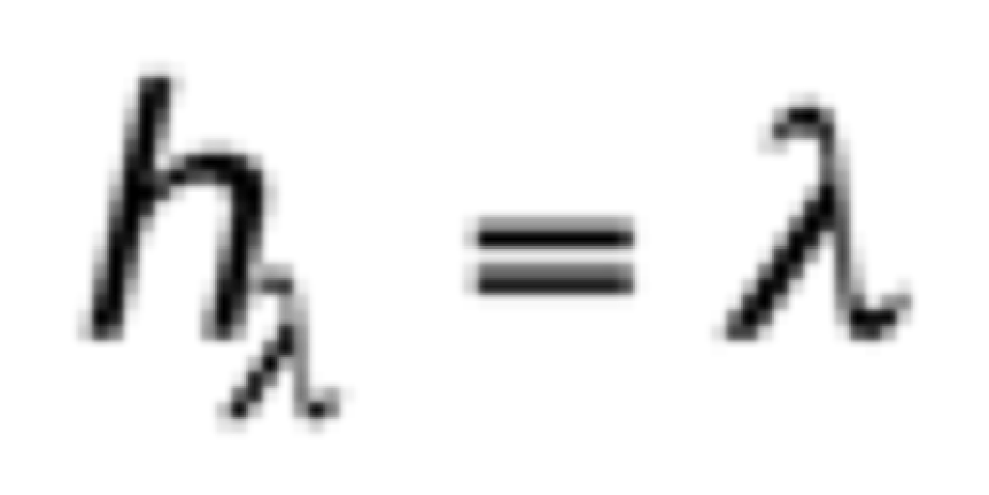
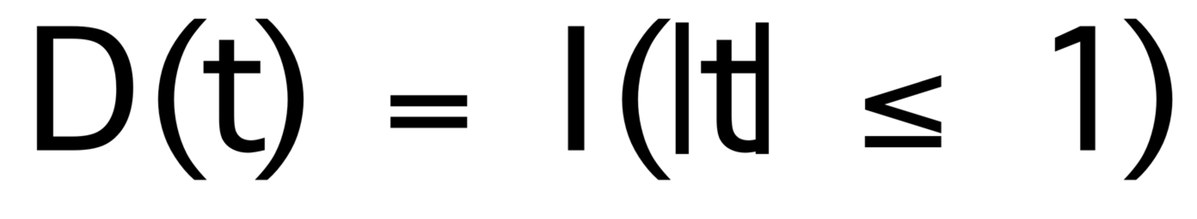
Uniform kernel
Local smoothing with this kernel yields moving averages
It is a compact support kernel.

Slide 10
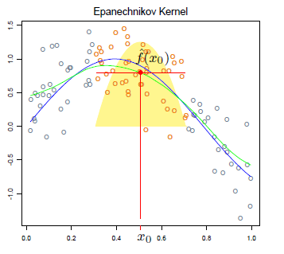
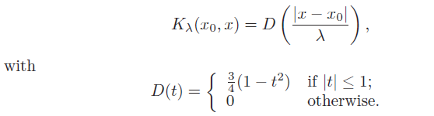
Epanechnikov Quadratic Kernel
Compact support

Slide 11
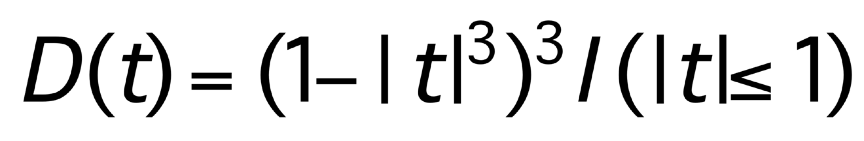
Tri-Cube Kernel
Compact support kernel

Slide 12
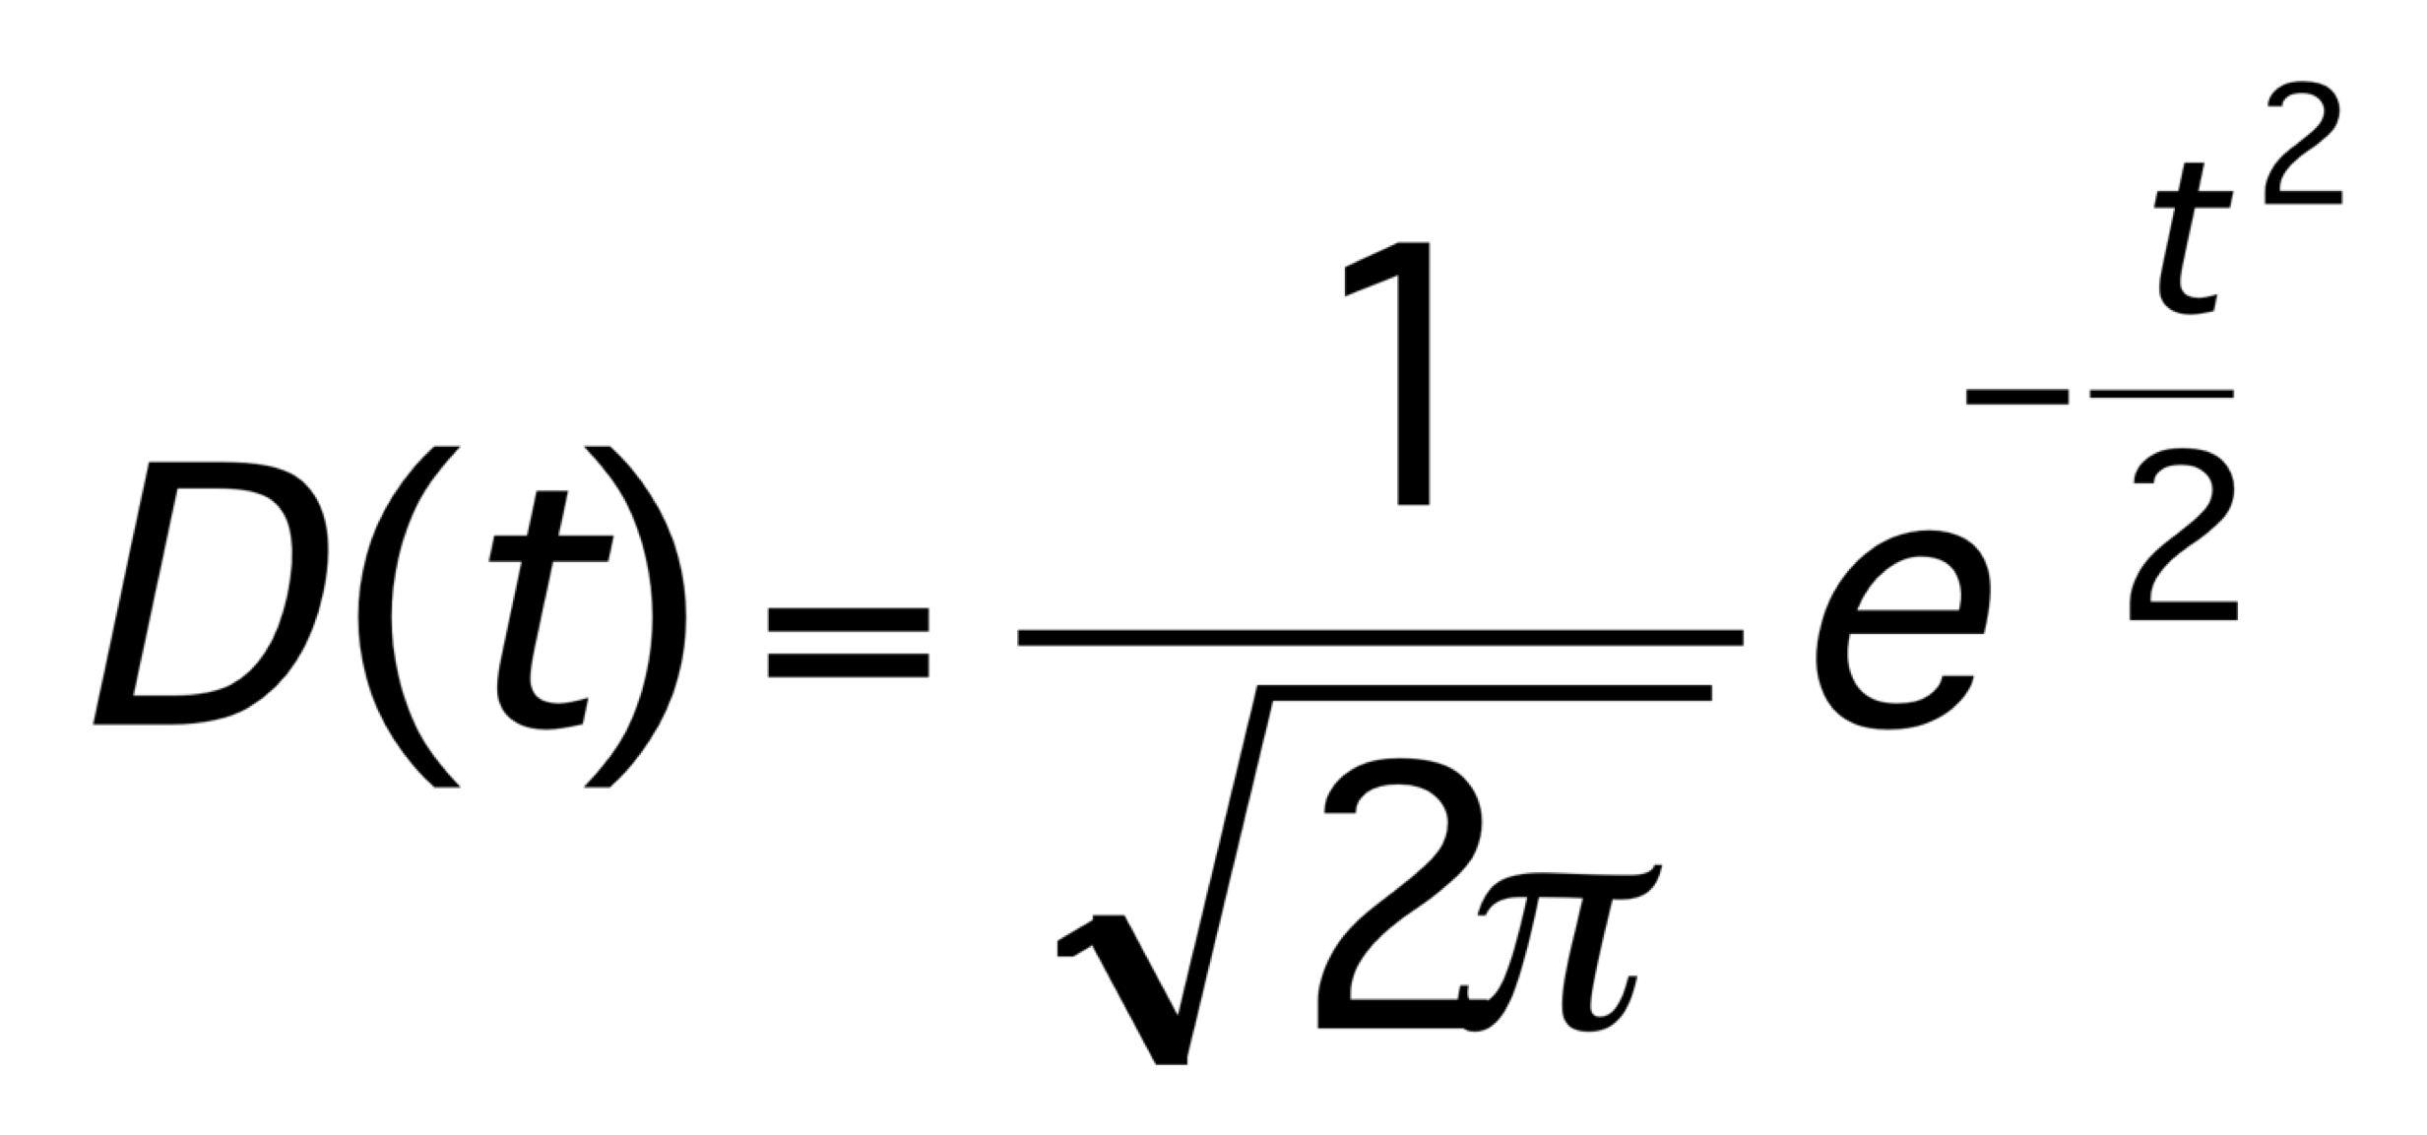
Gaussian Kernel
Noncompact support Kernel

Slide 13


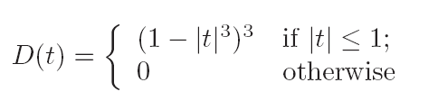
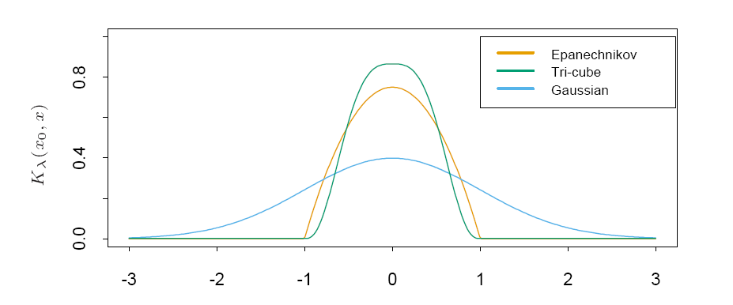

Shape of Kernels: Examples
Example: Epanechnikov Kernel –
K-NN: neighborhood size $k$replaces $λ$
Tri-cube:

Slide 14
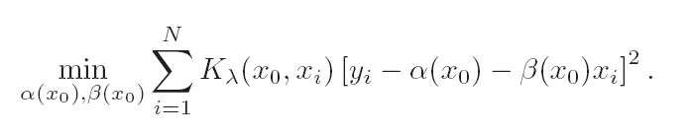

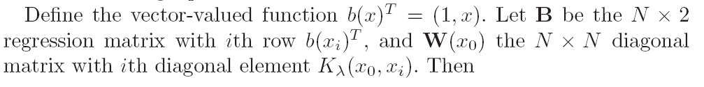
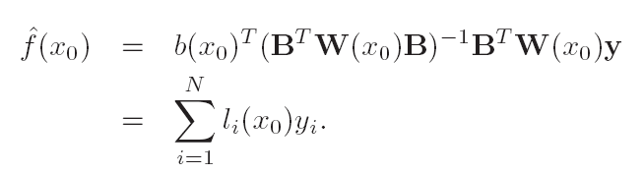
Local Linear Regression

Slide 15
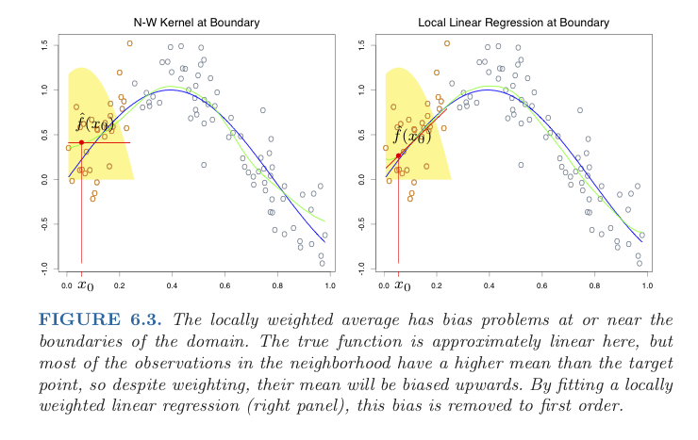
Local linear regression vs. N-W average at Boundary

Slide 16
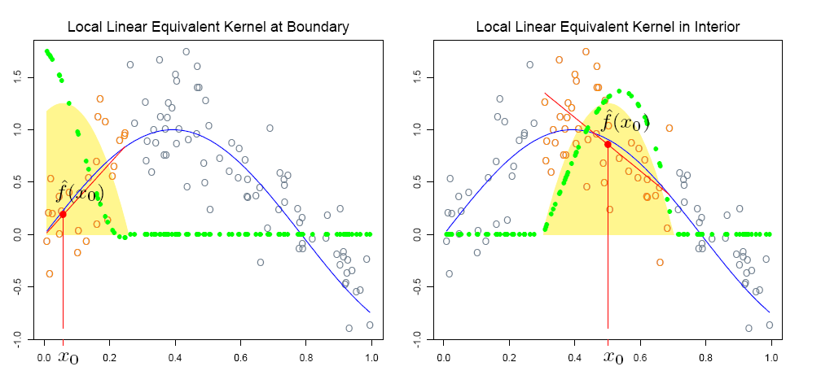
Local linear regression

Slide 17
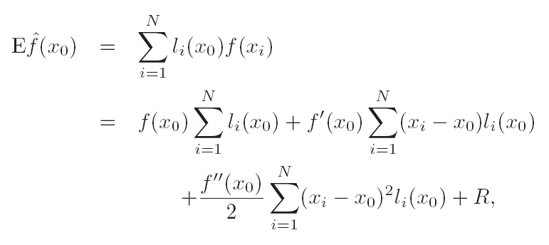


Local linear regression: Asymptotic Order of Bias
Make a first order bias correction

Slide 18
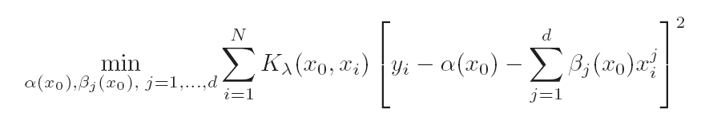
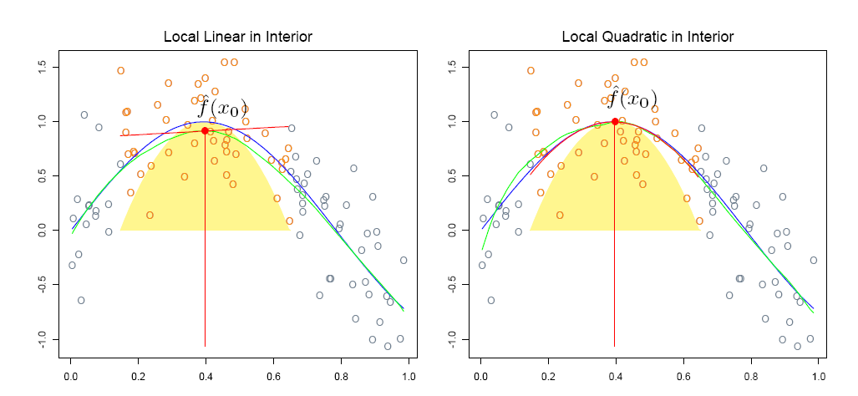
Local Polynomial Regression
Reduce the bias to (d+1)-order asymptotically

Slide 19
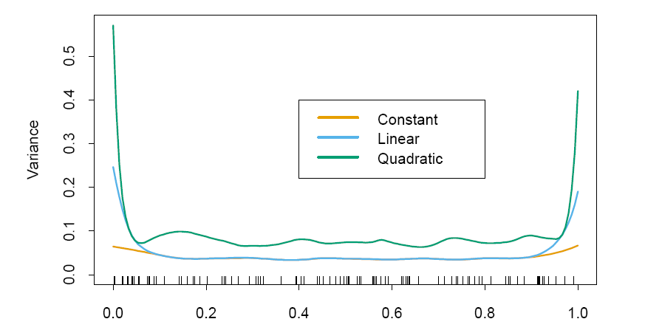
Local Polynomial Regression
The price of bias reduction? Variance!

Slide 20
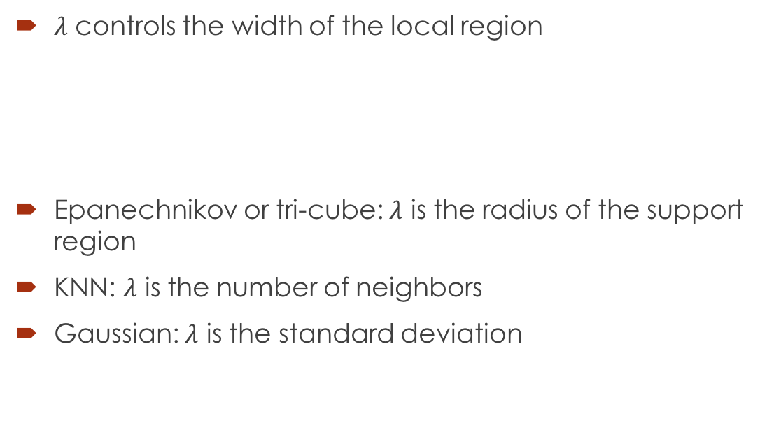
Selecting the Width of the Kernel
$λ$ controls the width of the local region
Epanechnikov or tri-cube: $λ$ is the radius of the support region
KNN: $λ$ is the number of neighbors
Gaussian: $λ$ is the standard deviation

Slide 21
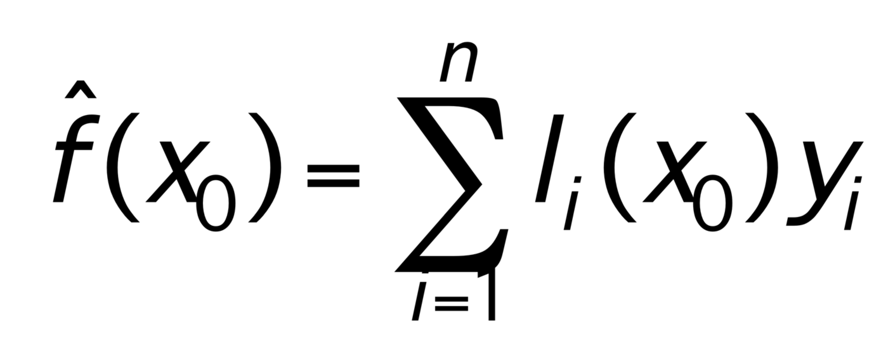
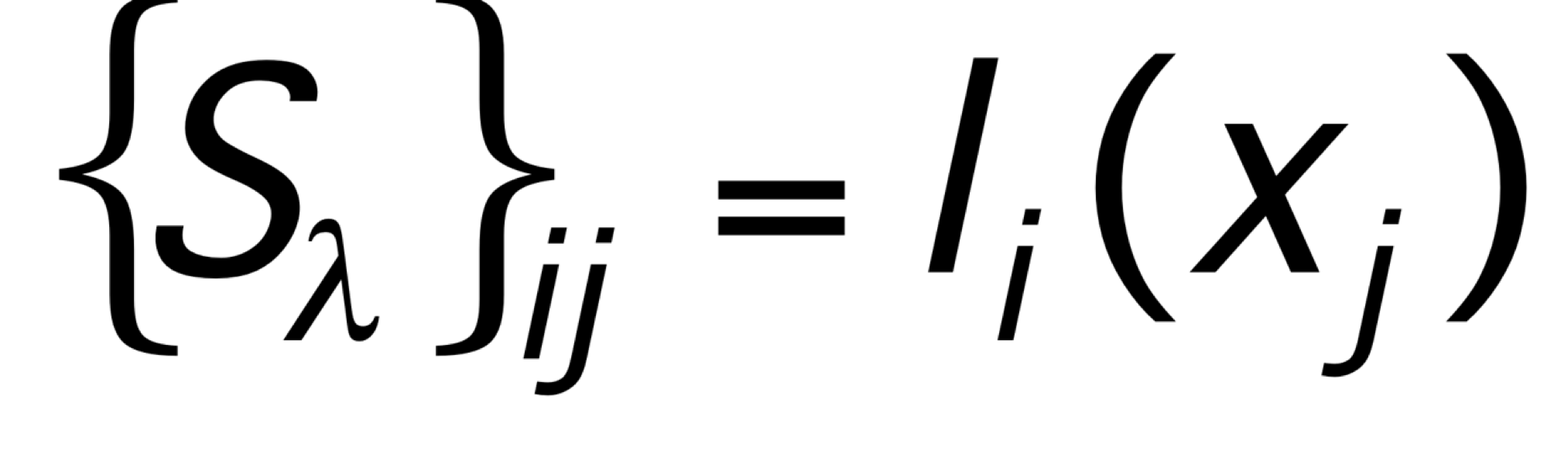
Smoother Matrix (Sensitivity) S_{λ}
Degrees of freedom = tr(S_{λ})

Slide 22
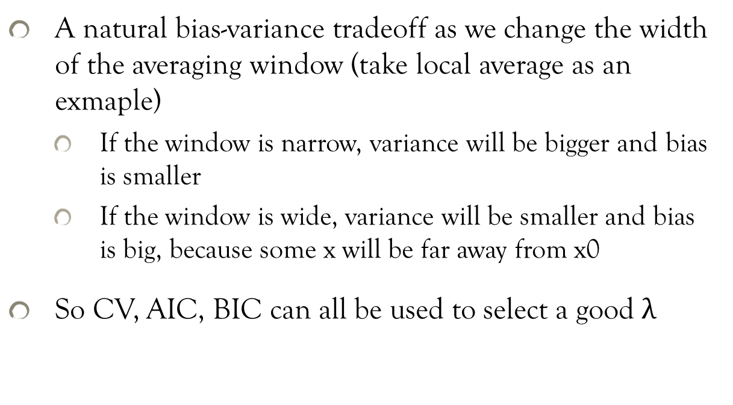
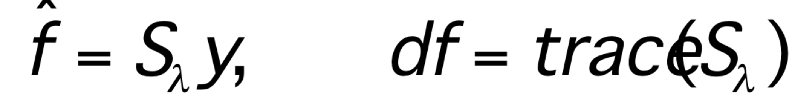
Selecting the Width of the Kernel
A natural bias-variance tradeoff as we change the width of the averaging window (take local average as an exmaple)
If the window is narrow, variance will be bigger and bias is smaller
If the window is wide, variance will be smaller and bias is big, because some x will be far away from x0
So CV, AIC, BIC can all be used to select a good $λ$

Slide 23
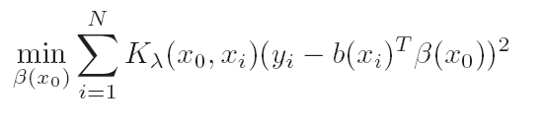

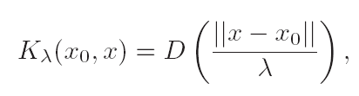
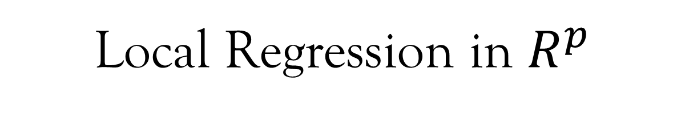
Local Regression in $R^{p}$

Slide 24
Local Regression in $R^{p}$
Boundary effects: boundary points increase with dimension
Less useful in high dimensions: localness (low bias) vs. insufficient samples (high variance)
Difficult for visualization

Slide 25
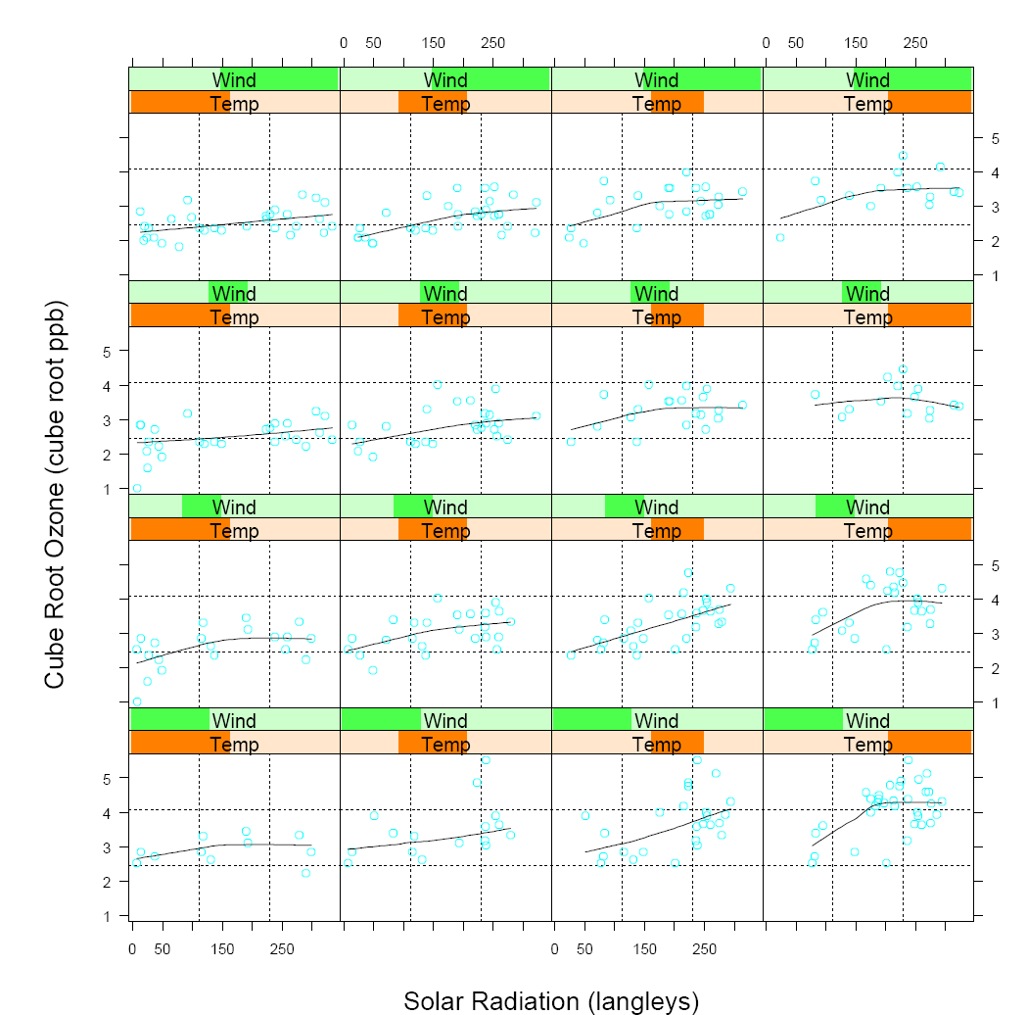
Data Visualization

Slide 26
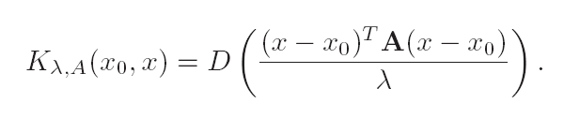
Structured Local Regression in R^{p}
When p/n is big, local regression is not helpful, unless we have some structural information.
Mahalanobis weighted distance

Slide 27
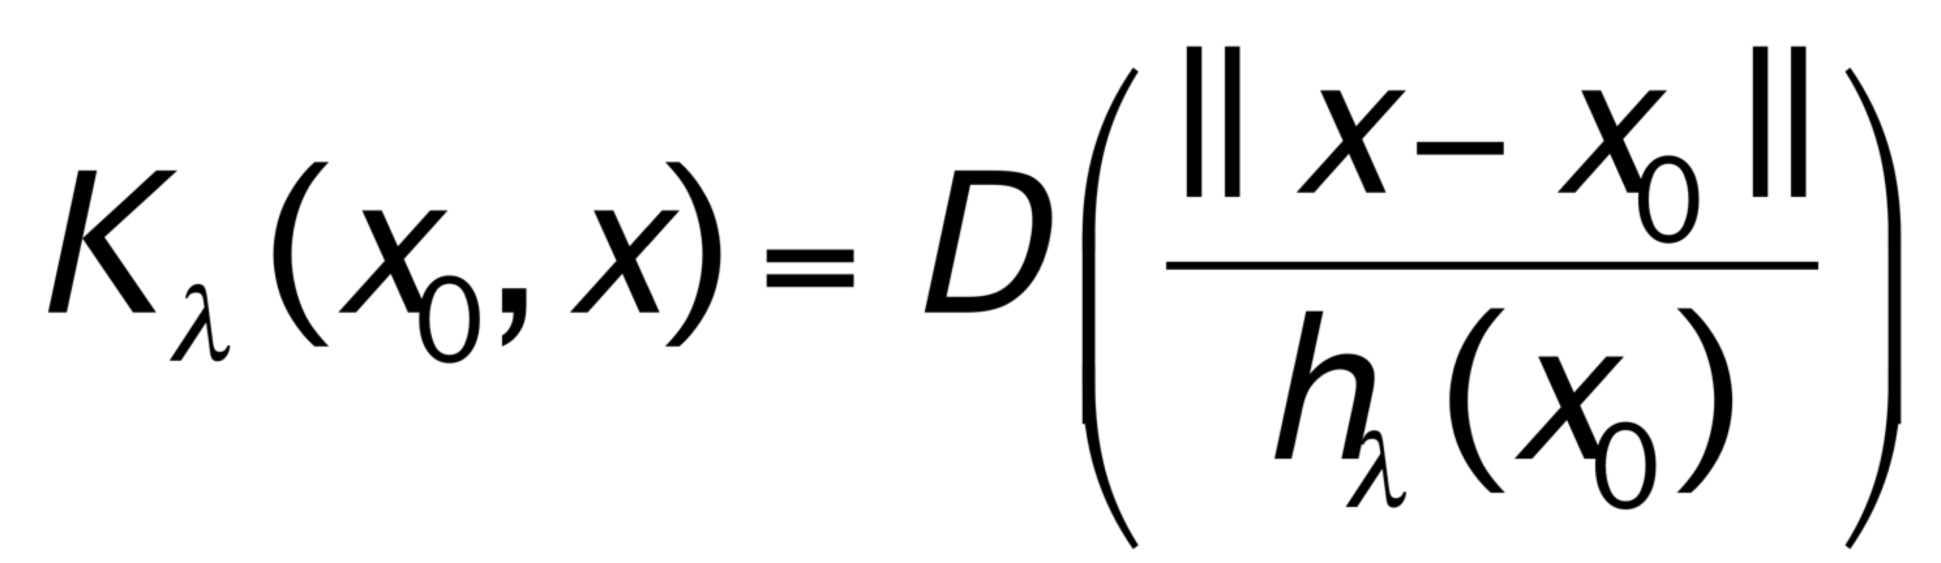
Radial Basis Kernels in P-dimensional Space
Radial kernels
Renormalized Radial basis is equivalent to Nadarayan-Watson weighted average

Slide 28
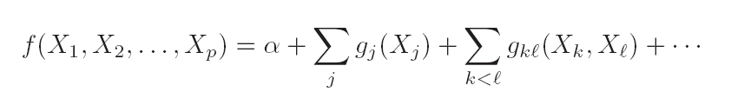
Structured Local Regression in R^{p}
Structured regression functions: high order iteractions
One-dimensional local regression for each stage

Slide 29

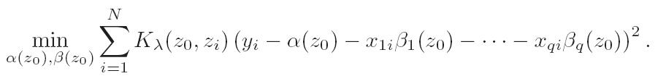
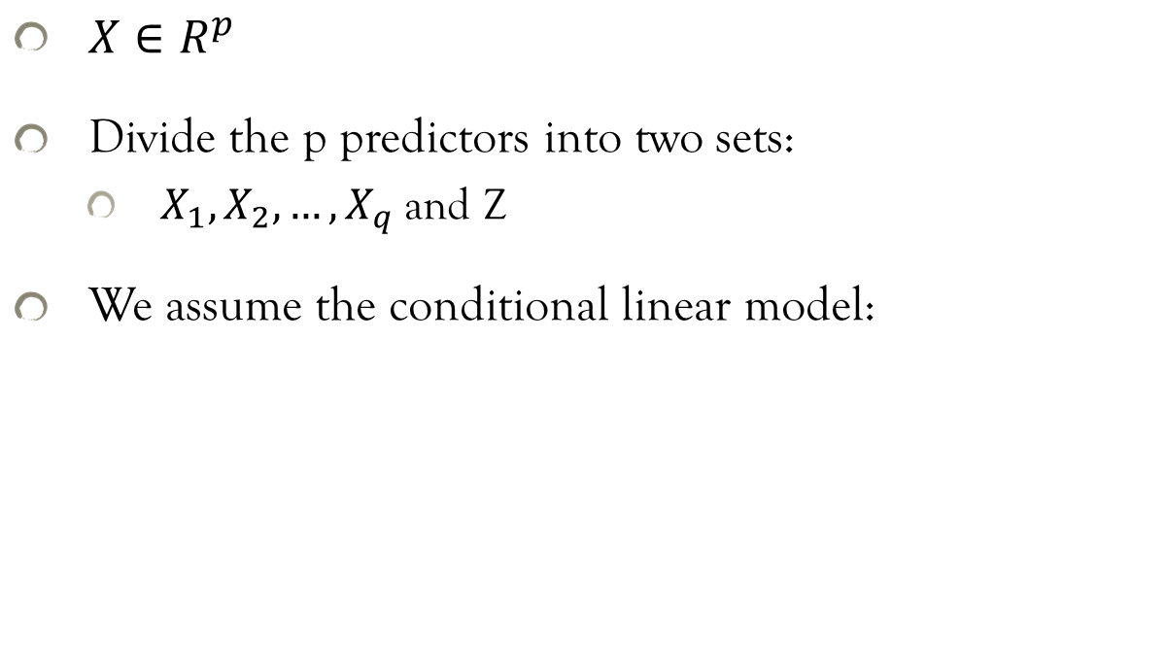
Varying Coefficient Models
$X∈R^{p}$
Divide the p predictors into two sets:
$X_{1},X_{2},…,X_{q}$ and Z
We assume the conditional linear model:
Extended reading: Gelman and Hill, Multilevel Models, 2007

Slide 30
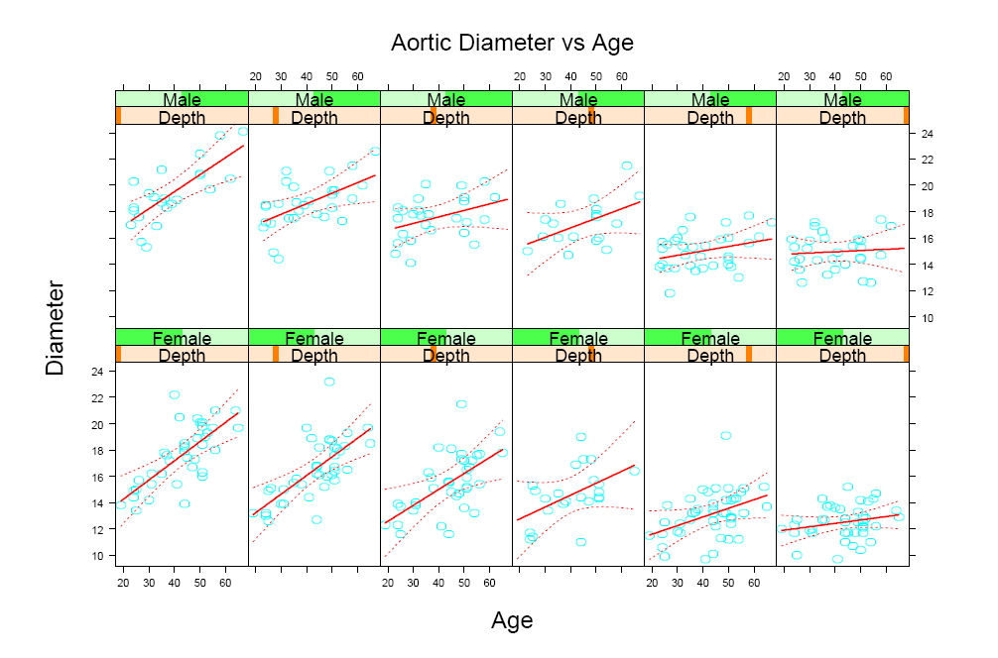
Varying Coefficient Models: an example

Slide 31
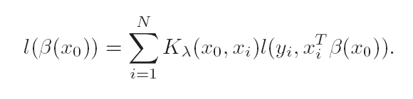
Local Likelihood and Other Models
From global to local:
Example: local logistic regression model.

Slide 32
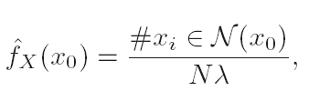
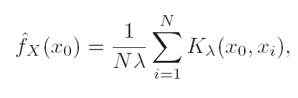

Kernel Density Estimation and Classification
Kernel Density Estimation: histogram
Parzen’s Smooth version:
One choice of the kernel:
histogram

Slide 33
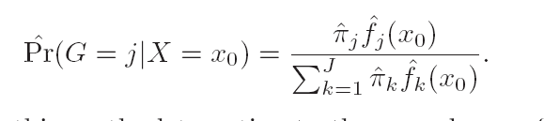
Kernel Density Classification

Slide 34
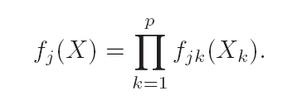
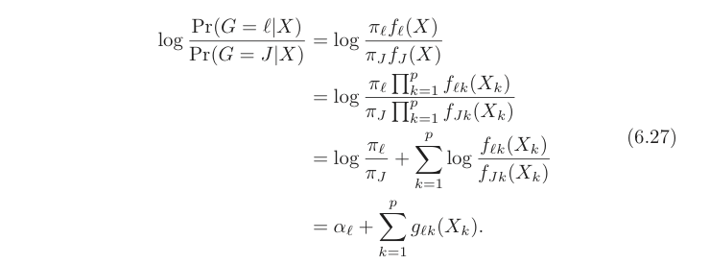
Naïve Bayes Classifier
Assumption: given class G=j, features are independent
Generalized Additive Model vs. Naïve Bayes

Slide 35
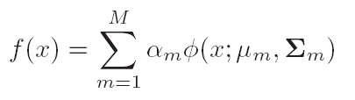
Mixture Models for Density Estimation and Classification
Gaussian mixture model: Any smooth function can be approximated well by mixture Gaussian models.
Maximum likelihood: EM algorithm is used for the parameter estimatation

Slide 36
Computation Consideration
Kernel and local regression (density estimation) are memory-based methods.
The method is based on the entire training data set.
For real-time applications, those methods can be infeasible.
Weibiao Wu et al. @Chicago online method

Slide 37
Homework
Due April 22
ESLII_print 10, Exercise: 6.2, 6.9, 6.12*

