Slide 1
ZENERA LABS · INTERNAL CAPABILITY ASSESSMENT
Customer Churn Prediction & Revenue-Recovery Analytics
Meridian Retail Group — Final client presentation
Days 1–5 completed results only. All figures are from the executed pipeline on synthetic data. Causal results are observational (not an RCT). ROI is scenario-based (no campaign cost in the data).
Seed 42 · TEST n = 8,924 · Frozen XGBoost threshold 0.63

Slide 2
Agenda
What this briefing covers
• Business problem and why silent churn matters
• Data, churn definition, and leakage-safe design
• EDA / RFM segmentation (descriptive)
• Recency baseline vs XGBoost on TEST
• SHAP drivers of the frozen model
• Observational campaign analysis (ATT) and why it is not proven causation
• Revenue at risk and scenario-based ROI (not observed ROI)
• Recommendations, limitations, and next steps
Meridian Retail Group · Customer Churn & Revenue Recovery · synthetic data demonstration
2 / 18

Slide 3
Business problem
Silent churn among customers who still look active
• Repeat purchase rate is described as down 14% over two quarters despite stable traffic and marketing spend.
• Leadership concern: mid-value customers who do not complain or unsubscribe — they simply buy less, then stop.
• Ask: who is likely to make zero purchases in the next 60 days, while they still look active today?
• Need: a model the internal team can explain, audit, and rerun monthly — not a black box score.
Predict
Prioritize
Decide
60-day purchase stop among currently active customers
High value × high risk, not all predicted churners equally
Whether campaigns can be ranked by ROI with the data on hand
Meridian Retail Group · Customer Churn & Revenue Recovery · synthetic data demonstration
3 / 18

Slide 4
Data used
Four connected synthetic tables — not real Meridian customers
Table | Rows | Grain | Audit
customers.csv | 6,000 | One row per customer | 0 duplicate IDs
transactions.csv | 128,131 | One purchase | 0 orphan customer_ids
marketing_touchpoints.csv | ~153,000 | One marketing contact | 0 orphan customer_ids
support_tickets.csv | ~10,500 | One ticket | 0 orphan customer_ids
• Observation window: 2024-03-01 to 2025-08-30 (18 months).
• Generated by src/data_generation.py with MASTER_SEED = 42. No real customer, transaction, or campaign data was provided.
• Data audit: missing-value scan, duplicates, referential integrity, invalid dates/amounts, leakage-keyword scan — reports/data_audit/.
• Treat every number in this deck as a methodology demonstration, not a live P&L finding.
DISCLAIMER: Synthetic dataset. Do not present these figures as Meridian’s actual revenue, churn, or campaign ROI.
Meridian Retail Group · Customer Churn & Revenue Recovery · synthetic data demonstration
4 / 18

Slide 5
Churn definition
Actionable silent churn — empirically validated, not hard-coded
• Eligible (as of prediction_date): ≥1 purchase in the 60 days strictly before that date (currently “in play”).
• churn = 1 if zero purchases in (prediction_date, prediction_date + 60 days]; else 0.
• Scoring already-dormant customers would inflate “churn” (~30% in an earlier all-customer cut) and is not an outreach use case.
Cut | Population | Churn rate
Latest feasible snapshot, 60-day eligibility | 4,552 customers | 9.56% (brief target ~9%)
All 13 monthly snapshots (modeling table) | 48,937 rows | 11.8% overall (train 11.4% / val 12.0% / test 12.6%)
Time split | Earliest 60% / next 20% / most recent 20% | No random row shuffle
Features use only records dated ≤ prediction_date. The 60-day label is never joined back as a feature. See leakage_audit.csv.
Meridian Retail Group · Customer Churn & Revenue Recovery · synthetic data demonstration
5 / 18

Slide 6
EDA / RFM segmentation
Descriptive structure for targeting — not a causal claim
• RFM quintiles (R inverted recency, F frequency, M monetary) are assigned within each prediction_date so snapshots are comparable.
• Latest snapshot in the EDA notebook: 2025-06-24, n = 4,531 labeled customers.
• Named segments include Champions, Loyal, Can’t Lose, At-Risk, Mid-Value, Promising, Dormant (Need Attention is rare).
• Marketing customer_segment on the file (Premium Shopper, Value Seeker, Trend Follower, Occasional Browser) is a generator attribute used as a covariate — distinct from RFM labels.
• Churn rates by RFM segment in the EDA notebook are associations in one snapshot, not evidence that the RFM rule causes churn.
• Leakage-safe features used later: recency_days, frequency_180d, monetary_180d, avg_order_value, recent_vs_prior_freq_delta, marketing and support rolling rates.
Meridian Retail Group · Customer Churn & Revenue Recovery · synthetic data demonstration
6 / 18

Slide 7
How the models were trained
TEST was not used to pick thresholds
• Recency baseline (brief-required heuristic): predict churn if recency_days exceeds a cutoff. Cutoff = 18 days, chosen on VALIDATION by max F1.
• XGBoost: sklearn ColumnTransformer fit on TRAIN only (median numeric impute; most-frequent + one-hot categoricals).
• Imbalance: scale_pos_weight = n_neg/n_pos from TRAIN only (~7.75). random_state = 42. Modest fixed hyperparameters (no TEST search).
• Probability threshold = 0.63, chosen on VALIDATION by max F1 among cutoffs whose predicted-positive rate is 0.5×–3× validation prevalence.
• TEST (n = 8,924) scored once after all fitting and threshold choices.
• Primary ranking metric: PR-AUC (class is imbalanced). Also ROC-AUC, precision/recall/F1 at the frozen threshold, Brier, precision@k / recall@k.
Meridian Retail Group · Customer Churn & Revenue Recovery · synthetic data demonstration
7 / 18

Slide 8
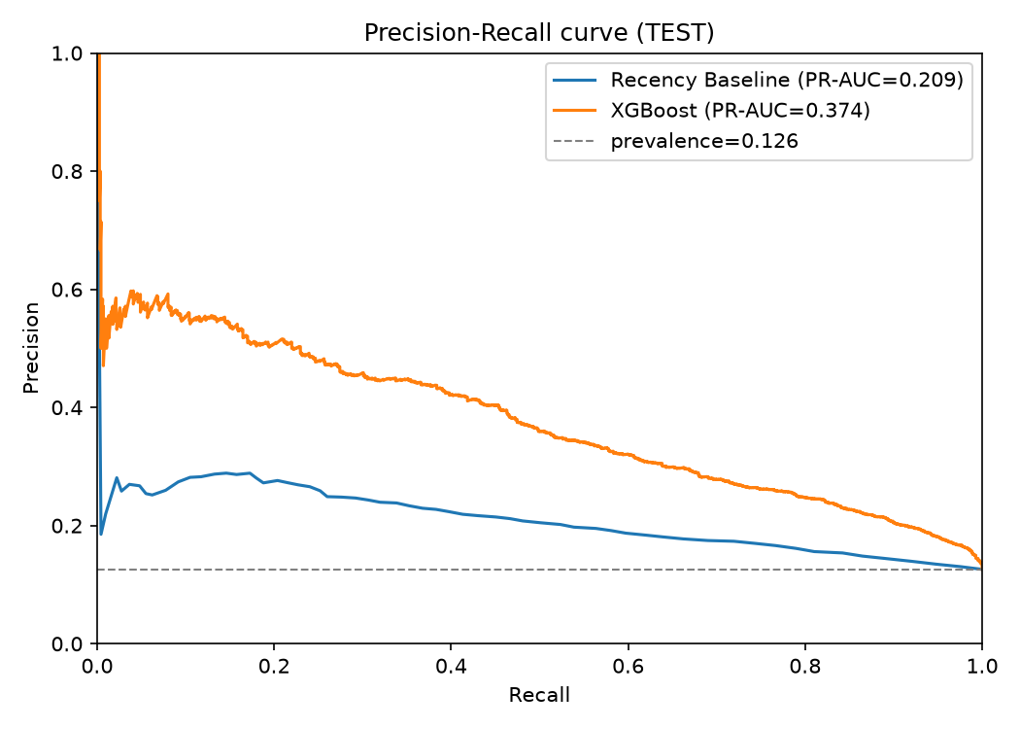
TEST results: recency vs XGBoost
Computed metrics — not invented. PR-AUC is primary.
Metric | Recency baseline | XGBoost
PR-AUC | 0.209 | 0.374
ROC-AUC | 0.656 | 0.804
Precision / Recall / F1 | 0.197 / 0.539 / 0.289 | 0.347 / 0.526 / 0.418
Brier score (lower better) | 0.163 | 0.157
• XGBoost improves ranking quality vs recency (PR-AUC +0.165, ROC-AUC +0.148).
• No DeLong/bootstrap test of ΔPR-AUC was run; treat the lift as a large point-estimate gain, not a p-value.
• Brier barely moves — probabilities are useful for ranking more than for calibrated dollar forecasts.
• Source: reports/model_evaluation/model_comparison.csv
Meridian Retail Group · Customer Churn & Revenue Recovery · synthetic data demonstration
8 / 18

Slide 9
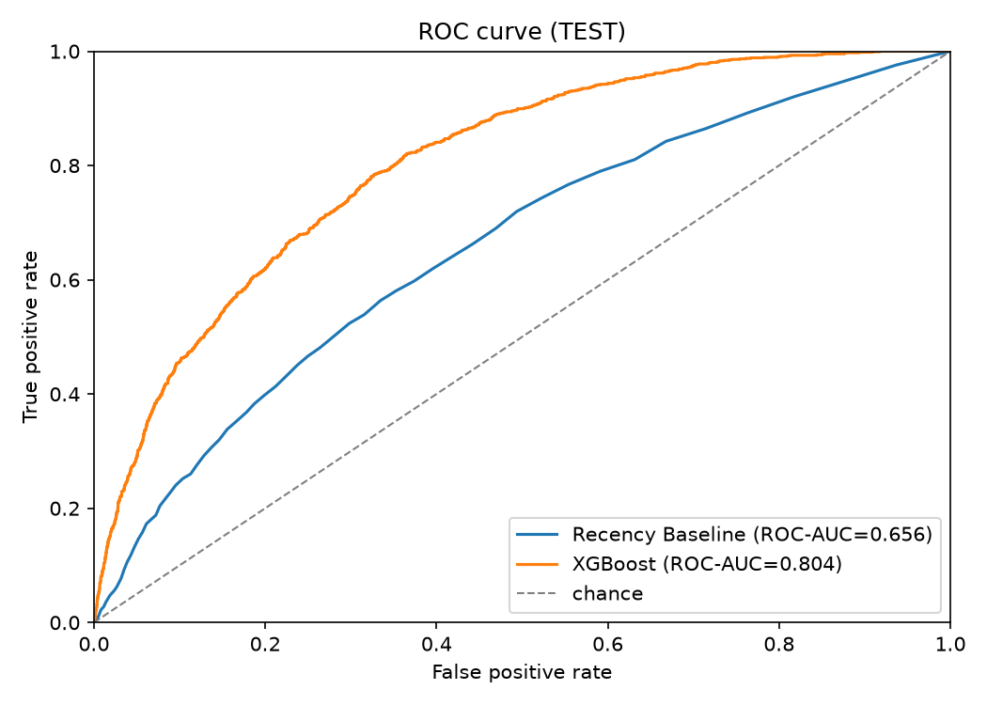
Outreach ranking on TEST
If the team can only contact the top k% by score
Contact list | k | XGB precision | XGB recall | Recency precision
Top 5% | 446 | 0.509 | 0.202 | 0.280
Top 10% | 892 | 0.446 | 0.354 | 0.271
Top 20% | 1,784 | 0.342 | 0.544 | 0.230
• At a 5% contact budget, about half of XGBoost-ranked customers actually churned in the 60-day window vs 28% for recency.
• TEST positives = 1,123 of 8,924.
• Source: reports/model_evaluation/precision_recall_at_k.csv
Meridian Retail Group · Customer Churn & Revenue Recovery · synthetic data demonstration
9 / 18

Slide 10
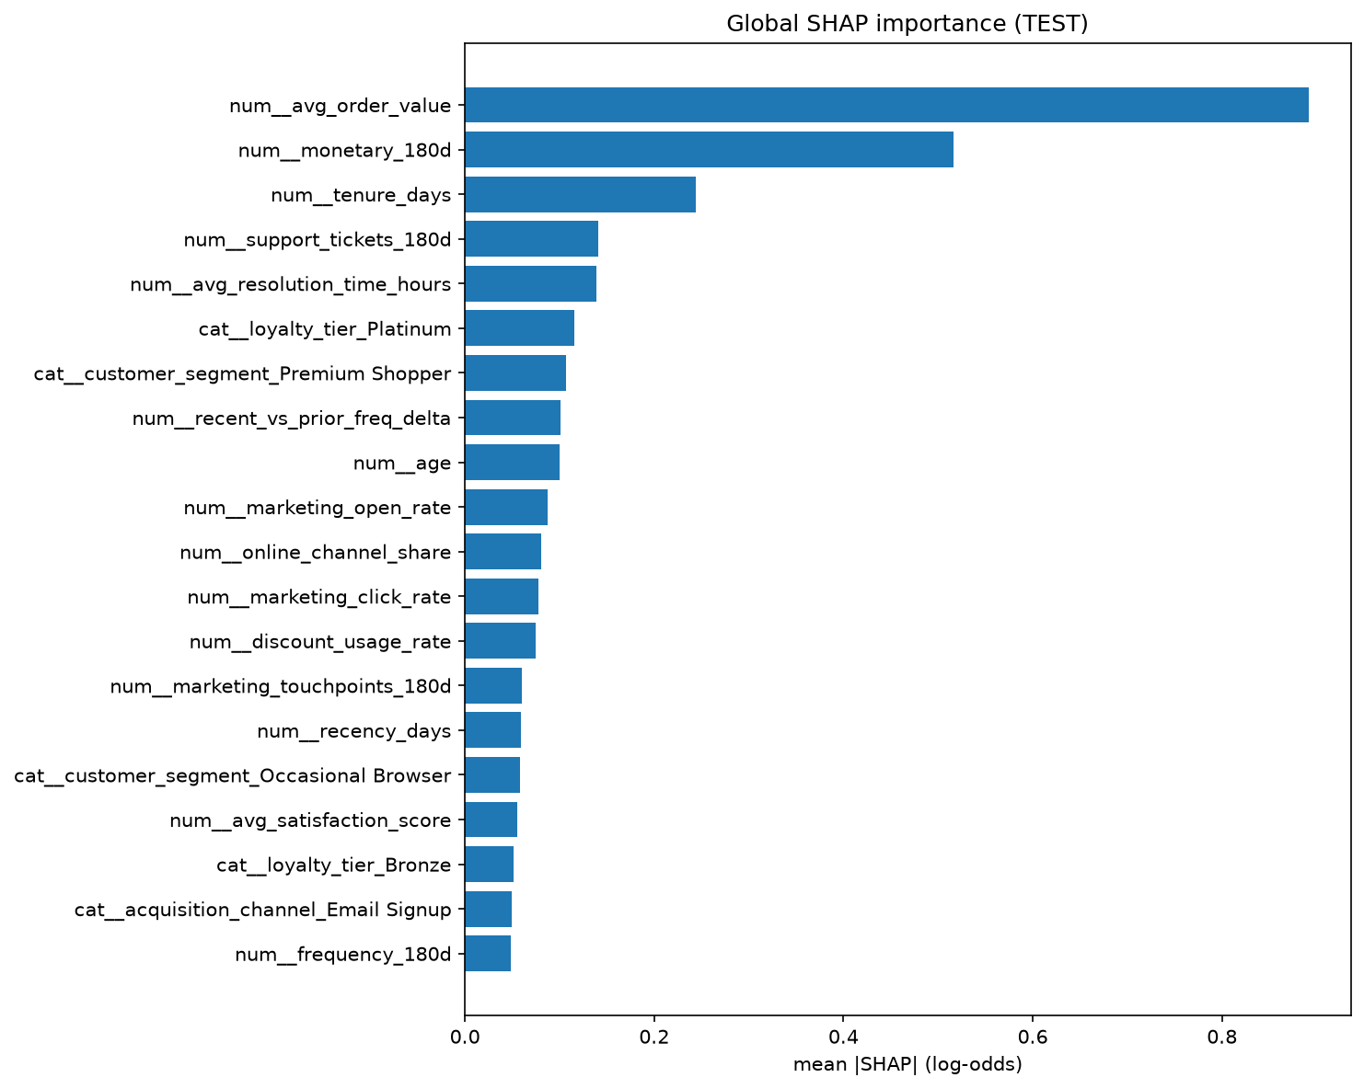
SHAP insights (TEST, frozen Day 2 model)
TreeSHAP log-odds of churn; shap library was not installed — XGBoost pred_contribs used
• Largest mean |SHAP|: avg_order_value, monetary_180d, tenure_days, support tickets, resolution time.
• Loyalty Platinum and Premium Shopper also rank in the top 10 (category effects after one-hot).
• Positive SHAP raises the churn score; negative lowers it. Values are in log-odds, not probability points.
• Local waterfalls for 8 TEST customers are in reports/explainability/local_waterfalls/.
• No retraining. Threshold 0.63 was not retuned on TEST.
Meridian Retail Group · Customer Churn & Revenue Recovery · synthetic data demonstration
10 / 18

Slide 11
Campaign analysis is observational — not an RCT
Treatment was constructed; it is not a randomized experiment
Do not present Day 4 ATT as a proven causal effect or as a recovery lift for budgeting.
• modeling_table.csv has no treatment column. T is built from marketing_touchpoints.csv.
• T = 1 if ≥1 of Promotional Discount, Loyalty Nudge, or Personal Outreach occurs in the same 60-day window as the churn label.
• That window overlap is a limitation: treatment and outcome are concurrent, not a clean pre-period experiment.
• Treated share is ~84% (TRAIN 23,003 treated vs 4,522 control). Raw TRAIN churn 11.48% vs 11.17% is not a causal effect.
• Propensity logistic regression fit on TRAIN covariates only. 1:1 nearest-neighbor matching on logit PS, without replacement, caliper 0.2 × SD(logit PS) = 0.0539.
• After matching, share of covariates with |SMD| > 0.1: 2.2% → 0%.
Meridian Retail Group · Customer Churn & Revenue Recovery · synthetic data demonstration
11 / 18

Slide 12
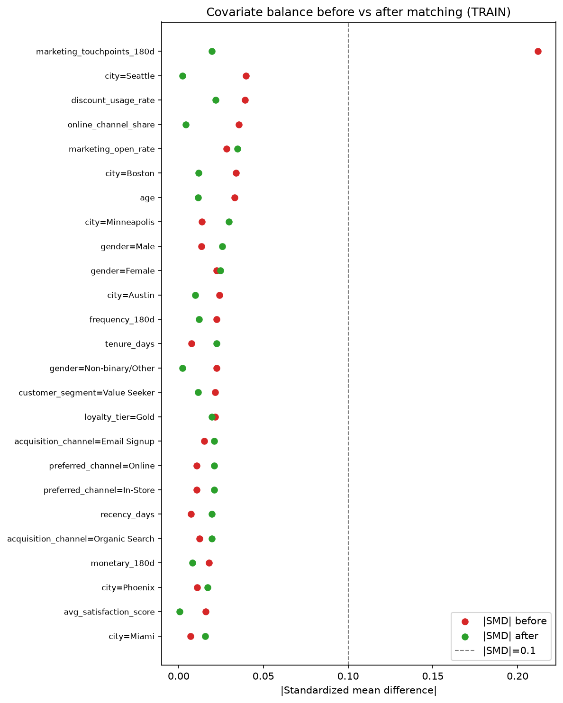
Matched ATT (observational)
95% CI includes 0 — not used as Day 5 lift
Estimand | Result
TRAIN matched pairs | 4,522 (all controls used; 18,481 treated unmatched)
Treated vs matched-control churn | 11.28% vs 11.17%
ATT (risk difference) | +0.0011
95% paired-bootstrap CI | −0.0124 to +0.0131 (includes 0)
TEST confirmatory ATT (frozen PS) | −0.0153 (CI −0.0389 to +0.0090, includes 0)
• ATE is not the primary estimand: 1:1 matching cannot represent the full treated population.
• Campaign-type splits in campaign_type_results.csv are overlapping/observational only.
• Source: reports/causal_analysis/att_results.csv
Meridian Retail Group · Customer Churn & Revenue Recovery · synthetic data demonstration
12 / 18

Slide 13
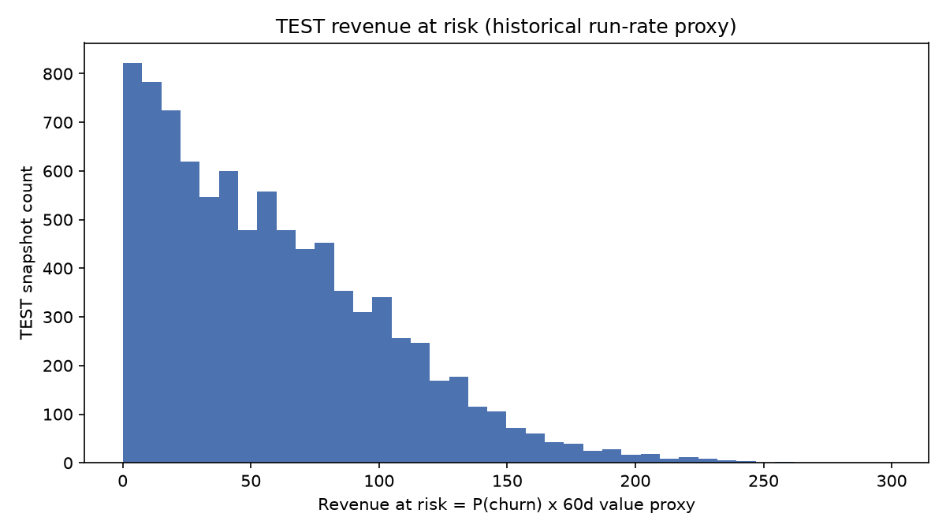
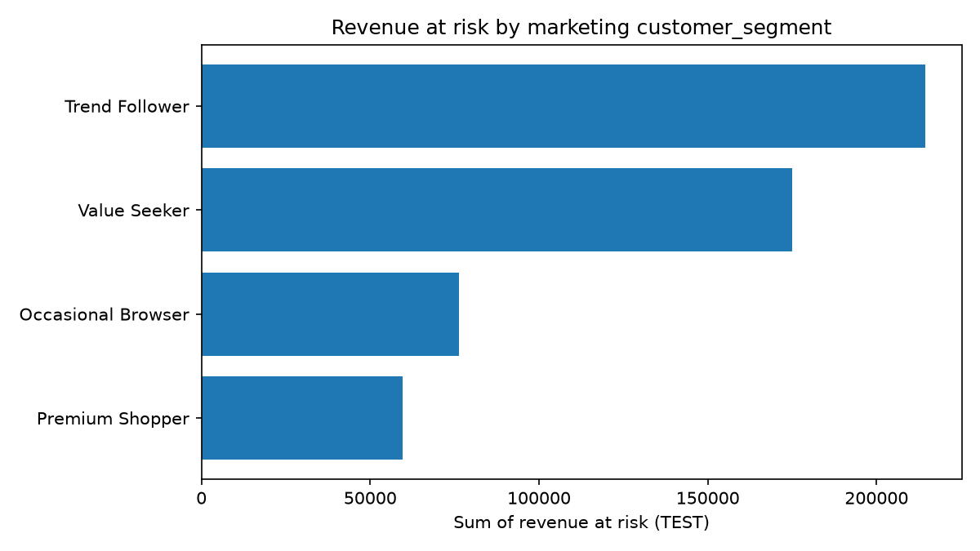
Revenue at risk (TEST)
Historical run-rate proxy — not observed future spend
Quantity | Definition | TEST value
A Historical revenue | monetary_180d (observed) | $10,706,205
B Churn risk | Day 2 predict_proba | threshold 0.63
C Revenue at risk | B × (monetary_180d × 60/180) | $525,262
High-risk customers | p ≥ 0.63 | 1,704 of 8,924
High-risk RAR | C among high-risk | $113,859
• The 60/180 factor is a run-rate proxy. It is not measured 60-day future revenue.
• Contacting by RAR (top 5/10/20%) concentrates more dollars than contacting all high-risk equally.
• Source: reports/revenue_roi/customer_revenue_at_risk.csv
Meridian Retail Group · Customer Churn & Revenue Recovery · synthetic data demonstration
13 / 18

Slide 14
ROI is scenario-based — not observed
No campaign cost field exists. offer_value is discount face value, not delivery cost.
Actual ROI cannot be estimated from the available data. Day 4 ATT is not used as a capture rate (CI includes 0).
Letter | Quantity | Status
D | Recoverable revenue | ASSUMED = RAR among contacted × capture 5/10/25/50%
E | Actual campaign cost | NOT IN THE DATA
F | Cost per contact | ASSUMED $5 / $10 / $25 / $50
G | Scenario ROI | (D − F×n) / (F×n) under those assumptions only
Policy (TEST) | Contacted | RAR among contacted | Break-even $/contact at 10% capture | at 25% capture
All high-risk (p≥0.63) | 1,704 | $113,859 | $6.68 | $16.70
Top 5% by RAR | 446 | $76,610 | $17.18 | $42.94
Top 10% by RAR | 892 | $134,895 | $15.12 | $37.81
Meridian Retail Group · Customer Churn & Revenue Recovery · synthetic data demonstration
14 / 18

Slide 15
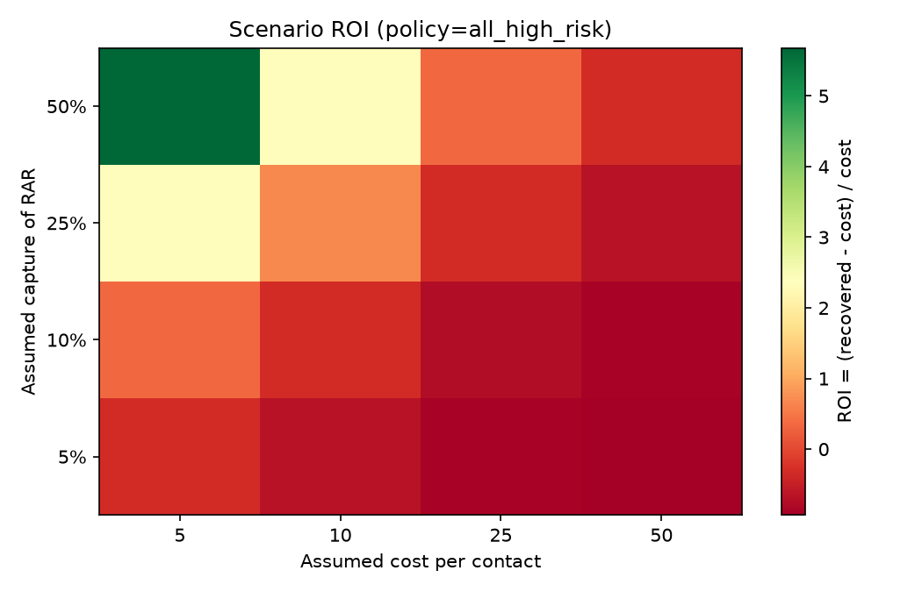
Scenario ROI sensitivity (all high-risk policy)
Green does not mean the campaign worked — it means those assumptions would break even
• Axes: assumed capture of high-risk RAR vs assumed $ per contact.
• If capture is 10% and cost is $10, contacting all 1,704 high-risk customers does not cover cost (break-even is $6.68).
• If the team can rank by RAR, fewer contacts carry more dollars at risk (top 5% break-even $17.18 at 10% capture).
• Do not rank Discount vs Loyalty vs Outreach by ROI: the data do not identify a non-zero campaign effect or a delivery cost.
• Source: reports/revenue_roi/roi_scenarios.csv and break_even_analysis.csv
Meridian Retail Group · Customer Churn & Revenue Recovery · synthetic data demonstration
15 / 18

Slide 16
Recommendations
What the completed analysis supports — and what it does not
Use the model to rank
Prefer XGBoost scores over a recency rule for who to review first. At a 5% list, TEST precision was 0.51 vs 0.28.
Prioritize dollars, not flags
Sort outreach by revenue at risk (probability × 60-day value proxy), not by high-risk flag alone.
Do not fund from ATT
Matched observational ATT is +0.11 pp with a CI that includes zero. Do not treat historical campaigns as proven retention lifts.
Pilot with a cost ledger
Instrument actual cost per contact and a holdout or stepped-wedge design before claiming ROI.
Explain locally
Use SHAP waterfalls when a store or CRM owner asks why a named customer scored high.
Rerun monthly on the same split logic
Point-in-time features, frozen threshold until a scheduled retrain — not a weekly TEST peek.
Meridian Retail Group · Customer Churn & Revenue Recovery · synthetic data demonstration
16 / 18

Slide 17
Limitations and next steps
Stay inside what Days 1–5 actually measured
Limitations
Next steps (not done)
• All data are synthetic.
• Treatment and churn share the same 60-day window.
• Unconfoundedness of observed covariates is assumed, not proven.
• No campaign delivery cost; offer_value is not cost.
• 60-day value is a 180-day run-rate proxy.
• SHAP used native TreeSHAP fallback (shap package unavailable on this Python 3.13 environment).
• ΔPR-AUC was not given a statistical test.
• loyalty_tier is a fixed attribute in the generator, not a time-varying as-of feature.
• Record unit cost and offer cost in the CRM extract.
• Design a true experiment or staggered rollout for Discount / Nudge / Outreach.
• If an instrument appears, revisit causal identification (beyond matching).
• Add drift monitoring before monthly silent retrains.
• Optional: install a 3.13-compatible shap wheel and bootstrap ΔPR-AUC if a reviewer requires them.
Meridian Retail Group · Customer Churn & Revenue Recovery · synthetic data demonstration
17 / 18

Slide 18
Bottom line
XGBoost ranks 60-day silent churn better than recency on TEST. Use scores × value to prioritize. Do not claim campaign ROI or proven causal lift from this dataset.
Evidence pack: reports/model_evaluation/ · reports/explainability/ · reports/causal_analysis/ · reports/revenue_roi/ Notebooks 01–06 executed. Random seed 42. This deck adds no new analytics.
Causal analysis: observational. ROI: scenario-based.

