Slide 1
Flight Delay Predictor
Team Pandas: Jason Bursey, Alyssa Gomes, Ruchan Harash, Diana Popa
USCS Data Analytics Boot Camp
September 2020

Slide 2

Notes:
Topic - Flight delays

Slide 3
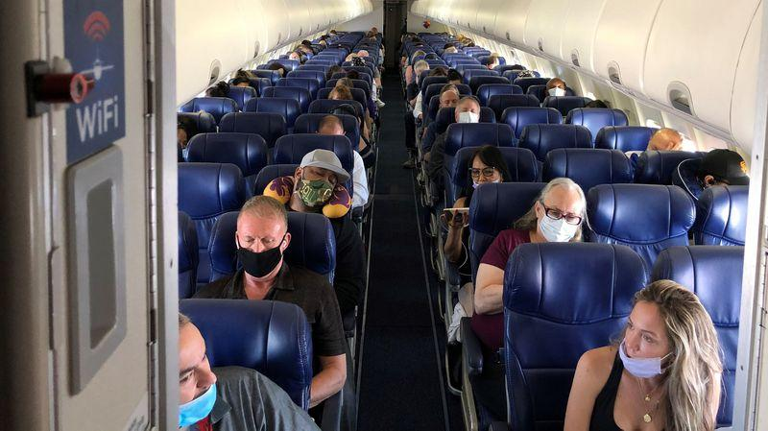
Notes:
Reasons we selected the topic
Air travel as we used to know it has been turned on its head because of the COVID-19 Pandemic. We are looking at flight delay data from 2015 to see which factors impact how many minutes a flight is delayed by. The airline industry is close to $900 billion in size worldwide as of 2019, with flight delays costing the industry $8 billion annually. Being able to predict which factors influence delays and by how many minutes, is the question airlines have been struggling to answer since their inception.

Slide 4

Data
Notes:
This dataset provides information on the flights in 2015. Data includes the date of the flight, the airline, flight and tail number, the origin and destination airport, the times and distance associated with the flights as well as the reason for delay and if the flight was cancelled or diverted. With 31 columns and so much data, we will remove certain columns to clean the dataset. Those columns include the year because all this data is only for 2015. We will also remove the cancellation reason column because 98% of the values are null. As well, we will remove all the flights that were cancelled as it does not provide us with any data on factors that could’ve influence delay and we will remove the whole cancelled column as well.
This dataset includes information on the airports according to the IATA_CODE. Information includes the airport name, the city, state, and country the airport resides in, and the latitude and the longitude of the airport.
This dataset provides information on the airlines including the code and airline name.

Slide 5
Data
Notes:
This dataset provides information on the flights in 2015. Data includes the date of the flight, the airline, flight and tail number, the origin and destination airport, the times and distance associated with the flights as well as the reason for delay and if the flight was cancelled or diverted. With 31 columns and so much data, we will remove certain columns to clean the dataset. Those columns include the year because all this data is only for 2015. We will also remove the cancellation reason column because 98% of the values are null. As well, we will remove all the flights that were cancelled as it does not provide us with any data on factors that could’ve influence delay and we will remove the whole cancelled column as well.
This dataset includes information on the airports according to the IATA_CODE. Information includes the airport name, the city, state, and country the airport resides in, and the latitude and the longitude of the airport.
This dataset provides information on the airlines including the code and airline name.

Slide 6
Data
Notes:
This dataset provides information on the flights in 2015. Data includes the date of the flight, the airline, flight and tail number, the origin and destination airport, the times and distance associated with the flights as well as the reason for delay and if the flight was cancelled or diverted. With 31 columns and so much data, we will remove certain columns to clean the dataset. Those columns include the year because all this data is only for 2015. We will also remove the cancellation reason column because 98% of the values are null. As well, we will remove all the flights that were cancelled as it does not provide us with any data on factors that could’ve influence delay and we will remove the whole cancelled column as well.
This dataset includes information on the airports according to the IATA_CODE. Information includes the airport name, the city, state, and country the airport resides in, and the latitude and the longitude of the airport.
This dataset provides information on the airlines including the code and airline name.

Slide 7
Data
Notes:
This dataset provides information on the flights in 2015. Data includes the date of the flight, the airline, flight and tail number, the origin and destination airport, the times and distance associated with the flights as well as the reason for delay and if the flight was cancelled or diverted. With 31 columns and so much data, we will remove certain columns to clean the dataset. Those columns include the year because all this data is only for 2015. We will also remove the cancellation reason column because 98% of the values are null. As well, we will remove all the flights that were cancelled as it does not provide us with any data on factors that could’ve influence delay and we will remove the whole cancelled column as well.
This dataset includes information on the airports according to the IATA_CODE. Information includes the airport name, the city, state, and country the airport resides in, and the latitude and the longitude of the airport.
This dataset provides information on the airlines including the code and airline name.

Slide 8
Data
Notes:
This dataset provides information on the flights in 2015. Data includes the date of the flight, the airline, flight and tail number, the origin and destination airport, the times and distance associated with the flights as well as the reason for delay and if the flight was cancelled or diverted. With 31 columns and so much data, we will remove certain columns to clean the dataset. Those columns include the year because all this data is only for 2015. We will also remove the cancellation reason column because 98% of the values are null. As well, we will remove all the flights that were cancelled as it does not provide us with any data on factors that could’ve influence delay and we will remove the whole cancelled column as well.
This dataset includes information on the airports according to the IATA_CODE. Information includes the airport name, the city, state, and country the airport resides in, and the latitude and the longitude of the airport.
This dataset provides information on the airlines including the code and airline name.

Slide 9
Data
Notes:
This dataset provides information on the flights in 2015. Data includes the date of the flight, the airline, flight and tail number, the origin and destination airport, the times and distance associated with the flights as well as the reason for delay and if the flight was cancelled or diverted. With 31 columns and so much data, we will remove certain columns to clean the dataset. Those columns include the year because all this data is only for 2015. We will also remove the cancellation reason column because 98% of the values are null. As well, we will remove all the flights that were cancelled as it does not provide us with any data on factors that could’ve influence delay and we will remove the whole cancelled column as well.
This dataset includes information on the airports according to the IATA_CODE. Information includes the airport name, the city, state, and country the airport resides in, and the latitude and the longitude of the airport.
This dataset provides information on the airlines including the code and airline name.

Slide 10

Schema
Flights
Unamed: 0
month smallint
day smallint
day_of_week smallint
airline varchar
flight_number smallint
tail_number varchar
origin_airport varchar
destination_airport varchar
scheduled_departure smallint
departure_delay decimal
elapsed_time decimal
air_time decimal
distance smallint
wheels_on decimal
taxi_in decimal
scheduled_arrival smallint
arrival_time decimal
arrival_delay decimal
air_system_delay decimal
security_delay decimal
airline_delay decimal
late_aircraft_delay decimal
weather_delay decimal
Airlines
iata_code varchar
airline varchar
Airports
iata_code varchar
airport varchar
city varchar
state varchar
country varchar
latitude varchar
longitude varchar

Slide 11
DATA EXPLORATION
Remove unnecessary features
Remove excess data
Check distribution
Cancelled and diverted flights
Considered airports with higher traffic levels
Considered delays under two hours
Notes:
Remove unnecessary features
Removed features include cancelled and diverted flights, the cancellation reason, departure time, taxi out, wheels off, scheduled time, and the year, as all data is from 2015.
Remove excess data
We only considered airports with over 20,000 number of visits in order to reduce the dataset from over 4 million samples to 3.3 million.
Check distribution
Checked the distribution of departure delays by plotting a graph and removed any delay times of over 2 hours based on the assumption that a longer delay time would be due to an outside factor impacting the delay, not the airline itself.

Slide 12
DATA ANALYSIS
Choosing a form of analysis
Choosing a model
Improving the model
Linear regression model
80/20 training and testing split
Deep neural network
Hyper parameter testing
Notes:
Choosing a form of analysis
Our target data being the number of minutes a flight is delay is numerical, which is why we chose a linear regression model. The data was split the training and testing data 80% to 20%, respectively.
Choosing a model
We chose a deep neural network because it works well with large amounts of data, has the ability to learn and model non-linear and complex relationships, performs well with high volatility and non-constant variance and is more accurate.
Improving the model
We tuned our model using hyper parameter testing on the number of neurons in each hidden layer and activation functions. We prevented overfitting by changing the number of epochs.

Slide 13
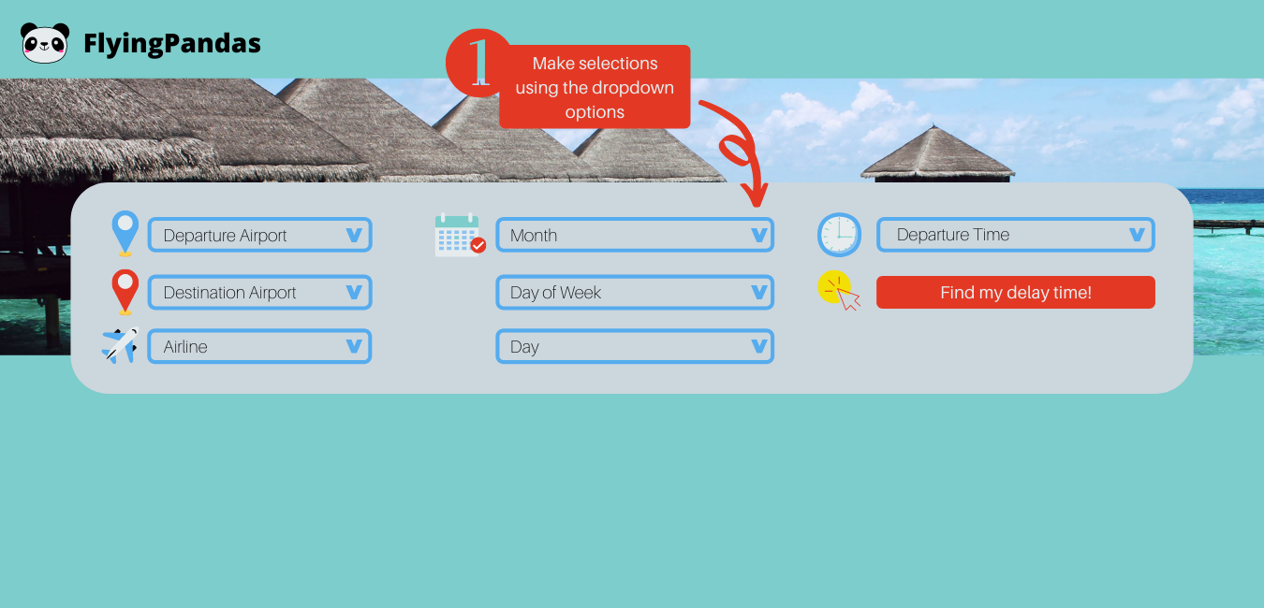
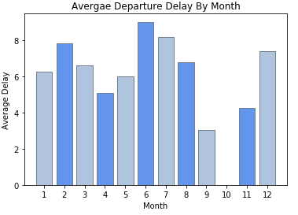
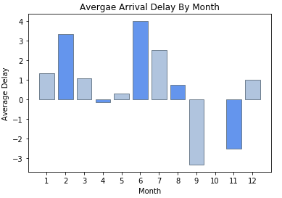
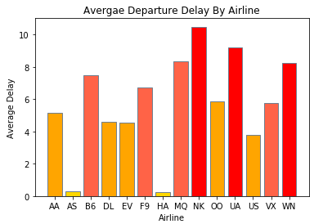
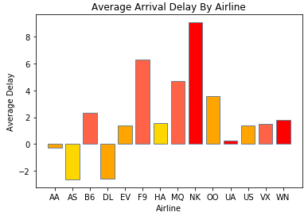
Storyboard - Interactive
Notes:
The interactive element of out dashboard is the main focus. The user will be able to select options from the dropdown menu of each feature. Once the Find my delay time! button is selected, the user’s predicted delay time based on those features will be displayed on screen as shown in the red box.

Slide 14
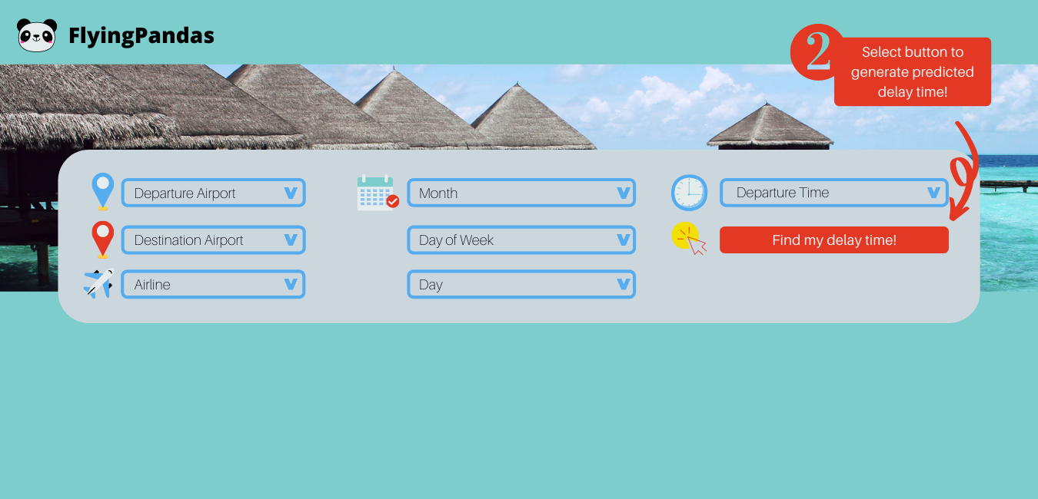
Storyboard - Interactive
Notes:
The interactive element of out dashboard is the main focus. The user will be able to select options from the dropdown menu of each feature. Once the Find my delay time! button is selected, the user’s predicted delay time based on those features will be displayed on screen as shown in the red box.

Slide 15
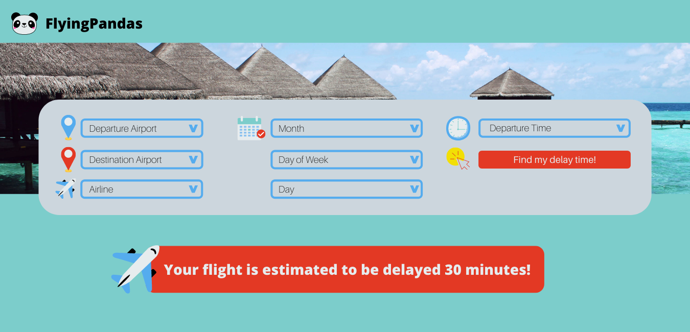
Storyboard - Interactive
Notes:
The interactive element of out dashboard is the main focus. The user will be able to select options from the dropdown menu of each feature. Once the Find my delay time! button is selected, the user’s predicted delay time based on those features will be displayed on screen as shown in the red box.

Slide 16




DASHBOARD TOOLS
Notes:
We will use Python for any analysis that needs to be completed.
We will leverage dash to visualize our data which is built on Flask.
We will use Jupyter Notebook to create our data visualization and share it with the team.
We will use HTML to code our webpage.

Slide 17
THANKS!
ANY QUESTIONS?

