Slide 1
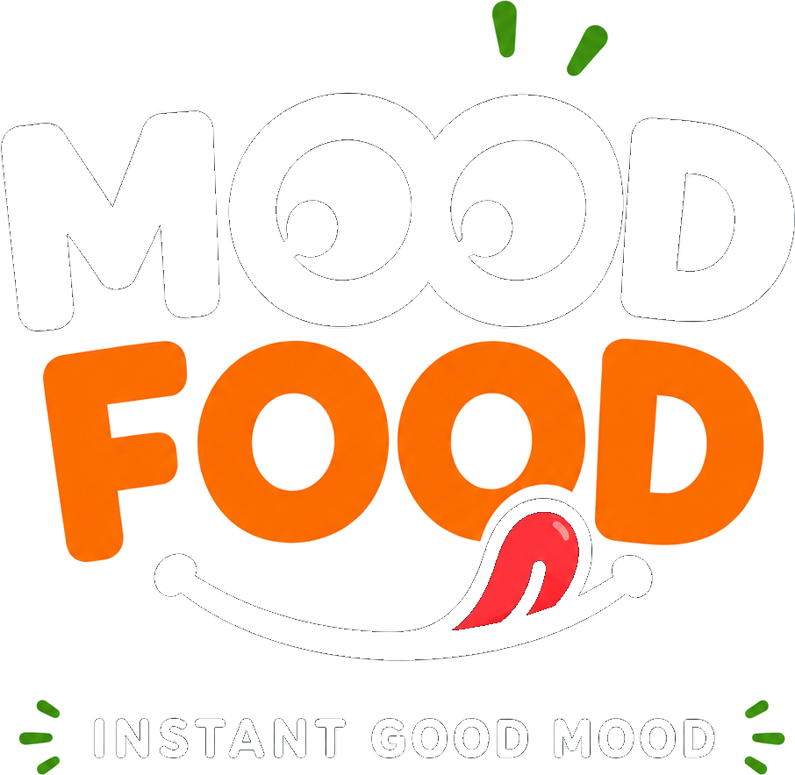
SEED DECK · 2026
The AI food companion that knows what you're craving — before you do.
Ending decision fatigue in online food ordering with an AI that learns through play, not paperwork.
Confidential — prepared for investor review

Slide 2
THE PROBLEM
Ordering food shouldn't feel like a chore
Every order starts the same way: an open app, an endless scroll, and the same tired question.
01
02
03
Choice overload is measurable
Overload breeds paralysis
Fatigue causes defaulting
Eye-tracking studies show long menus raise cognitive effort and decision fatigue — shorter, curated lists convert better than long ones.
Research on food-app choice overload links too many options to decision paralysis and lower satisfaction, especially for time-pressed users.
Under cognitive overload, people delay the decision or default to the same familiar order — regardless of what they actually want that day.
Sources: International Journal of Engineering, Management & Science (choice overload in food apps); ResearchGate, “Time of day & decision fatigue in online food choice.”
2

Slide 3
WHY NOW
Consumers already expect AI to know them
65%
But today's “AI” is still shallow
→
DoorDash's Sybil predicts restaurant demand and Dasher routing — operational AI, not personal taste.
of consumers say a restaurant remembering their preferences changes how often they choose it
→
Uber Eats surfaces past orders and discounts — reactive to history, blind to how you feel right now.
→
Swiggy & Zomato personalize search ranking, but still hand every user the same scroll-and-decide model.
$505.5B
None of them ask how you feel, learn through play, or get out of your way as they learn. That gap is MoodFood.
global online food delivery market by 2030, up from $288.8B in 2024 (9.4% CAGR)
Sources: DoorDash 2026 Restaurant Industry Trends Report; Grand View Research, “Online Food Delivery Services Market Report, 2025-2030.”
3

Slide 4
THE SOLUTION
Meet MoodFood
An AI food companion that learns you through play — then quietly gets out of your way.
1
2
3
Feels your mood
Learns through games
Gets out of your way
Quick check-ins on energy, stress, hunger and context feed one continuously-updated taste model — not a static form.
Swipes, duels, cravings and vetoes replace tedious preference forms with 30-second, sticky micro-games.
As confidence rises, the question budget shrinks — toward a “mind-reader” mode that recommends with zero questions asked.
4

Slide 5
HOW IT WORKS
One evolving user model, fed by everything you do
1
2
3
4
Signals
Unified user model
AI retrieval + ranking
Confident recommendation
→
→
→
Swipes, duels, mood check-ins, vetoes, orders and post-meal ratings — every interaction is logged as one signal type.
A taste vector, mood→food map, and per-context trade-off weights update continuously from that signal stream.
FAISS narrows the catalogue by embedding similarity; one GPT-4o call ranks the shortlist with legible reasoning.
Each pick ships with a confidence score — which also decides how many questions we ask next time.
Every learner is a pure fold over an ordered, durable signal log — the model can always be rebuilt from scratch.
5

Slide 6
THE PRODUCT
Preferences, captured as play — not paperwork
Six of 22 designed micro-games that make training the AI feel like the fun part of ordering.
M
Mood Check-In
S
Swipe-to-Train
T
This-or-That Duels
4 quick sliders — energy, stress, hunger, social — before you even open the menu.
Tinder-style dish swipes; reaction time itself is a taste signal.
Six playful head-to-head picks that quietly learn your price / health / speed trade-offs.
C
Craving Radar
R
Mind-Reader
G
Group Mode
Tap the cravings you're chasing right now to override your usual baseline.
One hero recommendation, no questions asked — unlocked once confidence is high.
Everyone swipes from their phone; a consensus pick balances the whole table.
6

Slide 7
WHY WE WIN
Built like a recommender system, not a chatbot wrapper
Two-tower embedding stack
Negative-preference space
OpenAI text-embedding-3-small item tower + an online-updated 256-d user vector in the same space, retrieved via FAISS.
A separate “disliked” vector actively pushes away recent vetoes — without permanently sinking a dish over one bad day.
Context-aware trade-offs
Calibrated confidence
Bradley–Terry learning fits price / health / speed / adventure weights per context bucket (weekday lunch, late night, rainy day…).
A rolling accuracy score decides how many questions to ask — the product gets quieter as it gets smarter.
Empirical-Bayes mood map
Durable, replayable signal log
Shrinkage-adjusted mood→food weights avoid over-fitting to a handful of early signals.
The learned model is a rebuildable cache over an ordered event log — no single point of data loss.
7

Slide 8
COMPETITIVE LANDSCAPE
Deep, proactive personalization is still open ground
PROACTIVE
DEEPLY PERSONAL
MoodFood
GENERIC
DoorDash (Sybil)
Uber Eats
Swiggy / Zomato
MoodFood is the only player pairing proactive, mood-aware personalization with a playful data-capture loop — competitors either stay generic or personalize only from what already happened.
REACTIVE
8

Slide 9
MARKET SIZE
A large, fast-growing market with a clear wedge
9.4% CAGR global (2025-2030) 22.2% CAGR India (2026-2034)
SOM (illustrative target): app-first Gen Z / Millennial orderers in Tier-1 Indian metros — the segment most primed for AI-native, mobile-first food discovery.
Sources: Grand View Research, “Online Food Delivery Services Market Report, 2025-2030”; IMARC Group, “India Online Food Delivery Market.” SOM figure is an illustrative placeholder, not a modeled estimate.
9

Slide 10
BUSINESS MODEL
Three ways MoodFood turns personalization into revenue
1
Order commission
A referral / affiliate cut on every order routed through delivery partners (e.g. Swiggy Food) that MoodFood recommends and hands off.
2
MoodFood+ subscription
A premium tier unlocking mind-reader mode sooner, group mode, deeper quests, and richer persona insights.
3
Partner insights (future)
Privacy-safe, aggregate demand signals (never individual identities) licensed to restaurant and brand partners.
Revenue mix is an illustrative target, not a modeled forecast.
10

Slide 11
EARLY SIGNAL
What success looks like as the model learns
ILLUSTRATIVE — PROJECTED PILOT TARGETS, NOT ACTUAL RESULTS
The core loop we're validating in pilot: engagement rises while the AI needs to ask less — the confidence-gated “mind-reader” mechanic working as designed.
11

Slide 12
ROADMAP
From signals spine to a self-sustaining habit loop
M0
M1
M2
M3
M4/M5
Q1
Q1–Q2
Q2
Q2–Q3
Q3–Q4
Foundation
Intelligence Core
Delight Loop
Smart Habits
Retention & Scale
Signals spine; mobile game-signal parity
Embeddings, FAISS, learning pipeline
Mood check-in, swipe training, duels, post-meal loop
Craving radar, mind-reader, persona reveal
Quests, group mode, anti-rut, twin-taste
M6 — Hardening: replay-drill the learning store, load-test signal batching, and confirm every learner rebuilds cleanly from the durable log.
Quarter labels are an illustrative sequencing, calibrated to internal milestone plan, not committed delivery dates.
12

Slide 13
TEAM
Founding team
+
+
+
[ Add founder name ]
[ Add founder name ]
[ Add founder name ]
CEO / Product
CTO / AI & ML
Head of Growth
[ 1-2 line background / relevant track record ]
[ 1-2 line background / relevant track record ]
[ 1-2 line background / relevant track record ]
Placeholder slide — replace with real founder photos, names and bios before sending.
13

Slide 14
THE ASK
Raising a seed round to build the intelligence layer
$1.2M
What this buys
12 months of runway to ship M0–M3
A working mind-reader mode live with real pilot users
Signed pilot partnerships in 2 metro markets
illustrative seed target
Figures on this slide are illustrative placeholders — replace with your actual raise size, allocation and milestones.
14

Slide 15
“The best recommendation is the one you never had to ask for.”
MoodFood — ending decision fatigue, one game at a time.
suryajirajebhosale@gmail.com

