Slide 1


WELCOME SHOP FOR HOME
TRAINER TEAM
JAVEED MOHAMMED HUSNUDDIN P. Radhika(52129751)
P.SHIVANI(52128901)
S.ASWINI(52129290)
P.NEERAJA (52129627)
P.SAI JYOTHISHMA(52129181)

Slide 2
BACKEND-[SPRING BOOT]
MICROSERVICES
SHOP FOR HOME
DISCOUNT
DATABASE
MYSQL
FRONTEND
REACTJS

Slide 3
MICROSERVICES
SHOP FOR HOME(MICROSERVICE)
Shop For Home Port No:– 8081
Dependency – Lombok, JPA, Spring Web, MySQL Driver, Validations
Classes :
Entities:
Admin
My Cart
My WishList
Order
Product
User
Exceptions
Repository Interfaces
Services
Rest Controllers
Vo:-DiscountVo

Slide 4
MICROSERVICES
Discount(microservice) Discount Microservice Port no:– 8082
Dependency – Lombok, JPA, Spring Web, MySQL Driver, Validations
Classes :
Dto:
DiscountDTO
Entities:
Discount
Repository Interfaces:
Discount Repository
Services:
IDiscountService
DiscountServiceImp
Rest Controllers:
DiscountRestController

Slide 5
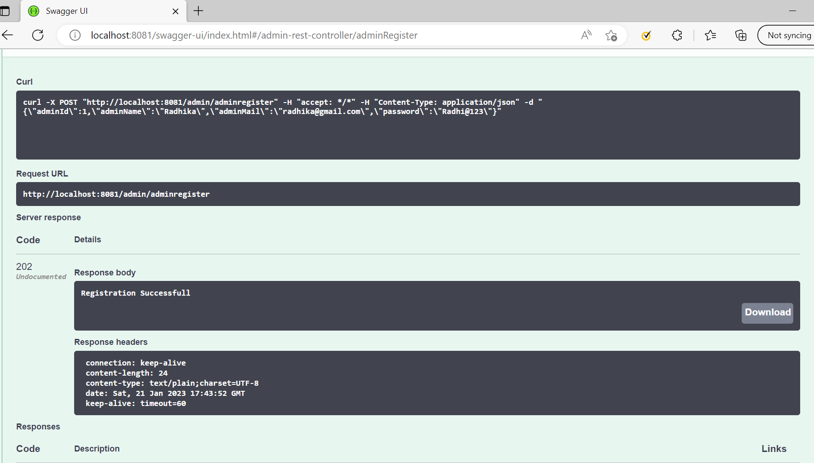
Backend Output

Slide 6
MySql
DataBase Name:
shop_db
Tables:
admin
discount
user_table
my_cart
my_wish_list
order_history
product

Slide 7
React JS
To create a react app ( npm install create-react-app->npm create-react-app react-app_name).
Installed react-router-dom , read-excel-file.
Created separate images folder in src.
Created separate components folder for admin, customer functions in src.

Slide 8
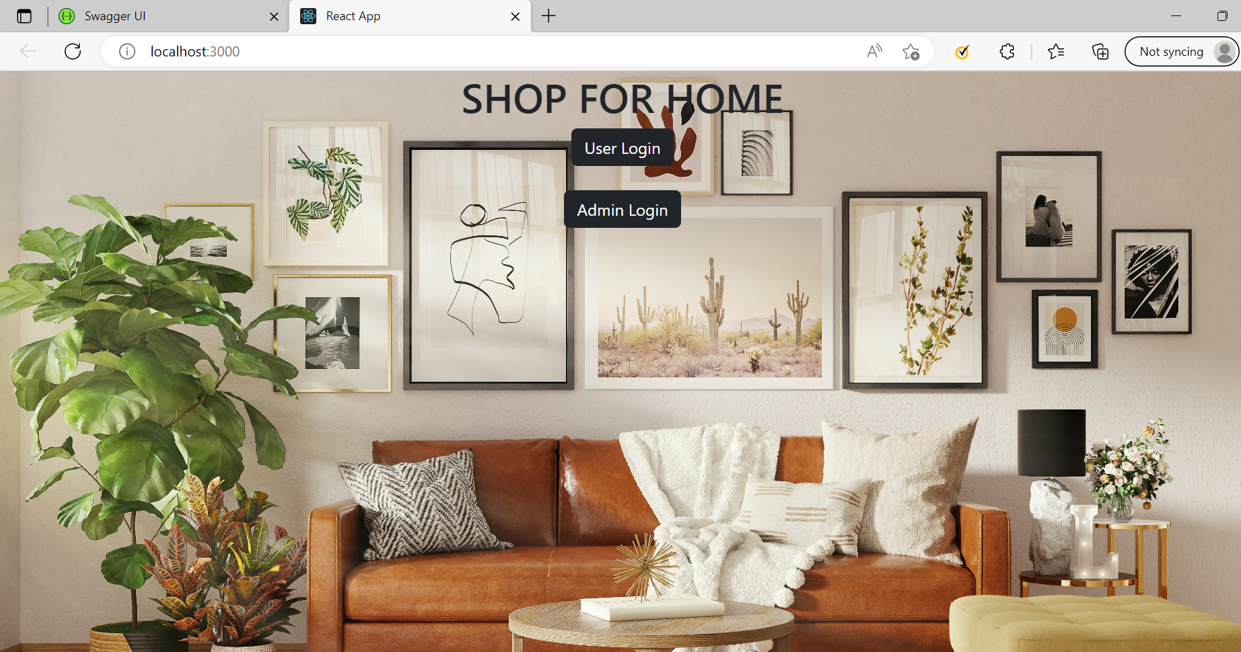
Frontend output

Slide 9


