Slide 1

BRITISH AIRWAYS
CUSTOMER BOOKING PREDICTIVE MODEL
AND RESULT
20-02-2024

Slide 2
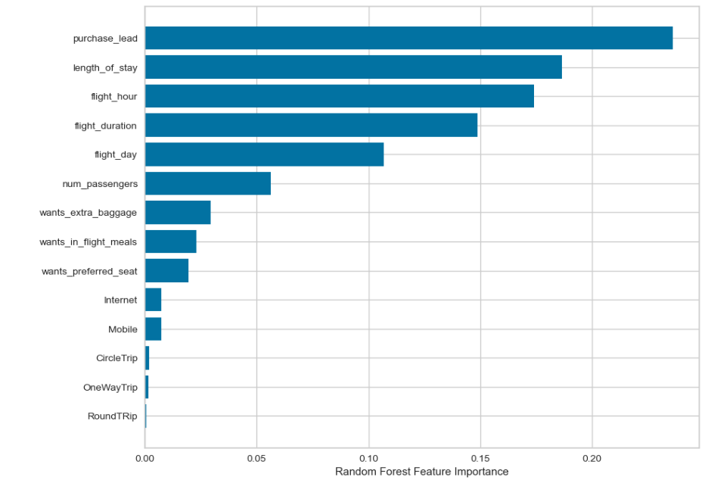
DKHH
PREDICTIVE MODELLING RESULTS
Probability of accurately predicting successful bookings: 60%
probability of correctly predicting true incomplete bookings: 66%
Recall Rate
60%
61% of successfully completed bookings are predicted accurately as completed
Precision
61%
Accuracy
60%
Accuracy of the model predicting successful or incomplete booking is 62%
Top features that drives successful flight booking

