Slide 1

BRITISH AIRWAYS
CUSTOMER REVIEWS ANALYSIS
19-02-2024

Slide 2
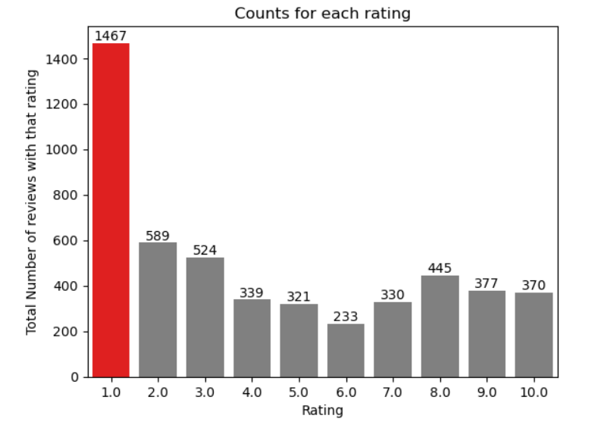
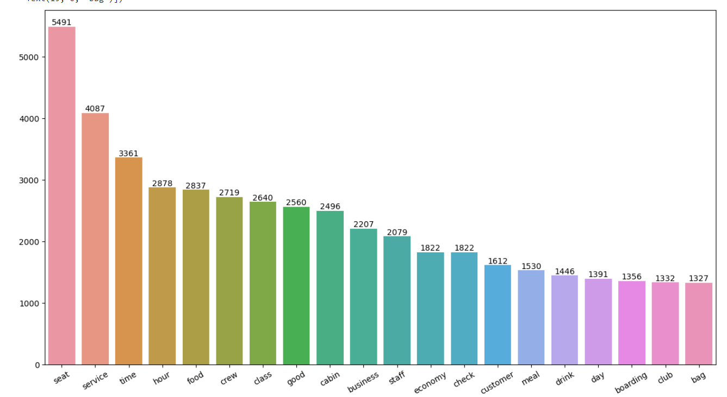
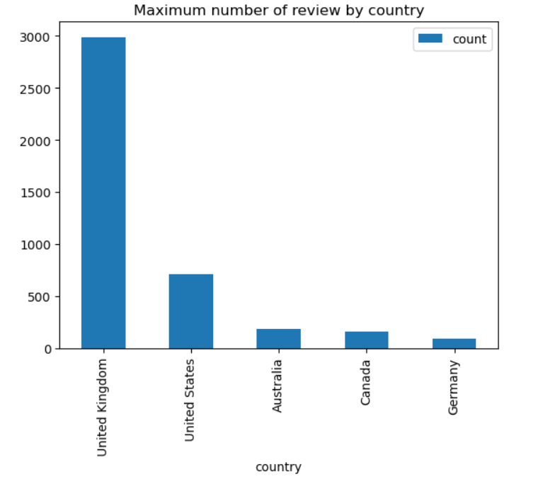
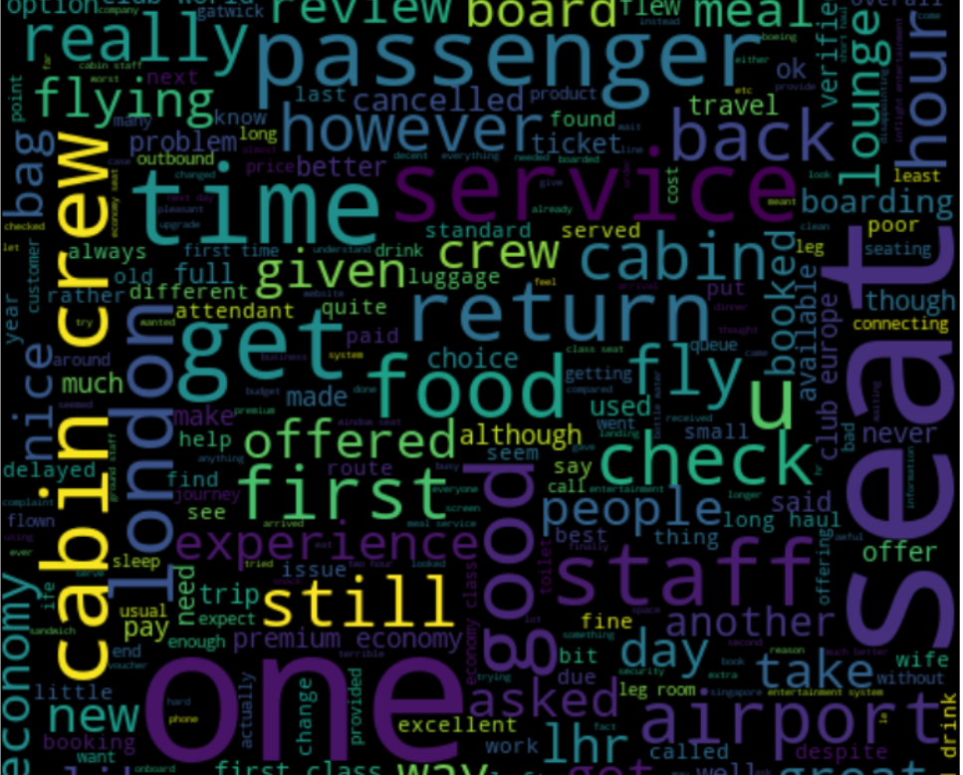
DKHH
KEY OBSERVATIONS
Average Overall
Rating
4.3/10
Reviews from
70 countries
5000 Total
reviews collected
What customers find satisfactory or dissatisfactory varies across different rating classes :
7-10 rating: wrote about good customer service, comfy seats, decent food, and companion voucher.
4-6 rating: faced problem with delay, long passport check queue, bad business class experience.
1-3 rating: wrote dissatisfaction on baggage handling, ticket cost
All customers were satisfied with the services provided by the cabin crew, staff, seating arrangements in economy, business class and suites. A significant number chose to travel in business class and premium accommodations.
Emphasize - efficient handling of luggage, seat comfort, enhancing the in-flight entertainment, and addressing delays as crucial aspects. Concerns also revolve around cost and the overall experience in relation to the price paid. Enhance customer service specifically regarding refund requests and streamline the process.

