Slide 1

Doki Doki Library Club Status Report
Lance Townsend, Carla Kolze
Carson Gustavel, Amanda Board, Patrick Du,
Owen McDaniel, Emily Smith

Slide 2
Demo

Slide 3
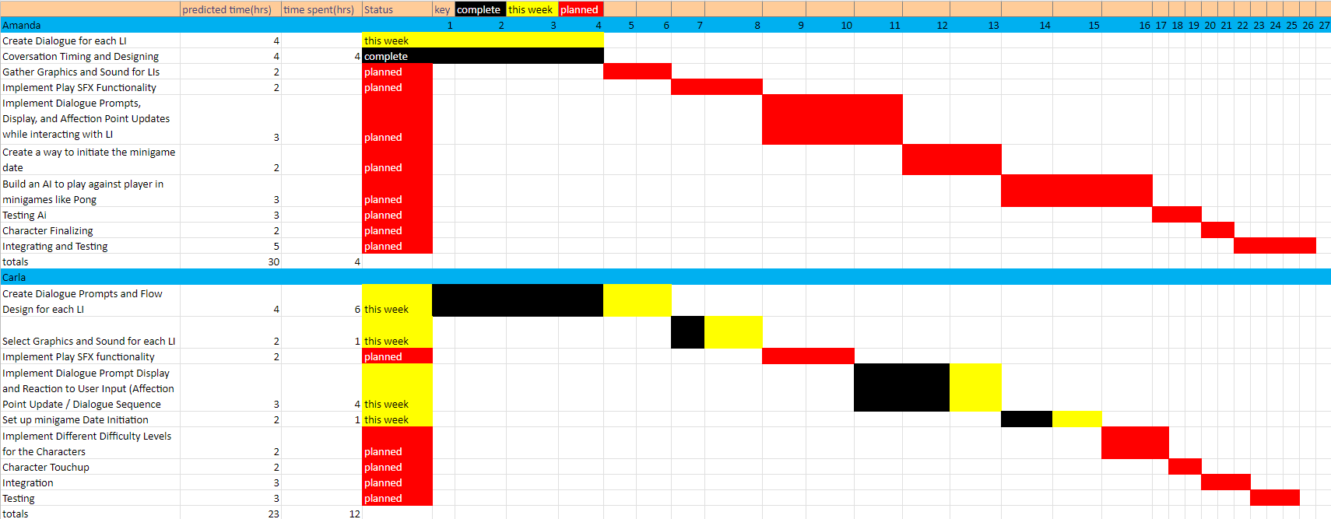
Gantt Chart

Slide 4
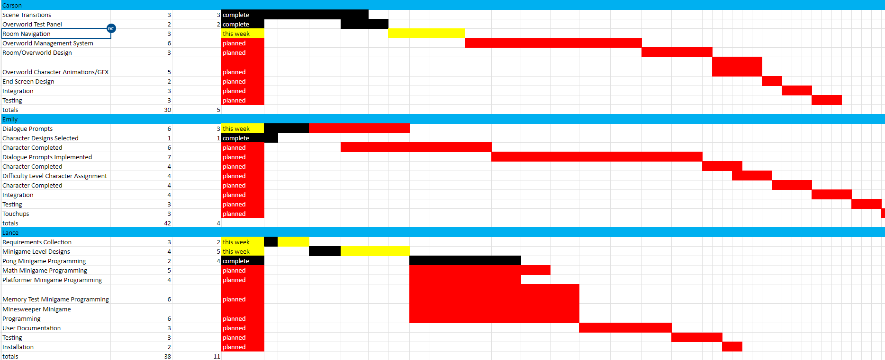
Gantt Chart

Slide 5
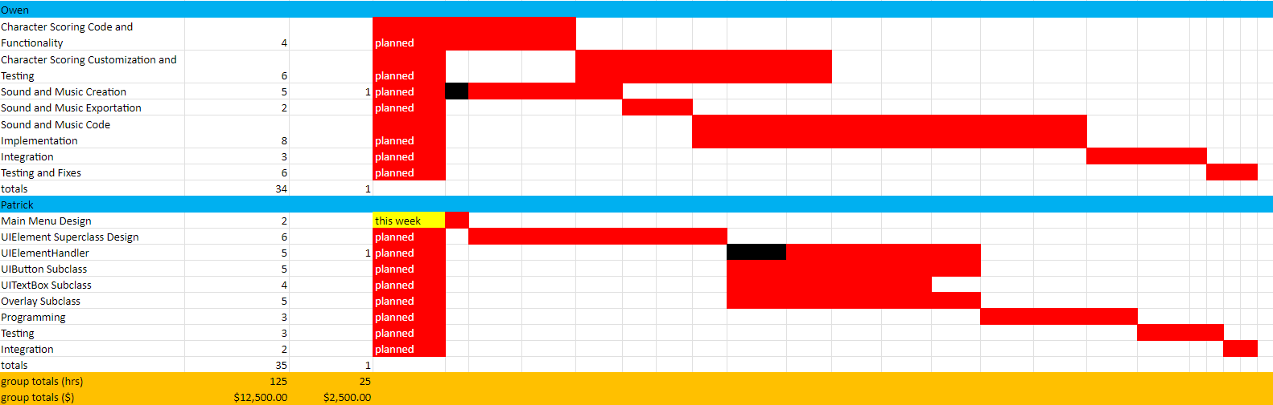
Gantt Chart

Slide 6
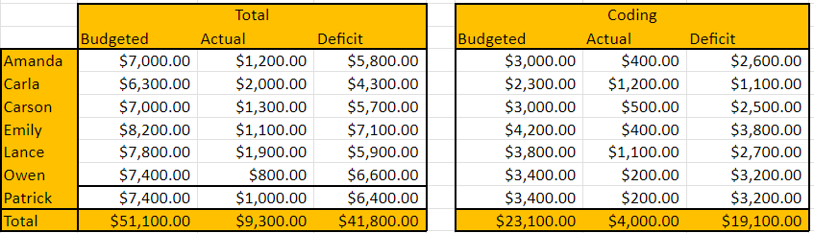
Current Schedule and Budget Analysis
Team Lead 2's had to add extra hours, but the rest of the team is on schedule
Current Cost: $9,300
Estimated Cost to Completion: $41,800
No known roadblocks

Slide 7
Gantt Chart

