Slide 1
Team Lead 3 Presentation
Ankeet, Davin, Gavin, Joe, Luke, Mikayla, Owen, Sam

Slide 2
Presentation Outline
Patterns
What is a pattern
Creational, Structural, and Behavioral Patterns
Testing Introduction
What is testing
Why is testing important
Types of testing
Unit and Stress Testing
Writing testable code (loose coupling)
Edit mode Vs. Play mode tests
Setting up testing (assemblies)
Boundary tests and creating them
Executing tests
Stress testing
Sam
2/45

Slide 3
Patterns
Bob
23/45

Slide 4
What is a pattern
•Intended to make code easier to understand and maintain, as well as reduce coupling
•Design patterns are typical solutions to commonly occurring problems in software design. They are like pre-made blueprints that you can customize to solve a recurring design problem in your code.
Mikayla
24/45
Notes:
Low coupling (good) means components are more independent, making the system easier to maintain and extend. High coupling (not-so-good) means components are tightly interwoven, making changes or maintenance more complicated.

Slide 5
Creational Patterns
25/45

Slide 6
Factory
•Factory is one of the simpler patterns.
•It provides an interface for creating objects in a superclass, but allows subclasses to alter the type of objects that will be created.
Mikayla
26/45

Slide 7
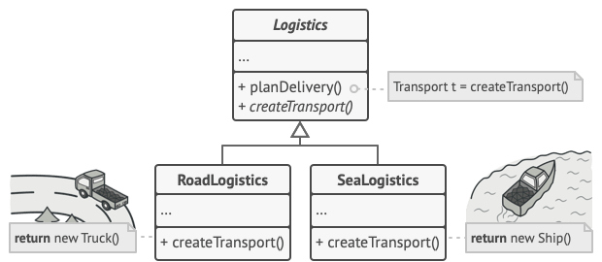
Factory Example
Mikayla
26/45
Notes:
In this example we have a logistics superclass with subclasses RoadLogistics and SeaLogistics.
The createTransport() function is a factory method that replaces a direct object construction call. So the object returned by RoadLogistics CreateTransport() method is a Truck, whereas the SeaLogistics is a Ship.

Slide 8
Abstract Factory
•Pattern that lets you produce families of related objects without specifying their concrete classes.
•Useful when we have a set of things we want to create in a factory but some of them need to be in their own distinct groups.
Mikayla
27/45

Slide 9
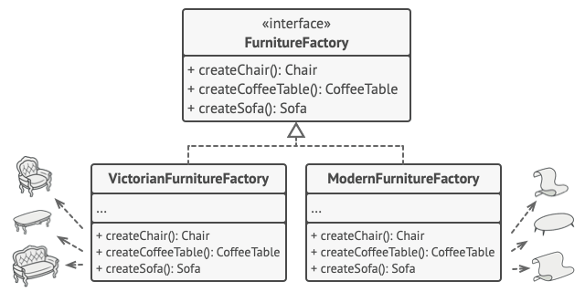
Abstract Factory
•createChair
•createSofa
•createCoffeeTable
These methods return abstract product types represented by: Chair, Sofa, CoffeeTable
Mikayla
27/45
Notes:
Imagine you have a furniture class with Chair, Sofa, and Coffee Table Objects. However, you have multiple variants of this furniture class, such as Modern, Victorian, and Art Deco.
Using an abstract factory pattern would allow you to produce a family of related objects with an abstract FurnitureFactory superclass, as is shown here.

Slide 10
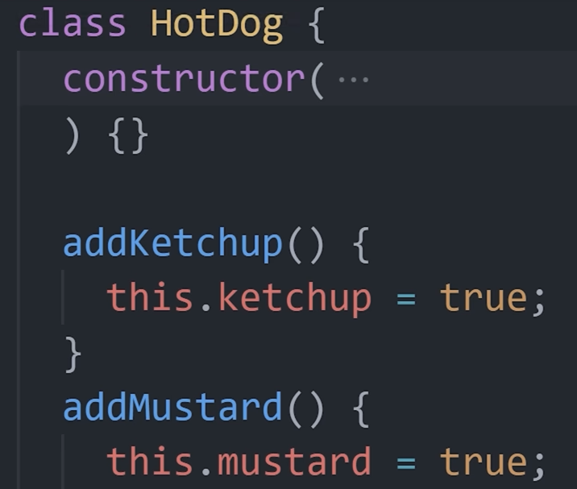
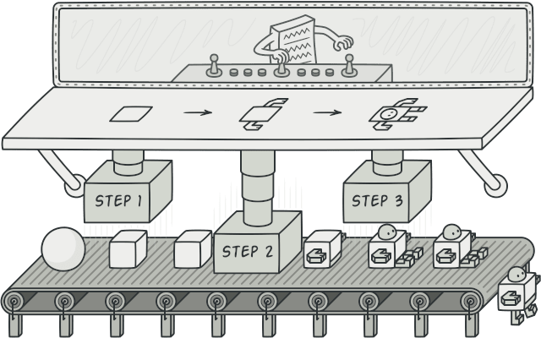
Builder
•Simplifies a process where there are multiple steps each having different possible pieces
Mikayla
28/45
Notes:
So here you can see we have this simple hotdog class. Rather than having a constructor with multiple parameters, we can simply build the object with a series of methods called builders. For example, addKetchup, addMustard, etc.

Slide 11
Resource Pool
•Instantiate a reasonable amount of resource intense objects towards the start, then loan them to different objects/processes as needed.
•Reduces work on the system so that it doesn’t have to re create the resource intense objects repeatedly.
•Example: Creating Bullets
Mikayla
29/45
Notes:
An example of this would be an ObjectPool class that handles the management of reusable objects such as bullets by improving performance since there would be reduced overhead due to less often creation and destruction of those objects.

Slide 12
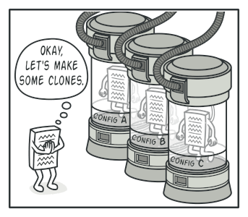
Prototype
•The Prototype design pattern is all about cloning. Imagine you have an object, and instead of creating new instances of this object from scratch every time, you want to create copies of the existing one.
•Unity’s prefab feature handles this for us
Mikayla
30/45

Slide 13
Structural Patterns
Bob
31/45

Slide 14
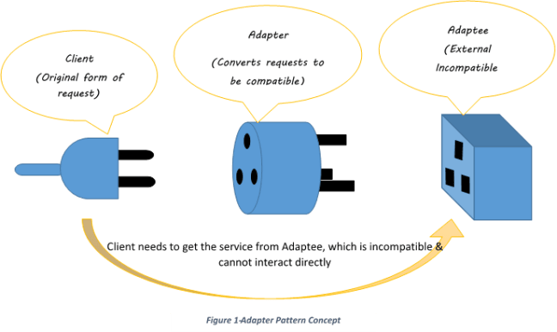
Adapter
•Take a class that’s incompatible with another class or function and encase it in an adapter to make it work as if it were.
Mikayla
32/45

Slide 15
Composite
•Composites apply to tree like structures
•They describes a group of objects that are treated the same way as a single instance of the same type of object.
Mikayla
33/45

Slide 16
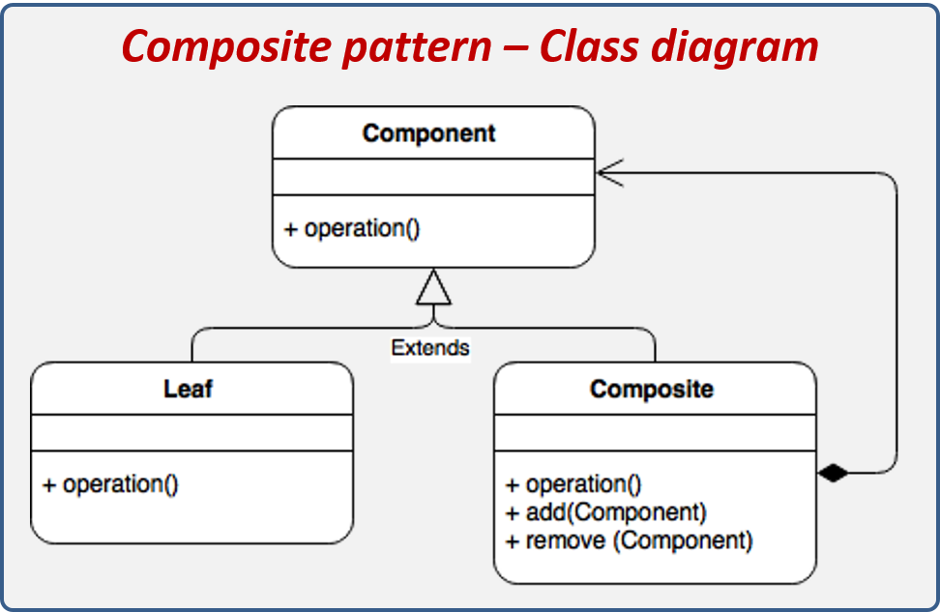
Mikayla
33/45
Notes:
Composite Patterns are made up of three things
Components
Leaves
And Composites

Slide 17
Composite Example
•Component: An abstract class/interface IEnemy with a method Attack().
•Leaf: A class SimpleEnemy implementing IEnemy.
•Composite: A class EnemyGroup that can hold and manage multiple IEnemy objects.
Mikayla
33/45
Notes:
An example of a Composite Pattern would be an Enemy class with an Attack method
A leaf of this class would be a SimpleEnemy
And a Composite would be an EnemyGroup class that holds multiple Enemy objects. Both SimpleEnemy and EnemyGroup class have an Attack method, but EnemyGroup contains an add and remove method so that it works like a SimpleEnemy attack method would.

Slide 18
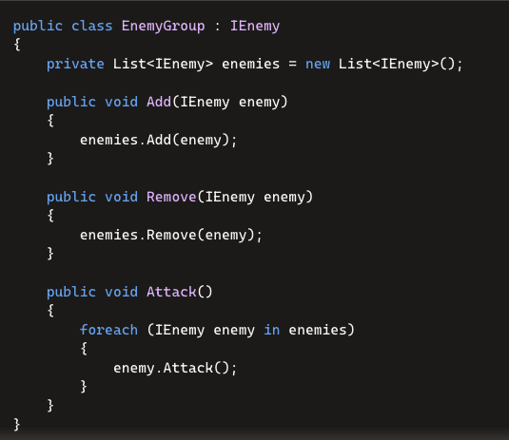

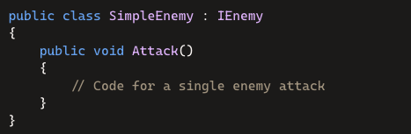
Mikayla
33/45
Notes:
Composite Patterns are made up of three things
Components
Leaves
And Composites

Slide 19
Facade
•The façade takes a complicated system and provides a simple interface for the user
•Example: Shop
Mikayla
34/45
Notes:
For a shop in Unity, it's essential to harmonize a wide array of objects from a complex library. The Shop class could serve as a Facade, orchestrating interactions among subsystems like Inventory, Pricing, and ShopUI. This design ensures that the player can purchase items without directly engaging with each subsystem. The Shop class simplifies the process, managing item storage, pricing details, and the user interface collectively.

Slide 20
Proxy
•Hide the real object behind a proxy object that either communicates with the real object or will allow the real object out once a condition is met.
Applicability: Lazy initialization. If you have a heavyweight service object that wastes system resources by being always up, even though you only need it from time to time.
•Example: NPC class with NPCProxy class that grants access to NPC class
Mikayla
35/45

Slide 21
Behavioral Patterns
Bob
36/45

Slide 22
Command
•Separate the command from the issuer and the receiver
•Allows us to manipulate the command freely as an object
•Example: Waiter taking orders in a restaurant
Luke
37/45

Slide 23
Iterator
•Allows a client to access what they need from a data structure without understanding the data structure.
•Example: Person with a messy house
Luke
38/45

Slide 24
Mediator
•Decouples interactions between two entities and allows easier many to many communication
•Example: Combat Manager
Luke
39/45

Slide 25
Memento
•A memento is an object which stores the state of an object when it is created and will return the object to that state when returned.
•The memento cannot do anything else, so it must have another object with it in order for it to return to the originator.
•Example: Save System
•Example: Restore State Item
Luke
40/45

Slide 26
State
•Used to facilitate a state machine style object which switches between distinct classes
•Must have a separate object which notifies the current state to change, and the current state must encapsulate different classes depending on its state
•Example: Vending machine behavior depends on it's current state
Luke
41/45

Slide 27
Template Method
•Create a general framework for several different classes with minor variances
•Differences in behavior between different subclasses can be accounted for by overriding certain functions
•Example: Firefighter and Post Worker daily routine
Luke
42/45

Slide 28
Strategy
General Approach applicable to an interface which can be adjusted to fit a specific implementation
Ex: Transportation methods
Luke
43/45

Slide 29
Null Object
•This is an object which does nothing
•Intended to be used when some object is required but no action is wanted
•Example: Customer support for registered vs unregistered users
Luke
44/45

Slide 30
Other Patterns
•Private Data Class
•Flyweight
•Bridge
•Chain of Responsibility
•Interpreter
•Visitor
Luke
45/45

Slide 31
Patterns
23/45

Slide 32
Individual Requirements
Initial Test Plan
Fully Automated:
Unit tests of at least two different boundary tests for a single script
Can be automated or manual:
A single stress test that breaks unity and records the breaking point as well as logs it in the console
The stress test visually shows the stress on Unity
The failure under stress can be implied (logs success until failure)
Sam
3/45

Slide 33
What is Testing?
Testing is intended to show that a program does what it is meant to and to catch defects before release.
Testing is executing a program with artificial data
A part of a software validation and verification process
Testing can reveal the presence of errors but not their absence.
Results can be checked for information on errors, and non-functional aspects of the program
Sam
4/45

Slide 34
Why is testing Important?
Allows us to find situations in which software operates incorrectly
Enables us to validate that the software meets its requirements
Validation
Shows that the system is operating as intended from design and implementation
Operates correctly under a set of test conditions
Sam
5/45

Slide 35

Types of Testing
There are several different types of software testing:
System testing
Use-case testing
Release testing
User testing
Alpha
Beta
Acceptance
Requirement based testing
Performance testing
Stress testing
Sam
6/45

Slide 36
System Testing
System testing is the testing of a fully integrated and complete piece of software.
Use-case testing is a basis for system testing.
Use cases are used to identify the interactions of the system
These interactions between system components are then tested
Sam
7/45

Slide 37
Release Testing
Release testing is a form of system testing.
There are some key differences between the two:
A separate team not involved in development is responsible for release testing
System testing should be focused on discovering bugs
Release testing should check whether a system meets its requirements and is ready for validation testing
Sam
8/45

Slide 38
User Testing
User testing is a type of testing in which the customers/users provide input on system testing.
It is essential to conduct even after release and system testing because the user’s environment can’t be reproduced in a testing environment.
Alpha
Users work with the dev team to test the software at the developer’s site
Beta
A release of the software is made available to users to allow them to experiment and find problems with the system
Acceptance
Customers test a system to decide whether or not it is ready to be accepted from the developers
Sam
9/45

Slide 39
Requirement Based Testing
Involves examining each requirement of a system and designing a specific test (or tests) for specific needs.
Sam
10/45

Slide 40
Performance Testing
Performance tests typically involve tests that incrementally increases the load on a system until the performance of that system reaches an unacceptable point
Stress Testing
Stress testing is a form of performance testing where the system is purposefully overloaded to see how it would react in a failure scenario
Seeks to test and analyze the failure behavior of the system
Sam
11/45

Slide 41
Create Loosely Coupled Code
Code is easier to understand
Makes program more modular
Program is easier to change, update, and expand
More testable code
Davin
12/45

Slide 42
One Function, One Function
One function should have only one function
Functions should be non-deterministic
Single Responsibility Principle
A function should either produce or process information, not both.
If a function needs extra data, have it passed as a parameter
Inversion of Control
Separate decision making code and action code
Davin
13/45

Slide 43
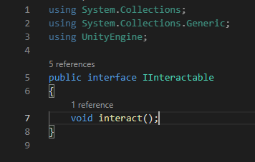
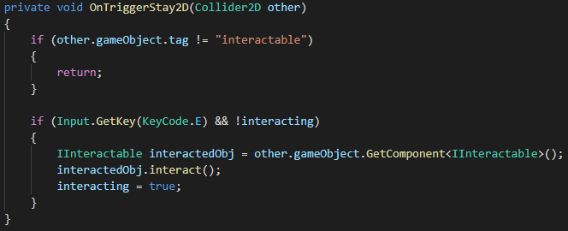
Interfaces
Very helpful in keeping code loosely coupled
Davin
14/45

Slide 44
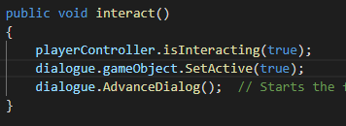
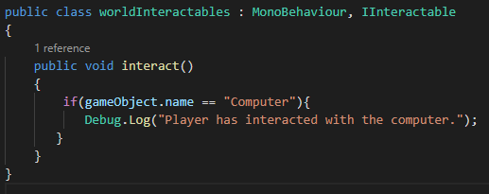
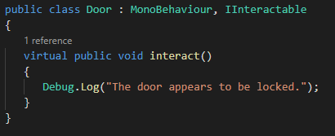
Interfaces
A single function call can have many implementations
A contract
Davin
15/45

Slide 45
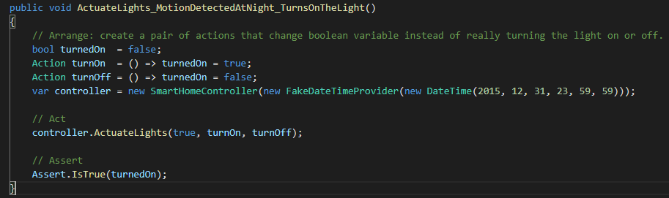
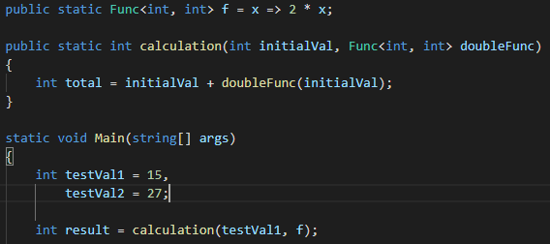
Higher Order Functions
Functions as arguments or return values of other functions
Returns functions as result
Davin
16/22

Slide 46
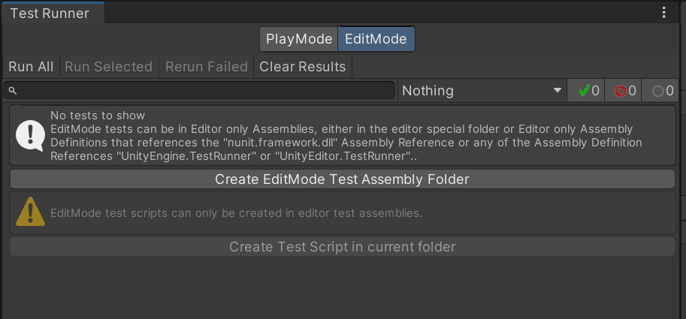
Edit Mode Vs. Play Mode tests
Edit mode:
Tests code that doesn’t require a running scene to test
More useful for calculation
Much faster to run
Play mode:
Tests code that needs to be executed in a running scene
Tests are ran as coroutines
More useful for testing things like movement
Owen
17/45

Slide 47
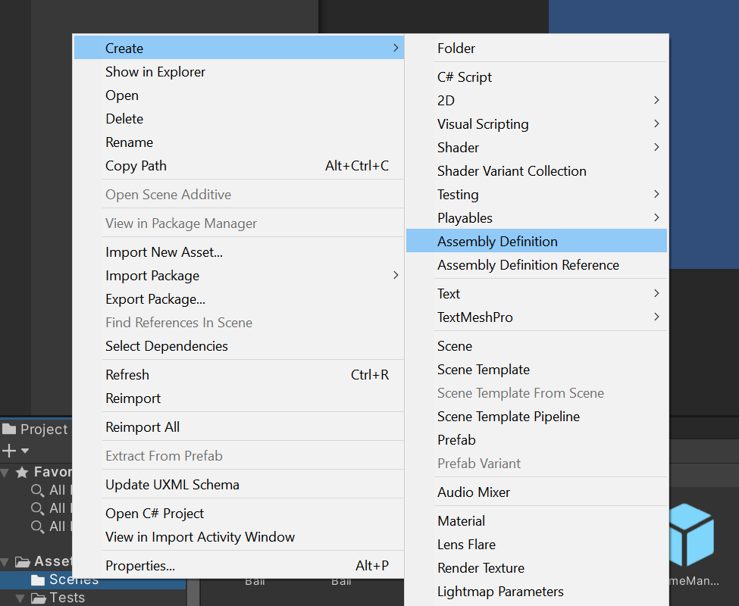
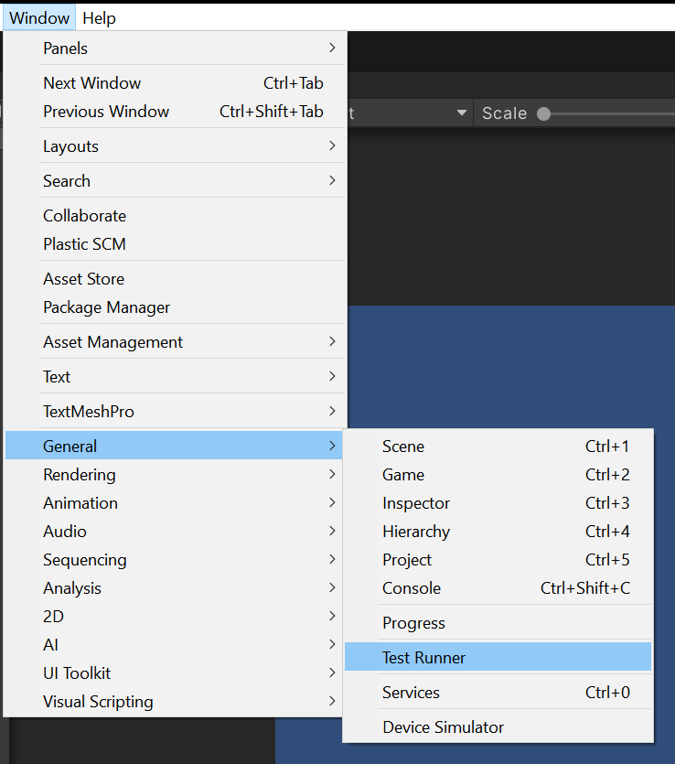
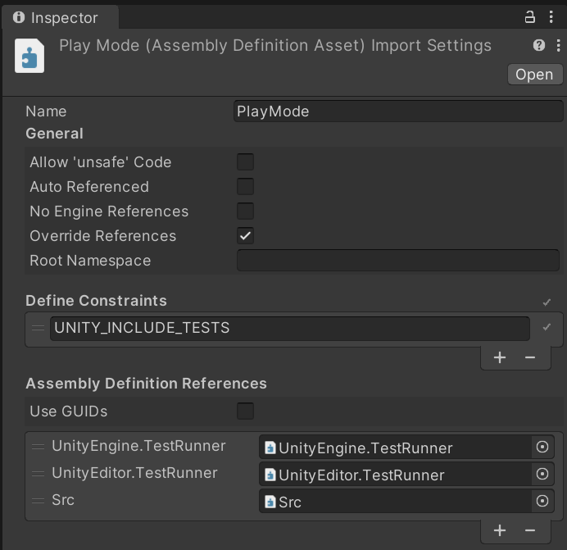
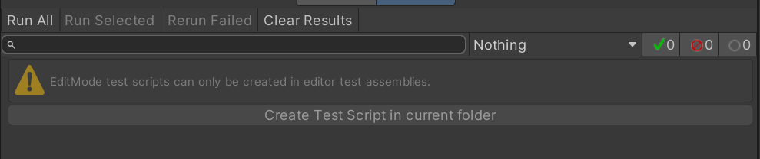
Setting up Testing (Refer to the how to document)
Owen
18/45

Slide 48
Boundary Tests
What are boundary tests?
A boundary test is any sort of test that checks whether a value is within some specified range
These tests can check for if a value is within, on, or outside of a boundary
Ex: Test whether a gainHealth function brings the health of the player to over 100
Owen
19/45

Slide 49
Creating Unit Boundary Tests
3 main areas of a unit test
Arrange
Act
Assert
A boundary test is a specific type of unit test
Tests to verify that edge cases are properly handled
Verify that unexpected behaviour doesn’t occur if given unexpected values
Tests just inside the boundary
Tests on the boundary
Tests just outside the boundary
Owen
20/45

Slide 50
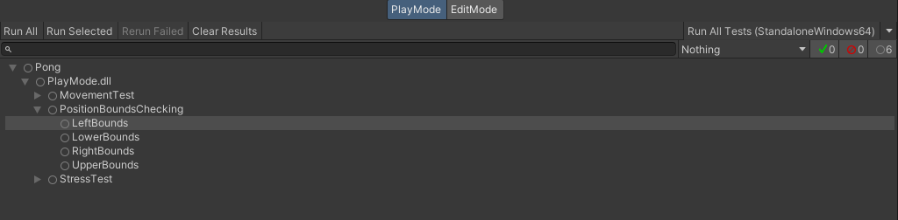
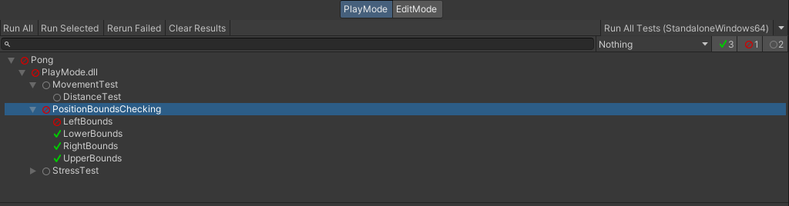
Executing tests
Owen
21/45

Slide 51
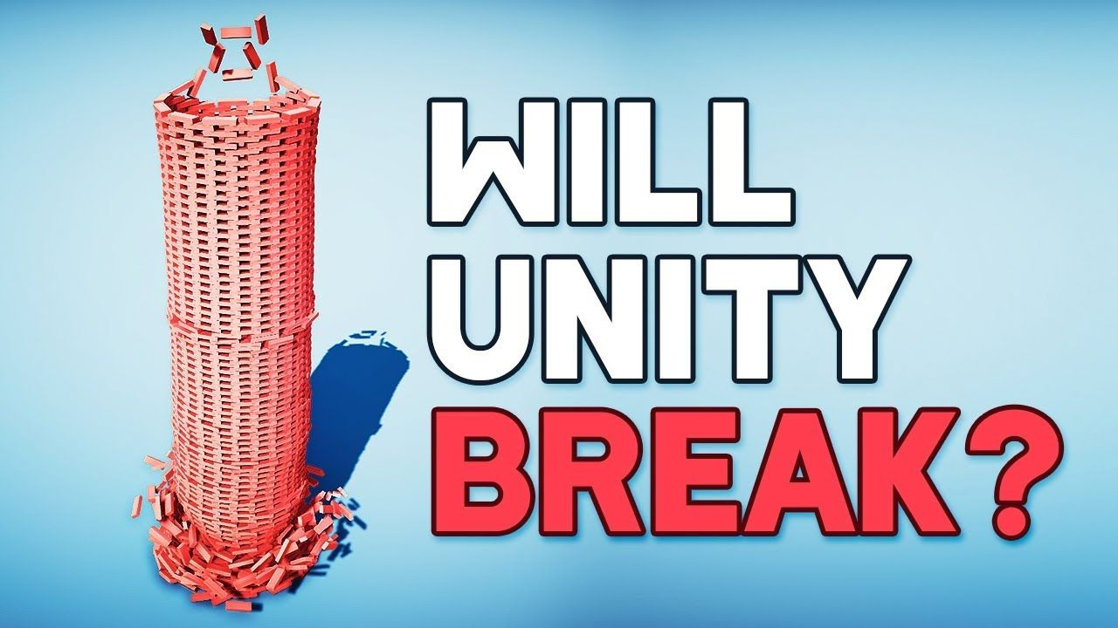
Stress Tests
What is a stress test?
A stress test is a test that applies stress to the system in an incremental manner until something breaks
The breaking point is recorded and is the measured limit of the software
Examples of failure under stress tests:
Failure to detect physical collision
Significant drop in frame rate
Doesn’t have to be automated
Will be different depending on the system
Owen
22/45

Slide 52
Godot Testing
Godot does not come with a built-in testing framework by default.
We need to download and integrate GUT (Godot Unit Testing), which is a popular third-party plugin for unit testing in Godot projects.
GUT provides comprehensive tools for creating and running tests in GDScript.
It supports TDD (Test Driven Development), allowing you to write tests for GDScript code before implementing functionality.
Supports various test types: unit tests, integration tests, and UI tests, helping ensure game functionality and stability.
Let's see how we can install and run tests
Ankit

Slide 53
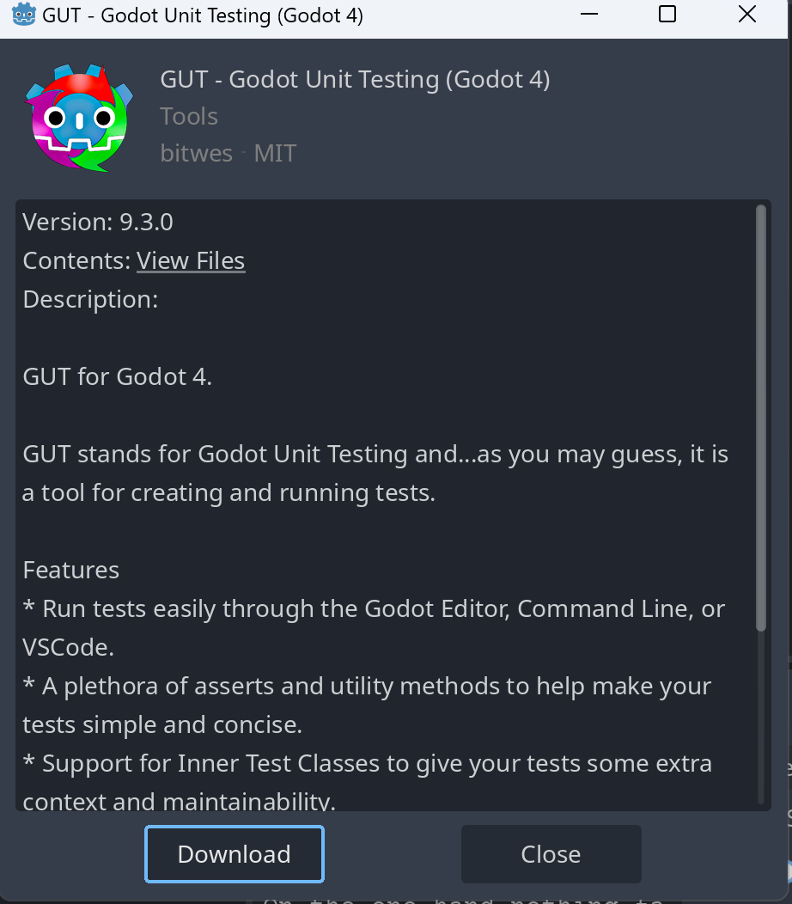
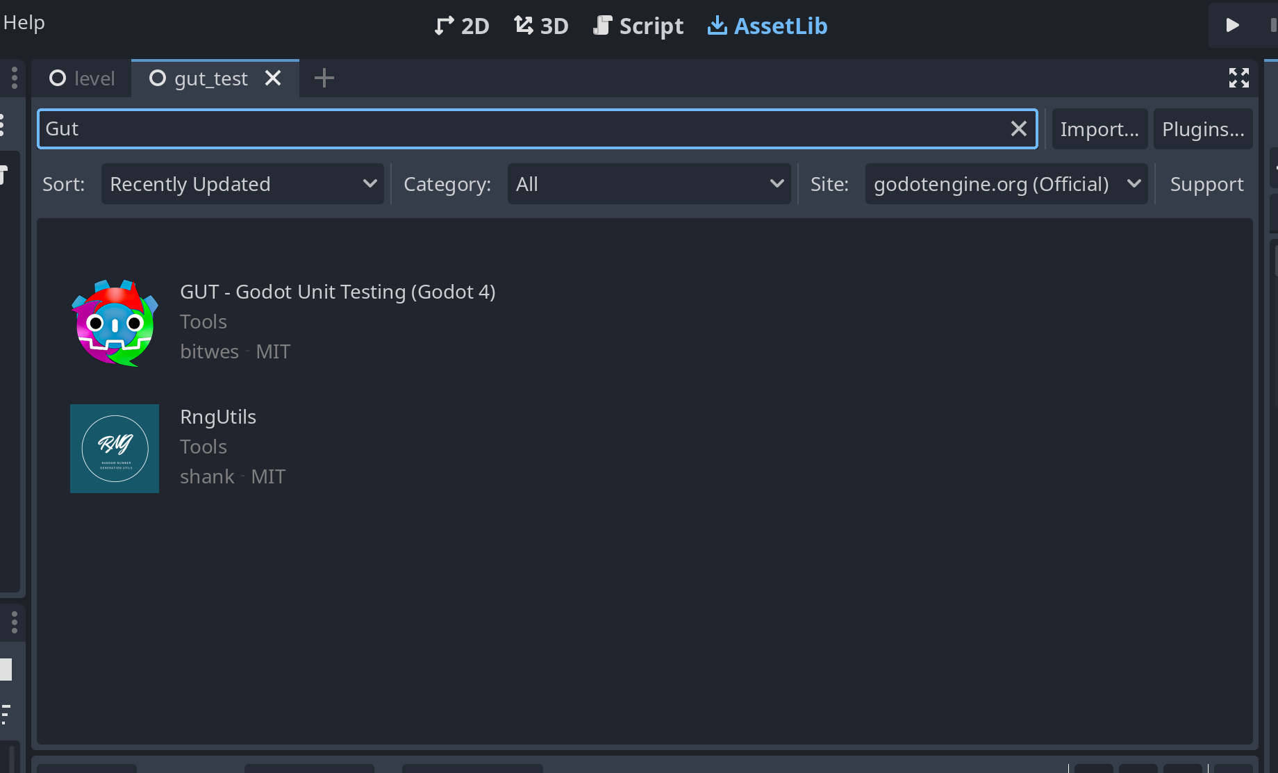
Install Gut
Open the Godot project and click on the "AssetLib" tab. Search for "GUT" to easily find the Godot Unit Testing framework.
Ankit

Slide 54
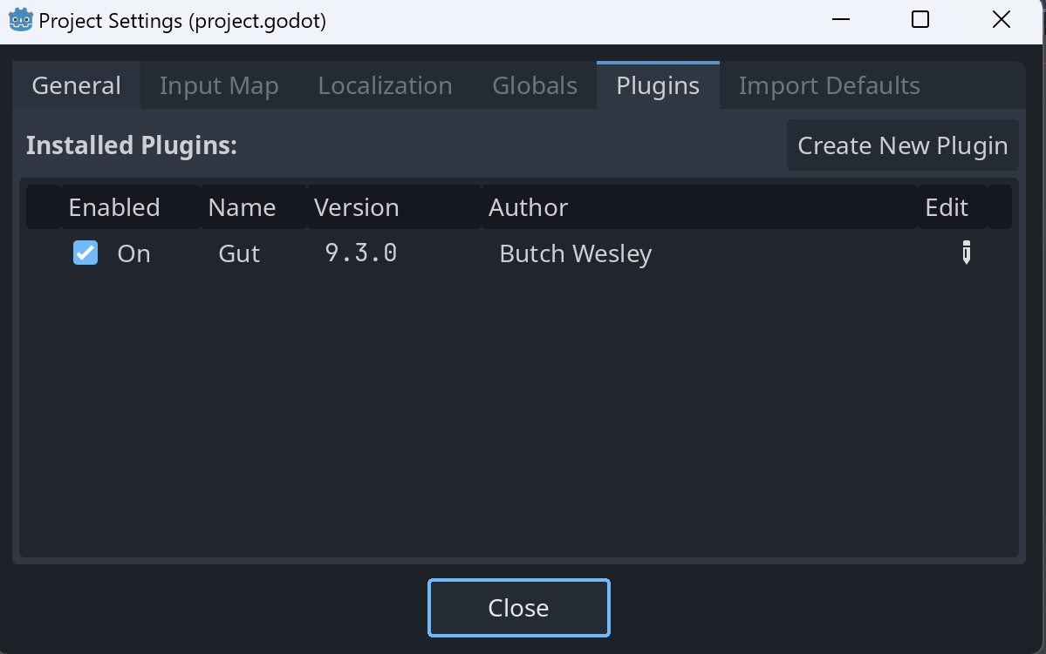
Activation of the GUT
Go to "Project Settings" and navigate to the "Plugins" tab.
The GUT appears alongside the Output, Debugger, and Animation tabs at the bottom of the Godot engine interface.
Ankit

Slide 55
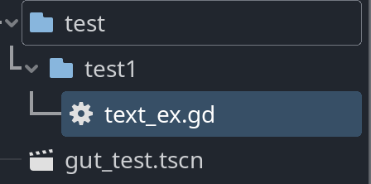
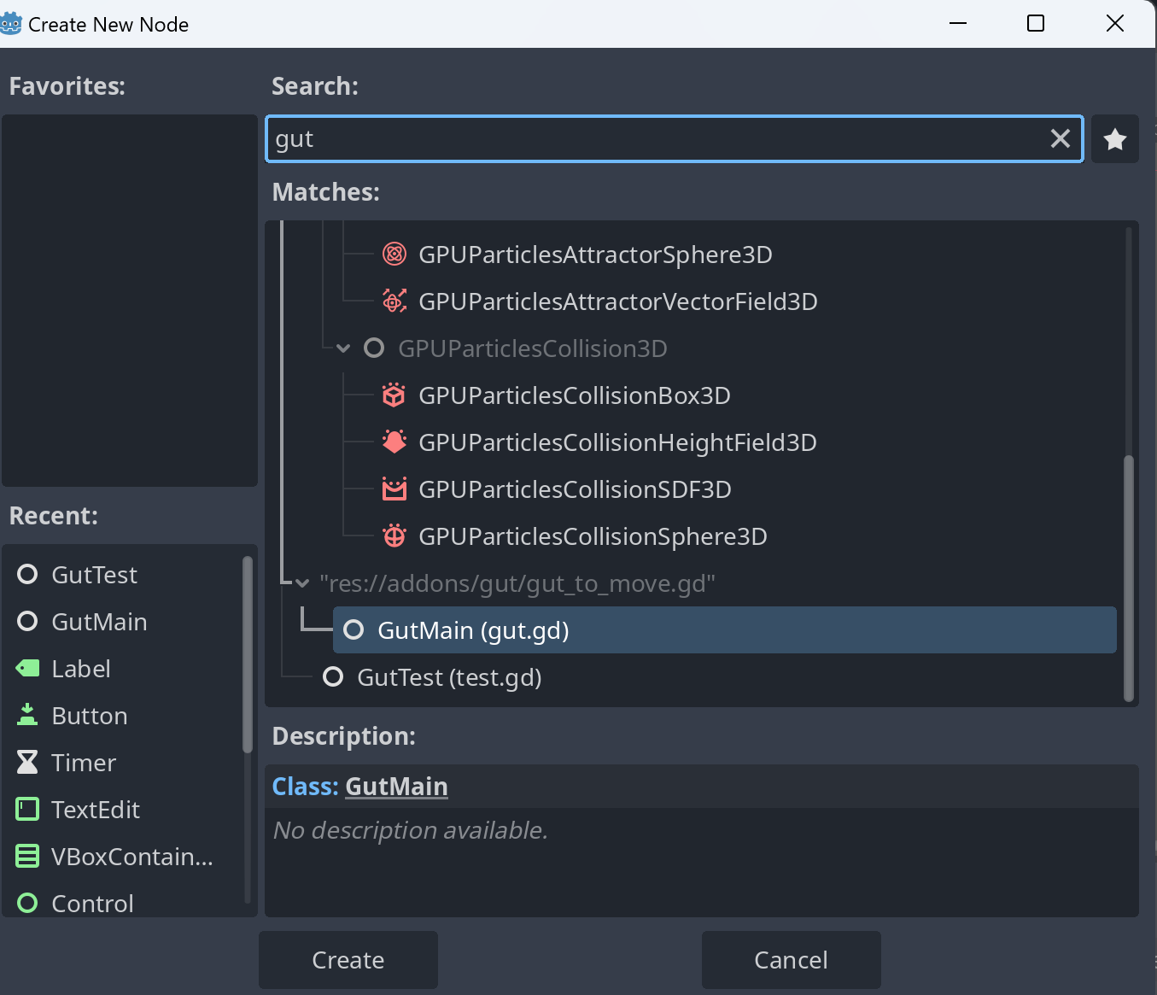
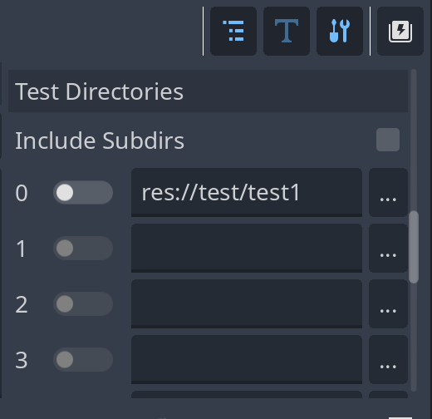
Running the Test
Create a tests/ folder: Right-click in the FileSystem dock, select "New Folder", and name it tests.
Add a Node: Create a new scene, add a Node, and rename it to TestRunner.
We need to guide our runner through the test Directories. We must ensure they know which directories contain the tests
Ankit

Slide 56
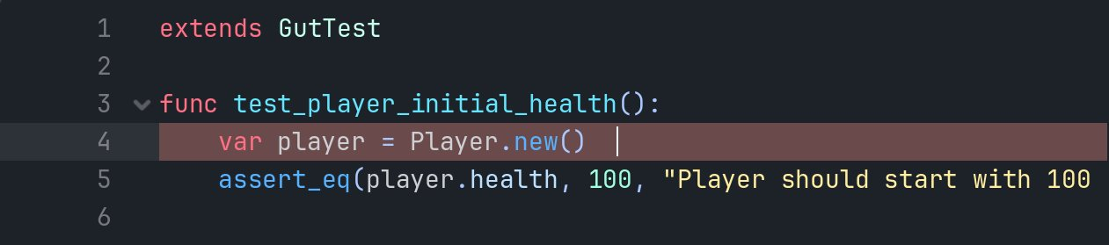
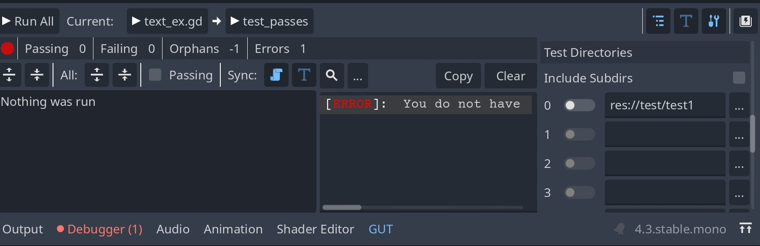
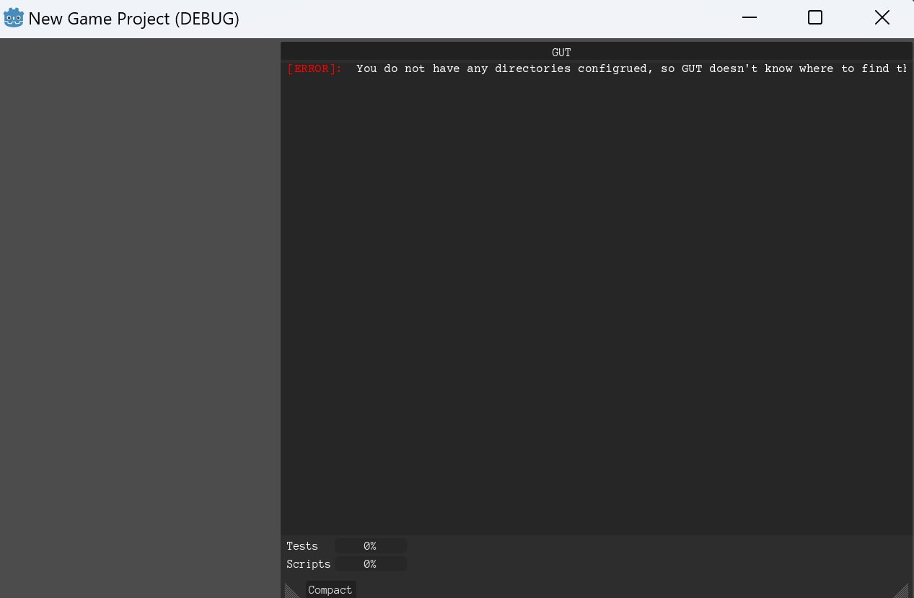
Running the Test
Create test scripts: Inside the tests folder, choose "New Script", save it with a relevant name like test_player.gd, and ensure it inherits from GutTest.
Attach a script: Attach a new script to TestRunner to execute tests
This setup initializes GUT, directs it to the tests folder, and runs all the tests within that directory, displaying results in the Godot output console.
Ankit

Slide 57
Unity/Godot Testing Demo
23/45

