Slide 1
Overview of Concepts, Data, Methods, & Measurements
Measures calculated over the past year (2021-2022) & dependent on testing data availability.
Concepts
Data
Methods
Metrics
Test positivity rate (TPR) = total # of COVID-19 cases/total # of COVID-19 tests
Average daily testing per 1000 persons = mean (# of COVID-19 tests per day)
Sufficient Diagnostic Capacity:
Countries reporting < 15% TPR, or >1 average daily testing per 1000 persons
FIND & OWID COVID-19 case data
Diagnostic Testing Capacity
WHO NGS capacity & base-install
data
Categorical data:
0 facilities or install bases identified
1-3 facilities & equivalent manufacturer bases
4+ facilities & equivalent manufacturer bases
Sufficient Sequencing Facility Access:
Countries reporting 1 or more facility & manufacturer bases
Sequencing Facility Access
Percent (%) of cases sequenced = # of SARS-CoV-2 cases sequenced/# of COVID-19 cases
Cumulative number of sequencing
per 100,000 persons = # of SARS-CoV-2 sequences
Sufficient SARS-CoV-2 Sequencing:
Countries reporting > 0.5% of cases sequenced or >30 sequences per 100K persons
OWID case data & GISAID
sequencing
data
SARS-CoV-2 Sequencing
Notes:
Measures – title of maps
Data
Metrics
Thresholds – insufficient/sufficient

Slide 2
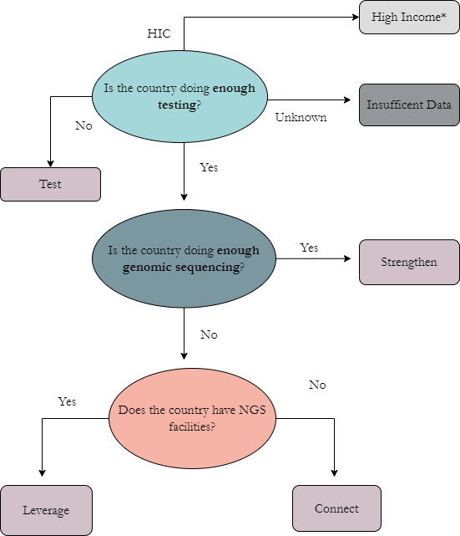
Overview of Hierarchical Conceptual Framework

