Slide 1

Overview of Methodologies Reiterations

Slide 2
Overview of Dimensions, Data, & Metrics
Metrics are calculated over the past year and data are updated monthly
Dimensions
Data
Metrics
Our World in Data¹ COVID-19 data & GISAID²
sequencing
data
Percent (%) of cases sequenced
Number of sequences
per capita
NGS SARS-CoV-2 Sequencing
WHO NGS capacity
& proprietary manufacturer
device data
Number of facilities
NGS Facility Access
Test positivity rate (TPR)
Average daily testing per capita
COVID-19 Diagnostic
Testing
FIND Test Tracker³
& Our World in Data COVID-19 data
Notes:
Measures – title of maps
Data
Metrics
Thresholds – insufficient/sufficient

Slide 3
Overview of Dimensions, Metric Calculations, & Targets
Metrics are calculated over the past year and data are updated monthly
Dimensions
Metric Calculations
Targets
Countries reporting ≥ 0.5% of cases sequenced &
≥ 10 sequences per 100K persons
Percent (%) of cases sequenced = # of SARS-CoV-2 cases sequenced/# of COVID-19 cases
Number of sequences
per 100,000 persons = # of SARS-CoV-2 sequences
NGS SARS-CoV-2 Sequencing
Number of facilities data:
0 facilities or installed devices identified
1-3 facilities & equivalent device access
4+ facilities & equivalent device access
Countries reporting 1 or more facility & manufacturer bases
NGS Facility Access
Countries reporting <20% TPR, & ≥ 0.5 average daily testing per 1000 persons
Test positivity rate (TPR) = total # of COVID-19 cases/total # of COVID-19 tests
Average daily testing per 1000 persons = mean (# of COVID-19 tests per day)
COVID-19 Diagnostic
Testing
Notes:
Measures – title of maps
Data
Metrics
Thresholds – insufficient/sufficient

Slide 4
Overview of Dimensions, Metric Calculations, & Targets
Metrics are calculated over the past year and data are updated monthly
Dimensions
Metric Calculations
Targets
Countries reporting ≥ 0.5% of cases sequenced &
≥ 10 sequences per 100K persons
Percent (%) of cases sequenced = # of SARS-CoV-2 cases sequenced/# of COVID-19 cases
Number of sequences
per 100,000 persons = # of SARS-CoV-2 sequences
NGS SARS-CoV-2 Sequencing
Number of facilities data:
0 facilities or installed devices identified
1-3 facilities & equivalent device access
4+ facilities & equivalent device access
Countries reporting 1 or more facility & manufacturer bases
NGS Facility Access
Countries reporting <20% TPR, & ≥ 0.5 average daily testing per 1000 persons
Test positivity rate (TPR) = total # of COVID-19 cases/total # of COVID-19 tests
Average daily testing per 1000 persons = mean (# of COVID-19 tests per day)
COVID-19 Diagnostic
Testing
Notes:
Measures – title of maps
Data
Metrics
Thresholds – insufficient/sufficient

Slide 5
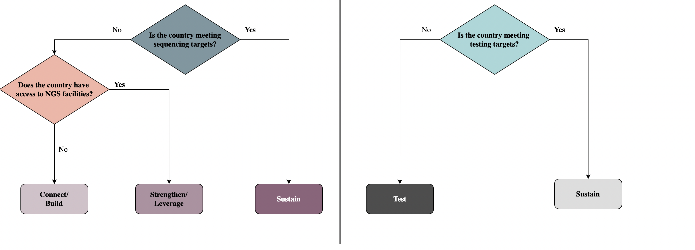
NGS & Testing Archetype Classification Framework
Drawio.edit

Slide 6
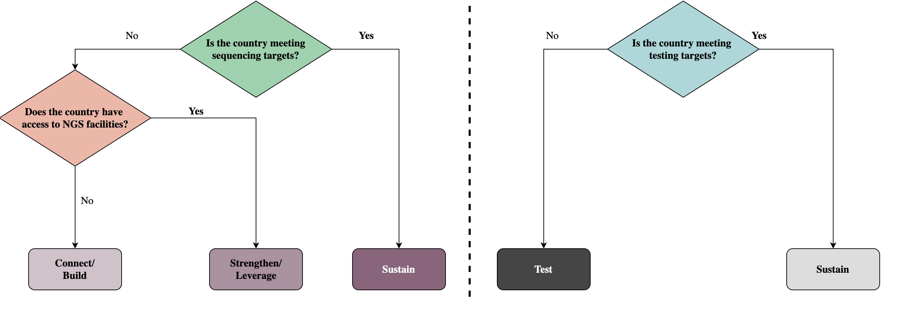
NGS & Testing Archetype Classification Framework
Drawio.edit

Slide 7
NGS & Testing Archetype Classification Framework
Drawio.edit

Slide 8
NGS & Testing Archetype Classification Framework
Drawio.edit

Slide 9
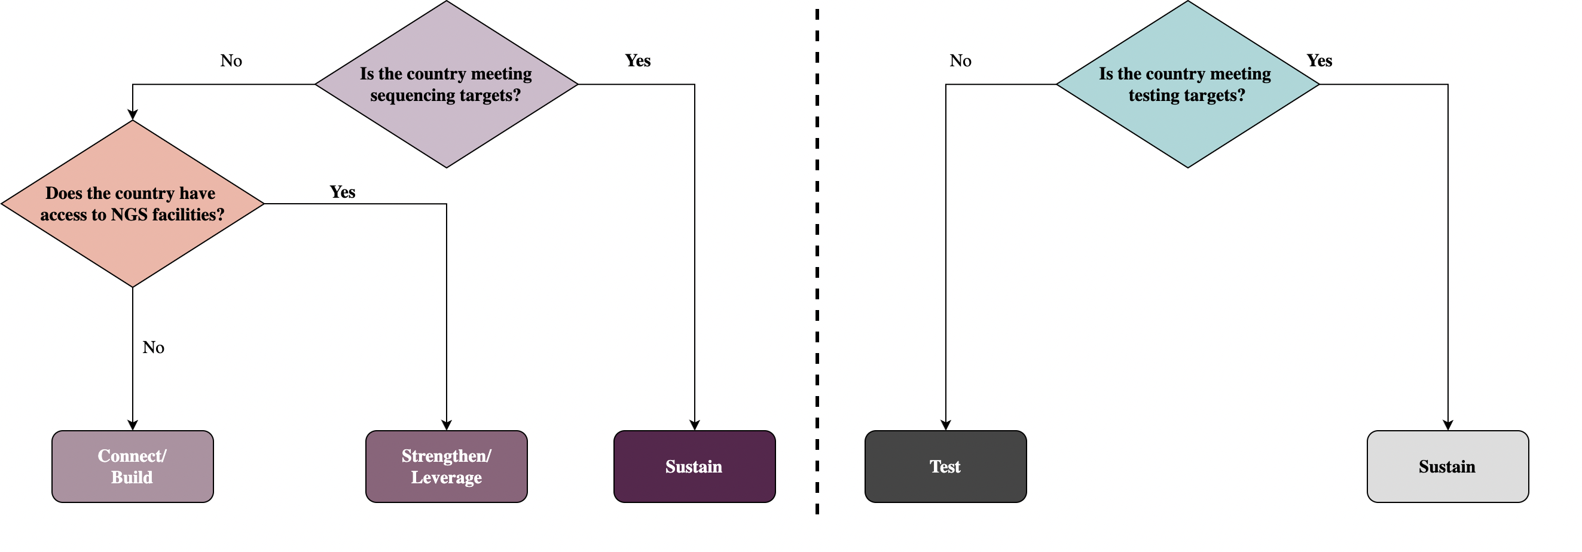

Slide 10
Overview of Archetypes, Descriptions, & Recommendations
Country archetypes updated on a monthly basis
Concept | Archetype | Description | Recommendations
NGS SARS-CoV-2 Sequencing and Facility Access Capacity | Sustain | Country has met SARS-CoV-2 sequencing & reporting targets. | Sustain and expand SARS-CoV-2 genomic sequencing & reporting capacity.
 | Strengthen/Leverage | Country has demonstrated access to NGS facilities². | Perform situational analysis to identify potential ways to strengthen, leverage, or repurpose existing NGS facility access for genomic surveillance.
 | Connect/Build | Country has not demonstrated access to NGS facilities. | Set-up sample referral networks to connect & utilize regional NGS capacity or build NGS capacity from scratch.
Diagnostic Testing Capacity | Sustain | Country has met COVID-19 diagnostic testing & reporting targets³. | Sustain and expand COVID-19 diagnostic testing & reporting capacity.
 | Test | Country has not met COVID-19 diagnostic testing & reporting targets. | Develop sufficient diagnostic testing capacity.

Slide 11
Overview of Archetypes, Descriptions, & Recommendations
Country archetypes updated on a monthly basis
Dimensions | Archetype | Description | Recommendations
NGS SARS-CoV-2 Sequencing and Facility Access Capacity | Sustain | Country has met SARS-CoV-2 sequencing & reporting targets¹. | Sustain and expand SARS-CoV-2 genomic sequencing & reporting capacity.
 | Strengthen/Leverage | Country has demonstrated access to NGS facilities². | Perform situational analysis to identify potential ways to strengthen, leverage, or repurpose existing NGS facility access for genomic surveillance.
 | Connect/Build | Country has not demonstrated access to NGS facilities. | Set up sample referral networks to connect & utilize regional NGS capacity or build NGS capacity from scratch.
Diagnostic Testing Capacity | Sustain | Country has met COVID-19 diagnostic testing & reporting targets³. | Sustain and expand COVID-19 diagnostic testing & reporting capacity.
 | Test | Country has not met COVID-19 diagnostic testing & reporting targets. | Develop sufficient diagnostic testing capacity.

