Slide 1
Weather Forecast APi Testing using Postman
Name: Nimesh Pandey
Reg no: 12220852
Roll no: 22
Section: K22KR

Slide 2
Introduction:
API (Application Programming Interface) are very commonly used in development.
Postman is a tool that can be used for API testing.
It involves verifying that APIs function correctly by sending requests and analyzing the responses.
Postman allows us to create and send API requests to test functionality, data flow and integrations.
We can automate these tests, create test suites & even integrate them into CI/CD pipelines.

Slide 3
MY Assignment
To test the understanding of API testing by creating and validating a mock API that simulates Weather forecast data. Students will build a Weather data structure and use Postman to perform various validations that ensure data correctness, availability, and performance.

Slide 4
Assignment Problem
1. Create a mock API using JSON-server that simulates IPL player data.
2. Design a JSON structure with detailed attributes for player profiles.
3. Perform comprehensive API testing using Postman, covering different validation types.
4. Document test cases along with expected and actual outcomes.
5. Apply Gamification: Record a video while executing the task, upload it to YouTube, and share the link in your assignment submission.
JSON Attributes: id , city, temperature, humidity, condition,wind_speed.

Slide 5
JSON Attributes: id , name, team, role, runs, strike_rate, wickets, economy, nationality, matches_played
Validation Criteria:
Status Code Validation – Ensure API returns 200 OK on successful requests.
Response Time Validation – Ensure response is within acceptable limits
Error Handling Validation – Submit invalid city ID and ensure correct error response (e.g., 404 Not Found).

Slide 6
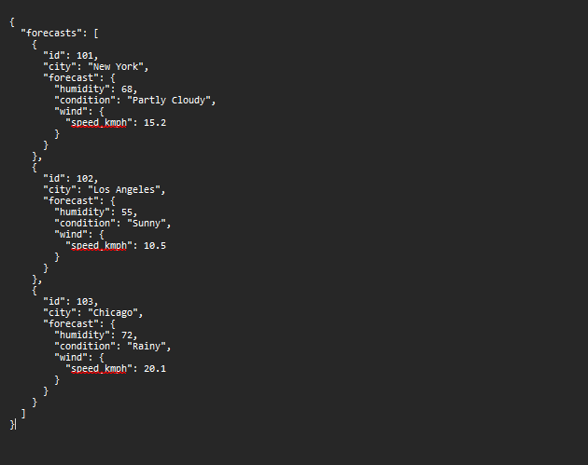
Assignment Answer
Create Mock API endpoints

Slide 7
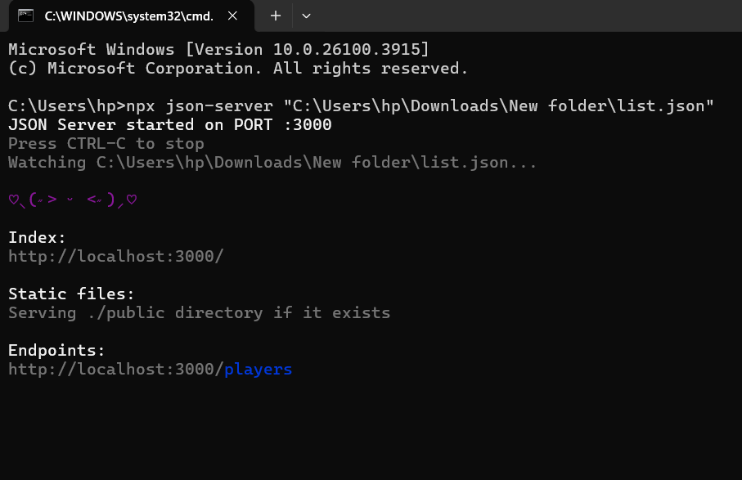
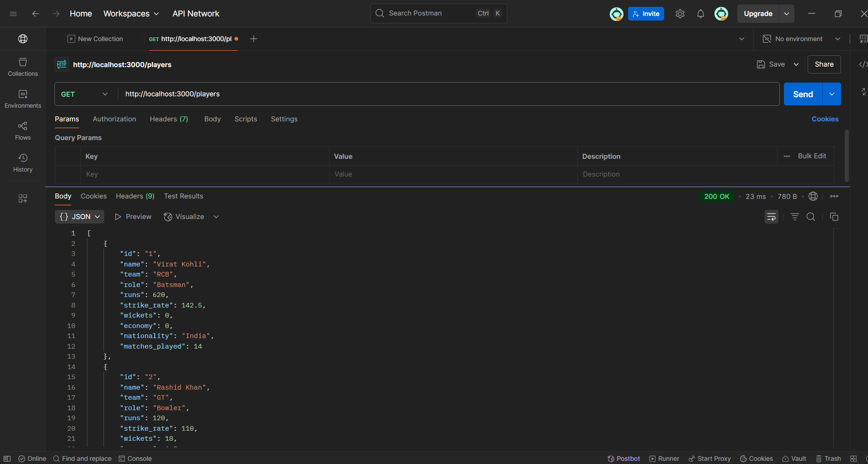
- End Points - Fetching data using get

Slide 8
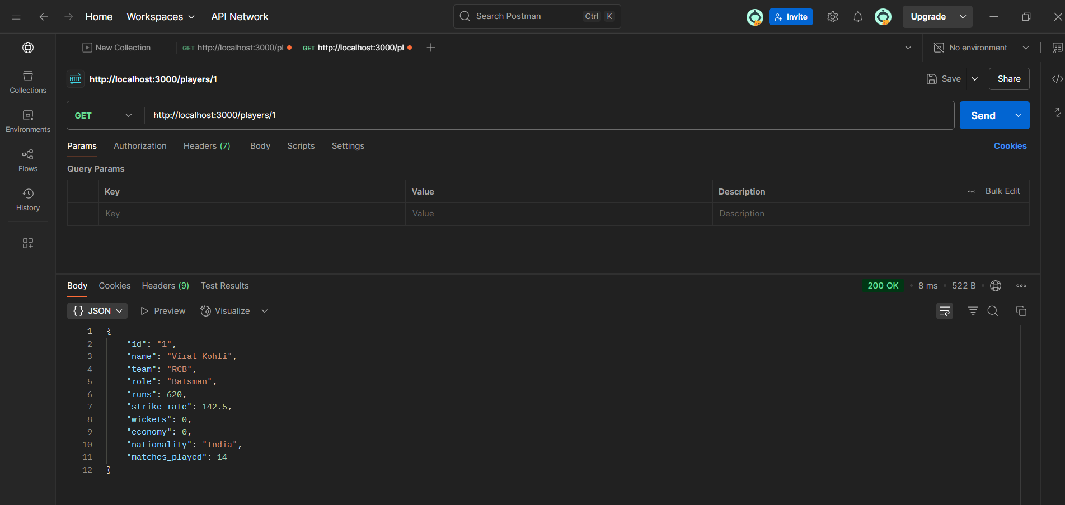
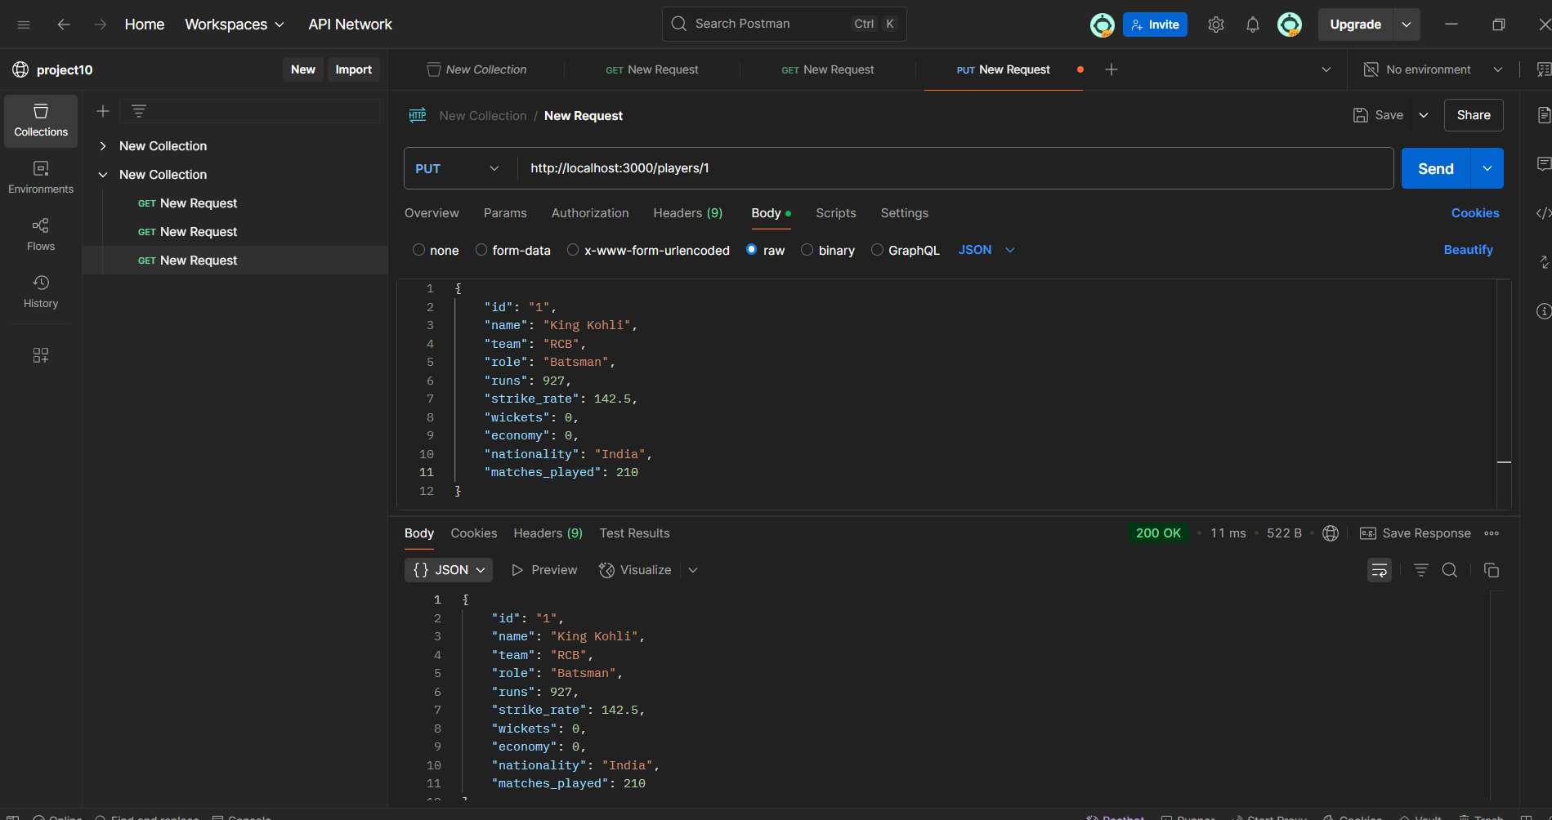
- Fetching data with id - Changing data using PUT

Slide 9
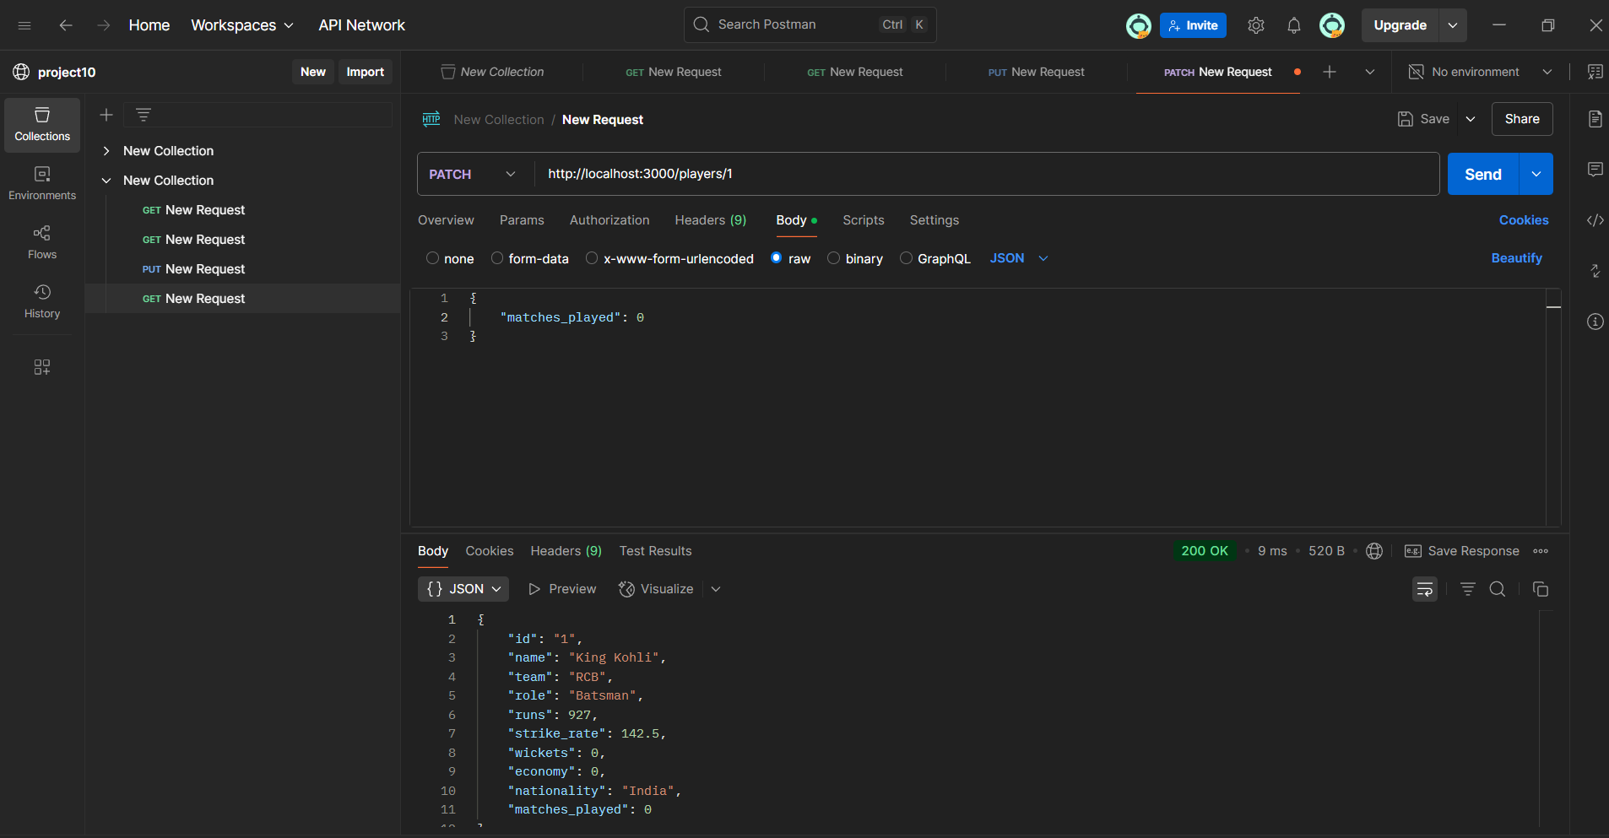
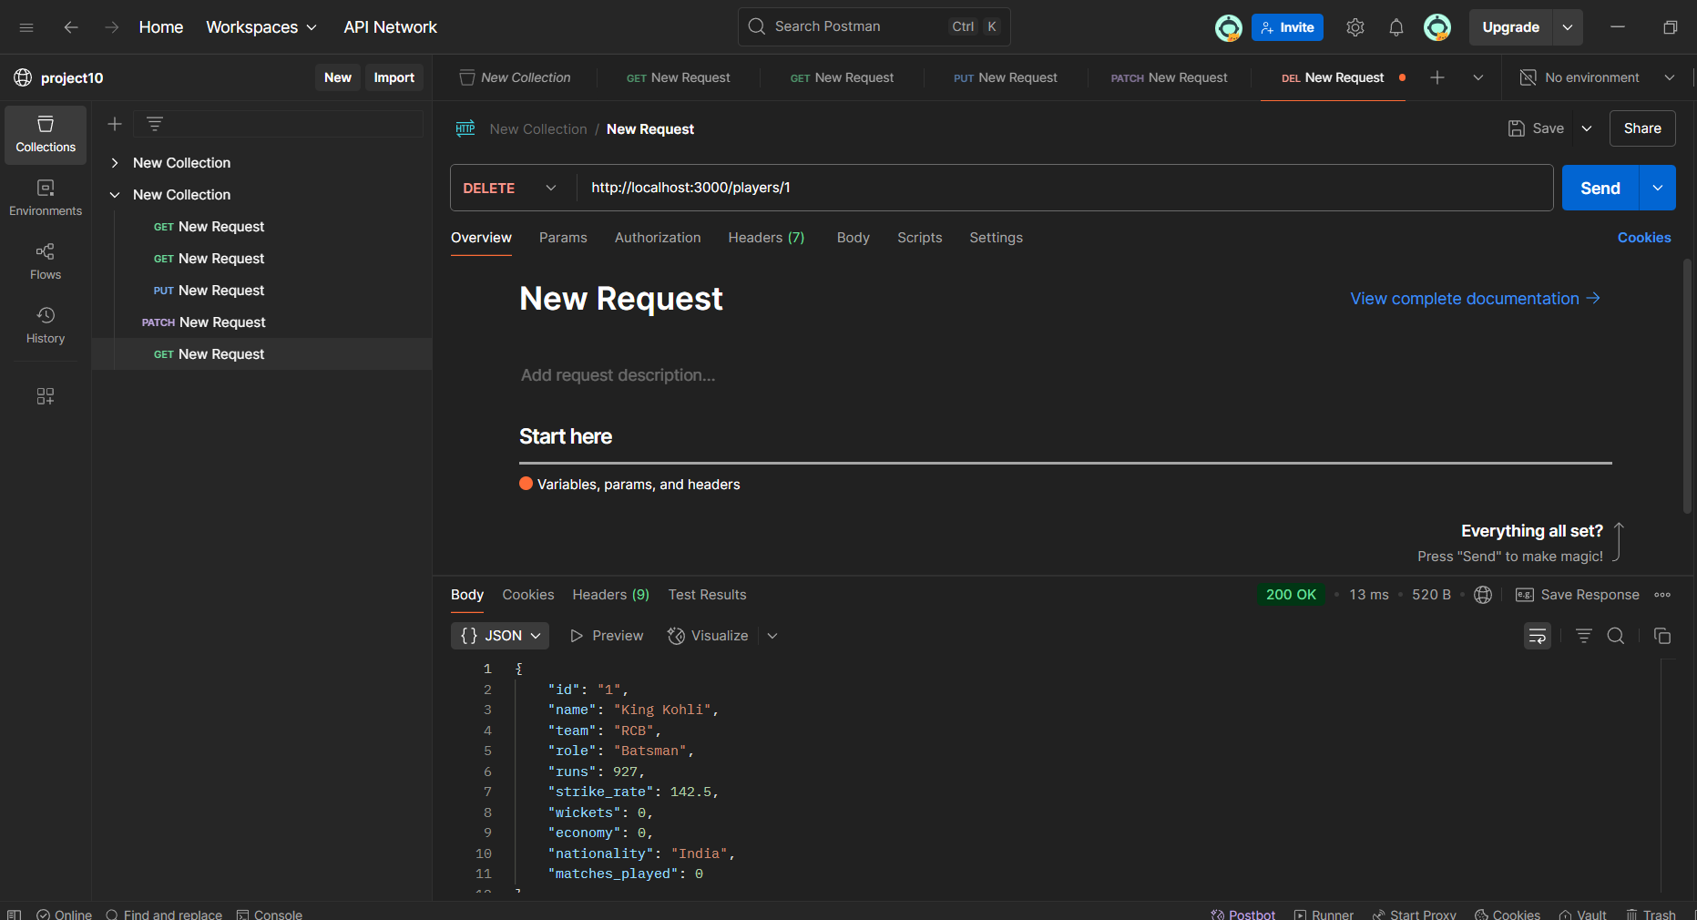
- Changing data using PATCH - Deleting data using DELETE

Slide 10
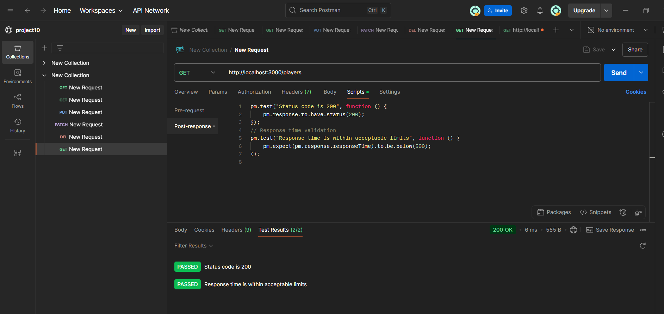
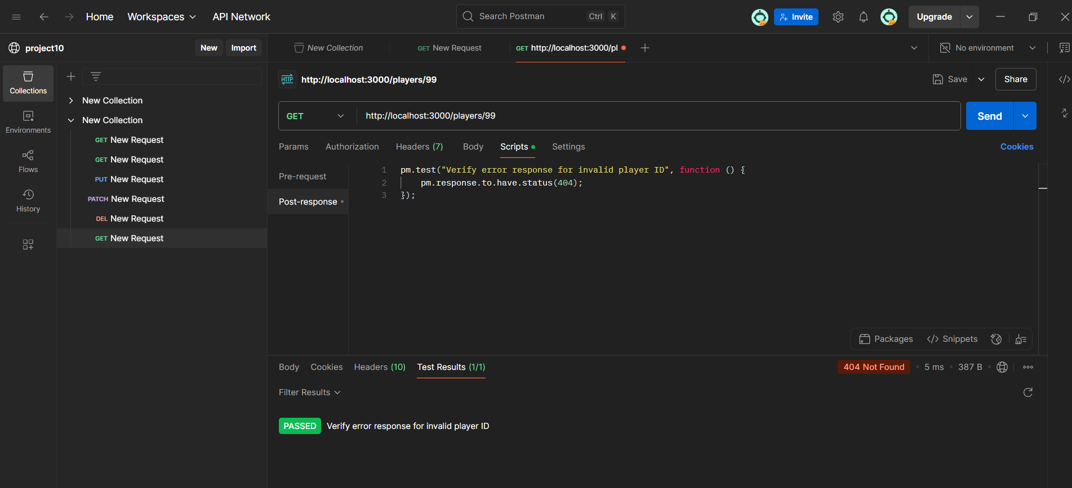
Test Scripts-Validation

Slide 11
Document test cases along with expected and actual outcomes:
Test Case ID | Test Description | Request Method | Expected Result | Actual Result | Status
TC01 | Get all players | GET | 200 OK | 200 OK | Pass
TC02 | Get player by valid ID | GET | 200 OK, valid data | 200 OK | Pass
TC03 | Get player with invalid ID | GET | 404 Not Found | 404 Not Found | Pass
TC04 | Response time under 500ms | GET | <500ms | 242ms | Pass

Slide 12
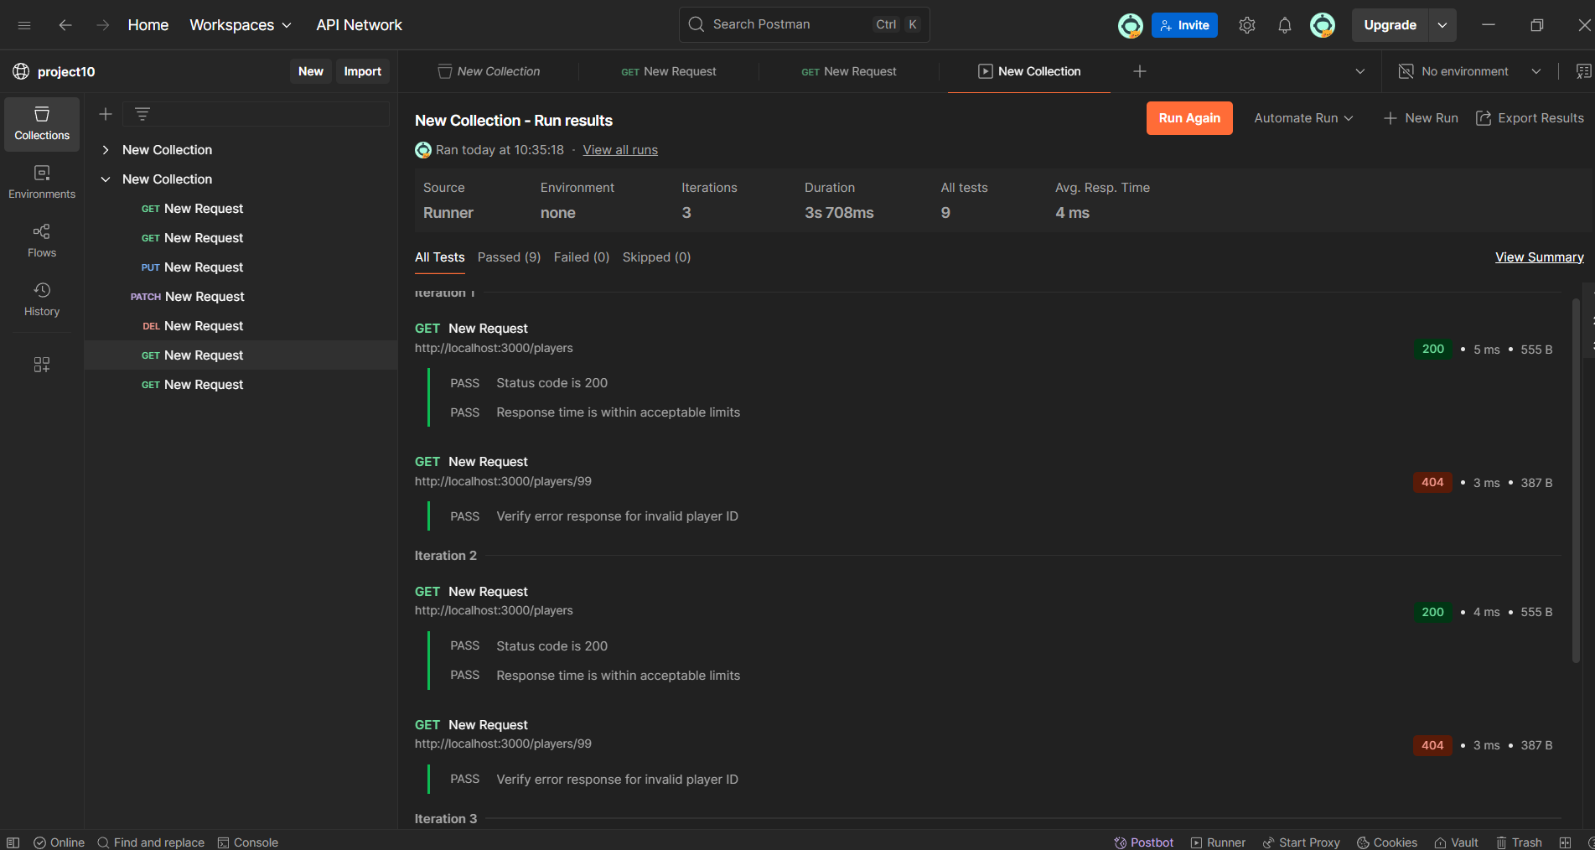
Test Result

Slide 13
Steps to solve this API Test:
Create a JSON file with the given mock API response code.
Open Command Prompt and paste the JSON file path in it and copy the endpoint in the command.
Open Postman.
Add a new request.
paste the endpoint by giving id or without id in the given request by using “GET”.
Click “Send” button. It will give the entered data with that id.
Add another new request.
Select “Scripts”.
Give the test scripts provided as per the assignment.
Save it & click “Send” button.
It provides the test results of test scripts.

Slide 14
Resources:
https://www.youtube.com/watch?v=yoWMdPB_dic

Slide 15
CONCLUSION
This assignment helped us understand API testing using Postman. We created a mock IPL player API, tested it with various validation methods like status code, response time, and error handling, and documented the results. It gave us practical experience in working with APIs and testing tools.

