Slide 1


SMART INDIA HACKATHON 2026
Problem Statement ID – 25026
Problem Statement Title- Develop API code to integrate NAMASTE and or the International Classification of Diseases (ICD-11) via the Traditional Medicine Module 2 (TM2) into existing EMR systems that comply with Electronic Health Record (EHR) Standards for India.
Theme- MedTech/BioTech/HealthTech
PS Category- Software
Team Name: Commit Issues

Slide 2
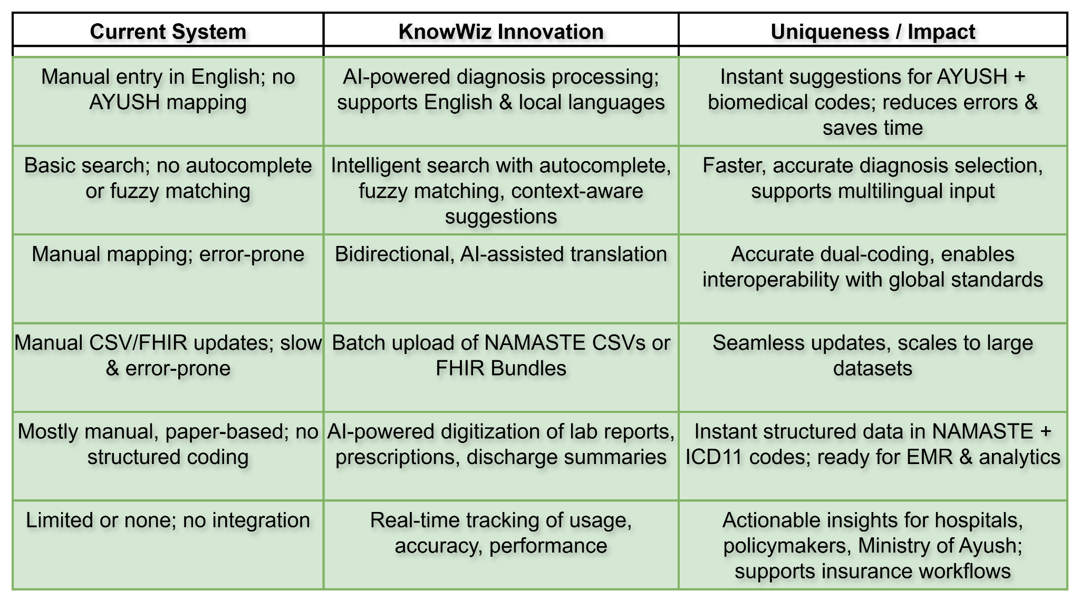
IDEA TITLE
Commit Issues
PROPOSED SOLUTION
It's a lightweight, FHIR R4–compliant terminology micro-service integrating NAMASTE, WHO Ayurveda, ICD-11 TM2, and Biomedicine into EMRs.
Enables AI-powered, real-time bidirectional translation with confidence scoring and continuous learning for accurate dual-coding.
Provides intelligent multilingual search with fuzzy matching and autocomplete for faster, error-free diagnosis entry.
Ensures secure and compliant data exchange with OAuth 2.0, ABHA-linked authentication, and ISO 22600–based consent.
Supports FHIR Bundle ingestion, analytics, and insurance-ready workflows for globally interoperable AYUSH-biomedicine records.
How Our Solution Solves the Problem
Bridges traditional & modern medicine with dual-coding (NAMASTE ↔ ICD-11 TM2 & Biomedicine) in EMRs.
Simplifies clinical workflows via real-time translation, intelligent search, and autocomplete, reducing errors and saving time.
Ensures interoperability & compliance with EHR 2016 standards, FHIR R4, ISO 22600, SNOMED CT, and LOINC.
Empowers analytics & insurance by linking traditional diagnoses with globally recognized ICD-11 codes.
Provides secure, consent-aware data handling for trusted integration into national healthcare systems.
Innovation and Uniqueness of the solution

Slide 3
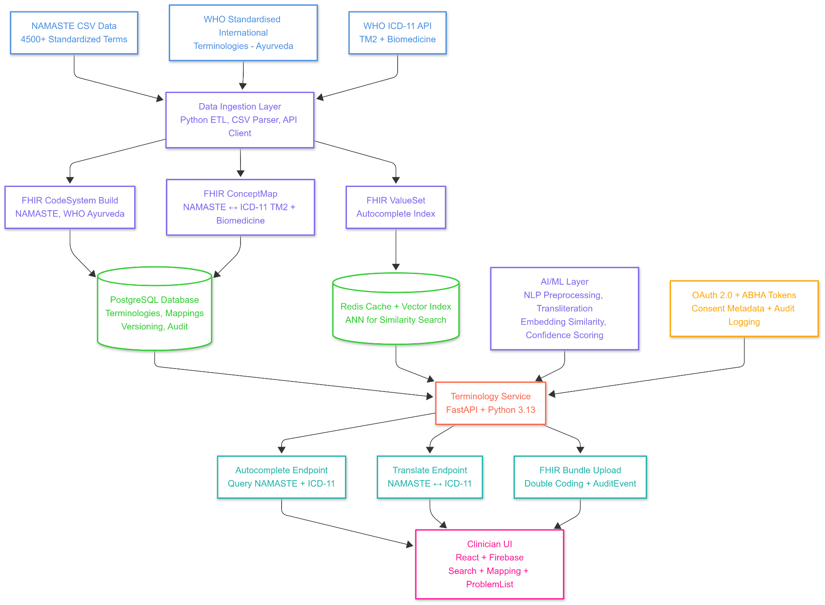
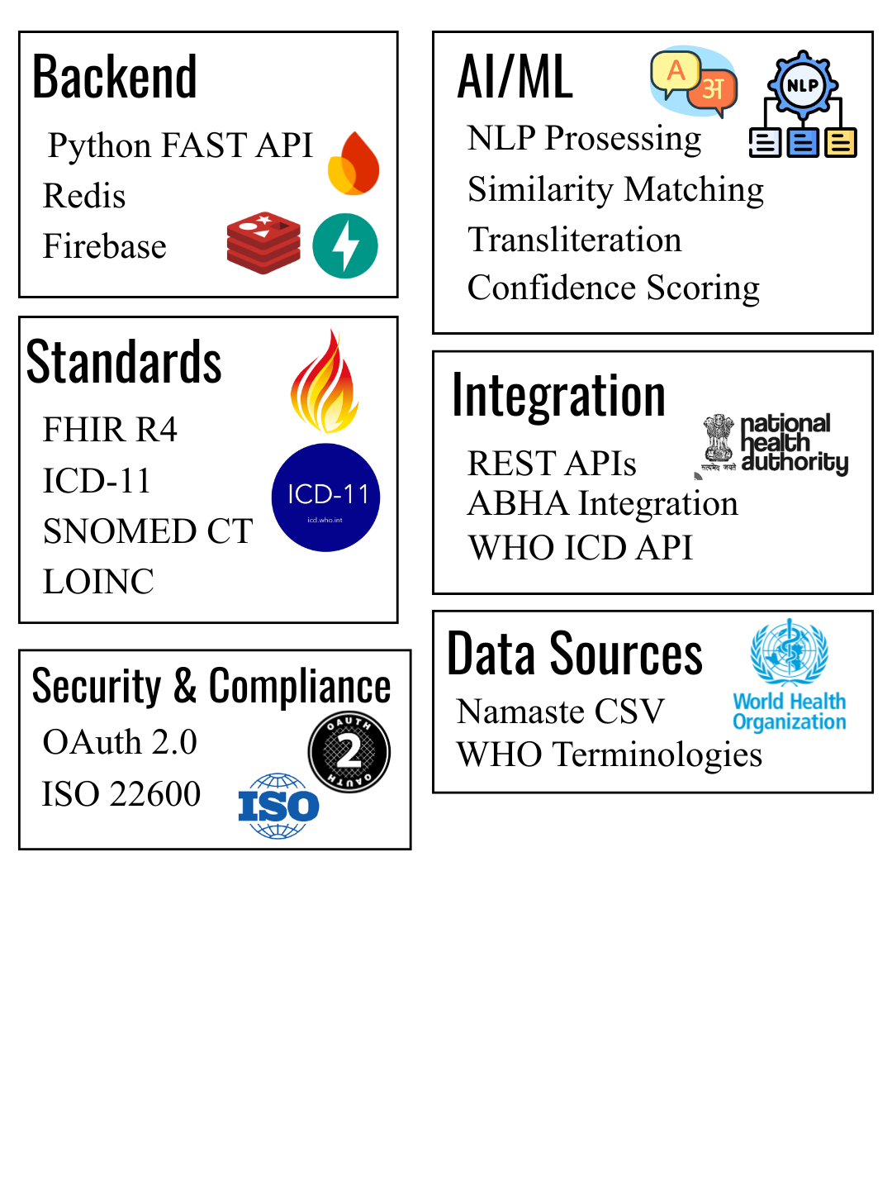
TECHNICAL APPROACH
Commit Issues
Technology Used

Slide 4
FEASIBILITY AND VIABILITY
Commit Issues
Feasibility Analysis
Technical Feasibility: FHIR R4 supports standardized resources, enabling CodeSystem, ConceptMap, and Bundle integration.
Operational Feasibility: RESTful APIs and SDKs allow easy integration with existing EMRs without overhauling infrastructure.
Economic Feasibility: Reduces manual effort in dual coding, digitization, and reporting, saving costs on labor and insurance claim rejections.
AI/ML Feasibility: Existing NLP and ML models can be trained on NAMASTE–ICD mappings with continuous improvement.
Potential Challenges and Risks
Data Standardization Issues: NAMASTE codes and ICD-11 may have partial or ambiguous mappings.
Integration Complexity: Different EMR vendors may have varied FHIR implementations.
Language & Transliteration: Local languages may pose challenges in AI-powered diagnosis processing.
Security & Privacy Risks: Handling sensitive patient data requires strict compliance with OAuth 2.0, ISO 22600, and ABHA regulations.
Performance Bottlenecks: Large-scale batch processing of CSV/FHIR bundles could impact response time.
Strategies to Overcome Challenges
Robust & Accurate Mapping: AI-assisted bidirectional translation with confidence scoring and human validation for ambiguous terms.
Modular & Scalable API Design: Lightweight FHIR R4 micro-service architecture supporting multiple EMRs and asynchronous batch processing.
Multilingual & Intelligent Input: Transliteration, fuzzy matching, and context-aware search for local language diagnoses.
Security & Compliance by Design: End-to-end encryption, audit trails, and ABHA-linked OAuth 2.0 authentication.

Slide 5
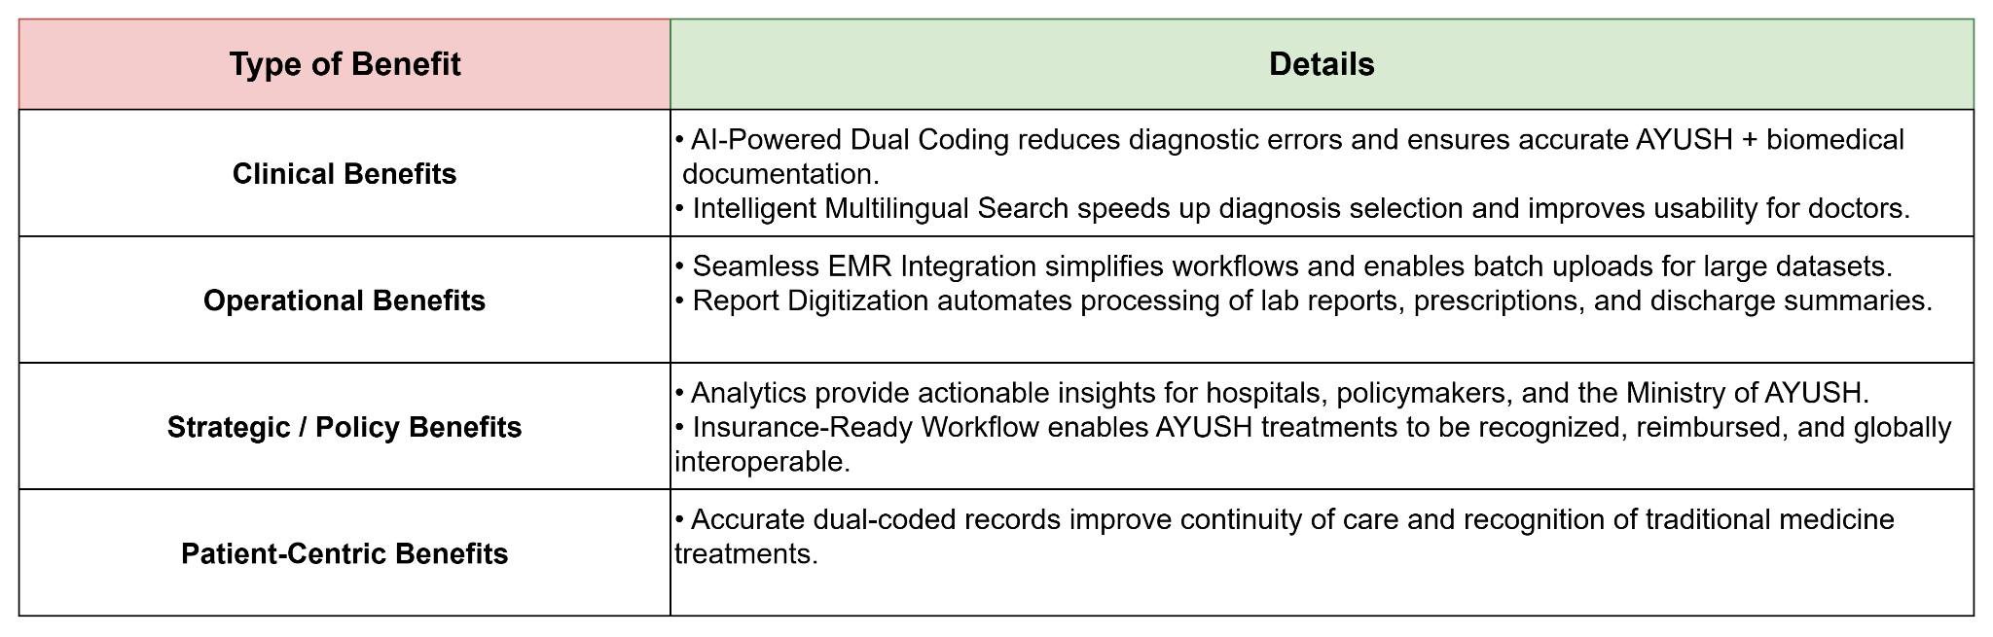
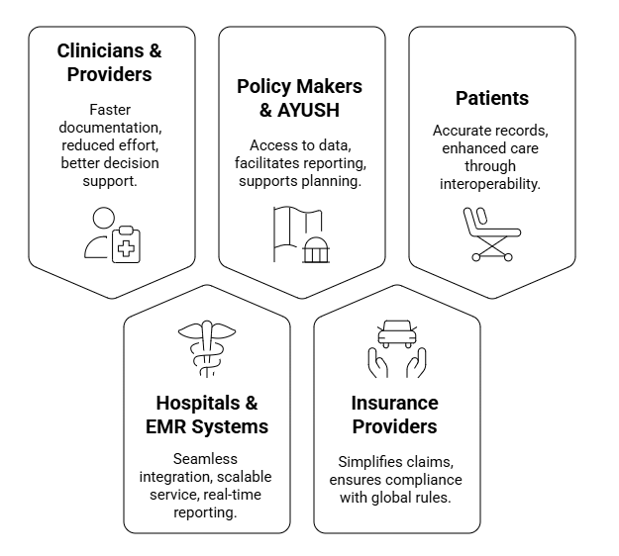
IMPACT AND BENEFITS
Commit Issues
Benefits of the Solution
Potential Impact on the Targeted Audience

Slide 6
RESEARCH AND REFERENCES
Commit Issues
RESEARCH
NAMASTE Portal launched by PM Narendra Modi on 2nd Ayurveda Day (October 17, 2017) at AIIA, New Delhi Initiatives: National Ayush Morbidity and Standardized Terminologies Electronic (NAMASTE) Portal - PMC - This establishes the foundational government support.
WHO ICD-11 TM Module 2 launch event held in New Delhi on January 10, 2024 Launch of the Traditional Medicine Morbidity codes of Ayurveda, Siddha and Unani Chapter in International Classification of Diseaseas (ICD) 11 as Module 2 - This is the most recent milestone making your problem statement highly relevant.
FHIR Implementation Guide for ABDM Health Data Interchange Specifications 1.0 based on FHIR Version R4 Home - FHIR Implementation Guide for ABDM v6.5.0 - This confirms the technical foundation you're building on.
TECHNICAL RESOURCES
WHO ICD-11 API: https://icd.who.int/icdapi
FHIR R4 Specification: https://www.hl7.org/fhir/
ABDM FHIR Guide: https://nrces.in/ndhm/fhir/r4/
NAMASTE Portal: https://namaste.ayush.gov.in/
GitHub Reference: https://github.com/CodexRaunak/NAMASTE-ICD-11-Integration

