Slide 1


Secure Meet
Anushka Pandhere
Sakshi Adhikari
Shweta Mehetre
Sarita Mukkani
Group Number: 36
Atharva College of Engineering

Slide 2

Introduction to SecureMeet
Secure Meet introduces an innovative solution leveraging AI to enhance the security and focus of virtual meetings. Our purpose is to create a disruption-free environment by intelligently detecting and preventing spam or disruptive behavior in online meetings, ensuring a safer and more enjoyable collaboration experience for all participants.

Slide 3

Detecting and Preventing Disruptions
Common Issue: Disruptive Participants
Virtual meetings often plagued by disruptive participants.
Instances of spam, irrelevant content, or disruptive behavior hinder meeting efficiency.
Negative Impact on User Engagement
Reduced Engagement: Disruptions lead to decreased engagement levels.
Loss of Productivity: Meeting flow interruptions result in productivity loss for all participants.
Our Goal
SecureMeet aims to tackle this common issue, providing a solution that
enhances meeting quality and participant experience.

Slide 4
How Secure Meet Works
Real-Time Analysis
Security and Privacy Measures
Historical Data
User Authentication
Choose Platform/Framework

Slide 5
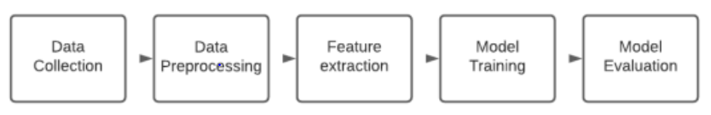
Block Diagram

Slide 6
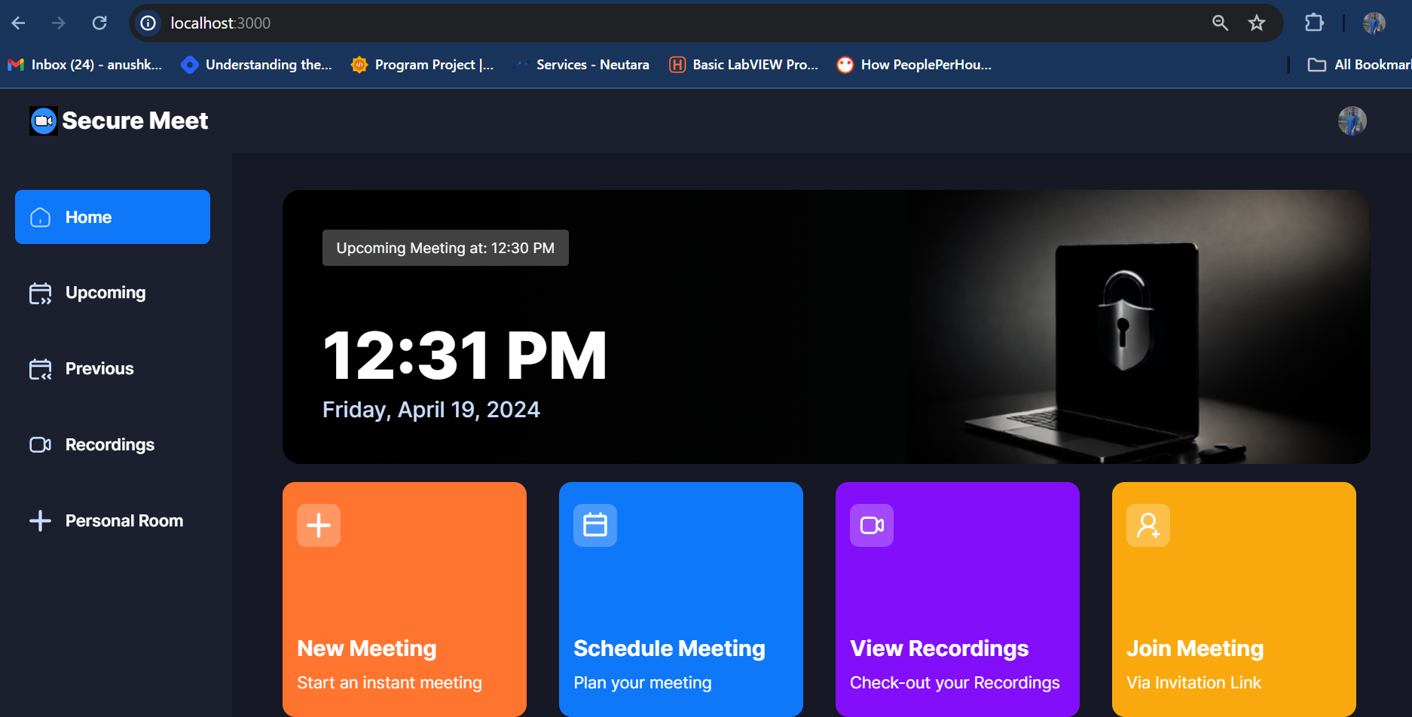
Output

Slide 7
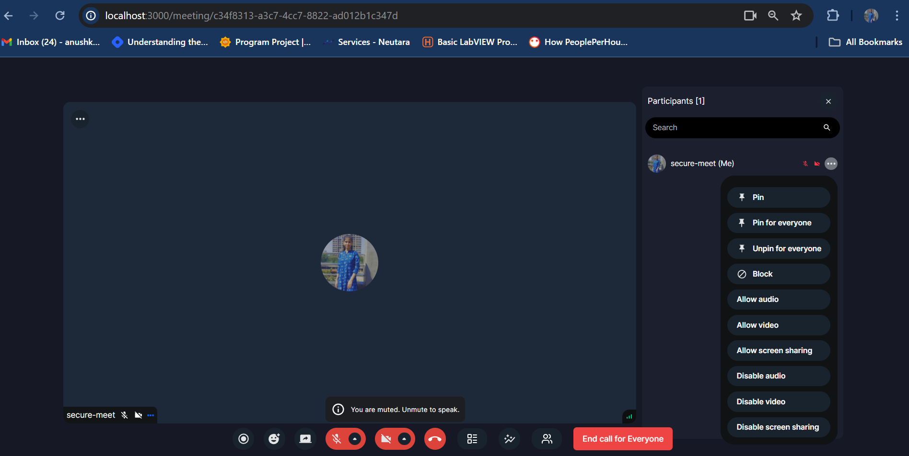
Output (Cont…)

Slide 8
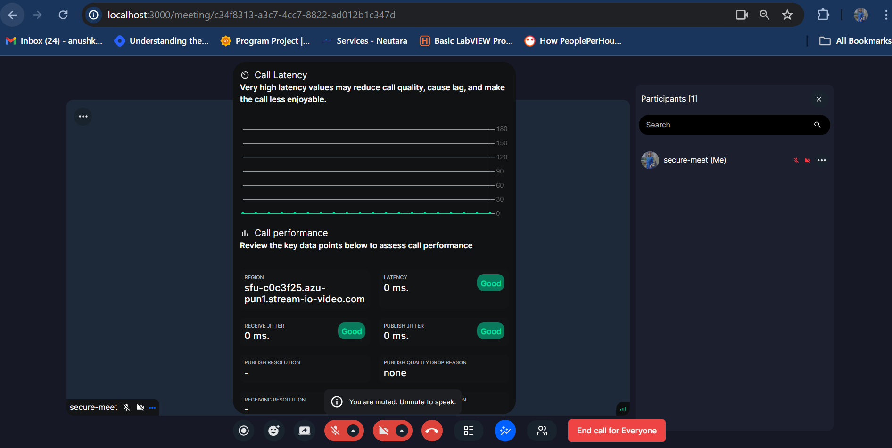
Output (Cont…)

Slide 9


Output (Cont…)

Slide 10
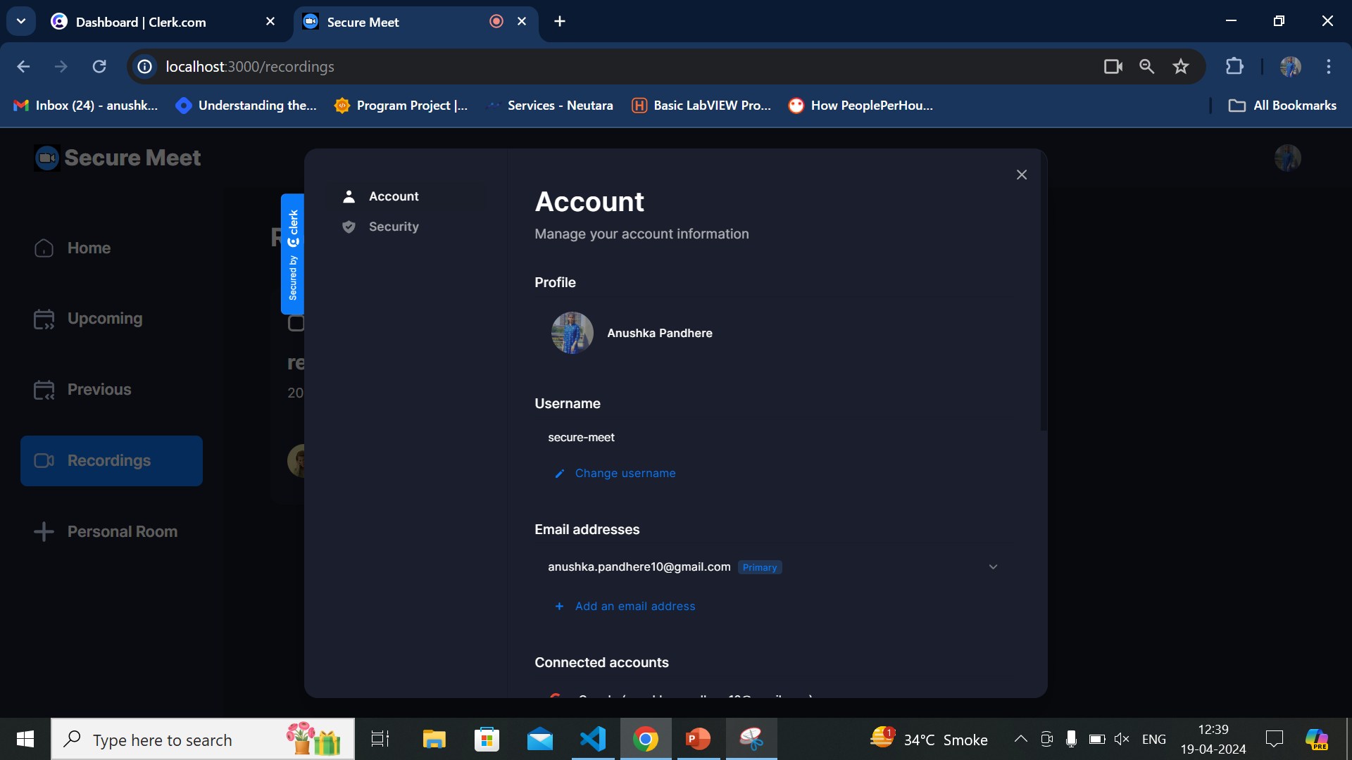
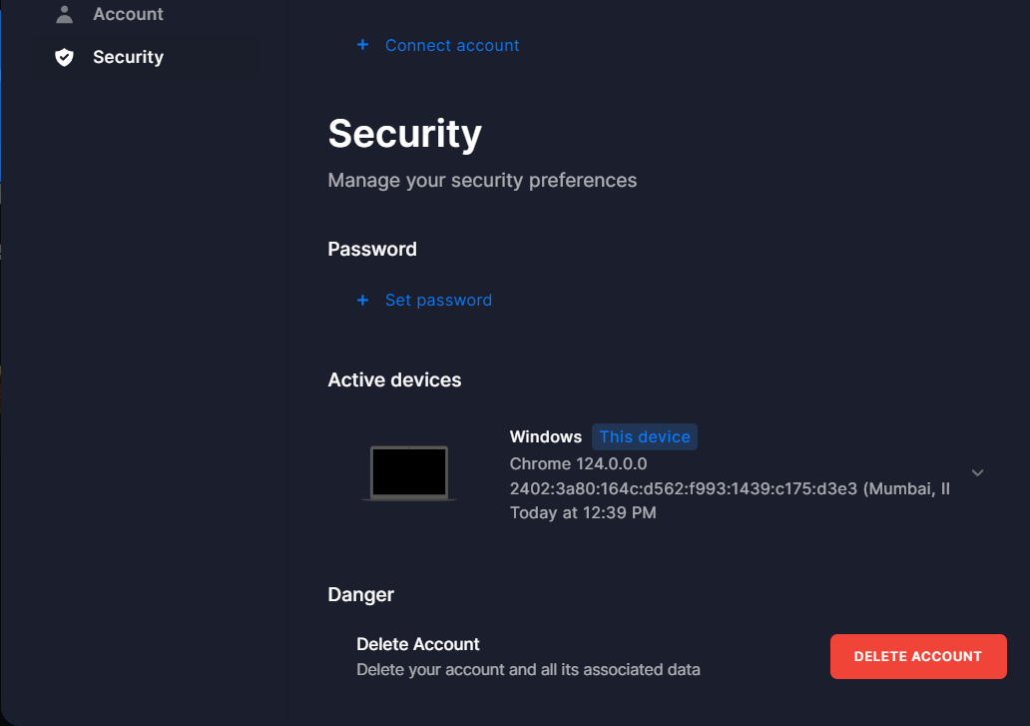
Output (Cont…)

Slide 11
Benefits of using SecureMeet
1
2
3
Secure Data
Transmission
Stress-free Meetings
Enhanced Productivity
Eliminates distractions and ensures a focused meeting environment, reducing stress for both hosts and participants.
Increases productivity by maintaining a secure and distraction-free space for meaningful discussions and collaboration.
Provides encrypted data transmission, safeguarding sensitive information shared during virtual meetings.

Slide 12
Literature Survey
Sr.no. | Name | Author name | Description
1. | SMS Spam Detection using Relevance Vector Machine | Shushanta Pudasainia , Aman Shakyaa,∗ , Sanjeeb Prasad Pandeya , Prakriti Paudelb, Sunil Ghimirec , Prabhat Alec | Spam in Short Message Service(SMS) is a serious issue that impacts mobile phone consumers all around the world. Many strategies have been applied using several deep learning and machine learning techniques to overcome these issues. The bagging approach is used in the study to combine four different algorithms, namely RVM, SVM, Naive Bayes, and KNN.
2. | Email Spam Detection Using Machine Learning Algorithms | Nikhil Kumar, Sanket Sonowal, Nishant | Email Spam has become a major problem nowadays, with Rapid growth of internet users, Email spams is also increasing. People are using them for illegal and unethical conducts, phishing and fraud. Sending malicious link through spam emails which can harm our system and can also seek in into your system.
3 | Detecting Spam Email With Machine Learning Optimized With Bio-Inspired Metaheuristic Algorithms | SIMRAN GIBSON 1 , BIJU ISSAC 1 , (Senior Member, IEEE), LI ZHANG 1 , (Senior Member, IEEE), AND SEIBU MARY JACOB2 , (Member, IEEE) | Electronic mail has eased communication methods for many organisations as well as individuals. This method is exploited for fraudulent gain by spammers through sending unsolicited emails. This article aims to present a method for detection of spam emails with machine learning algorithms that are optimized with bio-inspired methods.

Slide 13
References
[1] https://ieeexplore.ieee.org/stamp/stamp.jsp?arnumber=9222163
[2] https://www.researchgate.net/publication/344050184_Email_Spam_Detection_Using_Machine_Learning_Algorithms
[3] SMS Spam Detection using Relevance Vector Machine
[4] https://www.sciencedirect.com/science/article/pii/S1877050921007493
[5] https://ieeexplore.ieee.org/stamp/stamp.jsp?arnumber=9462825
[6] https://www.researchgate.net/publication/2691992_A_Secure_Desktop_Meeting_System
[7] Continuous software security through security prioritisation meetings - ScienceDirect

Slide 14
Thank You!

