Slide 1
GPU-Accelerated Conversion of RGBD Images to Textured Triangle Meshes
Collin Boots and Dalton Banks

Slide 2
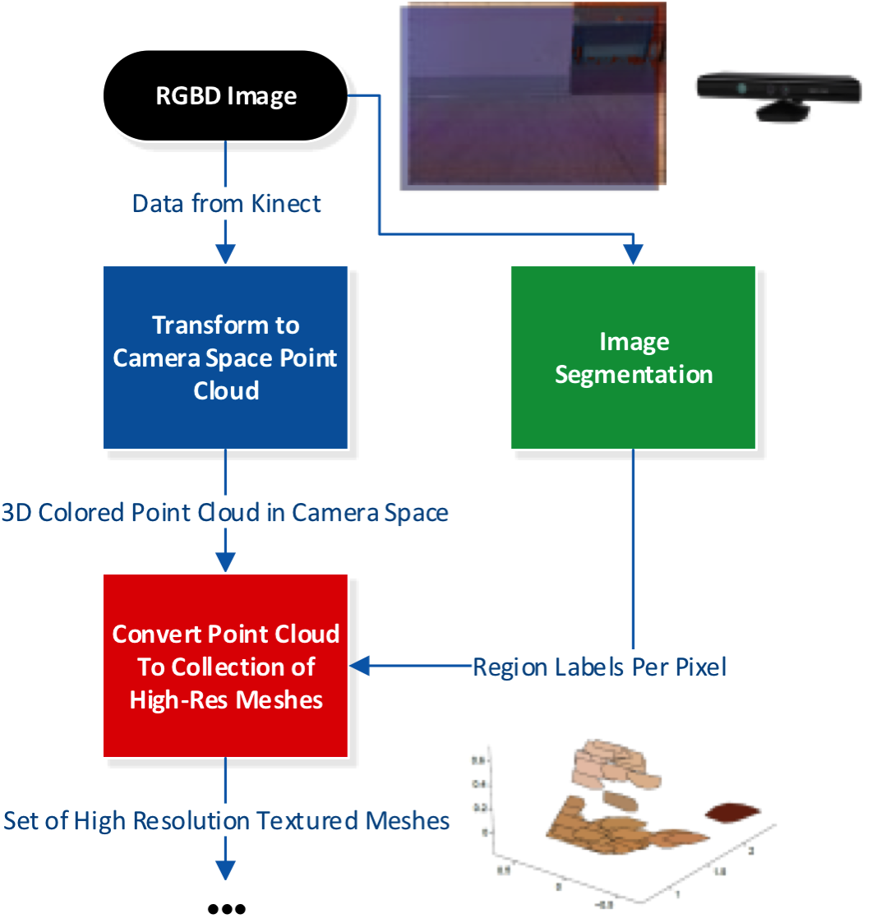
Processing Pipeline (part 1)

Slide 3
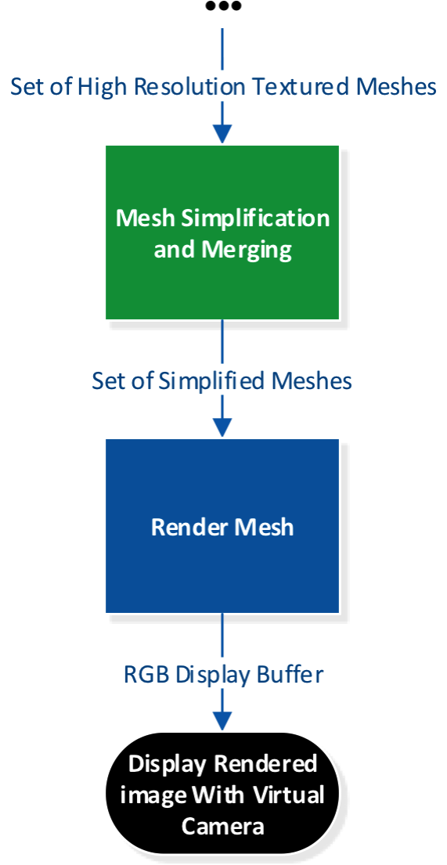
Processing Pipeline (part 2)

Slide 4
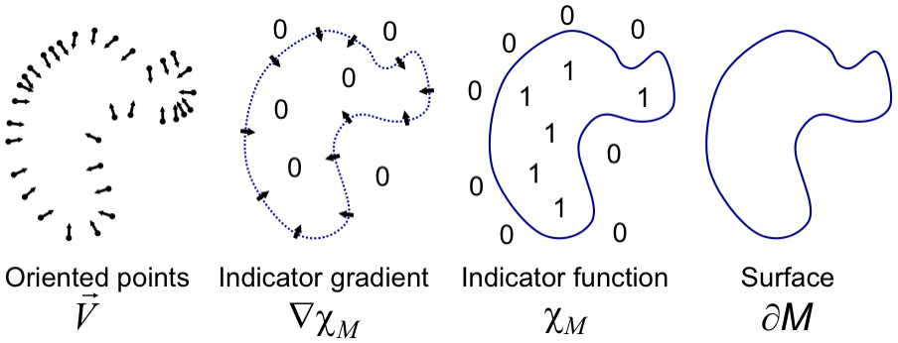
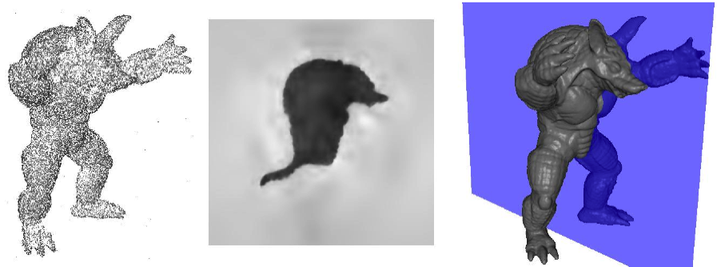
Mesh Reconstruction Algorithm
Poisson Surface Reconstruction
Approximates surface as boundary of underlying indicator function
Requires oriented point cloud (i.e. estimation of point normals)
CPU implementation won SGP Software Award
Highly parallelizable algorithm
Michael Kazhdan, Matthew Bolitho, and Hueges Hoppe. Poisson Surface Reconstruction. Eurographics Symposium on Geometry Processing (2006).

Slide 5
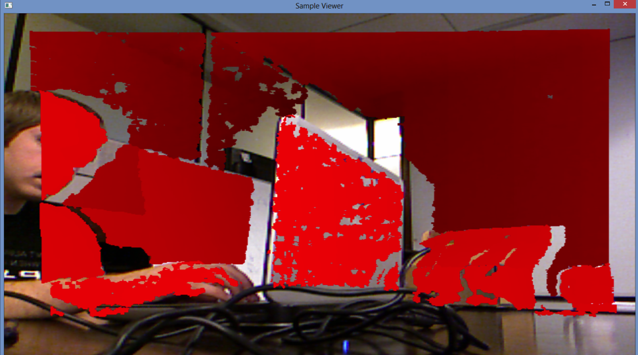
Low-Level Framework
Capture, synchronize, and optionally save RGB and depth images streaming from RGB-D capture device
Display and process either live or recorded RGB-D streams
Synchronized RGB and depth streams

Slide 6
Low-Level Framework Architecture

Slide 7
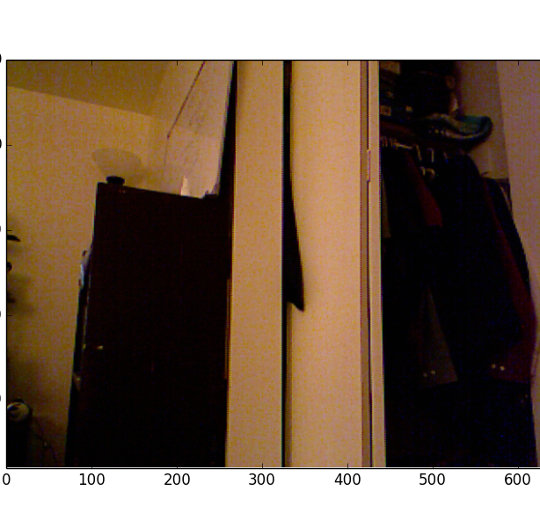
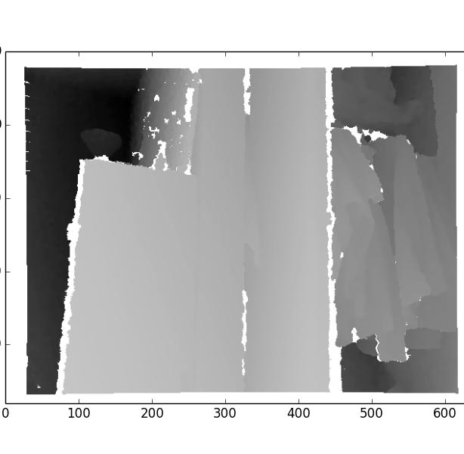
Point Cloud Reconstruction
RGB Image + Depth Image

Slide 8
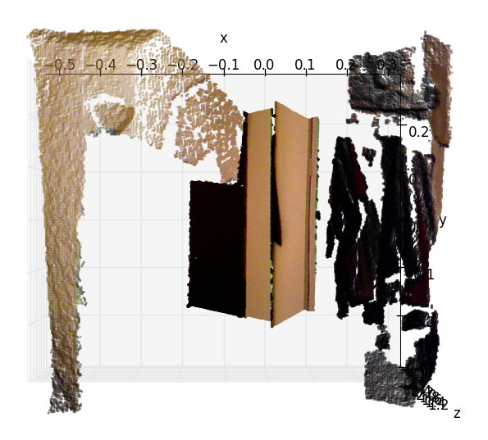
Point Cloud Reconstruction
Point Cloud

Slide 9
Point Normal Estimation
Identify nearest neighbors
First pass: XY image window
Second pass: 3D radius threshold
Estimate normal from NN best-fit plane using PCA
Too slow: reimplemented using averaging
Assign direction using dot-product with camera vector

Slide 10
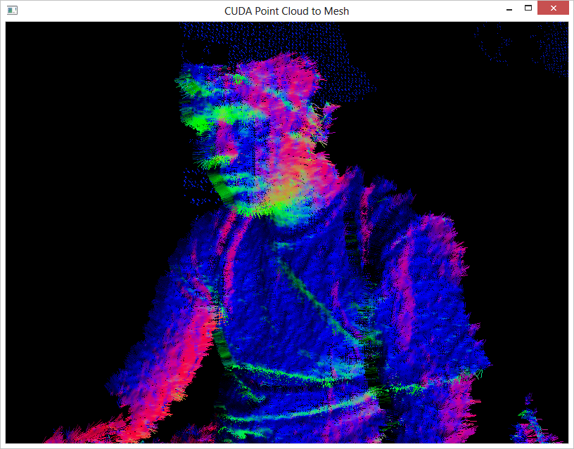
Point Normal Estimation

Slide 11
Mesh Reconstruction
Parameterize by triangle

