Slide 1
IOT Based Access Mechanism Using Inter Planetary File System
Team Members Group No: 18
Project Advisor : Dr. S Thangavelu / Assistant Professor/ CSE
S.No | Reg.No | Name of the Student | Section
1 | CB.EN.U4CSE15422 | Pandu Ranga Reddy | E
2 | CB.EN.U4CSE15358 | Sai Abhinav Reddy | D
3 | CB.EN.U4CSE15522 | Krishna Chaitanya Varma | C
4 | CB.EN.U4CSE15312 | Vamsi Krishna Reddy | D
Date: 09-04-2019
Group No: 18

Slide 2
Content
Introduction
Motivation
Problem Statement
Conclusion of Literature Survey
Challenges and Approaches
Progress
Drawback’s
Future Enhancement’s
Conclusion
References
Date: 09-04-2019
Group No: 18

Slide 3
Introduction
The Internet of Things is a global industry movement that brings together people, process, data and things to make networked connection more relevant and valuable than ever before. There are millions of IoT devices connected now and are estimated to grow rapidly to billions in next few years. Considering all these facts security plays a major role in communication between devices. There are many protocols that IoT devices use in which most of them are centralized which have intermediate node (broker) for communication. This broker has to know the data for decoupling techniques. This intermediate node can be a cloud service provider or any 3rd party database service provider. As the data is being stored in these 3rd party service providers, there are risks that the client should take like lack of trust and loss of control.
Date: 09-04-2019
Group No: 18

Slide 4
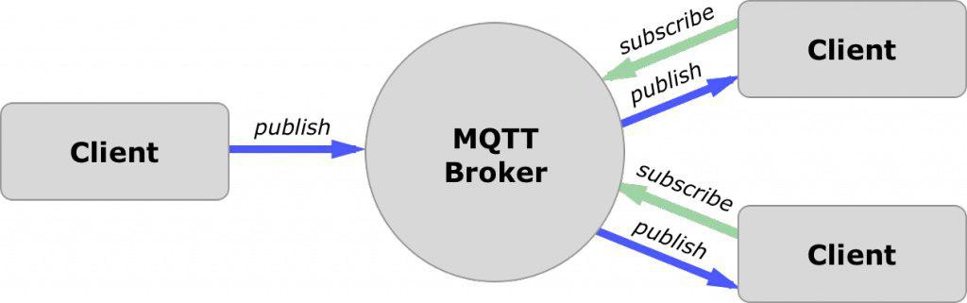
Contd..,
MQTT publish subscribe using broker as intermediate node
Considering all the those specified above, a decentralized and distributed architectural based protocol like IPFS can be used to address the issue of broker. IPFS is a protocol and network designed to create a peer-to-peer method of storing and sharing hypermedia in a distributed file system. It provides high performance and clustered persistence.
Date: 09-04-2019
Group No: 18

Slide 5
Contd..,
Specific Objective
There are lots of different solutions exist in the field. However, most of them either rely on a centralized or hierarchic network to have a reliable system, with stronger delivery and persistence guarantees, or end up sacrificing these same properties in order to have a decentralized system with the potential to scale to a much larger network.
The solution we propose is a pub-sub module to IPFS with a strong focus on reliability, delivery guarantees and data persistence, while maintaining the ability to scale to a vast number of users, using the network infrastructure we have in place today.
Date: 09-04-2019
Group No: 18

Slide 6
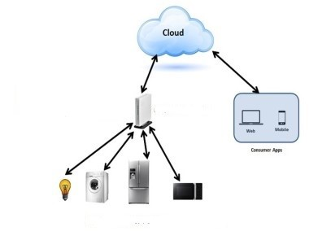
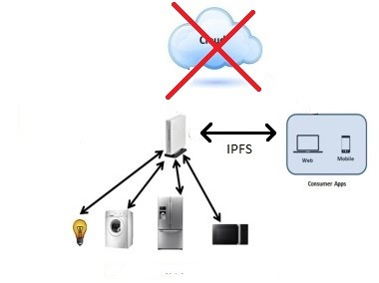
Contd..,
Using third party cloud Using IPFS
Date: 09-04-2019
Group No: 18

Slide 7
Motivation
The basic idea is that data produced by personal IoT devices are safely stored in a distributed system whose design guarantees privacy, leaving to the people -the real data owners- the decision of which of them to share and with whom mainly Medical data.
During the pro democracy protest in hongkong-2014 , The Government to incapacitate the protesters had shutdown the entire cities communication and blocked access to the social media. This is the problem of centralization the person who owns the server controls the people.(Similar situation Arab Spring-2016).
We believe in the fact that “Data is Power” and that power should not be given to some single entity, It has to be distributed among the people for greater good.
Date: 09-04-2019
Group No: 18

Slide 8
Problem Statement
Establishing a secure connection from an end application to an IoT device without depending on third party services like cloud, centralized services, etc. where the privacy is not guaranteed.
Date: 09-04-2019
Group No: 18

Slide 9
Conclusion of Literature Survey
The purpose of this literature review was to view the trends in composition studies within the past authors who reviewed about various Internet of Things applications and also different Communication protocols which are secure and robust. This research review’s purpose is to help us understand different aspects posed by the research on Inter Planetary File System and also its application in Real Time.
Date: 09-04-2019
Group No: 18

Slide 10
Challenges And Approaches
Challenge: Removing Middle Man (Broker)
  Approach: Introducing IPFS protocol
Challenge: Allowing only Authorized Users
  Approach: Confidentiality, Integrity, Availability via PGP
Challenge: While finding path for the first time between end applications, it requires more time as it has to find the shortest path possible.(Real Time)
  Approach: By implementing a Beacon node.
Date: 09-04-2019
Group No: 18

Slide 11
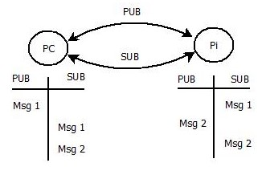
Results / Progress
STAGE 1: (Publish - Subscribe)[Status-Completed]
Enabling Publish Subscribe
between the end user (PC) and IoT device
(Raspberry Pi 2).
When a message is published from
the PC, it will be received by both the PC
and the Pi as PC is self-subscribed to the
topic and Pi is also subscribed to that topic.
        Pub-Sub between PC and Pi
Date: 09-04-2019
Group No: 18

Slide 12
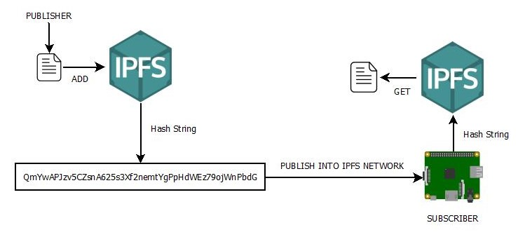
Contd..,
STAGE 2: (Transfer Files over IPFS) [Status-Completed]
Adding files to IPFS network and getting the hash for the uploaded file and publishing it to the IPFS network through pub-sub model.
File Transfer through IPFS network
Date: 09-04-2019
Group No: 18

Slide 13
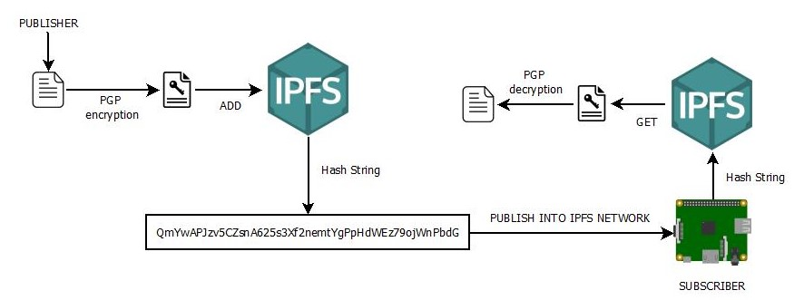
Contd..,
STAGE 3: (Encryption using PGP) [Status-Completed]
While sending Hash through the IPFS network encryption is being done for allowing only the authorized users to decrypt the file and access the contents of it. PGP (Pretty Good Privacy) is used to encrypt the file using symmetric-key encryption and public-key encryption.
File Encryption using PGP
Date: 09-04-2019
Group No: 18

Slide 14
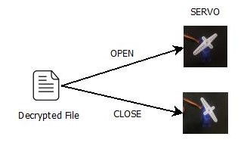
Contd..,
STAGE 4:[Status-Completed]
Changing the state of servo based on the data from the decrypted file at the subscriber.
Setting Servo State from file
Date: 09-04-2019
Group No: 18

Slide 15
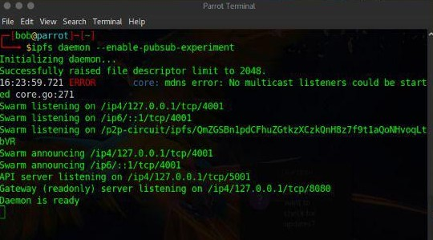
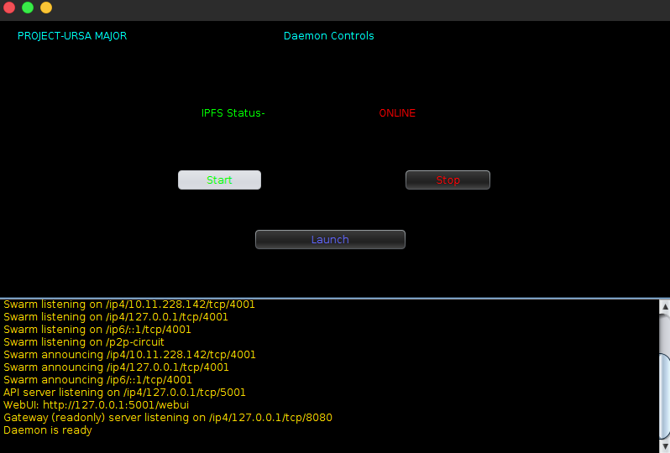
Progress
DAEMON RUNNING
Starting the IPFS network by running the following command
“ ipfs daemon –enable-pubsub-experiment “
Daemon running in console Daemon running through java applet
Date: 09-04-2019
Group No: 18

Slide 16
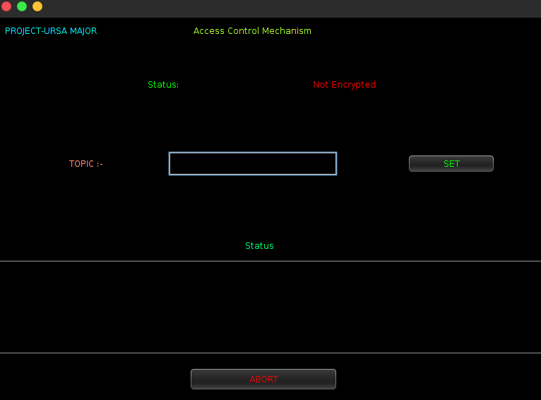
Contd..,
Access Control
This is the module where communication and abstraction happens
Date: 09-04-2019
Group No: 18

Slide 17
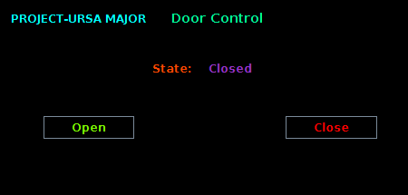
Contd..,
Door Control
This is the module where communication and encryption happens.
Date: 09-04-2019
Group No: 18

Slide 18
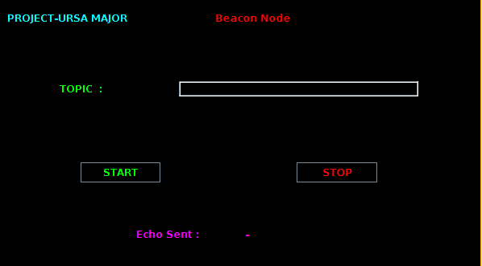
Contd..,
Beacon
This is the module used to bring the channel up in real time.
Date: 09-04-2019
Group No: 18

Slide 19
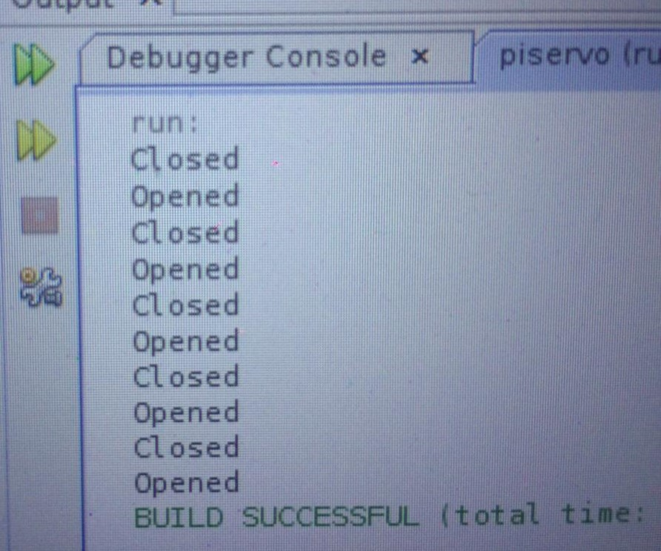
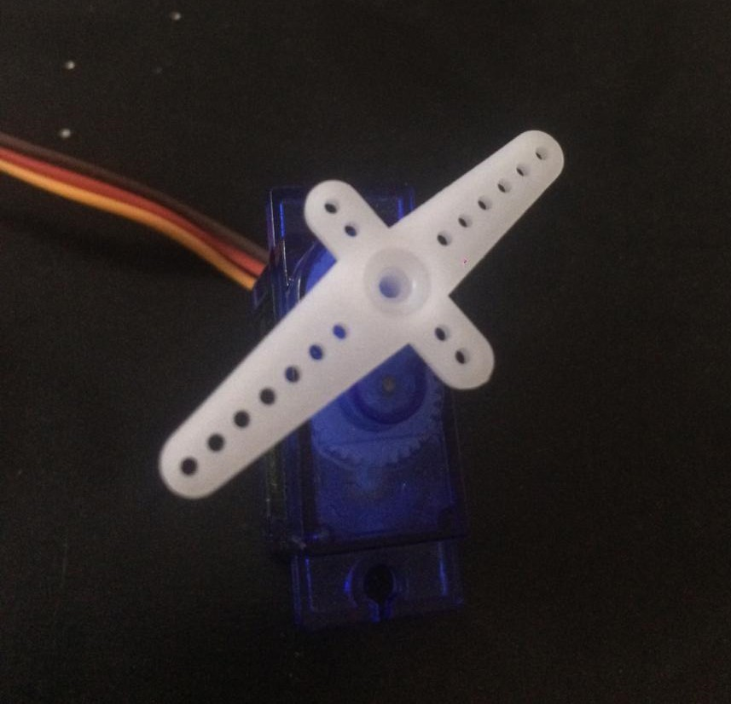
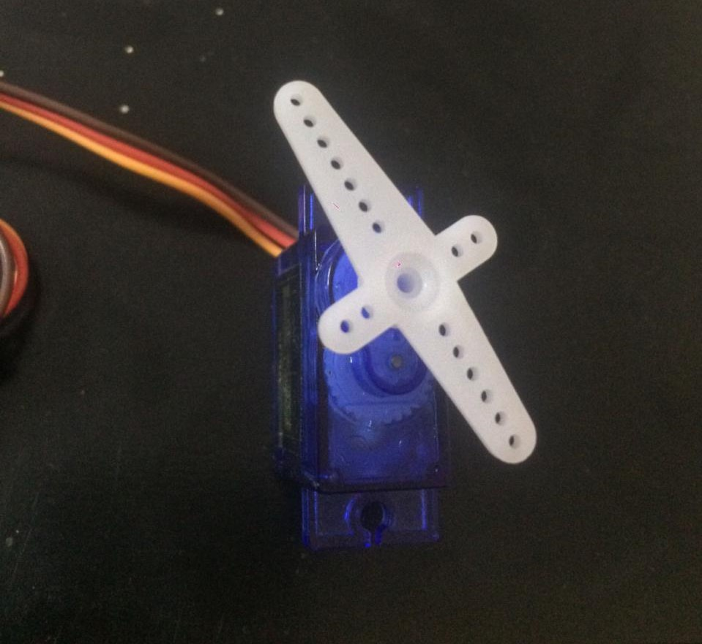
Contd..,
SERVO RESULTS
Checking the published value in terminal by running the following command
“ ipfs pubsub sub <topic> ”
0 → Close AND 1 → Open
Servo results in terminal
SERVO STATES
Open state Closed State results in debugger console
Date: 09-04-2019
Group No: 18

Slide 20
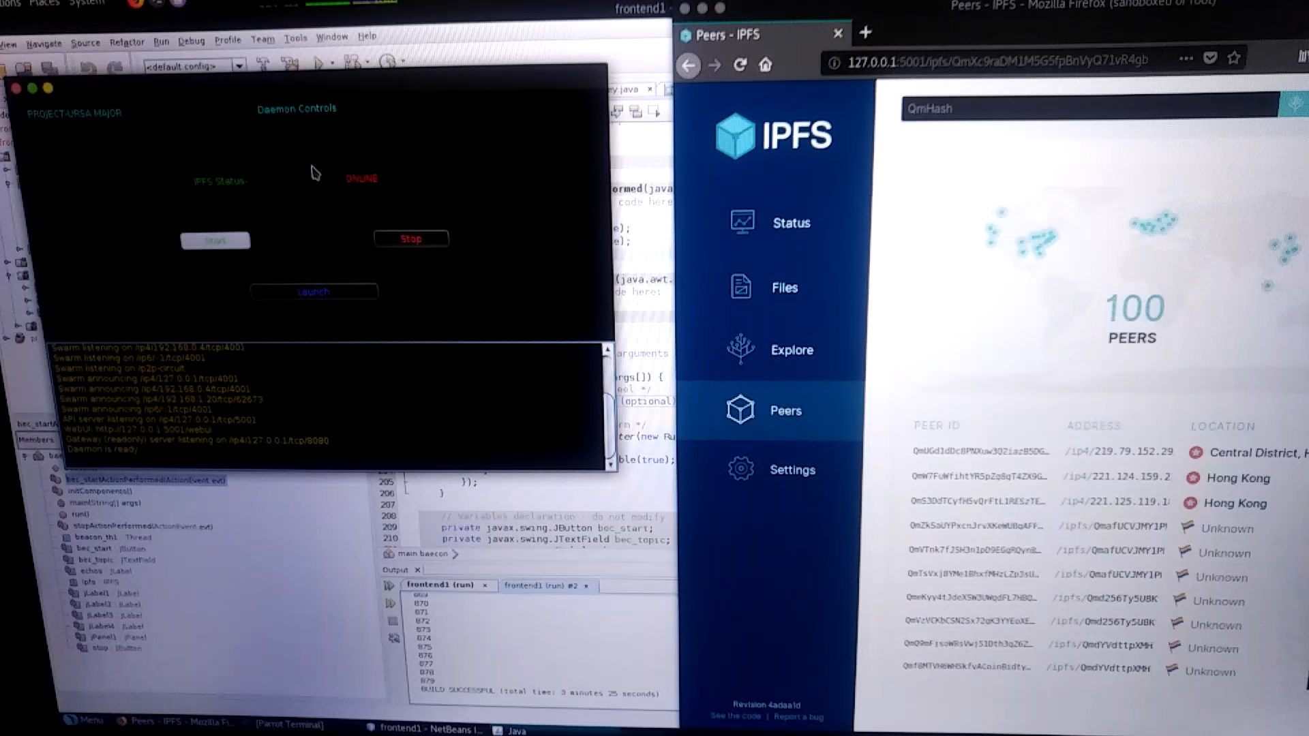
REAL TIME
Date: Date: 09-04-2019
Group No: 18

Slide 21
Time Schedule of activities
Understanding basic concepts | : June 18 | - | July 18
Designing the prototype | : Aug 18 | - | Oct 18
Implementation | : Nov 18 | - | Jan 19
Enchantments & Testing | : Feb 19 | - | Mar 19
Final Submission | : Apr 19
Date: 09-04-2019
Group No: 18

Slide 22
Drawback’s
Requires Very High Bandwidth to operate in real time environment.(i.e-10Mbps)
Date: 09-04-2019
Group No: 18

Slide 23
Future Enhancement’s
Improvised Filters.
Tracker Node to Track Requests (i.e:- Fire and Forget)
Accessing Multiple Sensors via Same Channel using the above Model in Real Time.
Date: 09-04-2019
Group No: 18

Slide 24
Conclusion
Inter Planetary File System indeed plays a major role in the field of D2D communication. It is not only keeps the data secure but also guarantees a total control of the device which can be accessible from any part of the world due to its distributed architecture. This project presents the use of IPFS in the field of Internet of things as a communication protocol which solves the problem of data accessibility and availability by scaling out centralized servers and cloud platforms. Which makes it reliable and inexpensive for users unlike MQTT.
Date: 09-04-2019
Group No: 18

Slide 25
References
IOT Enabled Home Automation through Nodered and MQTT by Archit Agarwal, Rajesh Singh, Anita Gehlot, Gautam Gupta and Mohit Choudhary in “International Journal of Control Theory and Applications-Volume-10-2017” ISSN: 0974-5572.
IPFS-Content Addressed, Versioned, P2P File System by Juan
An Object Store Service for a Fog/Edge Computing Infrastructure based on IPFS and Scale-out NAS by Bastien Confais , Adrrien Lebre , Benoit Parrein published in “2017 IEEE 1st International Conference on Fog and Edge Computing (ICFEC)” ISBN: 978-1-5090-3047-7/17
Internet of Things , Blockchain and Shared Economy Applications by Steve Huckle , Rituparna Bhattacharya ,Martin White , Natalia Beloff published at “International Workshop on Data Mining in Iot Systems (DaMIS 2016)” ISBN:1877-0509.
IPFS Usage Documentation (https://docs.ipfs.io/introduction/).
Date: 09-04-2019
Group No: 18

Slide 26
References
Loise Axon. 2015. Privacy-awareness in Blockchain- based PKI. Retrieved April 12, 2017 from http://goo.gl/3Nv2oK
Device Democracy: Saving the Future of the Internet of Things. Retrieved May 10, 2017 from https://goo.gl/18Y16F
Huckle, Steve, et al. Internet of things, blockchain and shared economy applications. Procedia Computer Science, Volume 98, 2016, Pages 461-466
Arvind P Jayan, Harini N, A Scheme to Enhance the Security of MQTT Protocol, International Journal of Pure and Applied Mathematics, Volume 119 No. 12 2018, 13975-13982
Date: 09-04-2019
Group No: 18

