Slide 1

Khedut Mitra (ખેડૂત મિત્ર)
● farmer welfare application ●

Slide 2
Team
Members
Viren Ribadiya ( 20SOECE11080 )
Siddharth Pandya ( 21SOECE13054 )
Darpan Hirapara ( 20SOEIT11009 )
Kinjal Kanjiya ( 20SOECE11028 )
1
2
3
4

Slide 3
Topics to be covered
Work Distribution
Scope of project
Technology
Dependencies
Functional Requirements
Non functional requirements
Prototype
Functionalities
Future scopes
Q &A

Slide 4
Work Distribution
Viren
Siddharth
Darpan
Kinjal
Diagrams:
Flow Chart
Sequence
Front end:
XML
SRS
Wireframes
Diagrams:
Use-Case
Front end:
XML
Back end:
Database
API
Diagrams:
Class
ER
Front end:
XML
SRS
Testing
Diagrams:
Activity
DFD
Wireframes
SRS
Testing

Slide 5
Scope of project
We had done the survey for the problems of the farmers.
Some of the problems are :
some farmers don’t know about government schemes.
at farms they don’t have TV to watch News.
they must go to yard for enquiries related crop selling.
some farmers don’t know the new crop protection techniques.
We together list out the problems and we come up with the solution as mobile application in Gujarati language.

Slide 6

Technology
Software ( user side )
Hardware ( user side )
mobile phone ( min. 2GB RAM)
Android 5.0 +
Software ( developer side )
Hardware ( developer side )
JDK
MySQL
Android SDK
Laptop (min. 8GB RAM )
Android mobile phones for testing purposes.

Slide 7
Dependencies
Shape of View
'io.github.florent37:shapeofview:1.4.7’
Give a custom shape to any android view.
Volley
'com.android.volley:volley:1.2.1’
HTTP library that makes networking for Android apps easier and most importantly, faster.
Gson
'com.google.code.gson:gson:2.8.9’
used to convert Java Objects into their JSON representation.
Image Picker
'com.github.dhaval2404:imagepicker:2.1’
to Pick an image from the Gallery or Capture image using Camera.
Lottie
'com.airbnb.android:lottie:5.2.0’
Lottie renders JSON animations natively on mobile!

Slide 8
Functional Requirements
Authentication
Internet
Location
Read Write external storage
php MySQL API
other API calls

Slide 9
Non functional Requirements
Availability: Info related farming such as Govt. Schemes, weather statistics, Farming news will available easily inside the app.
Usability: The app satisfies the maximum number of farmer’s needs.
Confidentially : We respect user privacy and we are storing all the data securely .

Slide 10

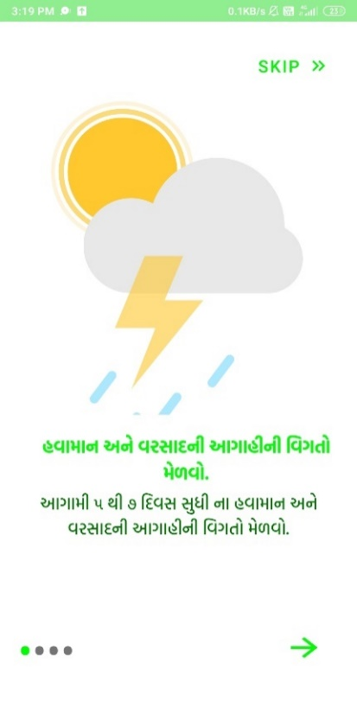
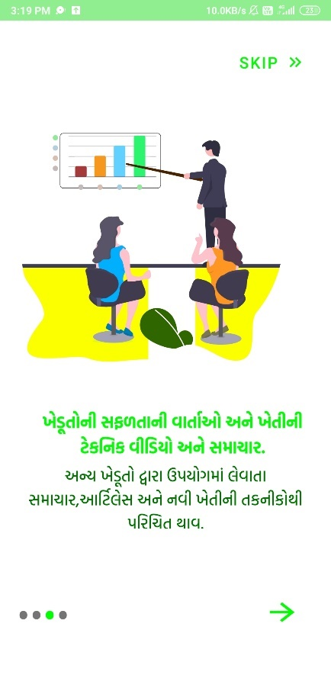
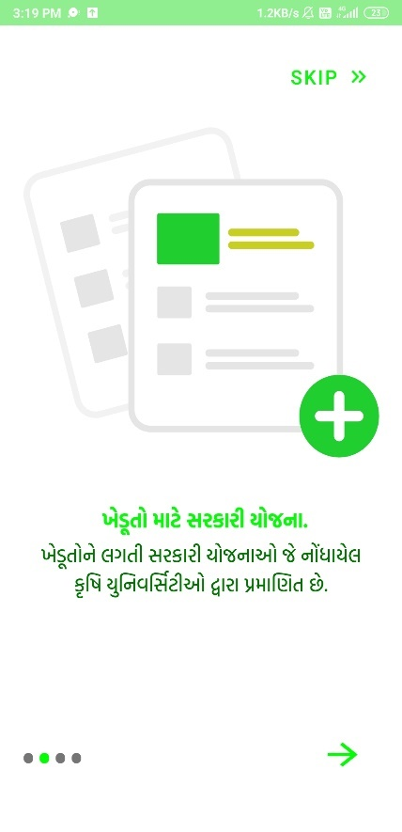
Prototype

Slide 11
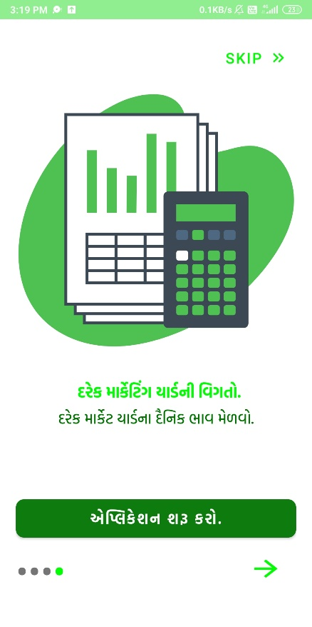
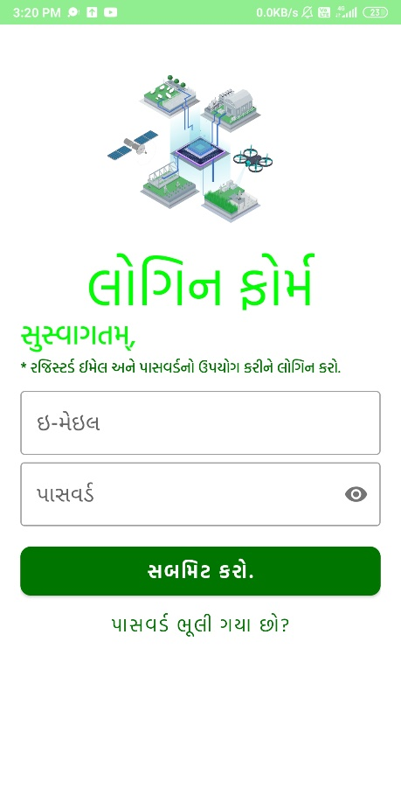
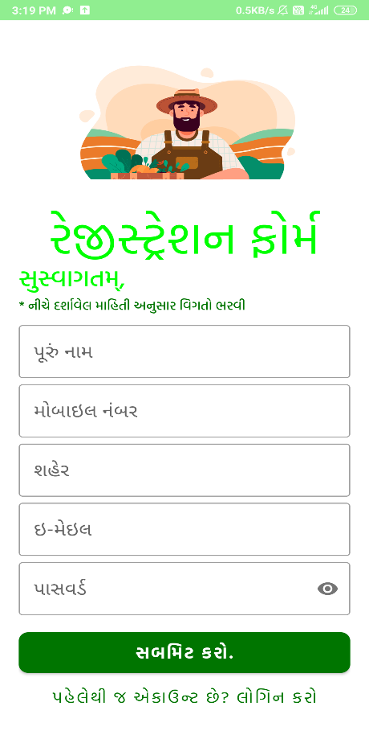
AUTHENTICATION

Slide 12
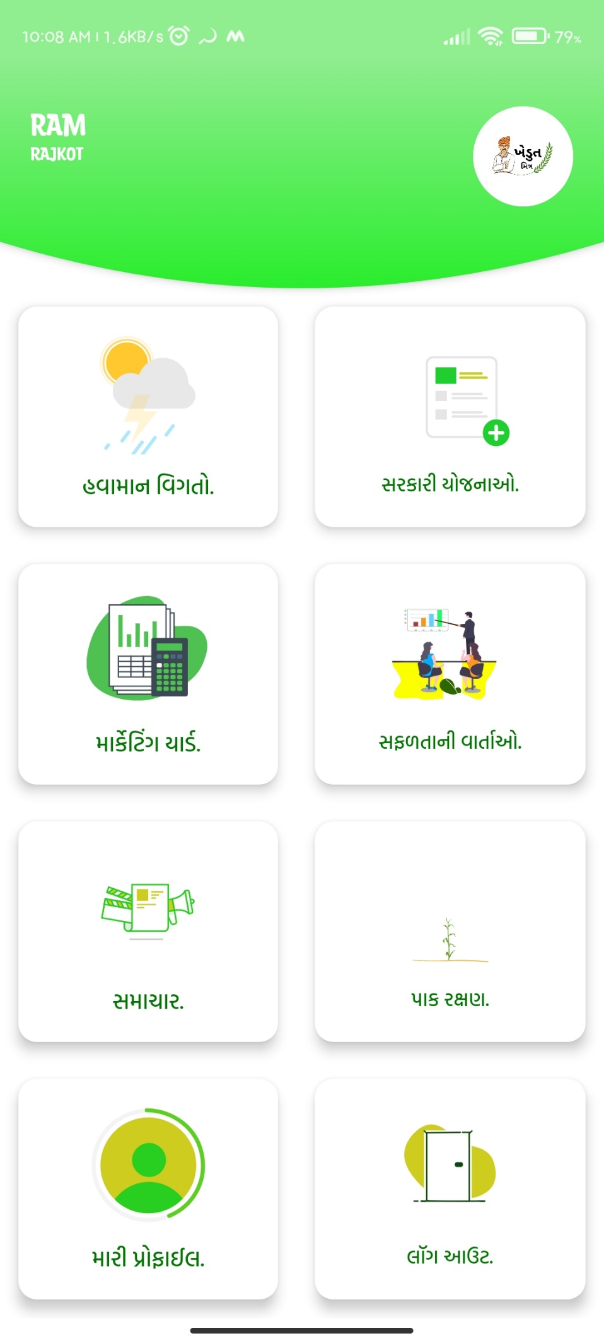
DASHBOARD

Slide 13
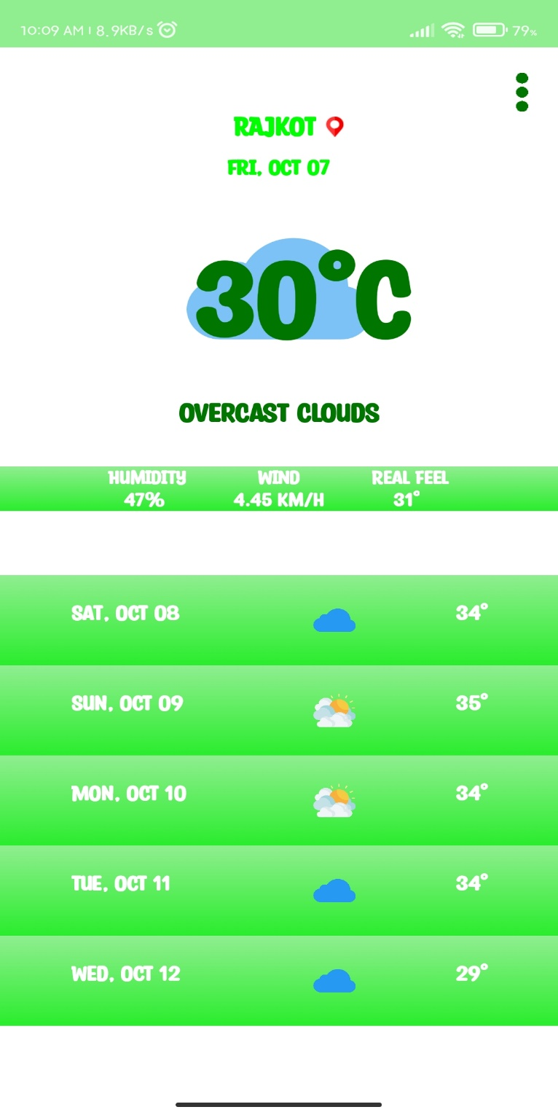
Weather (હવામાન)
In this weather Module, the users can see the weather of today and next 5 days. that will be helpful for crop growth.

Slide 14
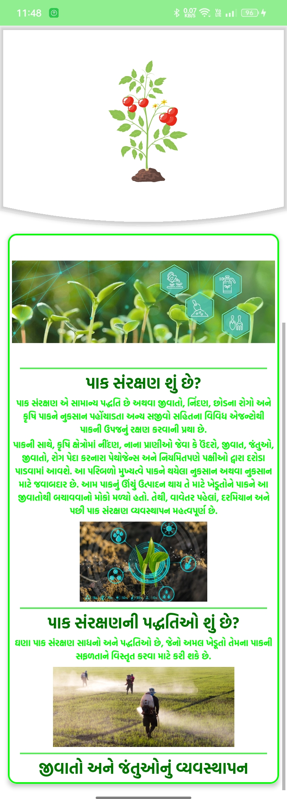
crop protection from diseases (પાક અને રોગો સામેરક્ષણ)
Crop protection module provides the list of different techniques which will be helpful to prevent from diseases of the commodity.

Slide 15
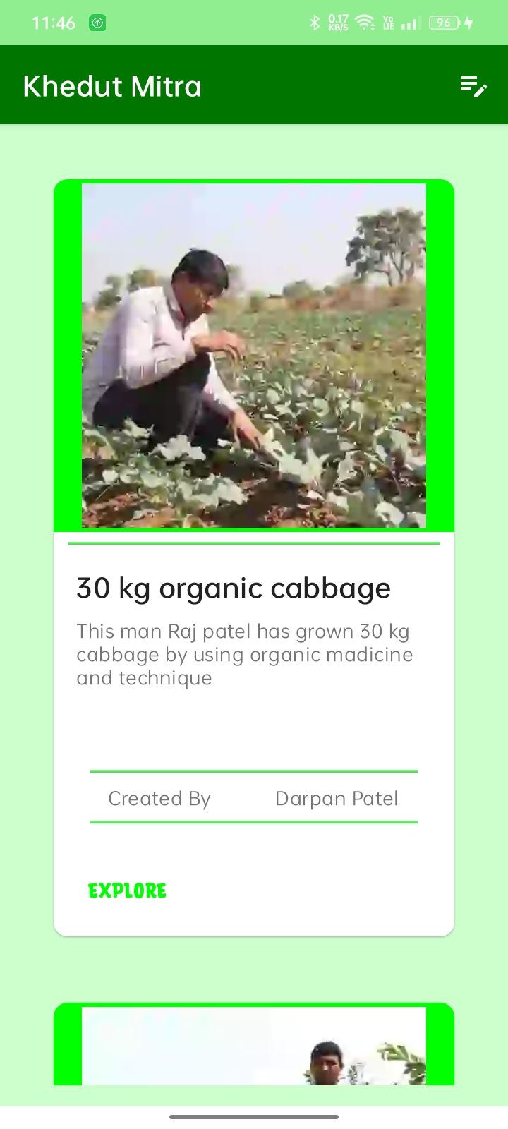
Success stories (સફલ ગાથા)
In this Success stories module, the users can see the posts of other farmers. That will be helpful for encouragement.

Slide 16
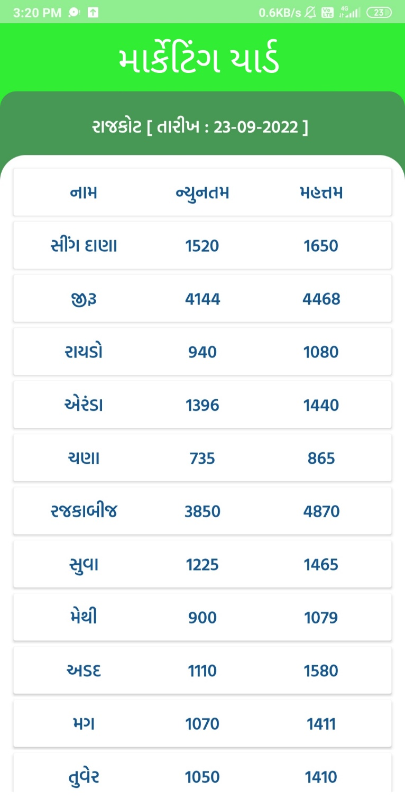
Market Yard (માકેટયાડ)
In the Market Yard module, users can check the daily market rates for the commodities in a particular region.

Slide 17
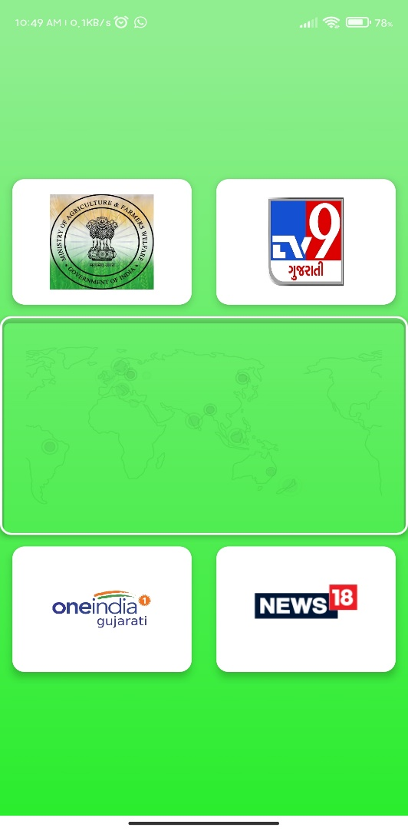
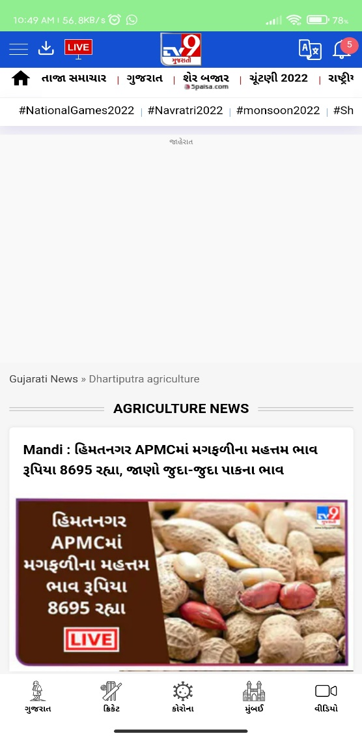
News (સમાચાર)
In this News Module, the users can see the news related to the farming. That news will be very helpful for the farmers.

Slide 18
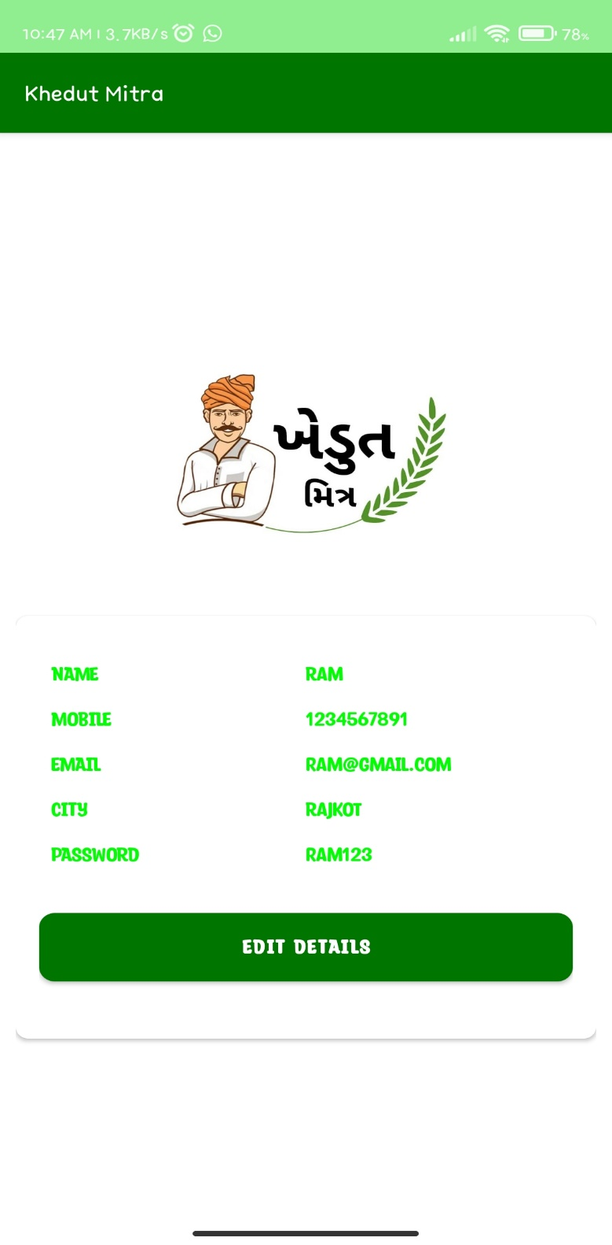
In the Profile module the users can see their details and users can add, edit, delete they details. Also, they can see they have uploaded Posts.

Slide 19
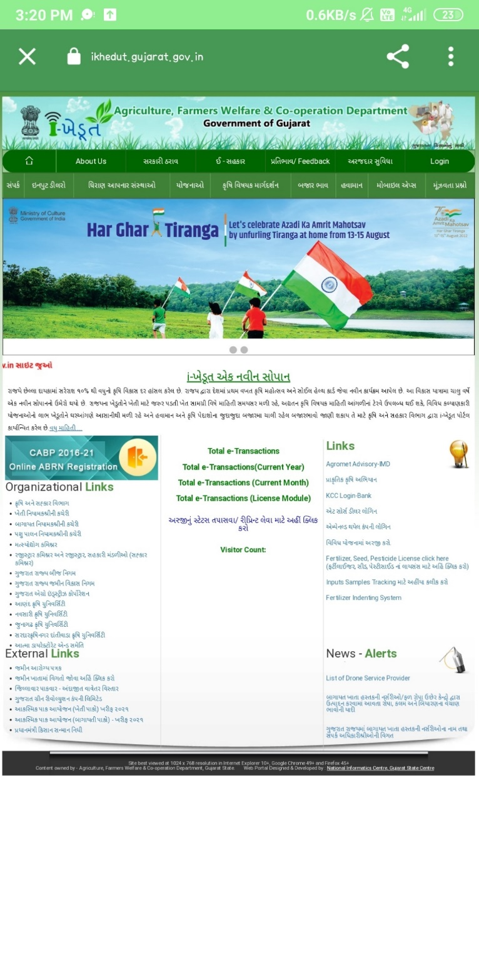
Govt. Schemes (સરકારી યોજનાઓ)
In the Schemes Module, the users can see the Government schemes for the farmers. This will be helpful for the farmer to take an advantage of schemes which will be provided by the government.

Slide 20
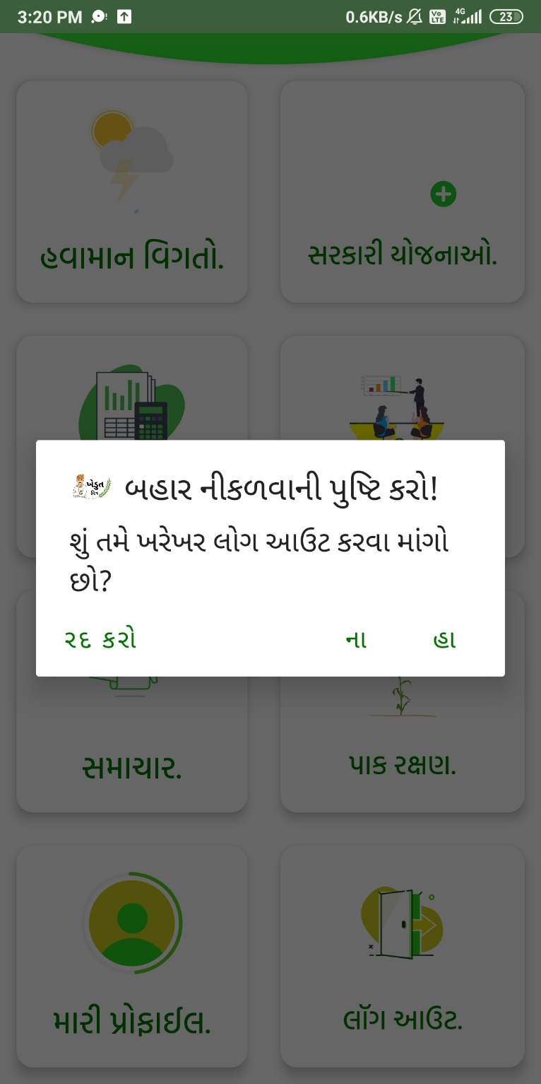
This Functionality allows the user to logout from the Account.

Slide 21
Functionality
App Language: Gujarati (ગુજરાતી)
Govt. Schemes (સરકારી યોજનાઓ)
crop protection from diseases (પાક અને રોગો સામેરક્ષણ)
News (સમાચાર)
Weather (હવામાન)
Success stories (સફલ ગાથા)
Market Yard (માકેટયાડ)

Slide 22
Future scope/Limitation
NPK Proportion calculator for the mixing of fertilizers.
panel for feedback.
other rural language support.

Slide 23
Any Questions ?

