Slide 1
CAUC204 –
Programming the internet
CSS & JAVASCRIPT
UNIT-1
Various types of CSS with its basic properties
Prepared By:
Konica Soni

Slide 2
Course Title | Teaching Scheme |  |  |  | Examination Scheme
 | Contact Hours |  |  | Credit | Theory |  |  | Practical |  |  | Total
 | Theory | Practical | Total |  | Internal |  | External | Internal |  | External
 |  |  |  |  | Case Study | Tests/ Criteria |  | Term work | Tests
Advance Web Designing | - | 3 | 3 | 3 | - | - | - | 15 | 15 | 70 | 100

Slide 3
What is advance web designing ?
This course will help you take your web design skills to the next level.
You’ll learn how to use the updated features in HTML5 and CSS3 to create flexible and modern websites, style them with new CSS techniques, optimize them for mobile platforms, use external libraries, and create animated elements.

Slide 4
A group of interlinked and well structure webpages that are exist on same domain is called website.
A webpage is a collection of Text, Images, Audio, Video, Animation, Link etc.
Web design refers to the design of websites that are displayed on internet.
Web is a huge collection of pages of information linked to each other around one globe.
It can be designed with HTML, CSS & Java Script.
HTML : Structure / Layout
CSS : Style / Decoration
Java Script : Logic

Slide 5
WHY IS CSS ?
Prior to CSS, nearly all of the presentational attributes of HTML documents were contained within the HTML markup (specifically inside the HTML tags); all the font colors, background styles, element alignments, borders and sizes had to be explicitly described within the HTML.
As a result, development of the large websites became a long and expensive process, since the style information were repeatedly added to every single page of the website.
To solve this problem CSS was introduced in 1996 by the World Wide Web Consortium (W3C), which also maintains its standard. CSS was designed to enable the separation of presentation and content. Now web designers can move the formatting information of the web pages to a separate style sheet which results in considerably simpler HTML markup, and better maintainability.

Slide 6
WHAT IS CSS ?
CSS stands for Cascading Style Sheet
The word cascading means that a style applied to a parent element will also apply to all children elements within the parent. So, if you set the color of the body text to "blue", all headings, paragraphs, and other text elements within the body will also get the same color (unless you specify something else)!
CSS is a standard style sheet language used for describing the presentation (i.e. the layout and formatting) of the web pages.
CSS3 is the latest version of the CSS specification. CSS3 adds several new styling features and improvements to enhance the web presentation capabilities.

Slide 7
Types of css
CSS can be added to HTML documents in 3 ways:
Inline
Internal
External

Slide 8
1) Inline css
An inline CSS is used to apply a unique style to a single HTML element.
Add inline CSS by using the style attribute inside HTML elements.
(We have already learned this in last semester)

Slide 9
Style attribute
The style attribute specifies the inline style for an element.
The style attribute can be used on any HTML element
Syntax :
< tag style = property: value; >

Slide 10
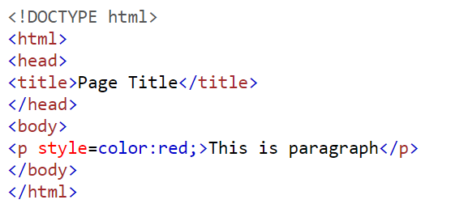

example
Input:
Output:

Slide 11
2) Internal css
An internal CSS is used to define a style for a single HTML page.
An internal CSS is defined in the <head> section of an HTML page, within a <style> element.

Slide 12
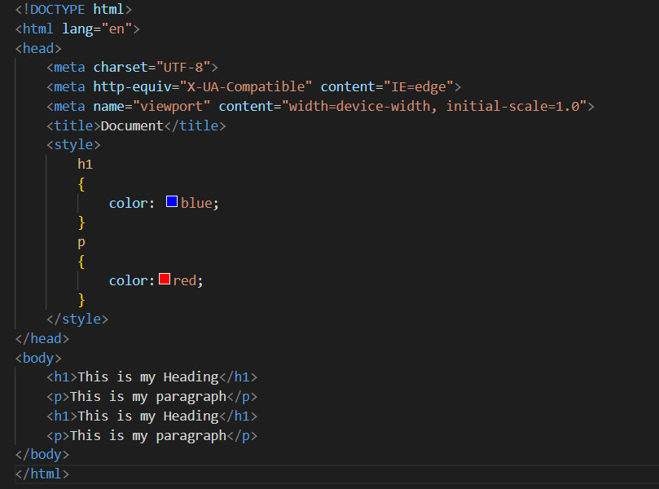
example
Input:

Slide 13
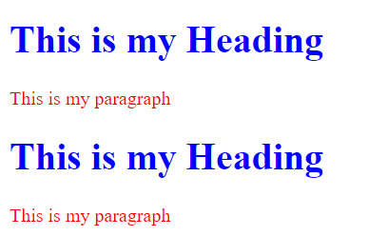
example
Output:

Slide 14
3) Extranal css
An external style sheet is used to define the style for many HTML pages.
The external style sheet can be written in any text editor. The file must not contain any HTML code, and must be saved with a .css extension.
To link an external style sheet in HTML, add a <link> to it in the <head> section of each HTML page.
The <link> HTML element specifies relationships between the current document and an external resource.
Syntax :
< link href = “style.css” rel = “stylesheet” >
  href attribute specifies the URL of the linked resource.
  rel attribute specifies relationship of the linked document to the current document

Slide 15
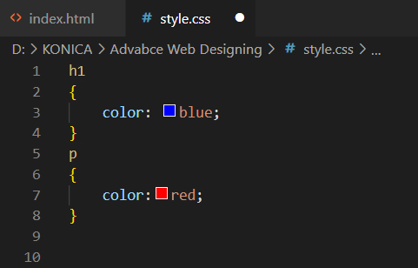
example
Input:
1) style.css

Slide 16
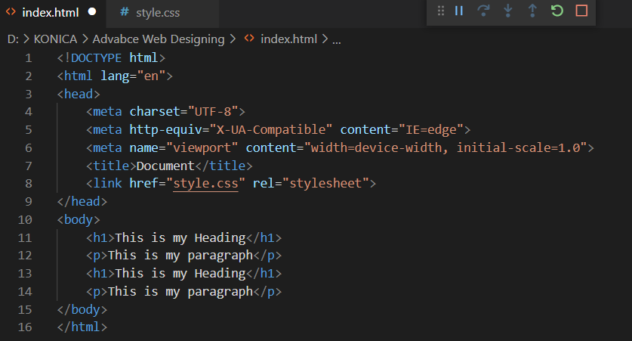
example
Input:
2) index.html

Slide 17
example
Output:
Note:
With an external style sheet, you can change the look of an entire web site, by changing one file!

Slide 18
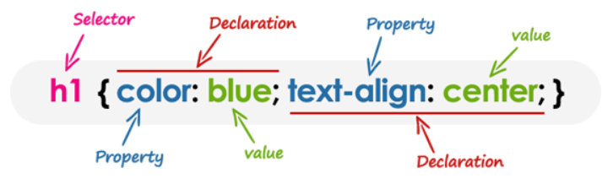
CSS syntax
A CSS consists of a set of rules that are interpreted by the web browser and then applied to the corresponding elements such as paragraphs, headings, etc. in the document.
A CSS rule have two main parts, a selector and one or more declarations:
  The selector specifies which element or elements in the HTML page the CSS rule applies to.
  Whereas, the declarations within the block determines how the elements are formatted on a webpage. Each declaration consists of a property and a value separated by a colon (:) and ending with a semicolon (;), and the declaration groups are surrounded by curly braces {}.

Slide 19
Important html attributes
1) ID attribute:
The id attribute specifies a unique id for an HTML element. The value of the id attribute must be unique within the HTML document.
The id attribute is used to point to a specific style declaration in a style sheet. It is also used by JavaScript to access and manipulate the element with the specific id.

Slide 20
Important html attributes
2) Class attribute:
The class attribute is often used to point to a class name in a style sheet. It can also be used by a JavaScript to access and manipulate elements with the specific class name.
Multiple HTML elements can share the same class.
The class attribute can be used on any HTML element.
The class name is case sensitive.

Slide 21
Rules for id and class
We can not use multiple ID attribute in one element.
We can use ID attribute only once in any HTML page.
ID gets higher priority than class in CSS.
We can use more than one class attribute in one HTML page.
We can use more than one class attribute in one element.
Example:
<p class=“c1 c2”>This is class example</p>

Slide 22
Css selector
A selector is an HTML tag at which a style will be applied. This could be any tag like <h1> or <table> etc.
property
Property − A property is a type of attribute of HTML tag. Put simply, all the HTML attributes are converted into CSS properties. They could be color, border etc.
etc.
value
Value − Values are assigned to properties.
For example, color property can have value either red or #F1F1F1 etc.

Slide 23
Types of css selector
1) Element Selector
The element selector selects HTML elements based on the element name.(Any HTML Tag).
Syntax:
Element name
{
property name:value;
}

Slide 24
example
Input:

Slide 25
example
Output:

Slide 26
Types of css selector
2) Universal Selector
The universal selector selects all HTML elements on the page.
The universal selector, denoted by an asterisk (*) Sign.
Rather than selecting elements of a specific type, the universal selector quite simply matches the name of any element type .
Syntax:
*
{
property name:value;
}

Slide 27
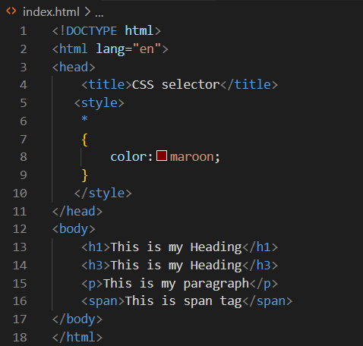
example
Input:

Slide 28
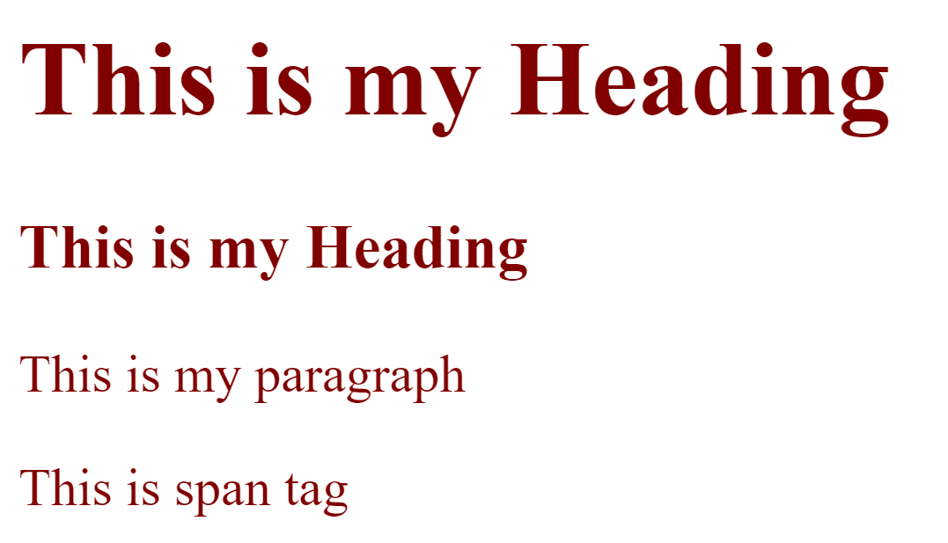
example
Output:

Slide 29
Types of css selector
3) ID Selector
The id selector is used to define style rules for a single or unique element.
The ID selector, denoted by an Hash (#) Sign.
The value of an id attribute must be unique within a given document — meaning no two elements in your HTML document can share the same id value.
Syntax:
#Element’s ID name
{
property name:value;
}
Note:
  The id name is case sensitive!
  The id name must contain at least one character, cannot start with a number, and must not contain whitespaces (spaces, tabs, etc.).

Slide 30
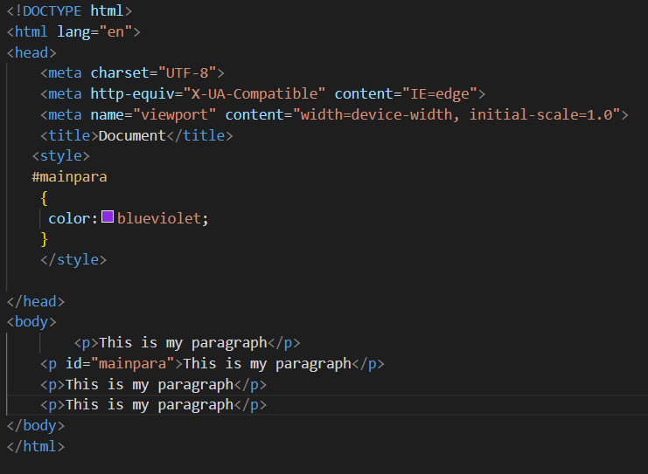
example
Input:

Slide 31
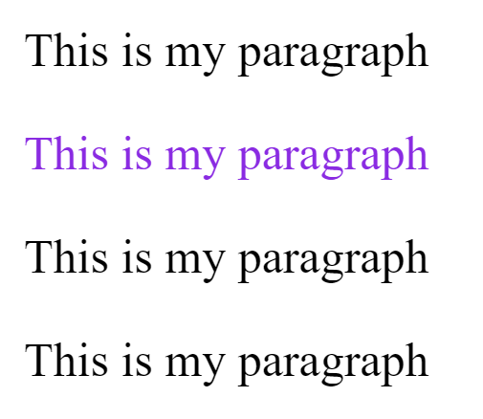
example
Output:

Slide 32
Types of css selector
4) Class Selector
The class selectors can be used to select any HTML element that has a class attribute. All the elements having that class will be formatted according to the defined rule.
The class selector, denoted by an Dot (.) Sign.
Syntax:
.Element’s class name
{
property name:value;
}
Note:
  The class name is case sensitive!
  The id name must contain at least one character, cannot start with a number, and must not contain whitespaces (spaces, tabs, etc.).

Slide 33
example
Input:

Slide 34
example
Output:

Slide 35
Types of css selector
5) Descendant Selector
You can use these selectors when you need to select an element that is the descendant of another element.
If you want to target only those <p> that are contained within <div> whose class name is mainpara, rather than targeting all <p> elements..
Syntax:
Element_name classname inside_element
{
property name:value;
}

Slide 36
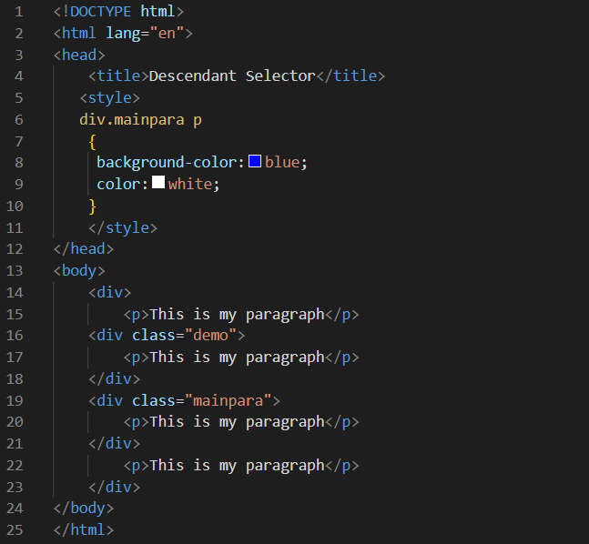
example
Input:

Slide 37
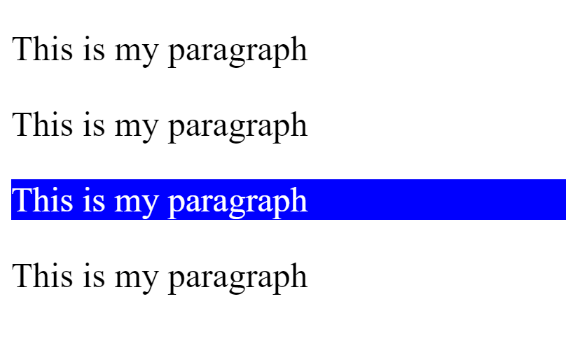
example
Output:

Slide 38
Types of css selector
6) Child Selector
A child selector is used to select only those elements that are the direct children of some element.
A child selector is made up of two or more selectors separated by a greater than symbol(>).
You can use this selector, for instance, to select the first level of list elements inside a nested list that has more than one level.
Syntax:
Element_name > Child element name
{
property name:value;
}

Slide 39
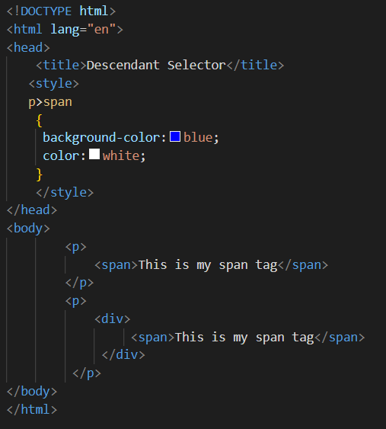
example
Input:

Slide 40
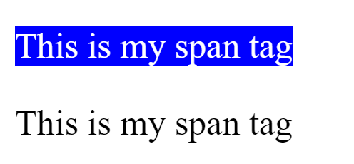
example
Output:

Slide 41
Types of css selector
7) Adjacent Sibling Selectors
It is used to select sibling elements.
This selector has the syntax like: E1 + E2, where E2 is the target of the selector.
A child selector is made up of two or more selectors separated by a plus sign(+).
The selector h1 + p in the following example will select the <p> elements only if both the <h1> and <p> elements share the same parent in the document tree and <h1> is immediately precedes the <p> element.
Syntax:
Element_name1 + Element name2
{
property name:value;
}

Slide 42
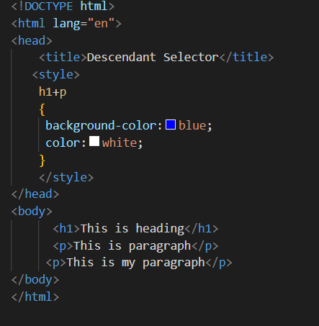
example
Input:

Slide 43
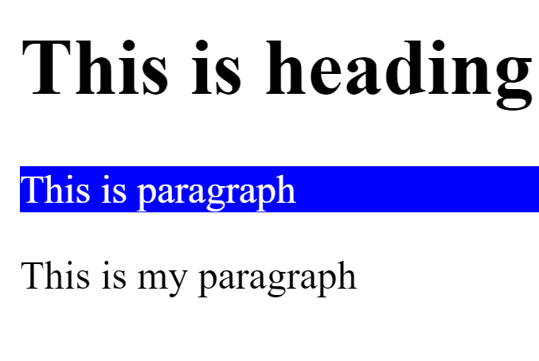
example
Output:

Slide 44
Types of css selector
8) General Sibling Selectors
It is used to select sibling elements.
This selector has the syntax like: E1 ~ E2, where E2 is the target of the selector.
A child selector is made up of two or more selectors separated by a tilde sign(~).
The selector h1 ∼ p in the example below will select all the <p> elements that preceded by the <h1> element, where all the elements share the same parent in the document tree.
Syntax:
Element_name1 ~ Element name2
{
property name:value;
}

Slide 45
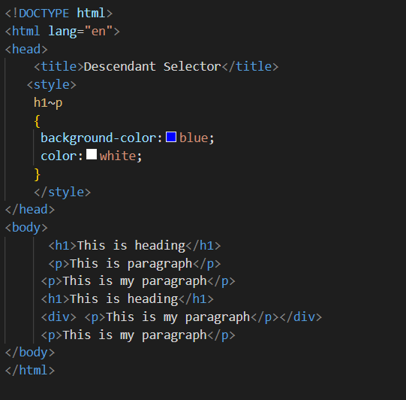
example
Input:

Slide 46
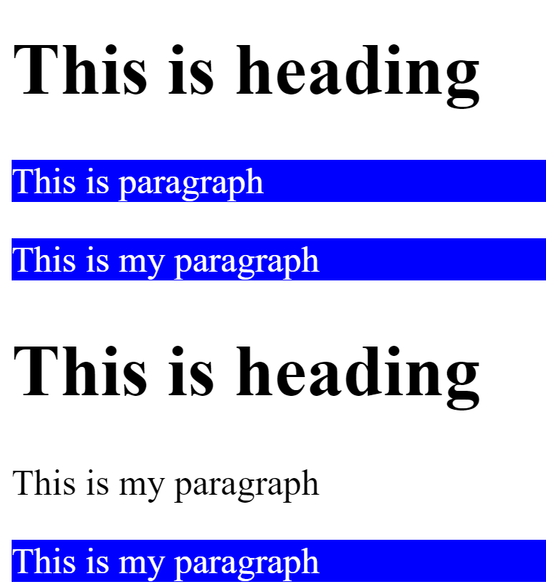
example
Output:

Slide 47
Types of css selector
9) Group Selectors
You can apply a style to many selectors if you like. Just separate the selectors with a comma(,).
Syntax:
Element1,Element2,Element3
{
property name:value;
}

Slide 48
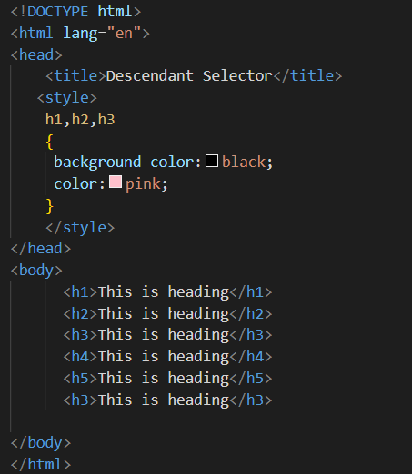
example
Input:

Slide 49
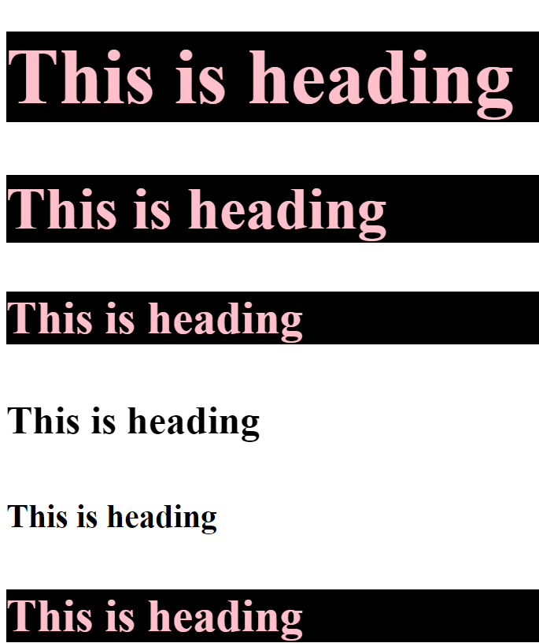
example
Output:

Slide 50
Types of css selector
10) Attribute Selectors
You can also apply styles to HTML elements with particular attributes.
Syntax:
Element_name[attribute_name=“value”]
{
property name:value;
}

Slide 51
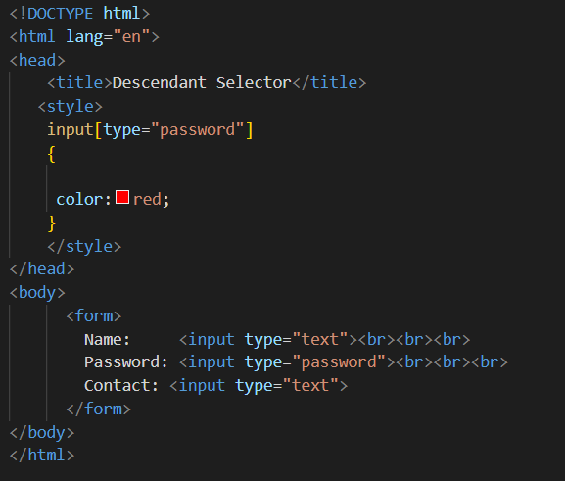
example
Input:

Slide 52
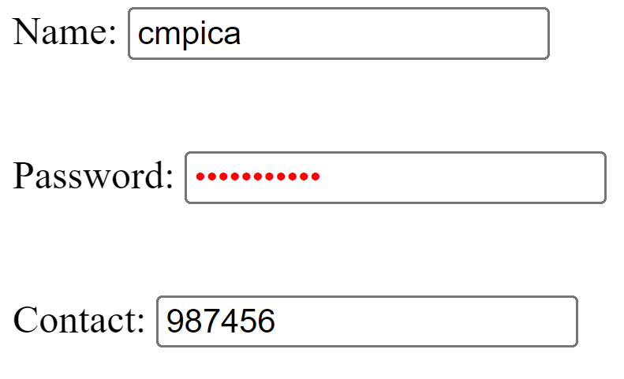
example
Output:

Slide 53
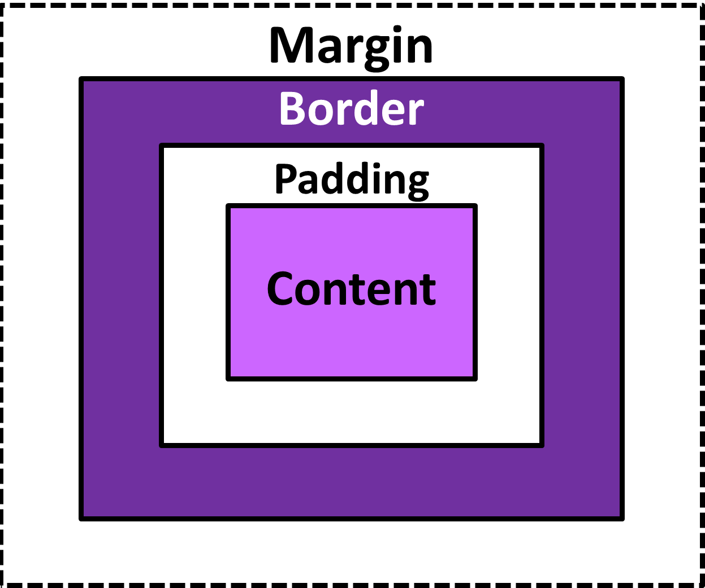
Css box model
The CSS box model is essentially a box that wraps around every HTML element. It consists of: margins, borders, padding, and the actual content. The image below illustrates the box model.

Slide 54
Css box model
Explanation of the different parts:
1) Content - The content of the box, where text and images appear
2) Padding - Clears an area around the content. The padding is transparent. space between the element's content and its border.
3) Border - A border that goes around the padding and content
4) Margin - Clears an area outside the border. The margin is transparent.
The box model allows us to add a border around elements, and to define space between elements.

Slide 55
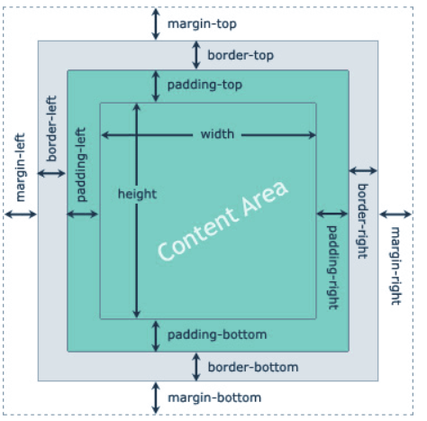
Css box model
When you set the width and height properties of an element with CSS, you just set the width and height of the content area. To calculate the full size of an element, you must also add padding, borders and margins.

Slide 56
Css box model
The total width & height of an element should be calculated like this:
Total element width =
width + left padding + right padding + left border + right border + left margin + right margin
Total element height =
height + top padding + bottom padding + top border + bottom border + top margin + bottom margin

Slide 57
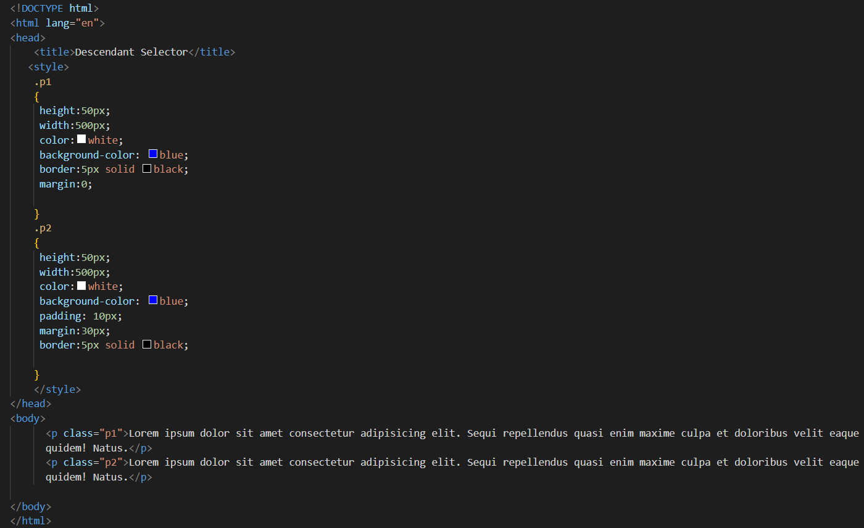
example
Input:

Slide 58
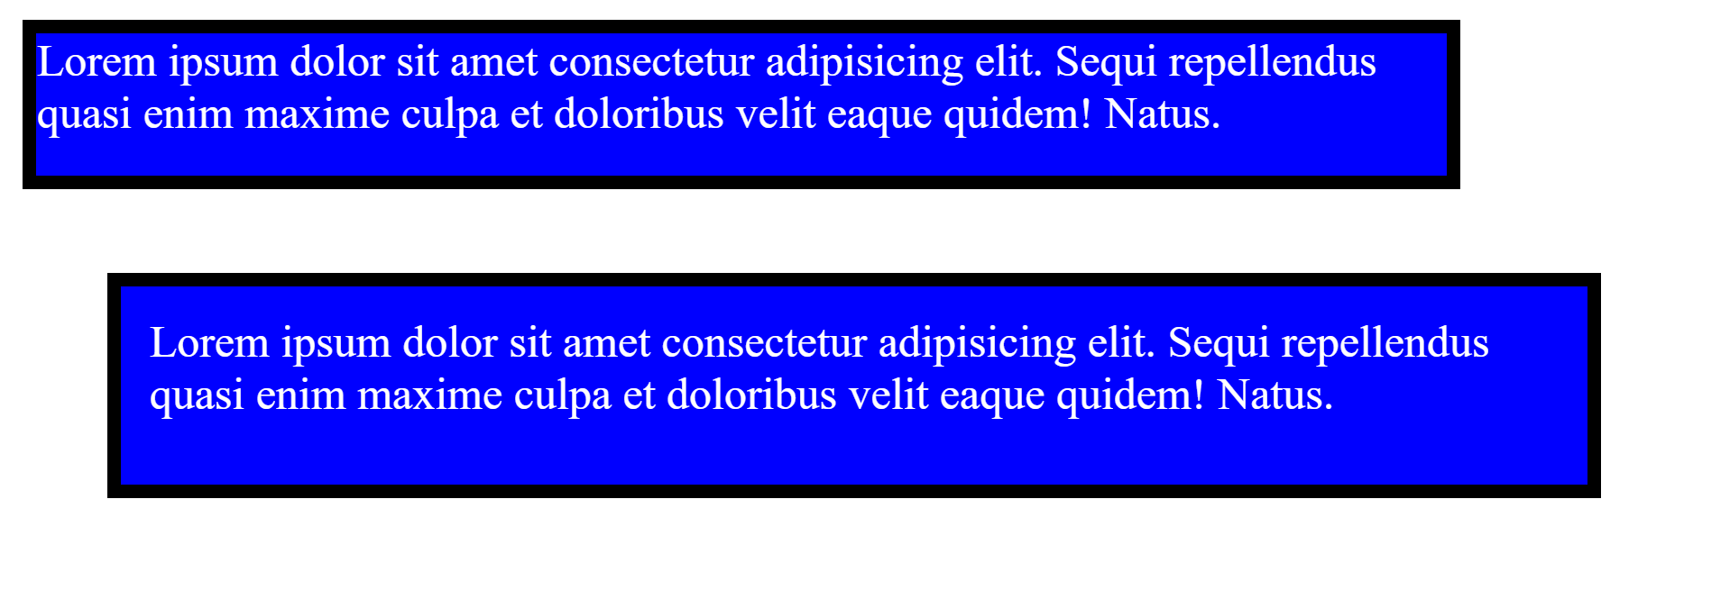
example
Output:

Slide 59
Css box model
The thickness of the padding is determined by the padding-top, padding-right, padding-bottom, padding-left, and shorthand padding properties.
The size of the margin area is determined by the margin-top, margin-right, margin-bottom, margin-left, and shorthand margin properties.

Slide 60
Cascade & inheritance
Cascading in CSS means the styling rules. This is the part where CSS can become unnecessarily complicated, even if the ability to use the cascading is occasionally useful.
What if you have two CSS classes that have conflicting properties?” Which one is applied?

Slide 61
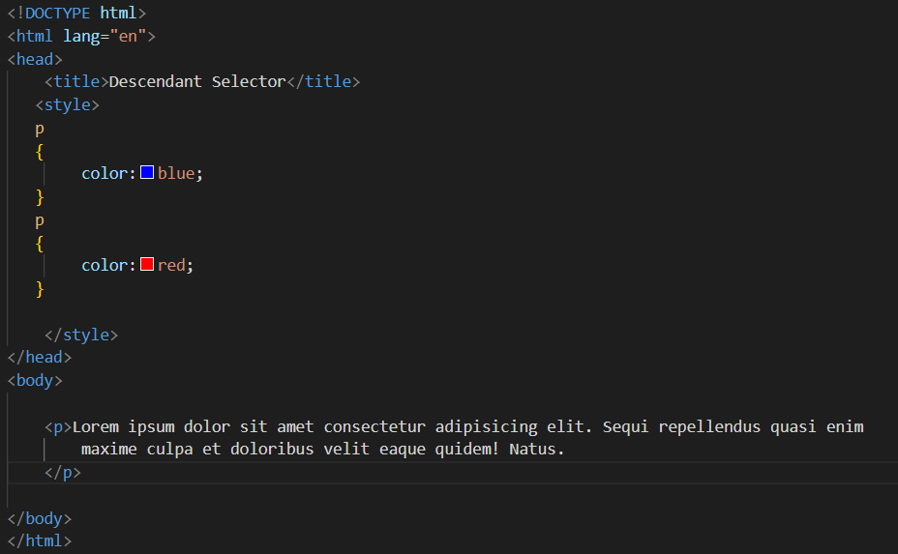
example
Input:

Slide 62
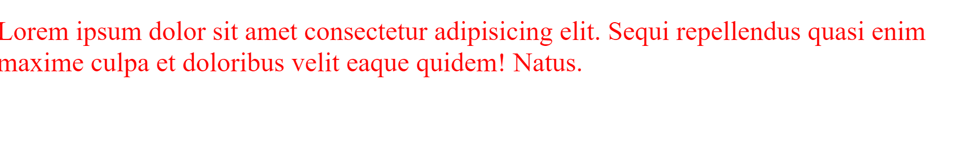
example
Output:
Note:
In above example, we have two color properties with the same <p> tag. So which one gets applied? Here comes the role of C in CSS, Since they’re equal, the one that comes last wins. So in this case, the <p> would be red.
So remember the rule: when everything is equal, the last one gets applied.

Slide 63
Cascade & inheritance
Inheritance is a concept that we see in our day-to-day life. Children inherit features like height, eyes, nose, etc. from their parents.
In CSS inheritance, the child element will naturally inherit properties from its parent element.

Slide 64
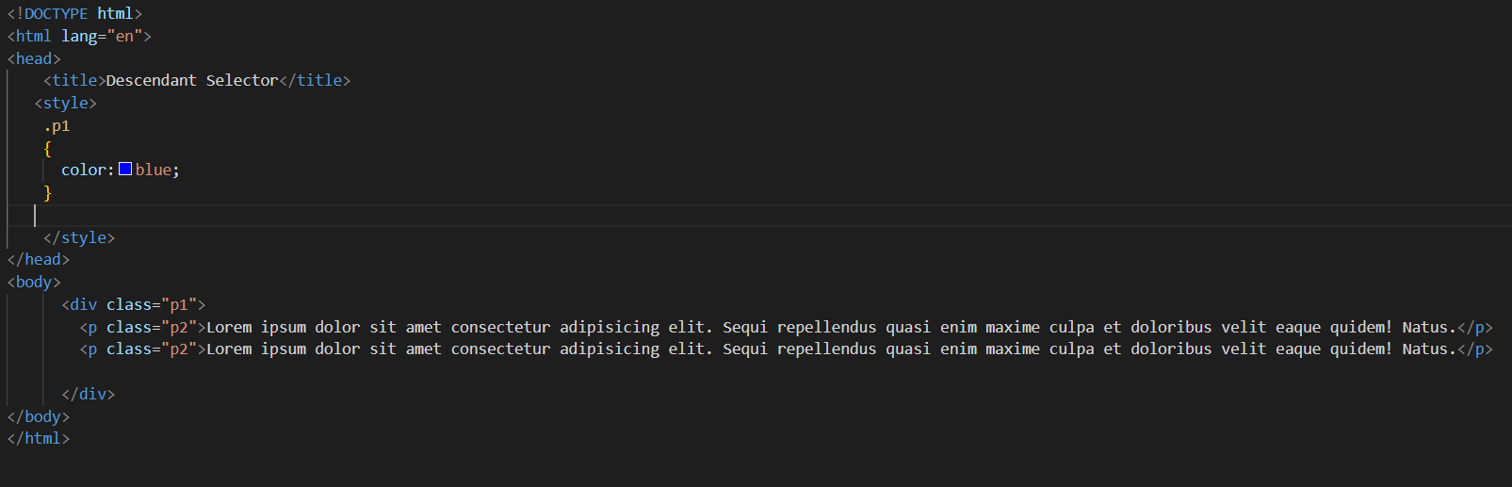
example
Input:

Slide 65
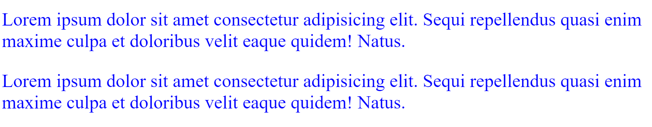
example
Output:
Note:
In above example, parentclass:p1 passes a CSS styling done as color to be blue. Whereas the child classes : p2 has no ruleset of color: blue set to them but they got displayed in blue.
It is because the child p2 inherited the properties from the parent i.e. p1

Slide 66
specificity
When more than one set of CSS rules apply to the same element, the browser will have to decide which specific set will be applied to the element. The rules the browser follows are collectively called Specificity.
Specificity Rules include:
  CSS style applied by referencing external stylesheet has lowest precedence and is overridden by Internal and inline CSS.
  Internal CSS is overridden by inline CSS.
  Inline CSS has highest priority and overrides all other selectors.

Slide 67
specificity
Specificity Hierarchy :Every element selector has a position in the sequance.
Inline style: Inline style has highest priority.
Identifiers(ID): ID have the second highest priority.
Classes and attributes: Classes and attributes are come next.
Elements : Elements have lowest priority.

Slide 68
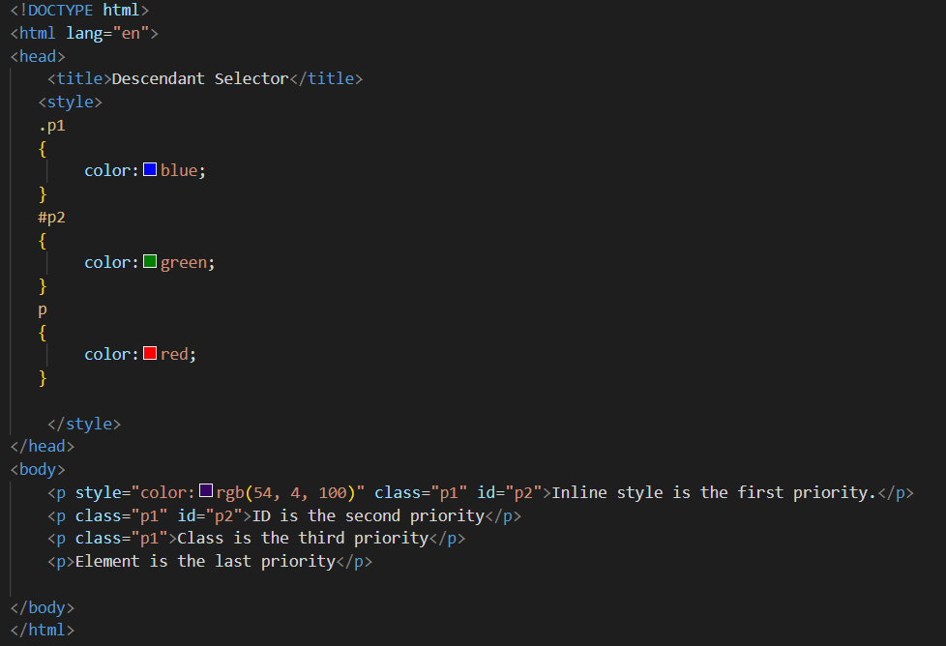
example
Input:

Slide 69
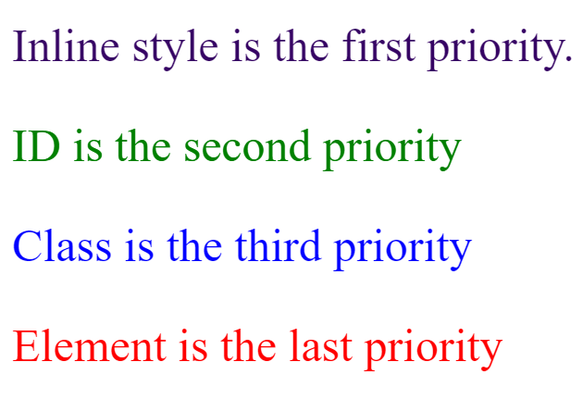
example
Output:

