Slide 1
CUHK(SZ) Online Interview Thesis Defense
Review of previous research
Name: Bo PANG 庞博
Major: Economics
School: Peking University
Date: 2023-05

Slide 2
Roadmap
Education Background
B.A. Economics Shanghai University of Finance and Economics
B.S. Applied Mathematics
M.A Economics, Peking University HSBC Business School
M.S. Financial Engineering, National University of Singapore
Papers
Ⅰ. Analysis of convenience yield on cryptocurrency market
  (Finance) Market microstructure topic
Ⅱ. Empirical study on the herding effect and its causes of stock funds in China
  (Finance) Behavior finance topic
Ⅲ. Empirical asset pricing via machine learning in the Chinese Stock Market
  (Accounting) Financial Accounting and Data Science topic
IV. Analysis of factors and changes affecting fund performance in PCA
  (Statistics) Applied Statistics topic TBD
V. Proposal on data assets
  Research on the Relationship between Data Assets and Capital Market

Slide 3
Roadmap
Analysis of convenience yield on cryptocurrency market
Jaehyuk Choi, Bo Pang
Ⅰ. Motivation
Ⅱ. Introduction
Ⅲ. Theoretical Framework
IV. Regression Design
V. Regression Results
VI. Summary

Slide 4
Ⅰ. Motivation
Definition of convenience yield
  income of holding spot than futures. For example, the utility or profit of usage.
  need to do the adjustment of the carrying cost, and so on
Definition of basis, a similar concept
  difference between the spot price and future price.
  mainly reflects the transportation and holding costs between the spot and futures markets.
The relationship between convenience yield and basis
  convenience yield is a subjective concept
    that exists but is inconvenient to directly observe, and it is necessary to find a visual indicator for it;
  while basis is a statistically observed concept
    that is affected by many parties, it is necessary to find a qualitative reason for it.

Slide 5
Ⅰ. Motivation
Research Background: A new world of Decentralized Finance and Economics
  unique finance and derivatives markets which develop rapidly and attract academic attention
  difficulty in valuing the underlying assets (i.e. cryptocurrencies),
  high moral hazard among the large number of exchanges without supervision,
  widespread adoption of perpetual swaps (Without Due Date and Execution) in the derivatives market.
Propose : Why cryptocurrency has interest rate?
  Its underlying asset is considered to have no use value, hence no interest rate
  DeFi and new products has made it useful, with its interest recognized by the market
  We can quantify this phenomenon in terms of convenience yield, and figure out its relationship with market.
Why I choose this topic? – Fill in the Gap: new markets, product, data and perspectives
  Related economic and financial theories cannot explain directly some phenomena very well: full of controversy
  Meaningful to policy makers: How to Define the Bitcoin Market via its Microstructure
  Meaningful to investors: Discover how the market works and arbitrage trading opportunities

Slide 6
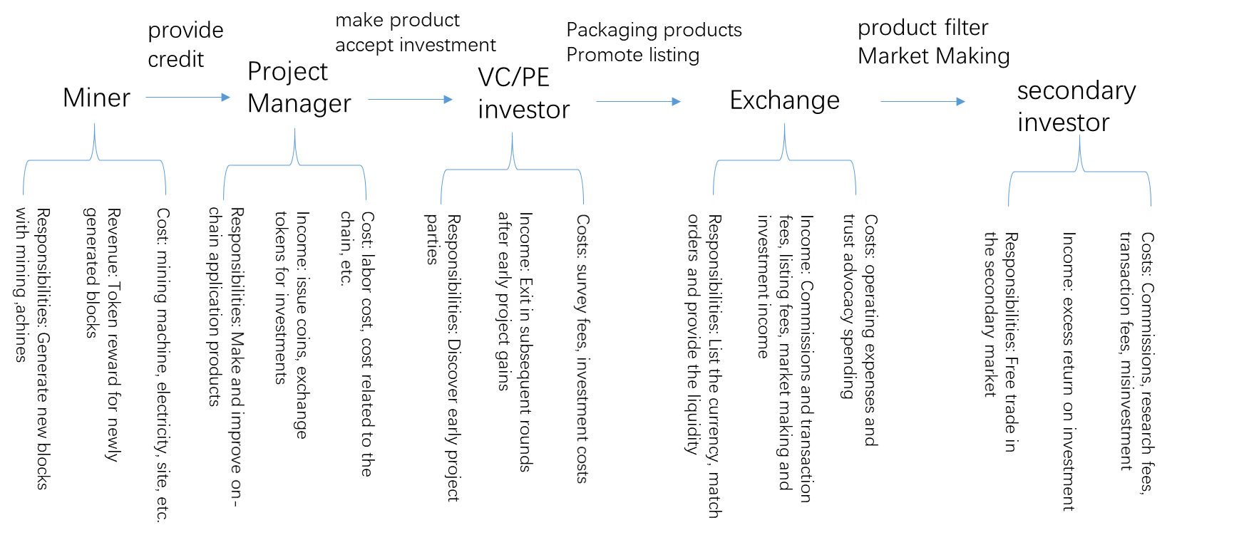
Ⅱ. Introduction
Cryptocurrency market participants (microstructure) in case study/interviewing
Transaction Mechanism:
  external reasons inside mkt
  expectations of participants in the market
  the transactions of participants
  the flow of money
  prices change
  data that bring analysis clues of convenient yield
Cryptocurrency Exchange (Key Player)
  Unregulated.
  spontaneously doing all the business of the upstream and downstream.
  most profitable inside the industry
  resulting in all kinds of strange innovations inside industry, for example, perpetual swap.

Slide 7
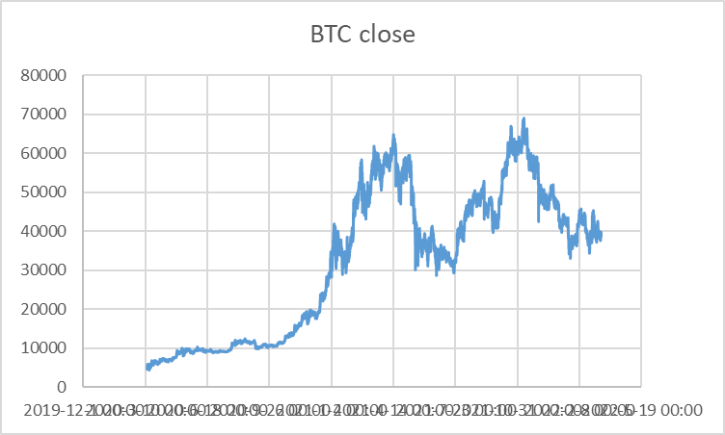
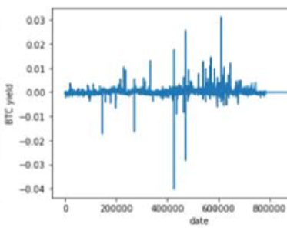
Ⅱ. Contribution
First, we adopted a novel topic selection.
  study the cryptocurrency market makeup
  develop a theoretical model of perpetual swap
  explain the makeup of convenience yield this market
  put forward reasonable assumptions and inferences.
Second, we employed new data and methodology.
  16 major cryptocurrencies
  minute frequency data from Binance Exchange
  unique independent variable data with weekly frequency.
  models of reflexivity for systemic explanation
Finally, we added an important “5.19” breaking point.
  compare parameters before and after “5.19” → use RD in the regression
  case analysis method: market microstructure and intelligence analysis

Slide 8
Ⅲ. Theoretical Framework
Source of convenience yield (normal commodity):
  the cash flow obtained by the resource owner from the temporary price increase -> investment value
  the income or utility generated by the ability applicable to production activities -> usage value.
  minus the cost of holding-spot: transportation, quality inspection, warehousing storage, issuing invoices
Source of convenience yield (cryptocurrency, respectively):
  *Normally NO investment value, due to the perpetual contract
  mining revenue: POS (Proof of Stake)-like mechanism
  market-making (or trading) revenue: provide liquidity for their financial market transactions
  some illegal transactions (actual usage cases) or behaviors will require cryptocurrencies as their medium, such as pornography, gambling, drug money laundering, etc.

Slide 9
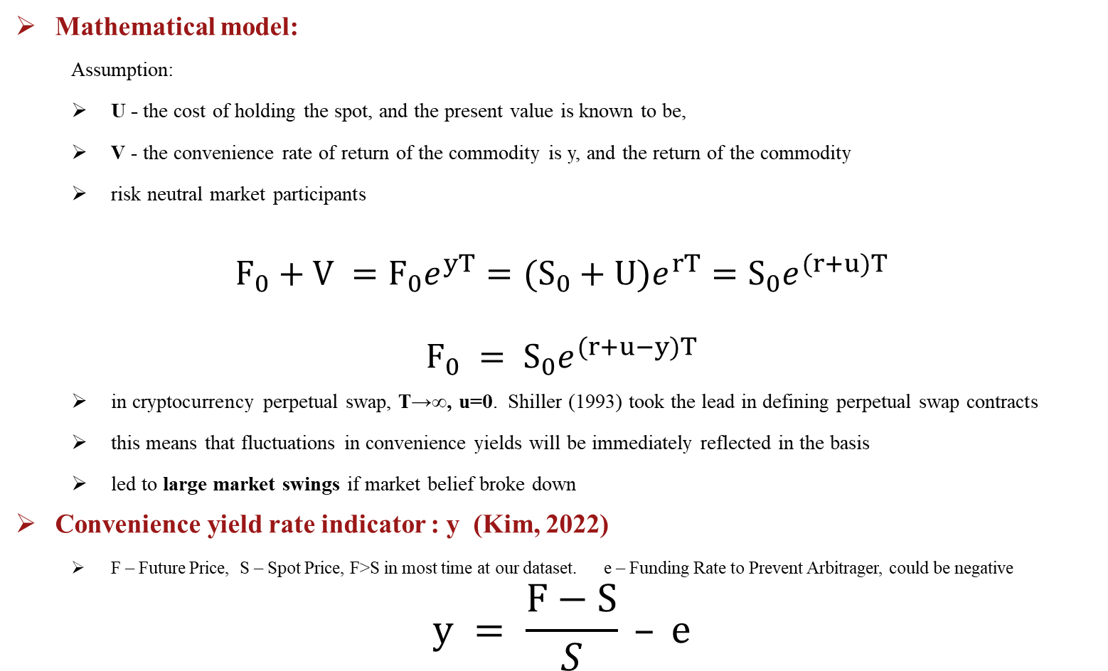
Ⅲ. Theoretical Framework
Mathematical model:
  Assumption:
  U - the cost of holding the spot, and the present value is known to be,
  V - the convenience rate of return of the commodity is y, and the return of the commodity
  risk neutral market participants
$$F_{0}+V =F_{0}e^{yT}=(S_{0}+U)e^{rT}=S_{0}e^{(r+u)T}$$
$$F_{0} = S_{0}e^{(r+u−y)T}$$
  in cryptocurrency perpetual swap, T→∞, u=0. Shiller (1993) took the lead in defining perpetual swap contracts
  this means that fluctuations in convenience yields will be immediately reflected in the basis
  led to large market swings if market belief broke down
Convenience yield rate indicator : y (Kim, 2022)
  F – Future Price, S – Spot Price, F>S in most time at our dataset. e – Funding Rate to Prevent Arbitrager, could be negative
$$y = \frac{F−S}{S} – e$$

Slide 10
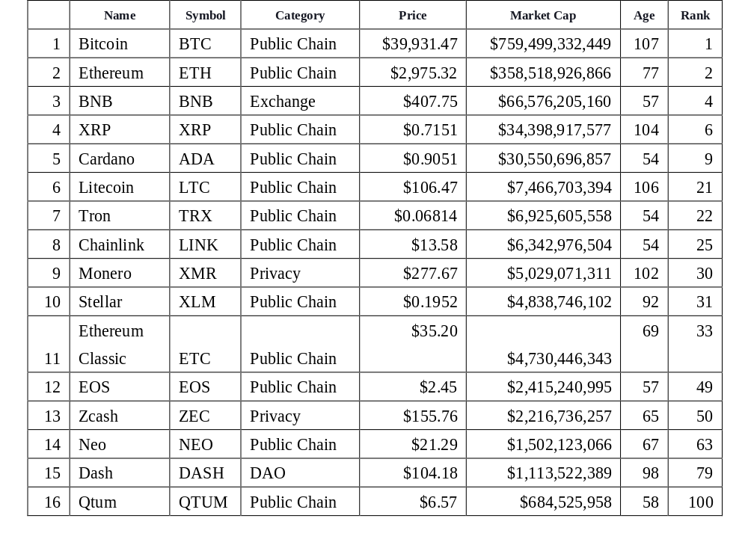
Ⅳ. Regression Data
Currency used for analysis:
  relative large market-cap and stable price
  long time and ranks high
  listed on exchanges
  good data availability
  high reputation
  Some intrinsic-value
Time Period:
  2 years minute level tick data
  Aggregrate as hour-level when regression for robustness
Other Influencer:
  Hourly or Weekly
  Due to availability
Table : Basic Information for top tie cryptocurrencies at May 16, 2022

Slide 11
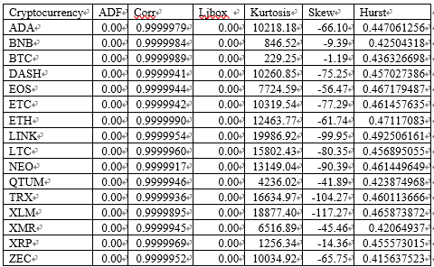
IV. Regression Data
Descriptive statistics on the convenience yield of different cryptocurrencies
  1. robust and significantly different from white noise
  2. high kurtosis and a strong fat-tailed distribution
  3. biased significantly at "5.19“ crisis
  4. Hurst<0.5, mean reversion
  Our measure is of great quality
mean | P(t > 0)
5.84E-05 | 0
4.29E-05 | 0
3.81E-06 | 0
6.39E-05 | 0
6.31E-05 | 0
6.73E-06 | 0
2.68E-05 | 0
2.95E-05 | 0
4.47E-05 | 0
-2.56E-05 | 1
-0.000716 | 1
-6.97E-05 | 1
7.62E-05 | 0
-7.71E-05 | 0
4.69E-05 | 0
9.01E-05 | 0
Two-side Granger test:
  We get significant results within ten lags.
  The spot market and the futures market are two-way Granger correlated and endogenous systems.
  good evidence for reflective system model we used here.

Slide 12
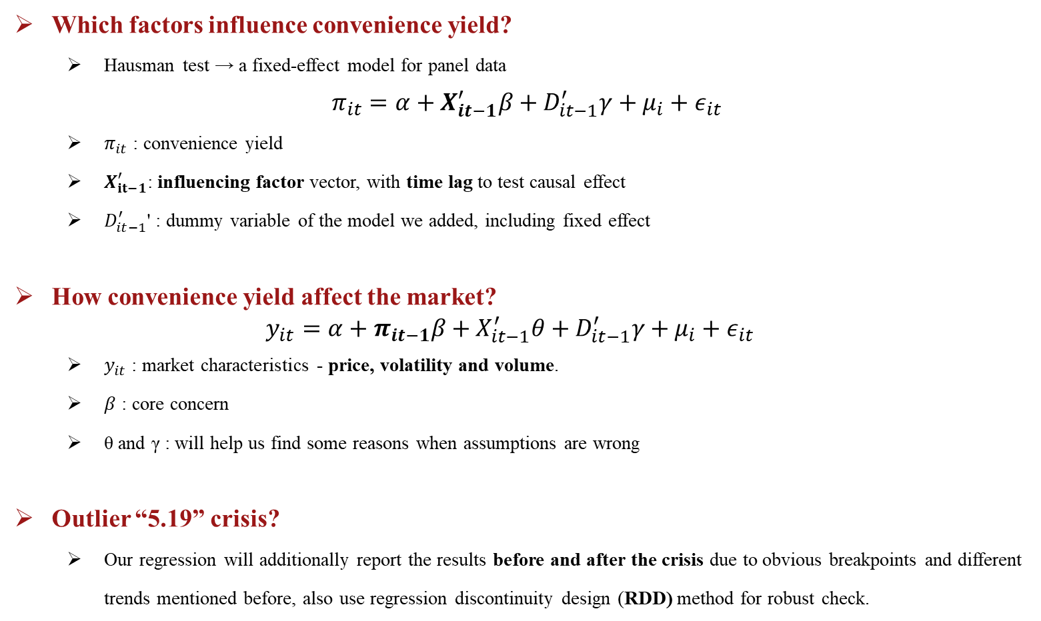
Ⅳ. Regression Models
Which factors influence convenience yield?
  Hausman test → a fixed-effect model for panel data
$$π_{it}=α+X_{it−1}^{′}β+D_{it−1}^{′}γ+μ_{i}+ε_{it}$$
  $π_{it}$ : convenience yield
  $X_{it−1}^{′}$: influencing factor vector, with time lag to test causal effect
  $D_{it−1}^{′}$' : dummy variable of the model we added, including fixed effect
How convenience yield affect the market?
$$y_{it}=α+π_{it−1}β+X_{it−1}^{′}θ+D_{it−1}^{′}γ+μ_{i}+ε_{it}$$
  $y_{it}$ : market characteristics - price, volatility and volume.
  $β$ : core concern
  θ and γ : will help us find some reasons when assumptions are wrong
Outlier “5.19” crisis?
  Our regression will additionally report the results before and after the crisis due to obvious breakpoints and different trends mentioned before, also use regression discontinuity design (RDD) method for robust check.

Slide 13
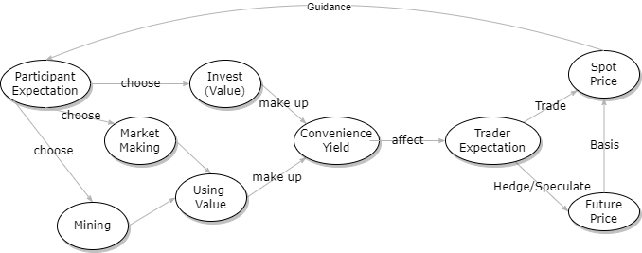
IV. Hypothesis of transmission mechanism we want to verify：
Diagram of casual relationship in complex system control theory (Li, 2010,MIS)
  Left is the source of convenience yield from industry research.
  Right represents how traders' expectations of convenience yield affect the market.
  No direct database or even IV variables, very hard to verify that complex network.
I refer to the graph hypothesis research methodology as commonly used in ISOR paper
  Assuming that our system is established, according to logic deduction, we will have many subsequent results and information that can be observed, in econometrics.
  Try my best to create some link between what I have and what I want.
  If all our evidence support the assumption, it means that we can only believe the original model to a large extent.

Slide 14
Ⅳ. Hypothesis
Which factors influence convenience yield? A series of Hypothesis
Market quotation conditions Influence
  For market making, volume, turnover will increase the benefits and open interest will reduce the risk, hence ∝ convenience yield
  Volatility will increase the cost of market making, hence ∝ - convenience yield
Cryptocurrency basic information Influence
  top-ranked mainstream currencies more mining and investment value ∝ convenience yield
Market hot topic Influence
  Higher market popularity will increase the investment and mining income ∝ convenience yield.
Holder's portrait Influence
  More institutional participants is a symbol of capture all good characteristics before. ∝ convenient yield
Time Influence (Control)
  Working days (especially Wednesday&Thursday) and working hours (GMT +8 10:00-16:00)
How convenience yield affect the market? causal relationship question
  Increase Price, volume: Similar to good news to traditional stock market
  Not clear for Volatility: Spot buyers place larger additional orders, increasing volume, offsetting volatility from rising prices - making its impact on market volatility difficult to measure

Slide 15
Ⅳ. Empirical Framework
Core research questions and models of reflexivity:
Key problem | Common influencing factors | Guessing Observable Variables (Has passed through non-Multi-Collinearity treatment)
What affects convenience yield | Market influence mechanism | Spot and futures market volume/number of trades, turnover, volatility, open interest
 | time-effect mechanism | Divide the working day of seven days a week, and divide it into three working time periods in one day
 | Currency Basic Information Influence Mechanism | Fixed effects of different currencies, correlation with the broader market (BTC), simple statistics and graphs of other basic information
 | Origin of autoregressive effect | Time series indicator
 | Market Heat Influence Mechanism | Telegram sentiment indicator, total addresses held
 | Holder Portrait Influence Mechanism | Data on the number of holders classified according to the length of holding time, the amount of assets, whether they are Dealer, and the holding concentration index of the currency
How convenience yields affect the market | Transmission Mechanisms Affecting Prices | Take the market price of the next period and explore the underlying transmission mechanism by controlling for other variables
 | Transmission Mechanisms Affecting Transaction Activity | Take the market volume of the next period and explore the underlying transmission mechanism by controlling for other variables
 | Transmission Mechanisms Affecting Market Risk | Take the market volatility of the next period and explore the underlying transmission mechanism by controlling for other variables
Convenience yield in crisis | The Crisis Theory of Convenience Yield | Collect textual information and conduct case studies on market microstructure

Slide 16
V. Regression Results
Convenience yield influencers (hourly frequency)
Spot market and futures market trading volume effect changed from positive to negative.
Indicates that the market structure changed a lot.
2. AR1 accounted for nearly all explanatory power.
most variables do not have explanatory power, and many of the effects we originally expected were not significant.
 | All time period |  | Before”5.19” |  | After”5.19”
 | All X | AR(1) | All X | AR(1) | All X | AR(1)
Convenience yield lag1 | 0.8096 | 0.8106 | 0.8037 | 0.8055 | 0.8046 | 0.8073
 | -0.001 | 0.001) | 0.002) | 0.002) | 0.001) | 0.001)
 | *** | *** | *** | *** | *** | ***
Volume spot | -9.00E-12 |  | 4.43E-12 |  | -1.65E-11
 | -1.52E-12 |  | -3.21E-12 |  | -1.97E-12
 | *** |  |  |  | ***
Volume future | -7.40E-13 |  | 1.59E-12 |  | -1.99E-12
 | -3.92E-13 |  | -5.69E-13 |  | -6.23E-13
 | * |  | *** |  | ***
Monday | 4.92E-07 |  | -4.50E-07 |  | 1.47E-06
 | -2.33E-06 |  | -3.53E-06 |  | -3.08E-06
Tuesday | 9.90E-06 |  | 1.01E-05 |  | 9.78E-06
 | -2.34E-06 |  | -3.56E-06 |  | -3.08E-06
 | *** |  | *** |  | ***
Wednesday | -1.38E-05 |  | -1.75E-05 |  | -1.08E-05
 | -2.34E-06 |  | -3.55E-06 |  | -3.08E-06
 | *** |  | *** |  | ***
Thursday | -5.40E-06 |  | 2.62E-06 |  | -1.09E-05
 | -2.34E-06 |  | -3.55E-06 |  | -3.10E-06
 | ** |  |  |  | ***
Friday | -1.28E-07 |  | -5.39E-06 |  | 3.79E-06
 | -2.35E-06 |  | -3.56E-06 |  | -3.09E-06
Saturday | 6.31E-07 |  | -1.39E-05 |  | 1.06E-05
 | -2.33E-06 |  | -3.55E-06 |  | -3.07E-06
 |  |  | *** |  | ***
Before dawn | 4.77E-06 |  | -7.38E-06 |  | 1.36E-05
 | -1.37E-06 |  | -2.08E-06 |  | -1.80E-06
 | *** |  | *** |  | ***
Work hour | -2.85E-06 |  | -1.01E-05 |  | 3.28E-06
 | -1.37E-06 |  | -2.10E-06 |  | -1.81E-06
 | ** |  | *** |  | *
Adj R² | 0.751 | 0.75 | 0.693 | 0.693 | 0.773 | 0.771
N | 2396745 | 2396745 | 1078535 | 1078535 | 1318210 | 1318210
3. No time variables effect.
We believe the reason is that the market is open 7*24.
However, the significant positive result means it has contain other information that we need to dig out.
Fixed Effect results(16 lines) on the table are skipped; VIF <5 for all

Slide 17
V. Regression Results
 | All | All with RDD | Before “5.19” | After “5.19”
Retail | -0.0003 | 0.0004 0.001 | 0.0017 | 0.0017
 | 0 |  | -0.001 | -0.001
 | *** |  | *
Volatility | 0.003 | 8.597e-05 (3.6e-05) | 0.0002 | -0.0005
 | -0.001 | ** | -3.27E-05 | -9.53E-05
 | *** |  | *** | ***
Total Address | -1.98E-11 | -7.13E-12 | 5.66E-12 | -1.97E-11
 | -4.78E-12 | -4.61E-12 | -9.24E-12 | -1.01E-11
 | *** |  |  | *
Sentiment | -1.78E-08 | -1.53E-08 | 1.23E-07 | -1.43E-08
 | -4.59E-09 | -4.28E-09 | -1.19E-07 | -4.97E-09
 | *** | *** |  | ***
Open Interest | 1.32E-13 | 1.83E-13 | 2.39E-13 | 1.83E-13
 | -2.52E-14 | -2.40E-14 | -4.36E-14 | -5.86E-14
 | *** |  | *** | ***
Num.Transaction | 9.57E-10 | 8.58E-10 | 1.46E-10 | 1.69E-09
 | -1.92E-10 | -1.79E-10 | -1.95E-10 | -6.05E-10
 | *** |  |  | ***
Corr. To Bitcoin | -0.0002 | -0.0001 | -0.0001 | -0.0003
 | -4.59E-05 | -4.35E-05 | -4.18E-05 | -8.93E-05
 | *** |  | ** | ***
Bull Bear difference | 3.97E-06 | 1.31E-06 | 5.68E-06 | -1.48E-06
 | -3.35E-06 | -3.13E-06 | -3.05E-06 | -6.04E-06
 |  |  | *
Hodlers | -3.27E-15 | -1.813e-14 (2.4e-14) | 1.80E-13 | 1.34E-13
 | -2.57E-14 |  | -1.96E-13 | -8.06E-14
 |  |  |  | *
Cruisers | -3.38E-14 | -4.32E-15 | 1.67E-13 | -7.25E-14
 | -9.31E-15 | -9.11E-15 | -1.10E-13 | -2.82E-14
 | ***
Traders | -2.06E-14 | -1.35E-14 | 1.57E-13 | -3.91E-14
 | -1.46E-14 | -1.37E-14 | -1.16E-13 | -3.98E-14
 |  |  |  | **
RD(“5.19”) |  | -0.0003
 |  | -3.18E-05
 |  | ***
Adj.R2 | 0.156 | 0.267 | 0.351 | 0.251
N | 793 | 793 | 793 | 793
Convenience yield influencers (weekly)
1. Traders: institutional-like investors on convenience yields is positive. a little unclear result, which can be well explained by dealer theory.
2. Transaction volume: positive effect as expected
3. Volatility and open interest: Vol unstable after the "5.19" crisis, open interest is as expected
4. Hot Topic: Not as expected, which can be well explained by dealer theory.
5. “5.19” crisis (Control): dummy variable, Negative effect
6. Currency basics (Control): Negative on mainstream currencies (BTC, ETH).
R²: some key explanatory information but not enough
Fixed Effect results(16 lines) on the table are skipped; VIF <5 for all

Slide 18
V. Regression Results
How convenience yield affect the market?
convenience yield significantly increase both the value and increment value of prices
Convenience yield has a significant increase transaction volume.
After “5.19”, the impact of convenience yield on the spot market has increased significantly.
Convenience yield increase market price volatility.
However, the influence direction and significance after the crisis have changed greatly.
 | Spot |  |  | Future
 | All | Before”5.19” | After”5.19” | All | Before”5.19” | After”5.19”
Convenience yield lag to volatility | 65.4736 | -51.5352 | 103.7493 | 66.7041 | -55.5025 | 103.945
 | -38.206 | -77.54 | -41.351 | -38.339 | -78.053 | -41.402
 | * |  | ** | * |  | **
Adj. R² | 0.565 | 0.576 | 0.582 | 0.558 | 0.567 | 0.577
Convenience yield lag to volume | 2.01E+07 | 1.27E+07 | 2.278e+07 (2.52e+06) | 1.00E+07 | 8.01E+07 | 7.26E+07
 | -2.00E+06 | -3.33E+06 | *** | -8.47E+06 | -2.02E+07 | -7.04E+06
 | *** | *** |  | *** | *** | ***
Adj. R² | 0.265 | 0.298 | 0.269 | 0.319 | 0.337 | 0.368
 |  |  |  | Spot Price Change
Convenience yield lag to price | 1.52E+05 | 1.86E+05 | 1.66E+05 | 274.4555 | 490.6036 | 250.042
 | -7753.752 | -6979.343 | -8552.532 | -139.554 | -289.028 | -150.895
 | *** | *** | *** | ** | * | *
Adj. R² | 0.769 | 0.963 | 0.702 | 0 | 0 | 0
N | 2396745 | 1078535 | 1318210 | 2396745 | 1078535 | 1318210
Fixed Effect results(16 lines) on the table are skipped; VIF <5 for all

Slide 19
V. Hypothesis Check
Which factors influence convenience yield?
  Results gained after cross-validation for different frequency data and before & after crisis
  Market quotation conditions Influence (√ ~)
  Cryptocurrency basic information Influence (√)
  Market hot topic Influence (√ ~)
  Institutional trader Influence (√)
  Time Influence (Control, Not clear)
How convenience yield affect the market?
  Increase Price (√)
  Increase volume (√)
  Increase Volatility, but the result is unclear and non-stable (√)
Build a system of the market, according to these results of causal relationship
  According to systems theory, all representations are corollaries of system axioms (to make it reasonable),
  We tried to restore the real system after reviewing a lot of other materials and data.

Slide 20
V. Micro-transmission mechanism：
Reflexive model diagram (Inspired by Soros, 1987)
  In the process on the left, the core of attention is the source of convenience yield.
  The graph on the right represents how traders' expectations of convenience yield affect the market.
Conclusion:
  We find very little negative evidence for the system assumption. Our model is very likely to be true.
  The market is not mature with some dealers (big whale), causing some anomalies in the evidence.
  After the crisis, the system mechanism of the market has partially failed, as shown in data. We skip this part.

Slide 21
VI. Summary
Define the basic concepts and sources of convenience, build the model, obtain a sequence of convenience yield.
  introduced a large number of qualitative analysis materials, and
  introduced the basic concepts such as market composition and product characteristics in detail.
Try to verify a reflexive system through econometrics results.
  Convenience yield change the characteristics of the market by affecting the expectations of traders in the spot and futures markets -> increasing price and volume.
  In addition, features such as spot prices will in turn affect the expectation of revenue of market participants, thereby affecting the convenience yield results of the next period.
  The result is robust before and after “5.19” crisis.
Analyze the characteristics and transmission mechanism of convenience yield under "5.19" crisis. (Skip due to time limitation)

Slide 22
Thanks！

Slide 23
Ⅰ. Basic introduction to the cryptocurrency market
Cryptocurrency Exchange
Being unregulated, centralized exchanges can make money in any way in the market. As a result, they spontaneously integrated the upstream and downstream industrial chains, and eventually became the most important part of the market, resulting in all kinds of strange innovations.
Features | Traditional Exchange | Cryptocurrency Exchange
Service content | Perform a single function service, order matching engine to carry out matching transactions | In addition to matching transactions, it can also assume the role of brokerage and investment bank, and individual crypto asset exchanges assume the role of market makers
Service area | Transaction matching, asset custody, and liquidation are completed by different institutions | Integrating asset custody, transaction matching, and liquidation
User asset security | Commercial banks with certain qualifications implement third-party custody of assets | CEX exchange controls user assets. DEX encrypted asset users keep it by themselves
Supervision | Traditional exchanges are regulated by local laws and perform public functions | There is a big difference in the identification of the attributes of encrypted assets. Surveillance is relatively weak, and cross-border movement is almost unrestricted
Technical route | Internet technology has fundamentally changed the open outcry system, and the new trading method of electronic continuous bidding is the most important form | Decentralized encrypted asset exchanges use cryptography technology to ensure asset security, cross-chain technology supports encrypted asset transactions, and smart contract design realizes transaction settlement

Slide 24
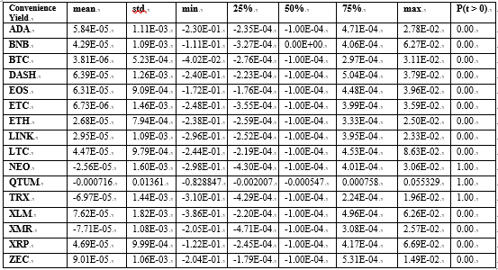
Ⅳ. Empirical Framework
Empirical methodology:
Ours will be written using a combination of qualitative and quantitative research.
Due to the high volatility of the market and the difficulty in finding quantifiable underlying underlying assets for cryptocurrency assets, we will dilute the mathematical model derivation.
Data
F,S,e in previous formulae comes from the Binance cryptocurrency exchange to calculate y.
Minutely quotation data (eg, volume) from both market.
Weekly independent variable data collected from CryptoQuant, CryptoCompare, CMECryptocurrency.
Convenience yield statistics
y = (F−S)/S – e
Thirteen of our convenience yield metrics are significantly positive, while three are significantly negative, suggesting that convenience yield are indeed observable.

Slide 25
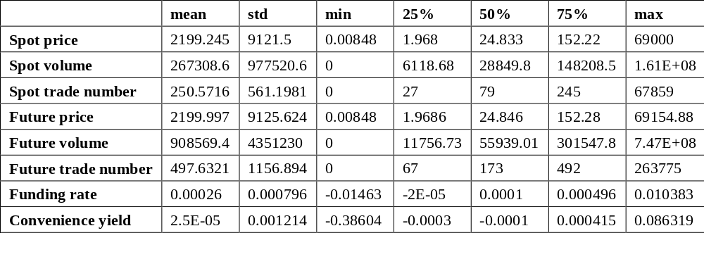
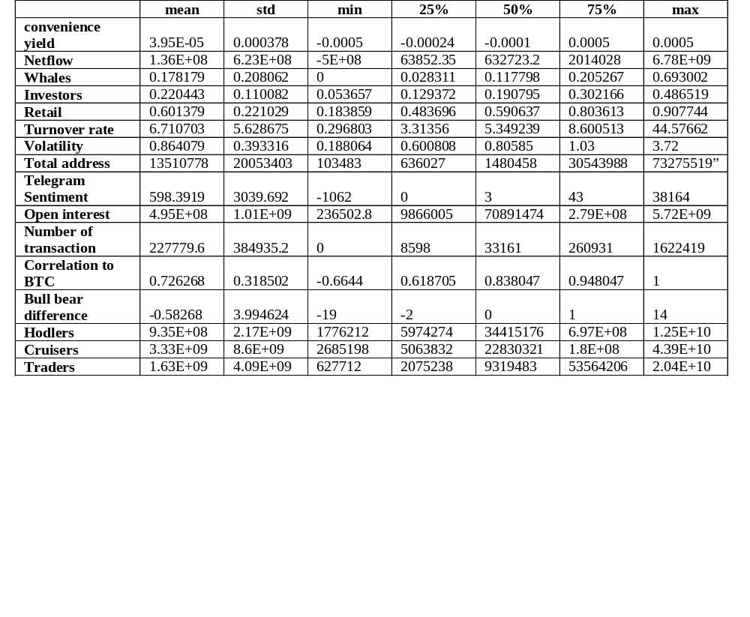
Ⅳ. Empirical Framework
Table 4.2 Regression Analysis Basic Indicators Descriptive Statistics (hourly frequency)
Table 4.3 Basic Indicators Descriptive Statistics in Regression (Weekly Frequency)

Slide 26
Ⅳ. Hypothesis
How convenience yield affect the market:
The following table describes the major players in the spot and futures markets and their widely agreed upon basic descriptions. Changes in convenience yield are captured by market participants and corresponding expectations are generated.
When the basis increases, indicating that higher convenience yield are recognized by the market, its effect is similar to that the market generates favorable information about the characteristics of the currency itself.
Since the news directly affects the spot market, the price change in the spot market will often be at least higher than that in the futures market, so the basis price will be fixed in the next period. After the fluctuation, the basis will reach an equilibrium point and show a stable state.
If it is reflected that the futures market rises more than the spot market, traders will irrationally interpret the increased basis as a greater positive, and the price will enter a synchronous upward spiral to form a bubble. Vice versa.
Participants | Behavior | Key Factors Affecting Behavior
Spot buyer | Bullish investment | Expectations of price increases, risks
Spot seller | Market making, take profit stop loss or short investment | Price drop expectations and realisation needs and risks
Future buyer | Long speculation with high leverage | Strong rise in price expectations (higher risk)
Future seller | Hedging, market making, highly leveraged speculation | Expectations of a sharp drop in prices (higher risk) and demand for risk control

Slide 27
“5.19” Crisis Case Analysis
On the day of "5.19", the extreme market situation of double leverage and liquidation(50% decline in index price) occurred in the market, and many virtual currency exchanges collectively "unplugged the network line" - it was again exposed that trading operations could not be carried out.
Individual investors may suffer heavy losses, while quantitative investment teams suffer relatively small losses. Miners suffered serious losses. Some miners even opted to shut down their rigs. The market value of encrypted assets has fallen, the return on investment of mining machines is far away, and miners have suffered heavy losses.
The exchange's early liquidation caused a stampede. Binance temporarily banned ether withdrawals, citing network congestion, while Coinbase said it was investigating “intermittent outages” on its platform. 590,000 investors were tragically liquidated, and the liquidation was mainly dominated by long positions, reaching US$4.94 billion, accounting for 85%. CryptoQuant data shows that the exchange’s one-hour long liquidation reached 10,525 BTC, a record high. However, the liquidation of long positions resulted in further selling and stampede, and blood flowed into the futures contract market. A few hours later, Bitcoin stabilized, rising back above $40,000.

Slide 28
Ⅰ. Basic introduction to the cryptocurrency market
Some basic understanding of the product and market is necessary in order to draw valuable research conclusions
Introduction to Cryptocurrencies
In the general opinion of the industry, cryptocurrencies are systems that satisfy six conditions:
    1. The system does not require a central institution, and its state is maintained through a distributed consensus mechanism.
    2. The system can record cryptocurrencies and their ownership.
    3. The system defines whether new cryptocurrencies can be generated. If so, the system needs to define the origin of the new coins and how to determine the owners of those new coins.
    4. The ownership of cryptocurrencies can only be proved by means of cryptography.
    5. The system allows the ownership of cryptocurrencies to be changed through transactions. Transactions can only be issued from entities that can demonstrate current ownership of the cryptocurrency.
    6. If two instructions to change the ownership of the same cryptocurrency are generated at the same time, the system can only execute one of them at most to ensure that multiple payments do not occur.

Slide 29
Appendix1: Binance Perpetual Swap Contracts
Contract Indicator | Meaning
The underlying asset of the contract | Binance BTC price index (calculated based on the volume-weighted BTC USD price of Bitfinex, Binance, Huobi, OKEX, Bitrex, HitBTC exchanges), 1USDT per point
Contract face value | The face value of each contract is 1BTC, but a minimum of 0.001 contracts can be traded
Margin and Settlement Currency Unit | USDT
Contract term | perpetual swap contract
Initial Margin Rate | 5% + commission for opening and closing positions
Leverage | up to 20x
Maintenance Margin Rate | The lowest tier 2.5% + closing fee
Ladder Maintenance Margin Rate | Have
Whether to use a reasonable markup price | Yes
Forced liquidation process | Calculates the maintenance margin rate for a trader's position using a reasonable mark price. The liquidation engine first partially closes the trader's position until the trader's remaining position meets the maintenance reserve ratio requirement of the corresponding risk level. If the trader's margin cannot meet the minimum maintenance margin requirement, the liquidation engine will take over the position at the actual liquidation price.
Liquidation of surplus funds | A liquidation fee of 0.5% of the position value is charged into the platform's risk reserve, and the rest is returned to the transaction
Distribution method | Automatic Lightweight System (ADL)

Slide 30
Roadmap
Empirical study on herding effect and its causes of stock funds in China
Tingting Ding, Bo Pang
(Jiang, 2018, JF)
Ⅰ. Motivation
Ⅱ. Introduction
Ⅲ. Theoretical Framework
IV. Regression Design
V. Regression Results and Explanations
VI. Solution and Summary

Slide 31
Introduction
  Content
  We establish a new herding effect index to describe the trend.
  Identify the reason for herding effect in using our index.
  Analyze the relationship between herding behavior and fund performance.
  Test the market response to the herding behavior.
  Motivation
  Develop new research on herding effect.
  Conductive to describing the stock fund market movement.
  Provides a new reference.

Slide 32
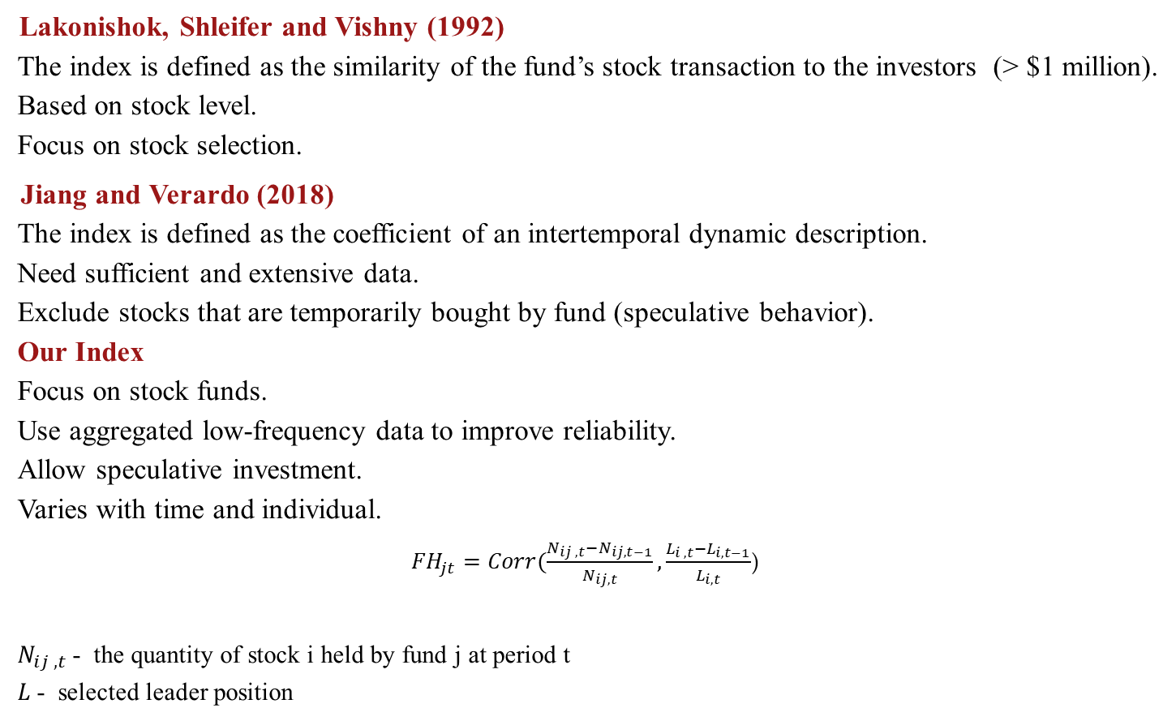
Related Literature
Lakonishok, Shleifer and Vishny (1992)
  The index is defined as the similarity of the fund’s stock transaction to the investors (> $1 million).
  Based on stock level.
  Focus on stock selection.
Jiang and Verardo (2018)
  The index is defined as the coefficient of an intertemporal dynamic description.
  Need sufficient and extensive data.
  Exclude stocks that are temporarily bought by fund (speculative behavior).
  Our Index
  Focus on stock funds.
  Use aggregated low-frequency data to improve reliability.
  Allow speculative investment.
  Varies with time and individual.
${FH}_{jt}=Corr(\frac{N_{ij ,t}−N_{ij,t−1}}{N_{ij,t}},\frac{L_{i ,t}−L_{i,t−1}}{L_{i,t}}$)
  $N_{ij ,t}$- the quantity of stock i held by fund j at period t
  $L$- selected leader position

Slide 33
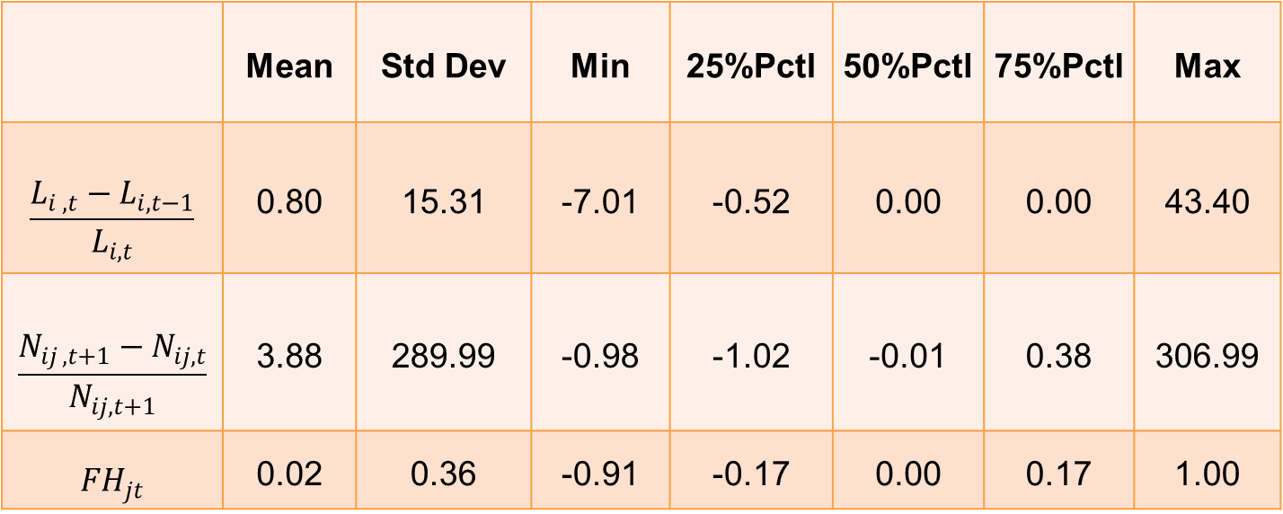
Our Index
Table 2 fund herding index and relative information
 | Mean | Std Dev | Min | 25%Pctl | 50%Pctl | 75%Pctl | Max
$$\frac{L_{i ,t}−L_{i,t−1}}{L_{i,t}}$$ | 0.80 | 15.31 | -7.01 | -0.52 | 0.00 | 0.00 | 43.40
$$\frac{N_{ij ,t+1}−N_{ij,t}}{N_{ij,t+1}}$$ | 3.88 | 289.99 | -0.98 | -1.02 | -0.01 | 0.38 | 306.99
$${FH}_{jt}$$ | 0.02 | 0.36 | -0.91 | -0.17 | 0.00 | 0.17 | 1.00

Slide 34
Hypothesis, based on economics intuition
Hypothesis 1: Herding effect is mainly determined by intrinsic characteristics of the fund.
  It’s reasonable… until proven otherwise.
Hypothesis 2: Herding effect decreases the fund performance.
  The herding effect of funds often indicates that fund managers are not confident or lack of skills and experience.
Hypothesis 3: Once the herding effect of a fund is discovered, the market will react with significant aversion.
  Market participants can accurately capture all available information and evaluate the fund reasonably.

Slide 35
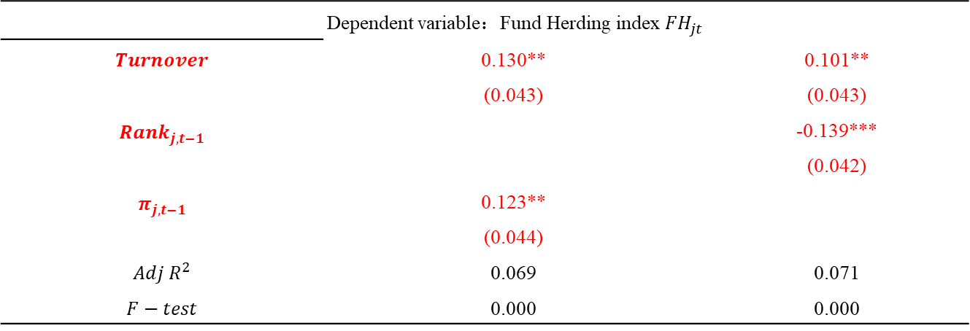
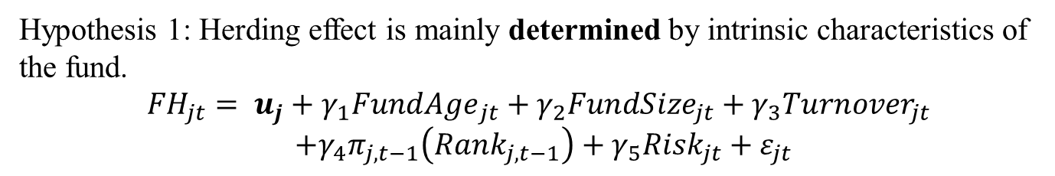
Regression Model
Hypothesis 1: Herding effect is mainly determined by intrinsic characteristics of the fund.
$${FH}_{jt}= u_{j}+γ_{1}Fund{Age}_{jt}+γ_{2}{FundSize}_{jt}+γ_{3}{Turnover}_{jt }$$
$$+γ_{4}π_{j,t−1}\left({Rank}_{j,t−1}\right)+γ_{5}{Risk}_{jt}+ε_{jt}$$
Dependent variable：Fund Herding index ${FH}_{jt}$
$$Turnover$$ | 0.130** (0.043) | 0.101** (0.043)
$${Rank}_{j,t−1}$$ |  | -0.139*** (0.042)
$$π_{j,t−1}$$ | 0.123** (0.044)
$$Adj R^{2}$$ | 0.069 | 0.071
$$F−test$$ | 0.000 | 0.000
(Fixed Effect Model on panel data via Housman Test)
Pass the test of multicollinearity and endogeneity.

Slide 36
Result
The turnover rate and the previous performance have significant influence to our index, while other “seemingly related” variables (such as fund age, risk, scale) are not showing significance.
F test is not very significant and the adjusted R² is only 0.045, which means the explanatory ability of our model is weak.
    This indicates that more in-depth reasons for adopting the herding effect in fund decision-making are not disclosed in the public information.
Explanation
Manager cannot stop investing even in a bad time.
Rank mechanism focuses on short-term performance (< 6 mth).

Slide 37
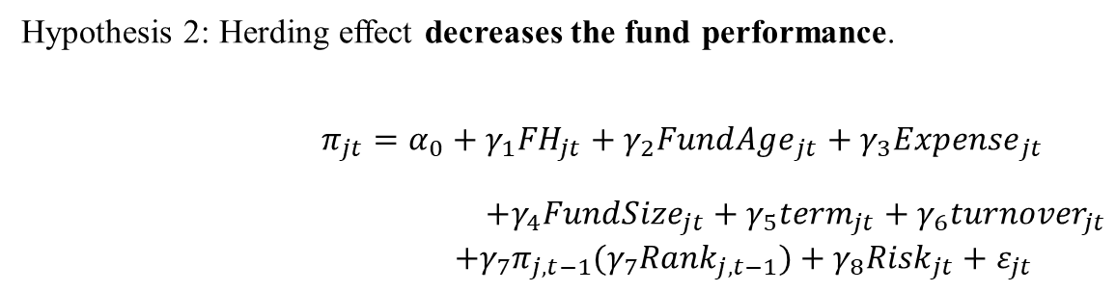
Regression Model
Hypothesis 2: Herding effect decreases the fund performance.
$$π_{jt}=α_{0}+γ_{1}{FH}_{jt}+γ_{2}{FundAge}_{jt}+γ_{3}{Expense}_{jt}$$
$+γ_{4}{FundSize}_{jt}+γ_{5}{term}_{jt}+γ_{6}{turnover}_{jt}$
$$+γ_{7}π_{j,t−1}(γ_{7}{Rank}_{j,t−1})+γ_{8}{Risk}_{jt}+ε_{jt}$$

Slide 38
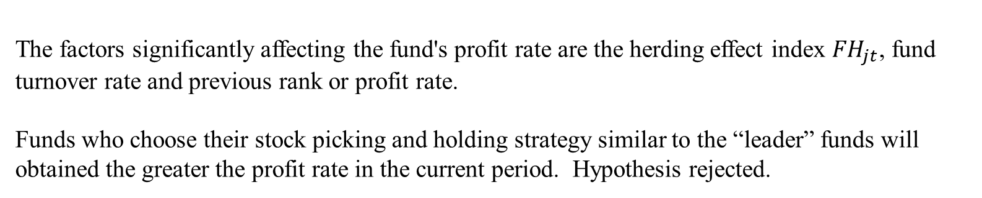
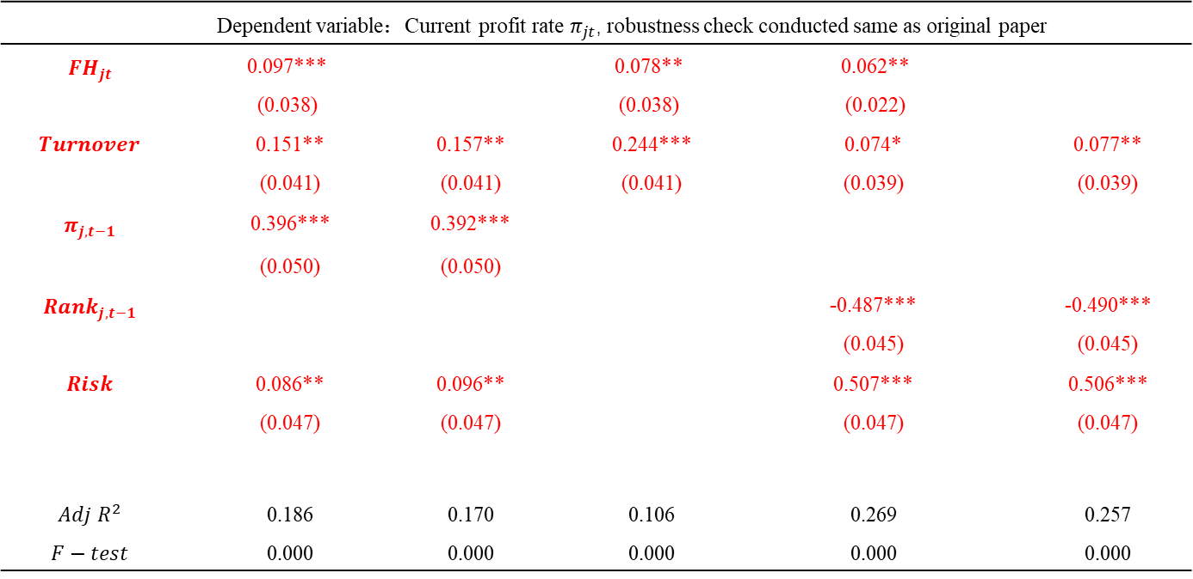
Dependent variable：Current profit rate $π_{jt}$, robustness check conducted same as original paper
$${FH}_{jt}$$ | 0.097*** (0.038) |  | 0.078** (0.038) | 0.062** (0.022)
$$Turnover$$ | 0.151** (0.041) | 0.157** (0.041) | 0.244*** (0.041) | 0.074* (0.039) | 0.077** (0.039)
$$π_{j,t−1}$$ | 0.396*** | 0.392***
 | (0.050) | (0.050)
$${Rank}_{j,t−1}$$ |  |  |  | -0.487*** (0.045) | -0.490*** (0.045)
$$Risk$$ | 0.086** (0.047) | 0.096** (0.047) |  | 0.507*** (0.047) | 0.506*** (0.047)
$$Adj R^{2}$$ | 0.186 | 0.170 | 0.106 | 0.269 | 0.257
$$F−test$$ | 0.000 | 0.000 | 0.000 | 0.000 | 0.000
The factors significantly affecting the fund's profit rate are the herding effect index ${FH}_{jt}$, fund turnover rate and previous rank or profit rate.
Funds who choose their stock picking and holding strategy similar to the “leader” funds will obtained the greater the profit rate in the current period. Hypothesis rejected.

Slide 39
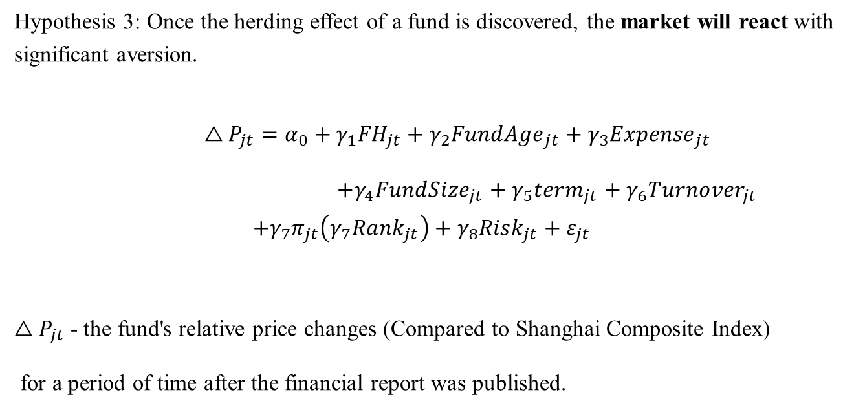
Regression Model
Hypothesis 3: Once the herding effect of a fund is discovered, the market will react with significant aversion.
$$△P_{jt}=α_{0}+γ_{1}{FH}_{jt}+γ_{2}{FundAge}_{jt}+γ_{3}{Expense}_{jt}$$
$+γ_{4}{FundSize}_{jt}+γ_{5}{term}_{jt}+γ_{6}{Turnover}_{jt}$ $+γ_{7}π_{jt}\left(γ_{7}{Rank}_{jt}\right)+γ_{8}{Risk}_{jt}+ε_{jt}$
$△P_{jt}$ - the fund's relative price changes (Compared to Shanghai Composite Index)
for a period of time after the financial report was published.

Slide 40
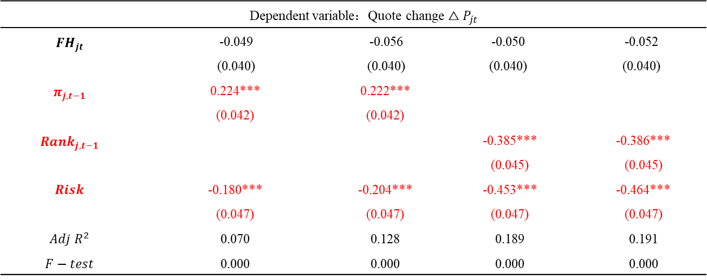
 | Dependent variable：Quote change $△P_{jt}$
$${FH}_{jt}$$ | -0.049 (0.040) | -0.056 (0.040) | -0.050 (0.040) | -0.052 (0.040)
$$π_{j,t−1}$$ | 0.224*** (0.042) | 0.222*** (0.042)
$${Rank}_{j,t−1}$$ |  |  | -0.385*** (0.045) | -0.386*** (0.045)
$$Risk$$ | -0.180*** (0.047) | -0.204*** (0.047) | -0.453*** (0.047) | -0.464*** (0.047)
$$Adj R^{2}$$ | 0.070 | 0.128 | 0.189 | 0.191
$$F−test$$ | 0.000 | 0.000 | 0.000 | 0.000
The variables that have a significant impact on the current fund market are the fund risk, the current rank and the current profit rate, and other control variables do not show significant correlation.
The herding effect index we care about does not show a significant effect to fund price.

Slide 41
Result
The variables that have a significant impact on the current fund market are the fund risk, the current rank and the current profit rate, and other control variables do not show significant correlation.
The herding effect index we care about does not show a significant effect to fund price.

Slide 42
Hypothesis Check
Hypothesis 1: Herding effect is mainly determined by intrinsic characteristics of the fund.
  Rejected
Hypothesis 2: Herding effect decreases the fund performance.
  Rejected
Hypothesis 3: Once the herding effect of a fund is discovered, the market will react with significant aversion.
  Rejected

Slide 43
Explanation
The investor component in A-share market is different from the US stock market.
Policy impact: trading-day policy is “T+1” in China but “T+0” in US.
China's financial market is still developing, and information disclosure channels need to be developed.
Fund manager's evaluation system has a misleading effect.

Slide 44
Solution
Strengthen the education of A-share retail investors.
Reform for the fund manager's evaluation system to focus more on long-term and value investment.
Further improve the information disclosure policy of A-share listed companies and establish an effective supervision mechanism.

Slide 45
Summary
We define the index of the herding effect and found that it has excellent characteristics and can clearly distinguish our fund samples.
The fund with relatively significant herding effect has the distinctive feature of high turnover rate, high previous profit rates and ranks at top while the other features are not significant.
Higher herding effect index can also significantly increase the fund's profit rate.
The market lack a response to the herding behavior.

Slide 46
Roadmap
Empirical asset pricing via machine learning in the Chinese Stock Market
Jaehyuk Choi, Jian Zhou, Bo Pang
(Xiu & Belly, 2018, JF)
Motivation
  Why Machine Learning
Methodology
An Empirical Study of China Equities
  Data
  Model Performance
  Predictor Importance
  Machine Learning Portfolio
Conclusion
Appendix

Slide 47
Motivation
Measure Equity Risk Premium
  Measurement of equity risk premium is one of the key research agendas in modern empirical asset pricing research
  It is fundamentally a problem of prediction – the risk premium is the condition expectation of a future excess return
    The Y is expected excess return
    The X are factors of stock characteristics
Why Machine Learning
  Unknown Functional Form
    Linear or nonlinear? Which nonlinear form? Predictor interactions?
    Solution: Machine Learning’s flexible function models can easily accommodate various model settings
  How to Tame the Predictor Zoo?
    Researchers have proposed hundreds of stock characteristics and dozens of macroeconomic variables in the literature
    Green et al(2013) list 330 stock-level predictors in published or circulated drafts.
    Solution: Machine learning condense redundant variation among predictors by variable selection and dimension reduction

Slide 48
Summary of the paper
Whether machine learning can improve the accuracy of stock return prediction in the Chinese stock market, given a set of predictors?
  We replicate Gu et al.(2020) analysis to a novel dataset in China
    Construct 89 predictive characteristics in China(Green et al., 2017)
    Test a canon of machine learning toolkits, including penalized linear models, dimension reduction, tree models, and neural networks
    Novel regularization method: dropout in neural network
  Main findings of the thesis
    Machine learning can achieve high numerical and ranking(classification) accuracy simultaneously
    All models agree on a small set of critical predictors
    Tradability constraints in China pose additional caveats to the application of machine learning to asset pricing

Slide 49
Algo Methodology
An Overarching Model
  R_{i,t+1} = E_{t}(r_{i,t+1}) + ε_{i,t+1}
  E_{t}(r_{i,t+1}) = g*(z_{i},t)
  Our objective is to
    Isolate a representation of E_{t}(r_{i,t+1}) as a function of predictors that maximizes the out-of-sample explanatory power for realized r_{i,t+1}
    Identify models that can best approximate function g*
Benchmark Models
  Pool regressions on lagged stock characteristics associated with Fama-French factors and momentum factors
    Includes beta, size, book-to-market, profitability, investment and momentum
    OLS-4: 3 factors + momentum
    OLS-6: 5 factors + momentum
Linear Models
  Ordinary Least Square (OLS) on all stock characteristics
  Penalized Linear Model – Elastic Net (ENet)
  Dimensionality Reduced Linear Model: Principal Component Regression (PCR), Partial Least Square Regression (PLS)

Slide 50
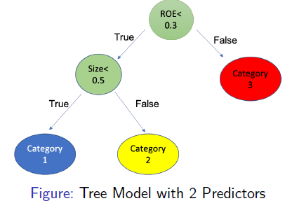
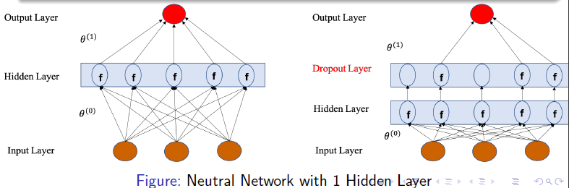
Algo Methodology
Nonlinear Models
  Allowing Nonlinearities and Interactions
    Ensemble Tree Models
      Boosting – Gradient Boosted Regression Trees (GBRT)
      Bagging – Random Forest (RF)
    Neural Networks (NN)
      1 – 6 fully connected hidden layers with ReLU activation function (NN1, NN2, …, NN6)
      To counter overfitting
        Batch normalization, early stopping, ensemble
        Novel regularization methods: dropout layers (Srivastava et al., 2014)

Slide 51
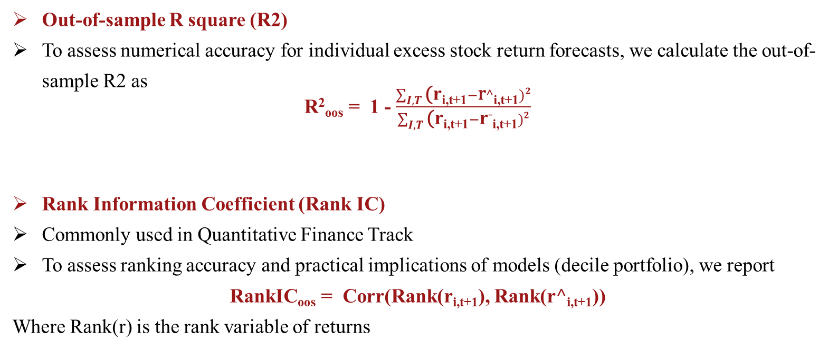
Performance Evaluation
Out-of-sample R square (R2)
To assess numerical accuracy for individual excess stock return forecasts, we calculate the out-of-sample R2 as
R²_{oos} = 1 - $\frac{\sum_{I,T}{\text{(}\text{r}\text{i}\text{,}\text{t}\text{+1}}−\text{r}^\text{i}\text{,}\text{t}\text{+1})2}{\sum_{I,T}{\text{(}\text{r}\text{i}\text{,}\text{t}\text{+1}}−\text{r}¯\text{i}\text{,}\text{t}\text{+1})2}$
Rank Information Coefficient (Rank IC)
Commonly used in Quantitative Finance Track
To assess ranking accuracy and practical implications of models (decile portfolio), we report
RankIC_{oos} = Corr(Rank(r_{i,t+1}), Rank(r$^$_{i,t+1}))
Where Rank(r) is the rank variable of returns

Slide 52
Data
Stocks
All firms listed in the Shanghai/Shenzhen Exchange excluding IPO stocks (IPO within 6 months)
Our sample begins in January 2010 and ends in December 2020, totaling 11 years
Risk-free rate: 3-month govt bond YTM
Predictors
Novel dataset in China: 89 stock characteristics based on literature (Green et al., 2017)
  Categorize into price trends, liquidity variables, risk measures, valuation ratios and fundamental signals
  Each of the characteristics is claimed to possess predictive power
  We cross-sectionally rank all stock characteristics period-by-period and map them into the [-1,1] interval
  Fill missing values by cross-section median, roll forward quarterly characteristics by 4 months, and monthly or more frequent characteristics by 1 month
7 macro variables selected from Welch and Goyal (2008)
Industry dummy variable

Slide 53
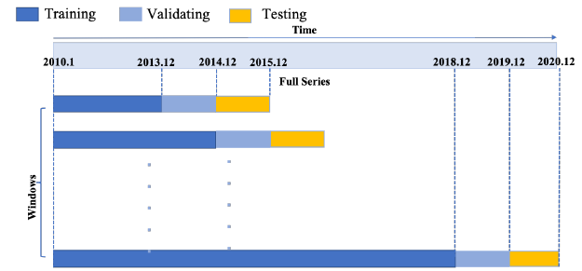
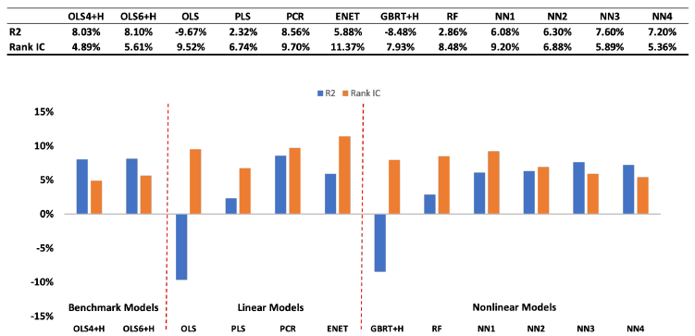
Sample Splitting and Tuning
Train Validation Test Split
The first training window is 2010-2013. Then we recursively increase the training window.
Use the next year as validation data; Predict the year after next
Performance on Individual Stocks
Machine learning achieves good numerical and ranking accuracy simultaneously
Results are robust when retrain quarterly/monthly (Appendix)

Slide 54
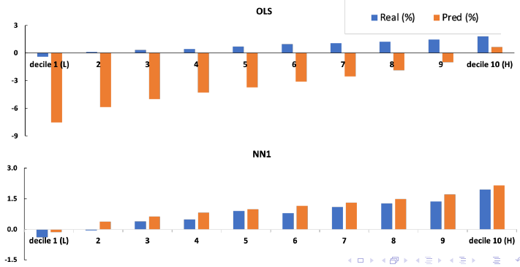
Decile Portfolios
Construct decile portfolios based on model predictions; Decile 10 are formed by stocks with top 10% predicted returns; Decile 1 are with bottom 10%
OLS: low numerical accuracy but high ranking accuracy
Machine learning models have higher numerical accuracy

Slide 55
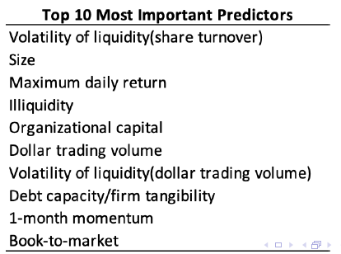
Which Predictors Matter?
Set the predictor of interest to 0; Make predictions based on the processed data; Compare the R2 to the original R2
R2 reduction reflects predictor importance => Rank predictor importance within a model => Average the rank across models
Models agree on similar sets of critical predictors, but feature importance in models with high numerical accuracy are distributed more evenly (Appendix)

Slide 56
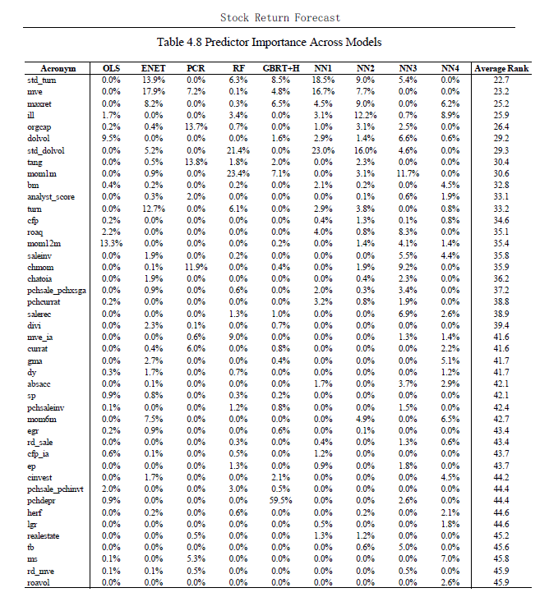
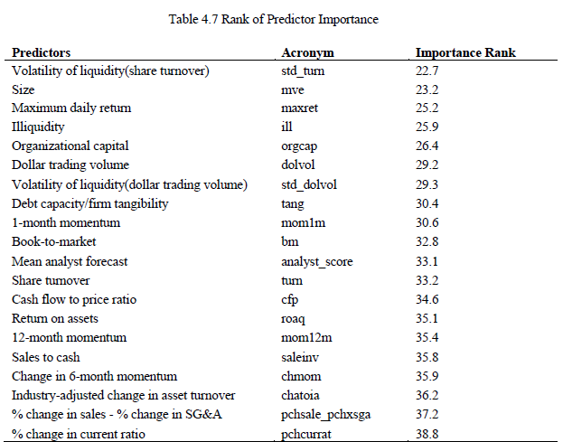
Which Predictors Matter?
4.1 Data
4.2 Train-validation-test Split
4.3 Stock Return Forecast Accuracy
4.4 Predictor Importance

Slide 57
Can We Trade What Models Learn?
Tradability Constraints
R2 reduction reflects predictor importance => Rank predictor importance within a model => Average the rank across models
Models agree on similar sets of critical predictors, but feature importance in models with high numerical accuracy are distributed more evenly (Appendix)
Avoid Paper Gains
Exclude IPO stocks in training set
  The average impact on Sharpe ratios decrease to 0.16
Mimic the real trading environment in backtesting
  Excludes IPO/Suspended/Price limit stocks and any other untradable stocks

Slide 58
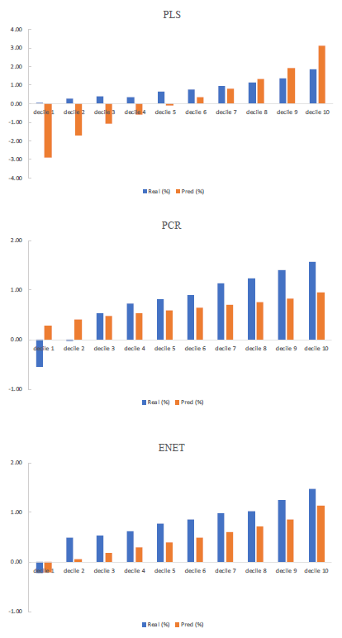
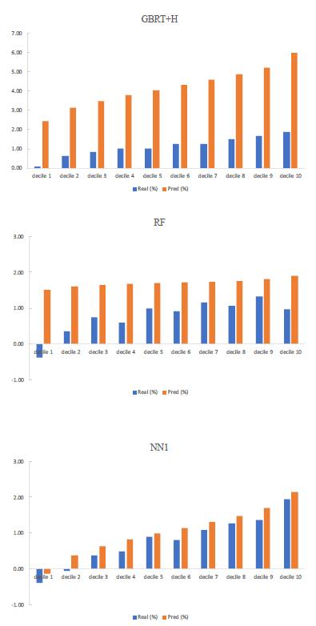
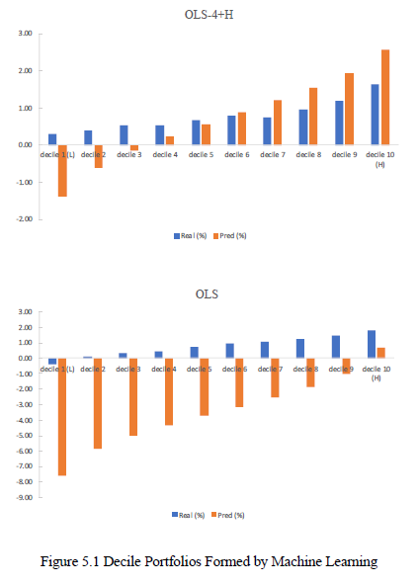
Machine Learning Portfolio

Slide 59
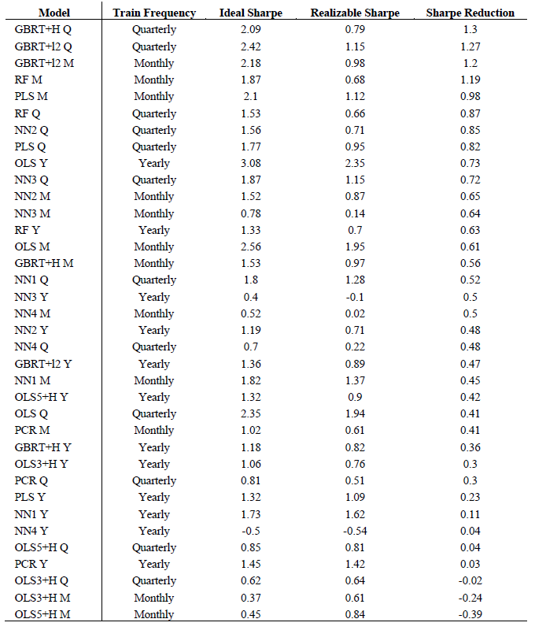
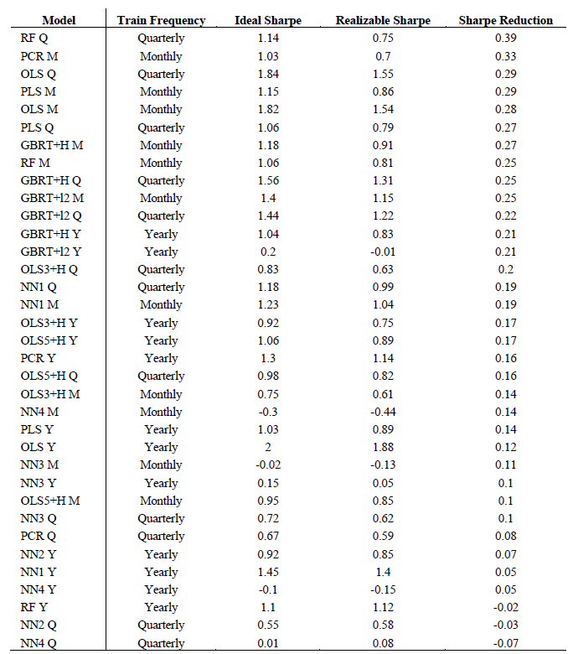
Machine Learning Portfolio: Ideal Sharpe Versus Realizable Sharpe

Slide 60
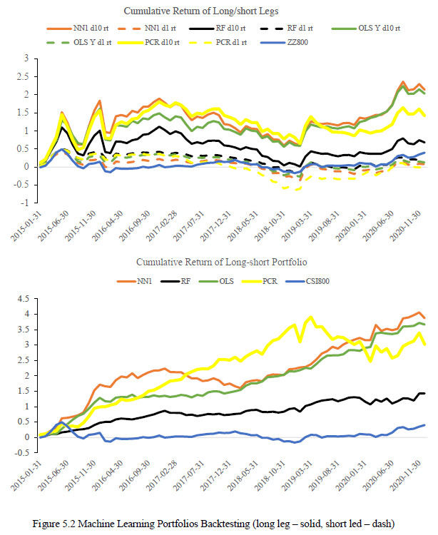
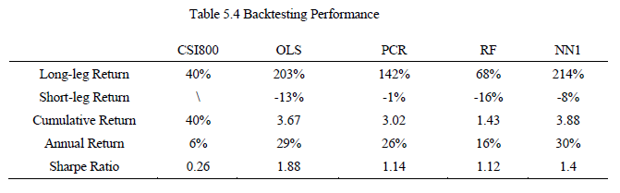
ⅠV. Stock Return Forecast, and V. Machine Learning Portfolio
5. Machine Learning Portfolio: Cumulative Return of Long/short Legs
Given that machine learning models learn some untradable features, such as buying IPO stocks or stocks that are on price limits for the whole trading period, we mimic the real-live trading environment and add tradability constraints as much as possible in the backtesting.
We build a long-short decile portfolio. To be more specific, we long the stocks whose predicted returns rank top 10% in the stock pool and short the bottom 10% of stocks with the lowest predicted returns.

Slide 61
Conclusion
We replicate Gu et al(2020) and demonstrate the potentials of machine learning in empirical asset pricing in the Chinese stock market.
Machine learning achieves good numerical accuracy and ranking accuracy simultaneously
All machine learning models agree on a small set of influential predictors, among which liquidity variables are the most important predictors.
Machine learning shows its skills by learning some China-specific price patterns such as bullish IPO stocks, but such stocks are not tradable due to lack of liquidity.
Tradability constraints, some of which are China specific, have great impacts on machine learning portfolios in backtesting.

Slide 62
Roadmap
Research on the Relationship between Data Assets and Capital Market
PhD Research Proposal
Introduction and Problem Statement
Research Content
  The impact of data assets on company stock prices and its mechanism
  Research on data asset valuation methods and accounting confirmation
  Research on the practical application of data asset valuation
  Research on the impact of data asset information disclosure on investor decision-making and regulation
Literature Review and Research Methods
  The Impact of Data Assets on Company Stock Prices and its Mechanisms
  Valuation Method and Application Research of Data Assets
  Research on the Impact of Information Disclosure of Data Assets on Investor Decisions and Regulation
Research Methodology
  Literature Analysis and Quantitative Analysis, Empirical Analysis
Reference and Appendix

Slide 63
Introduction and Problem Statement
Data assets are resources that are owned or controlled by an entity and have economic value, which can bring current or expected economic benefits.
Data assets include various types of data that companies collect, store, manage, and analyze, such as customer, sales, financial, and manufacturing data.
In the capital market, investors typically pay attention to a company's data asset situation, which may affect their views on the company's future development and potential investment returns.
The innovation of this study lies in its combination of empirical analysis and normative research methods, and it explores a series of issues related to the relationship between enterprise data assets and the capital market from a financial perspective.

Slide 64
Research Content
This study explores the relationship between data assets in the era of big data and the capital market from a micro-empirical analysis perspective, focusing on three main areas of research:
2.1 The impact of data assets on company stock prices, and its mechanism
  investigate the influence of quality, quantity, growth rate, and other factors of enterprise data assets on company stock prices, primarily focusing on two aspects:
  -The impact of data assets on company stock prices: exploring the extent to which factors such as data asset scale, quality, and usability affect company stock prices.
  -The mechanism of data assets on company stock prices: investigating how data assets can enhance a company's innovation capabilities, operational costs, and decision-making and how they can positively influence external stock prices through these channels.

Slide 65
Research Content
2.2 Research on data asset valuation methods and accounting confirmation
  This area of research aims to explore the methods and techniques used to evaluate the value of data assets and apply them to corporate practices. Unlike the first part, this research focuses more on the internal and directional improvement of enterprises to better account for these assets.
  Thus, publicly available data may be difficult to obtain, and case studies and surveys may be utilized more frequently.
  The research on data asset valuation methods and applications is mainly divided into two parts:
  -The research on data asset valuation methods: starting from a quantitative perspective,
  - The research investigates how to quantify the value of data assets and examines various methods and techniques for data asset valuation, as well as their applicability and correlation.
  microeconomics, econometrics, and information technology, combined with in-depth case studies to improve the accuracy and operability of data asset valuation.

Slide 66
Research on the practical application of data asset valuation
Qualitative research, starting from an industry application perspective, studying the specific application of data asset valuation in the finance, medical, logistics, and other sectors through practical case analysis.
This research examines the problems and challenges encountered during this process to better combine with enterprise value evaluations, providing a reference basis for accounting confirmation, calculation, disclosure, and auditing.
Quantitative analyses will be conducted using specific cases and data. This research is significant because data assets have become one of the essential resources for companies today.
Studying data asset valuation methods and applying them in practical scenarios can assist companies in better understanding the value of their data assets and thus help manage and utilize these resources more effectively.

Slide 67
Research on the impact of data asset information disclosure on investor decision-making and regulation
This research aims to analyze the impact of data asset information disclosure on investor trading decisions and regulatory issues, validated by survey questionnaires.
The research focuses primarily on two aspects:
-The impact of data asset information disclosure on investor decision-making: investigating how the level and quality of enterprise data asset information disclosure affect investor decision-making and the differences among different types of investors during this process.
-Research on data asset information disclosure regulation: starting from a regulatory perspective, researching how to develop and implement effective data asset information disclosure regulations to protect the legitimate interests of investors.
Additionally, as a novel type of asset, data asset information disclosure has some unique characteristics that require appropriate regulation to promote healthy market development, secure the legitimate rights and interests of investors, and avoid market imbalances and investment risks caused by information asymmetry and other issues.

Slide 68
Research on the impact of data asset information disclosure on investor decision-making and regulation
This research aims to analyze the impact of data asset information disclosure on investor trading decisions and regulatory issues, validated by survey questionnaires.
The research focuses primarily on two aspects:
-The impact of data asset information disclosure on investor decision-making: investigating how the level and quality of enterprise data asset information disclosure affect investor decision-making and the differences among different types of investors during this process.
-Research on data asset information disclosure regulation: starting from a regulatory perspective, researching how to develop and implement effective data asset information disclosure regulations to protect the legitimate interests of investors.
Additionally, as a novel type of asset, data asset information disclosure has some unique characteristics that require appropriate regulation to promote healthy market development, secure the legitimate rights and interests of investors, and avoid market imbalances and investment risks caused by information asymmetry and other issues.

Slide 69
Literature Review and Research Methods
3.1 The Impact of Data Assets on Company Stock Prices and its Mechanisms
This section mainly studies the impact mechanism of a company's data assets on stock value enhancement and the favorable expectations of creditors and investors that help reduce company financing costs.
There is relatively little research in this area, and we will try to fill this gap and share new insights in the academic community.
3.2 Valuation Method and Application Research of Data Assets
This section mainly studies the valuation method and application of data assets.
The literature review found that most studies used case analysis and methods, with fewer quantitative and statistical methods, and some used mathematical models and theorems.
There is many research in this area. We will consider new industry cases and data indicators, deepen theoretical research, and draw on financial engineering valuation theories based on established theoretical models.

Slide 70
Literature Review and Research Methods
3.1 Research on the Impact of Information Disclosure of Data Assets on Investor Decisions and Regulation
Due to the scarcity of micro-market data, there is relatively little literature in this section.
Based on summarizing theoretical research, we will use questionnaire surveys and case studies to conduct empirical analysis.
3.4 Summary
In summary, literature in this field is relatively scarce. While data assets are relatively easy to quantify, quantitative analysis and mathematical reasoning research are rare.
The relationship between data assets and capital markets is very close, and we need to explore it from different angles to provide better decision-making basis for enterprise managers, investors, and regulatory agencies.
Our future research will seek more accurate data valuation methods, more comprehensive data disclosure regulations, and deeper research into the mechanisms of data asset transmission to company performance and stock prices.
We will also explore the impact of data asset valuation on company financing and investment decisions, as well as regulatory policies and investor preferences.

Slide 71
Research Methodology
This study will employ a combination of literature analysis, statistical methods, empirical research, and qualitative and quantitative analysis to conduct empirical analysis with a focus on standardizing research on data assets and the capital market.
4.1 Common Methods: Literature Analysis and Quantitative Analysis
4.2 Empirical Analysis of Data Asset Valuation Methods and Application Research
survey research and case analysis to collect data on the valuation and identification of data assets facing enterprises and individuals in the era of big data.
4.3 An Empirical Study on the Effect of Data Assets on Company Stock Price and Its Mechanisms
case studies on representative companies with significant data assets, focusing on
  how these assets are utilized to empower their businesses and create value,
  how capital markets respond to this information.
4.4 An Empirical Study on the Impact of Data Asset Disclosure on Investor Decisions and Regulatory Policy
Case studies and surveys, supplemented with public market data. The study aims to explore the impact of data asset disclosure levels on investor decisions and analyze regulatory policy effectiveness.

