Slide 1


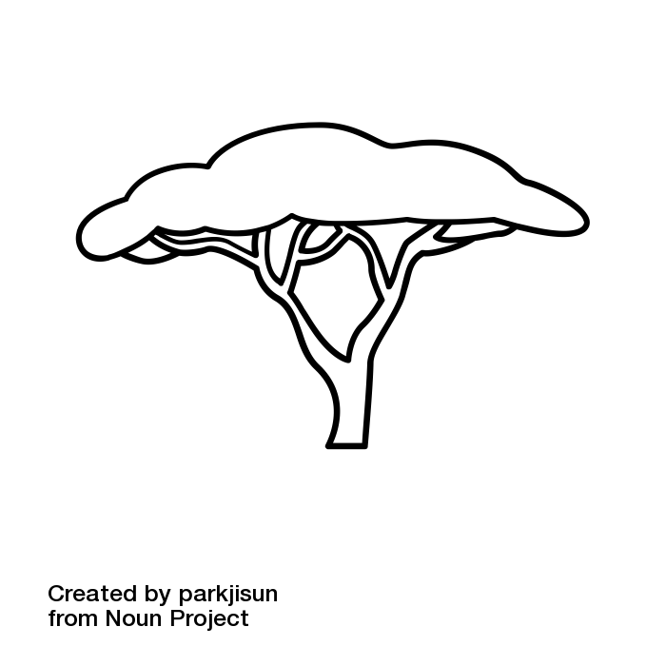
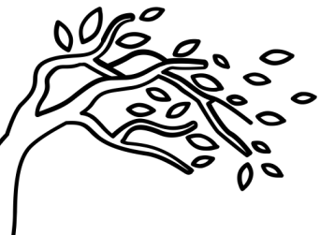
The Quiet Year
Spring
The Quiet Year
Summer
The Quiet Year
Autumn
The Quiet Year
Winter
What group has the highest status in the community? What must people do to gain inclusion in this group?
A contingent within the community demand to be heard. Who are they? What are they asking for?
1
Now is the time to conserve
energy and resources.
A project fails, but gain an Abundance.
The community becomes obsessed with a single project. Which one? Why? Choose one:
They decide to take more time to ensure that it is perfect. Add 3 weeks to the project die.
They drop everything else to work on it. All other projects fail.
1
1
1
Are there distinct family units in the community? If so, what family structures are common?
A contingent within the community have acted on their frustrations. What have they damaged, and why did they damage it? Is it permanent?
Now is the time for hurried
labour and final efforts.
A project finishes early, but gain a Scarcity.
The Quiet Year
Spring
The Quiet Year
Summer
The Quiet Year
Autumn
The Quiet Year
Winter
There’s a large body of water on the map. Where is it & what does it look like?
Someone new arrives. Who?
Why are they in distress?
Someone returns to the community.
Who? Where were they?
A headstrong community member takes charge of the community’s work efforts. A project fails, and then a different project finishes early.
2
2
2
2
There’s a giant, man-made structure on the map. Where is it? Why is it abandoned?
Someone leaves the community.
Who? What are they looking for?
You find a body. Do people
recognize who it is?
What happened?
A headstrong community member tries to take control of the community. How are they prevented from doing this? Due to the conflict, project dice are not reduced this week.

Slide 2
The Quiet Year
Spring
The Quiet Year
Summer
The Quiet Year
Autumn
The Quiet Year
Winter
Someone new arrives. Who?
Summer is a time for production and tending to the earth. Start a project related to food production.
Someone leaves the community after issuing a dire warning.
Who? What is the warning?
Someone comes up with an ingenious solution to a big problem and as a result a project finishes early.
What was their idea?
3
3
3
3
Two of the community’s younger members get into a fight.
What provoked them?
Summer is a time for conquest and the gathering of might. Start a project related to military readiness and conquest.
Someone issues a dire warning, and the community leaps into action to avoid disaster. What is the warning? Start a contentious project that relates to it.
Someone comes up with a plan
to ensure safety and comfort
during the coldest months.
Start a project related to this.
The Quiet Year
Spring
The Quiet Year
Summer
The Quiet Year
Autumn
The Quiet Year
Winter
What important and basic tools
does the community lack?
The eldest among you dies.
What caused the death?
The strongest among you dies. What caused the death?
All the animals and young children are crying and won’t stop. Hold a discussion about this in addition to your regular action for the week.
4
4
4
4
Where are you storing your food?
Why is this a risky place to store things?
The eldest among you is very sick. Caring for them and searching for a cure requires the help of the entire community. Do not reduce project dice this week.
The weakest among you dies.
Who’s to blame for their death?
A great atrocity is revealed. What is it? Who uncovers it?

Slide 3
The Quiet Year
Spring
The Quiet Year
Summer
The Quiet Year
Autumn
The Quiet Year
Winter
There is a disquieting legend about this place. What is it?
A project finishes early.
What led to its early completion?
The Parish arrives. Who are they? Why have they chosen your community, and for what?
Winter elements destroy a food source. If this was your only food source, add a Scarcity.
5
5
5
5
Alarming weather patterns
destroy something.
How and what?
The weather is nice and people can feel the potential all around them. Start a new project.
A small gang of marauders is making its way through local terrain. How many are there? What weapons do they carry?
Winter elements leave everyone cold, tired, and miserable. Project dice are not reduced this week.
The Quiet Year
Spring
The Quiet Year
Summer
The Quiet Year
Autumn
The Quiet Year
Winter
Are there children in your community? If there are, what is their
role in the community?
Outsiders arrive in the area.
Why are they a threat?
How are they vulnerable?
Introduce a dark mystery among
the members of the community.
The time has come to consolidate your efforts and your borders. Projects located outside the settlement fail,
and all remaining projects are reduced by 2 this week.
6
6
6
6
How old are the eldest members of the community? What special needs do they have?
Outsiders arrive in the area.
How many?
How are they greeted?
Conflict flares up among community members, and as a result,
a project fails.
Someone finds a curious opportunity on the edge of the map. Start a project related to this discovery.

Slide 4
The Quiet Year
Spring
The Quiet Year
Summer
The Quiet Year
Autumn
The Quiet Year
Winter
Where does everyone sleep? Who is unhappy with this arrangement,
and why?
Introduce a mystery at
the edge of the map.
A project just isn’t working out as expected. Radically change the nature of a project When it resolves, tell the community how it went.
7
What is winter like in this area?
How do community members
react to the weather?
7
7
7
What natural predators roam
this area? Are you safe?
An unattended situation becomes problematic and scary. What is it?
How does it go awry?
Something goes foul and supplies are ruined. Add a new Scarcity.
The Quiet Year
Spring
The Quiet Year
Summer
The Quiet Year
Autumn
The Quiet Year
Winter
An old piece of machinery is discovered, broken but perhaps repairable. What is it?
What would it be useful for?
Someone tries to take control of the community by force. Do they succeed? Why do they do this?
Someone sabotages a project, and the project fails as a result.
Who did this? Why?
8
Winter is harsh, and desperation gives rise to fear mongering. Choose one:
Spend the week calming the masses and dispelling their violent sentiments. The week ends immediately.
Declare war on someone or something. This counts as starting a project.
8
8
8
An old piece of machinery is discovered, cursed and dangerous. How does the community destroy it?
A headstrong community member decides to put one of their ideas in motion. Start a foolish project.
Someone is caught trying to sabotage the efforts of the community. How does the community respond?

Slide 5
The Quiet Year
Spring
The Quiet Year
Summer
The Quiet Year
Autumn
The Quiet Year
Winter
A charismatic young girl convinces many to help her with an elaborate scheme. What is it? Who joins her endeavours? Start a project to reflect.
A project fails.
Which one? Why?
The community works constantly and
as a result a project finishes early.
9
Someone goes missing. They’re alone in the winter elements. Choose one:
The community organizes constant search parties and eventually the person is found. Project dice are not reduced this week.
No one ever hears from that person again.
9
9
9
A charismatic young girl tries to tempt many into sinful or dangerous activity. Why does she do this?
How does the community respond?
Something goes foul and
supplies are ruined.
Add a new Scarcity.
A group goes out to explore the map more thoroughly, and finds something that had been previously overlooked.
The Quiet Year
Spring
The Quiet Year
Summer
The Quiet Year
Autumn
The Quiet Year
Winter
There’s another community somewhere on the map. Where are they? What sets them apart from you?
You discover a cache of
supplies or resources.
Add a new Abundance.
Harvest is here and plentiful.
Add an Abundance .
10
In preparation for the coming year,
the community begins a
huge undertaking.
Start a project that will take at least 5 weeks to complete.
10
10
10
What belief or practice helps to
unify your community?
A Scarcity has gone unaddressed for too long! Start a project that will alleviate that Scarcity.
Cold autumn winds drive out
your enemies.
Remove a threatening force from the map and the area.

Slide 6
The Quiet Year
Spring
The Quiet Year
Summer
The Quiet Year
Autumn
The Quiet Year
Winter
You see a good omen.
What is it?
Predators and bad omens are afoot. You are careless, and someone goes missing under ominous circumstances. Who?
11
11
A project finishes early.
Which one? Why?
If there are no projects underway, restlessness creates animosity, and animosity leads to violence. Who gets hurt?
An infected outsider arrives. They have some much-needed resources with them. Choose one:
Welcome them into the community. Remove a Scarcity, but also introduce an infection into the community.
Bar them from entry. What Scarcity could they have addressed?
How does its need
become more
dire this week?
11
11
You see a bad omen.
What is it?
Predators and bad omens are afoot. What measures do you take to keep everyone safe and under surveillance? Do not reduce project dice this week.
The Quiet Year
Spring
The Quiet Year
Summer
The Quiet Year
Autumn
The Quiet Year
Winter
What’s the most beautiful
thing in this area?
12
12
12
A project finishes early.
Which one? Why?
If there are no projects underway, boredom leads to quarrel.
A fight breaks out between two people. What is it about?
You see a good omen.
What is it?
Disease spreads through the community. Choose one:
You spend the week quarantining and treating the disease. Project dice are not reduced this week.
Nobody knows what to do about it. Add “Health and Fertility” as a Scarcity.
12
What’s the most hideous
thing in this area?

Slide 7
The Quiet Year
Spring
The Quiet Year
Summer
The Quiet Year
Autumn
The Quiet Year
Winter
A young boy starts digging in the ground, and discovers something unexpected. What is it?
13
13
13
Summer is fleeting.
Discard the top two cards off the top of the deck and take two actions this week.
The Frost Shepherds arrive.
The game is over.
A natural disaster strikes the area. What is it? Choose one:
You focus on getting everyone to safety. Remove an Abundance and a project fails.
You focus on protecting your supplies and hard work at any cost. Several people die as a result.
13
An old man confesses to past crimes
and atrocities. What has he done?
The Quiet Year
Every Week
The Quiet Year
Before you Begin
Draw a card & choose either the
top or bottom instructions to follow.
Separate & shuffle each suit; place the seasons in order in the deck.
&
&
Advance any projects by 1
Complete any projects that reach 0
Briefly discuss the area; each player introduces one detail.
&
&
Carry out one action:
Discover something new
Start a Project
Hold a Discussion
Each player declares an important resource. Collectively decide which one is in Abundance; the rest are Scarce.

