Slide 1


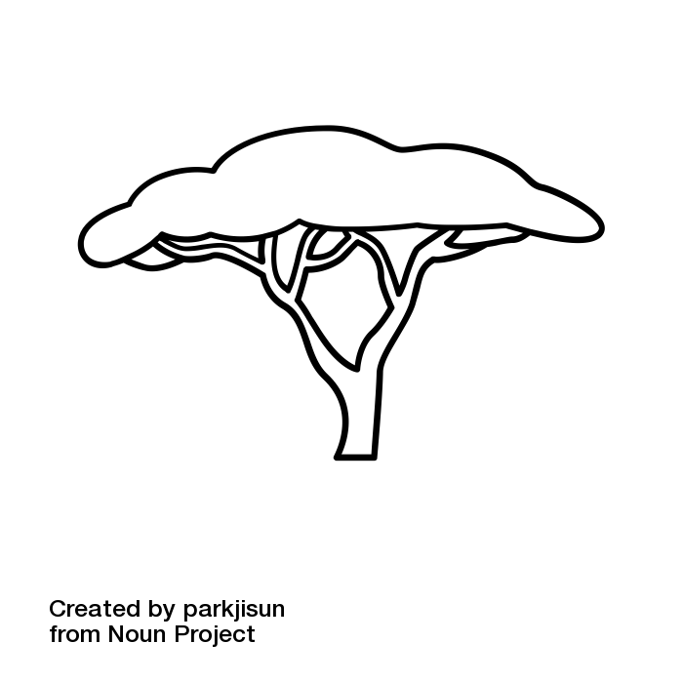

The Quiet Year
Spring
The Quiet Year
Summer
The Quiet Year
Autumn
The Quiet Year
Winter
Card description
Card Instructions
Card description
Card Instructions
Card description
Card Instructions
Card description
Card Instructions
1
1
1
1
Card description
Card instructions
Card description
Card instructions
Card description
Card instructions
Card description
Card instructions
The Quiet Year
Spring
The Quiet Year
Summer
The Quiet Year
Autumn
The Quiet Year
Winter
Card description
Card Instructions
Card description
Card Instructions
Card description
Card Instructions
Card description
Card Instructions
2
2
2
2
Card description
Card instructions
Card description
Card instructions
Card description
Card instructions
Card description
Card instructions

Slide 2
The Quiet Year
Spring
The Quiet Year
Summer
The Quiet Year
Autumn
The Quiet Year
Winter
Card description
Card Instructions
Card description
Card Instructions
Card description
Card Instructions
Card description
Card Instructions
3
3
3
3
Card description
Card instructions
Card description
Card instructions
Card description
Card instructions
Card description
Card instructions
The Quiet Year
Spring
The Quiet Year
Summer
The Quiet Year
Autumn
The Quiet Year
Winter
Card description
Card Instructions
Card description
Card Instructions
Card description
Card Instructions
Card description
Card Instructions
4
4
4
4
Card description
Card instructions
Card description
Card instructions
Card description
Card instructions
Card description
Card instructions

Slide 3
The Quiet Year
Spring
The Quiet Year
Summer
The Quiet Year
Autumn
The Quiet Year
Winter
Card description
Card Instructions
Card description
Card Instructions
Card description
Card Instructions
Card description
Card Instructions
5
5
5
5
Card description
Card instructions
Card description
Card instructions
Card description
Card instructions
Card description
Card instructions
The Quiet Year
Spring
The Quiet Year
Summer
The Quiet Year
Autumn
The Quiet Year
Winter
Card description
Card Instructions
Card description
Card Instructions
Card description
Card Instructions
Card description
Card Instructions
6
6
6
6
Card description
Card instructions
Card description
Card instructions
Card description
Card instructions
Card description
Card instructions

Slide 4
The Quiet Year
Spring
The Quiet Year
Summer
The Quiet Year
Autumn
The Quiet Year
Winter
Card description
Card Instructions
Card description
Card Instructions
Card description
Card Instructions
Card description
Card Instructions
7
7
7
7
Card description
Card instructions
Card description
Card instructions
Card description
Card instructions
Card description
Card instructions
The Quiet Year
Spring
The Quiet Year
Summer
The Quiet Year
Autumn
The Quiet Year
Winter
Card description
Card Instructions
Card description
Card Instructions
Card description
Card Instructions
Card description
Card Instructions
8
8
8
8
Card description
Card instructions
Card description
Card instructions
Card description
Card instructions
Card description
Card instructions

Slide 5
The Quiet Year
Spring
The Quiet Year
Summer
The Quiet Year
Autumn
The Quiet Year
Winter
Card description
Card Instructions
Card description
Card Instructions
Card description
Card Instructions
Card description
Card Instructions
9
9
9
9
Card description
Card instructions
Card description
Card instructions
Card description
Card instructions
Card description
Card instructions
The Quiet Year
Spring
The Quiet Year
Summer
The Quiet Year
Autumn
The Quiet Year
Winter
Card description
Card Instructions
Card description
Card Instructions
Card description
Card Instructions
Card description
Card Instructions
10
10
10
10
Card description
Card instructions
Card description
Card instructions
Card description
Card instructions
Card description
Card instructions

Slide 6
The Quiet Year
Spring
The Quiet Year
Summer
The Quiet Year
Autumn
The Quiet Year
Winter
Card description
Card Instructions
Card description
Card Instructions
Card description
Card Instructions
Card description
Card Instructions
11
11
11
11
Card description
Card instructions
Card description
Card instructions
Card description
Card instructions
Card description
Card instructions
The Quiet Year
Spring
The Quiet Year
Summer
The Quiet Year
Autumn
The Quiet Year
Winter
Card description
Card Instructions
Card description
Card Instructions
Card description
Card Instructions
Card description
Card Instructions
12
12
12
12
Card description
Card instructions
Card description
Card instructions
Card description
Card instructions
Card description
Card instructions

Slide 7
The Quiet Year
Spring
The Quiet Year
Summer
The Quiet Year
Autumn
The Quiet Year
Winter
Card description
Card Instructions
Card description
Card Instructions
Card description
Card Instructions
Card description
Card Instructions
13
13
13
13
Card description
Card instructions
Card description
Card instructions
Card description
Card instructions
Card description
Card instructions
The Quiet Year
Every Week
The Quiet Year
Before you Begin
Draw a card & follow the instructions in bold.
Separate & shuffle each suit; place the seasons in order in the deck.
&
&
Advance any projects by 1
Complete any projects that reach 0
Briefly discuss the area; each player introduces one detail.
&
&
Carry out one action:
Discover something new
Start a Project
Hold a Discussion
Each player declares an important resource. Collectively decide which one is in Abundance; the rest are Scarce.

