Slide 1

World Marriage Dataset
For Machine Learning Group 6:
BMCS2114
Clustering Techniques
Pang Zan Lam
Rishiiy A/L Tharmalingam

Slide 2
Introduction

Slide 3
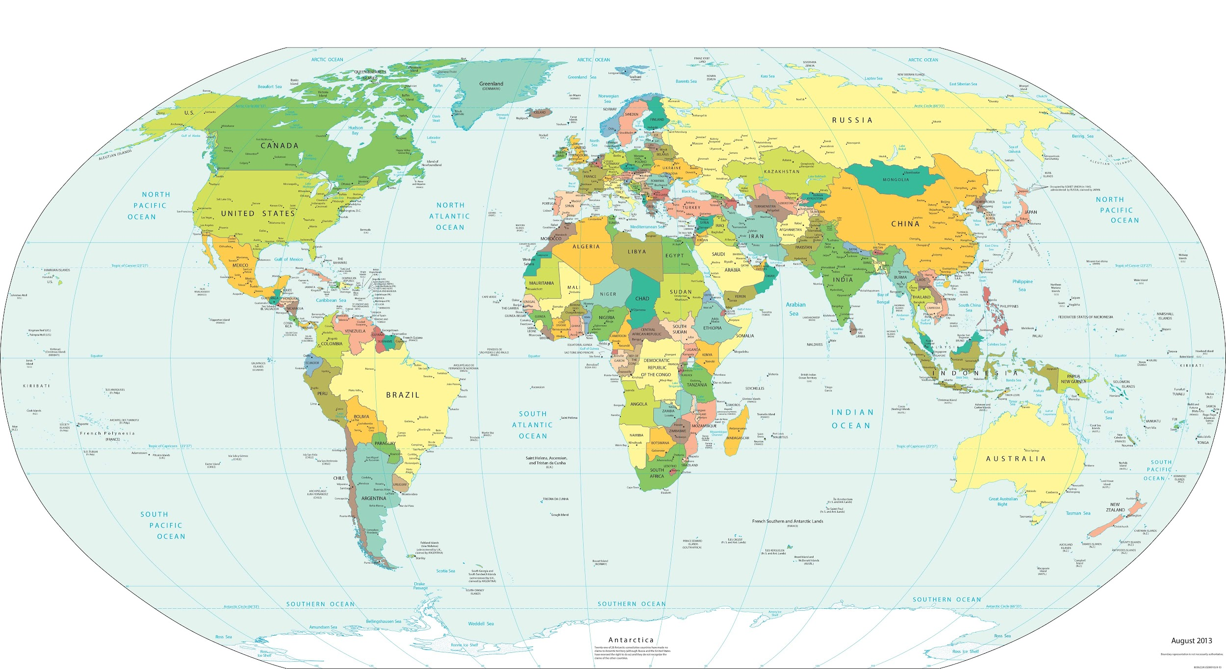
Introduction
→ World Marriage encompasses diverse marriage practices and institutions worldwide, varying greatly between different cultures. From arranged marriages in South Asia to evolving concepts in the West, this field of study explores how cultural, economic, and social factors influence marriage. It delves into the implications for individual identity, gender roles, and family dynamics, providing insight into how marital institutions are shaped by global and local contexts.

Slide 4
Introduction
→ Detailed data on marital status worldwide from 1970-2019 across 232 countries, offering a comprehensive overview.
→ Dataset with 271,605 rows and 9 columns showcases marital status distribution by age group and gender.
→ The dataset includes information on age groups, marital status, and sex in various countries/regions collected over almost 50 years. It also documents data collection methods, years of data collection, and information sources to maintain accuracy and reliability of statistics.
→Essential for researchers, sociologists, and policymakers investigating international marital patterns. It provides comprehensive information on marriage statuses in different demographics and regions, enabling thorough examination of societal trends. This source helps guide choices regarding family policies, social welfare, and demographic research, supporting historical examination and forecasting future patterns.

Slide 5
Problem Statement

Slide 6

Problem Statement
→ For developing targeted social policies and programs.
→ This diversity can highlight significant trends and disparities, but analyzing such a vast amount of data presents challenges
→ the ability to predict and cluster similar marital status patterns across countries can provide valuable insights for international organizations and governments.
→Evaluating the performance of different clustering algorithms
→ Challenging to interpret and apply clusters.

Slide 7
Objective

Slide 8

Objective
→To analyze and preprocess the World Marriage Dataset to ensure data quality and relevance for machine learning tasks.
→To evaluate and compare the performance of various machine learning algorithms, such as decision trees, support vector machines, and neural networks, in predicting marital status based on the available demographic data.
→To identify the most influential factors affecting marital status and determine how these factors vary across different regions and time periods.
→To build and validate a predictive model that can be used by policymakers, sociologists, and researchers to understand and forecast marital trends.

Slide 9
Literature Review

Slide 10

Literature Review
K-MEAN CLUSTERING
HIERARCHICAL CLUSTERING
DBSCAN
GMM
SPECTRAL CLUSTERING

Slide 11
K-Means Clustering

Slide 12
K-means Clustering
App 1: Identifying country groups based on marriage patterns
Objectives:To explore the influence of ethnicity on marriage patterns across different ethnic groups in Mozambique and determine whether these patterns are driven by cultural factors or socio-economic characteristics.
Method:Multivariate analyses of data from the 1997 Census and 1997 MDHS, focusing on five ethnic groups in Mozambique controlling for socio-economic and demographic characteristics.
Outcome:Marriage patterns are significantly influenced by ethnicity, with matrilineal groups showing earlier marriage, lower polygyny rates, and higher marital dissolution compared to patrilineal groups, even after controlling for other factors.
Purpose: To assess the role of cultural and socio-economic factors in shaping marriage patterns in Mozambique and contribute to the broader understanding of demographic behavior across different ethnic groups in sub-Saharan Africa.
http://www.bioline.org.br/pdf?ep04008

Slide 13
K-means Clustering
App 2: Analyze marriage patterns' ties to demography.
Objectives: The study aims to provide insights into the prevalence of female child marriage and analyze how various demographic, socio-economic, and regional factors contribute to the practice.
Method: Utilize binary logistic regression analysis to analyze data from the 2017 Indonesia Demographic and Health Survey
Outcome: The study found that the prevalence of female child marriage in Indonesia was 12.53%, with significant factors including lack of education, unemployment, poverty, and regional differences, while health insurance and the sex of the household head had no significant impact.
Purpose: To identify the socio-economic, educational, and regional factors that influence the likelihood of female child marriage.
https://www.proquest.com/docview/3076243303/903A8AD275934FAEPQ/10?accountid=38945&sourcetype=Scholarly%20Journals

Slide 14
Hierarchical Clustering

Slide 15
Hierarchical
App 1: Segmenting Age Groups by Marital Status Across Countries
Objectives:To investigate the relationship between marital status and well-being, exploring whether differences in well-being are due to marriage or the selection of happier, healthier individuals into marriage.
Method:Analysis of subjective and objective well-being measures (life satisfaction, subjective health, actual health problems, and physician consultations) from a sample of 11,131 Canadians, with a focus on age group variations
Outcome:Single individuals were generally healthier than married ones, with the causal link between marriage and well-being being supported only for life satisfaction, which aligns more with the selection hypothesis than causality.
Purpose: To challenge the prevailing view that marriage is causally related to well-being in Canada by examining evidence for the selection hypothesis across different age groups.
https://journals.sagepub.com/doi/abs/10.1177/019251392013003008

Slide 16
Hierarchical
App 2: Analyze marriage patterns evolution with algorithm.
Objectives: To present the SEV approach for analyzing marital patterns and apply it to assess multidimensional matching, focusing on homogamy in traits like age, education, and health-related behaviors.
Method: The study uses the Separable Extreme Value (SEV) model, extended to a multidimensional context, applied to a dataset from a survey of parents in the Campania region, Italy.
Outcome: The study finds that marital patterns are characterized by homogamy across various traits, and sorting in the marriage market is effectively captured by a few indices of attractiveness, including education and health consciousness.
Purpose: To demonstrate the application of the SEV model in understanding the complexity of marital matching and to explore how assortative matching impacts social inequality, particularly through human capital and health behaviors.
https://csef.it/wp-content/uploads/guerriero.pdf

Slide 17
DBSCAN

Slide 18
DBSCAN
App 1: Identifies country marriage patterns, outliers, and exceptional behaviors.
Objectives: To explain why France experienced the demographic transition earlier than other European countries by investigating marriage patterns and fertility control mechanisms.
Method: The study uses exploratory methods to analyze French counties and classify them based on discriminatory features, while also examining the impact of the French Revolution on societal changes.
Outcome: The study finds that the French fertility transition was complex and influenced by cultural factors, modernity, and gender equality, rather than following a linear pattern.
Purpose: To provide a deeper understanding of the demographic transition in France, highlighting the importance of cultural and societal factors in influencing fertility control and economic development.
https://link.springer.com/article/10.1007/s11698-021-00237-2

Slide 19
DBSCAN
App 2: Longitudinal data tracks marriage patterns, informs policy decisions.
Objectives: To explore factors that contribute to satisfying and enduring adult partnerships and understand how intimate relationships change.
Method:Review of recent research on intimate communication, personal strengths, vulnerabilities, and the impact of stress on relationship quality
Outcome:Insights into how social support, positive emotions, and stress influence relationship outcomes, with implications for improving relationship quality.
Purpose: To inform social policies and interventions aimed at strengthening intimate partnerships by integrating recent psychological research findings.
https://www.msd.govt.nz/about-msd-and-our-work/publications-resources/journals-and-magazines/social-policy-journal/spj23/understanding-and-altering-the-longitudinal-course-of-intimate-partnerships-pages1-30.html

Slide 20
GMM

Slide 21
GMM
App 1: Identify sub-populations within marriage patterns for understanding.
Objectives: To integrate psychological and demographic approaches to understand how individual mate selection behaviors lead to population-level marriage patterns
Method: Agent-based simulations are used to model individual mate search behaviors based on satisficing heuristics and compare the results with empirical age-at-marriage distributions
Outcome: The study highlights the need to refine psychological mechanisms, emphasizing the role of individual heterogeneity in producing realistic marriage timing patterns
Purpose: To bridge the gap between individual-level and population-level analyses of marriage by combining psychological and demographic perspectives through agent-based modeling
https://citeseerx.ist.psu.edu/document?repid=rep1&type=pdf&doi=9f8acec4f2e40d695496dbd699354d6cadeef76a

Slide 22
GMM
App 2: Study applies marriage patterns to demographics.
Objectives: To project future trends in late singlehood (ages 45 to 49) in East Asian societies and assess the impact of demographic changes and marriage norms on universal marriage patterns
Method: The study uses large-scale population data to estimate marriage matching norms by age and education, followed by counterfactual scenarios to project future singlehood trends based on current and gender-symmetrical norms.
Outcome: A substantial increase in late singlehood is projected across all four East Asian societies, with minimal impact from shifts toward gender symmetry in marriage norms.
Purpose: To explore how shifts in marriage norms and demographic changes will affect the universality of marriage and its implications for fertility, population growth, and social reproduction in East Asia.
https://www.demographic-research.org/articles/volume/43/46

Slide 23
SPECTRAL CLUSTERING

Slide 24
Spectral Clustering
App 1: Identifying marriage patterns in countries, complex relationships.
Objectives:To explore recent changes in marriage patterns across East, Southeast, and South Asia, focusing on differences in traditional systems and contemporary issues like delayed, early, and arranged marriages
Method:Comparative analysis of marriage trends across the regions, considering the impact of cultural traditions and demographic forces on marriage practices.
Outcome:Highlight the decline of traditional arranged marriages in East and Southeast Asia, the persistence of early and consanguineous marriages in South Asia, and the rise of delayed marriages affecting fertility rates
Purpose: To examine the evolving marriage systems in Asia, emphasizing regional variations and their implications for broader social and demographic trends.
https://www.researchgate.net/publication/228275712_Changing_Marriage_Patterns_in_Asia

Slide 25
Spectral Clustering
App 2: Geospatial analysis studies marriage patterns' impact.
Objectives:To estimate the impact of armed conflict on the incidence of child marriage across 56 countries.
Method: Geospatial analysis using georeferenced data on armed conflict and population-level microdata for over 2 million women
Outcome: The incidence of child marriage increases by 4.5% to 16.4% for girls in conflict zones, with higher risks associated with more severe conflicts.
Purpose: To highlight the correlation between conflict severity and the rise in child marriage, emphasizing the need for targeted interventions in fragile settings
https://www.researchgate.net/publication/382079387_Child_marriage_in_conflict_settings_a_geospatial_analysis

Slide 26
THANK YOU

