Slide 1
Integrating A Category-Partition Testing Tool With A Combinatorial Interaction Testing Tool To Produce T-Way Adequate Test Frames
MS Project Proposal
Andrew Graff

Slide 2
Overview
Introduction
Objective of the project
Background on category partition method
TSL tool
Background on combinatorial interaction testing
CASA tool
Demo of preliminary work
Remaining work and timeline
Notes:
2

Slide 3
Introduction
Creating fault free software is a hard task, which means testing is necessary to reduce the number of faults.
Black box testing helps to find functional faults and requires little knowledge of the inner workings of the program itself.
Category partition method allows for systematic design of test inputs (TSL tool)
+ This specification language can be translated into easy to run test frames
- All possible inputs add up quickly which is costly in execution time
Combinatorial interaction testing select a subset of test cases that are t-way adequate (CASA tool)
+Can reduce the number of test frames to a manageable level.
- Not a user-friendly interface
Notes:
3
Make a case somewhere that with TSL we can make less test cases by reducing categories or collapsing some values of a category together. For example, for an integer input instead of have positive, zero and negative choices, we reduce it no zero and non-zero. With such approach we coarsen the test suite. While CASA allows us to stay at the same granularity level, but still give us a smaller test suite due to t-way coverage optimization.

Slide 4
Objective of the project
Combine the user-friendly input/output interface of TSL with the powerful test case optimization algorithm of CASA
TSL a tool that uses category partitioning to generate test frames
CASA a tool that uses the combinatorial interaction method known as simulated annealing to find t-way covering arrays
Notes:
4
A bit better formating

Slide 5
TSL
Testing Specification Language (TSL) – a good front-end interface for the category partition method.
Create a single .tsl file that describes the categories and choices within those categories along with properties and selector statements.
Generates all possible permutations of inputs, and outputs the test frames.
Notes:
5

Slide 6
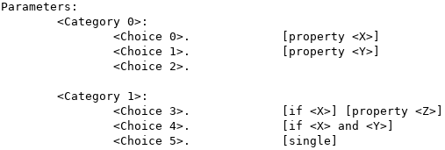
TSL input format
User needs to:
Define categories
Define choices
Define properties
Define selector statements
Define single inputs e.g. ‘-version’
User has some flexibility in how to define the description in order to optimize or reduce the number of test cases generated.
For example, use zero/positive/negative instead of exact numbers for input, etc.

Slide 7
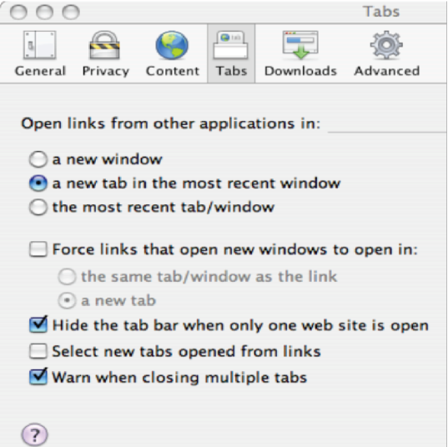
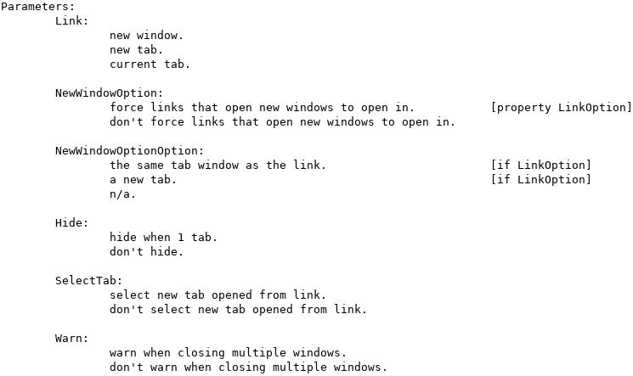
TSL – example input
Software under test: ‘Tabs’ options in a browser
Create tabs.tsl to formally specify the categories and choices
Pick 1 of 3
On or off. If on, get’s property
If property, then pick 1 of 2
n/a if no property
On or off
On or off
On or off
Notes:
7

Slide 8
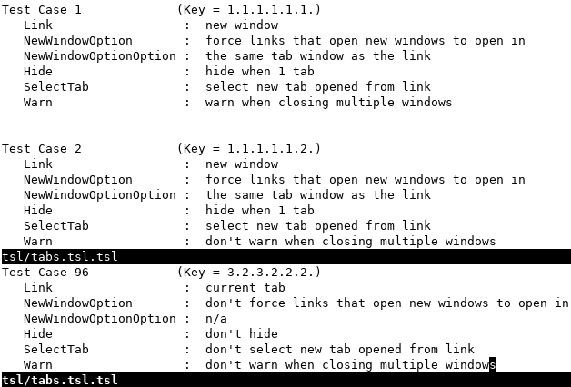
TSL – example output
96 test frames in the file
Choice indeces in category
Choice description in category
Category
Notes:
8

Slide 9
CASA
Covering Arrays by Simulated Annealing (CASA) – tool that implements the combinatorial interaction method of simulated annealing.
It can find t-way combinations of inputs to reduce the overall number of test frames required.
Programming the input is complicated.
Notes:
9
I am afraid that t-way combination is not clear here. Can you give a simple example: 3 categories and each has 2 choice. I think we had something like that:
The show 2-way (pairwise) result vs exhaustive result. Without such example it will not click for the committee.
I will add a slide on this tomorrow.

Slide 10
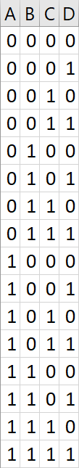
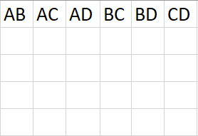
CASA – t-way covering arrays
A quick 2-way covering array example:
4 categories {A,B,C,D} have 2 choices {0,1} each
2-way indicates that if we pick a subset of entries, each pair of categories should have all combinations of choices represented.
Let’s create a table for all pairs and find a covering array.
00
00
00
00
00
00
01
01
01
01
01
01
10
10
10
10
10
10
11
11
11
11
11
11
It only takes 5 combinations to find a 2-way covering array from a total of 16 combinations!
Using this method, we can test all interactions between our inputs and reduce the total number of test frames required.

Slide 11


CASA – example input
.citmodel file
.constraints file
2 rules
2-way interaction
3 terms in this conjunctive clause
6 categories
If chose 3, then choose 5 or 6
# of choices
per category
2 terms in this conjunctive clause
If chose 4, then choose 7
The .citmodel describes the t-way interaction and the size of categories and choices
The .constraints file specifies our restrictions based on certain choices
Notes:
11
I like this slide very much!

Slide 12
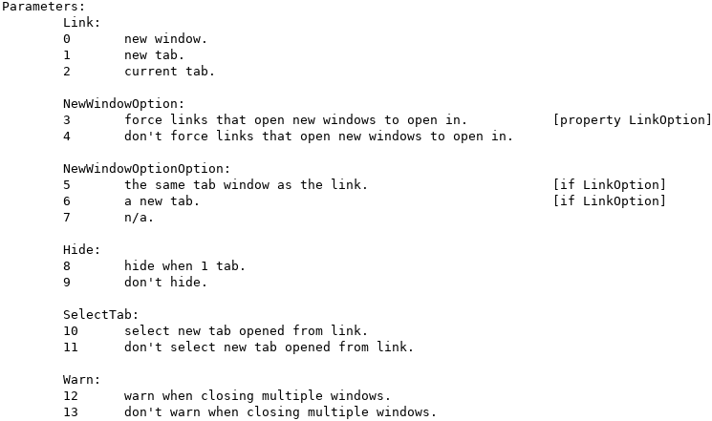
CASA – example input
.constraints file
If chose 3,
then choose 5 or 6
The .constraints file specifies our restrictions based on certain choices
The rules in the .constraints file will map back to the properties and prepositional logic selector statements used to control which options are possible from the original tsl input file.
Notes:
12
I like this slide very much!

Slide 13
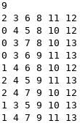
CASA – example output
9 total combinations found
Each column represents a category from the .citmodel input
Each number is a choice within it’s range of the category.
For example, the first category has 3 choices, so the valid
range is 0-2.
The second category has 2 choices, so the range is 3-4
and so on.
.citmodel input

Slide 14
CASA – example output
Again, we will map this back to the original inputs!

Slide 15
Demo – progress to date
Notes:
15
Do a live demo – it should not take long time or requires elaborate connections to some servers. Everything runs local. Just to make sure have all the windows open for demo.

Slide 16
Remaining work and timeline
May ‘21
Integrate Vojkan Cvijovic’s CNF-converter into the project
Continue coding
June ’21
Complete coding
Write project final description document
Prepare defense presentation
Defend Master’s project with a goal of graduating this summer

