Slide 1
Project Proposal
Integrating A Category-Partition Testing Tool With A Combinatorial Interaction Testing Tool To Product T-Way Adequate Test Frames
By Andrew Graff

Slide 2
Overview
Introduction
Objective of the project
TSL
CASA
Demo

Slide 3
Introduction
Testing is necessary to reduce faults in software.
Black box testing helps to find faults in usability and functionality.
Category partition method allows the break down of software inputs into easy to run test frames, but all possible inputs add up quickly which is costly in execution time.
Combinatorial interaction testing can select a subset of the test frames for adequate coverage while reducing the number of test frames to a manageable level.

Slide 4
Objective of the project
The objective of this project is to combine the user-friendly input/output components of TSL (a tool that uses category partitioning to generate test frames) and combine them with the powerful test case optimization algorithm of CASA (a tool that uses the combinatorial interaction method known as simulated annealing).

Slide 5
TSL
Testing Specification Language (TSL) – a good front-end interface for category partition method.
Create a single .tsl file that describes the categories and choices within those categories.
Generates all possible test frames with each category as an input.

Slide 6
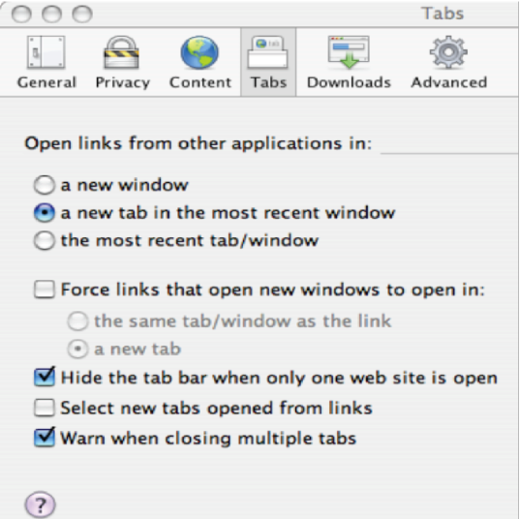
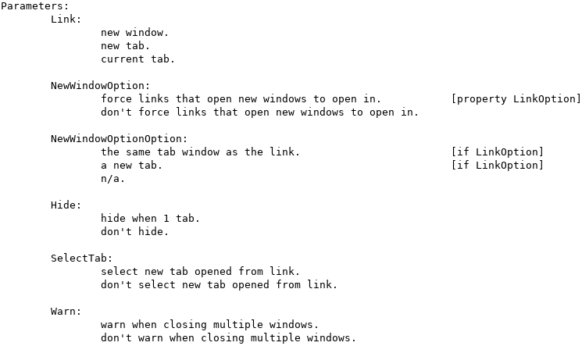
TSL – example input
Software under test: ‘Tabs’ options in a browser
Create tabs.tsl to represent the categories and choices

Slide 7

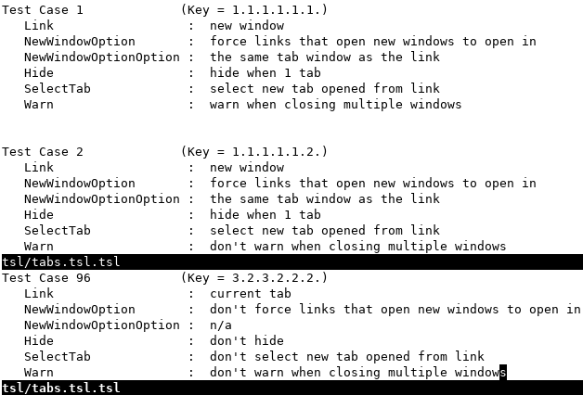
TSL – example output

Slide 8
CASA
Covering Arrays by Simulated Annealing (CASA) – tool that implements the combinatorial interaction method of simulated annealing.
It can find t-way pairwise combinations of inputs to reduce the overall number of test frames required.
Programming the input is complicated.

Slide 9
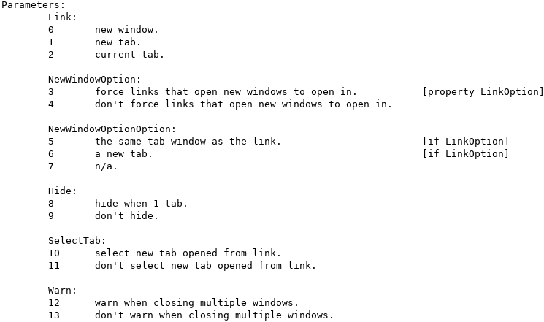


CASA – example input
.citmodel file
.contraints file
2-way interaction
2 rules
6 categories
3 terms in this conjunctive clause
# of choices
per category
If 3, then 5 or 6
2 terms in this conjunctive clause
If 4, then 7
*The numbers in the .constraints file will map back to
the choices from the original tsl input

Slide 10
Demo
Do you think I should record and explain or do a live demo?

