Slide 1


Meal-Master

Slide 2
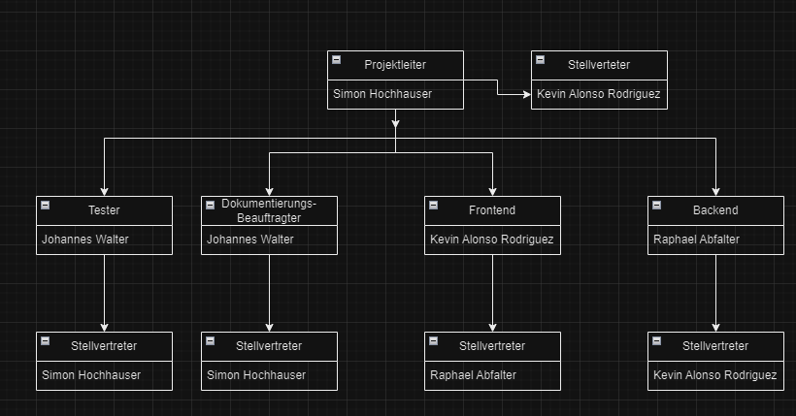
Organization chart

Slide 3

How it‘s made
Organization
Git
Jira
Implementation
PHP
Bootstrap

Slide 4
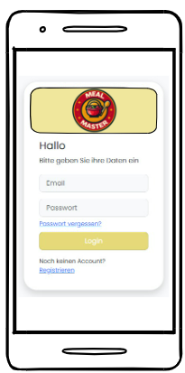
Login-Page (Abfalter)

Slide 5
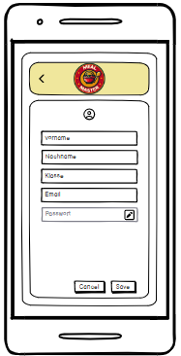
Account-Page Normal User (Abfalter)

Slide 6
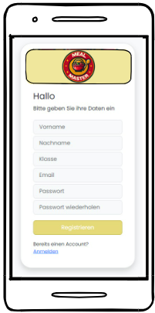
Register-Page (Abfalter)

Slide 7
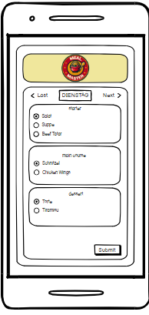
Student-Page (Alonso)

Slide 8
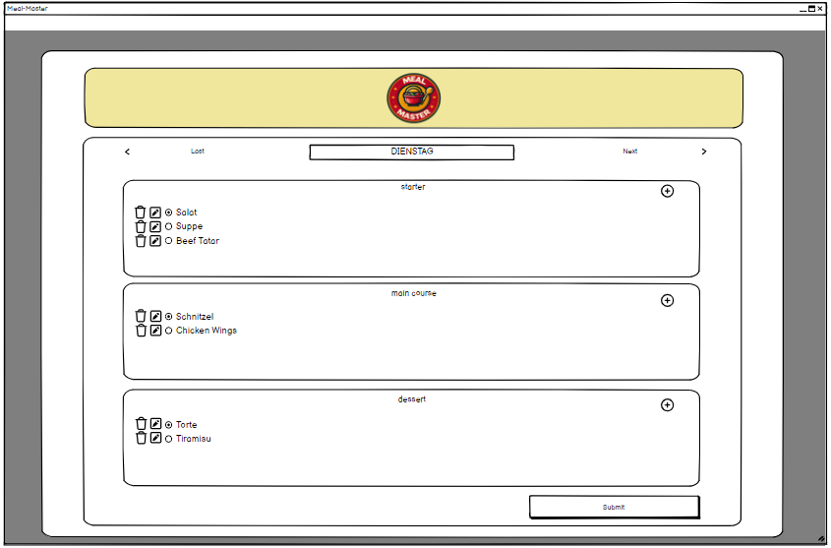
Admin-Page (Alonso)

Slide 9
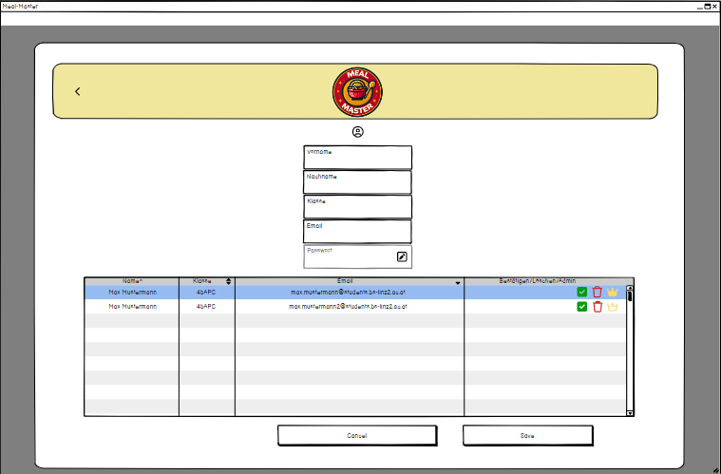
Account-Page Admin User

Slide 10

Thank you for your attention

