Slide 1
Facial expression detection using mat-lab

Slide 2

Why Emotion Detection?
The motivation behind choosing this topic specifically lies in the huge investments large corporations do in feedbacks and surveys but fail to get equitable response on their investments.
Emotion Detection through facial gestures is a technology that aims to improve product and services performance by monitoring customer behavior to certain products or service staff by their evaluation.

Slide 3
SUBMITTED BY
CH. VASHISTA (2305A44003)
U. SAI CHANDU (2305A44004)
P. SAI MANIKANTA GANESH (2305A42013)
K. PRAMODH KUMAR (2305A42016)

Slide 4
Introduction
Facial expression detection enables machines to understand human emotions.
Uses FER‑2013 dataset and MATLAB Deep Learning Toolbox.
CNN (VGG16‑based) model used for classification of emotions.
Supports both static images and real‑time webcam recognition.

Slide 5
Objectives
Develop automatic facial expression detection using deep learning.
Train & test model using FER‑2013 dataset.
Implement VGG16‑based CNN in MATLAB.
Design user‑friendly GUI for image selection & emotion detection.
Support real‑time emotion detection via webcam.
Improve accuracy and system reliability.

Slide 6
Daily Life Applications
Human–Computer Interaction: Emotion‑aware systems.
Education: Detect student engagement/confusion.
Healthcare: Emotional state monitoring.
Security: Detect suspicious or aggressive behavior.
Customer Service: Analyse customer sentiment.
Gaming/Entertainment: Adaptive emotional gameplay.

Slide 7
FER‑2013 Dataset
Source: Kaggle FER‑2013 dataset.
Contains 28,000+ grayscale facial images (48×48 pixels).
Seven emotion categories labeled.(Happy, Sad, Angry, Fear, Disgust, Surprise, Neutral.)
Preprocessing: Resize to 224×224 and convert to RGB.

Slide 8
CNN & VGG16 Architecture
CNN extracts deep spatial features from images.
CNN trained to detect 7 emotions: Happy, Sad, Angry, Fear, Disgust, Surprise, Neutral.
VGG16 used as backbone for transfer learning.
Last layers replaced to match 7‑class output.
Improves accuracy and training efficiency.

Slide 9
System Workflow
1. Image Input
2. Preprocessing (resize, RGB conversion)
3. CNN Feature Extraction (VGG16)
4. Fully Connected Layers
5. Softmax Classification
6. Emotion Output Display

Slide 10
Training in MATLAB
Training using Deep Learning Toolbox.
80:20 train-test split.
Optimizer: Adam, LR = 1e‑4, Epochs = 8.
Model saved as trainedCNN.mat.
GUI built for real‑time usage.
real‑time webcam detection.
image selection.

Slide 11
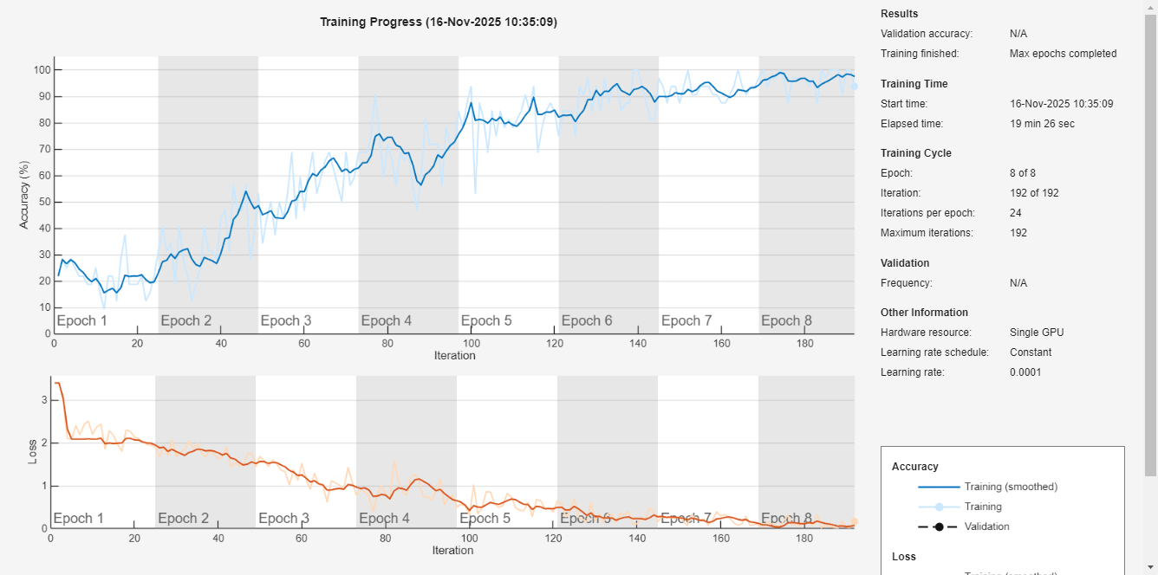
Graphs:

Slide 12
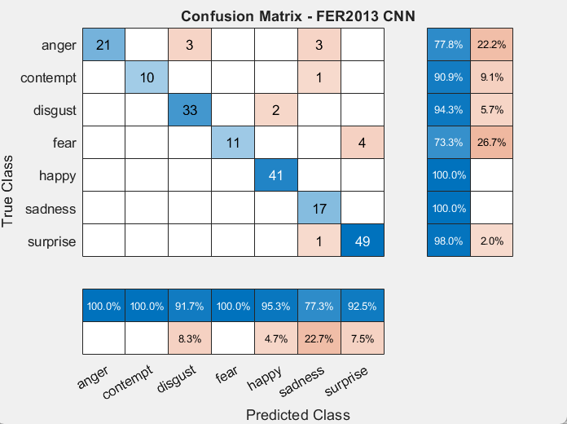
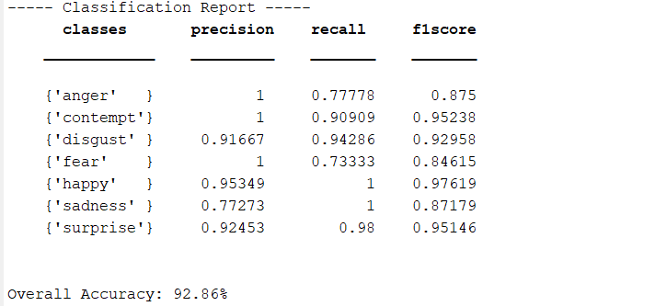
Classification Report
Confusion Matrix

Slide 13
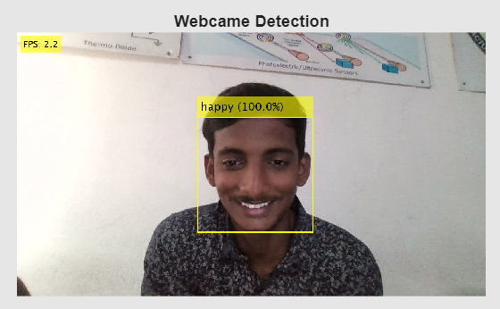
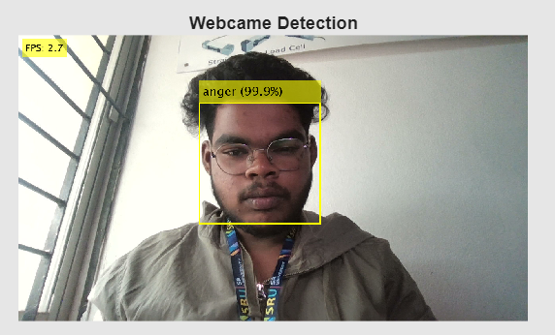
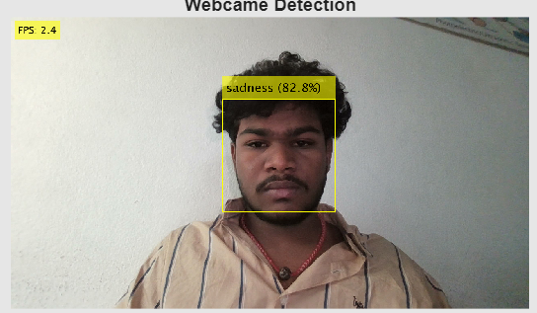
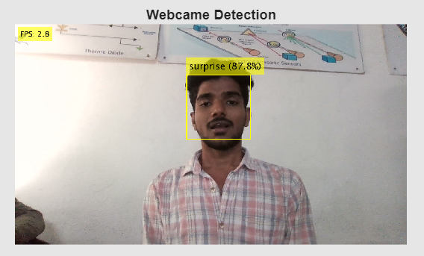
Results
CNN model shows strong accuracy across all emotion classes.
GUI displays emotion label and confidence score.
VGG16 improves robustness under varied lighting and image quality

Slide 14
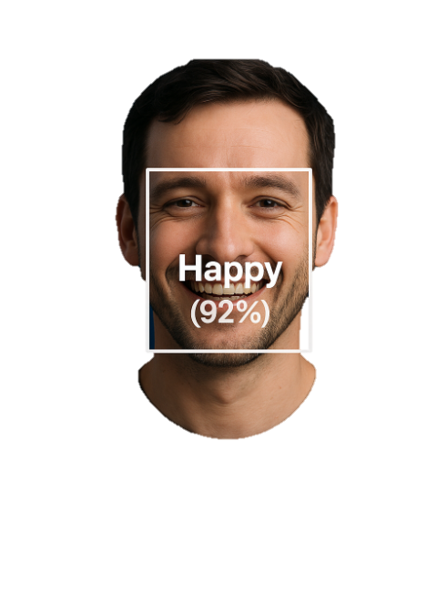
THANK YOU

