Slide 1
Lead Conversion Analysis for X Education
By: Pankaj Bhat, Nishaanth M S, Prashanth Kumar P
Optimizing Lead Scoring to Improve Conversion Rates

Slide 2
Problem Statement
X Education wants to improve its lead conversion rate, currently around 30%. By identifying 'Hot Leads' with a predictive model, the company aims to focus on high-potential leads and increase conversion to 80%.

Slide 3
Understanding the Data
Dataset contains around 9000 leads with various attributes:
- Lead Source
- Total Time Spent on Website
- Total Visits
- Last Activity
- Converted (Target Variable)

Slide 4
Exploratory Data Analysis (EDA)
We analyzed key trends in the dataset using:
- Distribution of Converted vs. Non-Converted Leads
- Impact of Total Time Spent on Website
- Lead Source Distribution
- Other Key Insights

Slide 5
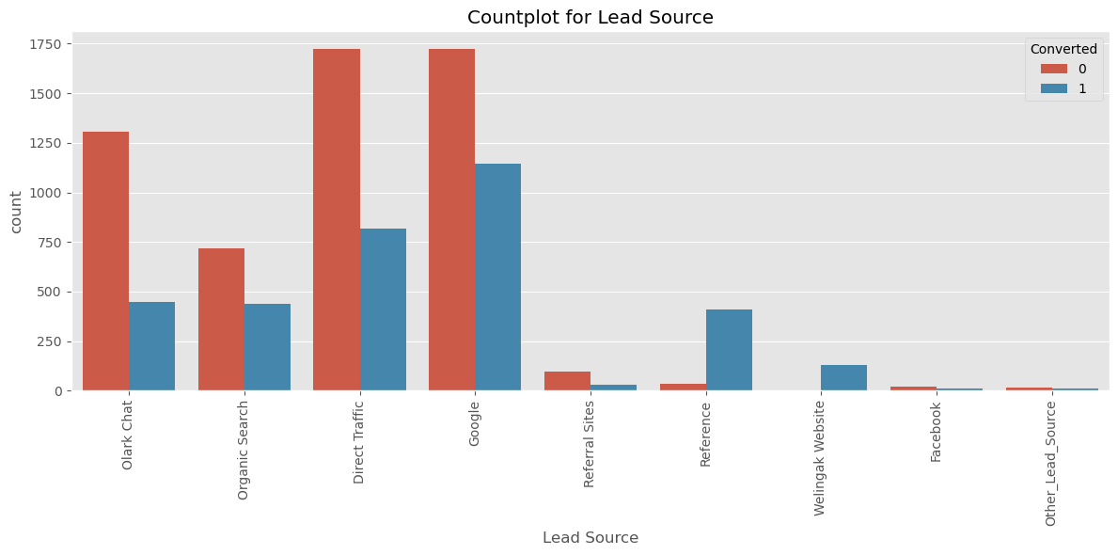
Graph 1

Slide 6
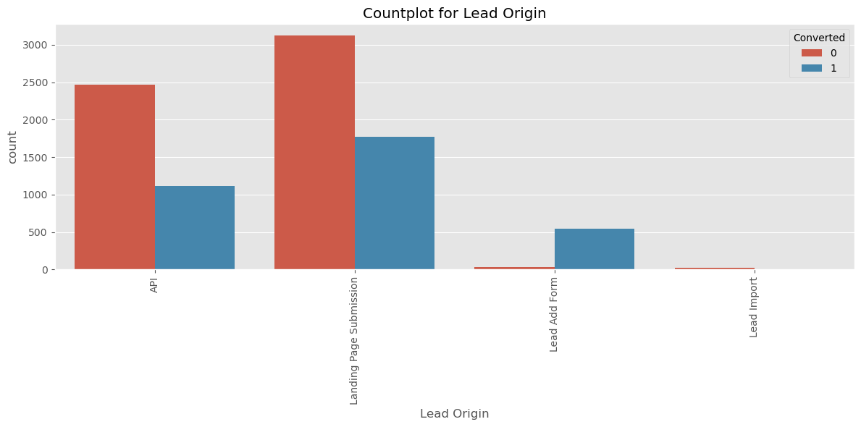
Graph 2

Slide 7
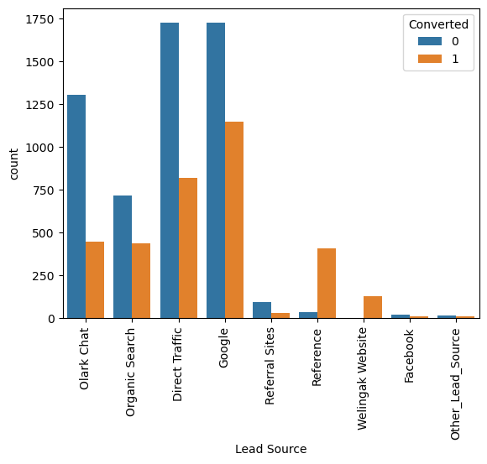
Graph 3

Slide 8
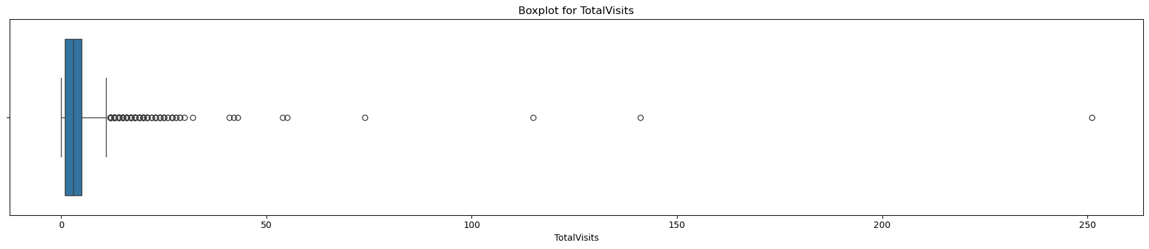
Graph 4

Slide 9
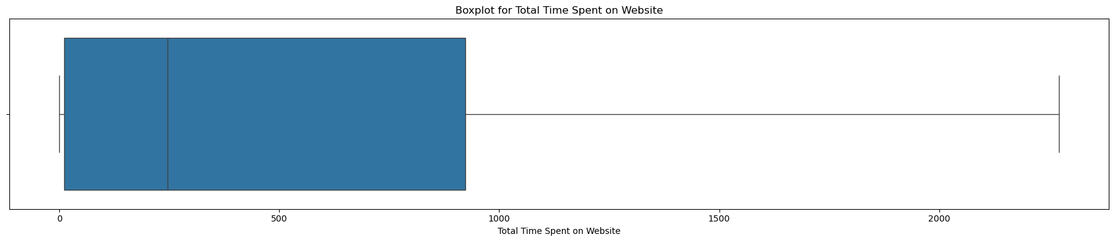
Graph 5

Slide 10
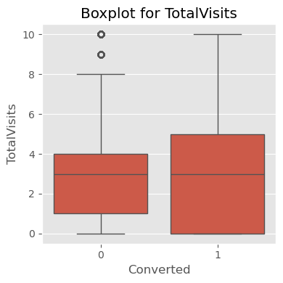
Graph 6

Slide 11
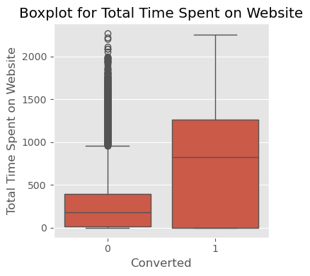
Graph 7

Slide 12
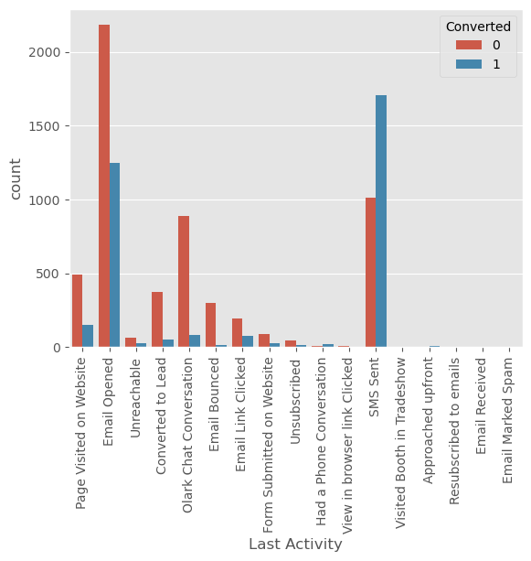
Graph 8

Slide 13
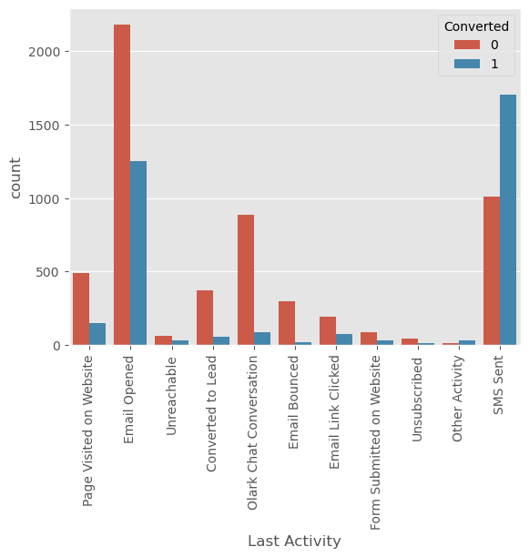
Graph 9

Slide 14
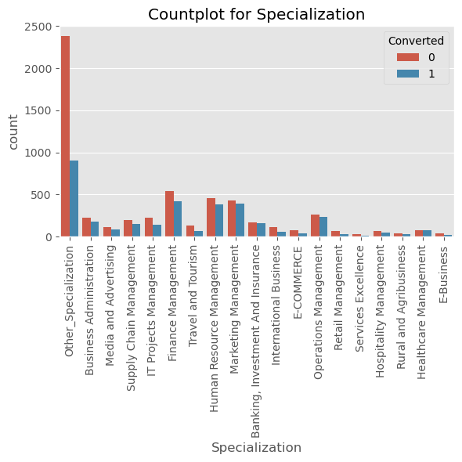
Graph 10

Slide 15
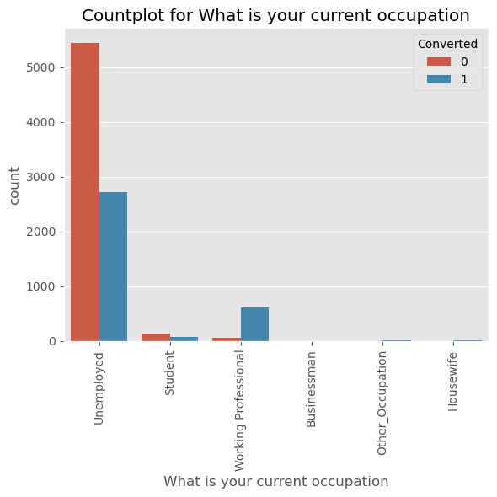
Graph 11

Slide 16
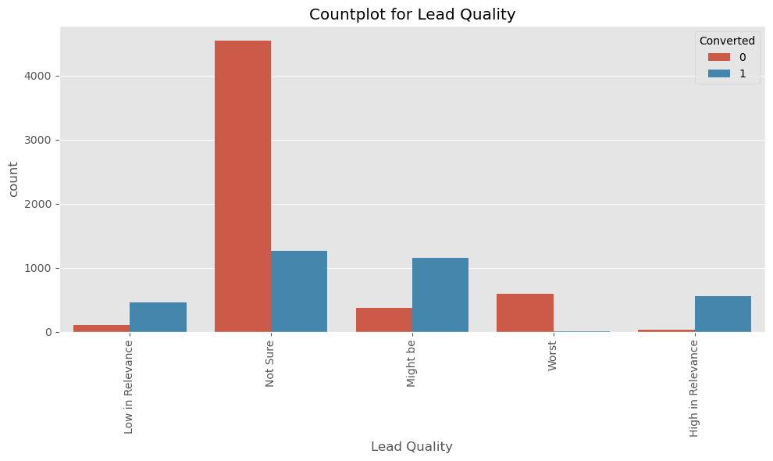
Graph 12

Slide 17
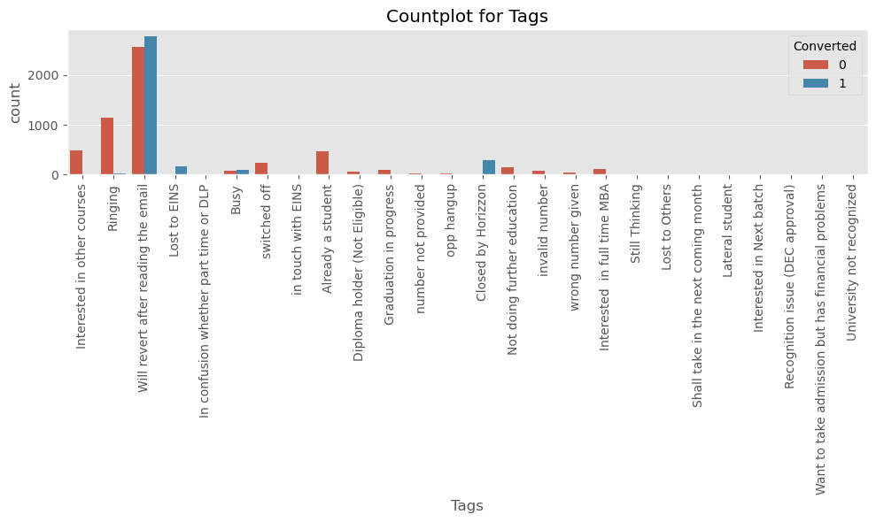
Graph 13

Slide 18
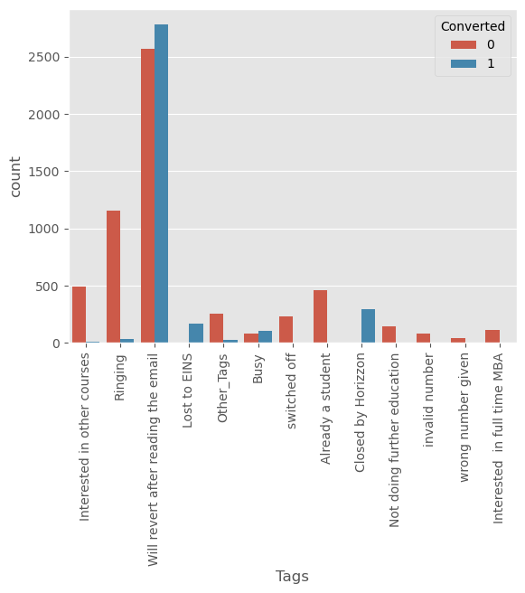
Graph 14

Slide 19
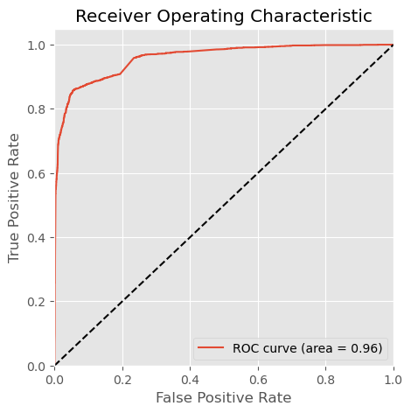
Graph 15

Slide 20
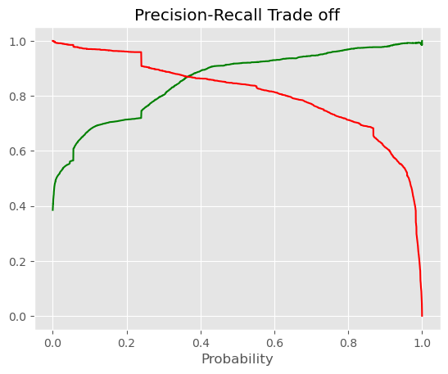
Graph 16

Slide 21
Lead Scoring Model: Logistic Regression
A logistic regression model was built to assign a lead score (0-100):
- Higher score = Higher probability of conversion
- Helps prioritize sales efforts on promising leads
- Target conversion rate: 80%

Slide 22
Key Recommendations
1. Focus sales efforts on leads with high scores.
2. Improve website engagement to boost conversion likelihood.
3. Optimize marketing channels with high lead quality.
4. Use data-driven insights for future improvements.

Slide 23
Conclusion
By leveraging a lead scoring model, X Education can increase efficiency, reduce wasted sales efforts, and significantly improve the lead conversion rate.

