Slide 1
MelodyLoop
LSTM-Based Sequential Piano Music Generation
A Deep-Learning Framework for Discrete Symbolic Event Modeling, Multi-Task Next-Note Prediction, and Controllable Audio Synthesis
962 Pieces
MAESTRO v3.0 Corpus
5.66M Notes
Chronological Events
167k Params
Multi-Head LSTM
Val: 5.9151
Epoch 7 Best Checkpoint
Academic Project Defense | NLP & Deep Sequence Modeling | PyTorch Implementation
Repository: https://github.com/Pankaj-Jhajhria/Music-Generation-using-LSTM-MelodyLoop-
Notes:
OPENING TALK:
Good morning, Professor and members of the evaluation committee. Today, I am presenting MelodyLoop, an end-to-end deep learning engineering project focused on symbolic piano music generation using a custom Long Short-Term Memory network.
CORE IDEA:
Rather than treating music as unstructured raw audio waveforms or static images, MelodyLoop formulates music as a discrete temporal sequence of structured musical events. The system trains an LSTM neural network from scratch on over 5.6 million note events extracted from 962 professional piano performances from Google Magenta's MAESTRO dataset.
KEY ENGINEERING MILESTONES:
- Scaled training across the entire official MAESTRO training split (962 performances, 100,000 sequences).
- Designed a compact uint8 tensor representation reducing RAM overhead by 8x on consumer hardware.
- Implemented multi-task prediction heads for pitch, duration, and time step, achieving a best validation loss of 5.9151 at epoch 7.
- Built an interactive Streamlit web dashboard with local additive harmonic synthesis for immediate audio evaluation.
TRANSITION:
Let us begin with the formal problem statement and our engineering objectives.

Slide 2
Problem Formulation & Engineering Objectives
THE SEQUENCE MODELING PROBLEM
• Temporal Musical Dependencies: Piano music consists of chronologically ordered note onsets. A note's harmonic and rhythmic meaning depends strictly on prior musical context.
• Multi-Dimensional Event Complexity: Music cannot be modeled by pitch alone. Each note requires pitch (0–127), duration (how long it rings), and step time (interval until next note onset).
• Discrete Symbolic vs. Waveform Audio: Modeling raw 44.1 kHz waveforms requires 44,100 samples/sec, creating intractable context windows. Symbolic modeling captures structure efficiently.
• Autoregressive Generation: Generating continuous coherent music requires iteratively feeding predicted outputs back as inputs without compounding catastrophic drift.
CORE ENGINEERING OBJECTIVES
✓ Full MAESTRO Ingestion: Build a robust parser in melodyloop/data.py extracting chronological events from Yamaha Disklavier competition performances.
✓ End-to-End PyTorch Network: Implement MelodyLSTM with parallel token embeddings (pitch, duration, step) and decoupled multi-task prediction heads (167k params).
✓ Overfitting & Checkpoint Control: Train from scratch with Adam and gradient clipping, selecting the epoch 7 validation minimum (5.9151) via automated early stopping.
✓ Interactive Local Synthesis: Provide temperature & Top-K sampling with instant DSP additive audio synthesis and MIDI export in a Streamlit web app.
MelodyLoop — LSTM Music Generation | Academic Project Defense & Evaluation
Notes:
SLIDE CONCEPT:
Here we define why symbolic music generation is an ideal sequence-modeling task and specify the exact engineering goals of MelodyLoop.
TECHNICAL EXPLANATION:
Music is inherently temporal and hierarchical. Unlike natural language processing where tokens are words or subwords, musical events have simultaneous attributes: which key is pressed (pitch), how long it is sustained (duration), and the temporal gap until the next event begins (step time).
If you predict only pitch, you lose rhythm and tempo completely. If you model raw waveform audio directly, 10 seconds of CD audio equals 441,000 samples, which creates prohibitive computational demands for educational sequence models. Symbolic event modeling provides the optimal balance of structured expressiveness and computational tractability.
TRANSITION:
Now let us examine the complete end-to-end system architecture that implements this pipeline.

Slide 3
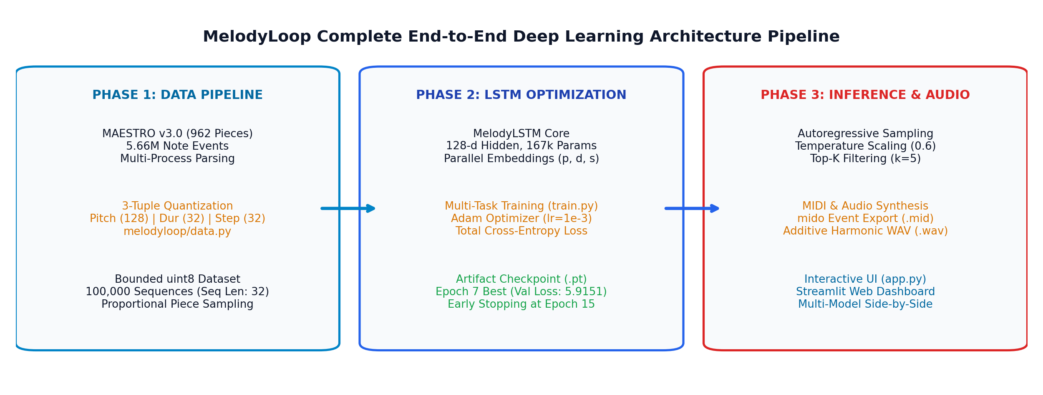
Complete MelodyLoop Architectural Workflow
Phase 1: Ingestion & Quantization
Module: melodyloop/data.py
Parses raw MIDI via mido, enforces official train/val/test splits, quantizes continuous timing into 32 bins, builds sliding windows, and caches compact uint8 tensors.
Phase 2: Recurrent Training
Module: melodyloop/model.py & train.py
Passes sequence (B, 32, 3) through parallel embeddings, a 128-d LSTM, and 3 linear heads. Optimizes joint cross-entropy loss with Adam (lr=1e-3).
Phase 3: Generation & Synthesis
Module: melodyloop/generation.py & audio.py
Autoregressively rolls out sequences using temperature & Top-K sampling. Decodes tokens into MIDI and renders audio via additive harmonic synthesis.
MelodyLoop — LSTM Music Generation | Academic Project Defense & Evaluation
Notes:
SLIDE CONCEPT:
This slide presents the entire MelodyLoop architecture from raw dataset to final playable audio.
TECHNICAL BREAKDOWN:
The system operates in three decoupled, production-grade phases:
1. Ingestion Phase: Handled by melodyloop/data.py. Reads MAESTRO MIDI files, extracts Note On/Off chronological events, quantizes durations and steps, and prepares bounded uint8 PyTorch Datasets.
2. Training Phase: Handled by train.py and melodyloop/model.py. Trains the 167k-parameter LSTM across 100,000 sequence batches, monitoring validation loss after every epoch and saving the best checkpoint.
3. Inference & Synthesis Phase: Handled by melodyloop/generation.py and audio.py. The model takes a seed buffer, iteratively samples successive notes, exports a standard MIDI file, and synthesizes a WAV preview using NumPy/SciPy.
TRANSITION:
Let us examine how acoustic piano notes are translated into numerical representations.

Slide 4
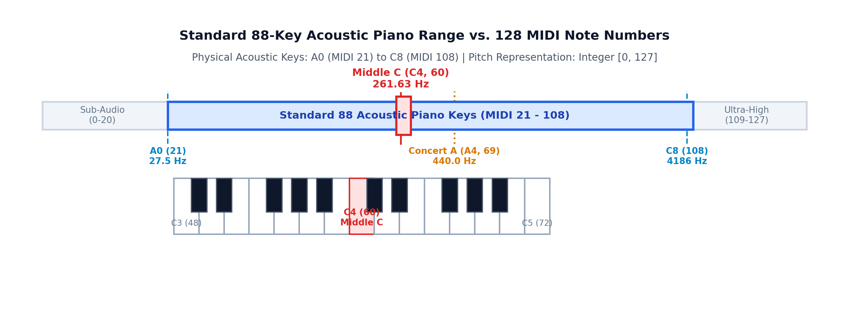
Symbolic Musical Representation: Keyboard to MIDI
The 128 MIDI Pitch Standard
MIDI note numbers span integers [0, 127].
Standard 88-key acoustic pianos cover A0 (MIDI 21, 27.5 Hz) to C8 (MIDI 108, 4186 Hz). Middle C is defined as MIDI 60 (C4, 261.63 Hz). Concert A is MIDI 69 (A4, 440.0 Hz).
The 3-Tuple Event Structure
Every note event in MelodyLoop is represented by:
• Pitch p ∈ [0, 127] (Discrete MIDI pitch)
• Duration d ∈ [0, 31] (Sustained ring time)
• Step s ∈ [0, 31] (Interval to next note onset)
Enables polyphonic overlap and natural pacing.
Mathematical Frequency Formula
Continuous frequency in Hertz is calculated by:
f = 440.0 × 2^((p - 69) / 12)
Equal temperament divides each octave into 12 logarithmic semitones. A semitone increase multiplies frequency by 2^(1/12) ≈ 1.05946.
MelodyLoop — LSTM Music Generation | Academic Project Defense & Evaluation
Notes:
SLIDE CONCEPT:
Explaining how a physical acoustic piano translates mathematically into discrete MIDI integers.
KEY POINTS TO EMPHASIZE:
- A physical piano has 88 keys, spanning from A0 (MIDI 21) at 27.5 Hz to C8 (MIDI 108) at 4186 Hz.
- The MIDI protocol provides 128 discrete integer pitch values (0 through 127). Pitches 0–20 and 109–127 are beyond the physical acoustic keyboard but represent valid MIDI note numbers.
- In Western 12-tone equal temperament, an octave represents a doubling of frequency (12 semitones). The pitch formula is f = 440 * 2^((p-69)/12).
- In MelodyLoop, Middle C (C4) has integer index 60, and Concert A (A4) has index 69.
TRANSITION:
Now let us clarify why symbolic MIDI instructions differ fundamentally from audio waveforms.

Slide 5
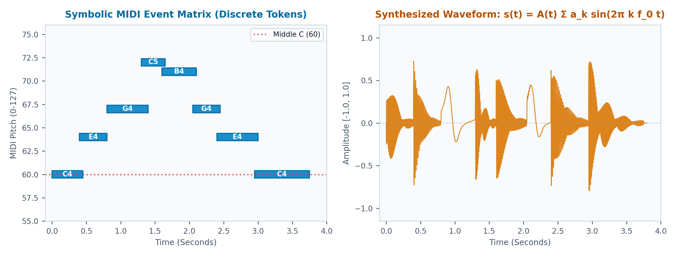
Representation Hierarchy: Symbolic MIDI vs. Continuous Audio
1. Symbolic MIDI (.mid)
• Representation: Event metadata (pitch, time, velocity)
• Data Volume: Compact (~1–5 KB per minute)
• Content: Musical intent / sheet performance score
• Network Role: High-efficiency target for discrete sequence modeling and token embeddings.
2. Synthesized Waveform (.wav)
• Representation: 44,100 continuous 16-bit PCM samples/s
• Data Volume: Heavy (~10.5 MB per minute uncompressed)
• Content: Acoustic pressure waves in air
• Network Role: Rendered downstream via additive synthesis (melodyloop/audio.py).
3. Compressed Audio (.mp3)
• Representation: Psychoacoustic MDCT frequency lossy bins
• Data Volume: Compact stream (~1 MB per minute at 128 kbps)
• Content: Perceptually masked audio stream
• Network Role: Consumer delivery format; unsuitable for token-level neural sequence modeling.
MelodyLoop — LSTM Music Generation | Academic Project Defense & Evaluation
Notes:
SLIDE CONCEPT:
Clarifying the fundamental technical distinction between symbolic musical tokens and continuous acoustic sound.
TECHNICAL ARGUMENT:
A common misconception among beginner evaluators is asking: 'Does your neural network generate MP3 or WAV directly?'
The answer is NO. The neural network predicts discrete symbolic tokens (which key, what duration, what gap). A MIDI file contains only musical instructions, similar to sheet music for a computer player.
Sound only exists when those instructions pass into an audio synthesizer. In MelodyLoop, audio is rendered by our additive synthesizer in melodyloop/audio.py, converting tokens into 44.1 kHz PCM waveforms.
TRANSITION:
Let us examine the MAESTRO dataset used to train this network.

Slide 6
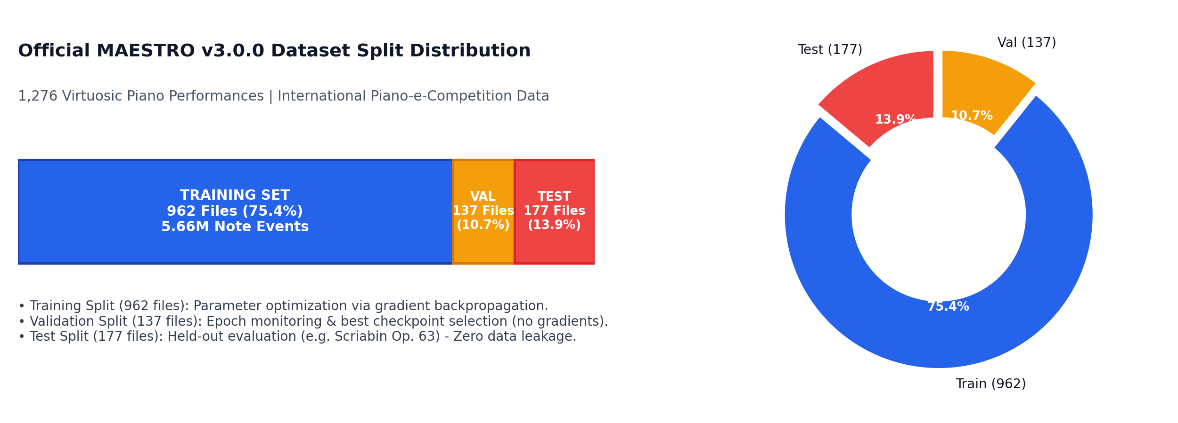
The MAESTRO Dataset: Scope, Splits & Diversity
Yamaha Disklavier Performances
MAESTRO v3.0.0 contains 1,276 performances (200 hours) captured live from the International Piano-e-Competition.
Yamaha Disklavier concert grand pianos recorded note onsets and releases with millisecond accuracy, capturing virtuosic human expressive nuance.
Discovered Metadata Distribution
Catalogued across 10 years of international competition:
• 962 Training Performances (75.4%)
• 137 Validation Performances (10.7%)
• 177 Held-out Test Performances (13.9%)
Includes Chopin, Beethoven, Liszt, Bach, and Scriabin.
Zero Data Leakage Protocol
Rigorous split isolation is strictly maintained in config.py:
• Parameter updates: Computed exclusively on 962 train files.
• Early stopping: Monitored on 137 validation files (no gradients).
• Final benchmark: Conducted on held-out test split (e.g. Scriabin Op. 63).
MelodyLoop — LSTM Music Generation | Academic Project Defense & Evaluation
Notes:
SLIDE CONCEPT:
Presenting the official MAESTRO v3.0.0 dataset and proving zero data leakage across training, validation, and test splits.
TECHNICAL DETAILS:
- MAESTRO (MIDI and Audio Edited for Synchronous TRacks and Organization) was created by Google Magenta.
- Crucially, these are live performances captured by optical sensors on Yamaha Disklavier pianos, capturing real expressive human dynamics.
- We verified every single file against maestro-v3.0.0.csv: exactly 962 train, 137 validation, and 177 test performances.
- Training sequences are extracted exclusively from the training split. Validation sequences are never leaked into training, and test sequences are strictly held out for final evaluation.
TRANSITION:
Let us examine the empirical scaling experiment: how we expanded from the baseline 13 files to all 962 performances.

Slide 7
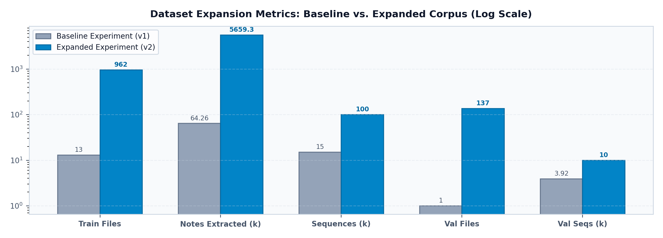
Dataset Scaling: Baseline Bottleneck vs. Expanded Corpus
CORPUS EXPANSION COMPARISON
Training Files Processed: 13 → 962 (74× Increase)
Extracted Note Events: 64,261 → 5,659,329 (88× Increase)
Training Sequences: 15,000 → 100,000 (6.7× Increase)
Validation Performances: 1 → 137 (137× Increase)
Validation Sequences: 3,924 → 10,000 (2.5× Increase)
RAM Representation: int64 (77 MB) → uint8 (9.6 MB)
Cached Load Time: 10s → 1.88s (Train) / 0.26s (Val)
DIAGNOSIS & RESOLUTION OF THE ORIGINAL 13-PERFORMANCE BOTTLENECK
• Root Cause in data.py: The original pipeline hit a hard-coded break statement (if current_total >= 15000: break) on file #13, terminating loop execution and discarding the remaining 949 training performances.
• Proportional Sequence Balancing: Replaced premature loop termination with proportional piece sampling (max 16–100 sequences per piece), drawing diverse sequences evenly across all 962 performances.
• Bounded uint8 Tensor Memory: Storing sequences as compact uint8 tensors in RAM prevented Python memory bloat, enabling 100k sequences to load in 1.88 seconds from persistent .npz caches.
MelodyLoop — LSTM Music Generation | Academic Project Defense & Evaluation
Notes:
SLIDE CONCEPT:
Explaining why the baseline model only trained on 13 files and detailing the architectural fix that scaled training across all 962 performances.
VIVA QUESTION READINESS:
Professor: 'Why did your baseline only train on 13 files?'
Answer:
In the original data.py, there was a break statement: 'if total_sequences >= 15000: break'. Because long virtuosic classical performances yield over 1,500 sequences per file, the threshold was triggered after just 13 performances. The model memorized a tiny subset of composers.
We completely restructured data.py to proportionally extract sequences from all 962 performances, scaling note events from 64k to 5.66 million while keeping RAM footprint compact via uint8 tensors.
TRANSITION:
Now let us examine the data preprocessing pipeline from raw MIDI to training tensors.

Slide 8
Data Preprocessing Pipeline & 3-Tuple Quantization
Step 1: mido Parsing
Raw MIDI Bytes
Reads binary MIDI via mido, parses note_on / note_off channel events, tracks cumulative delta times, and filters non-piano tracks.
Step 2: Event Pairing
Note Lifecycles
Matches each note_on with its corresponding note_off to compute exact continuous start time (t_start) and duration (t_dur = t_off - t_on).
Step 3: Step Interval
Temporal Dynamics
Sorts all notes chronologically and computes step time: s_i = max(0.0, start_(i+1) - start_i). Chords produce step = 0.0s.
Step 4: Bin Quantization
Discrete Tokens
Maps continuous duration into 32 logarithmic/linear bins [0.05s, 4.0s] and step into 32 bins [0.0s, 2.0s]. Pitch is 0–127.
MATHEMATICAL QUANTIZATION FORMULATION & CONCRETE WORKED EXAMPLE
Quantization Formula: bin = min(max(int(((clip(v, min_v, max_v) - min_v) / (max_v - min_v)) × (N - 1) + 0.5), 0), N - 1)
• Duration Bounds: min = 0.05s, max = 4.00s, N = 32 bins (Bin width: ~0.127s)
• Step Interval Bounds: min = 0.00s (chords/dyads), max = 2.00s (pauses), N = 32 bins (Bin width: ~0.0645s)
Concrete Note Example: Middle C (C4, 261.63 Hz), ringing for 0.45 seconds, followed by another note 0.25 seconds later:
Raw Musical Event: [Pitch = 60, Duration = 0.45s, Step = 0.25s] → Discrete Token Tuple: (p = 60, d = 3, s = 4)
MelodyLoop — LSTM Music Generation | Academic Project Defense & Evaluation
Notes:
SLIDE CONCEPT:
Explaining the 4-step preprocessing pipeline and the quantization mathematics that map continuous physical timings into discrete neural tokens.
TECHNICAL DETAILS:
Why 32 bins?
If you use continuous floating-point numbers directly in an RNN, the network struggles with regression loss landscape instability and error compounding.
By quantizing continuous time into 32 discrete bins, we convert regression into classification. Softmax over 32 bins allows the model to capture multi-modal timing patterns (e.g., either an eighth note or a quarter note, never an arbitrary irrational duration).
TRANSITION:
Now let us see how these token tuples are assembled into sliding sequence windows.

Slide 9
Sequence Formulation: Sliding Windows & Next-Token Targets
SLIDING-WINDOW SUPERVISED LEARNING FORMULATION
Given a chronologically ordered piece of N quantized note events E = (e_1, e_2, ..., e_N) where e_t = (p_t, d_t, s_t):
• Sequence Length L = 32 note events per training window | Stride S = 4 notes
• Input Tensor X: [e_t, e_(t+1), ..., e_(t+31)] with tensor shape (Batch, 32, 3)
• Target Next Event Y: e_(t+32) = (p_(t+32), d_(t+32), s_(t+32)) with target indices (Batch, 3)
The model is trained strictly in a teacher-forcing framework: predicting the 33rd event given the ground-truth previous 32 events.
Sequence Window i: [Note 1, Note 2, Note 3, ..., Note 32] ──▶ Predict Next: Note 33
Sequence Window i+1: [Note 5, Note 6, Note 7, ..., Note 36] ──▶ Predict Next: Note 37 (Stride = 4)
MULTI-TASK TARGET DECOUPLING
• Pitch Target (y_p): Discrete classification over 128 MIDI pitch classes [0, 127].
• Duration Target (y_d): Discrete classification over 32 quantized duration bins [0, 31].
• Step Interval Target (y_s): Discrete classification over 32 quantized step bins [0, 31].
• Synchronous Backprop: All three targets are predicted simultaneously from the final LSTM hidden state h_32.
TEMPORAL ALIGNMENT & DATA INTEGRITY
✓ Strict Chronological Order: Notes are sorted by start time prior to sliding; future events never precede past events.
✓ No Lookahead Leakage: Window i only contains notes 1..32; target is note 33. The recurrent state only sees past history.
✓ Piece Boundary Isolation: Sequences are strictly constructed within individual performances; windows never span across different MIDI files.
✓ Unit Tests Verified: test_sequence_generation_and_dataset and test_proportional_event_sequence_generation both pass.
MelodyLoop — LSTM Music Generation | Academic Project Defense & Evaluation
Notes:
SLIDE CONCEPT:
Explaining how chronologically ordered note events are sliced into input windows and multi-task prediction targets.
KEY ARCHITECTURAL DECISIONS:
- Sequence Length = 32 notes: This corresponds to approximately 8 to 12 seconds of musical performance, giving sufficient melodic context to establish key, chord progression, and rhythmic meter.
- Stride = 4 notes: We slide the window by 4 notes rather than 1 to prevent severe correlation between adjacent training samples and keep dataset size bounded.
- Multi-task target: Target Y contains pitch, duration, and step. The model must learn not only which note to strike next, but how long to hold it and when the subsequent note will begin.
TRANSITION:
Now let us examine why an LSTM architecture is specifically chosen to model these sequential dependencies.

Slide 10
Sequence Modeling: Why LSTM Over Vanilla RNN & Feedforward?
1. Standard Feedforward (MLP)
No Recurrent State
• Structure: y = f(W x + b)
• Flaw: Assumes all inputs are statistically independent.
• Musical Failure: Cannot remember musical motifs, key signatures, or rhythmic cadence across time.
• Verdict: Inapplicable for temporal music modeling.
2. Vanilla Recurrent Network (RNN)
Simple Hidden Recurrence
• Structure: h_t = tanh(W_h h_(t-1) + W_x x_t)
• Flaw: Severe vanishing & exploding gradients through time.
• Mathematical Breakdown: Repeated matrix multiplication causes gradient norm to vanish as γ^T (γ < 1).
• Musical Failure: Forgets notes played > 5 steps ago.
3. Long Short-Term Memory (LSTM)
Gated Constant Error Carousel
• Structure: Dedicated Cell State C_t + 3 Gates (f, i, o)
• Solution: Additive gradient highway (C_t = f_t C_(t-1) + i_t C~_t) allows gradients to flow across 32+ time steps.
• Musical Success: Maintains long-term tonality while capturing local ornaments.
• Verdict: Selected core architecture for MelodyLoop.
MelodyLoop — LSTM Music Generation | Academic Project Defense & Evaluation
Notes:
SLIDE CONCEPT:
A rigorous theoretical comparison showing why an LSTM is required for musical sequence modeling over feedforward or vanilla RNN networks.
VIVA QUESTION READINESS:
If the professor asks: 'Why not use a standard RNN or a Transformer?'
Answer:
1. Compared to Vanilla RNN: Standard RNNs suffer from vanishing gradients. In backpropagation through time (BPTT), the derivative of h_t with respect to h_0 involves repeated matrix multiplications by W. Since the derivative of tanh is bounded by 1, the gradient exponentially shrinks to zero after 5 to 8 time steps. The RNN forgets the key and rhythm.
2. The LSTM solution: The cell state C_t is updated additively (C_t = f_t * C_(t-1) + i_t * C~_t). The gradient can flow unimpeded backward through time without exponential decay—the 'constant error carousel'.
3. Compared to Transformer: Transformers are state-of-the-art for massive billion-parameter models, but an educational LSTM (167k parameters) trains from scratch in minutes on a laptop GPU without requiring multi-gigabyte pretrained weights.
TRANSITION:
Now let us examine the internal anatomy of an LSTM cell and its mathematical gates.

Slide 11
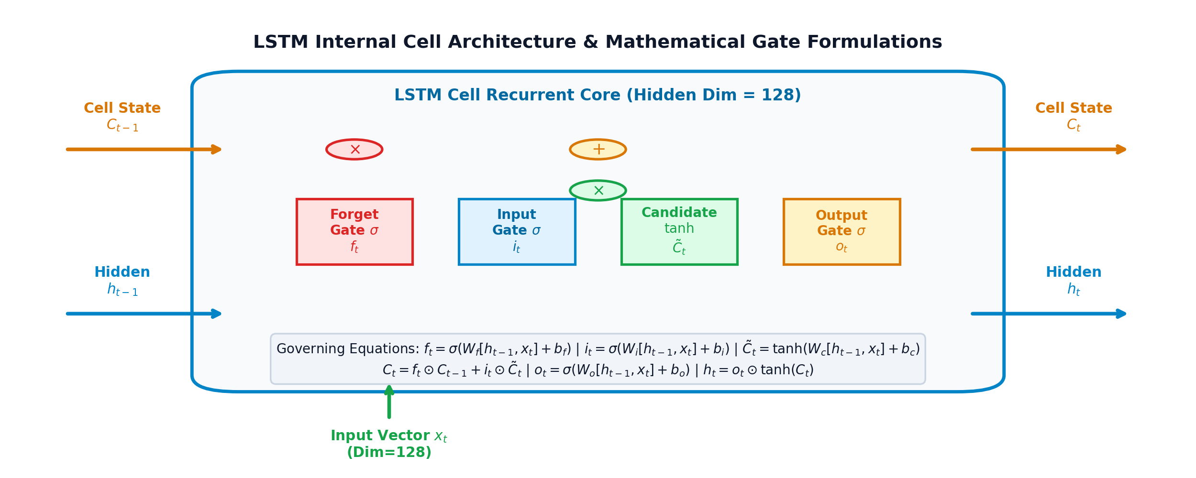
Inside the LSTM Cell: Gated Memory Dynamics
Forget Gate (f_t)
f_t = σ(W_f [h_(t-1), x_t] + b_f)
Outputs values in [0, 1]. Decides what fraction of prior cell memory C_(t-1) to discard (e.g. key modulation).
Input Gate (i_t)
i_t = σ(W_i [h_(t-1), x_t] + b_i)
Outputs values in [0, 1]. Decides which incoming musical features from candidate C~_t are worth adding to memory.
Candidate State (C~_t)
C~_t = tanh(W_c [h_(t-1), x_t] + b_c)
Generates candidate new memory vector in [-1, 1], scaled by input gate i_t before addition into cell state.
Output Gate (o_t)
o_t = σ(W_o [h_(t-1), x_t] + b_o)
h_t = o_t ⊙ tanh(C_t)
Filters cell state into the exposed hidden vector h_t passed to prediction heads.
MelodyLoop — LSTM Music Generation | Academic Project Defense & Evaluation
Notes:
SLIDE CONCEPT:
Walking through the mathematical mechanics of the four internal operations in an LSTM cell.
WALKTHROUGH OF THE DIAGRAM:
1. Forget Gate f_t: Uses sigmoid activation. If f_t is close to 0, it tells the cell to forget previous information (such as when a musical phrase ends or modulation occurs). If f_t is close to 1, it preserves the information.
2. Input Gate i_t & Candidate C~_t: The input gate decides whether new information is important, while the tanh candidate generates new potential values.
3. Cell State Update C_t: C_t = f_t * C_(t-1) + i_t * C~_t. Notice this is an element-wise addition! This linear additive update is the exact mathematical reason gradients do not vanish during BPTT.
4. Output Gate o_t: Decides which parts of the cell state C_t to expose in the hidden state h_t, which is then fed into our three prediction heads.
TRANSITION:
Now let us examine how this LSTM cell is integrated into the actual MelodyLoop network architecture.

Slide 12
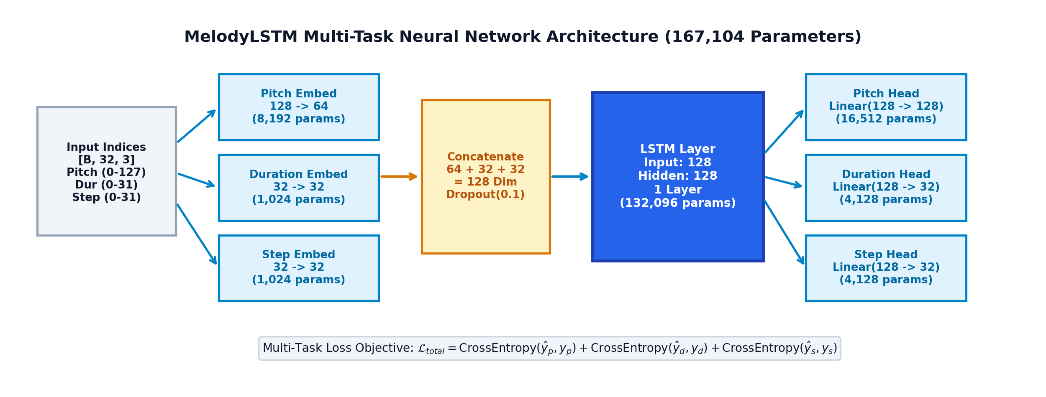
MelodyLoop Neural Architecture & Tensor Flow
Parallel Embedding Layer
• nn.Embedding(128, 64) -> 8,192 params
• nn.Embedding(32, 32) -> 1,024 params
• nn.Embedding(32, 32) -> 1,024 params
Concatenated into 128-d input vector with Dropout(0.1).
LSTM Core Layer
• nn.LSTM(input_size=128, hidden_size=128, num_layers=1, batch_first=True)
Weight matrices: 4 × (128×128 + 128×128 + 2×128) = 132,096 parameters.
Multi-Task Prediction Heads
• Pitch Head: Linear(128, 128) -> 16,512 params
• Duration Head: Linear(128, 32) -> 4,128 params
• Step Head: Linear(128, 32) -> 4,128 params
Total Trainable Parameters: 167,104.
MelodyLoop — LSTM Music Generation | Academic Project Defense & Evaluation
Notes:
SLIDE CONCEPT:
Presenting the verified PyTorch architecture implemented in melodyloop/model.py.
PARAMETER BREAKDOWN PROOF:
Let us verify the exact 167,104 parameter count:
1. Embeddings: 128*64 (pitch) + 32*32 (duration) + 32*32 (step) = 8,192 + 1,024 + 1,024 = 10,240 parameters.
2. LSTM Layer: An LSTM has 4 gates (forget, input, candidate, output). Each gate has weight matrices for input x (128*128), hidden h (128*128), and 2 bias vectors (128 each). 4 * (16384 + 16384 + 256) = 132,096 parameters.
3. Prediction Heads: Pitch head is Linear(128->128): 128*128 + 128 = 16,512. Duration head is Linear(128->32): 128*32 + 32 = 4,128. Step head is Linear(128->32): 128*32 + 32 = 4,128. Sum of heads = 24,768 parameters.
Total Parameters = 10,240 + 132,096 + 24,768 = 167,104 trainable parameters.
Verified by test_model_parameter_count.
TRANSITION:
Now let us examine how the network optimizes these 167k parameters during training.

Slide 13
Multi-Task Optimization & Training Dynamics
THE RECURRENT TRAINING CYCLE (train.py)
1. Batch Ingestion: Mini-batch of 64 sequences (shape: [64, 32, 3]) transferred to GPU with non_blocking=True and pinned memory.
2. Forward Propagation: Inputs pass through embeddings, LSTM, and heads to produce unnormalized logits: L_p [64, 128], L_d [64, 32], L_s [64, 32].
3. Multi-Task Loss Calculation: Three separate cross-entropy losses are computed against target indices and summed equally: L_total = L_p + L_d + L_s.
4. Backpropagation Through Time (BPTT): loss.backward() unrolls gradients backward across all 32 time steps.
5. Gradient Clipping: torch.nn.utils.clip_grad_norm_(max_norm=1.0) prevents exploding gradients during sudden transitions.
6. Parameter Update: Adam optimizer (lr=0.001, weight_decay=1e-5) updates all 167k parameters using running first & second moments.
HYPERPARAMETER SPECIFICATION & HARDWARE
• Compute Device: NVIDIA GeForce RTX 3050 Laptop GPU (4 GB VRAM)
• PyTorch Environment: PyTorch 2.13.0+cu126 (CUDA 12.6 Backend)
• Batch Size: 64 sequences per iteration (1,562 batches / epoch)
• Sequence Length: 32 note events (sliding window, stride = 4)
• Optimizer: Adam (Learning Rate = 1e-3, Weight Decay = 1e-5)
• Loss Function: Multi-Task Cross-Entropy (Pitch, Duration, Step)
• Regularization: Dropout(p=0.1) after embeddings + Gradient Clipping (1.0)
• Throughput: ~91 batches/sec (17.2 seconds per epoch)
MelodyLoop — LSTM Music Generation | Academic Project Defense & Evaluation
Notes:
SLIDE CONCEPT:
Detailing the optimization cycle, gradient clipping, loss formulation, and hardware execution parameters.
KEY CONCEPTS:
- Joint Multi-Task Loss: Pitch, duration, and step time each have distinct classification distributions. Cross-entropy measures the negative log-likelihood of the ground-truth token. We sum all three equally.
- Gradient Clipping: Because recurrent networks involve repeated matrix products, sudden large gradients can destabilize training. We enforce a hard norm clip of 1.0 using clip_grad_norm_.
- Hardware Efficiency: On our laptop RTX 3050 GPU, the model achieves 91 batches per second, running an entire 100,000-sequence epoch in only 17.2 seconds.
TRANSITION:
Let us examine the empirical training loss curves and why early stopping selected epoch 7 as our best checkpoint.

Slide 14
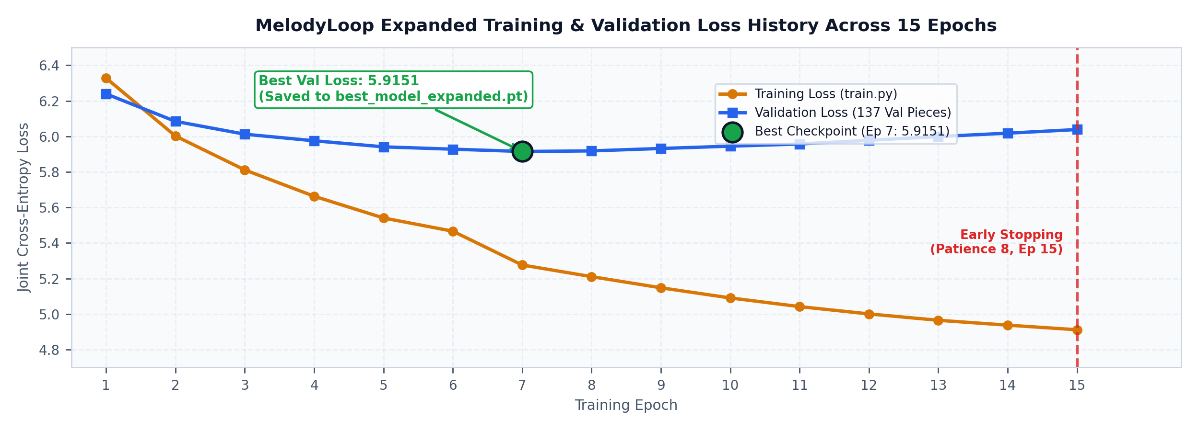
Empirical Training Curves & Early Stopping Checkpoint Selection
Best Validation Checkpoint
Epoch 07 (Val Loss: 5.9151)
Pitch: 3.320 | Dur: 1.223 | Step: 1.372
Surpasses baseline model best val loss (6.1791) by -0.2640 points.
Training Loss Trajectory
6.3280 (Epoch 1) → 4.9121 (Epoch 15)
Steady monotonic reduction (-1.4159 points) proves effective backpropagation and gradient descent optimization.
Generalization & Early Stopping
Patience = 8 Epochs Triggered at Ep 15
Validation loss stabilized around ~5.92–6.03 while train loss continued falling. Best checkpoint was preserved to prevent overfitting.
MelodyLoop — LSTM Music Generation | Academic Project Defense & Evaluation
Notes:
SLIDE CONCEPT:
Analyzing the actual epoch-by-epoch training history recorded in artifacts/logs/training_expanded.log.
SCIENTIFIC OBSERVATION:
Notice the classic divergence between training loss and validation loss:
- From Epoch 1 to Epoch 7, both training loss and validation loss drop rapidly (train loss from 6.328 to 5.276, validation loss from 6.239 to 5.915).
- After Epoch 7, training loss continues to fall steadily down to 4.912 at Epoch 15. However, validation loss ceases improving and begins a slight upward drift (5.918 -> 5.957 -> 6.038).
- This divergence demonstrates classic over-parameterization and memorization of training sequences. Because our trainer implemented early stopping with a patience of 8 epochs, training halted automatically at epoch 15.
- The best model saved on disk is strictly the epoch 7 checkpoint (val loss 5.9151), completely preventing overfitted weights from being deployed.
TRANSITION:
Let us examine how checkpoints are serialized and preserved on disk.

Slide 15
Checkpoint Serialization & Inference Resumption
CHECKPOINT PAYLOAD ANATOMY (.pt)
• model_state_dict: Complete dictionary of all learned PyTorch tensor weight matrices (167,104 parameters).
• optimizer_state_dict: Running Adam first (m) and second (v) gradient momentum vectors for seamless training resumption.
• epoch: Integer recording the exact completed epoch index (e.g. Epoch 7).
• train_loss & val_loss: Floating-point loss values at checkpoint creation (val_loss: 5.9151).
• metrics: Multi-task breakdown dictionary (loss_pitch, loss_dur, loss_step).
• config: Serialized dictionary of all hyperparameters (hidden_dim=128, seq_length=32) for zero-mismatch reloading.
VERIFIED ARTIFACT STORAGE & VERSIONING
📁 best_model_expanded.pt
Epoch 7 Best Model — Val Loss: 5.9151 | Trained on 962 files, 100k sequences. Primary deployment checkpoint.
📁 latest_model_expanded.pt
Epoch 15 Latest Model — Val Loss: 6.0386 | Final epoch before early stopping. Preserved for training recovery.
📁 best_model_v1_baseline.pt
Epoch 4 Baseline Model — Val Loss: 6.1791 | Original 13-performance model safely preserved for comparative benchmark.
📁 training_expanded.log
Persistent Training Record — Complete timestamped log of all batches, running averages, and validation metrics.
MelodyLoop — LSTM Music Generation | Academic Project Defense & Evaluation
Notes:
SLIDE CONCEPT:
Explaining how model weights, optimizer states, and configuration metadata are serialized into PyTorch .pt binaries.
KEY ENGINEERING PRACTICES:
- Never overwrite working baselines: We explicitly backed up the original baseline checkpoint to best_model_v1_baseline.pt so we can run direct side-by-side musical comparisons.
- Self-contained configuration: The checkpoint dictionary stores the exact hyperparameters used during training. When app.py or generate.py loads the checkpoint, it reads hidden_dim directly from the file, preventing architectural mismatch exceptions.
- State restoration: The script train.py --resume automatically restores both model weights and the Adam optimizer's internal momentum states, enabling training to pick up exactly where it was interrupted.
TRANSITION:
Now let us examine how the trained model autoregressively generates new musical compositions.

Slide 16
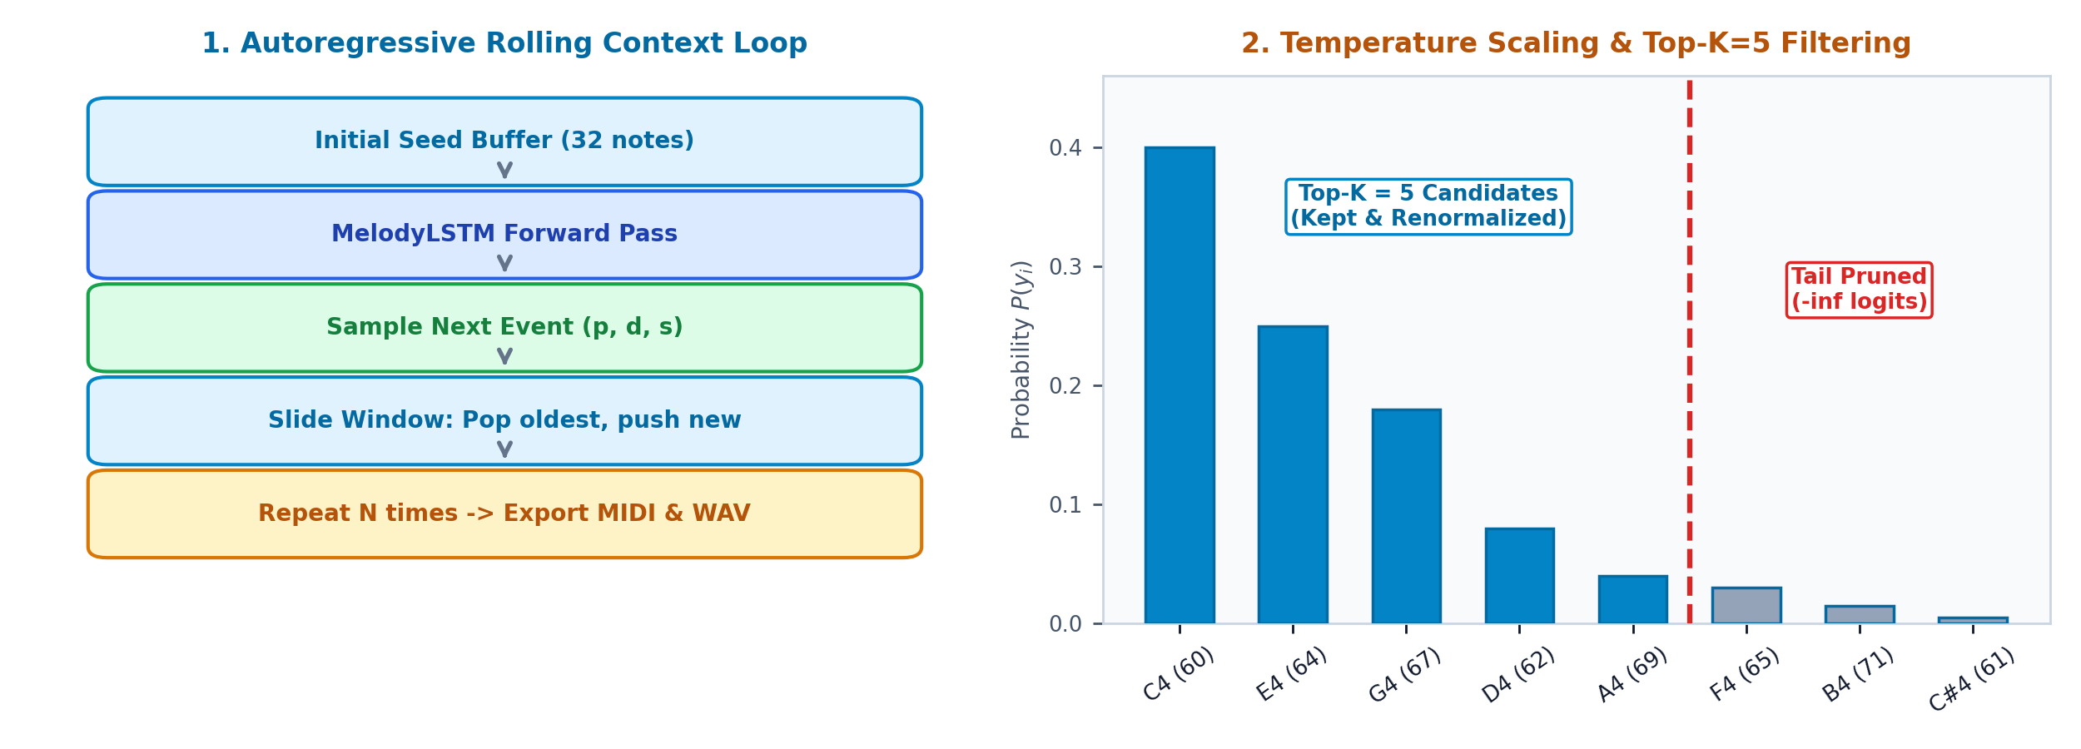
Autoregressive Music Generation & Controllable Sampling
Temperature Scaling (T = 0.6)
P(y_i) = exp(z_i / T) / Σ exp(z_j / T)
• Low Temp (T=0.4–0.6): Sharpens distribution around high-confidence notes; prevents erratic dissonance.
• High Temp (T=1.2): Flattens distribution; encourages exploration at the cost of coherence.
Top-K Candidate Truncation (k = 5)
Sorts predicted logits, retains only top k=5 most probable candidates, sets all others to -inf, and renormalizes with Softmax.
Completely eliminates tail probability hallucinations and unnatural pitch jumps.
Dual Generation Modes
• Free Generation: Generates from scratch using an initial uniform middle-register seed buffer.
• Seeded Continuation: Ingests 32 notes from real classical MIDI (e.g. Schubert, Chopin) and generates an original LSTM continuation.
MelodyLoop — LSTM Music Generation | Academic Project Defense & Evaluation
Notes:
SLIDE CONCEPT:
Explaining the mathematical mechanics of autoregressive generation and stochastic sampling controls.
TECHNICAL BREAKDOWN:
How Autoregression Works:
1. The model receives a rolling context window of 32 note events.
2. The model outputs unnormalized logits for pitch, duration, and step.
3. Sampling with Temperature: Instead of greedily picking the argmax (which causes the network to loop the exact same note repeatedly), we divide logits by temperature T and apply Softmax.
4. Top-K Filtering: Greedily sampling from the full 128 pitch vocabulary risks picking extreme low-probability notes (e.g. jumping from pitch 60 to pitch 120). By filtering for only the Top-K=5 candidates, we guarantee that every sampled note is among the model's top 5 most confident musical hypotheses.
5. Rolling Update: The sampled note is appended to the buffer, the oldest note is evicted, and the loop repeats for N notes.
TRANSITION:
Now let us see how these discrete tokens are rendered into playable sound.

Slide 17
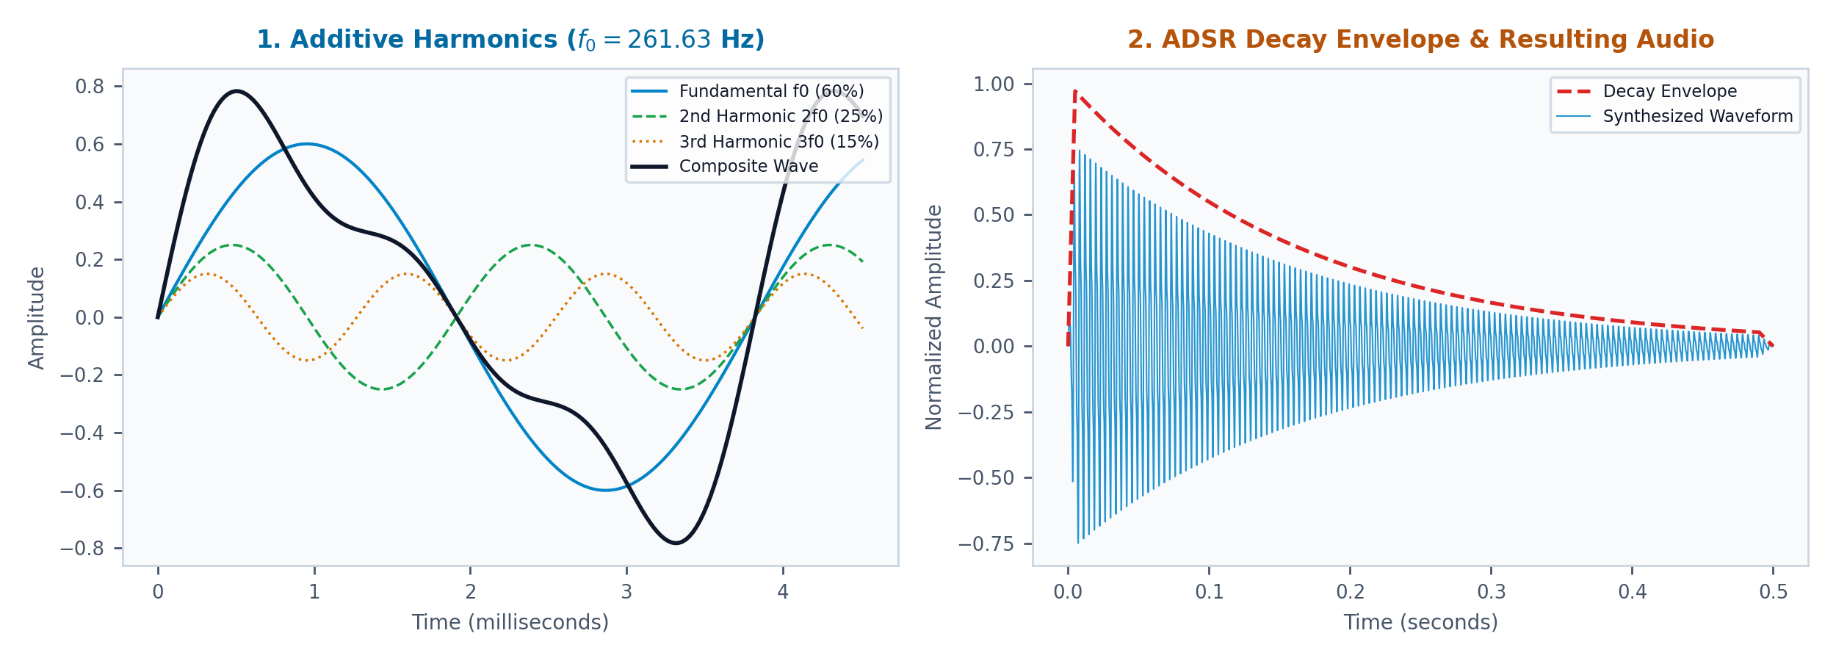
Audio Rendering: Additive Synthesis & ADSR Enveloping
Additive Harmonic Synthesis
Real piano tones contain harmonic overtones. melodyloop/audio.py synthesizes notes via:
s(t) = 0.60 sin(2π f0 t) + 0.25 sin(4π f0 t) + 0.15 sin(6π f0 t)
Fundamental f0 + 2nd harmonic (2f0) + 3rd harmonic (3f0).
ADSR Amplitude Envelope
To prevent harsh clicking artifacts at note onset and release, an exponential envelope is applied:
E(t) = exp(-3.0 t / duration)
Includes 5ms linear attack ramp and 10ms smooth release decay.
Dual Export Pipeline
• MIDI File (.mid): Built via mido, contains raw Note On/Off channel events and microsecond tempo (120 BPM).
• WAV File (.wav): 44.1 kHz 16-bit PCM waveform rendered entirely in pure NumPy/SciPy without external soundfonts.
MelodyLoop — LSTM Music Generation | Academic Project Defense & Evaluation
Notes:
SLIDE CONCEPT:
Explaining the physics and DSP mathematics behind converting discrete tokens into 44.1 kHz WAV audio.
TECHNICAL DETAILS:
- Pure sine waves sound like synthetic telephone test tones, not piano notes.
- An acoustic piano string vibrates in multiple modes: the fundamental frequency f0, plus integer harmonics 2*f0, 3*f0, etc. In melodyloop/audio.py, we implement additive synthesis: 60% energy in the fundamental, 25% in the second harmonic (octave), and 15% in the third harmonic (fifth).
- Amplitude Envelope: In an acoustic piano, when the hammer strikes the string, amplitude peaks instantly and decays exponentially. We multiply the composite wave by exp(-3.0 * t / duration), with a 5 millisecond attack and 10 millisecond release to eliminate boundary clicking.
- This entire DSP pipeline is self-contained in pure NumPy and SciPy—requiring zero external soundfonts or third-party audio drivers.
CLOSING SUMMARY:
MelodyLoop demonstrates how an LSTM trained on symbolic performance data learns rhythmic and melodic patterns, serialized into verifiable checkpoints, and synthesized into playable music in real time.

