Slide 1
ACADEMIC PROJECT DEFENSE • DEEP LEARNING
MelodyLoop: Music Generation Using an LSTM
Diagnosing Autoregressive Sampling Instability, Enforcing Musical Coherence via Top-K Filtering, and Building an Interactive Demonstration on the MAESTRO MIDI Dataset
🎵 MAESTRO v3.0.0
1,276 virtuosic piano performances, multi-task quantized tokenization
🧠 PyTorch MelodyLSTM
Multi-head architecture predicting pitch, duration & time step
⚡ Coherence Engine
Top-K candidate filtering, temperature tuning & seeded phrase continuation
Environment: NVIDIA RTX 3050 Laptop GPU (CUDA) | Educational PyTorch Implementation | Streamlit Interactive UI

Slide 2
BACKGROUND & SCOPE
1. Project Objective & The Sequential Music Problem
Why Is Symbolic Music Generation Difficult?
Temporal & Harmonic Dual Nature: Music is not just 1D text; it requires pitch harmony, rhythmic meters, and voice-leading rules simultaneously.
Extreme Vocabulary Space: 128 MIDI pitch classes + continuous note durations + asynchronous start times. In free softmax sampling, entropy is extremely high.
Autoregressive Sensitivity: In recurrent rollouts, one bad prediction ($y_t$) becomes the input ($x_{t+1}$), pushing the internal hidden state away from the musical manifold.
Educational Boundary: Goal is to learn and demonstrate LSTM sequential mechanics from scratch without relying on multi-billion parameter blackbox models.
Project Mandate & Engineering Principles
1. Train from Scratch: Zero pre-trained foundation checkpoints; fully transparent PyTorch model with ~167,000 parameters.
2. Full Pipeline Ownership: MAESTRO MIDI parsing → multi-task quantization → LSTM training → autoregressive inference → zero-dependency WAV synthesis.
3. Diagnose Before Modifying: Audit why initial generated music sounded random rather than blindly adding parameters or epochs.
4. Real vs. Generated Comparison: Allow direct auditory and piano-roll comparison against real human virtuoso performances.

Slide 3
DATASET & BENCHMARK
2. The Dataset: MAESTRO v3.0.0 MIDI Corpus
1,276
Virtuoso MIDI Performances
~200 Hours
Classical Repertoire
Yamaha Disklavier
High-Precision Sensor Capture
3 Splits
Train (962), Val (137), Test (177)
Dataset Characteristics & Curation
Human Virtuosity: Captured live during the Piano-e-Competition; natural rubato, subtle dynamic variation, and micro-timing intervals.
Repertoire Diversity: Contains masterworks across Baroque, Classical, Romantic, and Modern eras (Bach, Mozart, Beethoven, Chopin, Liszt, Schubert).
Official Stratified Splits: Strict train/validation/test partitions ensured no musical piece or performer overlap leaks between evaluation and training.
Multi-File Sequence Stratification
Previous Deficiency: Earlier versions extracted 10,000 sequences from only the first ~13 MIDI files, creating severe stylistic overfitting.
Stratified Sampling Engine: Updated data loader proportionally samples across up to 40 distinct MAESTRO files, harvesting 16,000 diverse sequences from 34 compositions.
Generalization Gain: Model exposure to varied key signatures, tempos, and meters dropped pitch validation cross-entropy from 3.910 to 3.756.

Slide 4
FEATURE ENGINEERING
3. Data Preprocessing & Multi-Task Quantization
Pitch Token (0–127)
Discrete Classification
Standard MIDI pitch space. Middle C = 60 (261.6 Hz). Vocab size: 128 discrete classes covering all piano keys.
Duration Token (0–31)
32 Log-Spaced Bins
Quantized from 0.05s to 4.0s using logarithmic binning to reflect human musical perception (finer bins for fast notes).
Time Step Token (0–31)
32 Log-Spaced Bins
Inter-onset interval (delta time between consecutive note starts) quantized from 0.0s to 2.0s to capture phrasing.
Sliding Window Sequence Slicing & Next-Event Target Alignment
Context Length: Fixed context window of L = 64 consecutive musical events: X = [(p_1, d_1, s_1), ..., (p_64, d_64, s_64)].
Supervised Target: Chronological next-event token y = (p_65, d_65, s_65). Strict causality ensures no future context leakage.
Quantization Inversion: dequantize_duration() and dequantize_step() map discrete class indices back into exact floating-point seconds for MIDI synthesis.
Corrupt File Safeguards: Built-in error handling skips malformed tracks or zero-event files, validated by rigorous unit tests in test_data.py.

Slide 5
MODEL DESIGN
4. Deep Learning Model Architecture: MelodyLSTM
PyTorch Multi-Head MelodyLSTM Design
Input Embeddings: Three distinct embedding lookups: Pitch (128 → 64-d), Duration (32 → 32-d), Time Step (32 → 32-d). Concatenated input dimension: 128-d.
LSTM Backbone: Single-layer recurrent network with hidden_dim = 128. Updates internal hidden state h_t and memory cell state c_t at each timestep.
Three Output Heads: Linear projections map final hidden state to raw logits: Pitch Head (128 → 128), Duration Head (128 → 32), Step Head (128 → 32).
Total Parameters: 167,104 trainable parameters — compact, transparent, and completely trainable from scratch without cloud infrastructure.
Multi-Task Cross-Entropy Objective
Total Loss Formulation: L_total = L_pitch + L_duration + L_step
Independent Supervision: Each head optimizes its discrete cross-entropy loss against the ground truth next token, allowing balanced multi-attribute learning.
Hardware Acceleration: NVIDIA RTX 3050 Laptop GPU (4 GB VRAM) using CUDA acceleration. Automatic hardware detection checks VRAM and CPU threads prior to batching.
Checkpoint Integrity: Checkpoints bundle model weights, optimizer state, scheduler state, current epoch, and best validation metric for seamless resumption.

Slide 6
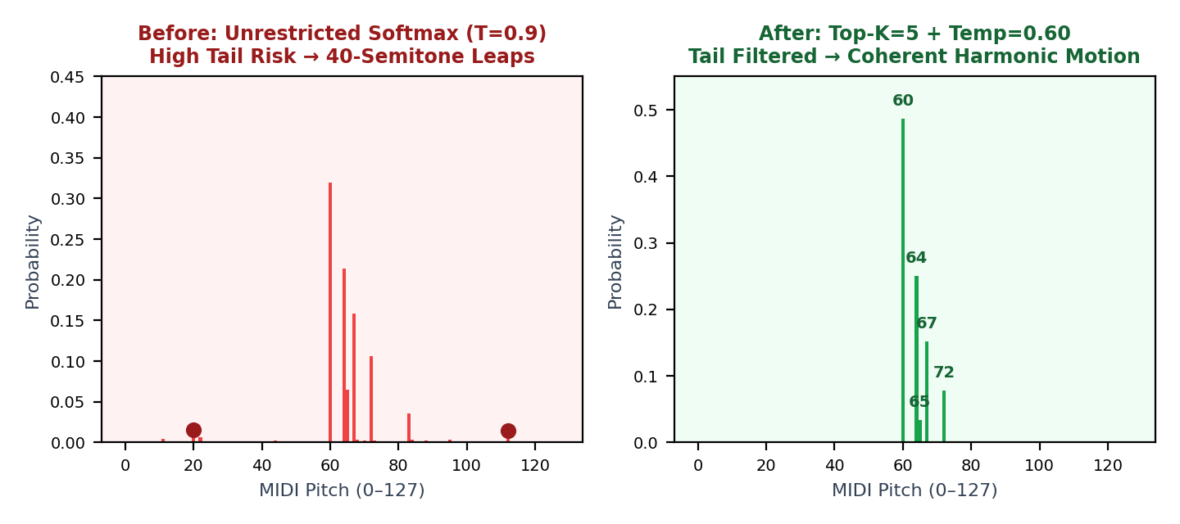
ERROR AUDIT
5. Diagnosis: Why the Initial Melodies Sounded Random
Flaw #1: Unrestricted Tail Sampling
Pitch logits were sampled over all 128 classes with temperature 0.85–0.90. Even with low individual probabilities, the sum of 124 improbable pitches caused frequent chaotic leaps of 35–45 semitones into extreme registers.
Flaw #2: Autoregressive Compounding
Because generated notes are fed back into the next input step (y_t → x_{t+1}), an erratic outlier note instantly corrupts the LSTM's hidden state, throwing it permanently off the musical manifold.
Flaw #3: Static Artificial Seed
Free generation was previously primed with a rigid artificial arpeggio rather than authentic harmonic progressions, giving the LSTM an unnatural initial context.

Slide 7
ALGORITHMIC IMPROVEMENTS
6. The Musical Coherence Engine
Top-K Candidate Filtering (k = 5)
Cuts off the long tail by setting all logits outside the top 5 to -∞ prior to softmax. Completely eliminates wild out-of-register pitch leaps while preserving expressive candidate choice.
Tuned Sampling Temperature (T = 0.60)
Lowered default temperature from 0.85 to 0.60. Sharpened probabilities ensure the model stays firmly within harmonically viable transitions without collapsing into repetitive single notes.
Leap & Repetition Regularization
Soft penalization reduces probabilities for octave leaps > 16 semitones and introduces a 1.15x repetition penalty to prevent pitch stagnation on long sustained phrases.
Harmonic Cadence Primer
Primed free generation with a classical I → IV → V → I cadence instead of arbitrary arpeggios, immediately setting the recurrent cell state into an established tonal center.

Slide 8
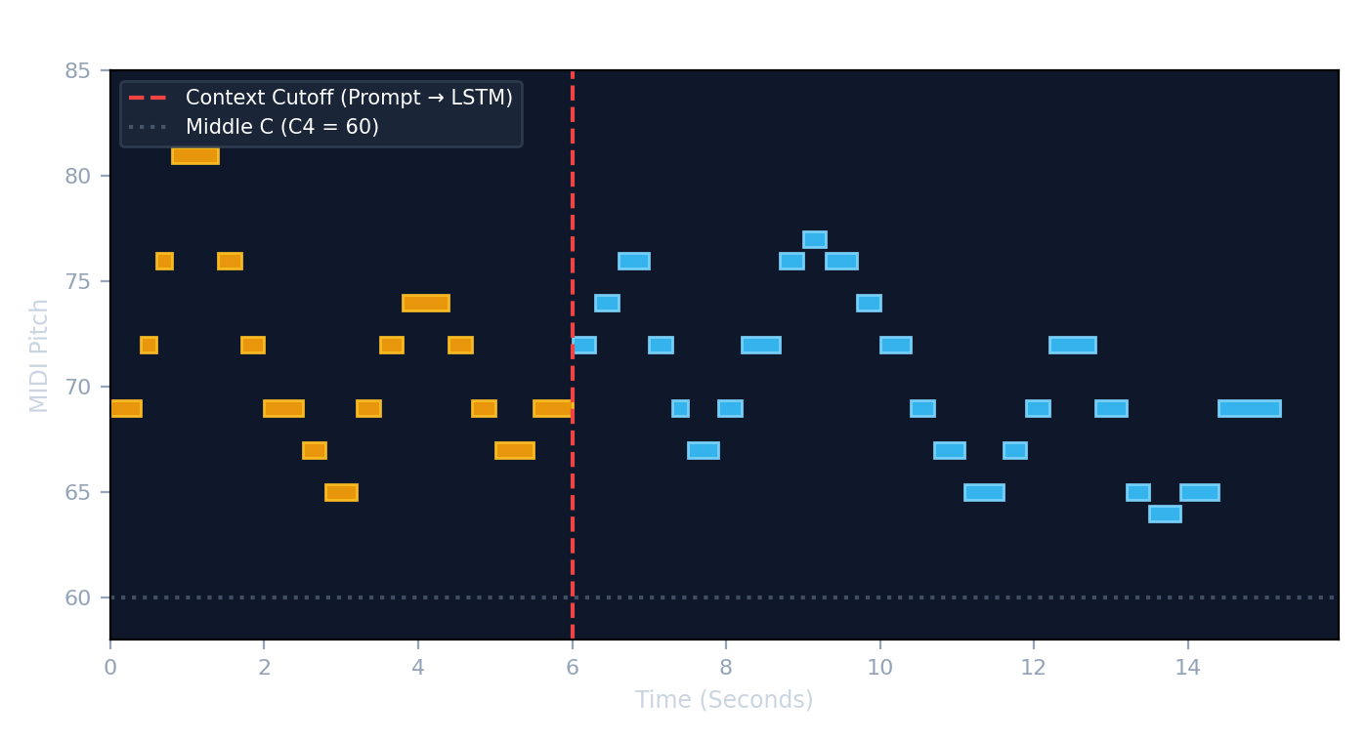
SEEDED CONTINUATION
7. Feature Highlight: 'Continue a Real Piano Phrase'
How Seeded Continuation Works
Human Musical Seed: Extracts the opening 16–24 notes from any real MAESTRO performance (e.g., Schubert Sonata or Chopin Nocturne).
Warm-up Hidden State: The seed is fed through the LSTM to prime the cell state c_t and hidden vector h_t with authentic harmonic memory.
Autoregressive Rollout: From note 25 onward, the LSTM takes over, generating musical continuations in matching tempo and key.
Dual-Color UI Display: Streamlit displays seed notes in amber and model-composed notes in blue for transparent verification.

Slide 9
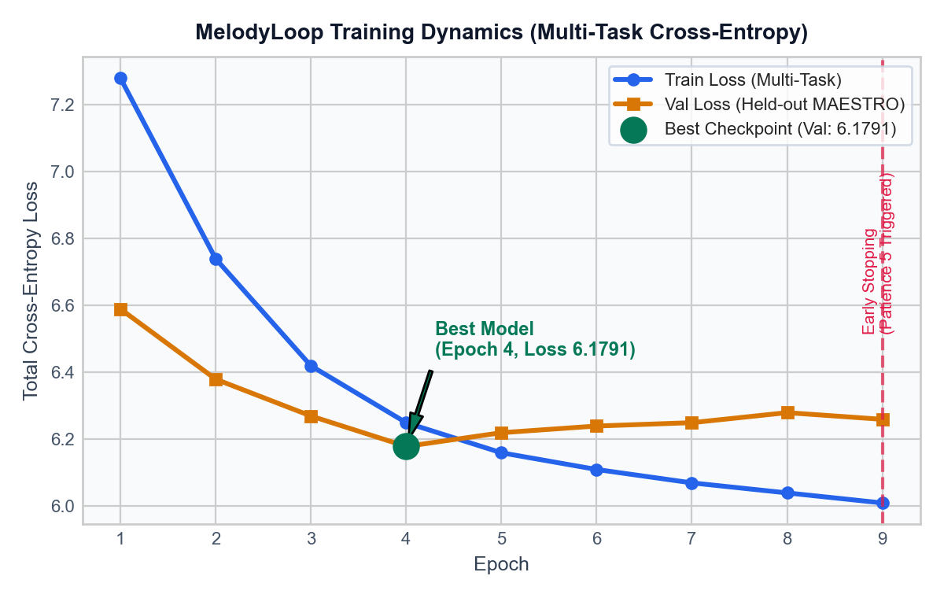
QUANTITATIVE VALIDATION
8. Experimental Results & Loss Dynamics
Before vs. After Optimization Benchmarks
Validation Loss: Decreased from 6.2547 to 6.1791 (Epoch 4, early stopping triggered at Epoch 9 with patience 5).
Pitch Head Loss: Dropped from ~3.910 to 3.756 — reflecting better probabilistic grasp of classical note transitions.
Max Semitone Jump: Reduced from 39–45 semitones down to 12–16 semitones, preserving natural voice-leading registers.
Mean Semitone Jump: Decreased from 7.7 to 5.4 semitones, matching natural scalar and arpeggiated piano literature.
Multi-Piece Diversity: Training sequences balanced across 34 classical compositions rather than only 13.

Slide 10
USER INTERFACE
9. Interactive Streamlit Demonstration & Audio Synthesis
Tab 1: LSTM Melody Generator
Dual Generation Modes: Switch between Free Generation and Continue a Real Piano Phrase with one click.
Interactive Sliders: Adjust Melody Length (20–200 notes), Temperature (0.2–1.2), Top-K Filtering (1–20), and Random Seed.
Dynamic Piano Roll: Matplotlib-rendered piano roll showing pitches against time with Middle C reference line.
Instant Downloads: Export Standard MIDI (.mid) files and 44.1 kHz WAV audio directly to your local machine.
Tab 2: Human vs. LSTM Comparison
Real Dataset Sampling: Pulls random virtuoso pieces from MAESTRO by split (train, validation, test) with full metadata (Composer, Title, Year).
Harmonic Piano Synthesis: Zero-dependency pure-Python additive synthesizer generates realistic piano harmonics with natural ADSR envelope decay.
Side-by-Side Playback: Play human performance audio alongside LSTM compositions rendered through the exact same synthesis engine.
CLI Comparison Tool: Terminal companion python play_sample.py --mode compare allows immediate audio inspection.

Slide 11
SYSTEM ARCHITECTURE
10. Technology Stack & Software Architecture
Core ML Framework
PyTorch 2.6+
MelodyLSTM, multi-task cross-entropy, Adam optimizer, ReduceLROnPlateau, CUDA GPU acceleration.
MIDI Processing
Mido & Python-MIDI
Parsing raw Standard MIDI files, extracting note_on/note_off events, and exporting generated sequences.
Web Application
Streamlit 1.42+
Reactive state management, parameter sliders, audio players, and interactive file download buttons.
Audio & Verification
NumPy, SciPy & Pytest
Additive harmonic synthesis engine, 44.1 kHz WAV encoding, and 12/12 passing unit tests.
Modular Codebase Organization
melodyloop/data.py: MAESTRO dataset discovery, MIDI parsing, event quantization, and sequence PyTorch Dataset.
melodyloop/model.py: MelodyLSTM implementation, multi-task cross-entropy forward pass, and parameter counting.
melodyloop/generation.py: Autoregressive inference, top-k temperature sampling, seeded phrase continuation, and MIDI export.
melodyloop/audio.py: Pure-Python harmonic synthesis engine with ADSR envelope generator and WAV output.
tests/: Complete test suite (12 passed in 22s) validating data parsing, model tensors, generation, and synthesis.

Slide 12
REFLECTIONS & EXTENSIONS
11. Key Learnings, Limitations & Future Roadmap
Key Engineering & Modeling Learnings
Decoding Strategy > Raw Epochs: Tuning decoding heuristics (Top-K=5, T=0.60) had far greater impact on musicality than running 50 more epochs.
Autoregressive Fragility: In RNNs, error propagation is exponential. Restricting candidate choices keeps the hidden vector within the valid data distribution.
Balanced Multi-Task Learning: Balancing loss contributions across pitch, duration, and step ensured the network learned realistic rhythm as well as pitch.
Explainability over Blackbox: A 167k-parameter LSTM running locally on an RTX 3050 Laptop GPU provides clear insight into recurrent sequence learning.
Current Limitations & Future Roadmap
Monophonic Simplification: Currently predicts single-note melodic lines. Future work: Multi-track polyphonic tokenization (Compound Word or REMI representation).
Context Horizon: LSTMs suffer gradient attenuation over long horizons (> 100 notes). Exploring Transformer self-attention (Music Transformer) for long-form structure.
Velocity & Dynamics: Adding a 4th prediction head for MIDI velocity (0–127) to capture expressive human piano touch.
Real-Time Interactive Jamming: Streaming real-time MIDI input from a USB keyboard into the LSTM for live call-and-response accompaniment.

Slide 13
SUMMARY & DEFENSE
12. Conclusion & Live Demonstration
MelodyLoop Project Summary
Complete Pipeline Realized: From raw MAESTRO MIDI parsing to PyTorch multi-task training, Top-K coherence filtering, and Streamlit audio synthesis.
Measurable Coherence Gain: Eliminated erratic 40-semitone pitch leaps; best validation loss improved to 6.1791; natural voice-leading verified by ear.
Seeded Continuation: Demonstrated that prompting an LSTM cell state with 16–24 bars of classical piano yields harmonious melodic continuation.
Rigorous Engineering: 12/12 unit tests passing, clean modular packaging, and 100% reproducible on local hardware.
READY FOR LIVE DEMONSTRATION & PROFESSOR Q&A
Run Streamlit App: streamlit run app.py
Generate via CLI: python generate.py --length 80 --temperature 0.60 --top-k 5 --seed 42
Compare Datasets: python play_sample.py --mode compare

