Slide 1

DOWN N DOWN
A presentation by-
Pankaj Kar & Sanjoy mahato

Slide 2
Presentation Outlines
Introduction
Gameplay and Features
Game Structure
Some Features We Should Have Added
Bugs
Lessons Learnt
Concept Source

Slide 3
Introduction
Down N Down is made from the concept of RAPID ROLL game of NOKIA.
This game is made with the help of Borland Graphics Interface(BGI) in C Programming Language.
Code blocks is used as the compiler.

Slide 4
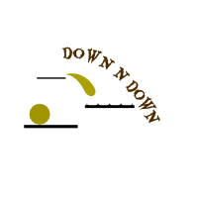

Gameplay
In this game you aim is to keep the ball within the blue sparks.
You can move the ball using LEFT and RIGHT key.
There are stairs coming from down continuously. If you can put the ball in the surface of any stairs you will get one point. That is how you can score points.

Slide 5
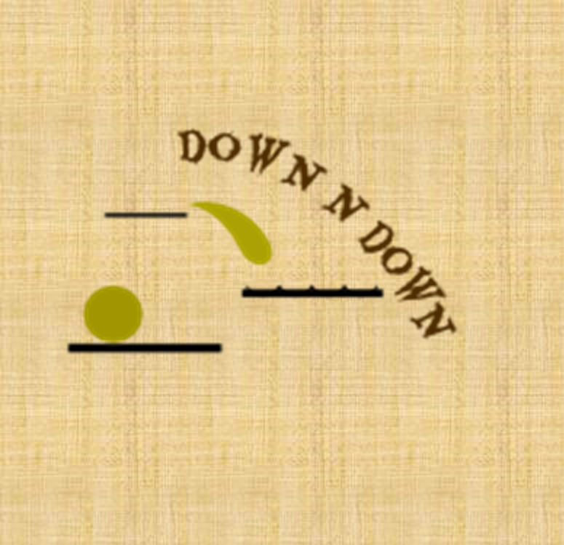
Gameplay
The ball is safe on the surface of every stairs.
But the ball will continue to go down if it is not within the touch of the surface of any stairs.
There are three lives for each game.

Slide 6
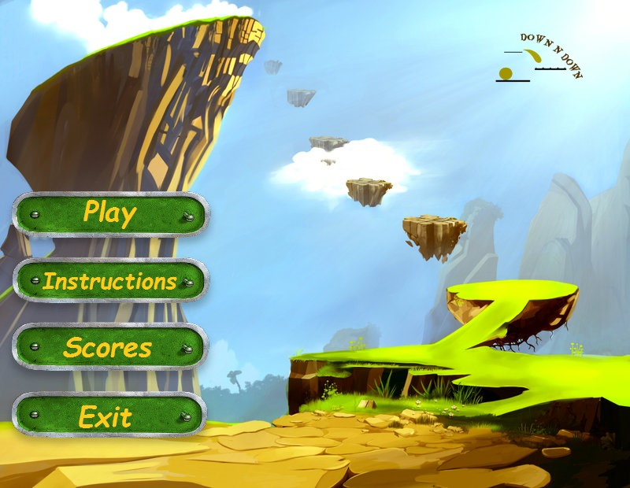
Features
There are four buttons in the main menu.

Slide 7
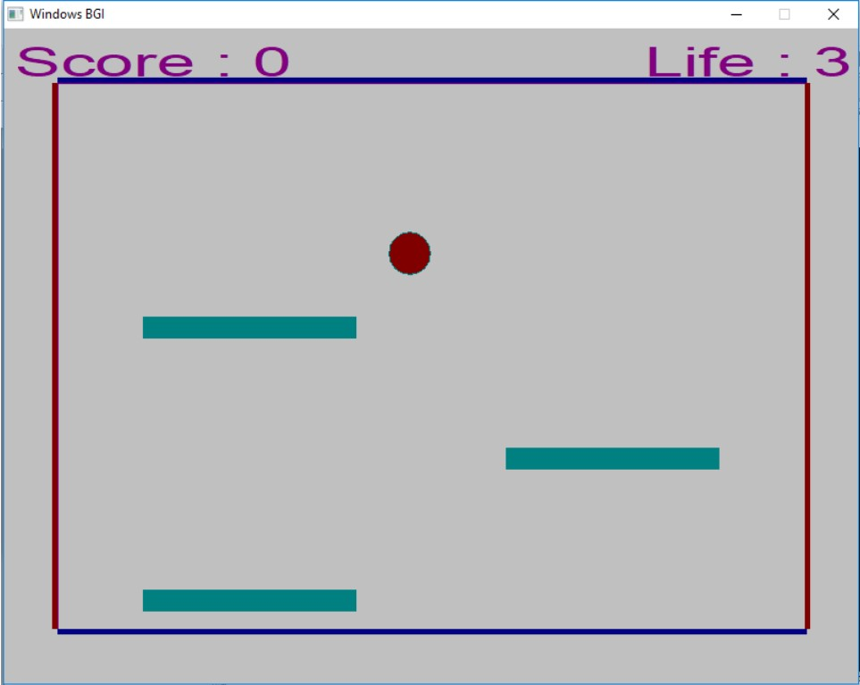
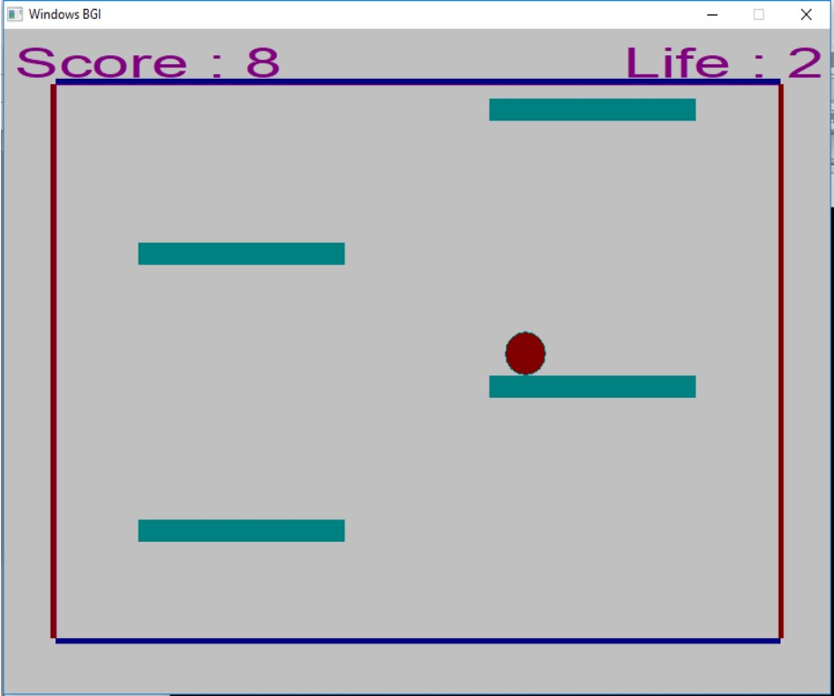
Features – GAMEPLAY Display

Slide 8
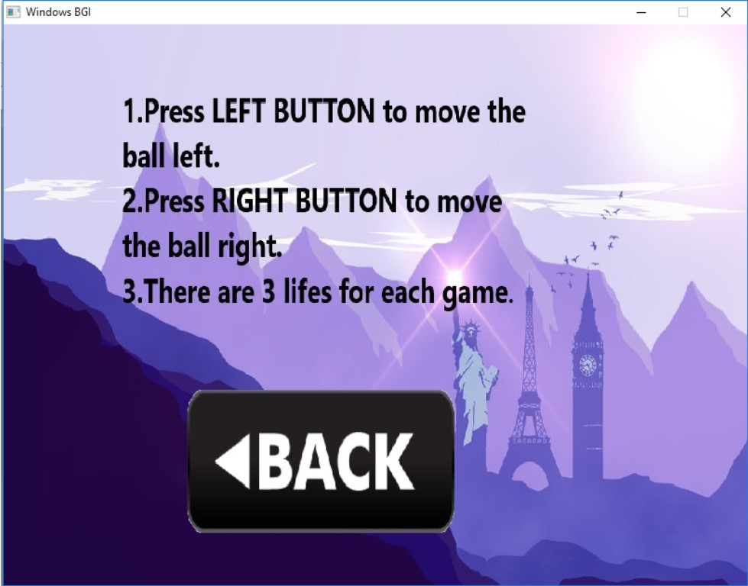
Features – instruction Display

Slide 9
Features

Slide 10
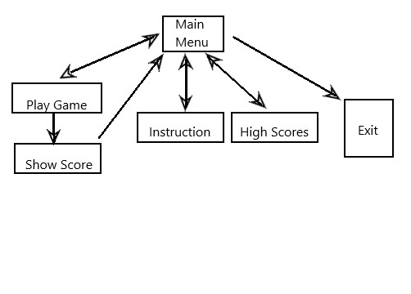
Game Structure

Slide 11
Some Features We Should Have Added
Random Stairs
Real Sparkles
Speed Increasing

Slide 12
Bugs
We have found that the ball can go through below the upper surface of any stair.

Slide 13
Lessons Learnt
Real Life Implementation
Idea About Software Development
First Time Experience In User-Friendly Application
Teamwork

Slide 14
Concept Source
RAPID ROLL game from NOKIA.

Slide 15

Thank You

