Slide 1

BEEJGURU
FARMER WELLNESS PROJECT
Guided By :
MADE BY :
Mr. Swatesh Kumar
(Ancient Labs )
Mahendra Pankaj
Ashutosh Singh Netam
Janak rajwade

Slide 2
Table of contents
1. Introduction
2. Attribute Information
3. Objective
4. Artificial Neural Networks
5. Approach
6. Build and Train ANN
7. Result
8. Conclusion

Slide 3
Introduction
The examined group comprised kernels belonging to three different varieties of wheat: Kama, Rosa and Canadian, 70 elements each, randomly selected for the experiment.
High quality visualization of the internal kernel structure was detected using a soft X-ray technique. The images were recorded on 13x18 cm X-ray KODAK plates. Studies were conducted using combine harvested wheat grain originating from experimental fields, explored at the Institute of Agrophysics of the Polish Academy of Sciences in Lublin.
Seed Classification :
Determine the class and quality of seeds
Selection between a choice and demand of wheat
The user does not claim an identity
Closed set identification – Assume that all speakers are known to the system.

Slide 4
Attribute Information
To construct the data, seven geometric parameters of wheat kernels were measured:
Area A,
Perimeter P,
Compactness C = 4*pi*A/P^2,
Length of kernel,
Width of kernel,
Asymmetry coefficient ,
Length of kernel groove.
All of these parameters were real-valued continuous.

Slide 5
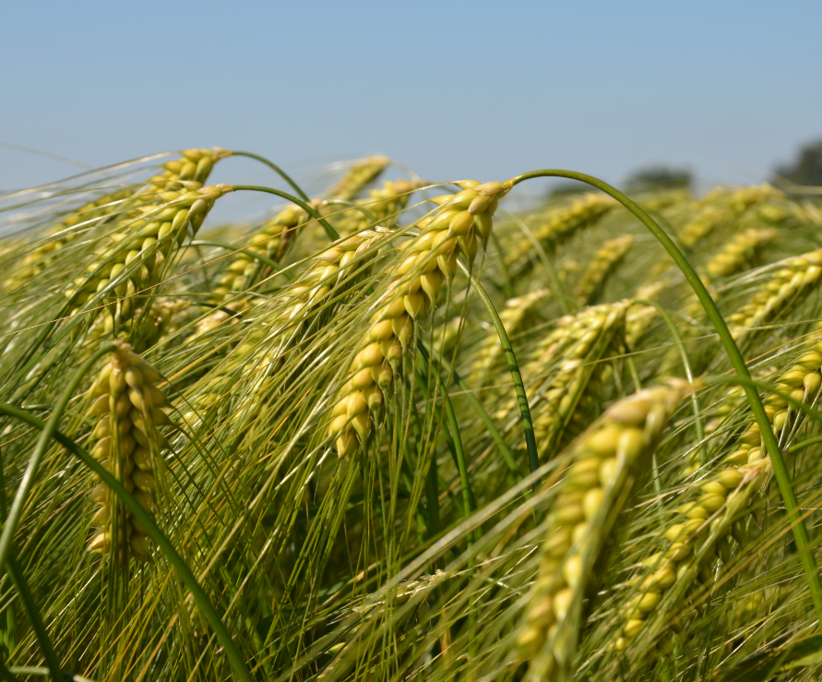
Objective
The main objective of application of this model is to help in the mass distribution or other commercial ventures to provide them a classification of seeds about what they are using to do the work.
This model helps to classify the seeds according to several aspects of their quality and Other properties they showcase which can occur like a problem to their business and can leads them towards a big loss or misconcious business. So to avoid this problem we have worked on this model.

Slide 6
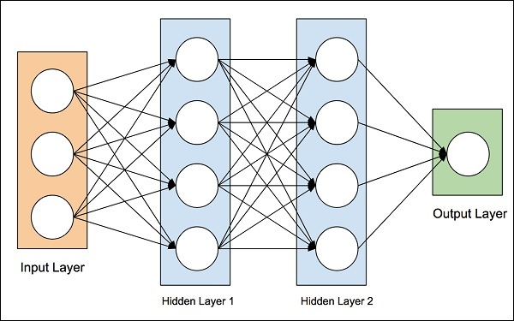
Artificial Neural Networks
An artificial neuron network (ANN) is a computational model based on the structure and functions of biological neural networks. Information that flows through the network affects the structure of the ANN because a neural network changes - or learns, in a sense - based on that input and output.

Slide 7
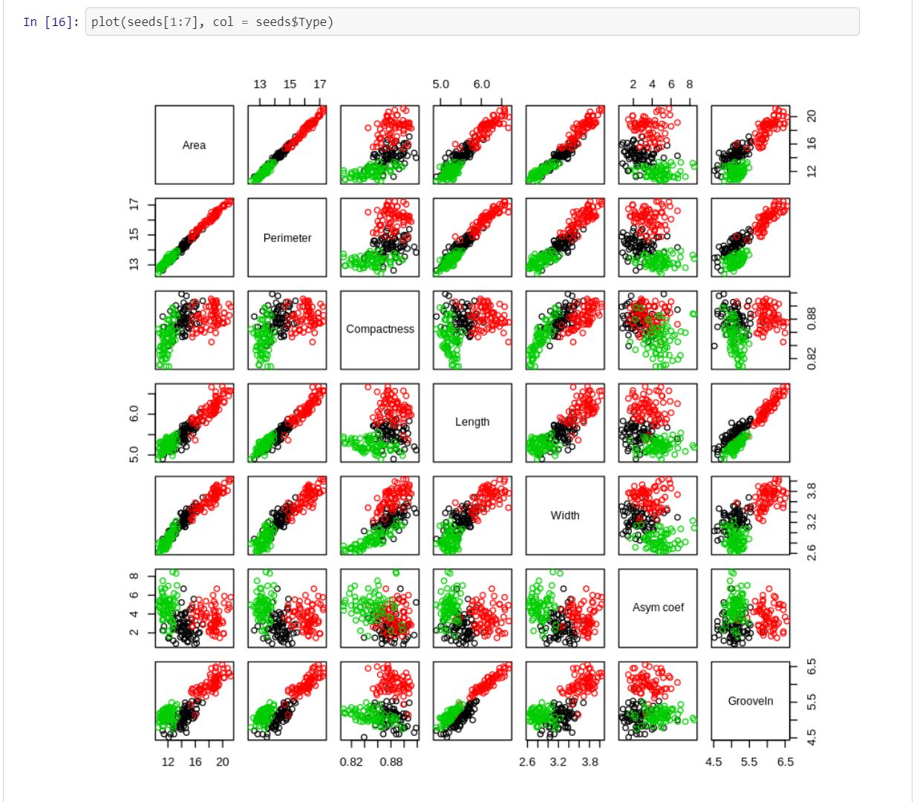
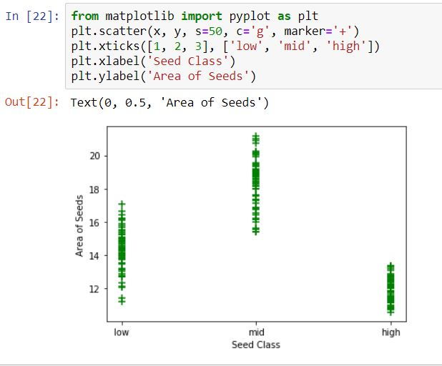
Approach
Here we are showing some parameters graph of the seeds where it definening the seeds according their properties.

Slide 8
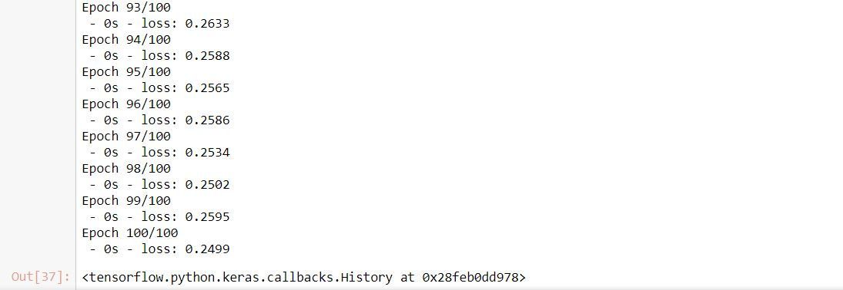
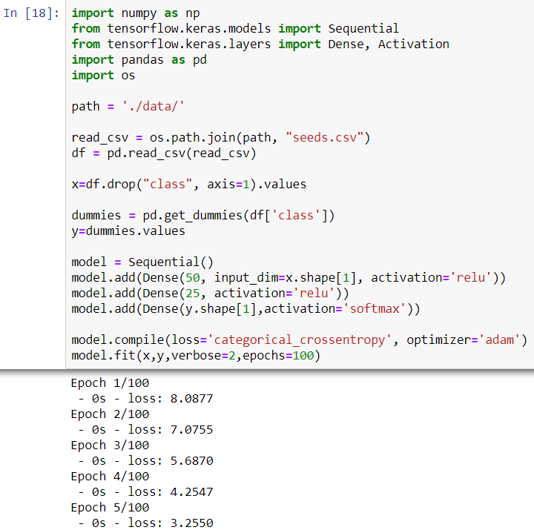
Build and Train ANN
Our approach for this model is to train it from the sample dataset with 100 epochs.Which ensure the continuity of training of the model for its better prediction.

Slide 9
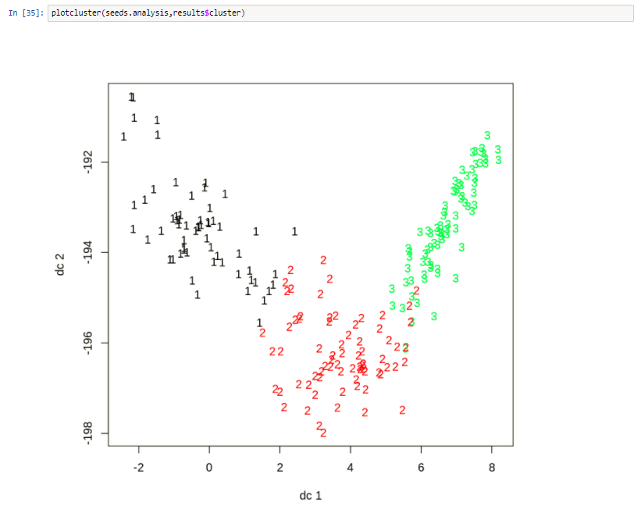
Result
Result
We have given the model a dataset of wheat which includes 3 classes of seeds to train.
After the training when we give the model certain properties of the seed then it shows which class of seeds it belogs to Kama, Rosa and Canadian.

Slide 10


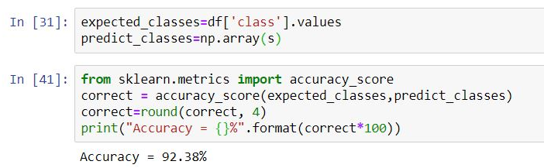
Conclusion
At last I come to the conclusion that the model we made can make a big impact on farming industry if we take it for further more actions to perform.
This model is accurate for about 92.38% which can predict the seed class which it got by training the model with the same dataset that we have used to train it before.
92.38%

Slide 11
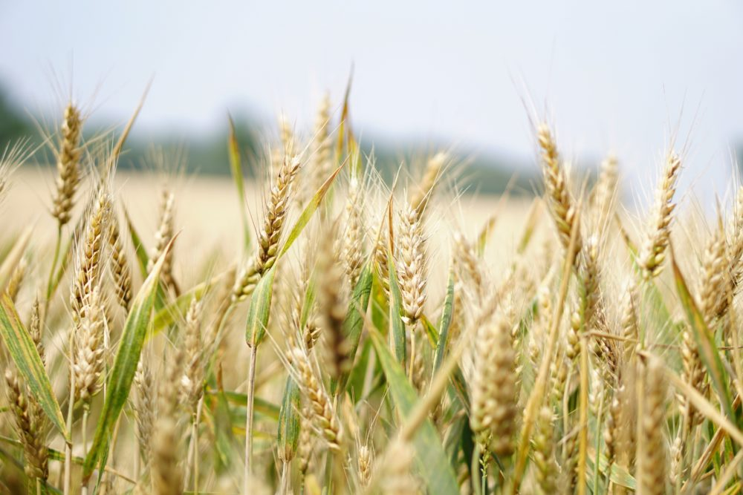

Thank you
BeejGuru
Seed Classifier

