Slide 1
Infiniband (IB)
The InfiniBand Architecture (IBA) is a new industry-standard architecture for server I/O and inter-server communication.
InfiniBand is a high-performance interconnect technology
Developed by InfiniBand Trade Association (IBTA).
- It defines a switch-based, point-to-point interconnection network that enables
High-speed
Low-latency
communication between connected devices.

Slide 2
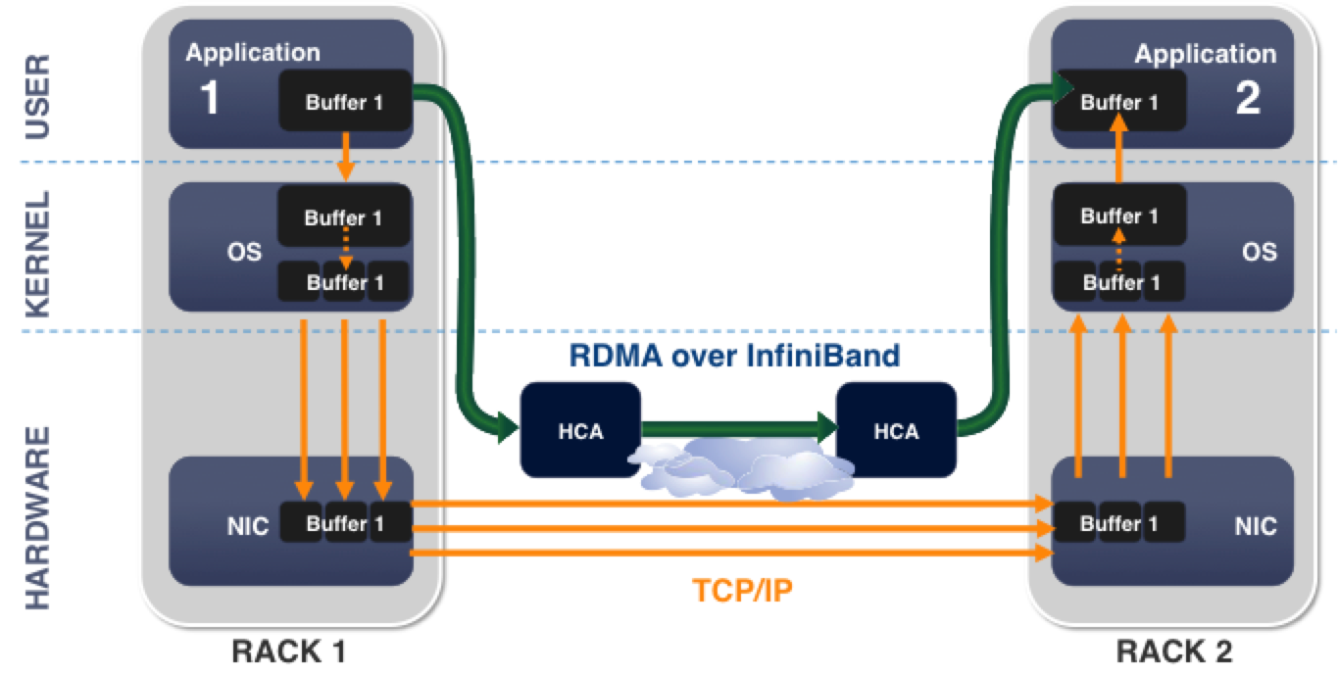

Slide 3
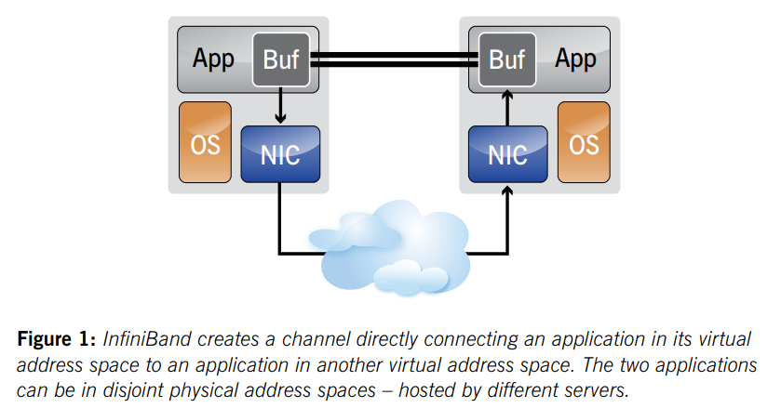
IB Working

Slide 4
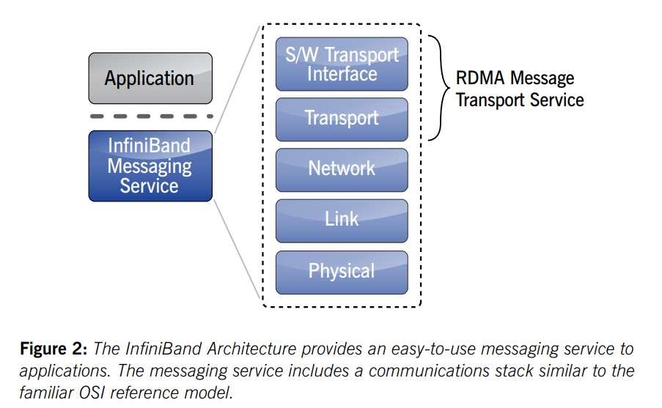
IB Network Stack/ Infiniband Messaging Service

Slide 5
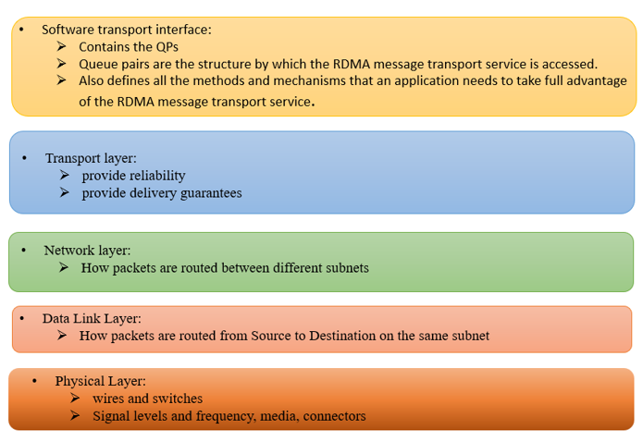

Slide 6
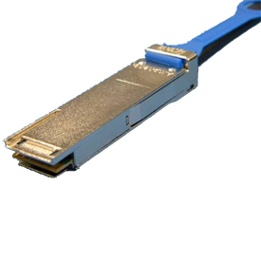
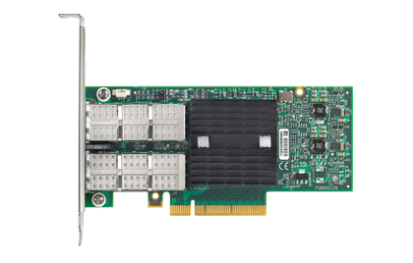

InfiniBand Devices
The InfiniBand Architecture defines a full set of hardware components necessary to deploy the architecture. Those components are:
Cable
Adapter Card
Switch

Slide 7
Channel Adapter
Channel Adapter (CA) is the interface between an end node and a Infiniband Network
There are two types of channel adapters
Host channel adapter(HCA)
For inter-server communication
Has a collection of features that are defined to be available to host programs
Target channel adapter(TCA)
For server IO communication
No defined software interface

Slide 8
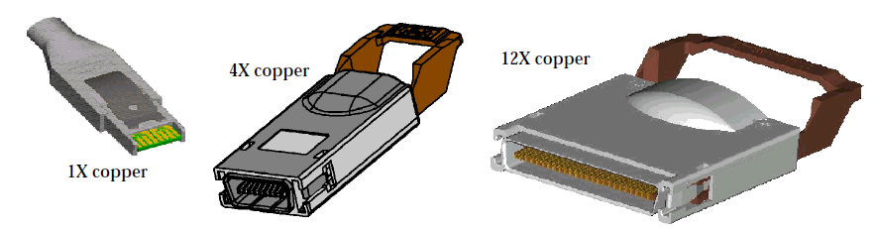
Links
IBA links are bidirectional point-to-point communication channels, and may be either copper and optical fibre.
Link widths are 1X, 4X, and 12X.

Slide 9
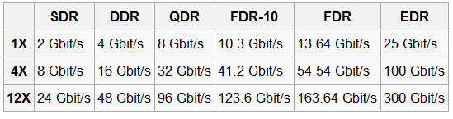
Data Rate
Performance

Slide 10
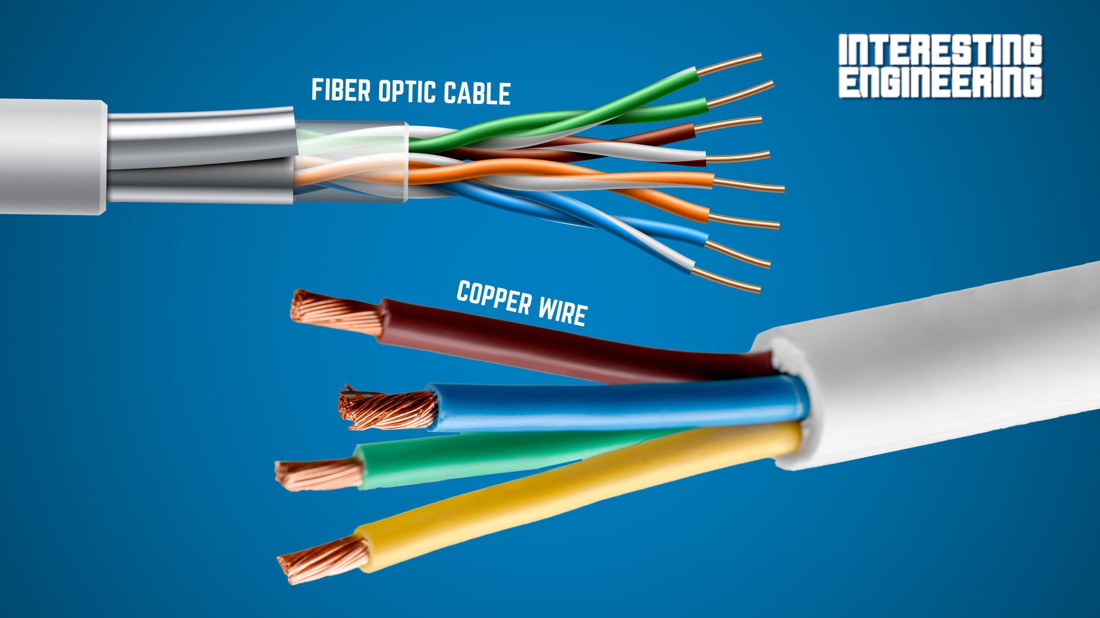
IB Cables
Copper Cables: InfiniBand copper cables are commonly used for short-range connections within a rack or between adjacent racks. They are typically constructed with high-quality copper conductors and insulation. Copper cables are cost-effective and offer lower power consumption compared to optical cables. They are available in various lengths, such as 1 meter, 3 meters, or longer, to accommodate different network setups.

Slide 11
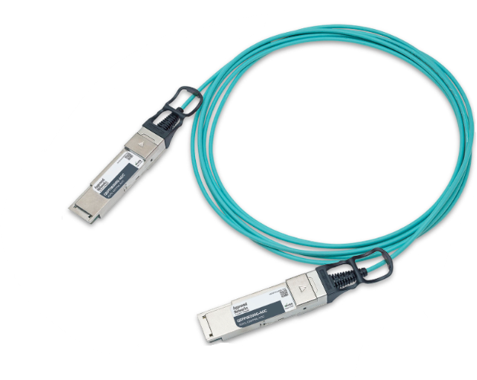
Optical Fiber Cables:
InfiniBand optical fiber cables are used for longer-range connections, typically spanning multiple racks or floors in a data center. They utilize optical fibers to transmit data signals using light instead of electrical signals. Optical fiber cables offer higher bandwidth and longer reach compared to copper cables. They provide enhanced signal integrity over longer distances.

Slide 12

Switches
A device that moves packets from one link to another link of the same IB Subnet
IBA switches route messages from their source to their destination based on routing tables
Switch size denotes the number of ports
The maximum switch size supported is one with 256 ports

Slide 13
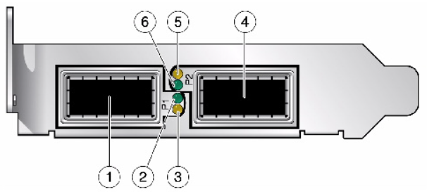
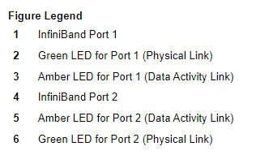
LED Color | LED Name | LED State | Meaning
Green | Physical Link | Lit | The link bring-up process has been successfully completed and the link width, link speed, link polarity, and link reversal have been negotiated with the neighbor port on the other end of the cable.
 |  | Unlit | A physical connection has not been established.
Amber | Data Activity | Steady light | Infiniband is discovered over the physical link, but no data is being passed.
 |  | Blinking light | Data is being passed.
 |  | Unlit | A physical or logical connection (or both) has not been established.

Slide 14
InfiniBand VS. Ethernet
 | Ethernet | InfiniBand
Commonly used in what kinds of network | Local area network(LAN) or wide area network(WAN) | Interprocess communication (IPC) network
Transmission medium | Copper/optical | Copper/optical
Bandwidth | 1Gb/10Gb | 2.5Gb~120Gb
Latency | High | Low
Popularity | High | Low
Cost | Low | High

Slide 15
THANK YOU

