Slide 1
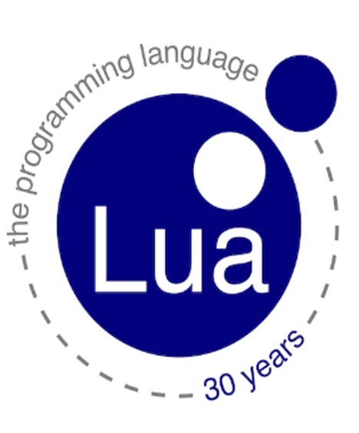
Mahendra Pankaj
Project Engineer​

Slide 2
AGENDA
Introduction​
Lua basics
​Use case in HPC
Lua plugin for Slurm
Vulnerabilities
Summary

Slide 3
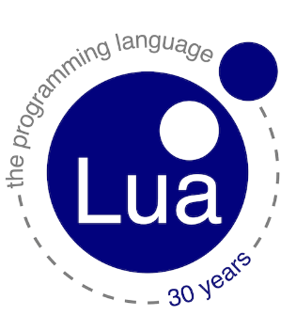
Introduction
Lua is a lightweight, efficient, and powerful scripting language that was first released in 1993. It was designed to be easy to embed into applications written in other programming languages, and has found wide use in video games, web development, and other applications that require scripting functionality.
Lua has been used in many popular applications, including the video games World of Warcraft and Angry Birds, and the web server software NGINX. It is known for its flexibility, speed, and ease of integration with other programming languages.

Slide 4
LUA basics
Lua is a versatile language that can be used in a variety of work areas, including:
Video game development: Lua is widely used in the video game industry, both for developing games and for modding existing games.
Web development: Lua can be used in web development for server-side scripting, particularly through the popular web server software NGINX, which includes a Lua scripting module.
3.Scientific computing: Lua's support for complex data structures and metaprogramming make it a popular choice for scientific computing, particularly in the field of computational physics.
4.Scripting and automation: Lua's simplicity and flexibility make it a good choice for scripting and automation tasks, such as build scripts, system administration, and game automation.

Slide 5


Lua in hpc (high-performance computing)

Slide 6
Lua plugin for slurm
job Submit Plugin
Job Accounting Plugin
Node Health Check Plugin
Power Management Plugin
Slurm configuration
This can be useful for adding or removing job parameters, or for implementing custom job submission workflows.
A node health check plugin written in Lua can be used to perform custom health checks on compute nodes before jobs are scheduled on them.
These plugins are loaded dynamically at runtime, and can be enabled or disabled using the Slurm configuration file.
This can be useful for generating custom reports or for exporting data to external systems.
This can be useful for reducing energy consumption and optimizing performance based on workload characteristics.

Slide 7

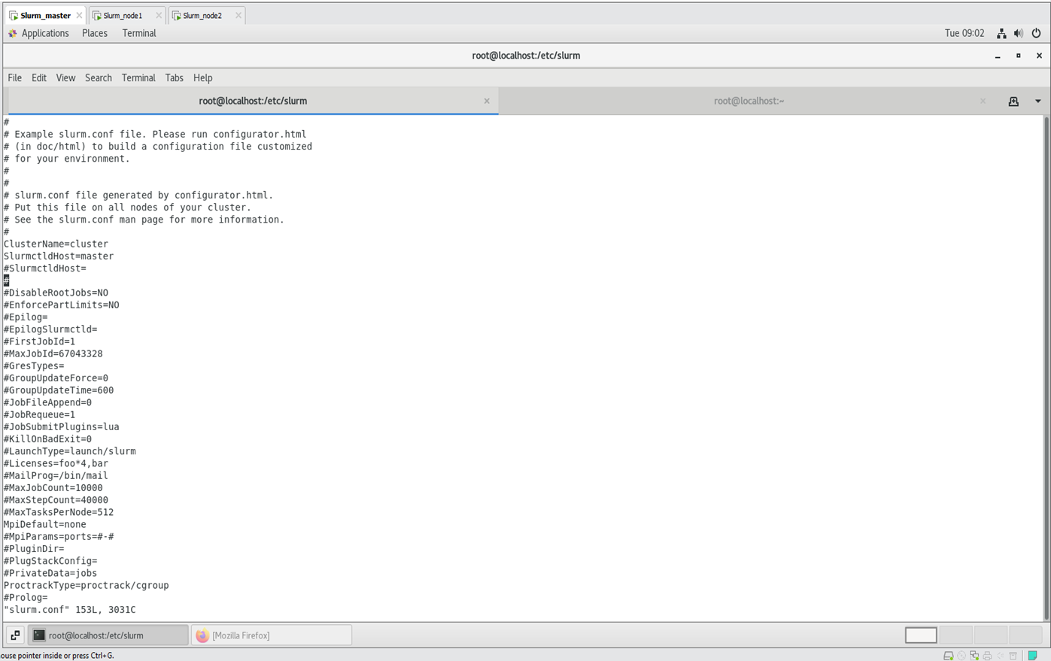

Slide 8

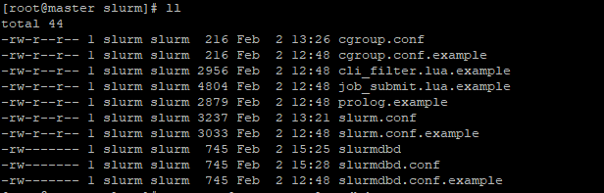
# ll /etc/slurm.conf

Slide 9
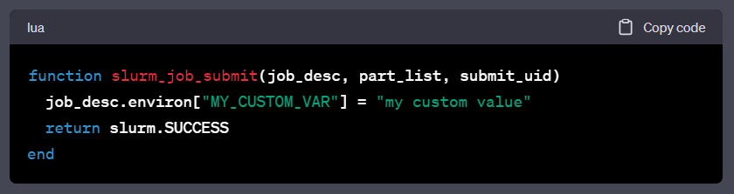
job Submit Plugin
The Slurm documentation provides more information on the available Lua-C API functions and data structures that can be used in job submit plugins.

Slide 10
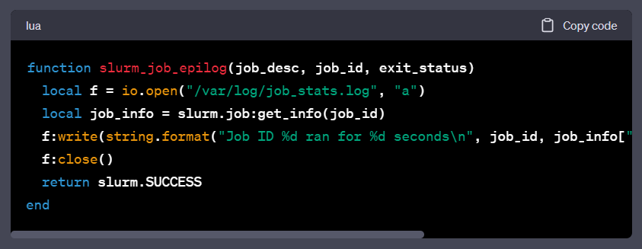
Job Accounting Plugin
Here's an example of a Lua job accounting plugin that logs job runtime statistics to a file.

Slide 11
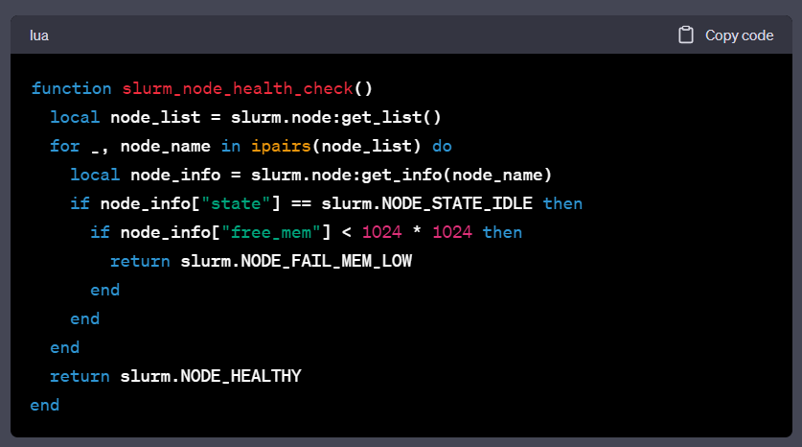
Node Health Check Plugin
Node Health Check Plugins are used to check the health of compute nodes before they are allocated to jobs. They are called periodically by the Slurm controller to ensure that nodes meet certain health criteria, such as having enough free memory or disk space.

Slide 12
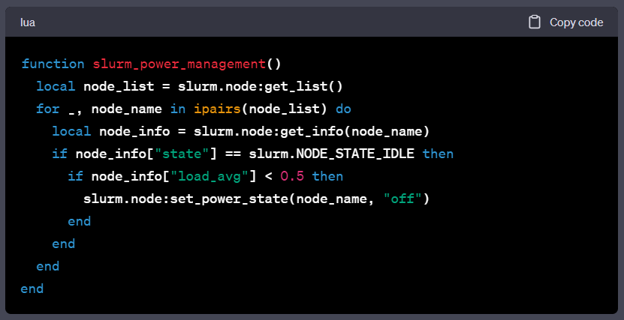
Power Management Plugin
The Slurm documentation provides more information on the available Lua-C API functions and data structures that can be used in Power Management Plugins.

Slide 13
vulnerabilities
To mitigate these risks, it is important to ensure that Lua scripts used in Slurm schedulers are properly secured and that only trusted users are given access to modify them. Additionally, it is important to regularly update the Lua interpreter and any Lua modules used in the scheduler to ensure that any known vulnerabilities are patched.

Slide 14
SUMMARY
In conclusion, Lua is a powerful scripting language that can be used to extend the functionality of the Slurm scheduler. It allows users to write custom plugins that can perform a variety of tasks, including job submission, accounting, power management, and node health checking. These plugins can be written in Lua and integrated into the Slurm scheduler to perform custom actions that are not supported by default.

Slide 15

THANK YOU

