Slide 1



Red Hat Enterprise Linux
Mahendra Pankaj
Project Engineer

Slide 2
RHEL LIFE CYCLE :
RHEL VERSION | LAST RELEASE | RELEASE DATE | END OF THE FULL SUPPORT (Extended)
2 | U - 7 | 26 March 2002 | 31 May 2009
3 | U - 9 | 23 October 2003 | 31 October 2010
4 | U - 9 | 14 February 2005 | 29 February 2012
5 | U - 11 | 15 March 2007 | 31 March 2017
6 | U - 10 | 10 November 2010 | 30 November 2020
7 | U - 9 | 10 June 2014 | 30 June 2024
8 | U - 7 | 7 May 2019 | 31 May 2031
9 | U - 2 | 17 May 2022 | 31 May 2034

Slide 3
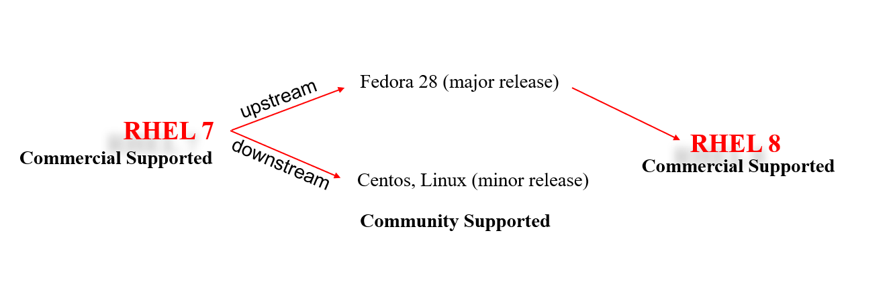
Red Hat Enterprise Linux
Centos Stream (minor release)

Slide 4
Red Hat Enterprise Linux 7 8 9
Installation:-
Boot Loader:-
Package manager:-
File system:-
Kernel:-
Virtualization:-
Linux containers:-
System and Services:-
Compiler:-
Security:-

Slide 5

7
8
9
vs
Features | RHEL 7 | RHEL 8 | RHEL 9
Date of Release | 09 June 2014 | 07 May 2019 | 17 May 2022
Default File System | XFS | XFS | XFS
Kernel Version | 3.10 | 4.18 | 5.14
Kernel Code Name | Maipo | Ootpa | Plow
Package Management | YUM | DNF, YUM | DNF, YUM
Network Time Synchronization | Using either ntp or chronyd. | Using only Chronyd.. | Uses chronyd daemon provided by the chrony package
Supported Hardware Architecture | - 64-bit AMD - 64-bit Intel - IBM POWER7 - IBM System z | - AMD and Intel 64-bit architectures - The 64-bit ARM architecture - IBM Power Systems - IBM Z | - AMD and Intel 64-bit architectures (x86) - The 64-bit ARM architecture - IBM Power Systems, - 64-bit IBM Z
Repositories | Red Hat Enterprise Linux 7 Server (RPMs) | BaseOS - AppStream | BaseOS AppStream

Slide 6
Features | RHEL 7 | RHEL 8 | RHEL 9
Dynamic Programming Languages Versions. | - Python 2 (2.7.X) - PHP 5.4 - Ruby 2.0.0 | - Python 3 - Perl 5.26 - PHP 7.2 - Ruby 2.5 - Node.js 16 | - Python 3.9 - Perl 5.32 - PHP 8.0 - Ruby 3.0 - Node.js 10
Desktop GUI and Graphics | X.org server is the default display server in RHEL 7. | The default display server is ‘Wayland’ but X.org is also in use. Wayland 1.15 | "Wayland" is still the default display server The X.org has been deprecated. Wayland 1.191
Max. RAM Supported | 12 TB | 24 TB | 48 TB
Compiler | GCC 4.8 | GCC 8.2 | GCC 11.2
Default Databases | MariaDB is the default implementation of MySQL in Red Hat Enterprise Linux 7 | The following database servers are available in RHEL8*: - MySQL 8.0 - MariaDB 10.3 - PostgreSQL 10 and PostgreSQL 9.6 | The following database servers are available in RHEL9*: - MySQL 8.0 - MariaDB 10.5 - PostgreSQL 13 - Redis 6.2

Slide 7
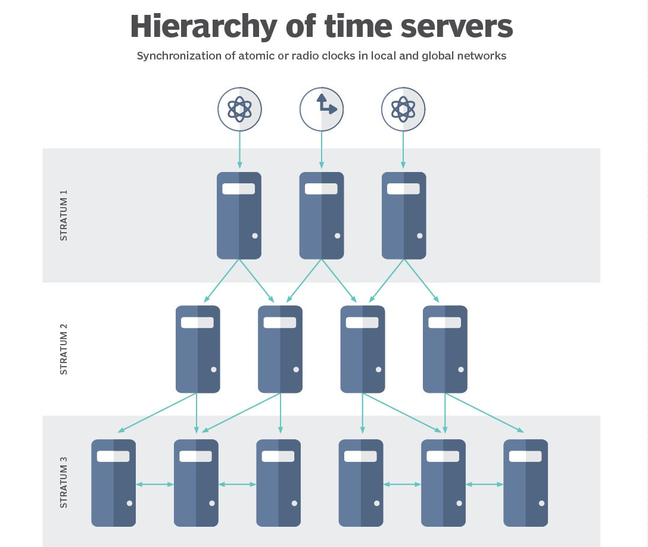
NTP
What is NTP?
How does NTP work?
How is time information obtained?
-Poll based NTP associations
-Broadcast based NTP associations
What are stratum levels?

Slide 8
Thank You

