Slide 1
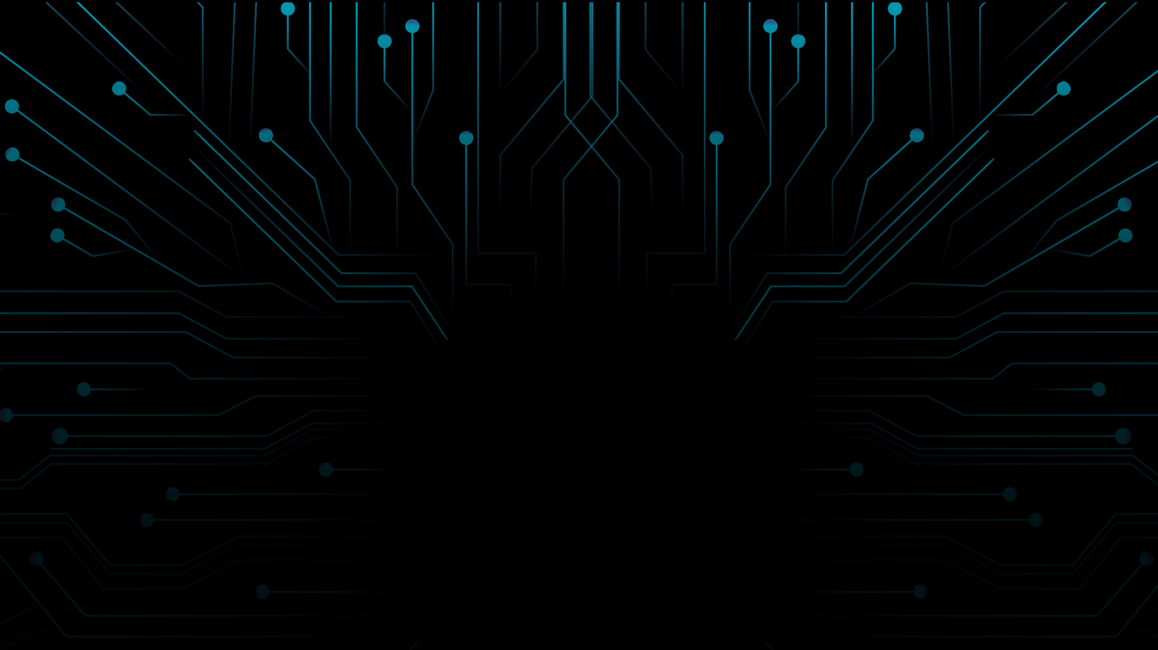

Blockchain-based eCommerce warranty system using NFTs
Team Name: Coding Edge
Institute Name: Odisha University of Technology And Research, Bhubaneswar

Slide 2
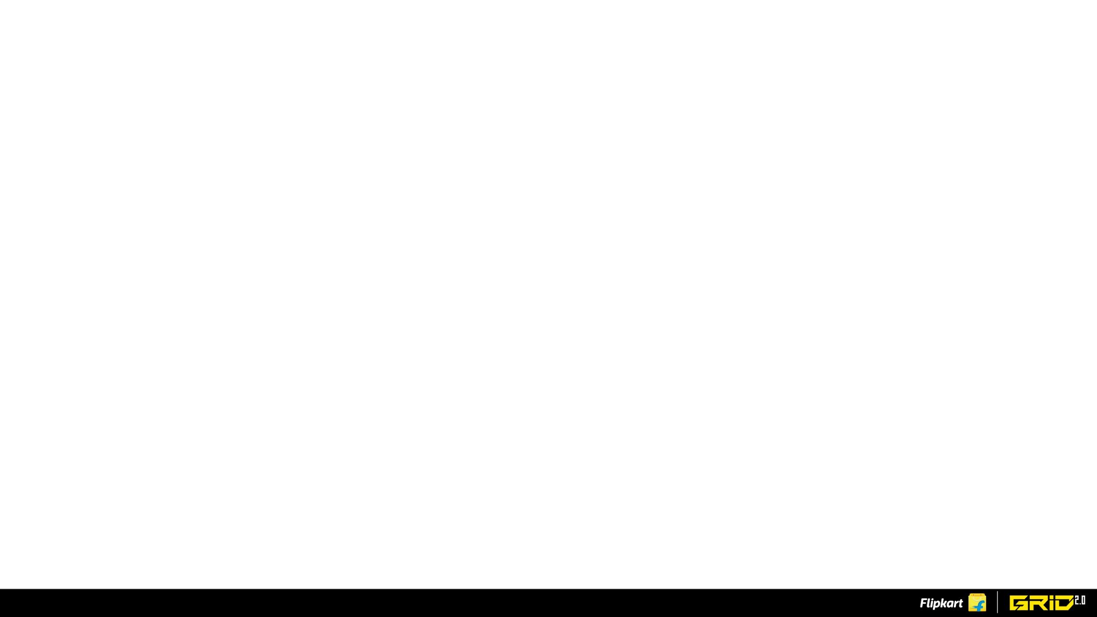
Team members details
Team Name | Coding Edge
Institute Name | Odisha University Of Technology And Research .Bhubaneswar
Team Members > | 1 (Leader) | 2 | 3
Name | Swastik Panda | Pankaj Agrawal | Anshuman Mishra
Batch | 2020-2024 | 2020-2024 | 2020-2024

Slide 3
Deliverables/Expectations for Level 2 (Idea + Code Submission)
The solution should focus on:
The blockchain smart contract should allow users to prove ownership
Provide the purchasing history, warranty period, and other item information
The warranty card should include the item’s serial number and upon purchase be sent to the customer’s smartphone.
The NFTs should be decaying in nature, in that, after a certain period their use for the redemption of warranty benefits offered by the brand/retailer will expire
Bonus - GUI-based tool that doesn’t require knowledge of any Blockchain programming to use by Brands and Retailers.
Bonus - Usage of Soulbound NFTs
Bonus - Add any engagement/gamification construct to the loyalty program

Slide 4
Glossary
BLOCKCHAIN:-A blockchain is a distributed database or ledger that is shared among the nodes of a computer network. As a database, a blockchain stores information electronically in digital format. The innovation with a blockchain is that it guarantees the fidelity and security of a record of data and generates trust without the need for a trusted third party.
NFT:-A unique digital identifier that cannot be copied, substituted, or subdivided, that is recorded in a blockchain, and that is used to certify authenticity and ownership (as of a specific digital asset and specific rights relating to it).
SMART CONTRACT:-Smart contracts are computer programs or protocols for automated transactions that are stored on a blockchain and run in response to meeting certain conditions. In other words, smart contracts automate the execution of agreements so that all participants can ascertain the outcome as soon as possible without the involvement of an intermediary or time delay.
MINTING NFT:- It is the process by which your digital art or digital content becomes a part of the Ethereum blockchain.
METAMASK:-It is a software cryptocurrency wallet used to interact with the Ethereum blockchain. It allows users to access their Ethereum wallet through a browser extension or mobile app, which can then be used to interact with decentralized applications.
GASS FEE:- Gas refers to the fee, or pricing value, required to successfully conduct a transaction or execute a contract on the Ethereum blockchain platform.

Slide 5
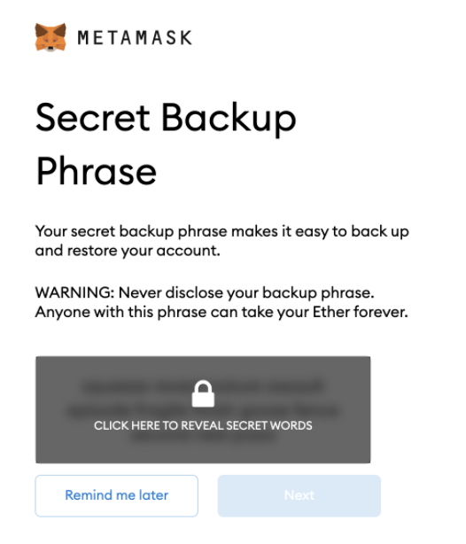
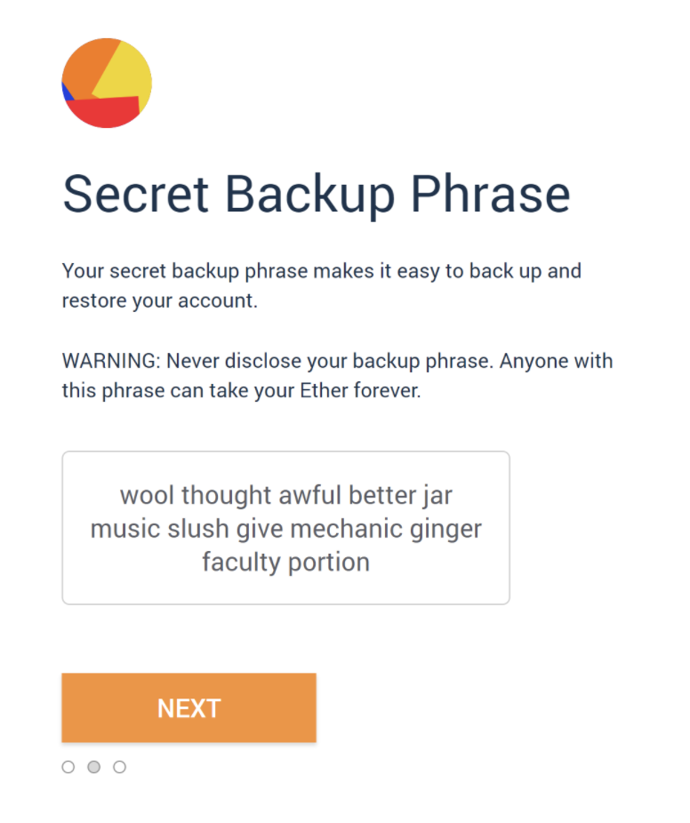
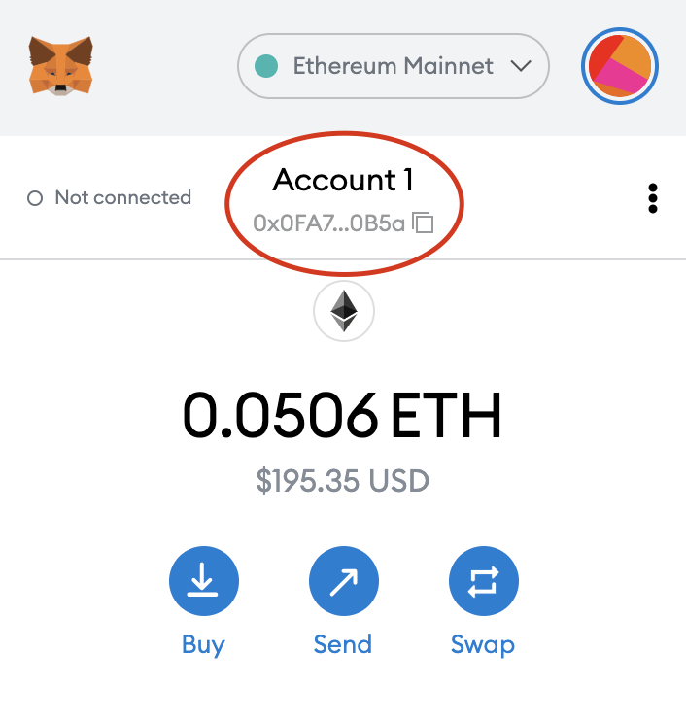
Prerequisite:- Setting up Metamask Account
STEP-1: click on https://metamask.io/download/ and download metamask extension
STEP-2: Open metamask and then click CREATE WALLET
STEP-3: Reveal secret code and copy it in your local storage and click ne
STEP-4: Enter the secret code and click confirm
STEP-5: Now that you have a wallet, if you want to use it, the next thing to do would be accessing your address and funding it.

Slide 6
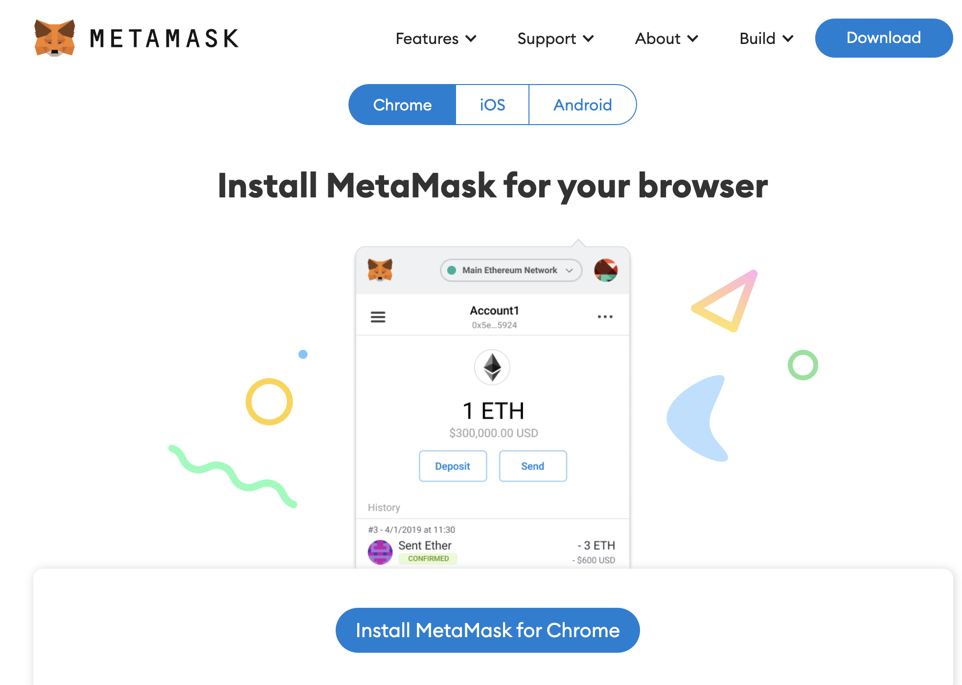
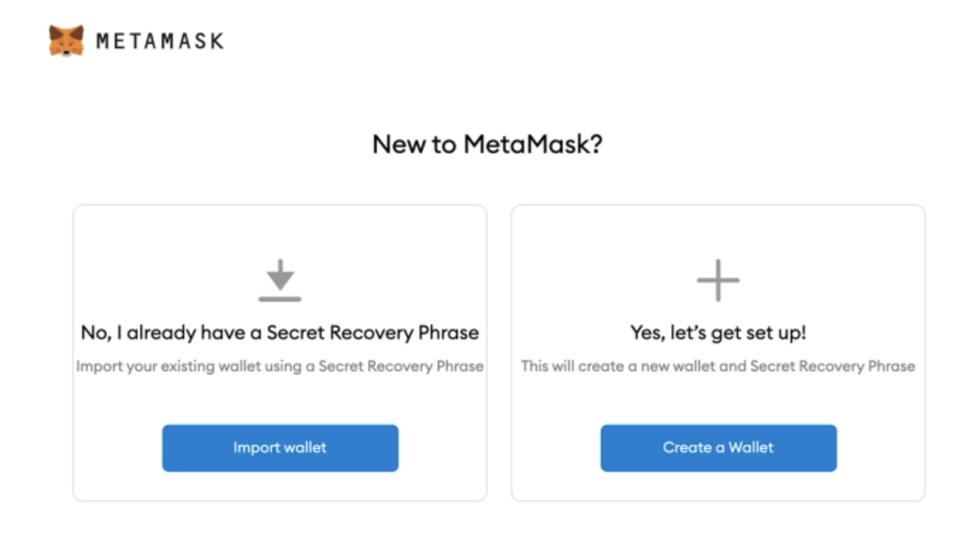
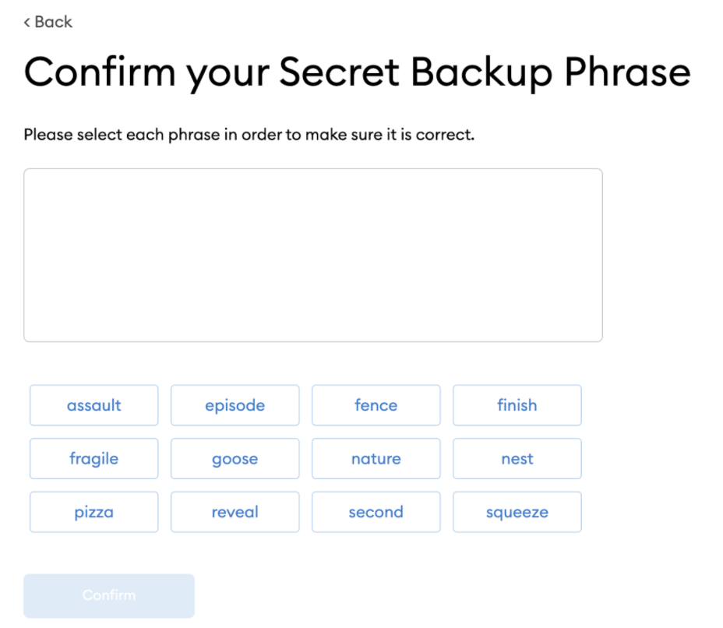
Pictorial Representation
Install Metmask
Create wallet
Reveal Phrase
Wallet Created
Write Secret Phrase
Copy Secret Phrase

Slide 7
Use-cases
Companies having a wide range of products can take advantage of the gamification of the warranty registered products.
Third party warranty providers providing multiple product warranties can take advantage of the product.
As the user register more products his account level increases and according to his level he/she gets more offers on future purchases (or) his warranty period may increase.
4. Ecommerce websites can also take advantage of this by integrating the metaverse into it.
Example- when the user registers fashion apparels his metaverse avatar by updating his wardrobe and his level also increases.

Slide 8
Solution statement/ Proposed approach
We have created a React App which serves as a GUI that helps users to a mint a Digital Warranty NFT of their product.
Upon landing on the GUI, first we have to simply click on connect my wallet button ,so that the NFT will be generated in that account.
The user will be asked whether he is new user or and existing user and fill the details accordingly.
For new user two NFTs will be generated Warranty NFT and Level NFT , for existing Warranty NFT will be generated and his corresponding Level NFT will be updated.
Warranty NFT is to prove the ownership of product and it is static.
Level NFT is a dynamic NFT which will increase it’s level attribute when we register for new product with the same wallet address . This NFT can be used to add any engagement/Gamification construct to the loyalty program.
Upon entering the details we have to click mint button and NFTs will be generated in our wallet address.
The minted NFTS can be viewed using Openseas.testnet
The NFTs generated are transferable.
These NFTs are burnable i.e these NFTs will be decomposed automatically after a period of six months from the date of purchase.

Slide 9
Deployment Links
https://nft-as-warranty.netlify.app/
(OPEN WITH A BROWSER HAVING METAMASK EXTENSION)
https://youtu.be/BbLjolUW46A
(DEMO VIDEO WITH CAPTION)
https://youtu.be/77nR-QSvQfo
(DEMO VIDEO WITHOUT CAPTION)
https://github.com/Obito2002/NFT_as_warranty
(GITHUB LINK)

Slide 10
Working
Smart Contracts :
The contracts are written in solidity and are ERC721 compatible.
We are minting on-chain NFTs that have the metadata on the blockchain itself
Here in the warranty smart contract we set the time period for deletion after which the NFT will be deleted.
The time interval is set using the set Interval function.
The validity of the NFT is shown on the warranty in the form of days where validity is calculated by the setTimeInterval/86400 (time interval set in seconds/no of seconds in a day).

Slide 11
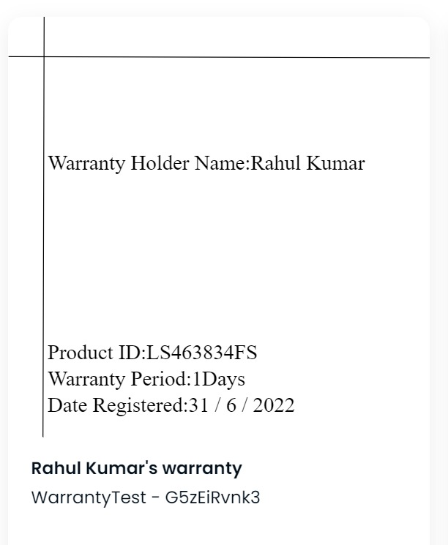
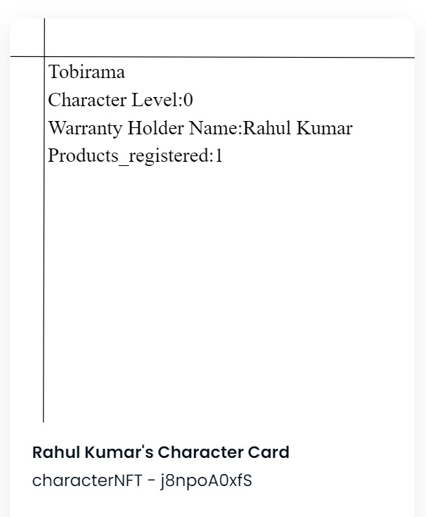
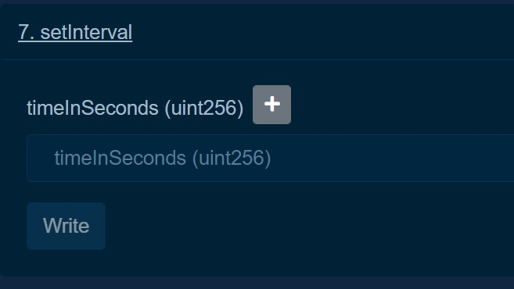
The Warranty NFT(AS in Openseas)
The Character NFT(AS in Openseas)
setInterval Function

Slide 12
React GUI Page :
The GUI is designed in such a way that the user will have to enter only basic data for the NFT and on the click of a button the NFTs will be minted.
All the transactions are automated and are taken care of using JavaScript.
Decaying Functionality :
The decaying functionality has been implemented using gelato. Gelato calls a specified function after every 5 minutes(here 5 minutes is given for test purposes.).
This function checks the time elapsed since the minting of the NFT and then it deletes the NFT if the time elapsed is greater than 5 minutes(again 5 minutes is given for testing purposes)

Slide 13
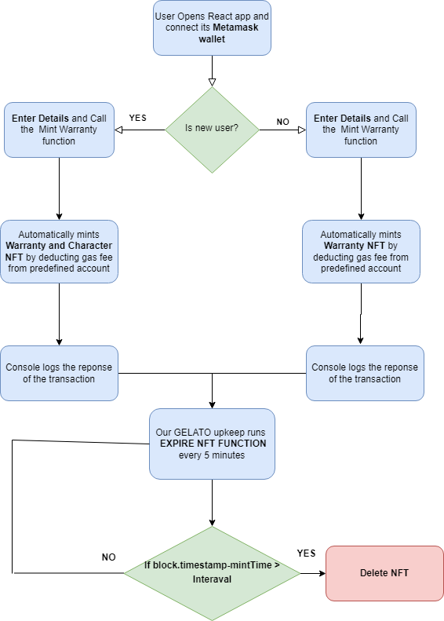
Flowchart

Slide 14
Limitations
User’s should have prerequisite knowledge of NFTs. Like what is NFT,how can he check his registered NFTs.
In the near future rinkeby Testnet will de depriciated so we have to deploy our smart contract on other testnet(Polygon prefered).
Rinkbey cost more gas fees to mint NFTs.
We are minting on-chain NFTs, as we store more data in the NFTs the gas fee will increase in comparison to IPFS to store their meta data.
For each period of warranty we need a separate smart contract to mint NFTs for that period of time. For example if a company has products having warranty periods of 6,12,18 months we need to have different smart contract for each period of time that mint NFTs having a validity of 6,12,18 months respectively.

Slide 15
Future Scope
Migrating the project to polygon for lower gas fees.
Connecting the GUI to a company database to verify the PRODUCT_ID to check its authenticity.
Adding a section in the GUI to show the user owned NFTs instead of the user going to
openseas.testnet.
Engagement/Gamification:-
Using Level attribute of Character NFT we can provide attractive discounts and offers to
customers based on their level. Like level-1 will get 10% discount on next purchase
level-2 will get 20% discount and so on.

