Slide 1

CS4225/CS5425 Big Data Systems for Data Science
Assignment 2: Spark
Chengxi Xue, Bingsheng He
School of Computing
National University of Singapore
xuechengxi@u.nus.edu
Notes:
.

Slide 2
Coding Assignment Guideline for CS4225&5425: Assignment 2
Task1: CommonWords using Spark
Task2: K-means
Information about assignment 2:
Submission requirement
What is this coding assignment about

Slide 3
Task1: Commonwords in Spark
You need to implement the Commonwords using Spark.
The application description is same as Task1 in assignment1, except that we require you to write the program in Scala.
Why Scala? Because it is native in Spark.
Learn Scala here: https://docs.scala-lang.org/learn.html

Slide 4
Task 1: Report
You need to summarize Task1 and write a report (up to 2 pages), including at least the following two aspects.
Comparisons on programming with Hadoop and Spark
The difference between your implementation with two programming platforms.
Pros and Cons among Hadoop and Spark
…
Comparisons on runtime execution with Hadoop and Spark
Program performance (in comparison with Hadoop)
Pros and Cons between Hadoop and Spark
…

Slide 5
Task2
1.The goal of Task2 is to implement a k-means algorithm using Scala which clusters some posts according to their score and domains. Moreover, this clustering should be executed in parallel for different domains.
2.Do not use some libraries like Mllib directly, you need to implement k-means step by step.

Slide 6
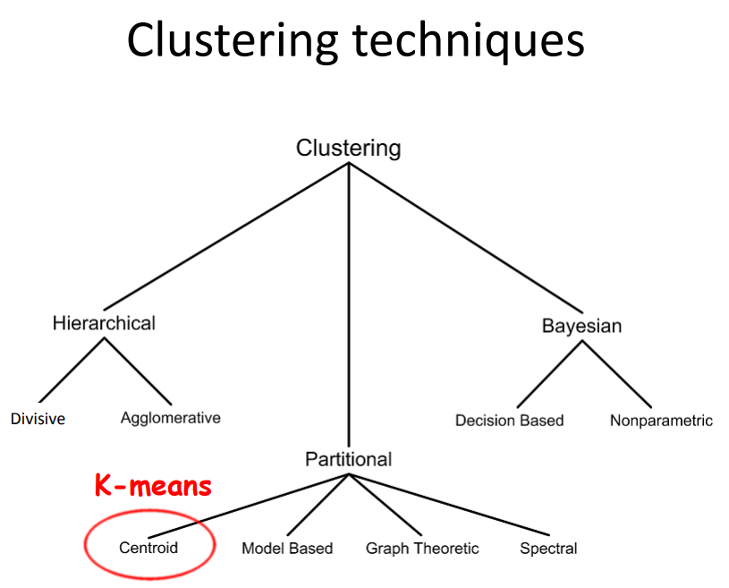
Task Overview
Motivation
Clustering is an unsupervised learning problem whereby we aim to group subsets of entities with one another based on some notion of similarity.
Different kinds of clustering techniques:
Hierarchical algorithms
Partitional algorithms
Bayesian algorithms.

Slide 7
k-means
k-means is one of the most commonly used clustering algorithms that clusters the data points into a predefined number of clusters.
Given k, the k-means algorithm works as follows:
1. Choose k (random) data points (seeds) to be the initial centroids, cluster centers
2. Assign each data point to the closest centroid
3. Re-compute the centroids using the current cluster memberships
4. If a convergence criterion is not met, repeat steps 2 and 3

Slide 8
Background
Now we have some popular question-answer platforms like Quora, yahoo answers, StackOverflow…
There are a lot of posts there, we can cluster some posts according to their score and domains(tags) to find some interesting results.
For example: some questions about "Machine-Learning", "Compute-Science", "Algorithm", "Big-Data", "Security“… and the score is used to evaluate the quality of the answer.

Slide 9
Data format
Input data Task2_data/QA_data.zip
The data value: (1,100, ,9,Big Data)
The meaning: PostingType, ID, ParentID, Score, Domains.
PostingType:
PostingType=1: this post is a question.
PostingType=2: this post is an answer.
ID: the id for the post
ParentId: which question it belongs to.
Score: the score of the posts (question and answer).
Domains: which domain does this question belong to.

Slide 10
Requirements
You need to follow a structure like this.
1.group the questions and answers together
2.computing the highest score
3.design the vectors for clustering from the data
4.clustering
5.some additional parts
You can see the code framework in Task2_code, you need to fill this code and test it using Spark.
Note: keep the function name but you can modify the parameters for this function

Slide 11
Hints
You should use pair RDDs. It’s something like a map data structure, and it is similar to a format of key-value paris. Comparing to regular RDDs you get a set of powerful functions which you can apply to exactly to pair RDDs. They give a more easier way to operate with data. For example when you want to group or aggregate a data based on some of its properties. For this purposes, Spark has a special set of functions such as: groupByKey, aggregateByKey, reduceByKey etc.
Small example. If you have an RDD of goods and You want to group these goods by their price. With Spark, you need 1.create a pair RDD, where a role of key will play a price field, a role of value will play an appropriate good. 2.apply groupByKey function to the pair RDD.

Slide 12
Hints
There are many ways to create a vector from a post for clustering. In this task, we choose this methods:
For a question from domain A, Score s is the highest score from all its answers. And the index of domain A in the domain list (provided) is x, a predefined parameter DomainSpread is d, the vector for this question is (d*x, s).

Slide 13
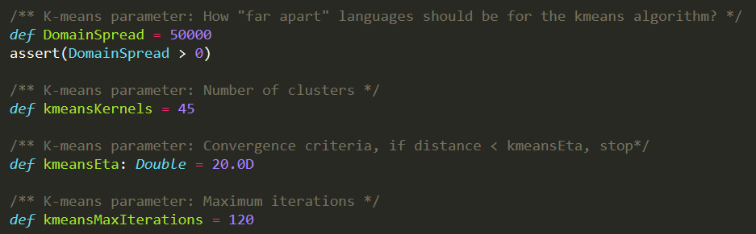
Parameters in k-means
You can see these key parameters in k-means are predefined in the provided code framework.

Slide 14
Clustering Result
Include the below output into your lab report:
The cluster centroid for every cluster (the domain).
The percentage of the centroid’s domain in its cluster.
The size of every cluster.
The median score of every cluster.
The average score of every cluster.

Slide 15
Report
In Task2, you need to submit a report (2-3 pages), including:
Analyse your result
The insight that you can get from the result of clustering for QA_data.
Analysis of the parameters (in Slide 13) in k-means
how do different parameters impact the performance and clustering results of k-means?
Further discussion on the system performance
How to improve the efficiency?
How to speed up the processing?

Slide 16
Submission requirement
Deadline: Apr 5, 2019 11:59pm
Submit the following:
Your whole project code without the data (with documentation within the code)
Task1: Top-15 output of the result using the data files listed above.
Task1 report.(1-2 pages)
Task2: the clustering results with predefined parameters. (shown in previous slides)
Task2 report.(2-3 pages)

Slide 17
Submission requirement
Files should be compressed in a zip file to IVLE, with the name [Your Student ID]-Assignment2.zip

Slide 18
Marking Schemes
Total: 12% of final mark.
Task1 Code & Report: 4%
Task2 Code & Report: 6%
Writing assessment: 2%
The written assessment’s questions depend on your submission. You need to understand your code. For example, please explain some specific lines of your code.
The written assessment will be conducted in tutorial session.
Time: Tutorial Week 12 (“9 (Stream Processing)”).

Slide 19
Notice1
Please don't consider this homework as the same as ACM-ICPC programming contest (check by exact input-output pairs), we use this to enhance your understanding about the programming using Spark.
Don't need to worry about whether your result "exactly matches" final result.

Slide 20
Feedbacks are Welcome
Email me: xuechengxi@u.nus.edu
Or, post your questions in the IVLE forum (preferred).

