Slide 1

Career Trends Explorer and Personalized Job Matcher
Name: Pankaj Devikar
Institute: Digicrome Academy

Slide 2

INTRODUCTION
Project Scope
Project Purpose
This project analyzes and predicts trends related to remote work and job openings, with a particular focus on the future workforce.
By leveraging historical job data and advanced forecasting models like ARIMA and Prophet, we provide insights into the growth of remote jobs and other workforce patterns.

Slide 3
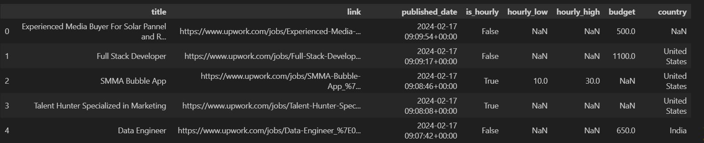
DATA OVERVIEW
Key Dataset Features
Data Points for Job Analysis
Job Details
Job Title
Salary Range
Country
Job Type (e.g., Remote, Full-Time, Part-Time) Budget Trends)
Historical Job Postings
Data by Year and Month
Metrics:
Total Job Count
Remote Job Count
Budget Information (e.g., Salary Allocations or

Slide 4
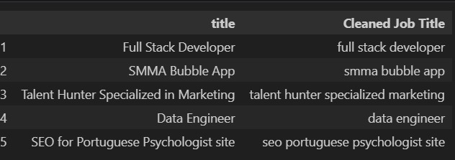
DATA PREPROCESSING
Cleaning and Preparing Data
Grouping and Aggregating
Handling missing values and inconsistencies.
Grouping and aggregating data by year and job type for better forecasting.
Creating New Columns
Creating new columns, such as 'YearMonth' for time-series analysis.

Slide 5
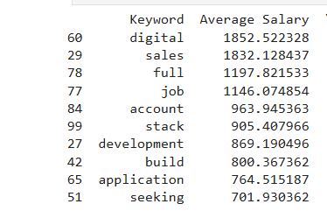
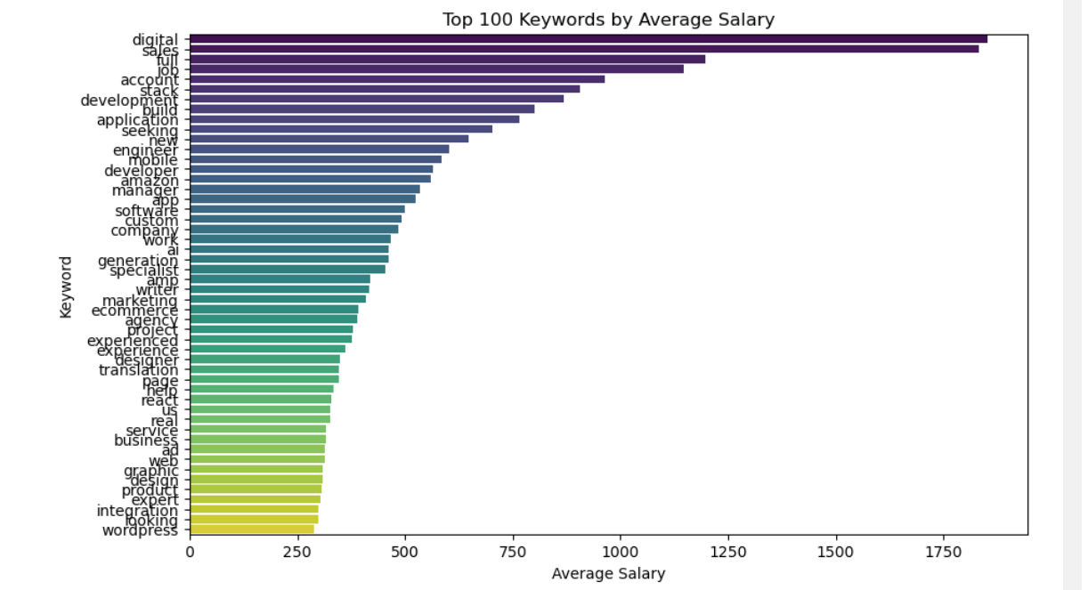
High-Paying Keywords:
The terms "digital" and "sales" are associated with the highest average salaries, indicating that roles related to these keywords are highly valued.
Mid-Range Salaries:
Keywords like "full", "job", and "account" fall in the mid-range of average salaries, suggesting they are commonly used but may represent roles with more variable compensation.
Technical Keywords:
Terms like "stack", "development", and "build" suggest a focus on technical skills. However, their average salaries are slightly lower than those of sales and digital roles, perhaps due to a broader range of experience levels or job types.
Lower Salary Keywords:
Keywords such as "application" and "seeking" have the lowest average salaries, which might indicate entry-level roles or more generalized positions.

Slide 6
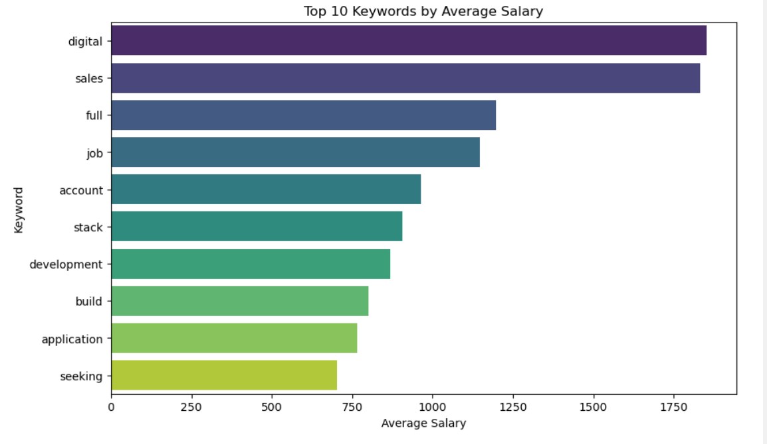
Task 1: Analyzing Keywords and Salaries
High-Salary Keywords: Niche roles like marketplace and month offer high earnings.
Earning Potential: Keywords such as representative signal lucrative opportunities.
Emerging Roles: Unconventional terms like webseries suggest growing job markets.
Generalized Roles: Keywords like department reflect less lucrative, broader roles.

Slide 7
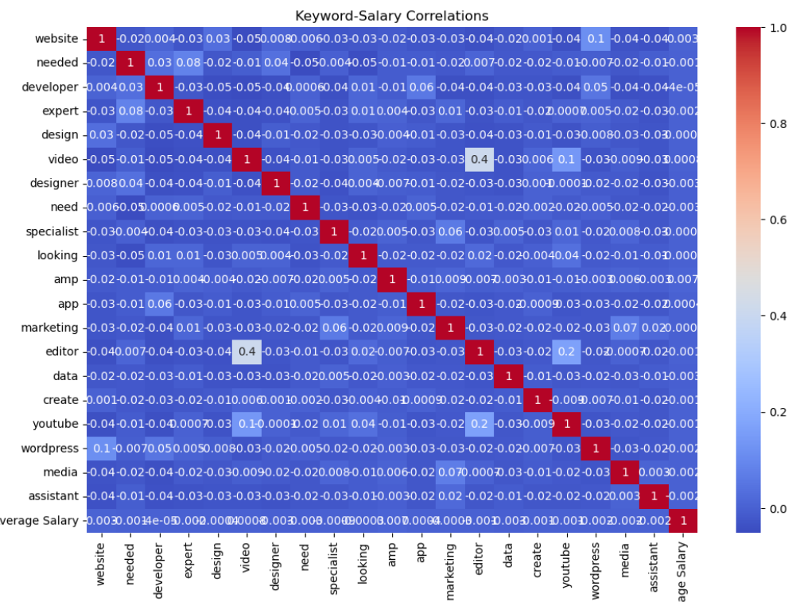
Correlation Analysis
Low Salary Correlation: Most keywords show weak links to salary, implying broader factors at play.
Positive Correlation: Terms like "Editor" and "Design" show moderate correlation (~0.41), linking them to higher salaries.
Negligible Impact: Keywords like "Website," "Developer," and "Marketing" have minimal or no salary correlation.
Key Insight: Specialized skills, such as editing and design, may have a stronger influence on salary.

Slide 8
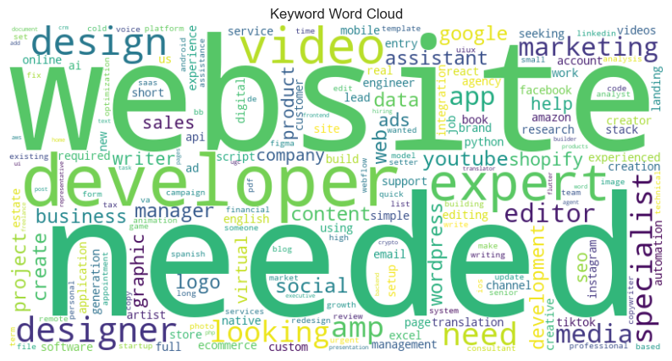
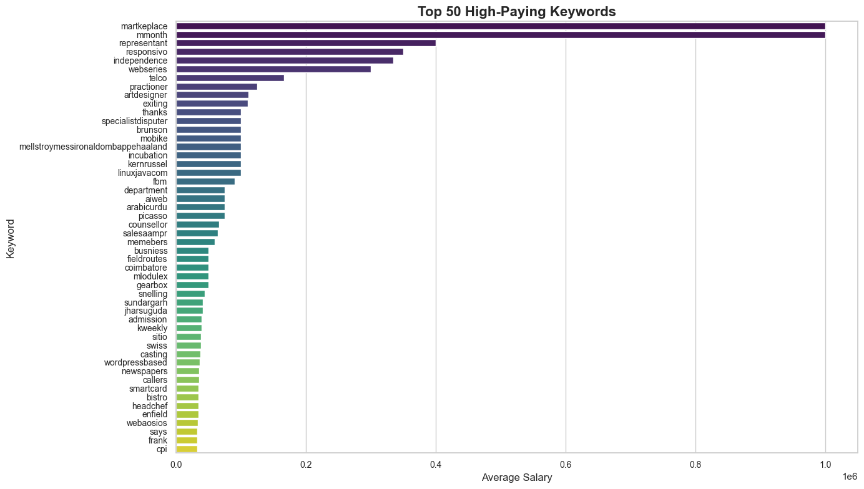
Word Cloud For The Most Frequent Keywords
Top 50 High-Paying Keywords
This word cloud highlights frequently used terms in project or task postings, emphasizing "website," "developer," "needed," "expert," and "design," suggesting high demand for web-related expertise and creative roles.
Top-Paying Keywords: Terms like "marketplace" and "representant" signal high salaries, with niche roles and tech-focused keywords like "linuxjavacom" also emerging.
Geographic Insights: Place-based keywords like "sundargarh" highlight high-salary roles tied to specific locations.

Slide 9
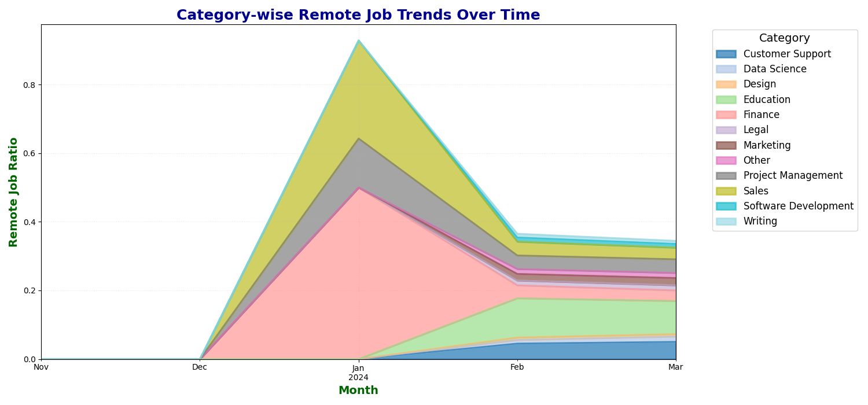
Task 2: Identifying Emerging Job Categories
The chart shows the growth in job postings across various categories over time, with Software Development experiencing a significant surge from January to March 2024. Other categories show steady but smaller increases, reflecting broader demand trends.

Slide 10
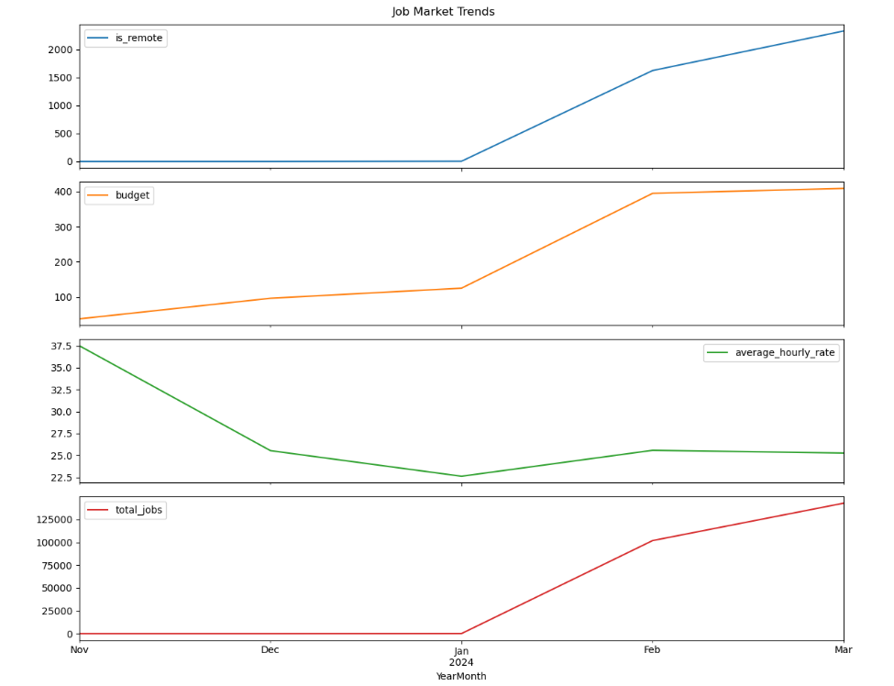
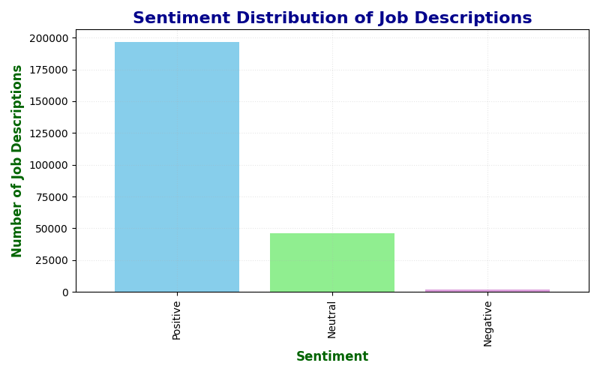
Task 3: Forecasting High-Demand Roles

Slide 11
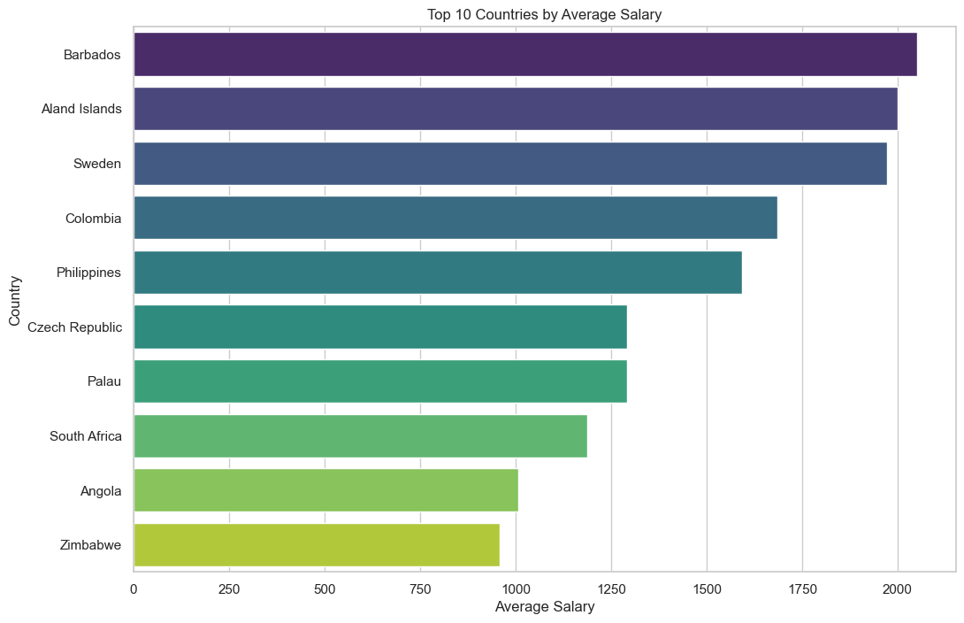
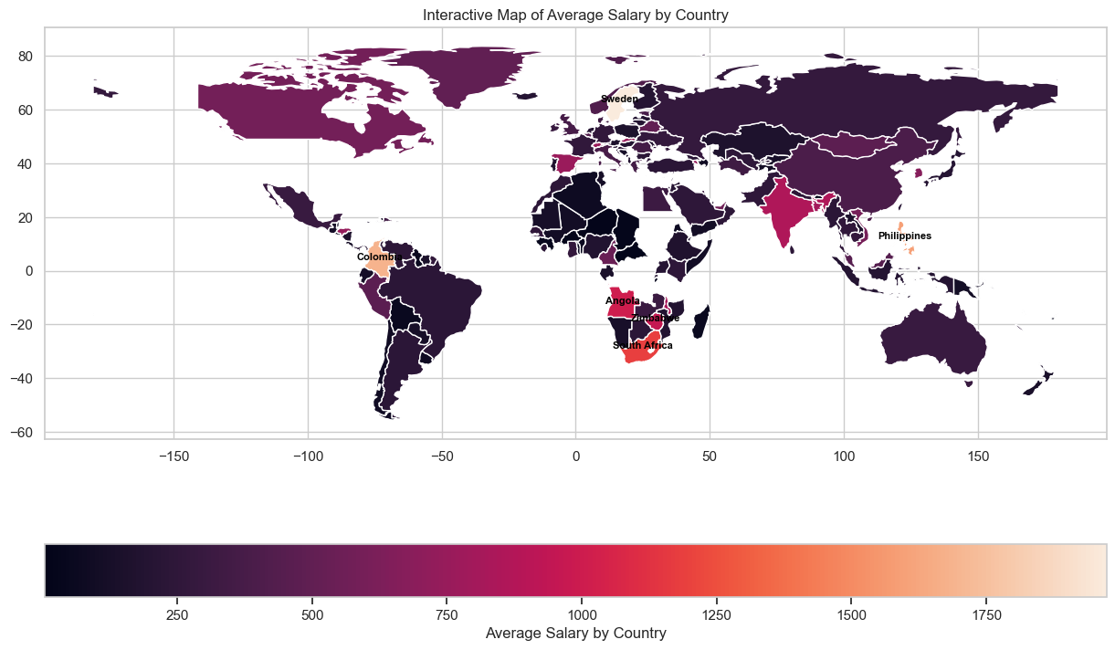
Task 4: Comparative Salary Analysis by Region
This chart depicts the top 10 countries ranked by average salary, showcasing that Barbados leads, followed by Åland Islands and Sweden. The graph highlights variations in income levels across these countries, emphasizing economic disparities globally.

Slide 12
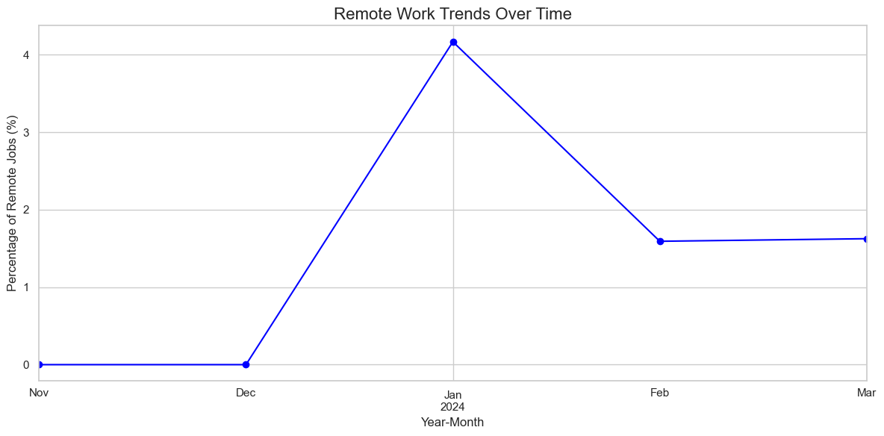
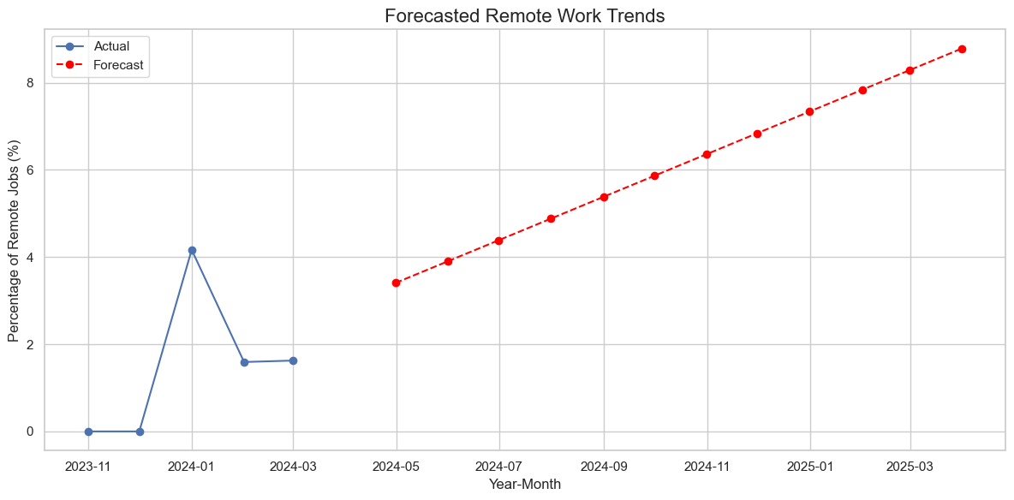
Remote Work Trends Analysis
The graph illustrates the trends in remote job percentages over time, with a significant peak in January 2024, followed by a decline and stabilization in February and March. This indicates a temporary surge in remote work opportunities at the start of the year.
The chart shows actual remote work trends until early 2024, with a peak in January, followed by a stabilization. The forecast suggests a steady increase in remote job percentages from mid-2024 to early 2025, highlighting a growing adoption of remote work.

Slide 13
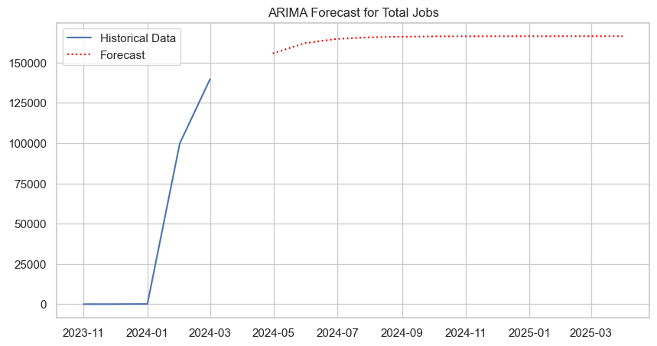
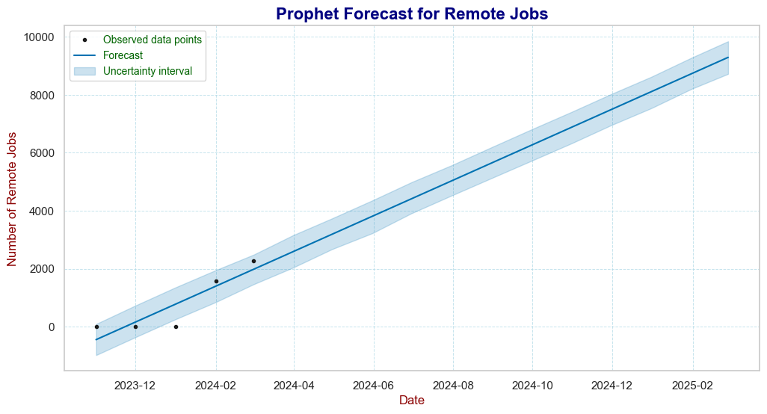
Models Used for Forecasting
ARIMA (Autoregressive Integrated Moving Average)
Prophet
Developed by Facebook for forecasting time-series data. Robust to missing data and outliers. Ideal for seasonal trends in the job market.
Time series forecasting model. Suitable for predicting trends in job openings and remote work.

Slide 14

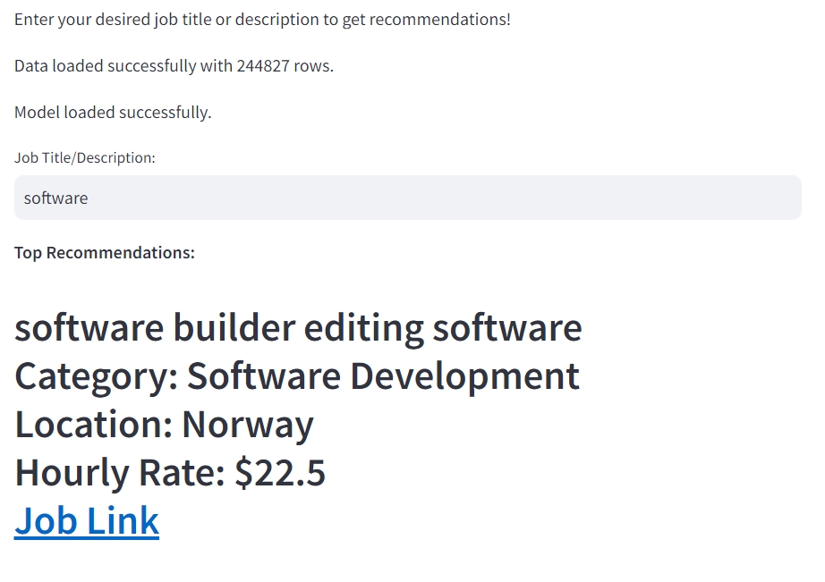
OUTPUTS IN STREAMLIT

Slide 15
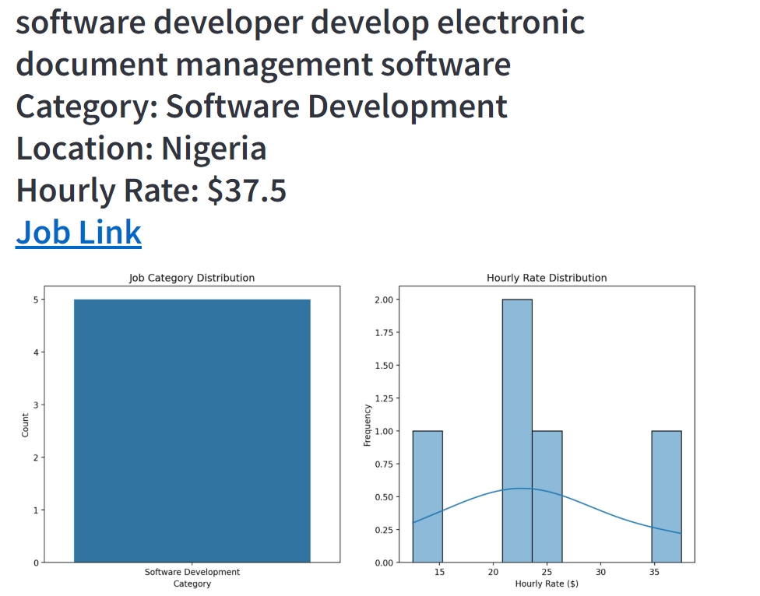

Slide 16
Key Insights from Forecasting
Remote Jobs
Salary Trends
Remote work is projected to continue growing, becoming a larger share of total job openings.
Salaries in tech and healthcare are expected to rise due to increasing demand. Remote job salaries show slight growth due to the competitive job market.
Job Categories
High-demand sectors, such as technology, healthcare, and data science, are expected to lead in job creation.

Slide 17



Recommendations
For Job Seekers
For Employers
For Policymakers
Target roles in high-growth sectors, such as technology, data science, and healthcare. Focus on improving skills related to remote work and digital transformation.
Invest in remote work infrastructure. Upskill your workforce to meet future demands.
Support upskilling initiatives and provide resources for career transitions. Invest in remote work-friendly policies and digital skill training.

