Slide 1
AgroMart
Guide- Mr. Harshal Waghchaure
Pankaj Babaji Dukare 243058 Akshay Keshav Balte 243008

Slide 2
CONTENTS
1
Introduction
2
Prupose
3
Objective
4
ER Diagrams
5
Web Site
6
Futurer Scopes
7
Conclusion
8
References

Slide 3
Introduction
AgroMart is a web-based platform designed to help
fertilizer shop owners manage their business efficiently.
It simplifies product management, order processing, and deliveries, providing role-based access for shop owners, farmers, and delivery boys.
AgroMart ensures smoother operations and better customer engagement through features like automated alerts, give
Discount ,offer to farmer.

Slide 4
Purpose
The purpose of AgroMart is to create a simple and secure online platform for
fertilizer shop management. It helps shop owners automate routine tasks, reduce errors, and improve productivity.
Farmers can easily browse products, place orders, and track deliveries.
Delivery boy check their order and also update order status.
AgroMart connects shop owners, farmers, and delivery workers for seamless
operations.

Slide 5
Objective
1. Simplify fertilizer shop management with an online platform.
2. Automate tasks like inventory management and order tracking.
3. Provide a convenient platform for farmers to order fertilizers.
4. Improve communication between shop owners, farmers, and delivery boy.
5. Reduce manual errors and enhance business productivity.
.

Slide 6
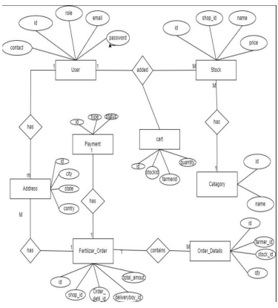
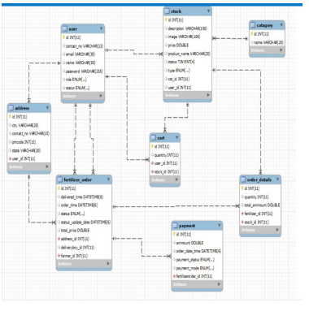
ER Diagrams

Slide 7
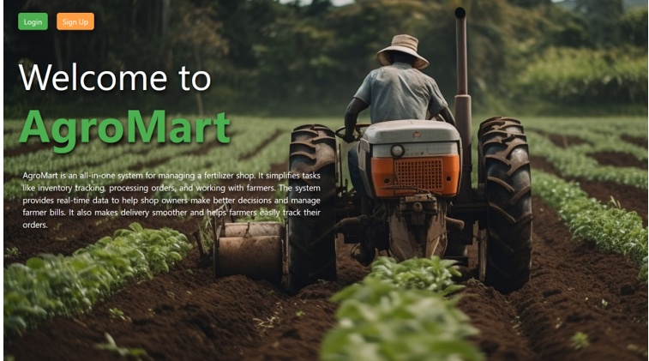
WebSite

Slide 8
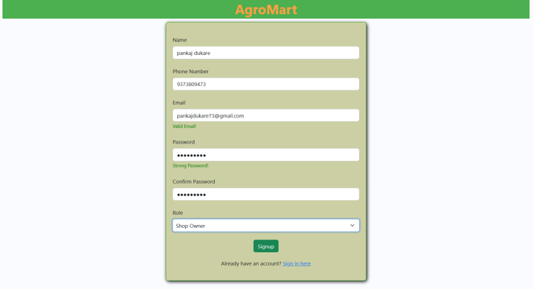
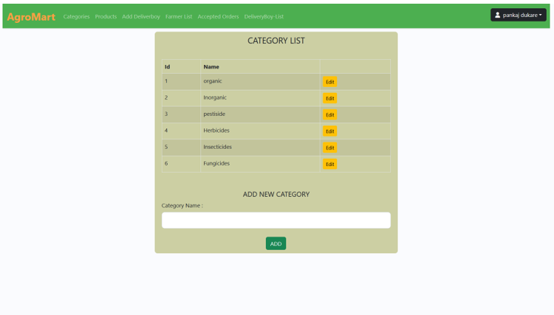
Shop Owner

Slide 9
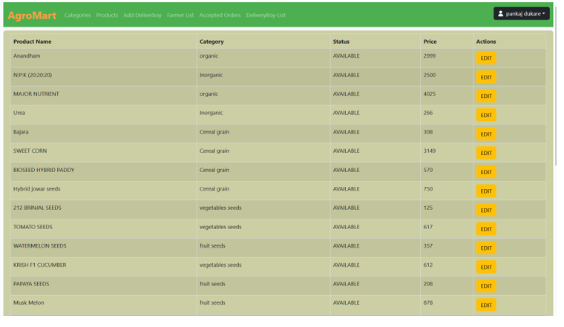
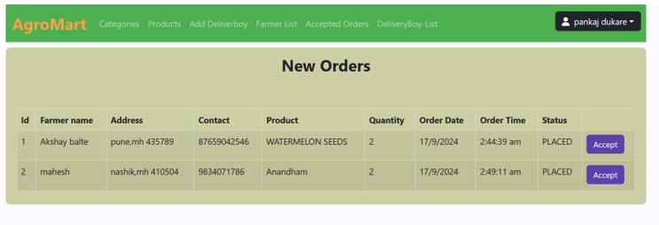
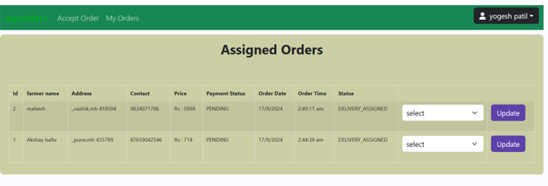
Product &order List

Slide 10
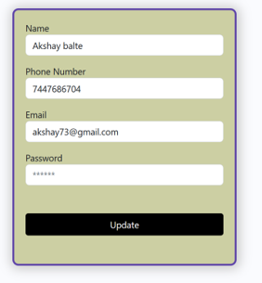
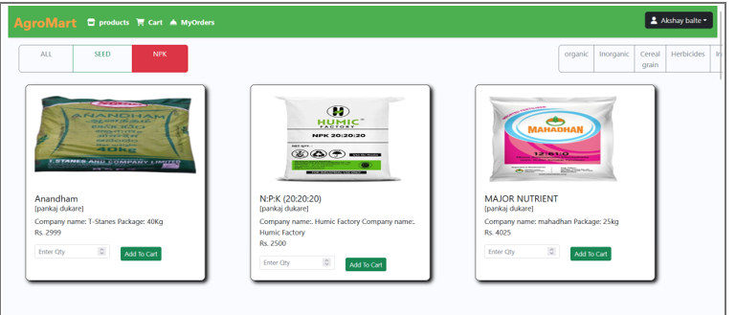
Farmer login and List Of Product

Slide 11
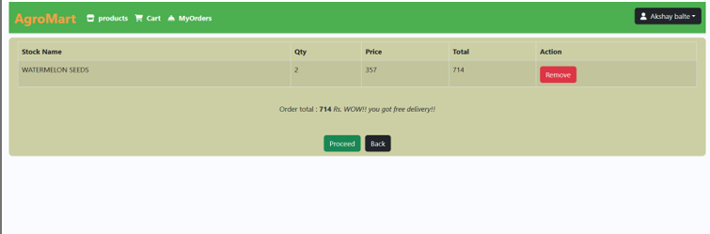
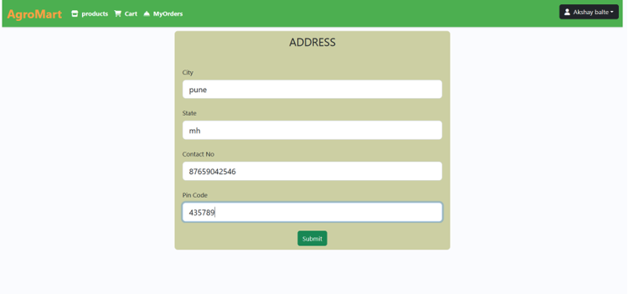
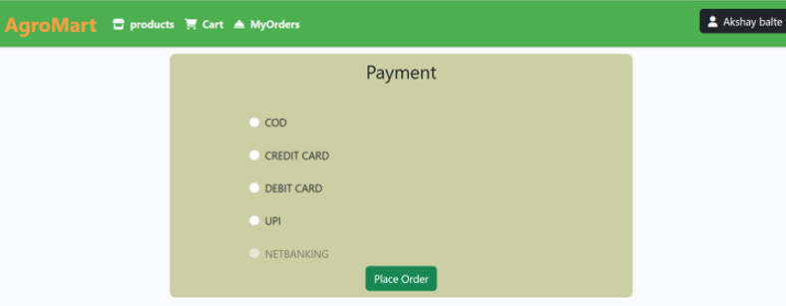
Cart and Payment Process

Slide 12
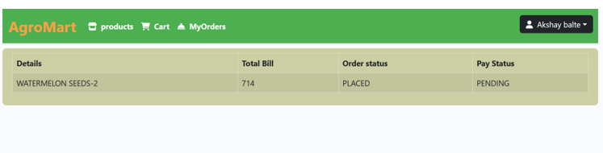
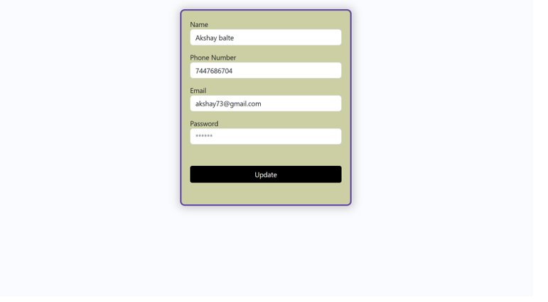
Order List and Update Profile

Slide 13
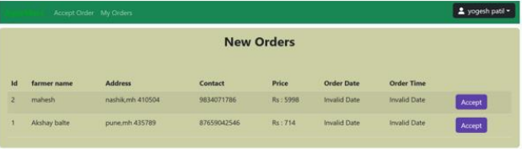
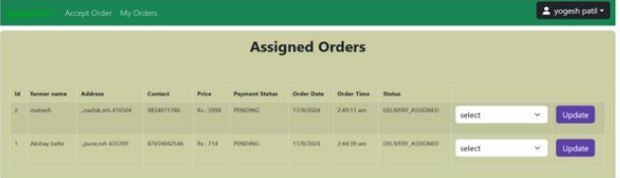
Delivery Boy

Slide 14
1. Making mobile app for beter use of shop owner ,farmer.
2. Multi-Language Support
3. Manage Supplies information for restocking and expence management
4. Weather-based recommendation
Future Work

Slide 15
CONCLUSION
AgroMart is a powerful platform that simplifies fertilizer shop managementIt connects shop owners, farmers, and delivery workers, offering a
streamlined solution for product management, order processing, and
delivery tracking.
AgroMart enhances productivity, reduces errors, and provides valuable insights for better business decisions.
As the platform grows, it will continue to evolve with new features to
further support the needs of the agricultural industry

Slide 16
References:-
i. https://getbootstrap.com/docs/5.1/getting-started/introduction/ ii. https://reactjs.org/docs/getting-started.html iii. https://www.baeldung.com/ iv. https://www.w3schools.com/ v. https://docs.spring.io/spring-data/jpa/docs/current/reference/html/#reference vi. https://javaee.github.io/javaee-spec/javadocs/ vii. https://javadoc.io/doc/org.springframework.data/spring-data-jpa/latest/index.html

Slide 17
THANK YOU

