Slide 1
R-Square (R² )

Slide 2
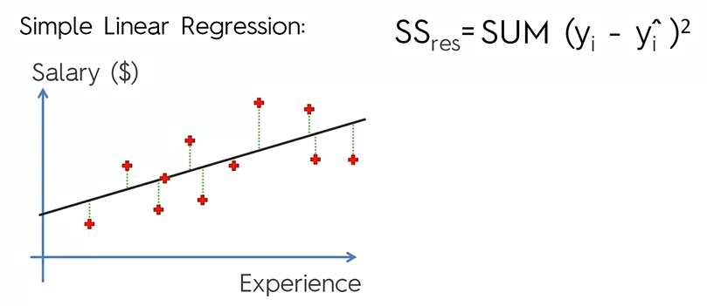
R² (R-Square)
R² tells us how well our model has fitted the data.

Slide 3
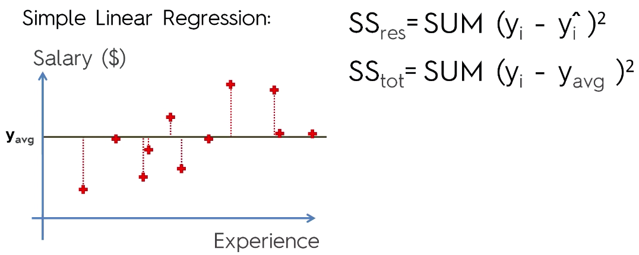
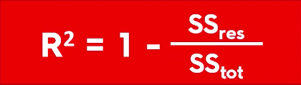
R² (R-Square)

Slide 4
R² (R-Square)

Slide 5
R² (R-Square)

Slide 6
R² (R-Square)
Closer the R-Squared is to 1 the better.
The further away it is from 1 i.e. the lower, it is the worse.

Slide 7
SSE / SST -→ Value closer to zero if SSE is higher = Higher value closer to 1
Original
Ypred1 - Y_test = value1 = sq(value1)
Ypred2 - Y_test = -value2 = sq(value2)
Ypred3 - Y_test = value3 = sq(value3)
Ypred4- Y_test = -value4 = sq(value4)
Ypred5 -Y_test = value5 = sq(value5)
Sum Square Error (residual)
If they any difference
Ypred – ytest = value1
Ymean
Yavg - Y_test = value1 = sq(value1)
Yavg - Y_test = -value2 = sq(value2)
Yavg - Y_test = value3 = sq(value3)
Yavg - Y_test = -value4 = sq(value4)
Yavg -Y_test = value5 = sq(value5)
Sum Square Total (average)
Y = Bo + b1X1 + B2X2 + … + + B9X9
Training Data : X_train, Y_train
Fit method of Linear Regression
Found– Bo, B1, B2, … B9
X1, X2, ,… Xn
Test Data : X_test, y_test ==== 5 row
X_test = X1, X2,…. X9
Y = Bo + b1X1 + B2X2 + … + + B9X9 --- y_pred

Slide 8
Adjusted R-Square (R² )

Slide 9
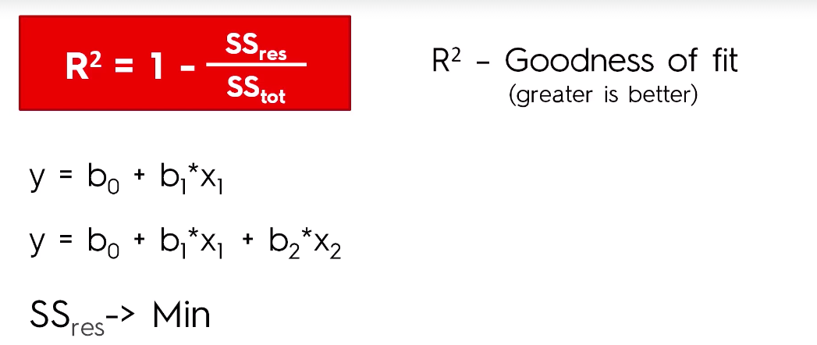
Adjusted R² (Adjusted R-Square)

Slide 10
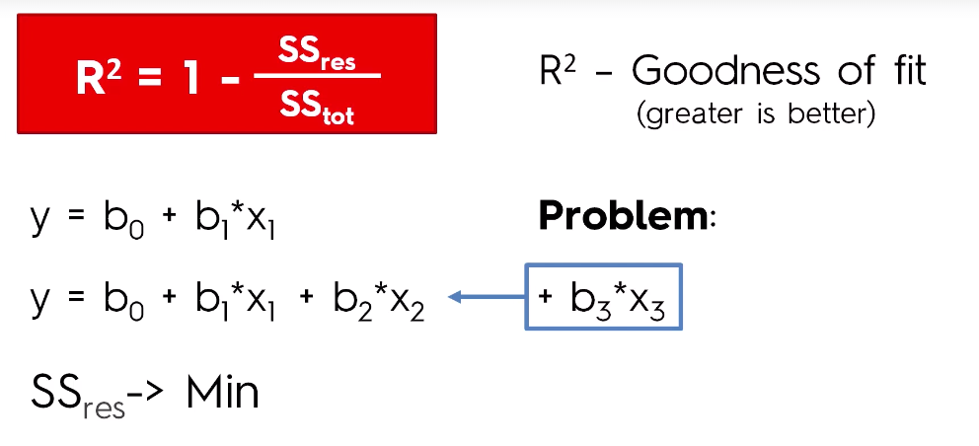
Adjusted R² (Adjusted R-Square)
R² will never decrease

Slide 11
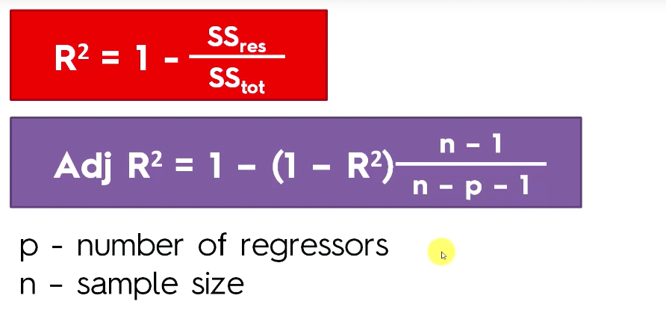
Adjusted R² (Adjusted R-Square)
Closer the Adjusted R-Squared is to 1 the better.
The further away it is from 1 i.e. the lower, it is the worse.

Slide 12
Regression Project 1:
https://www.kaggle.com/c/house-prices-advanced-regression-techniques
In a Single Jupyter Notebook File.
Train Data:
EDA : Numerical and Catergorical Variable
Divide the data into Training (80%) and Test (20%)
Apply the Model
Linear Regression
Decision Tree
Random Forest
Compare the Accuracy
Comment “The model” + Model + “is giving accuracy of” + <accuracy>

