Slide 1
Decision Trees
~ Pankaj

Slide 2




Decision Trees - Explanation
Classification And Regression Tree

Slide 3
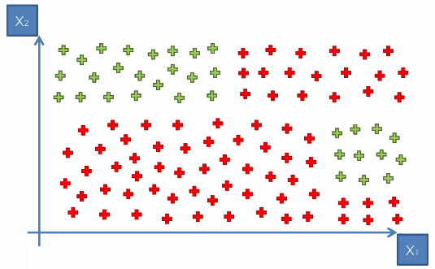
Decision Trees - Explanation

Slide 4
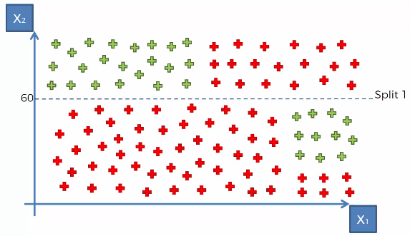
Decision Trees - Explanation

Slide 5
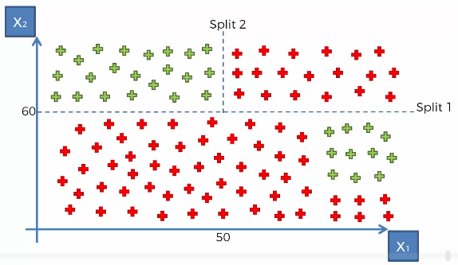
Decision Trees - Explanation

Slide 6
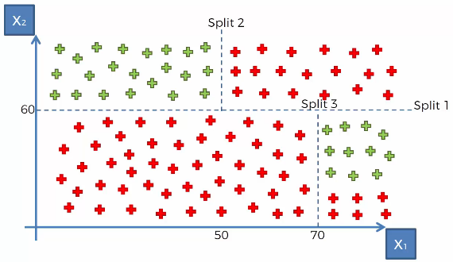
Decision Trees - Explanation

Slide 7
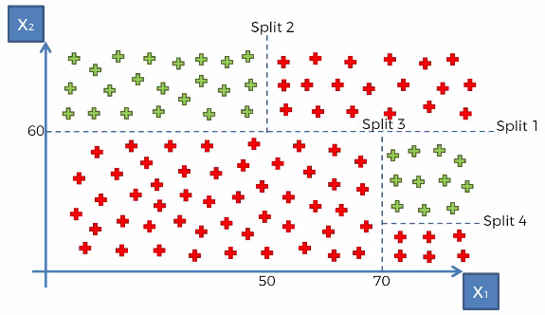
Decision Trees - Explanation

Slide 8
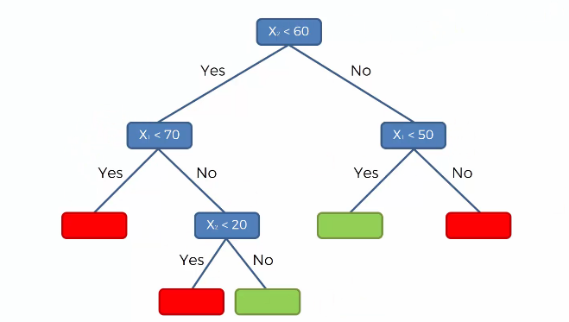
Decision Trees - Explanation

Slide 9
Decision Trees - Assumption
The below are the some of the assumptions we make while using Decision tree:
At the beginning, the whole training set is considered as the root.
Feature values are preferred to be categorical. If the values are continuous then they are discretized prior to building the model.
Records are distributed recursively on the basis of attribute values.
Order to placing attributes as root or internal node of the tree is done by using some statistical approach

Slide 10
Decision Trees – Attribute Selection
The primary challenge in the decision tree implementation is to identify which attributes do we need to consider as the root node and each level.
Handling this is know the attributes selection.
We have different attributes selection measure to identify the attribute which can be considered as the root note at each level.
The popular attribute selection measures:
Information gain
Gini index

Slide 11

Decision Trees – Information Gain
Information Gain
By using information gain as a criterion, we try to estimate the information contained by each attribute.
To measure the randomness or uncertainty of a random variable X is defined by Entropy.
For a binary classification problem with only two classes, positive and negative class.
If all examples are positive or all are negative then entropy will be zero i.e, low.
If half of the records are of positive class and half are of negative class then entropy is one i.e, high.
By calculating entropy measure of each attribute we can calculate their information gain. Information Gain calculates the expected reduction in entropy due to sorting on the attribute. Information gain can be calculated.

Slide 12

Decision Trees – Gini Index
Gini Index
Gini Index is a metric to measure how often a randomly chosen element would be incorrectly identified.
It means an attribute with lower gini index should be preferred.

Slide 13
Decision Trees - Overfitting
Overfitting
Overfitting is a practical problem while building a decision tree model.
The model is having an issue of overfitting is considered when the algorithm continues to go deeper and deeper in the to reduce the training set error but results with an increased test set error i.e, Accuracy of prediction for our model goes down.
It generally happens when it builds many branches due to outliers and irregularities in data.
Two approaches which we can use to avoid overfitting are:
Pre-Pruning
Post-Pruning

Slide 14
Decision Trees – Over fitting solution
Pre-Pruning
In pre-pruning, it stops the tree construction bit early. It is preferred not to split a node if its goodness measure is below a threshold value.
But it’s difficult to choose an appropriate stopping point.
Post-Pruning
In post-pruning first, it goes deeper and deeper in the tree to build a complete tree. If the tree shows the overfitting problem then pruning is done as a post-pruning step.
We use a cross-validation data to check the effect of our pruning. Using cross-validation data, it tests whether expanding a node will make an improvement or not.
If it shows an improvement, then we can continue by expanding that node. But if it shows a reduction in accuracy then it should not be expanded i.e, the node should be converted to a leaf node.

Slide 15
Decision Trees – Over fitting solution
https://dataaspirant.com/2017/01/30/how-decision-tree-algorithm-works/

Slide 16
Random Forest
~ Pankaj

Slide 17
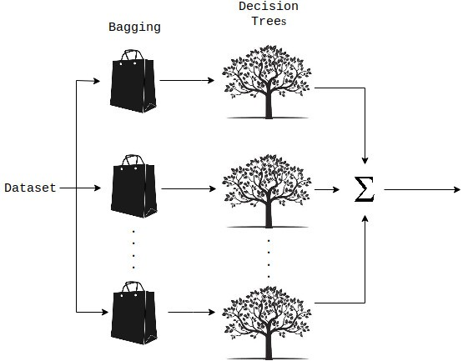
Random Forest- Explanation
A Random Forest is an ensemble technique.
It is capable of performing both tasks with the use of multiple decision trees and a technique called Bootstrap Aggregation, commonly known as bagging.
What is bagging?
Bagging, in the Random Forest method, involves training each decision tree on a different data sample where sampling is done with replacement.
OOB (out of Box) The left-over dataset are used for validating
:: ::
Error is known as OOB error
Majority Vote

Slide 18
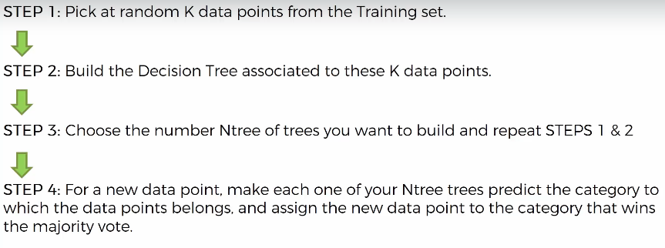
Random Forest - Explanation

Slide 19

Random Forest - Explanation

Slide 20

Random Forest – Application
Microsoft – Kinnect device e.g. X-Box

Slide 21

Random Forest – BodyPart Recognition

Slide 22
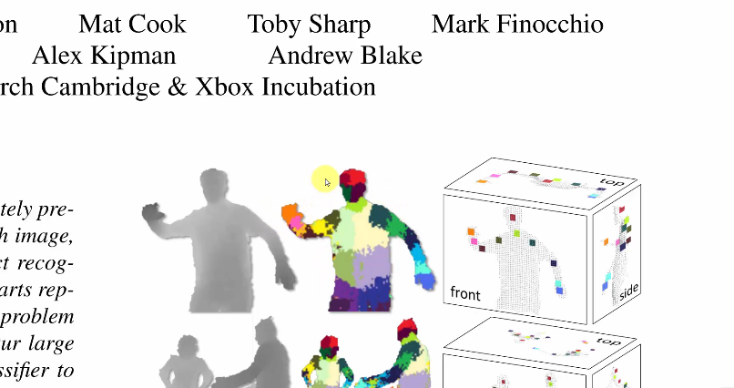
Random Forest - BodyPart Recognition

Slide 23
Random Forest … Microsoft Body Part Recognition.pdf
https://www.microsoft.com/en-us/research/wp-content/uploads/2016/02/BodyPartRecognition.pdf

