Slide 1
K-Nearest Neighbors - KNN
~ Pankaj

Slide 2
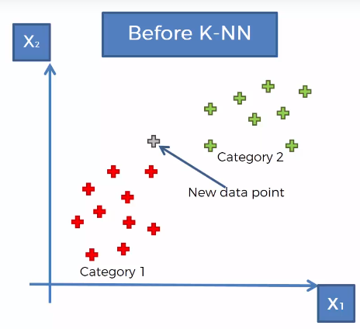
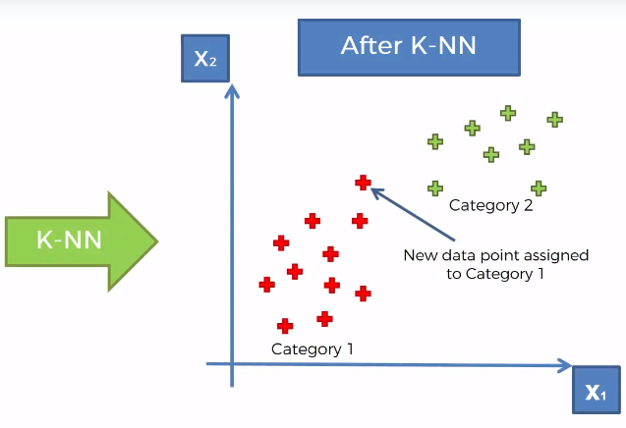
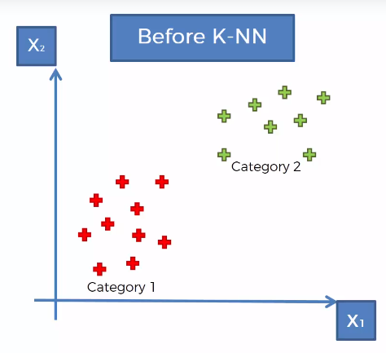
K-NN Explanation
Suppose we have 2 category of Data Point :-

Slide 3
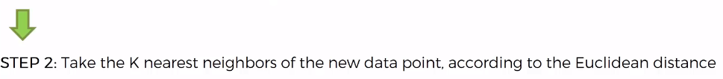
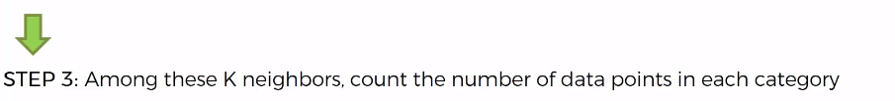
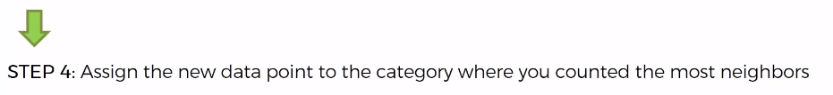

K-NN Explanation
Our Model is Ready …

Slide 4
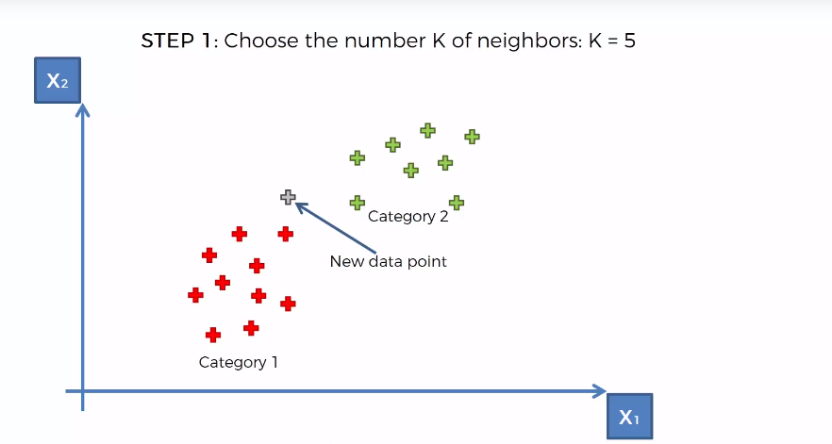
K-NN Explanation

Slide 5
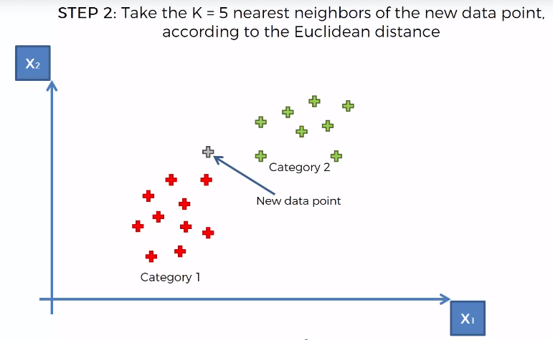
K-NN Explanation

Slide 6
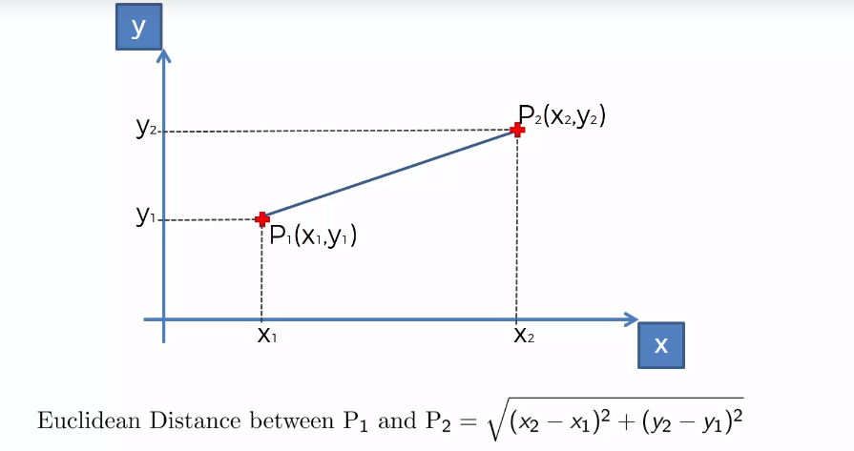
Euclidean Distance Explanation

Slide 7
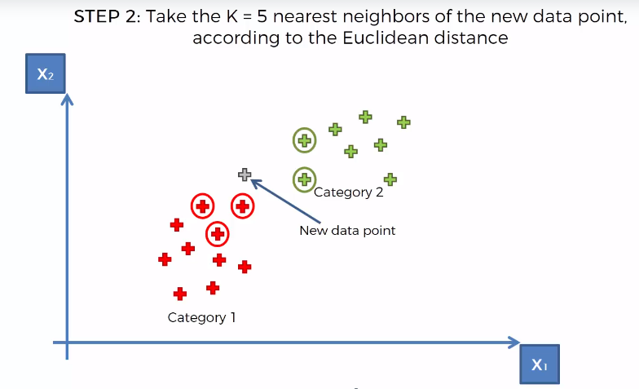
K-NN Explanation

Slide 8
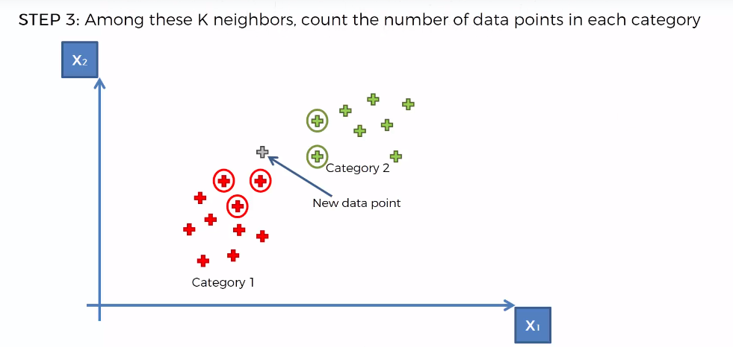
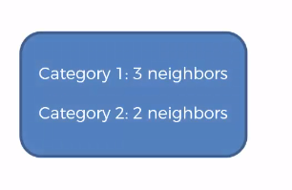
K-NN Explanation

Slide 9
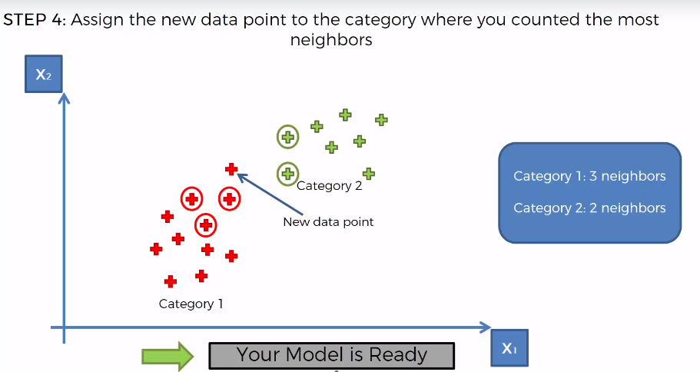
K-NN Explanation

Slide 10
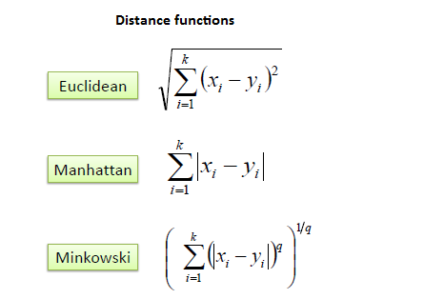
Distance Formula for Continuous Variable

Slide 11
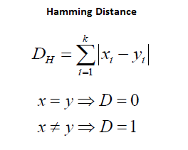
Distance Formula for Categorical Variable

Slide 12
Elbow Method
Accuracy = From Confusion Matrix (TP+ FP)/Number of observation
1
2
3
K

