Slide 1
Python for Data Science
~ Pankaj

Slide 2
Basic Concept of Python
The six base concepts will be:
Variables and data types
Data Structures in Python
Functions and methods
If statements
Loops
Python syntax essentials

Slide 3
1. Variable
Variable are used to assign values.
Let’s see how it works! Say we have a dog (‘Freddie’), and we would like to store some of his attributes (name, age, is_vaccinated, year_of_born, etc.) of this dog in Python variables! We will type this into a Jupyter notebook cell:
Variable_Name = Variable_Value
dog_name = ‘Freddie‘, age = 2, is_vaccinated = True height = 1.1, birth_year = 2019
If we type the variable name, then value will be returned

Slide 4
Variable
A variable can have a short name (like x and y) or a more descriptive name (age, carname, total_volume).
Rules for Python variables:
A variable name must start with a letter or the underscore character
A variable name cannot start with a number
A variable name can only contain alpha-numeric characters and underscores (A-z, 0-9, and _ )
Variable names are case-sensitive (age, Age and AGE are three different variables)
Multiple value can be assign to variable
e.g:
x, y, z = "Orange", "Banana", "Cherry“
x = y = z = "Orange“
The variable in python can also be over-riden.

Slide 5
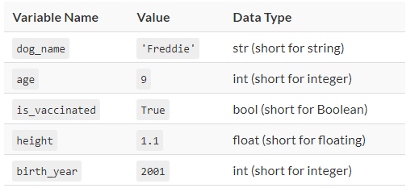
1. Variable – Data Type
1. type(variable_name) – prints the data type of the variable.
2. The datatype can be set as well. E.g.
x = str("Hello World")
x = float(20.5)
x = list(("apple", "banana", "cherry"))

Slide 6
Python Numbers
There are three numeric types in Python:
int
float
Complex
Variables of numeric types are created when you assign a value to them
x = 1 # int
y = 2.8 # float
z = 1j # complex
-→ type(x) # to return the datatype of variable
Type Conversion
We can convert from one type to another with the int(), float(), and complex()
x = 1 # int y = 2.8 # float z = 1j # complex #convert from int to float: a = float(x) #convert from float to int: b = int(y) #convert from int to complex: c = complex(x)

Slide 7
Python Strings
String literals in python are surrounded by either single quotation marks, or double quotation marks. 'hello' is the same as "hello“
Assign String to a Variable : a = "Hello World“
Multiline Strings : b = “””Hello,
how are you?“””
Strings are array: print(a[1])
Slicing : print(a[1:3])
Negative Indexing : print(a[-5: -3])
String Length : print(len(a))
Check String : x = ‘ll’ in a or x = ‘am’ not in a
print(a[1])
String Concatenation : a + b or a + “ “ + b
String Format :
age = 36
txt = "My name is Rahul, and I am {}“
print(txt.format(age))
Escape Character : An escape character is a backslash \ followed by the character you want to insert.
str = ‘a king\s kingdom’’
Strings Method : Python has a set of built-in methods that you can use on strings like upper(), lower()

Slide 8
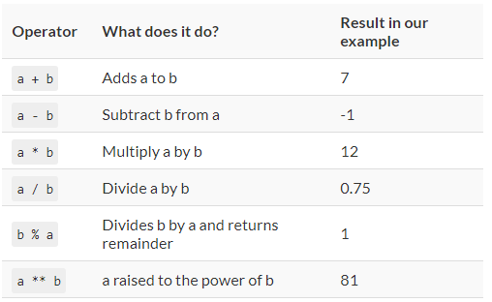
1. Variable – Basic Math Operators

Slide 9
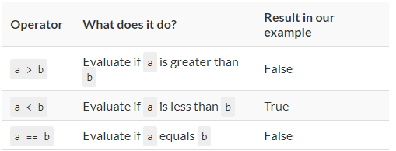
1. Variable – Basic Boolean Operators

Slide 10
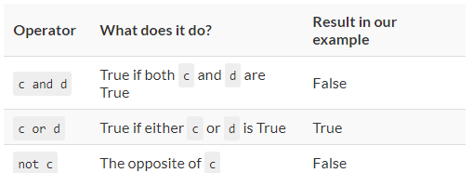
1. Variable – Basic Logical Operators
If c = TRUE and d = FALSE
The evaluation order of the logical operators is:
not
and
or

Slide 11
Test # 1
a = 1 b = 2 c = 3 d = True e = 'cool‘
What will be the returned data type and the exact result of this operation?
a == e or d and c > b

Slide 12
Test # 1 - Answer
The answer is: it’s gonna be a Boolean and it will be True.
Why? Because:
a == e is False – as 1 is not equal to ‘cool’
d is True by definition
c > b is True, because 3 is greater than 2
So a == e or d and c>b translated is:
False or True and True, which is True.

Slide 13
Test # 2
a = 1 b = 2 c = 3 d = True e = 'cool‘
What will be the returned data type and the exact result of this operation?
not a == e or d and not c > b
not 1 == ‘cool’ or True and 3 > 2
not False or True and True
True or True and True
True

Slide 14
Test # 2 - Answer
Here’s the solution: True. Why?
Let’s see! Using the previous exercise’s logic, this is what we have: not False or True and not True
As we have discussed, the first logical operator evaluated is the not. After firing all the nots, this is what we have: True or True and True
The second step is to evaluate the and operator. Translated it’s: True or (True and False), which leads to True or False.
And the last step is the or: True or False –» True

Slide 15
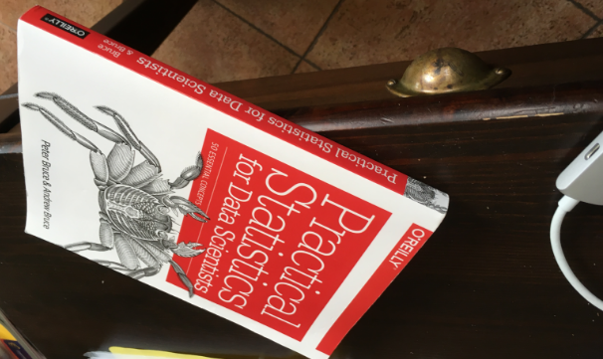
2. Data Structures in Python
Imagine – I have a book the desk and I want to store this info in Python
my_book = "Practical Statistics for Data Scientists"

Slide 16
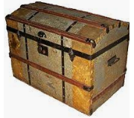
2. Data Structures in Python
But, later while cleaning my shelf, I found two more books:
Chetan Bhagat’s Two States and Amish’s The Immortals of Meluha.
We will write 2 new variables:
my_book2 = ‘Two States’
my_book3 = ‘The Immortals of Meluha’
But, wait I just found trunk containing thousand of books.
So many variables should I create to store the name of the book.
?

Slide 17
2. Data Structures in Python
In Python, to store similar kind of relevant information in one object – instead of several small variables. We have Data Structures. There are three major Python data structures:
Lists. book_list = [‘Two States’, ‘The Immortals of Meluha’, 'Practical Statistics for Data Scientists']
Tuples. book_tuple = (‘Two States’, ‘The Immortals of Meluha’, 'Practical Statistics for Data Scientists')
Dictionaries book_dictionary = {‘Chetan Bhagat': ' Two States ', ‘Amish': ' The Immortals of Meluha ', 'A. & P. Bruce': 'Practical Statistics for Data Scientists'}
All three are good for different things and you have to use them slightly differently…

Slide 18
2. Data Structures - List
A list is a sequence of values. Basically, it’s data put into brackets and separated by commas.
An easy example – a list of integers:
[3, 4, 1, 4, 5, 2, 7]
A list is an object – and generally speaking it’s treated like any other data type (e.g. integers, strings, booleans, etc.).
This means that you can assign your list to a variable, so you can store and make it easier to access:
my_first_list = [3, 4, 1, 4, 5, 2, 7] my_first_list

Slide 19
2. Data Structures - List
A list can hold every other type of data, not just integers – strings, Booleans, even other lists.
e.g. list1 = [‘name’, 9, 1.1, True, 2017]
It can also store list i.e. list in a list.
List2 = [‘king’, ‘queen’]
List1 = [‘name’, 9, 1.1, True, 2017, [‘king’, ‘queen’]]
This is known as nested list.
Usage :: creating a matrix:
sample_matrix = [[1, 4, 9], [1, 8, 27], [1, 16, 81]]

Slide 20
2. Data Structures - List
How to access a specific element of a Python list?
By name
List_name
By index
List_name[1]
We can access multiple element of the list by using index.
List_name[2:5]
Negative Indexing : Negative indexing means beginning from the end, -1 refers to the last item, -2 refers to the second last item etc.
list[-1]
Change Item Value : To change the value of a specific item, refer to the index number
Loop Through a List : using for loop & Combination with If block
List Length : To determine how many items a list has, use the len() function
Add Items : To add an item to the end of the list, use the append() method
Remove Item : using remove() method, pop() method, del keyword removes the complete list, clear() method removes the complete list
Copy a List : built-in List method copy(), the list() method,
Join Two Lists : using + operator, append() method, extend() method, using list() constructor

Slide 21
2. Data Structures - Tuples
A Python tuple is almost the same as a Python list, with a few small differences.
Syntax-wise: when you set up a tuple, you won’t use brackets, but parentheses.
A Python list is mutable – so you can add, remove and change items in it. On the other hand, a Python tuple is immutable, so once it’s set up, it’s sort of “set in stone.” This strictness can be handy in some cases to make your code safer.
Python tuples are slightly faster than Python lists with the same calculations.

Slide 22
2. Data Structures - Tuples
tuple_item = tuple(("apple", "banana", "cherry")) # note the double round-brackets
x = ("apple", "banana", "cherry")
Access element in Tuple
Slice in Tuple
Loop through a Tuple using a for loop
Check if item exist using in keyword
Tuple Length using len() method
To Create Tuple with 1 item add , (comma) after the item
thistuple = ("apple",) print(type(thistuple))
Remove Item is not allowed but Tuple will be deleted using del keyword
Join 2 Tuple using + keyword

Slide 23
2. Data Structures - Tuples
It uses similar function of list except
Add item is not allowed
But there is a work around, convert the tuple to list, add item to it and convert back to tuple
x = ("apple", "banana", "cherry") y = list(x) y[1] = "kiwi" x = tuple(y)

Slide 24
2. Data Structures - Set
A set is a collection which is unordered and unindexed. In Python sets are written with curly brackets.
set = {"apple", "banana", "cherry"}
Access Items using for loop
Change Items we cannot change the item, but new item can be added using the add() method. Add multiple items to a set, using the update() method.
To check Length using len() method.
Remove Item - To remove an item in a set, use the remove(), or the discard() method.
Pop() method will remove the last added item. {Since, set is unordered, we would not know which item gets removed.}
Clear() method empties the set.
del keyword will delete the set completely.
Join 2 set - union() method that returns a new set containing all items from both sets,
the update() method that inserts all the items from one set into another.

Slide 25
2. Data Structures - Dictionaries
They are actually very different from lists – and very commonly applied and useful in data science projects.
A dictionary is a collection which is unordered, changeable and indexed. In Python dictionaries are written with curly brackets, and they have keys and values.
e.g:
dict = {'name': 'Freddie', 'age': 9, 'is_vaccinated': True, 'height': 1.1, 'birth_year': 2001, 'belongings': ['bone', 'little ball']}
Accessing Items : access the items of a dictionary by referring to its key name, inside square brackets. dict[“name]
Change Values : change the value of a specific item by referring to its key name.
Loop Thru Dictionary: using for loop
for x in dict: for x in dict.values() print(x) # will print all the key # to access the values.
print(dict[x]) # will print all the value
To Loop thru both key, values using items() function:
for x, y in thisdict.items(): print(x, y)
Dictionary Length : using the len() method

Slide 26
2. Data Structures - Dictionaries
Adding the item: using a new index key and assigning a value to it
Removing the item: the pop() method to remove item from specified key
dict.pop(“name")
popitem() method removes the last inserted item.
dict.popitem()
del keyword removes the item with the specified key name. del dict[“name"]
clear() keyword empties the dictionary dict.clear()
Copy a Dictionary : by using copy() method dict.copy()
or by using built-in method dict() newdict = dict(olddict)
Nested Dictionaries : A dictionary can also contain many dictionaries, this is called nested dictionaries.
child1 = { "name" : “Sun", "year" : 2004 }
child2 = { "name" : “Moon", "year" : 2007 }
child3 = { "name" : “Star", "year" : 2011 } myfamily = { "child1" : child1, "child2" : child2, "child3" : child3 }

Slide 27
2. Data Structures - Test
test = [{'Arizona': 'Phoenix', 'California': 'Sacramento', 'Hawaii': 'Honolulu'},
1000, 2000, 3000,
['hat', 't-shirt', 'jeans', {'socks1': 'red', 'socks2': 'blue'}]]
Exercise #1: Return 2000 on your screen! Exercise #2: Return the dictionary of the cities and states on your screen! (This: {'Arizona': 'Phoenix', 'California': 'Sacramento', 'Hawaii': 'Honolulu'}) Exercise #3: Return the list of the clothes on your screen! (This: ['hat', 't-shirt', 'jeans', {'socks1': 'red', 'socks2': 'blue'}]) Exercise #4: Return the word 'Phoenix' on your screen! Exercise #5: return the word 'jeans' on your screen! Exercise #6: Return the word 'blue' on your screen!

Slide 28
2. Data Structures - Answer
EXERCISE #1
test[2] –» The only trick here is the zero-based indexing, so in our list 2000 is in the 2nd place in Python terms.
EXERCISE #2
test[0] –» This will print the whole dictionary from our main list.
EXERCISE #3
test[4] –» Same as the previous two – it will print the nested list.
EXERCISE #4
test[0]['Arizona'] –» This is basically the next step of exercise #2 – we are calling the 'Phoenix' value with its key: 'Arizona'.
EXERCISE #5
test[4][2] –» And this one is related to exercise #3 – referring to'jeans' by its number – don’t forget the zero-based indexing.
EXERCISE #6
test[4][3]['socks2'] –» And one more step – calling the item of a dictionary of a nested list within a list – by its key: 'socks2'.

Slide 29
What’s the difference between Python functions and methods?
A function looks like this: function(something)
And a method looks like this: something.method() (Look at the examples above!)

Slide 30
3. Python Built-in Functions and Methods
Complete list of built-in function can be found at:
https://docs.python.org/3/library/functions.html
Important Built-in Function for Data Science:
abs() - returns the absolute value of a numeric value (e.g. integer or float). Obviously it can’t be a string. It has to be a numeric value.
round() - returns the rounded value of a numeric value.
min() - returns the smallest item of a list or of the typed-in arguments. It can even be a string.
max() – opposite of min() function

Slide 31
3. Python Built-in Functions and Methods
sum() - It sums a list. The list can have all types of numeric values, although it handles floats… well, not smartly.
len() - returns the number of elements in a list or the number of characters in a string.
type() - returns the type of the variable.

Slide 32
3. Python Built-in Functions and Methods
Methods for Python Strings
The string methods are usually used during the data cleaning phase of the data project.
E.g. imagine that you collect data about what people are searching for on your ecommerce website.
And you find these strings: 'mug', 'mug ', 'Mug'. You know that this is the same, but to let Python know too, you should handle this situation!

Slide 33
3. Python Built-in Functions and Methods
str.lower() : returns the lowercase version of a string.
str.upper() : the opposite of lower()
str.strip() : if the string has whitespaces at the beginning or at the end, it removes them.
str.replace('old', 'new') : replaces a given string with another string. Note that it’s case sensitive.
str.split('delimiter') : splits your string into a list. Your argument specifies the delimiter.
'delimiter'.join(a) : It joins elements of a list into one string. You can specify the delimiter again.

Slide 34
3. Python Built-in Functions and Methods
Methods for Python List
list.append(arg) - The .append() method adds an element to the end of our list.
list.remove(arg) - If we want to remove the birth year, we can do it using the .remove() method. We have to specify the element that we want to remove and Python will remove the first item with that value from the list.
list.count(arg) - returns the number of the specified value in a list.
list.clear() - removes all elements of the list. It will basically delete Freddie. No worries, we will get him back.

Slide 35
3. Python Built-in Functions and Methods
Methods for Python Dictionaries
dict.keys() - will return all the keys from your dictionary.
dict.values() - will return all the values from your dictionary.
dict.clear() - will delete everything from your dictionary.
Adding an element to a dictionary doesn’t require you to use a method; you have to do it by simply defining a key-value pair like this: dict['key'] = 'value'

Slide 36
3. Test
Take this list: test_yourself = [1, 1, 2, 2, 3, 3, 3, 3, 4, 5, 5]
Calculate the mean of the list elements – by using only those things that you have read in this and the previous articles!
Calculate the median of the list elements – by using only those things that you have read in this and the previous articles!

Slide 37
3. Answer
2. sum(test_yourself) / len(test_yourself) Where the sum() sums the numbers and the len() counts the elements. The division of those will return the mean. The result is: 2.909090
3. test_yourself[round(len(test_yourself) / 2) - 1] We are lucky to have a list with an odd number of elements.

Slide 38
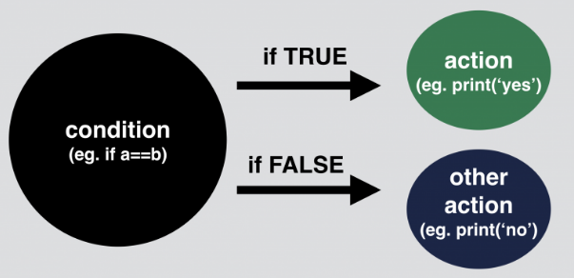
4. Python If Statements
We use if statements in our everyday life all the time – even if our everyday life is not written in Python.
e.g. If the light is green then I’ll cross the road; otherwise I’ll wait.

Slide 39
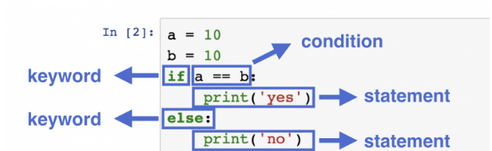
4. Python If Statements
If statement syntax:
an if keyword, then
a condition, then
a statement, then
an else keyword, then
another statement.

Slide 40
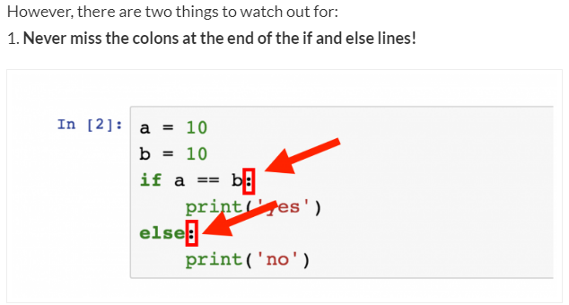
4. Python If Statements

Slide 41
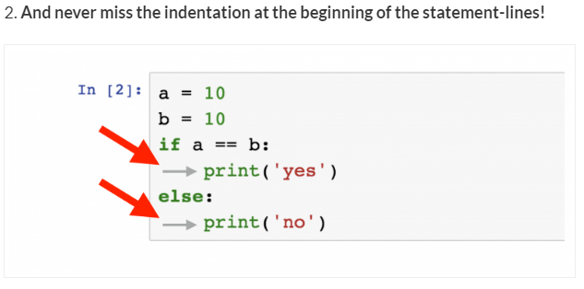
4. Python If Statements
If you miss any of the above two, an error message will be returned saying “invalid syntax” and your Python script will fail.

Slide 42
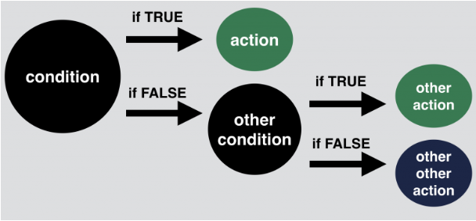
Python if statement – level 3
Nested ifelse by using elif keyword.
a = 10
b = 11
c = 10
if a == b:
print('first condition is true')
elif a == c:
print('second condition is true')
else:
print('nothing is true. existence is pain.')

Slide 43
Python if statement - Test
Here’s a random integer: 918652728452151.
First, I’d like to know 2 things about this number:
Is it divisible by 17?
Does it have more than 12 digits?
If both of these conditions are true, then I want to print “super17“.
And if either of the conditions are false, then I’d like to run a second test on it:
Is it divisible by 13?
Does it have more than 10 digits?
If both of these two new conditions are true, then I want to print “awesome13“.
And if the original number is not classified as “super17” nor “awesome13“, then I’ll just print: “oops, this is just an average random number“.
So: is 918652728452151 a super17, an awesome13 or just an average random number?

Slide 44
Python if statement - Answer
my_number = 918652728452151
if my_number % 17 == 0 and len(str(my_number)) > 12:
print("super17")
elif my_number % 13 == 0 and len(str(my_number)) > 10:
print("awesome13")
else:
print(" oops, this is just a random number")

Slide 45
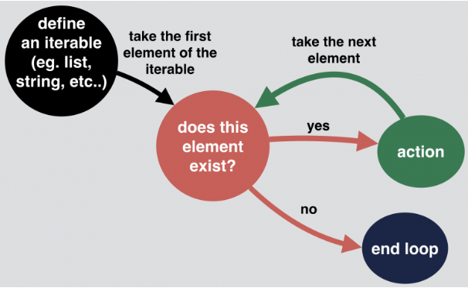
5. Python For Loop
For Loop flowchart
We will look how the flow chart works for below 3 lines of code:
numbers = [1, 5, 12, 91, 102]
for i in numbers:
print(i * i)

Slide 46
5. Python For Loop
for loops are for iterating through “iterables”.
Most of the time these “iterables” will be well-known data types: lists, strings or dictionaries.
Sometimes they can also be range() objects.
Example 1:
dog = ['Freddie', 9, True, 1.1, 2001, ['bone', 'little ball']]
for i in dog:
print(i)

Slide 47
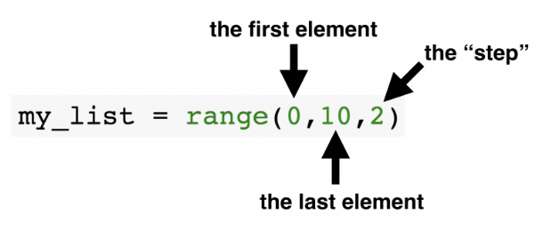
5. Python For Loop
Iterating through Strings
my_list = "Hello World!"
for i in my_list:
print(i)
Iterating through Range
my_list = range(0,10)
for i in my_list:
print(i)

Slide 48
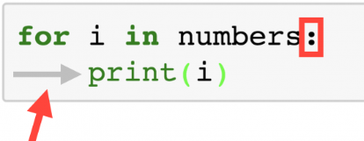
5. Python For Loop
Best Practise and Common Mistake:
At the end of the for line, a colon is required. And at the beginning of the lines in the loop’s body you have to use indentations.
You can’t print strings and integers in one print() function by simply using the + sign.
number = 1
for i in my_list:
print(“My List” + number + “is printed” + i)
Turn the integer to string to print the result
print(“My List” + str(number) + “is printed” + i)

Slide 49
5. Python For Loop - Test
Take a variable and assign a random string to it.
Then print a pyramid of the string like in this example:
my_string = "python"
OUTPUT:
p
py
pyt
pyth
pytho
python
pytho
pyth
pyt
py
p

Slide 50
5. Python For Loop – Test Solution
my_string = "python"
x = 0
for i in my_string:
x = x + 1
print(my_string[0:x])
for i in my_string:
x = x - 1
print(my_string[0:x])

Slide 51
6. Python For Loop & If statement combined
Nested For Loop: for loop inside for loop
Example:
my_movies = [['How I Met Your Mother', 'Friends', 'Silicon Valley'],
['Family Guy', 'South Park', 'Rick and Morty'],
['Breaking Bad', 'Game of Thrones', 'The Wire']]
for sublist in my_movies:
for movie_name in sublist:
char_num = len(movie_name)
print("The title " + movie_name + " is " + str(char_num) + " characters long.")

Slide 52
6. Python For Loop & If statement combined
for loop with if loop.
Go through all the numbers up until 99. Print ‘fizz’ for every number that’s divisible by 3, print ‘buzz’ for every number divisible by 5, and print ‘fizzbuzz’ for every number divisible by 3 and by 5! If the number is not divisible either by 3 or 5, print a dash (‘-‘)!
Here’s the solution!
for i in range(100):
if i % 3 == 0 and i % 5 == 0:
print('fizzbuzz')
elif i % 3 == 0:
print('fizz')
elif i % 5 == 0:
print('buzz')
else:
print('-')

Slide 53
6. Python While Loop
The while loop we can execute a set of statements as long as a condition is true.
i = 1 while i < 6: print(i) i += 1

Slide 54
Break & Continue Statement
The break Statement
With the break statement we can stop the loop even if the while condition is true:
i = 1 while i < 6: print(i) if i == 3: break i += 1
The continue Statement
With the continue statement we can stop the current iteration of the loop, and continue with the next.
fruits = ["apple", "banana", "cherry"] for x in fruits: if x == "banana": continue print(x)

Slide 55
Python Functions
A function is a block of code which only runs when it is called.
You can pass data, known as parameters, into a function.
A function can return data as a result.
Creating a Function: by using def keyword.
def my_function(): print("Hello from a function")
Calling a Function: To call a function, use the function name followed by parenthesis
my_function()
Parameters: Information can be passed to functions as parameter.
Parameters are specified after the function name, inside the parentheses. You can add as many parameters as you want, just separate them with a comma.
def my_function(fname): print(fname + " Refsnes") my_function("Emil") my_function("Tobias") my_function("Linus")

Slide 56
Python Functions
Default Parameter Value : If we call the function without parameter, it uses the default value.
def my_function(country = “India"): print("I am from " + country) my_function(“United Kingdom") my_function()
Passing a List as a Parameter
Return Values: To let a function return a value, use the return statement:
def my_function(x): return 5 * x
Keyword Arguments: We can also send arguments with the key = value syntax.
This way the order of the arguments does not matter.
def my_function(child3, child2, child1): print("The youngest child is " + child3)
my_function(child1 = “Sun", child2 = “Moon", child3 = “Star")

Slide 58
Python Functions
Arbitrary Arguments : If we do not know how many arguments that will be passed into your function, add a * before the parameter name in the function definition.
This way the function will receive a tuple of arguments, and can access the items accordingly.
def my_function(*kids):
print("The youngest child is " + kids[2])
my_function(“Sun", “Moon", “Star")
The pass Statement : Function definitions cannot be empty, but if you for some reason have a function definition with no content, put in the pass statement to avoid getting an error.
def myfunction: pass

Slide 59
Python Syntax Essentials
Python syntax rule #1: one statement per line.
There are some exceptions, though. Expressions
in parentheses (eg. functions and methods),
in bracket frames (eg. lists),
and in curly braces (eg. directories)
Python syntax rule #2: make sure that you use indentations correctly and consistently.
Python syntax rule #3: Python is case sensitive.

Slide 60
Python Best Practices
Python Best Practice #1: Use Comments
Python Best Practice #2: Variable Names
Python Best Practice #3: Use blank lines
Python Best Practice #4: Use white spaces around operators and assignments
Python Best Practice #5: Max line length should be 79 characters
Python Best Practice #6: Stay consistent

Slide 61
Python Import Statement and the Most Important Built-in Modules
Import Statement is used to get the Python modules and packages into our project.
Import [Module_Name] – Will import all the packages inside the module name
from [Module_Name] import [specific_item] – will import only the specified item in the our project.
We can also rename our imported module_name using as keyword so that we easily the method inside our module.
Import [Module_Name] as mn

Slide 62
Python Import Statement and the Most Important Built-in Modules
Five most important modules from Python Standard Library with dozens of built-in modules used by data analysts and scientists. These are:
random
statistics
math
datetime
csv

Slide 63
Python Built-in Module #1: random
If you import the random module, you can generate random numbers by various rules
import random
random.random() – This will generate random float between 0 and 1
random.randint(1,10) -

Slide 64
Python Built-in Module #2: statistics
The statistics built-in module which contains functions like: mean, median, mode, standard deviation, variance and more…
import statistics
#Create a Sampe List
a = [0, 1, 1, 3, 4, 9, 15]
Then calculate all the above mentioned values for this small list:
statistics.mean(a)
statistics.median(a)
statistics.mode(a)
statistics.stdev(a)
statistics.variance(a)

Slide 65
Python Built-in Module #3: math
There are a few functions that are under the umbrella of math rather than statistics. So there is a separate module for that. This contains factorial, power, and logarithmic functions, but also some trigonometry and constants
import math
math.factorial(5)
math.pi
math.sqrt(5)
math.log(256, 2)

Slide 66
Python Built-in Module #4: datetime
DateTime module are used to handle date and time specifically used in logs.
import datetime
datetime.datetime.now() datetime.datetime.now().strftime("%F")

Slide 67
Python Built-in Module #5: csv
“csv” stands for “comma-separated values” and it’s one of the most common file formats for plain text data logs.
import csv
with open('fruits.csv') as csvfile:
my_csv_file = csv.reader(csvfile, delimiter=';')
for row in my_csv_file:
print(row)

Slide 68
Good To Know ….
Function: it’s a block of code that you can (re-)use by calling it with a keyword. Eg. print() is a function.
Module: it’s a .py file that contains a list of functions (it can also contain variables and classes). Eg. in statistics.mean(a), mean is a function that is found in the statistics module.
Package: it’s a collection of Python modules.
Eg. numpy.random.randint(2, size=10)
randint() is a function in the random module of the numpy package.
Library: it’s a more general term for a collection of Python codes.

Slide 69
Python – Pandas Libarary
Pandas is one of the most popular Python libraries for Data Science and Analytics.
I like to say it’s the “SQL of Python.” Why? Because pandas helps you to manage two-dimensional data tables in Python.
import numpy as np
Import pandas as pd

Slide 70
Python – Pandas Libarary
Pandas data structures
There are two types of data structures in pandas: Series and DataFrames.
Series: a pandas Series is a one dimensional data structure (“a one dimensional ndarray”) that can store values — and for every value it holds a unique index, too.
DataFrame: a pandas DataFrame is a two (or more) dimensional data structure – basically a table with rows and columns. The columns have names and the rows have indexes.
In this pandas tutorial, I’ll focus mostly on DataFrames. The reason is simple: most of the analytical methods I will talk about will make more sense in a 2D datatable than in a 1D array.

Slide 71
Python – Pandas Library
Let’s Start …..
Read the a File
data = pd.read_csv(‘file_name', delimiter=';')
Print a Sample:
data.head()
The last few line:
data.tail()
The random Sample:
data.sample(5)
Specific Column:
data[[‘column_name’, ‘column_name2’]]
NOTE: the outbracket is to tell pandas to select the dataframe and the inner bracket to pass the data as a list.
If we change the order of the column, the data will be retrieved in similar manner
data[[‘column_name2’, ‘column_name’]]
………………..

Slide 72
Python
Object Orient Concept:
CLASS
VARIABLE
FUNCTION
OBJECT

